Slide 1
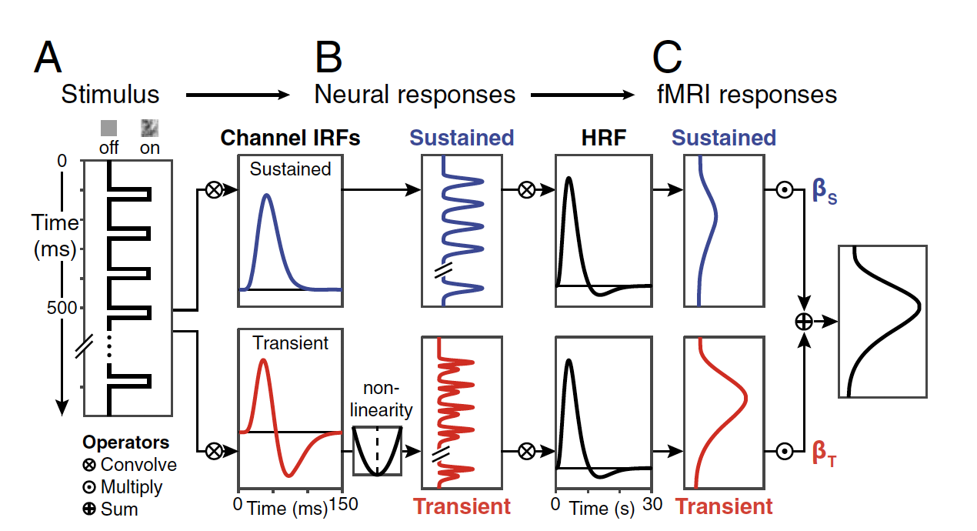

Slide 2
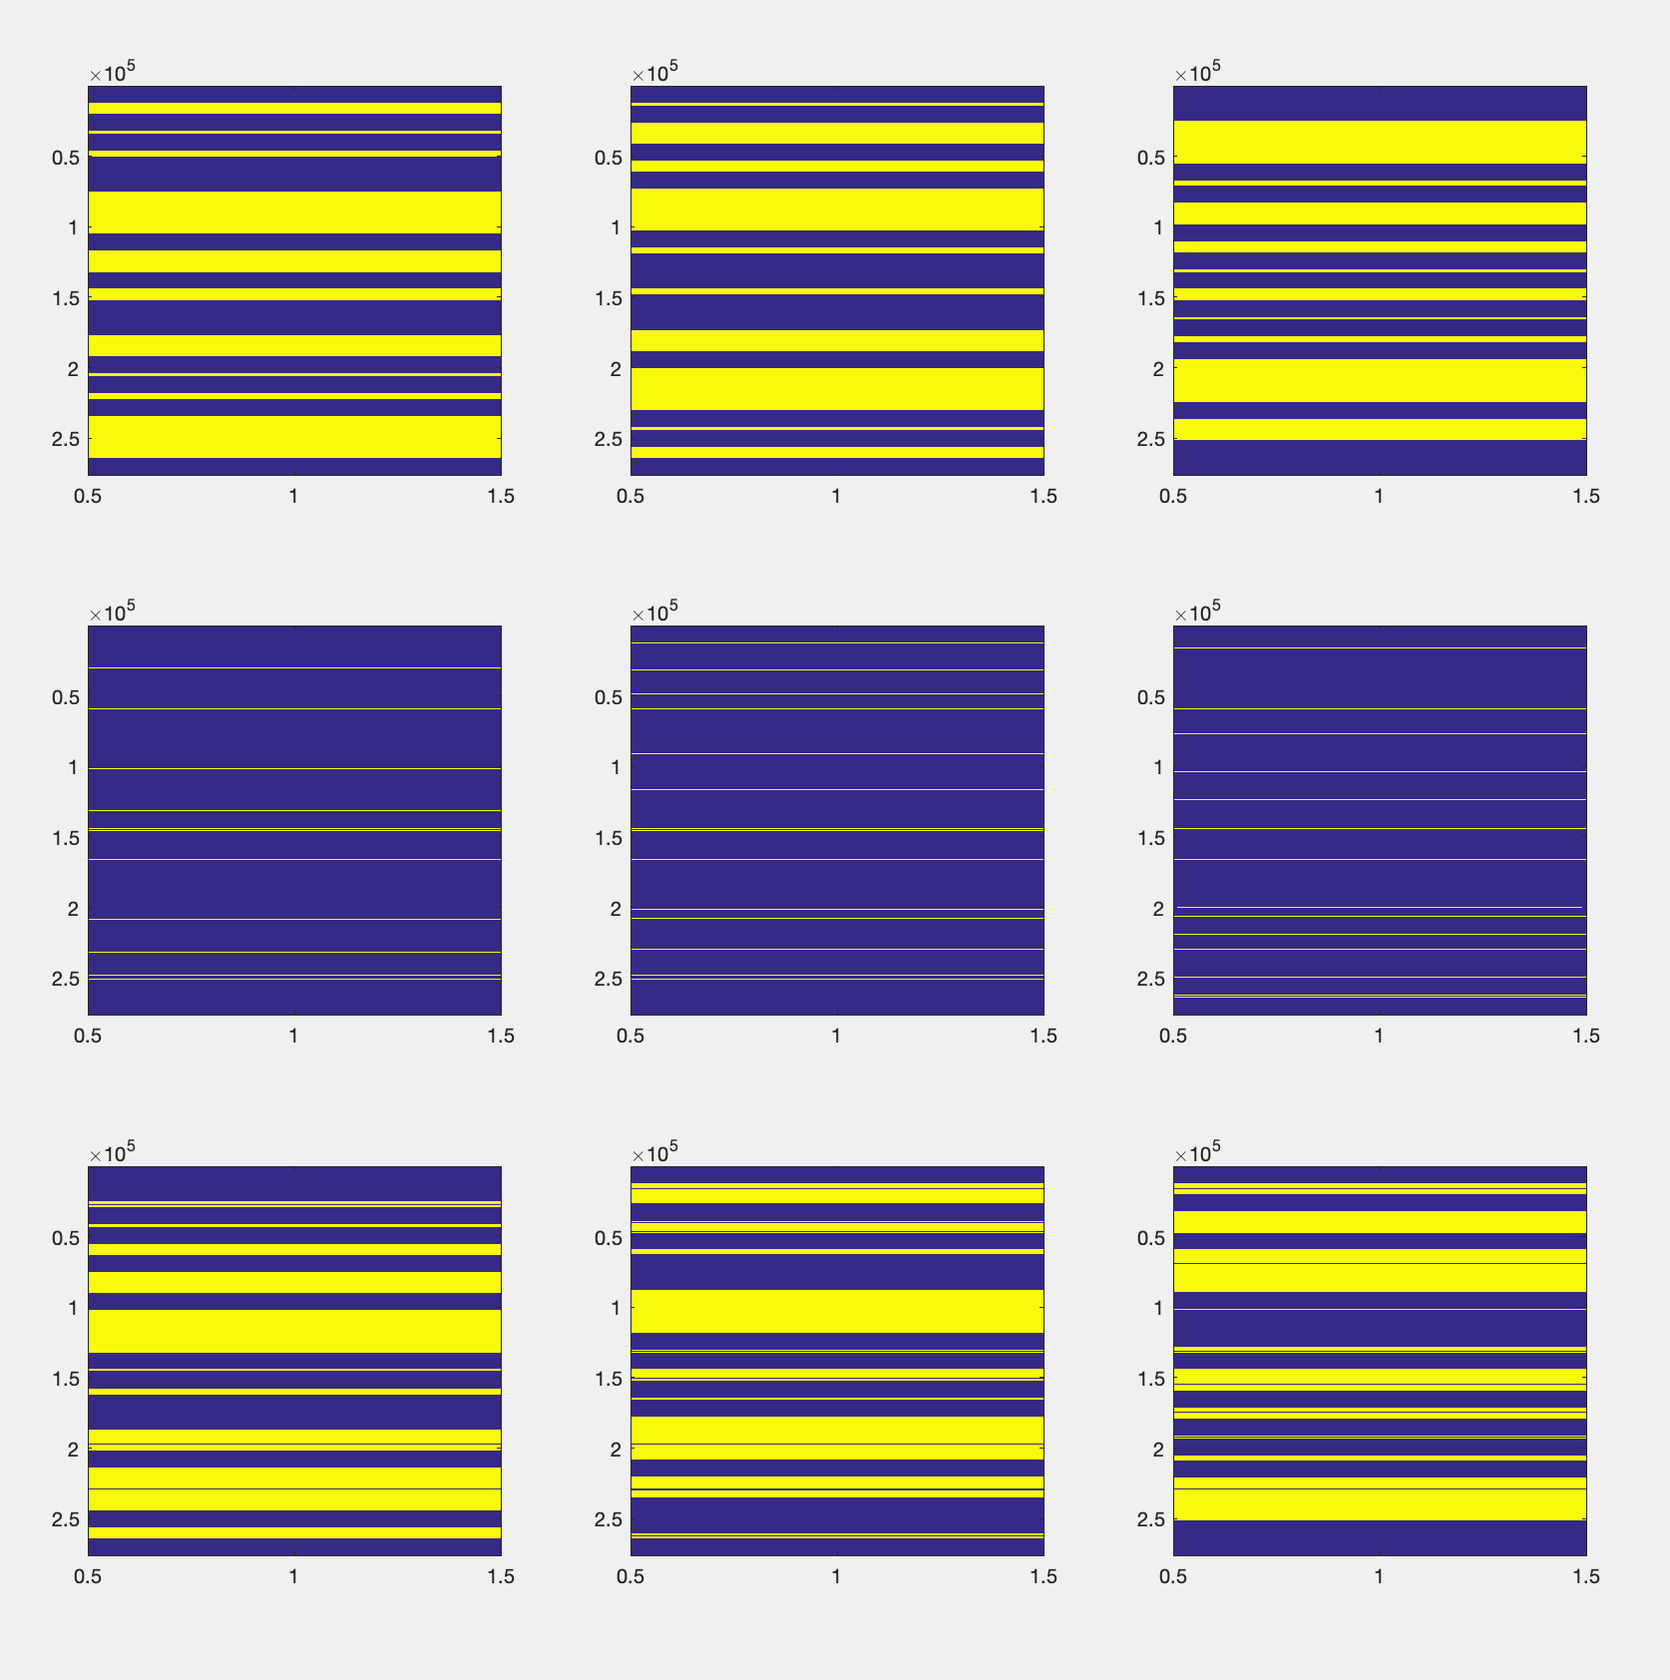
Stimulus Design
run 1
run 2
run 3
Exp 1
Exp 2
Exp 3
code_stim(model)

Slide 3
Normalization
function model = norm_model(model, custom_norm)
imodel = tchModel(model.type, model.experiments, model.sessions);
imodel.normT = 1; imodel.normP = 1; nch = imodel.num_channels;
imodel = code_stim(imodel); imodel = pred_runs(imodel);
[normTs, normPs] = deal(zeros(1, length(imodel.sessions)));
ncats = length(unique([imodel.cats{:}]));
for ss = 1:length(imodel.sessions)
% get predictors for all runs in this session
spreds = cell2mat(imodel.run_preds(:, ss));
% find max of each set of channels
maxS = max(max(spreds(:, 0 * ncats + 1:1 * ncats)));
maxT = max(max(spreds(:, 1 * ncats + 1:2 * ncats)));
% compute scalars to normalize max heights to sustained
normTs(ss) = maxS / maxT;
end
% set normalization constant to average across sessions
model.normT = mean(normTs);
function model = pred_runs_2ch_lin_quad(model)
predS = cellfun(@(X, Y) convolve_vecs(X, Y, fs, fs), ...
stim, irfs.nrfS, 'uni', false); predS(empty_cells) = {[]};
predTq = cellfun(@(X, Y) convolve_vecs(X, Y, fs, fs) .^ 2, ...
stim, irfs.nrfT, 'uni', false); predTq(empty_cells) = {[]};
fmriS = cellfun(@(X, Y) convolve_vecs(X, Y, fs, 1 / tr), ...
predS, irfs.hrf, 'uni', false); fmriS(empty_cells) = {[]};
fmriT = cellfun(@(X, Y) convolve_vecs(X, Y, fs, 1 / tr), ...
predTq, irfs.hrf, 'uni', false); fmriT(empty_cells) = {[]};
run_preds = cellfun(@(X, Y) [X Y * model.normT], fmriS, fmriT, 'uni', false);
model.run_preds = run_preds;

Slide 4
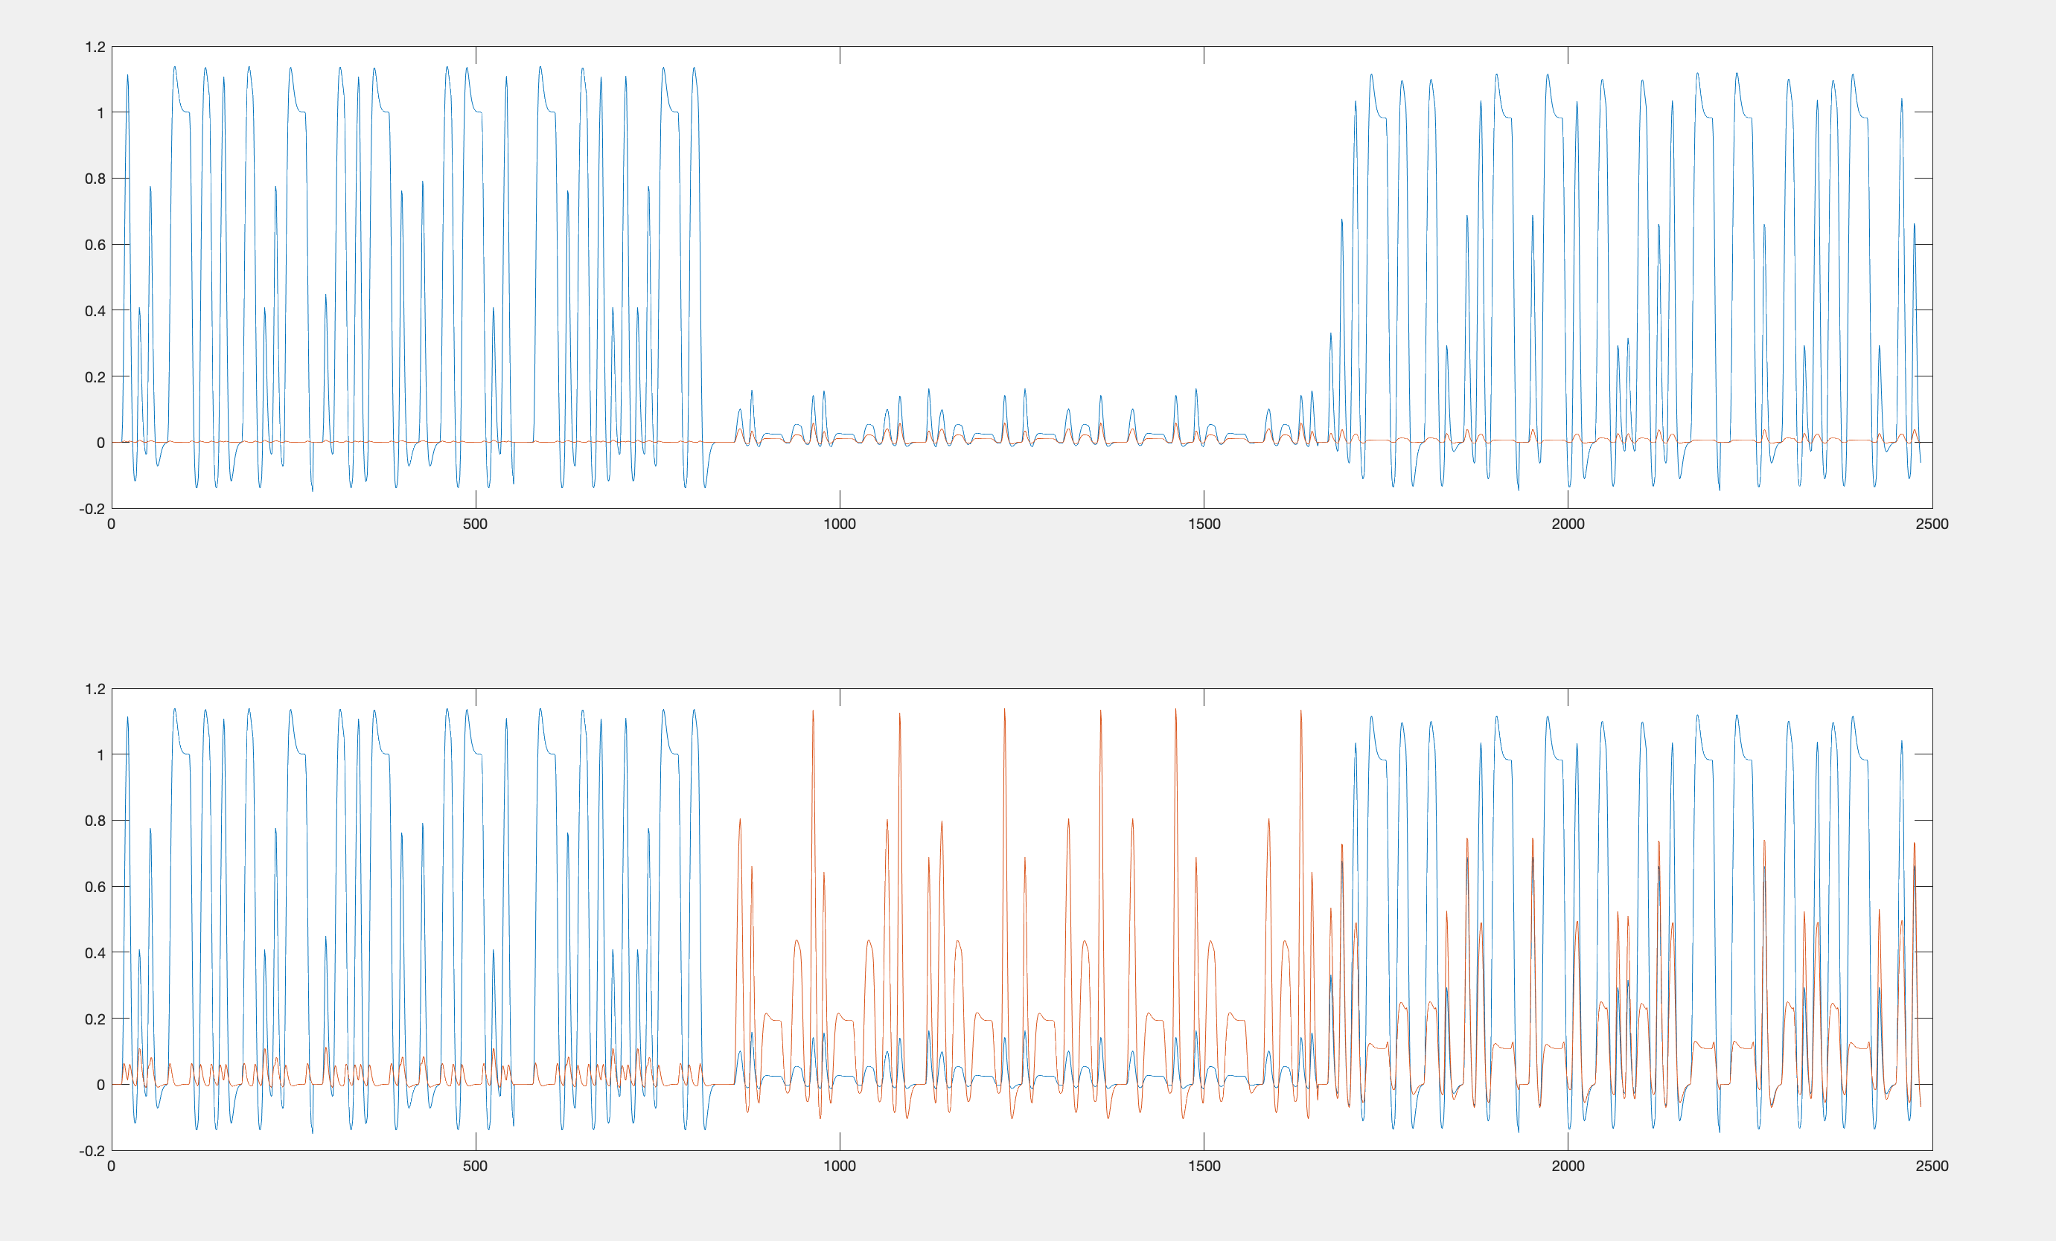
preNorm
postNorm
Default is set to 20
normT = 20; % transient channel normalization scalar

Slide 5
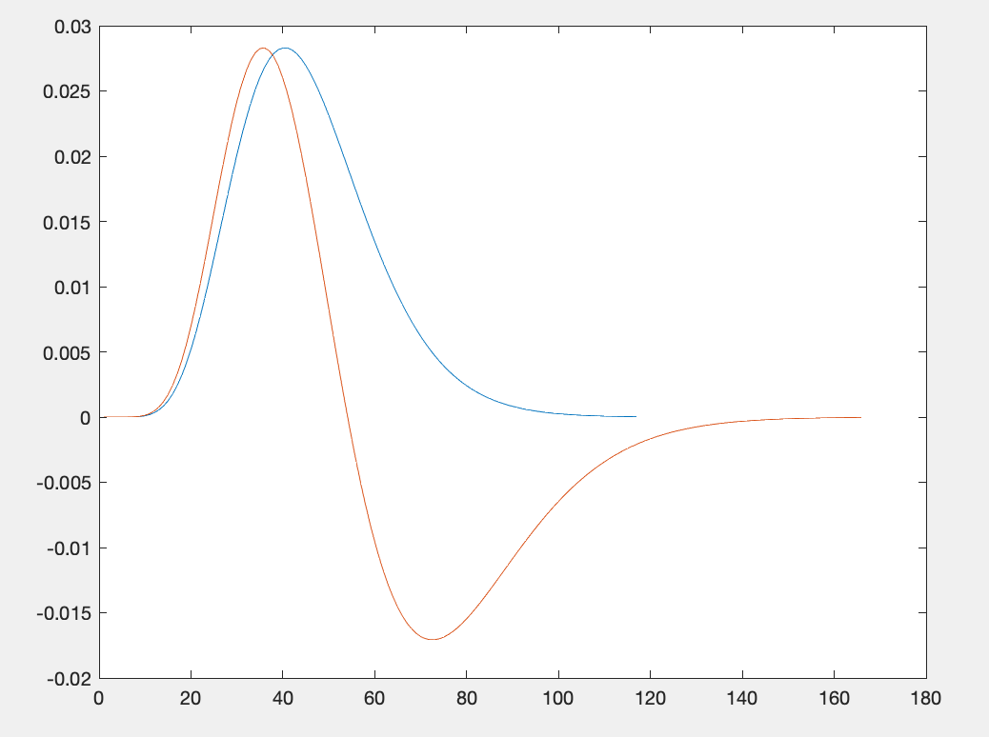
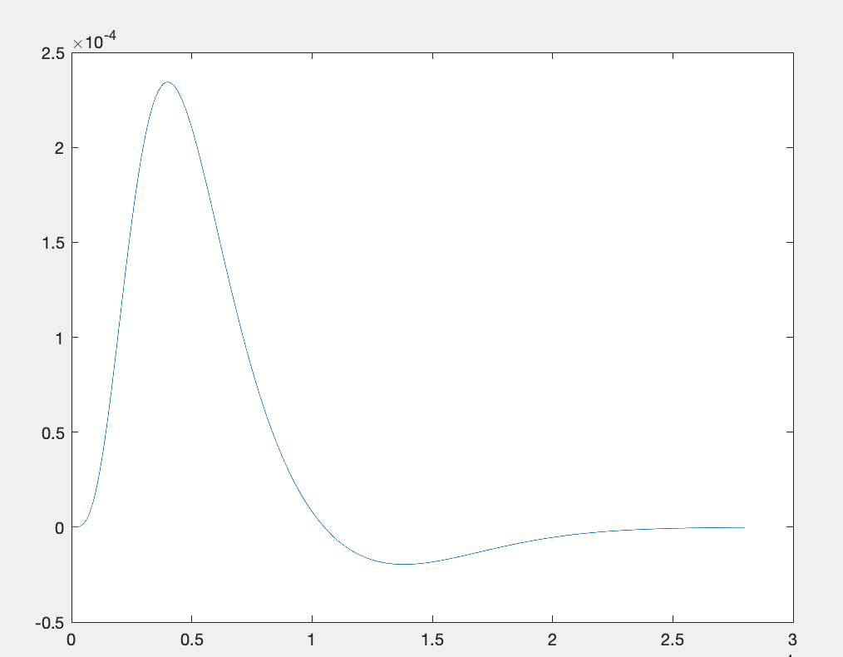
model.irfs.nrfS
model.irfs.nrfT
Normalized as the max height
model.irfs.hrf
Need to play more with this
irf = tch_irfs(channel, tau, n1, n2, kappa, fs)
tch_init_params(model_type, nsessions, fs)

Slide 6
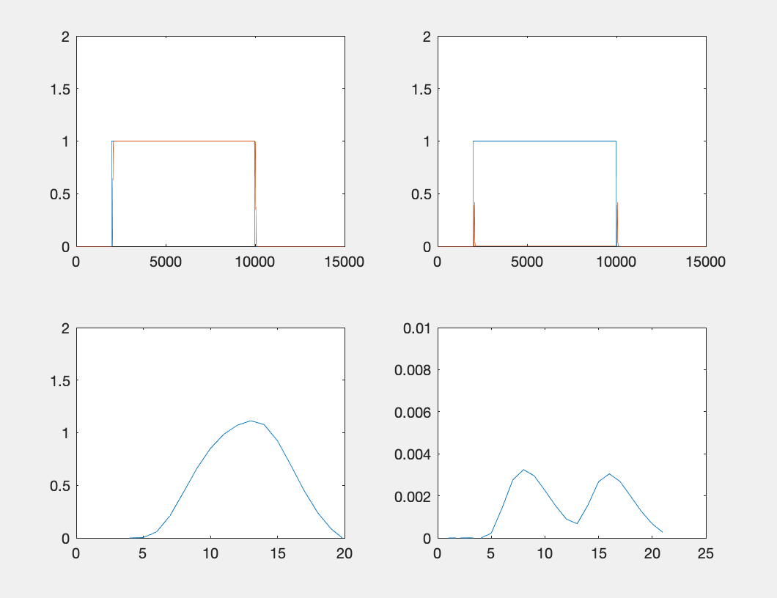
Exp1
Sustained
Transient
convolving the stimulus and IRF
convolving with HRF

Slide 7
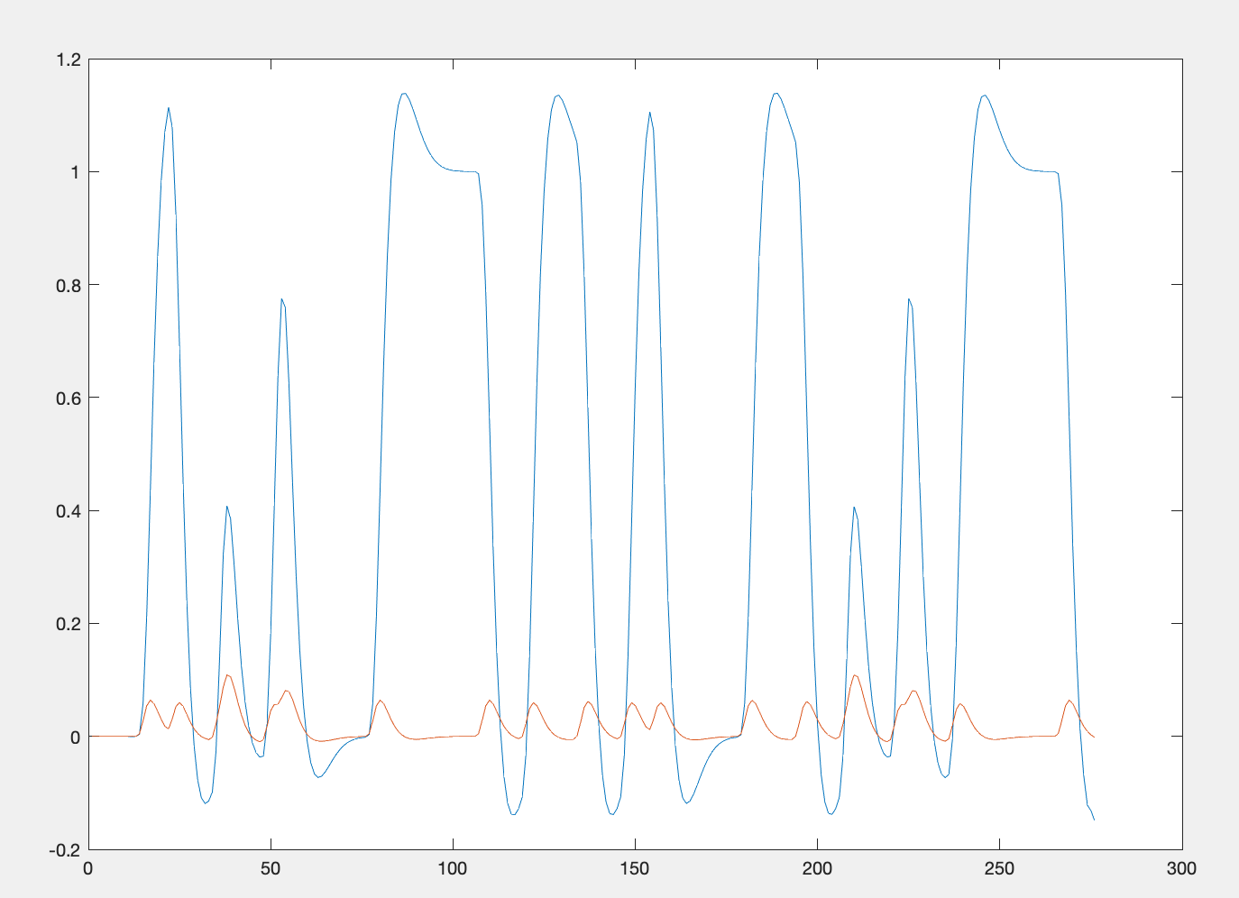
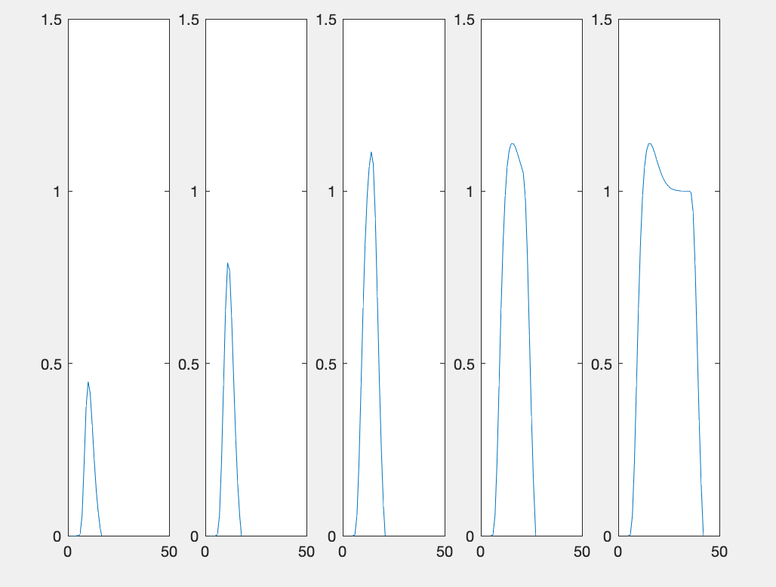
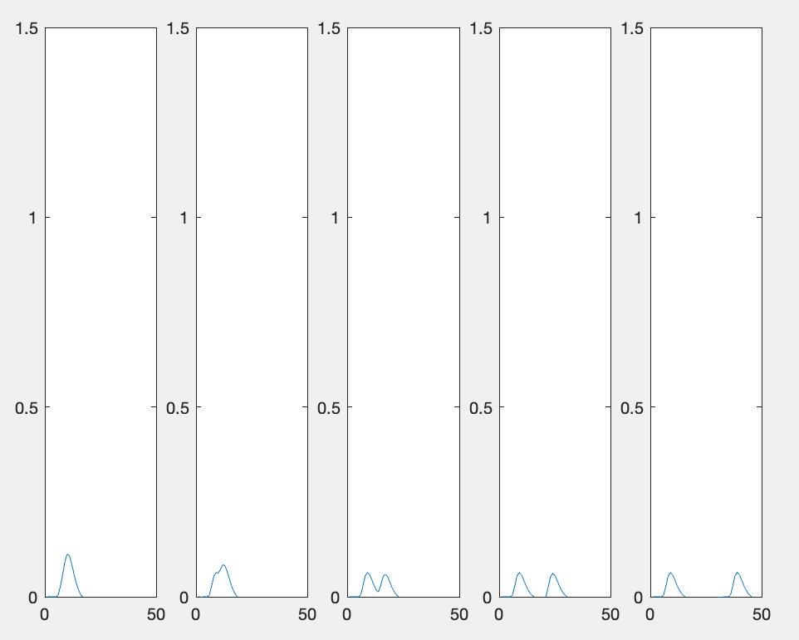
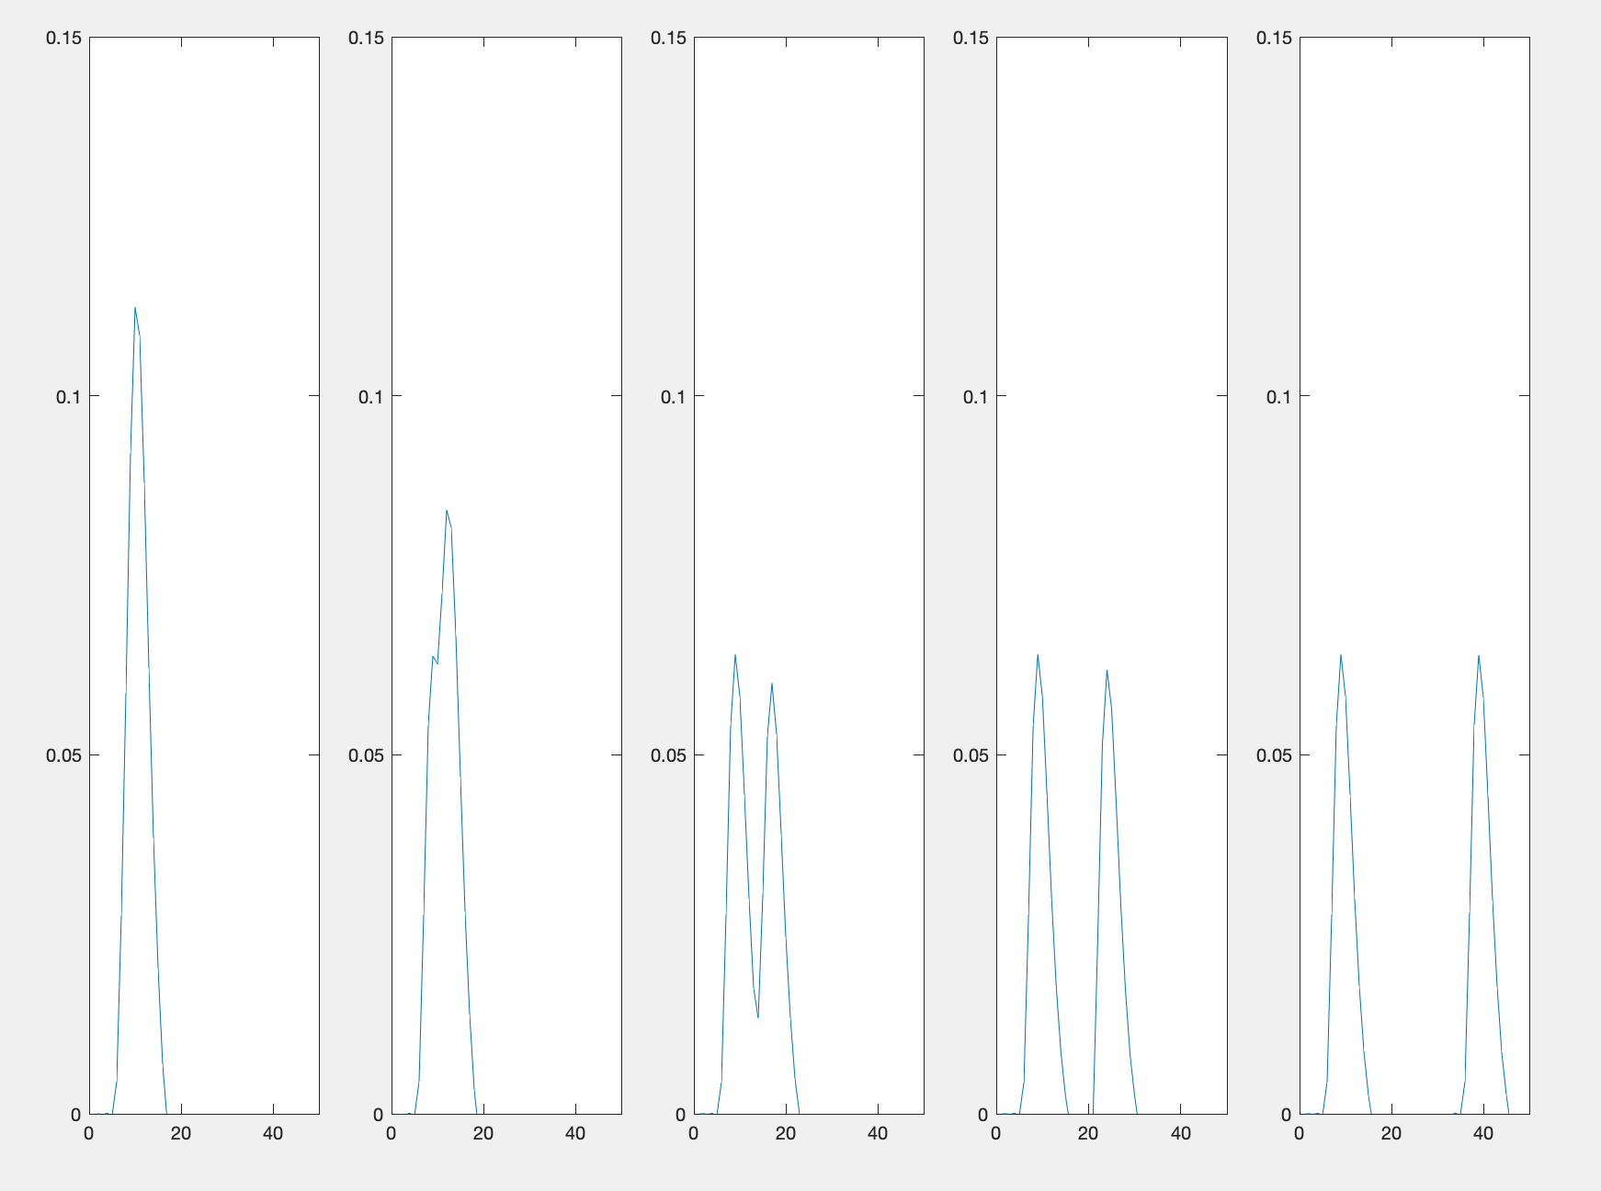
Exp1
Condition (s)
Across run prediction
2 4 8 15 30
Sustained
Transient

Slide 8
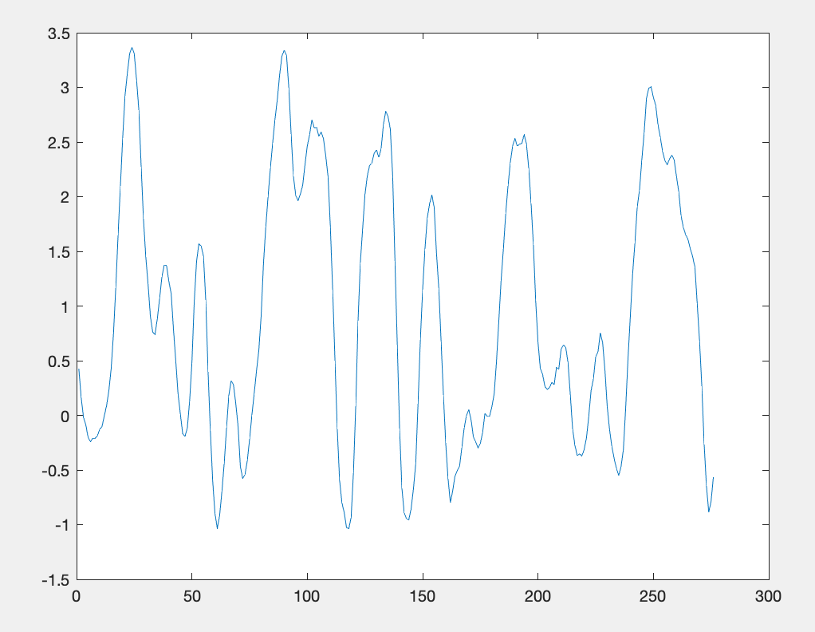
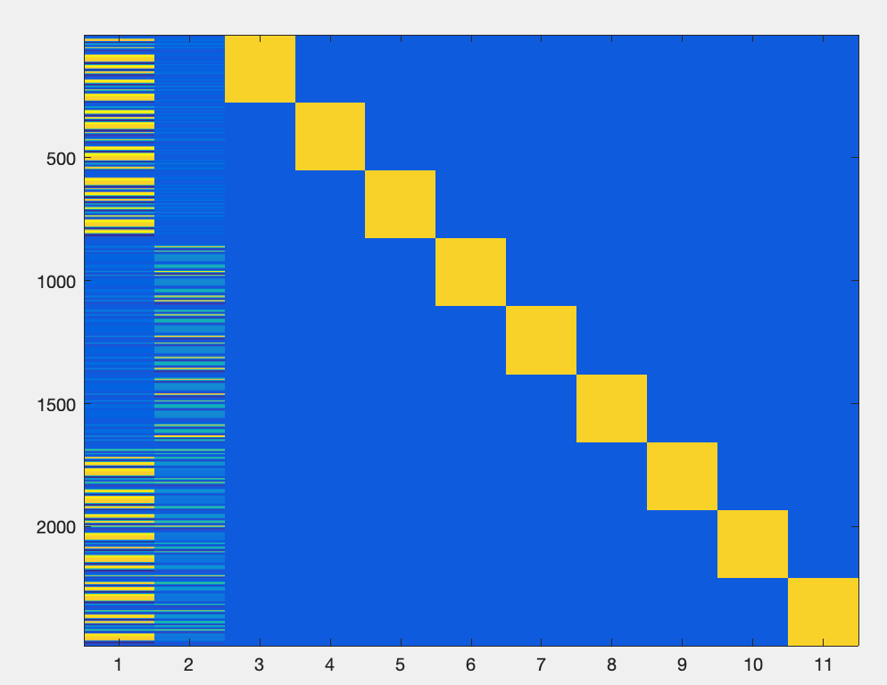
GLM
Timecourse
Predictor (design Matrix)
mm = tch_glm(tc, predictors);

Slide 9
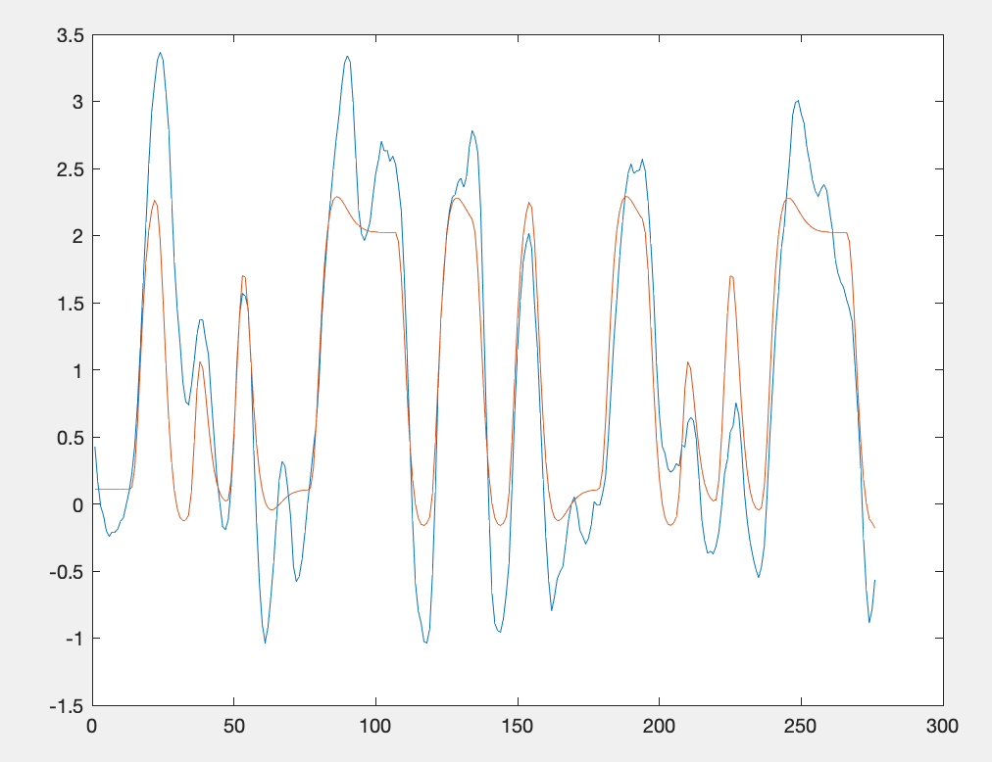
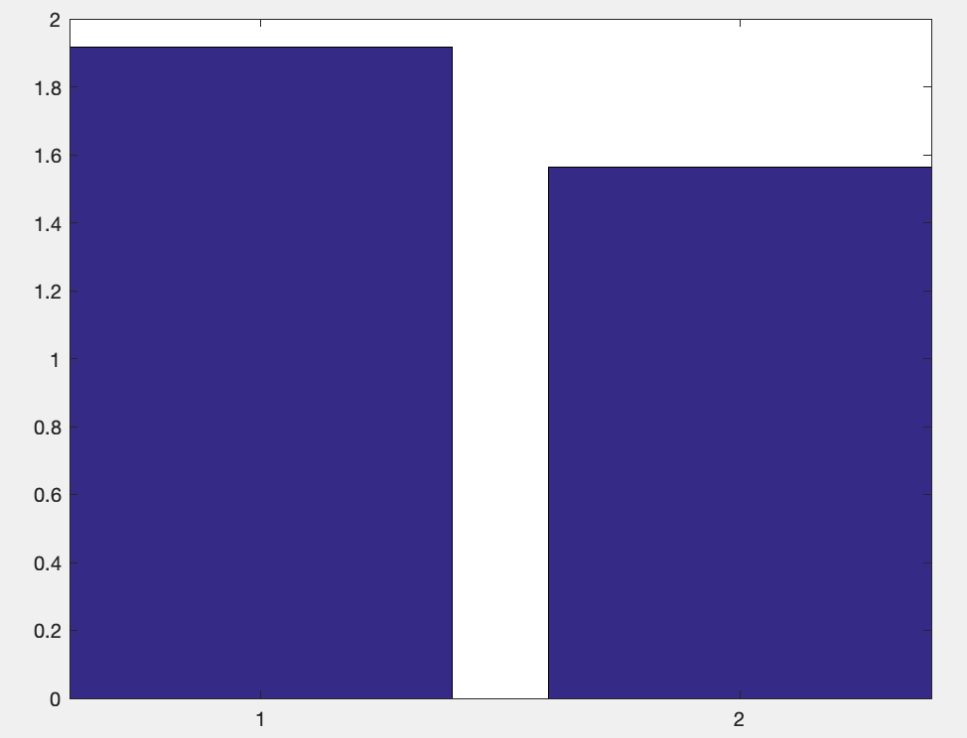
GLM
Beta
Sustained transient
Betas: 1.9156, 1.5638
Blue: time course
Red: Predictor

Slide 10
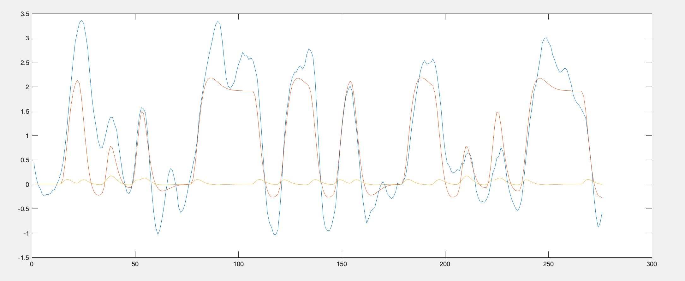
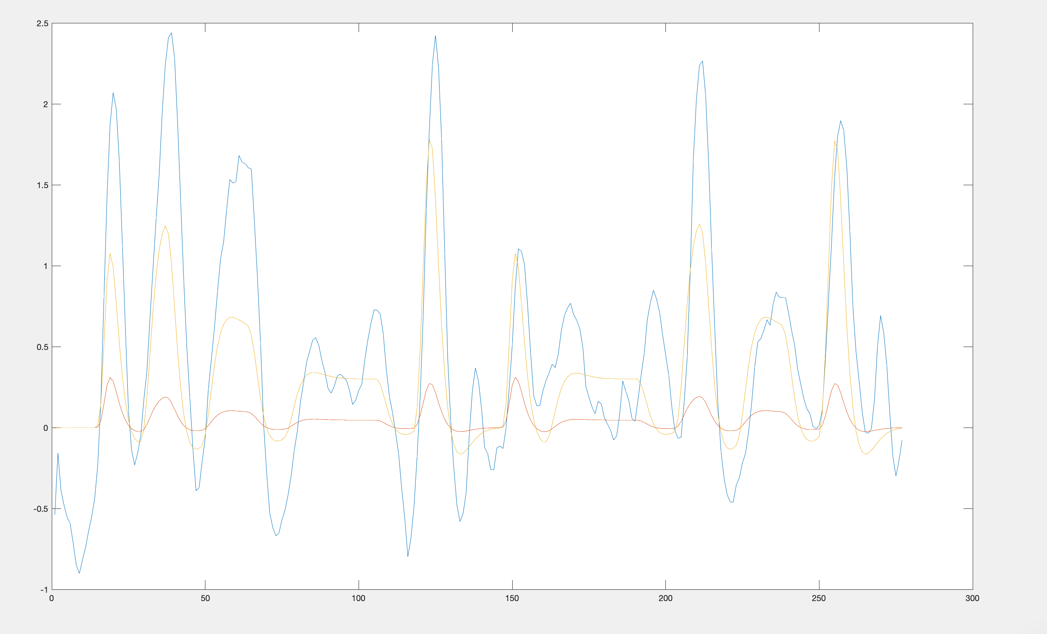
Exp1
Exp2

Slide 11
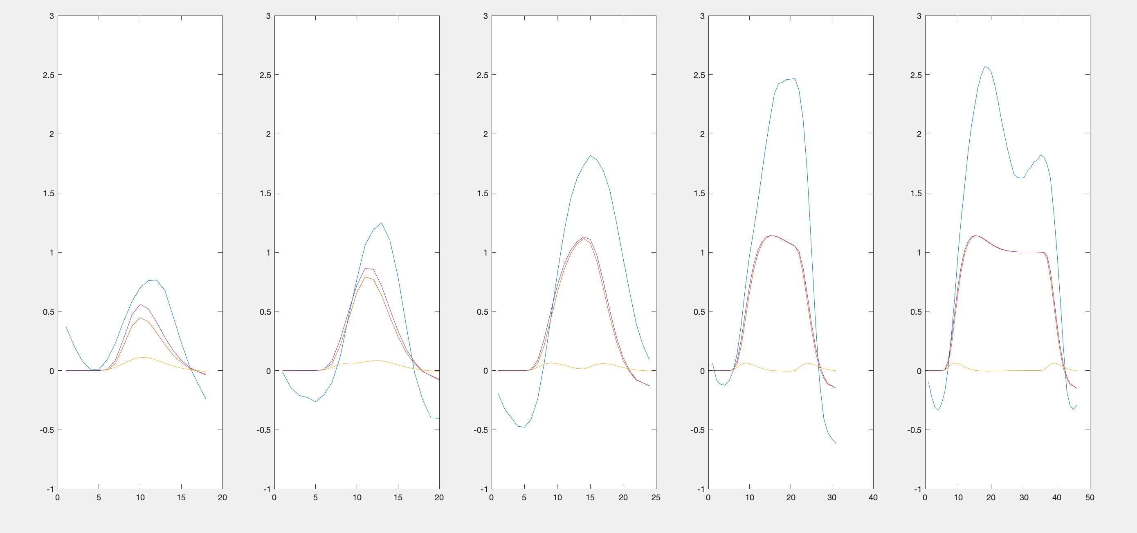
Exp1, blue = timecourse; red = S; y = T; p= S+T
2
4
8
15
30

Slide 12
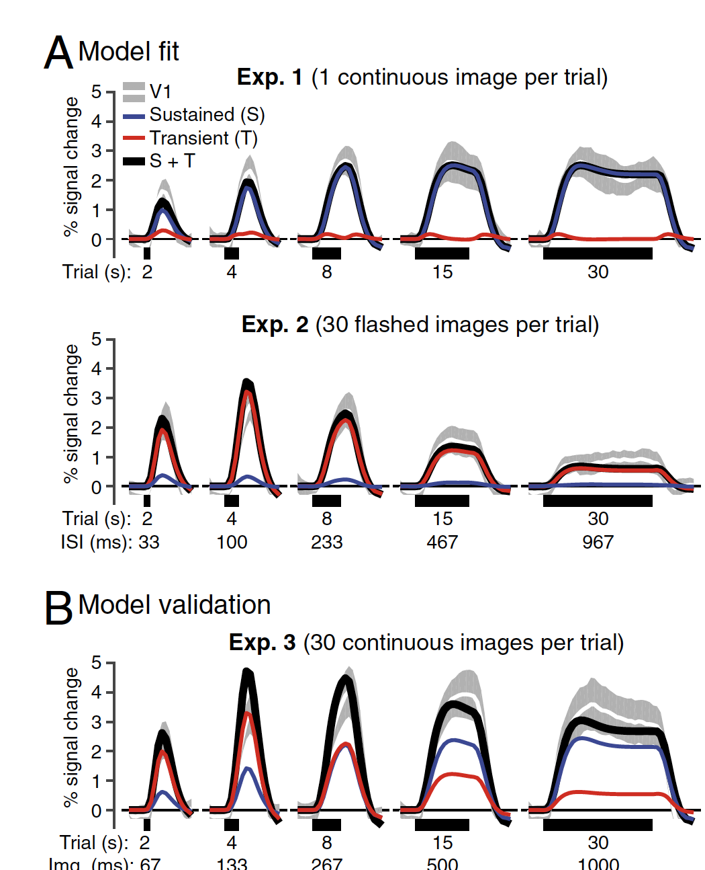
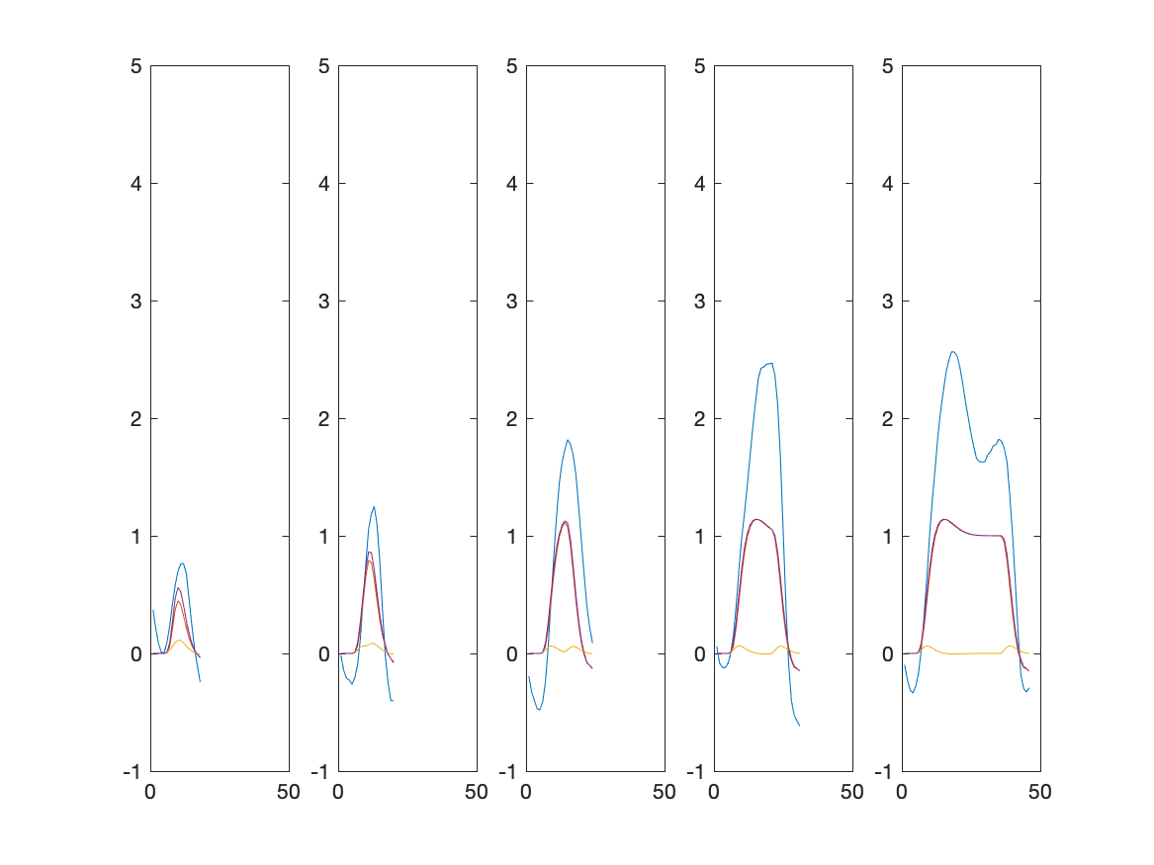
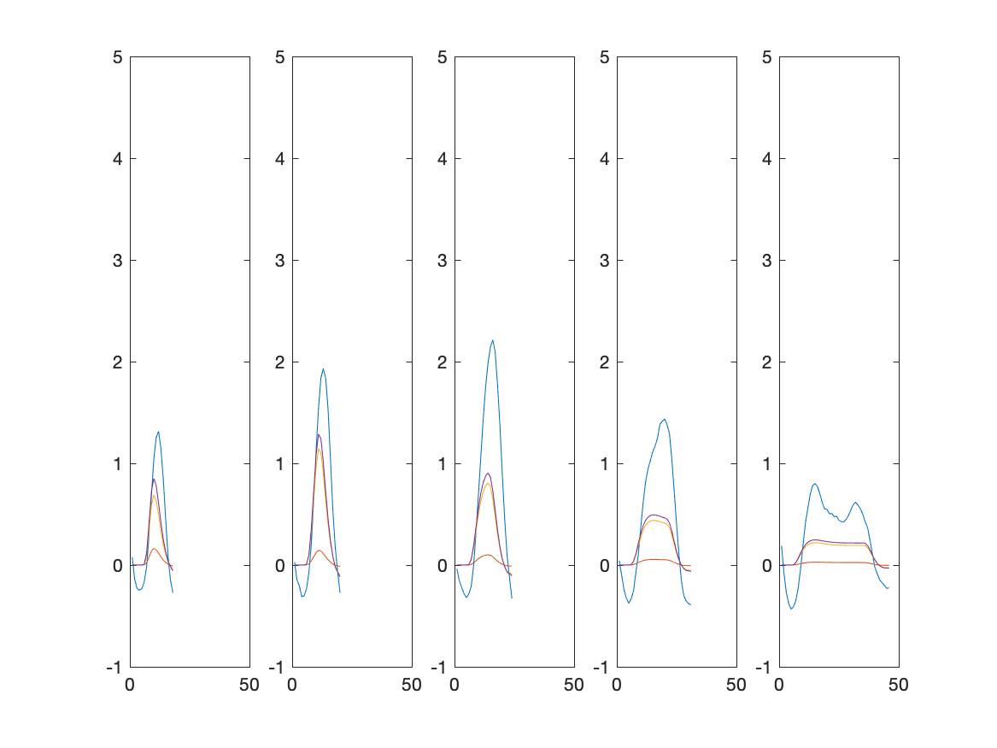
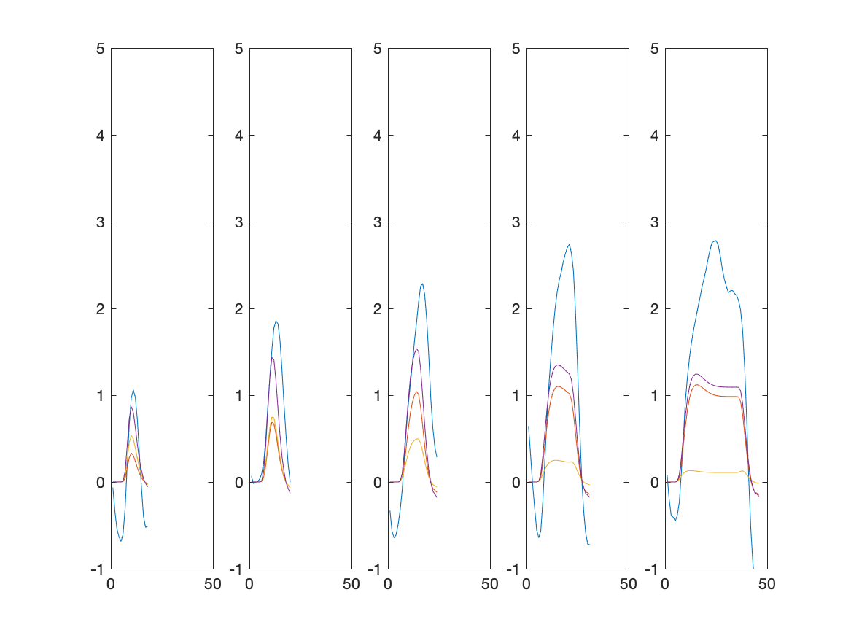

Slide 14
Convolution
Integral of the product of the two functions, after one is reversed and shifted

Slide 15
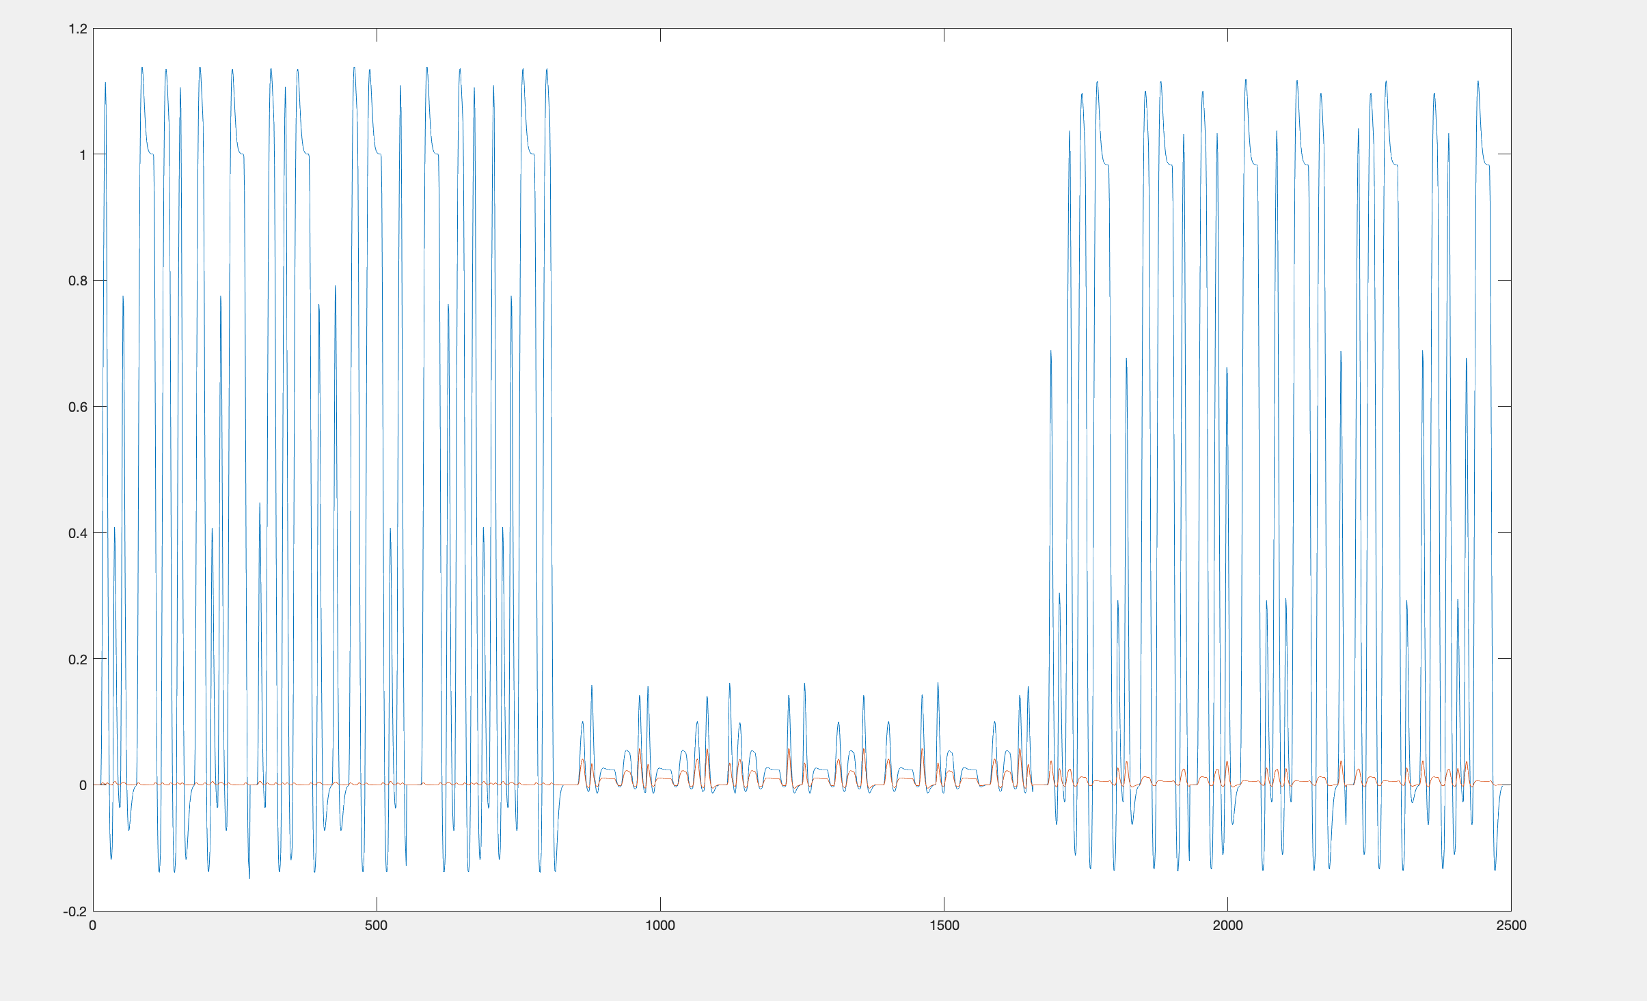
spreds = cell2mat(imodel.run_preds(:, ss));
Blue –sustained
Red - transient
normTs = maxS / maxT

Slide 16
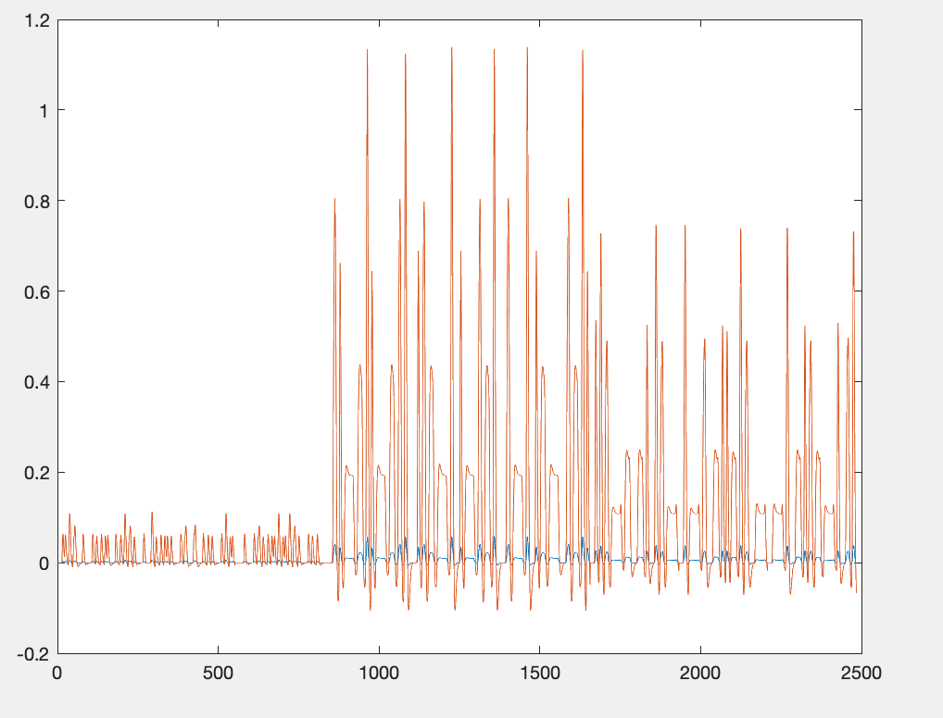
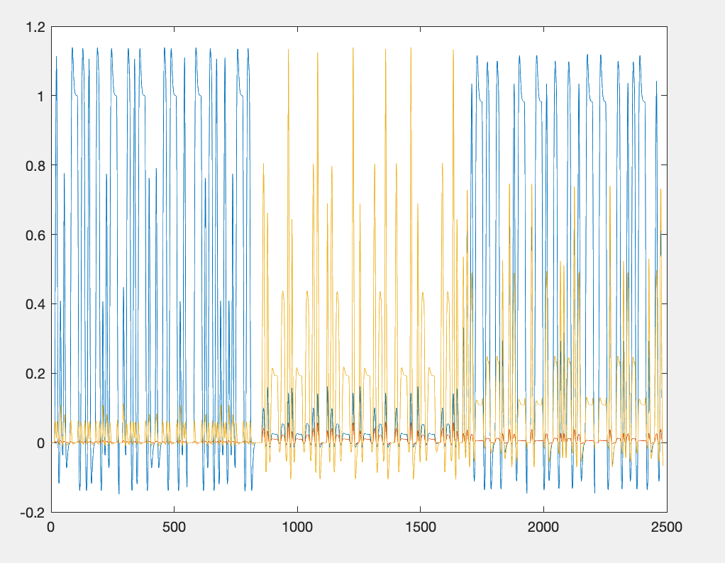
Transient
Blue – before norm
Red – after norm
After Normalization
Blue – sustained
Red – transient before norm
Yellow - transient after norm
model.normT ~ factor of 19

Slide 17
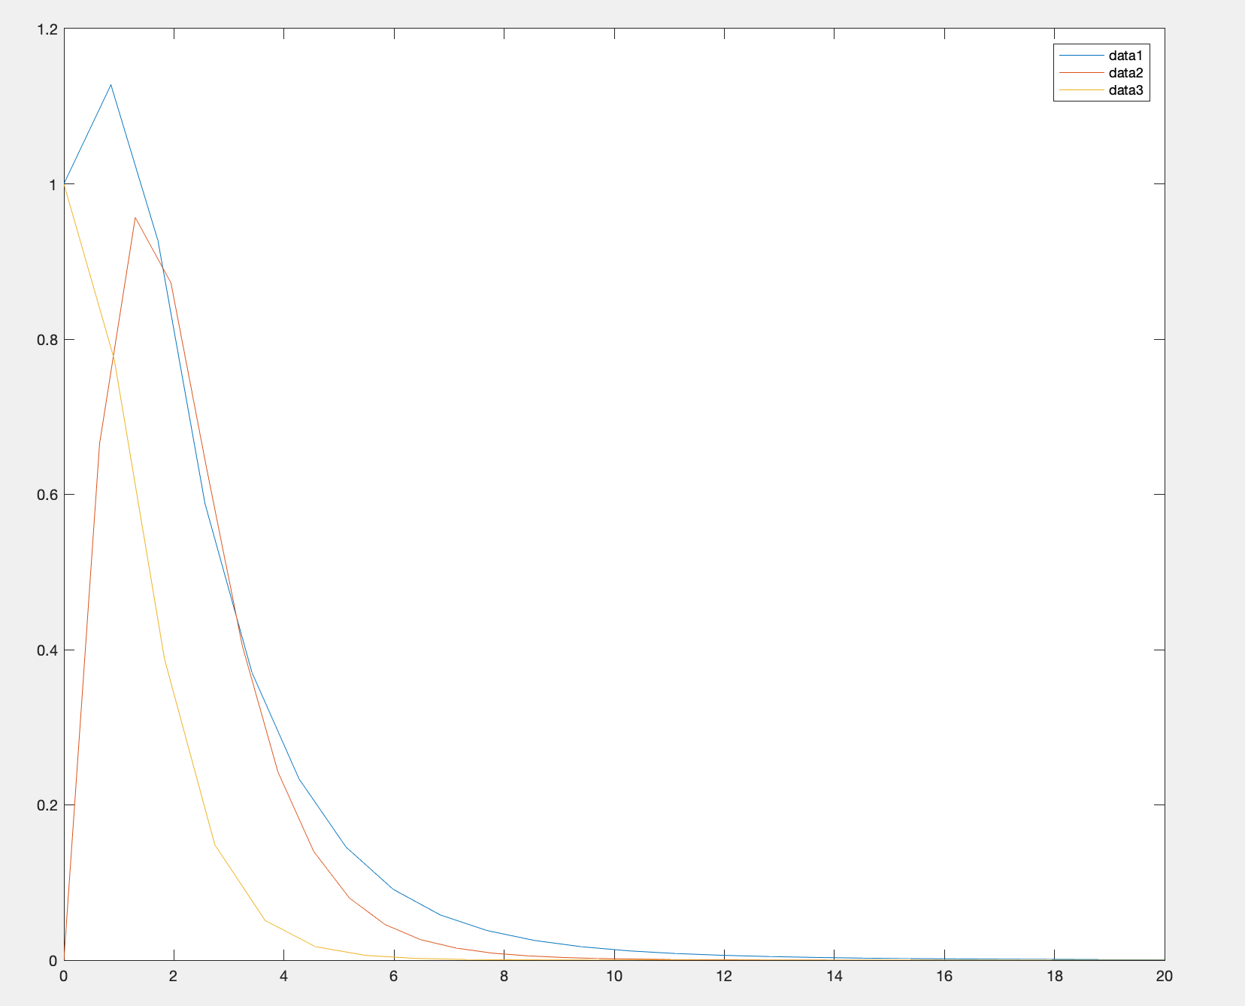
HRF
IRFs
IRFt
In frequency domain

