Slide 1


3 |  | 4 |  |  |  | 5 |  |  |  |  | 6
20 | 27 | 3 | 10 | 17 | 24 | 1 | 8 | 15 | 22 | 29 | 5 | 12 | 19
주제 선정
주제 구체화
Application Design
자료 조사
Data Base
Android Studio
Final Test

Slide 2

Milestone
3 |  | 4 |  |  |  | 5 |  |  |  |  | 6
20 | 27 | 3 | 10 | 17 | 24 | 1 | 8 | 15 | 22 | 29 | 5 | 12 | 19
KALDI
주제 선정
주제 구체화
Application Design
자료 조사
Data Base
Android Studio
Final Test

Slide 3

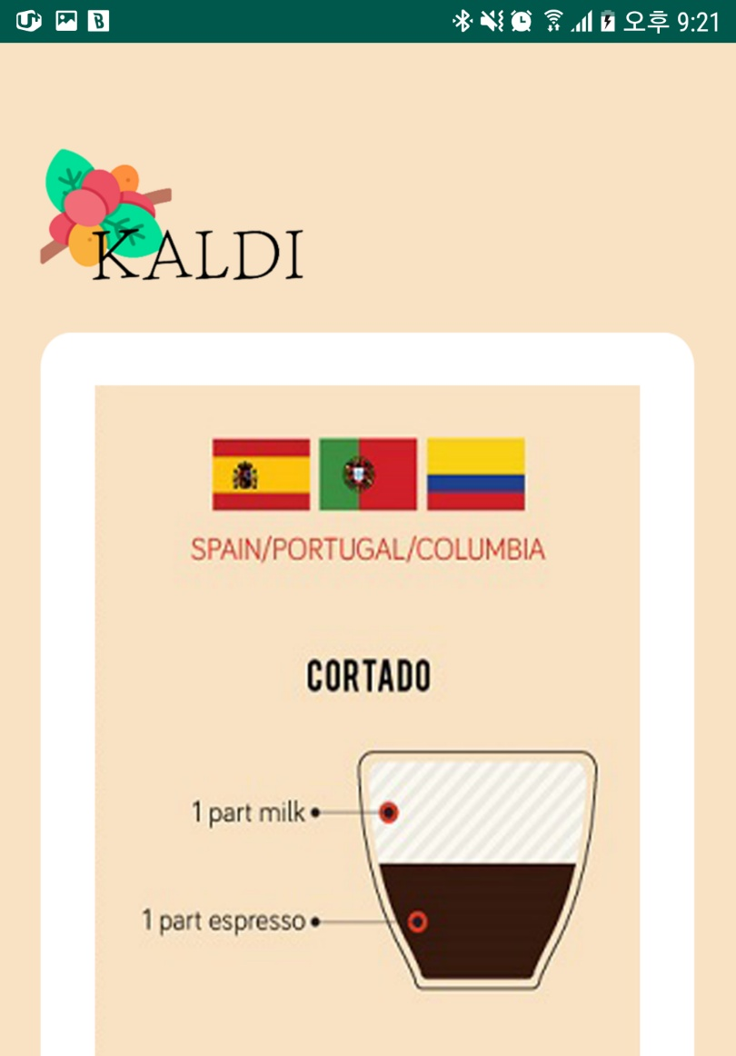

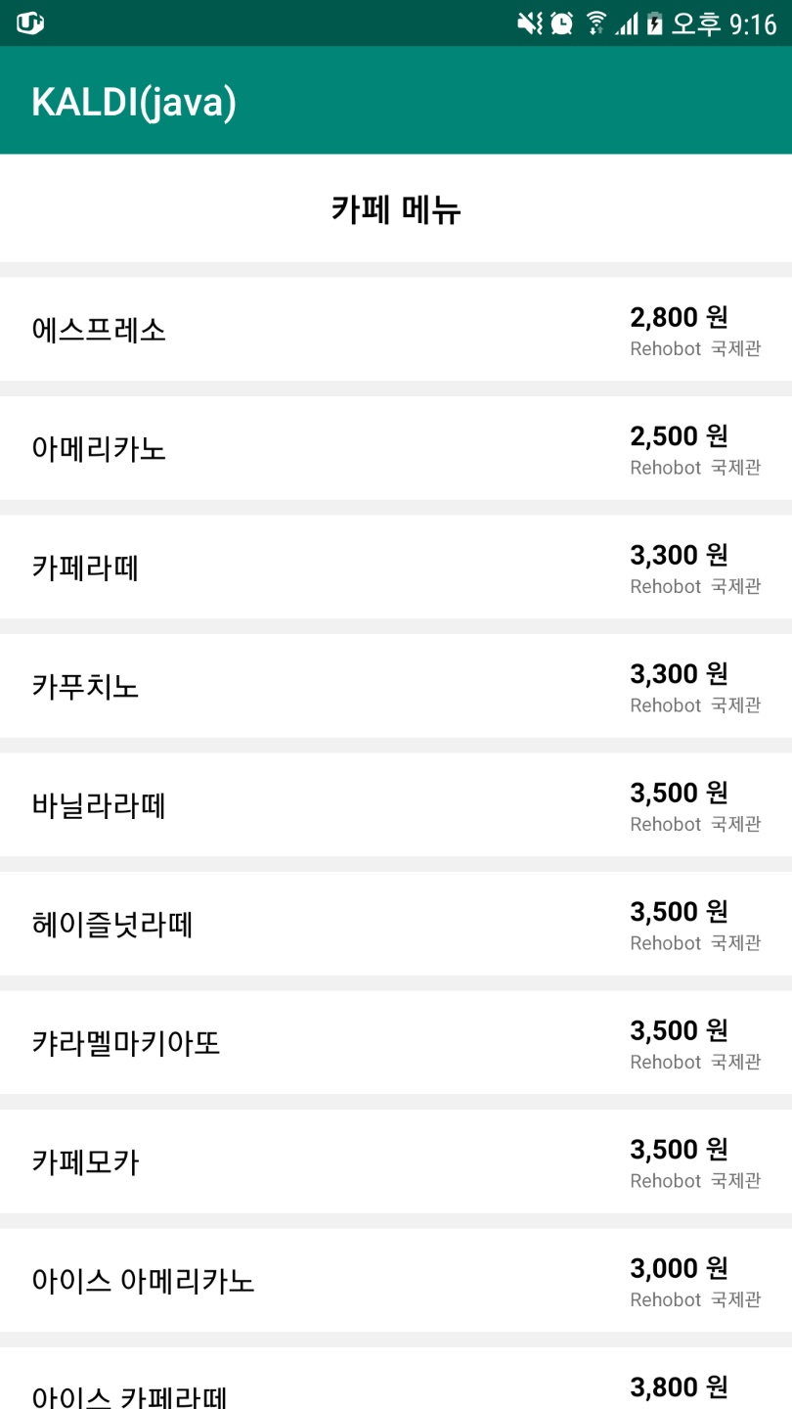

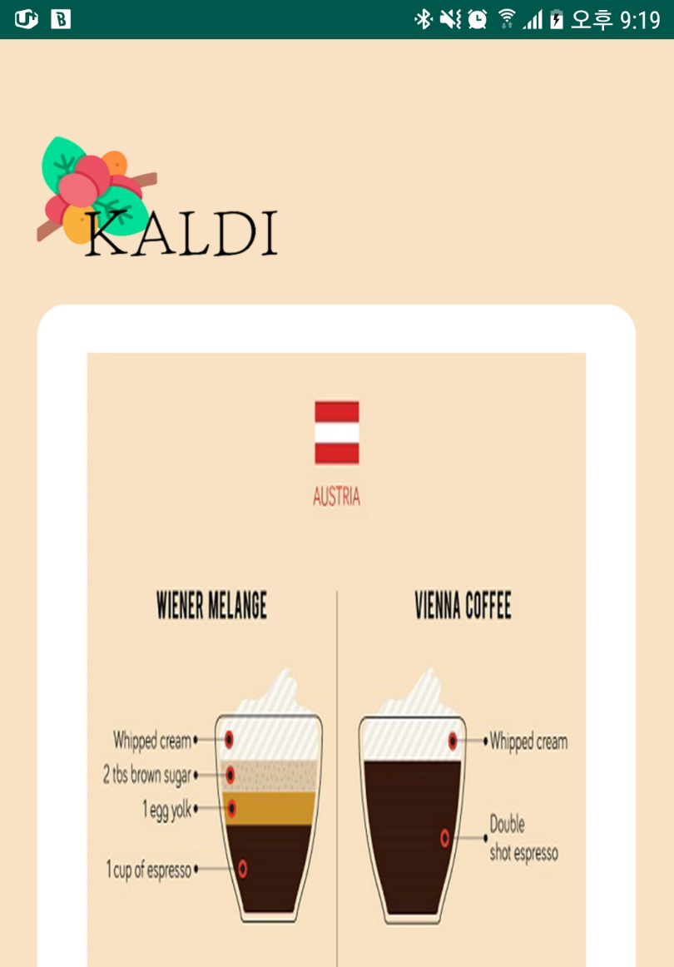


Application Operating
KALDI
Display coffee menu
Randomly display displays about world’s coffee

Slide 4


References
The importance of the private coffee order:
https://blog.naver.com/businessinsight?Redirect=Log&logNo=221485699389
https://www.mk.co.kr/news/business/view/2018/04/231863/
http://www.biznews.or.kr/news/article.html?no=8770
http://www.futurekorea.co.kr/news/articleView.html?idxno=111291

Slide 5




Project Design
1. GPS _ Coffee store finder
2. Kaldi order
3. Information about coffee consumption

Slide 6
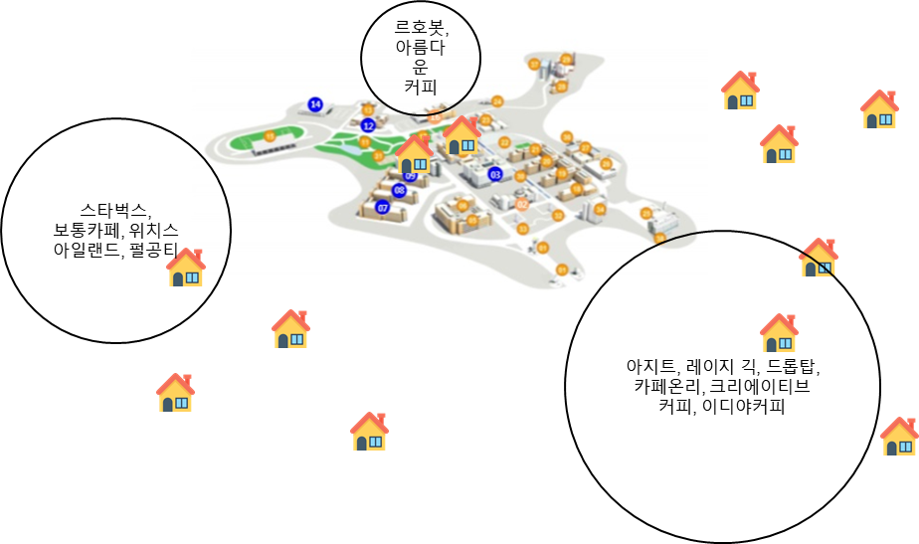

Recent state of shop
: waiting for response
: confirmed shop
?
Contact with more than 2 shops
Recent state:
Rehobot (International)
Witch’s Island

Slide 7
Application Design
0
100
Consumption Management
Hyo Bin
: swapping code error
Global Positioning System
Geun Hwa
: swapping code error
Alarm Function
Jae Hyeon
: push alarm Function error
Log in, Register
Jae Yeon
: authentication error

Slide 8
publisher
broker
subscriber
Subscribe(topic)
Publish(topic, data)
Publish(topic, data)

Slide 9


Android Studio
Hyo Bin
Consumption Management
Geun Hwa
Global Positioning System
Jae Hyeon
Alarm Function
Jae Yeon
Log in, Register

Slide 10

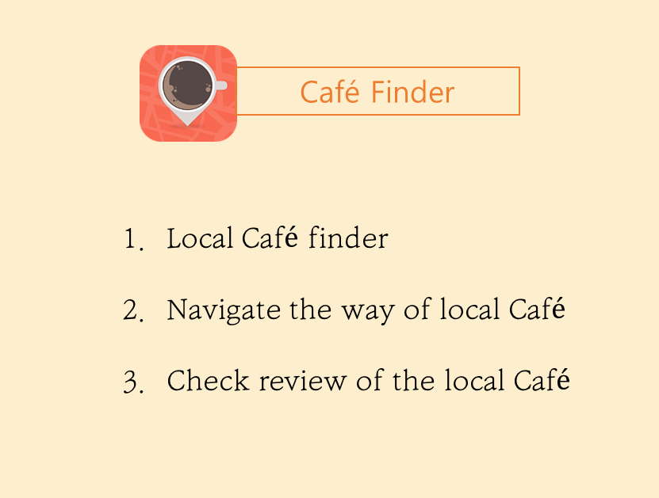

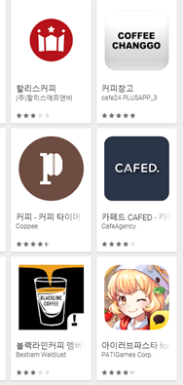
Notes:
우리가 설계하려는 어플과 비슷한 앱인데 이 앱에 대해 설명하면서 우리 앱은 어떤 차별성을 가지고 있는지 설명하면 될 것 같음
https://play.google.com/store/apps/details?id=com.novelux.findcoffee

Slide 11
Project Theme
1.
2.
3.
Coffee (café) aficionado
Increased demand of
Coffee Consumption & Smartphone distribution rate
Implement siren order function in Franchise chain’s mobile application
Notes:
우리가 설계하려는 어플과 비슷한 앱인데 이 앱에 대해 설명하면서 우리 앱은 어떤 차별성을 가지고 있는지 설명하면 될 것 같음
https://play.google.com/store/apps/details?id=com.novelux.findcoffee

Slide 12
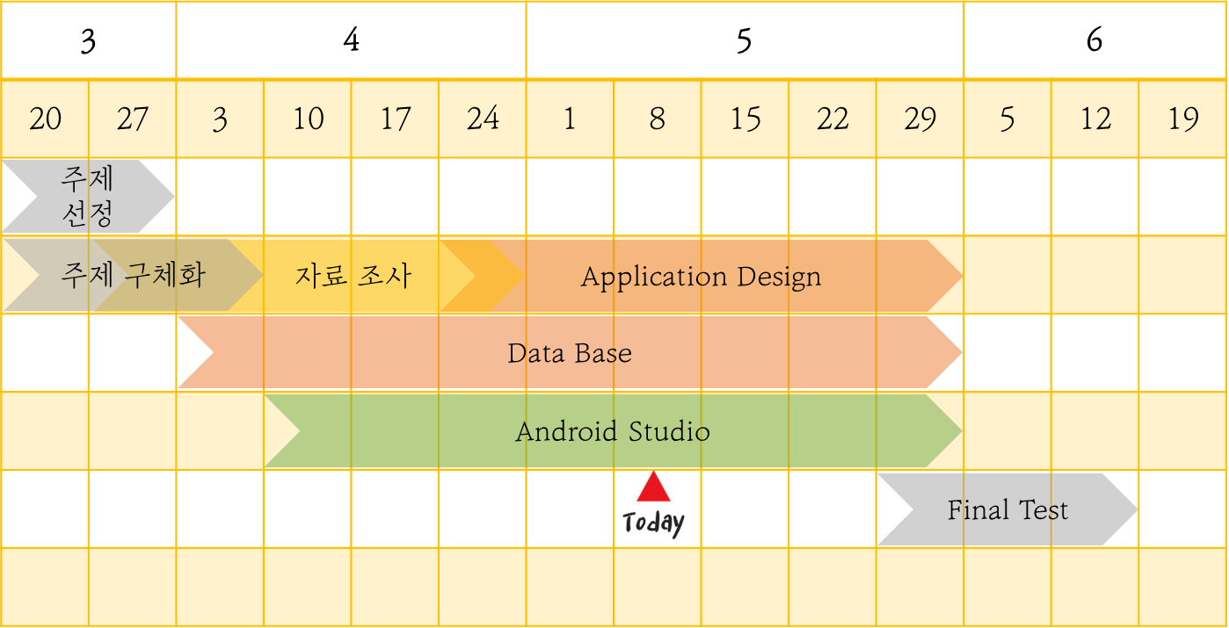
Milestone
KALDI

Slide 13
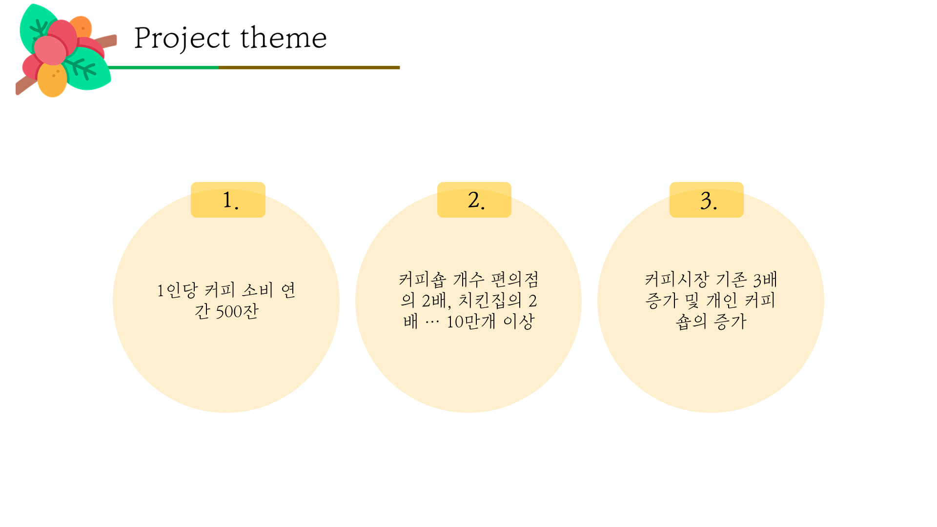

Slide 14
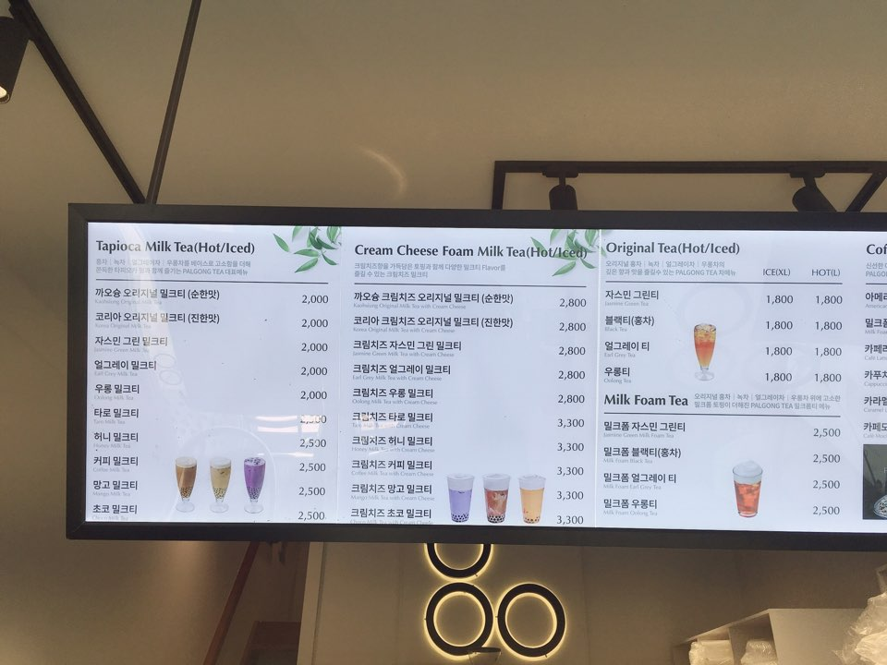
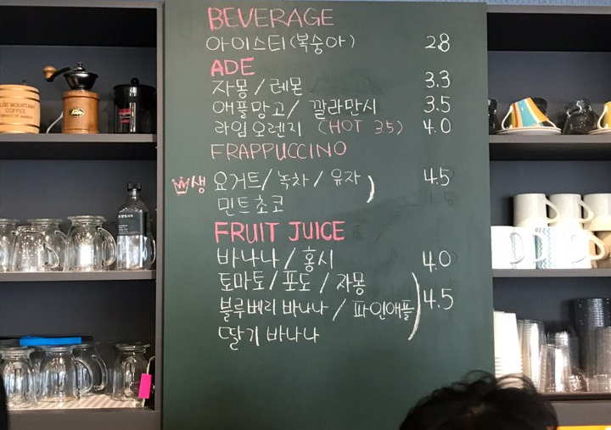
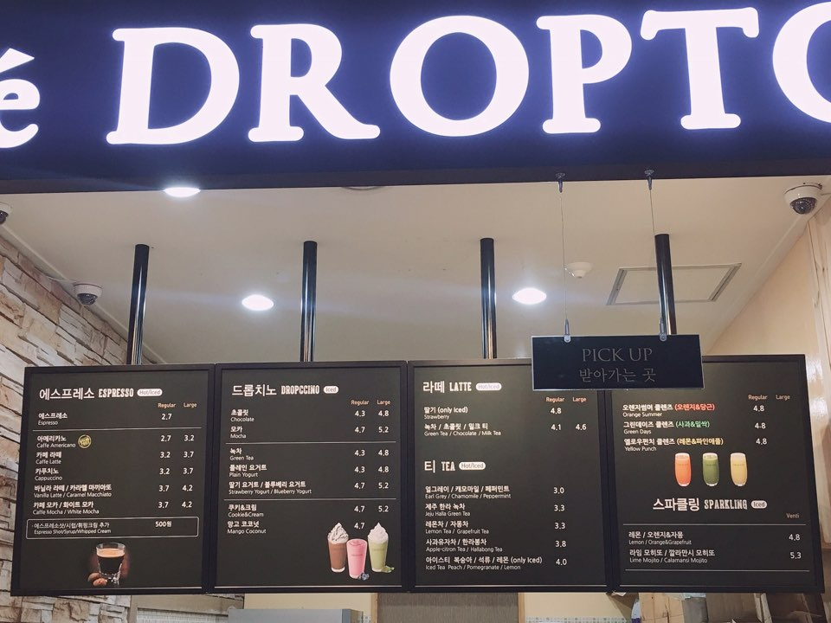
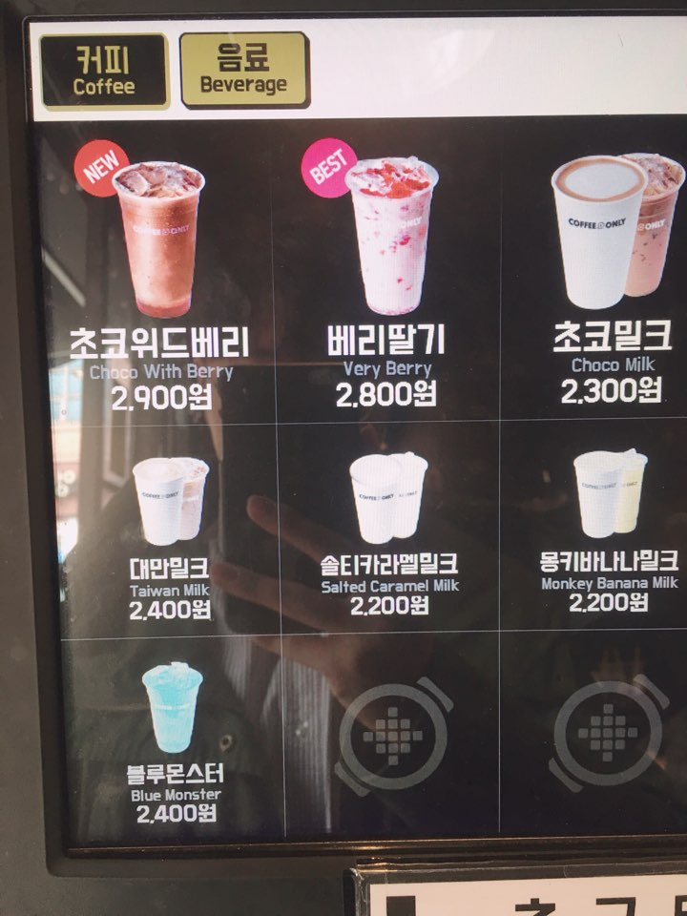
Project Design #2.
DB Table
<회원 가입>
ID
PW
Nick Name
<카페 테이블>
Café ID
Café Name
Address
Coffee
Price
<회원 관리 >
ID
Nick Name
Expenditure
Work Space
Bonus Point

Slide 15



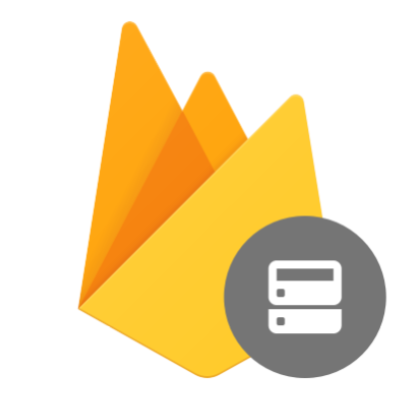
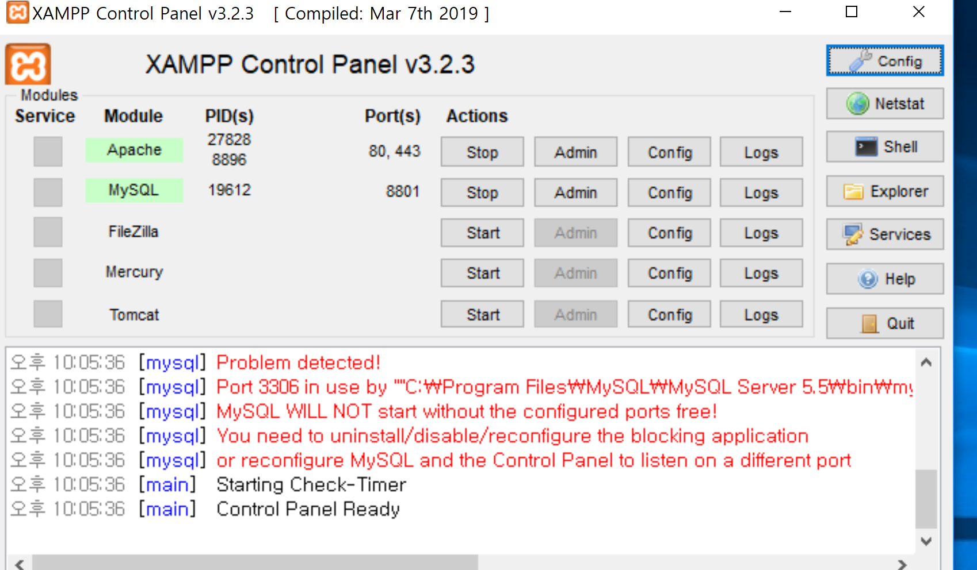
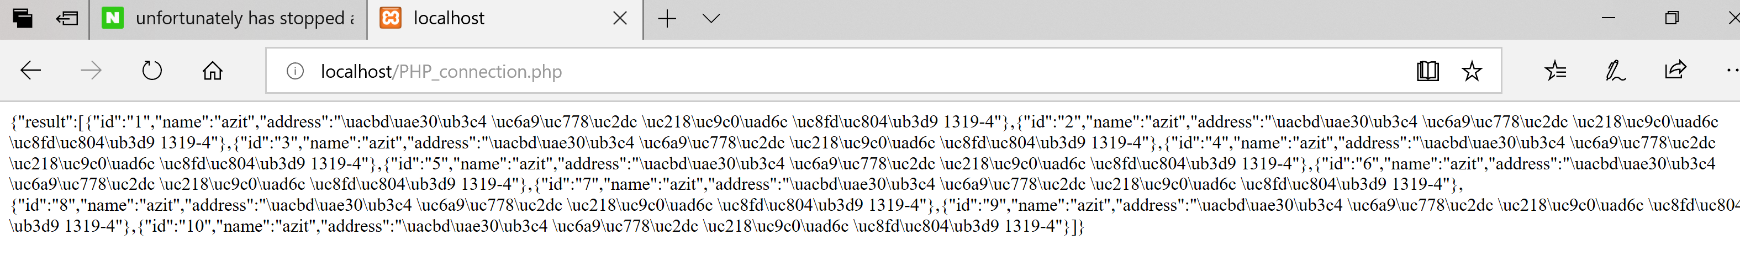
Application Design
Testing
Kaldi order
Alarm
0508 ~
Rehoboth
KALDI order

Slide 16
KALDI
Q & A

Slide 17
KALDI

Slide 18
Contents
1. Application Operating
2. Application Testing
- Application Problem
- Testing Plan
3. The Progress of Mentoring
4. Milestone

Slide 19

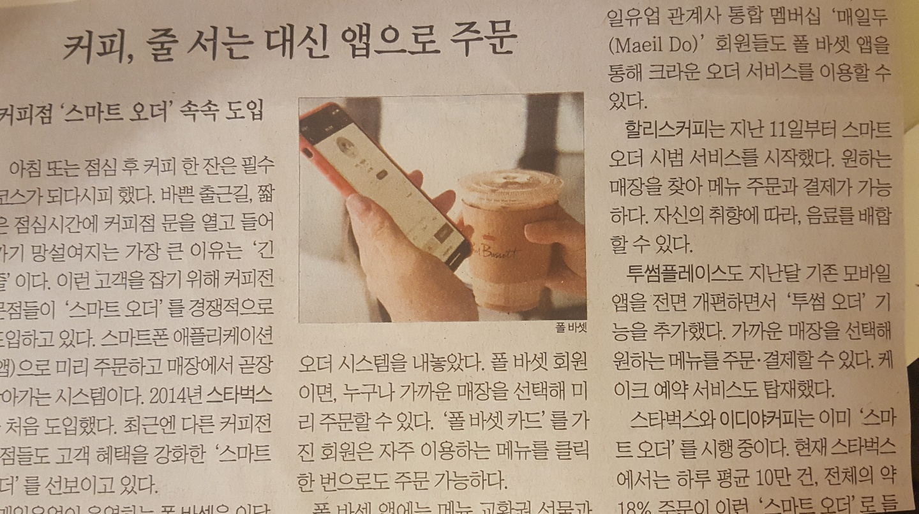



The Progress of Mentoring
1st Mentoring
KALDI
Mentoring Topic: Importance of the pre-investigation division of labor and team leader
“ “
프로젝트를 진행하기전에 계획을 철저하게 세워야 하고 사전조사, 역할 분담이 이루어지면 각각의 기능에 대해서 기능명세서를 작성해서 개발 전에 이러한 사전 작업을 매우 중점을 두고 진행해야 한다. 실제로 프로젝트에서 이러한 사전 작업들이 40~50% 정도를 차지할 정도로 매우 중요함을 강조할 수 있다.
2nd Mentoring
Mentoring Topic: How to write Technical Specification

Slide 20



Application Testing
Testing
KALDI
Final Testing
0522 ~
~ 0529
Step 01
Step 02
Step 01. install cell phone which has café App.(receive order) at RH
Step 02. one of team members turn on “kaldi order” and order coffee
Step 03. check the order signal is coming or not
Rehoboth
Step 04
Step 03
Step 04. after every testing wrap up all the stuff we brought in !

Slide 21

Cooperative work
Recent state of the cooperative work 01
Select café
Coordination
Testing
Final Testing
0417
0502
0508 ~
~ 0529
Terms #1. Final testing wrap up on May 29.
Terms #2. After every testing clean things out.
x
Rehoboth

Slide 22
Cooperative work
Recent state of the cooperative work 02
Step 01
Step 02
Testing
Final Testing
0522 ~
~ 0529
Rehoboth
Step 04
Step 03
Step 01. install cell phone which has café App.(receive order) at RH
Step 02. one of team members turn on “kaldi order” and order coffee
Step 03. check the order signal is coming or not
Step 04. after every testing wrap up all the stuff we brought in !
Notes:
테스팅 루트

Slide 23
이름을 입력해주세요
내용을 입력해주세요 입력 해주세요
여기에는 내용을 입력해주세요 입력 해주세요
여기에는 내용을 입력해주세요 내용입력

