Slide 1

TEAM 18 / DATA SCIENCE FINAL PROJECT
Beyond Negative
Reviews on Steam
Which dissatisfied players should
game developers prioritize?
Predict engagement. Use complaint themes to guide responses.

Slide 2
Data and prediction target
16.4M
INPUTS AVAILABLE AT POSTING
Prior playtime, reviewer characteristics,
review timing and NLP complaint features
negative reviews
From 113.9M Steam reviews
covering 8,183 games
ENGAGEMENT TARGET
D30 engagement proxy from historical data
Unequal follow-up limits interpretation
Kaggle reviews + SteamDB metadata
One record = one player–game review
TRAIN | VALIDATE + CALIBRATE | TEST
2010–2021 | 2022 | 2023
Historical snapshot: the target does not confirm activity on exactly day 30.
02

Slide 3
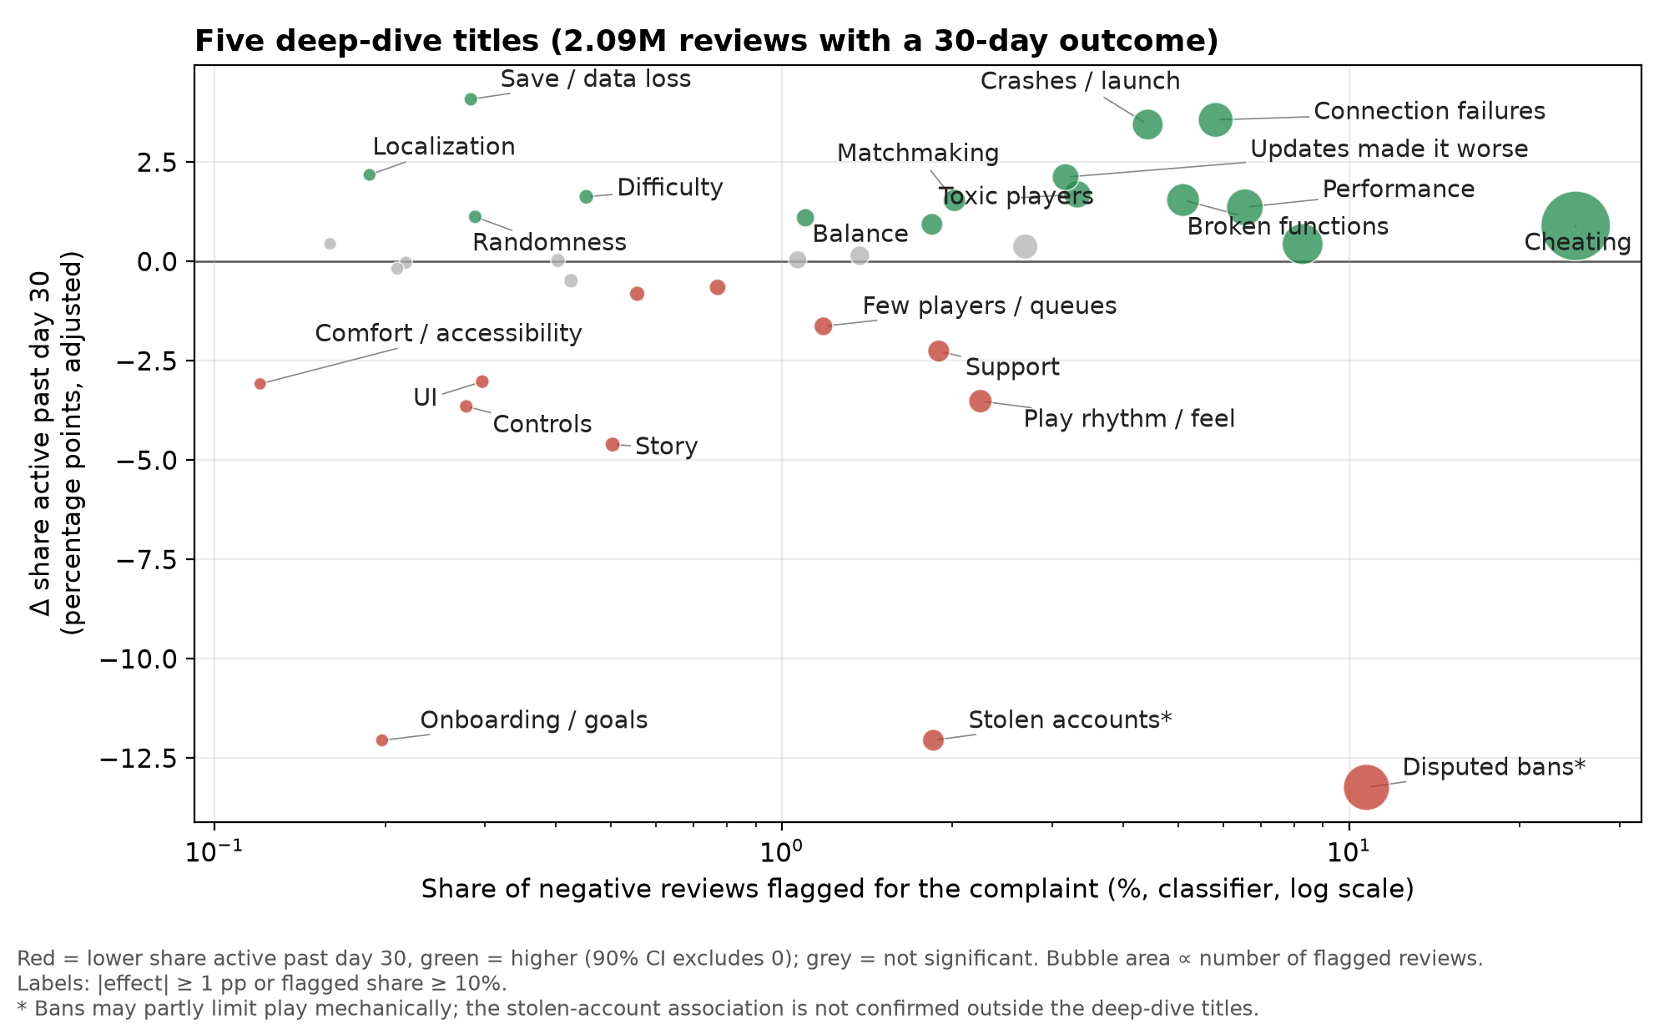
Engagement varies by complaint type
35 of 78 complaint factors met the threshold for use at scale
−12 pp
Onboarding complaints
Lower engagement in
five deep-dive games
+1 to +7 pp
Technical complaints
Higher engagement
Adjusted associations, not causal effects
03

Slide 4
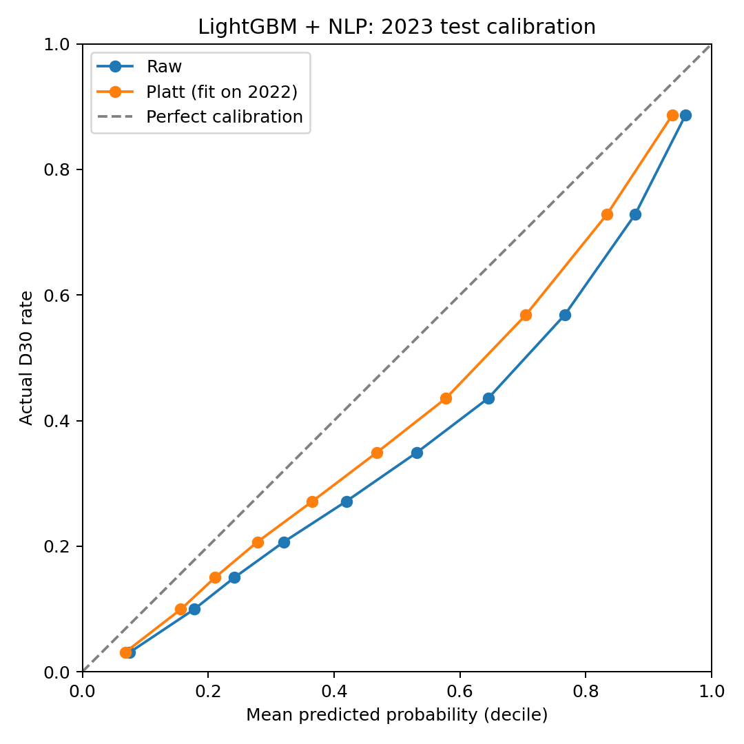
LightGBM + NLP performs best
10-fold model comparison, 2010–2021
Model / features | Average precision
Logistic / structured | 0.8012
L2 logistic / + NLP | 0.8194
LightGBM / structured | 0.8226
LightGBM / + NLP | 0.8457
2023 TEST: 2.15M REVIEWS
0.824
88.7%
ROC-AUC
Engaged in top-scored 10%
2.38× lift over test baseline
Mean prediction 46.0% vs. observed 37.3%
Probabilities still overestimate by 8.7 pp
04

Slide 5
Four segments guide review prioritization
2023 test set, 2,154,782 review-level records
Segment | Prior playtime | Predicted engagement | Share
Hardcore | High | High | 36.06%
Dropout | High | Low | 6.59%
New Blood | Low | High | 8.94%
Nobody | Low | Low | 48.41%
High playtime: > 11.78 hours
High predicted engagement: at or above each period’s 55th percentile
Relative profiles, not confirmed churn. The “Nobody” label does not imply low-value feedback.
05

Slide 6
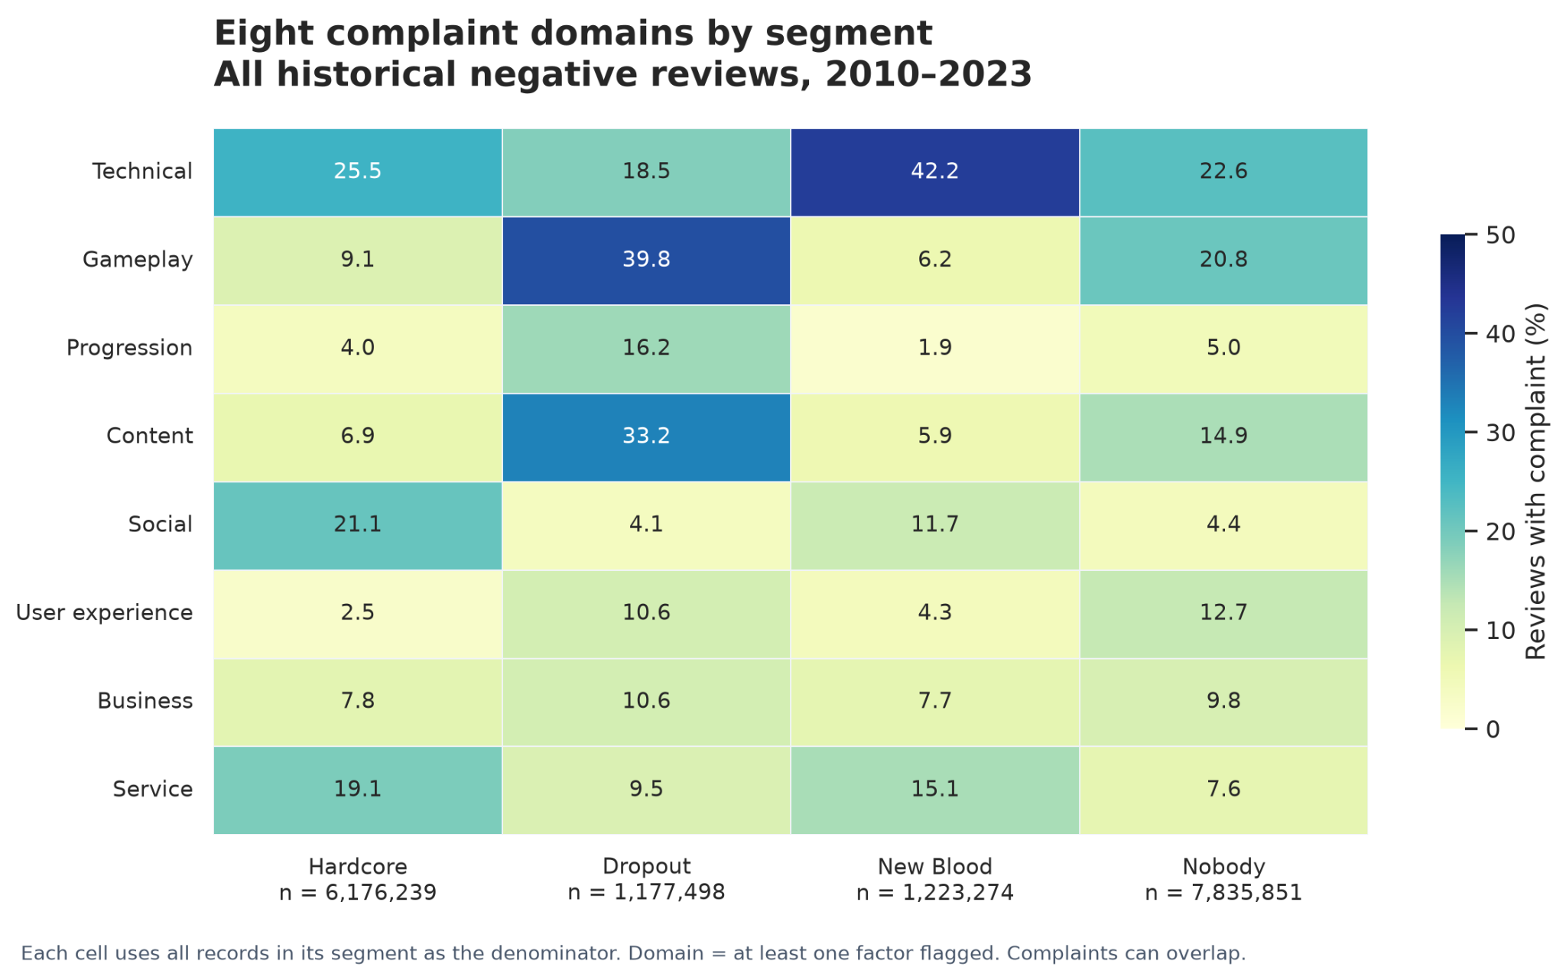
Targeted responses need a measured pilot
Dropout
Investigate gameplay and
progression dissatisfaction
New Blood
Resolve technical friction
in the early experience
Hardcore
Use service and social feedback
to improve ongoing play
Pilot targeted responses against current practice
Measure engagement and support costs. Recalibrate scores and keep human review.
06

