Slide 1
Mobile Programming
Term Project Proposal Presentation

Slide 2
Title
★★★★★
★★★★★
MEMBER
MEMBER
Brief Description
Name : 유정재
Student ID : 201533655
E-mail Address : yy5538012@naver.com
Name : 임홍재
Student ID : 201533665
E-mail Address : iihhjj2002@naver.com
Contents
★★★★★
★★★★★
Key Features
MEMBER
MEMBER
Name : 김준호
Student ID : 201635807
E-mail Address : inpie212@gmail.com
Name : 이철순
Student ID : 201635842
E-mail Address : chirsoon@naver.com
Technologies
Timeline

Slide 3
Title
Index
Brief Description
Title
Brief description
Contents
Key features
Technologies
Timeline
Contents
Key Features
Technologies
TimeLine

Slide 4
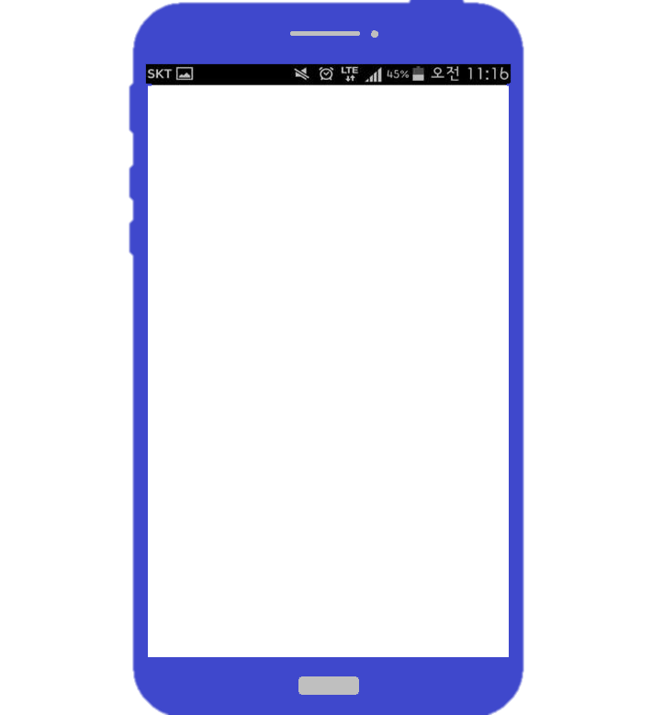

Title
Brief Description
Contents
CloseT: 당신의 옷장에 가까이
Clothes Management & Stylist Recommendation App
Key Features
CloseT
Technologies
TimeLine

Slide 5
Title
Brief Description
“
Contents
Do you exactly remember what clothes are in your closet?
With ‘CloseT’, you can check what clothes you have,
find the best dress code by matching clothes one by one.
Don’t you spend too much time deciding what to wear in every morning?
”
Key Features
Technologies
TimeLine

Slide 6
Title
Clothes
d
Brief Description
Clothes Registration
1) Taking a picture of your clothes and registering them.
2) Entering information about clothes when registering them.
(ex. Type, Color, brand, Price, Proper situation)
Clothes List
Displaying registered clothes as a list by categories based on information about clothes.
Clothes Removal
1) If clothes are thrown away or lost removing clothes from a closet.
Contents
Key Features
Technologies
TimeLine

Slide 7
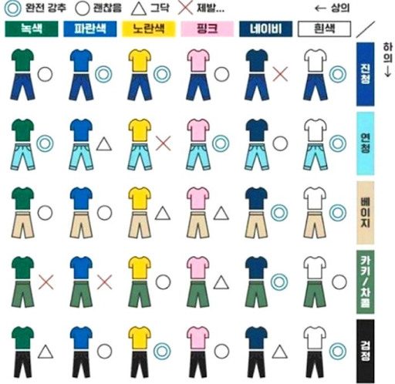
Title
Cody
d
Brief Description
Clothes matching
1) Displaying registered clothes as a list by categories based on information about clothes.
2) Matching clothes on a user model.
Contents
Key Features
Technologies
TimeLine

Slide 8
Title
Check Point
CloseT
Brief Description
Category
Clothes
상의
하의
신발
d
Contents
Color
Displaying registered clothes as a list by categories based on information about clothes.
검정
흰색
파랑
초록
노랑
빨강
Key Features
Style
격식
일상
운동
Technologies
완료
초기화
Timeline

Slide 9
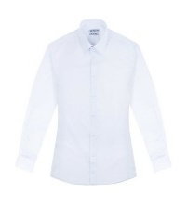
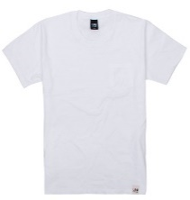

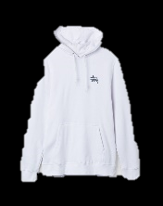
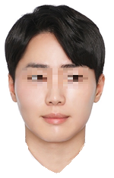

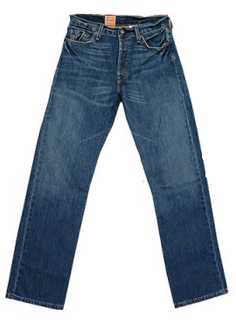
Title
Check Point
CloseT
Brief Description
Category :
상의
Cody
Color :
흰색
d
Style :
Contents
일상
Finding the best dress code by
matching clothes on a user model.
Key Features
<예상 이미지>
Technologies
완료
초기화
Timeline

Slide 10



Title
Brief Description
Contents
Database
Key Features
Technologies
Image Processing
Android GUI
TimeLine

Slide 11
Title
Schedule
Brief Description
< April >
SUN | MON | TUE | WED | THU | FRI | SAT
 |  |  | 1 | 2 | 3 | 4
5 | 6 | 7 | 8 | 9 | 10 | 11
12 | 13 | 14 | 15 | 16 | 17 | 18
19 | 20 | 21 | 22 | 23 | 24 | 25
26 | 27 | 28 | 29 | 30 | 1
Creating team
Selecting subject
Contents
Creating wiki page
Making and presenting proposal presentation
Key Features
Technologies
Designing GUI
Designing database
Timeline

Slide 12
Title
Schedule
Brief Description
< May >
SUN | MON | TUE | WED | THU | FRI | SAT
 |  |  |  |  | 1 | 2
3 | 4 | 5 | 6 | 7 | 8 | 9
10 | 11 | 12 | 13 | 14 | 15 | 16
17 | 18 | 19 | 20 | 21 | 22 | 23
24 | 25 | 26 | 27 | 28 | 29 | 30
31
Searching image processing open API
Contents
Visualizing GUI
Constructing database
Key Features
Technologies
Combining GUI
Combining database
Timeline

Slide 13
Title
Schedule
Brief Description
< June >
SUN | MON | TUE | WED | THU | FRI | SAT
 | 1 | 2 | 3 | 4 | 5 | 6
7 | 8 | 9 | 10 | 11 | 12 | 13
14 | 15 | 16 | 17 | 18 | 19 | 20
21 | 22 | 23 | 24 | 25 | 26 | 27
28 | 29 | 30 | 1 | 2
Applying image processing
Contents
Debugging
Completing prototype
Key Features
Completing development
Technologies
Preparing final presentation
Timeline

Slide 14
Title
Schedule
Brief Description
< July >
SUN | MON | TUE | WED | THU | FRI | SAT
 |  |  | 1 | 2 | 3 | 4
5 | 6 | 7 | 8 | 9 | 10 | 11
12 | 13 | 14 | 15 | 16 | 17 | 18
19 | 20 | 21 | 22 | 23 | 24 | 25
26 | 27 | 28 | 29 | 30 | 31
Final presentation
Contents
Key Features
Technologies
Timeline

Slide 15
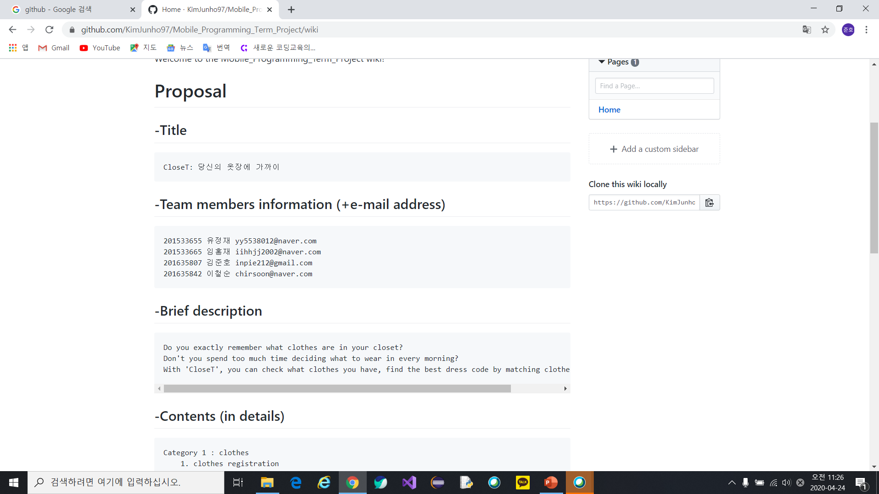
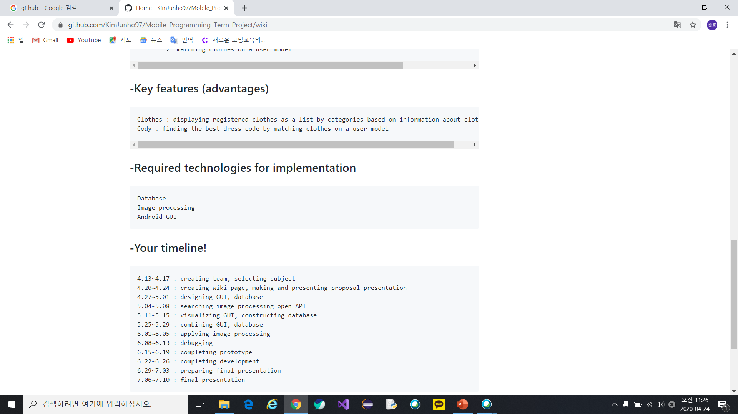
Title
Brief Description
Contents
Key Features
Technologies
TimeLine

Slide 16
Q & A

Slide 17
Thank you

Slide 18
GitHub URL : https://github.com/KimJunho97/Mobile_Programming_Term_Project
Font Information :
맑은 고딕
나눔 고딕
배달의 민족 주아

