Slide 1
DengAI: predicting disease spread
Kimberly Kaminsky
Predict 413 Section 55

Slide 2
Problem Definition significance
Dengue Fever is a Mosquito-Born Disease
Symptoms
Severe Bleeding
Low Blood Pressure
In Extreme Cases, Death
Occurs in Tropical and Sub-Tropical Climates
Spread of the Disease May Be Related to Temp & Precipitation
Why Try to Predict it?
Prevent Further Outbreaks
Ability to Educate Affected Populations

Slide 3
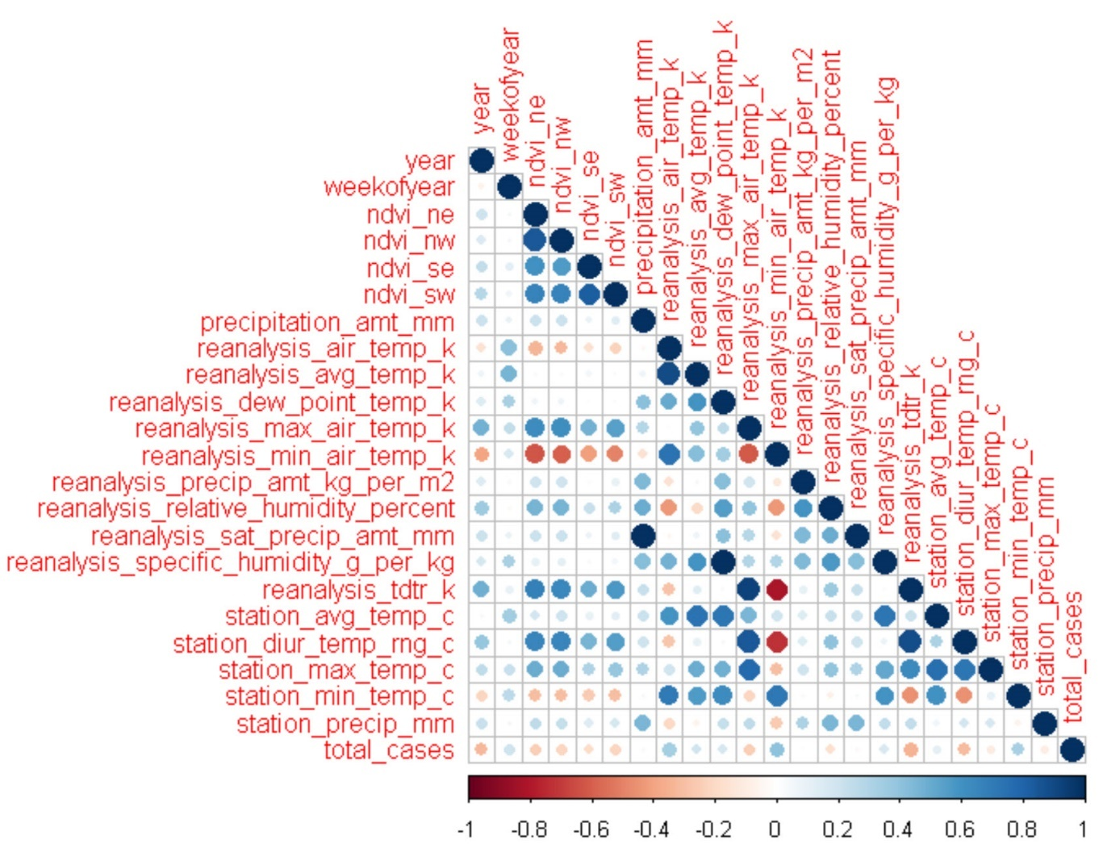
Data Exploration
Training Data 1436 rows
936 rows for San Juan
520 rows for Iquitos
All predictor variables missing data
No variables missing more than 13% of data
No strong correlations between predictor variables and response variable
Possible multicollinearity

Slide 4
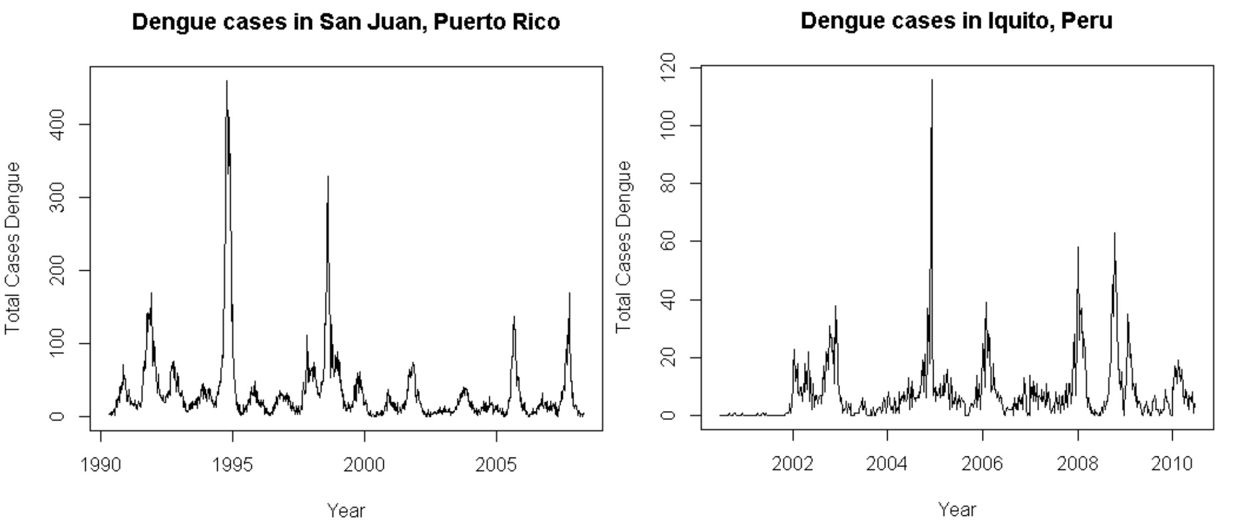
Data Exploration
Time series shows strong seasonality for San Juan and Iquitos
Both datasets have some volatility
Iquitos has more volatility than San Juan

Slide 5
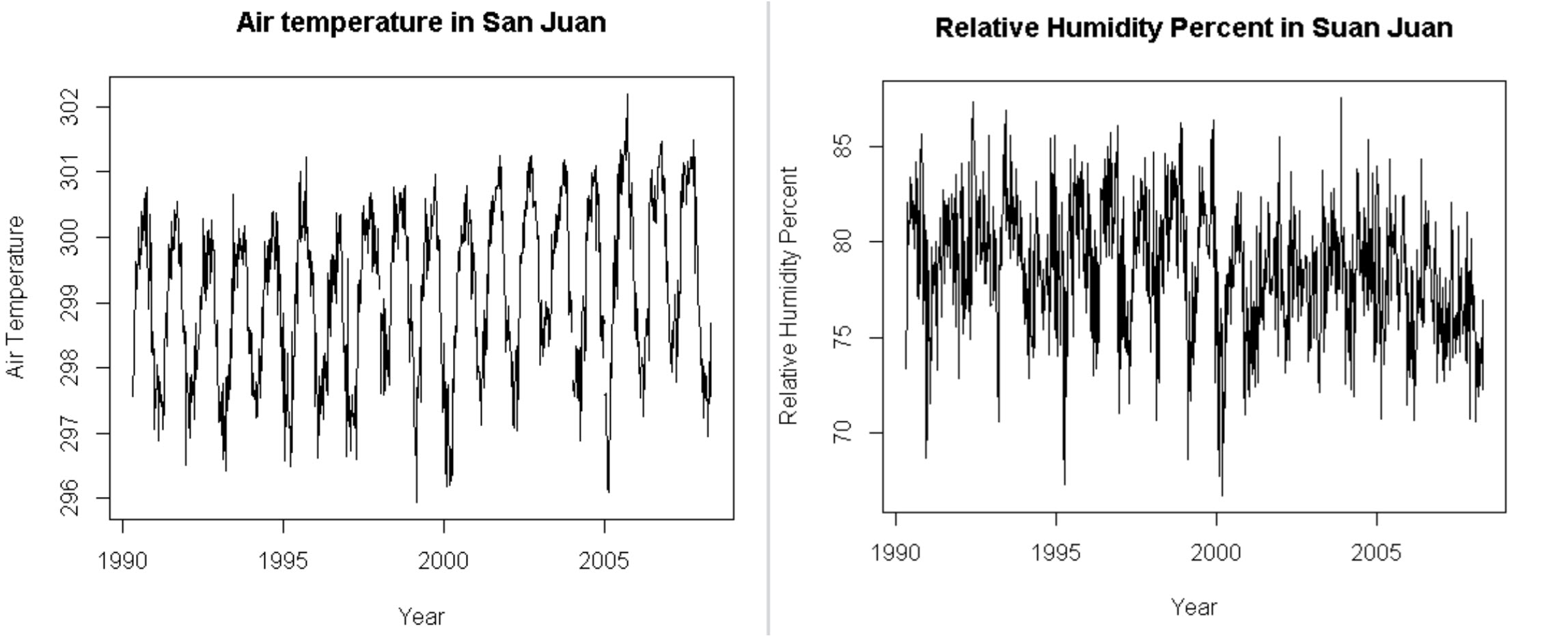
Data Preparation
Used time series to impute missing values when data showed consistent pattern
Air temperature San Juan – see red circles for missing values
Imputed using mean of previous and following value
Use MICE when time series did not show a consistent pattern
Relative humidity percent in San Juan

Slide 6
Model results
Modeling Method | San Juan | Iquitos | DengAI
Seasonal AA w/ Climate Data** | 13.4616 | 34.9956 | 29.7236
Seasonal AA** | 13.0084 | 25.796 | 30.8389
GARCH | 13.478 | 7.7509 | 26.6154
GARCH w/ Climate Data | 14.6438 | 7.5736 | 28.3702
Neural Net w/ Climate Data | 12.048 | 7.0255 | 30.8389
Neural Net | 13.0013 | 6.6414 | 29.5769
Two models for each method: one for San Juan and one for Iquitos
Best models on the test data did not perform best against DengAI holdout
GARCH performed best against DengAI
Including climate data did not always improve the score (only for Auto Arima)
Model Comparison of Mean Absolute Error against San Juan & Iquitos test sets and Final DengAI result
** Note that the model submitted to DengAI was the Seasonal AA for San Juan and the AA without Seasonality for Iquitos

Slide 7
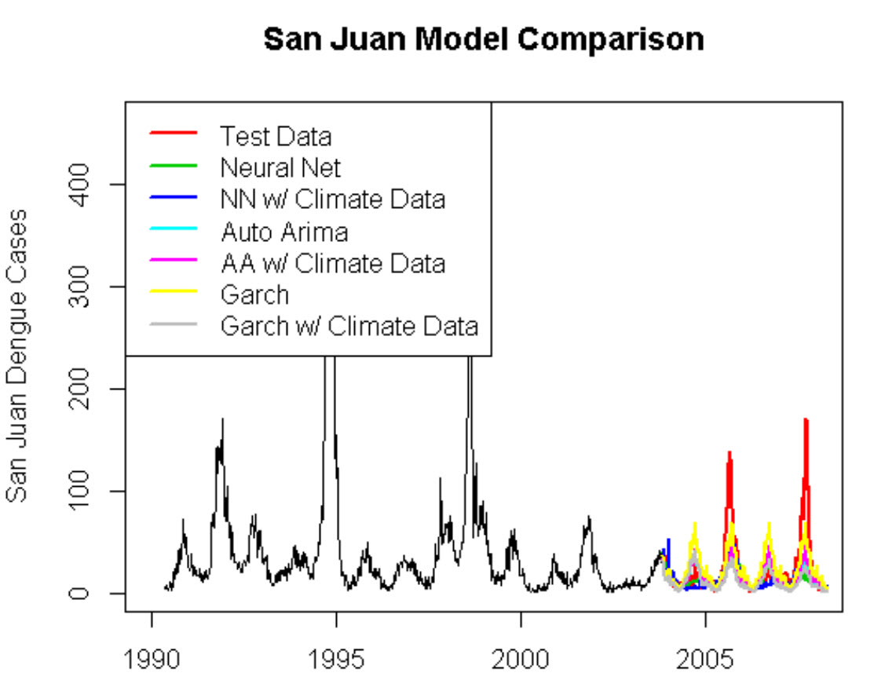
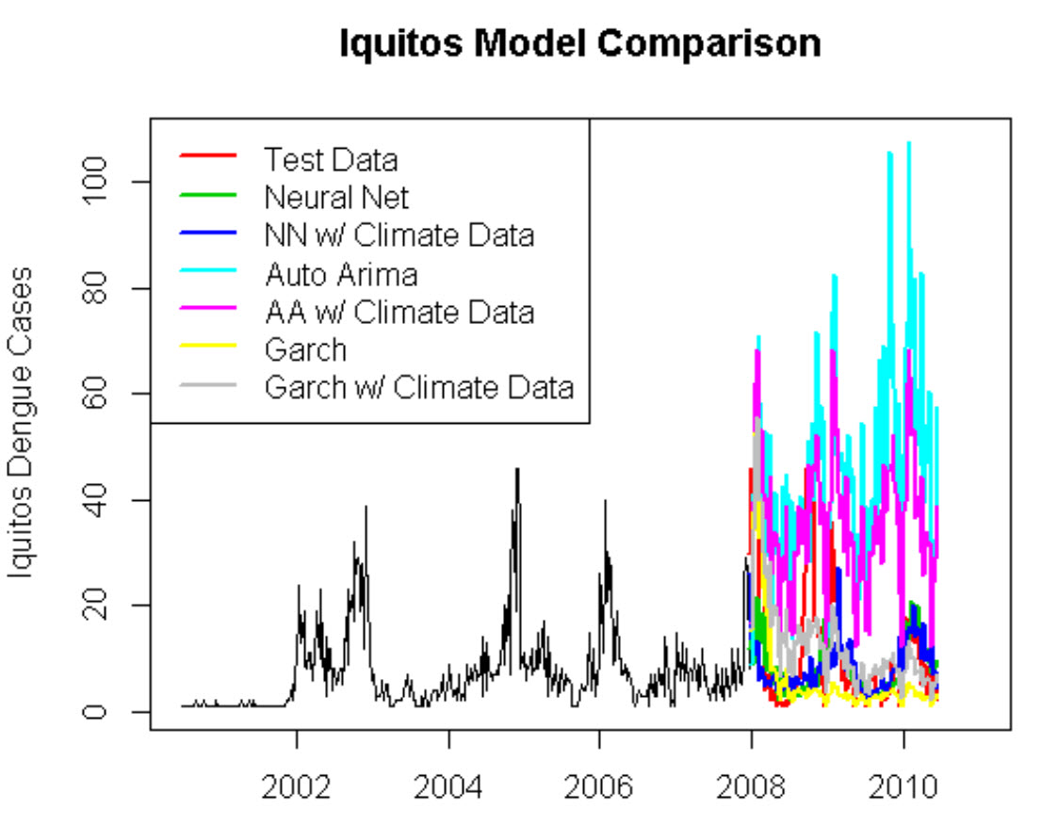
Test results for San Juan & Iquitos Models
San Juan models grouped together more than Iquitos
May be some opportunities to use ensembles, with Iquitos, to smooth out results
San Juan models don’t capture the peaks

Slide 8
Conclusions \Future work
Despite differences in test results, most models performed similarly against DengAI holdout data
Including climate data did not necessarily enhance the results
GARCH model performed the best
Future work
Try adding in lags to the predictor variables (heavy rainfall may take some days before producing an affect on an outbreak)
Variable selection to reduce multicollinearity
Ensembles – especially with the Iquitos
Other types of models
Poisson
Linear Regression
PCA
Mix and match models for Iquitos and San Juan

Slide 9
DengAI: predicting disease spread
Kimberly Kaminsky
Predict 413 Section 55

