Slide 1
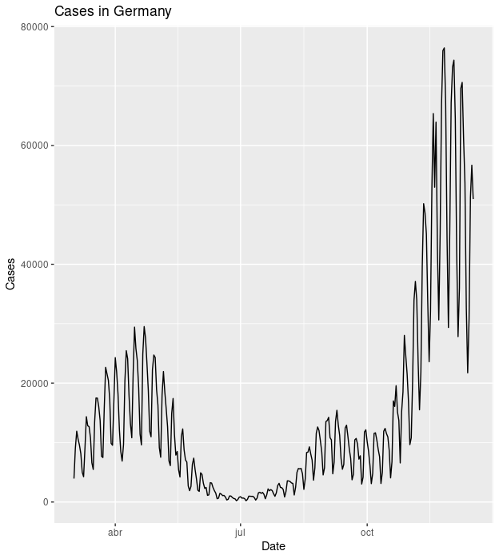
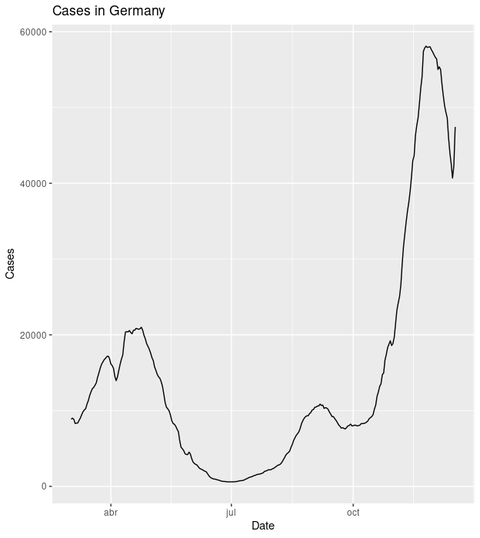

Slide 2
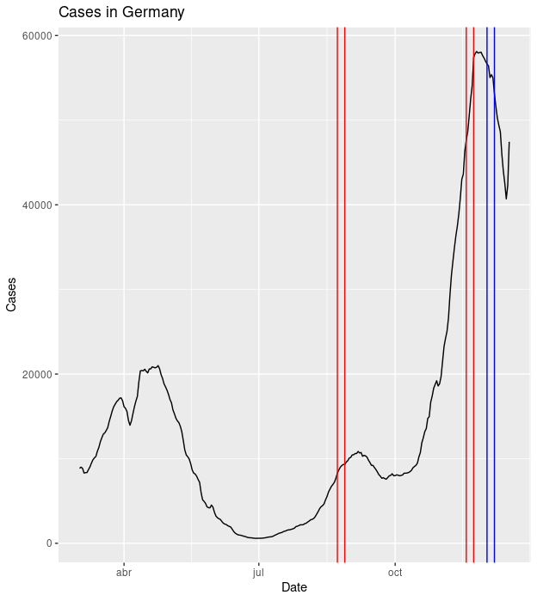
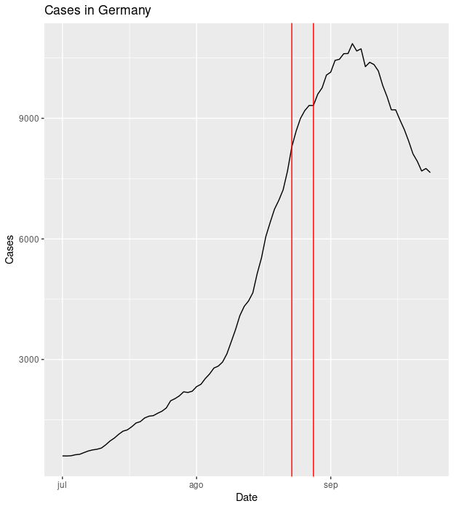

Slide 3
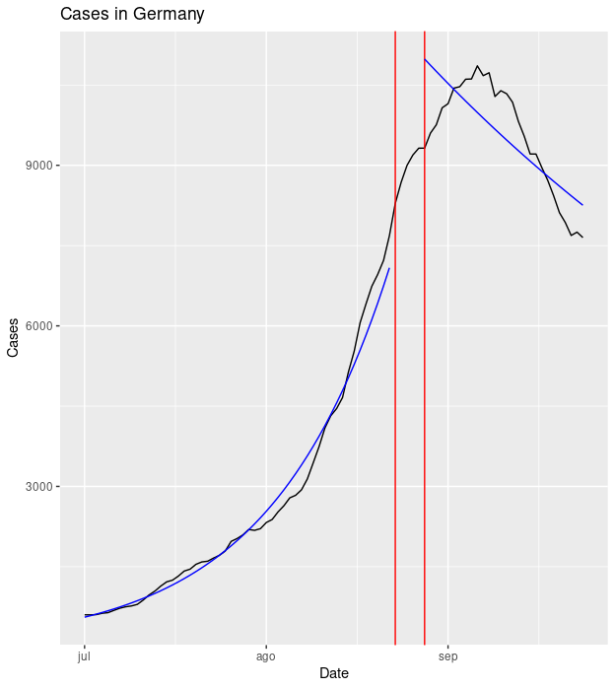
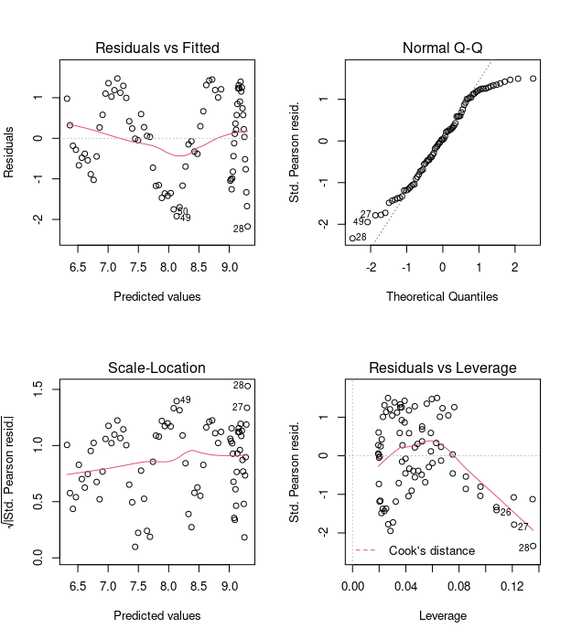

Slide 4
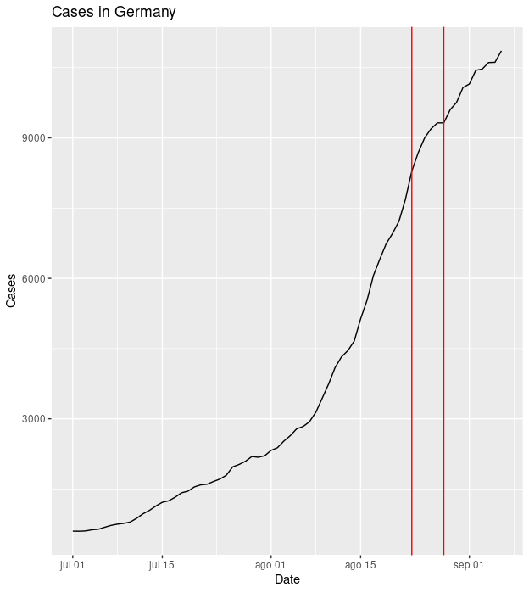
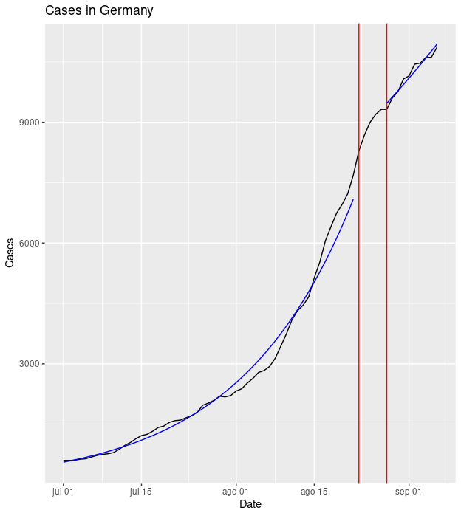

Slide 5
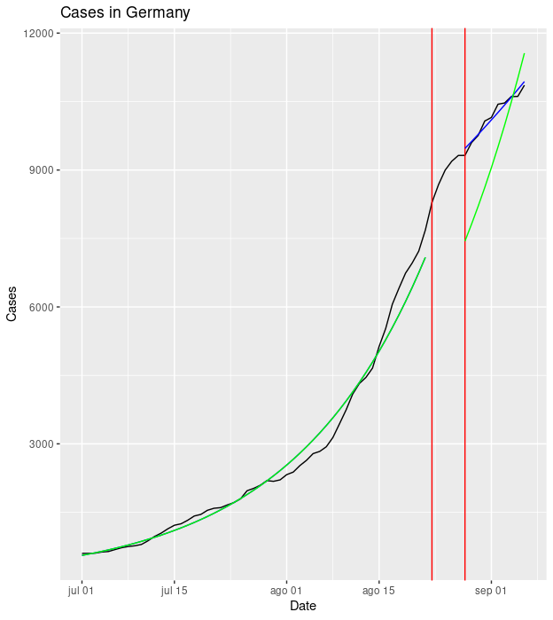
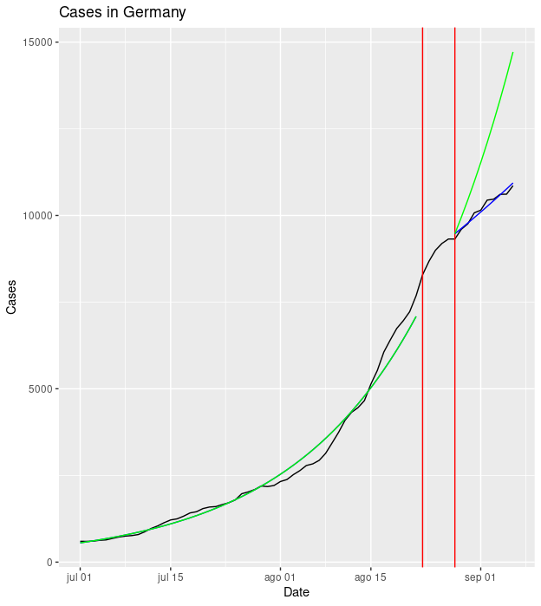

Slide 6
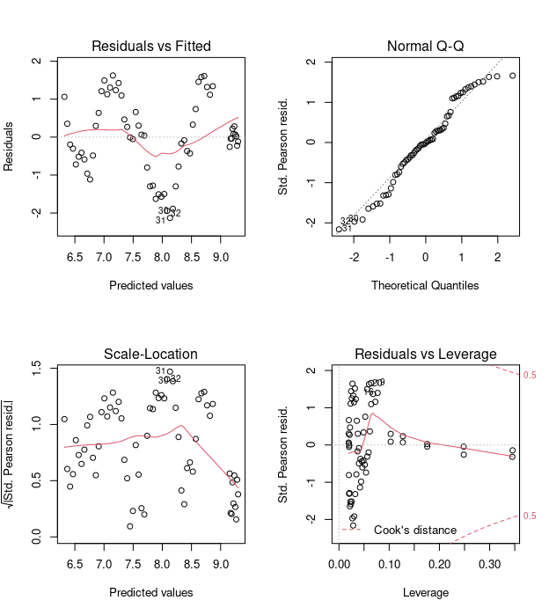
Estimate 2.5 % 97.5 %
(Intercept) 6.32086356 6.28397116 6.35788826
CP1_De_int 0.24129238 0.16139652 0.32207582
CP1_De_t1 0.04894423 0.04776791 0.05012221
CP1_De_t2 -0.03296725 -0.04657145 -0.01936238
exp(est)
Estimate 2.5 % 97.5 %
(Intercept) 556.0529699 535.9126394 577.0265365
CP1_De_int 1.2728931 1.1751508 1.3799894
CP1_De_t1 1.0501618 1.0489272 1.0513996
CP1_De_t2 0.9675702 0.9544964 0.9808239

