Slide 1
Introduction to
Artificial Intelligence
Lecture: Problem Solving Using Searching

Slide 2
Outline
Problem-Solving Agents
Example Problems
Searching for Solutions

Slide 3
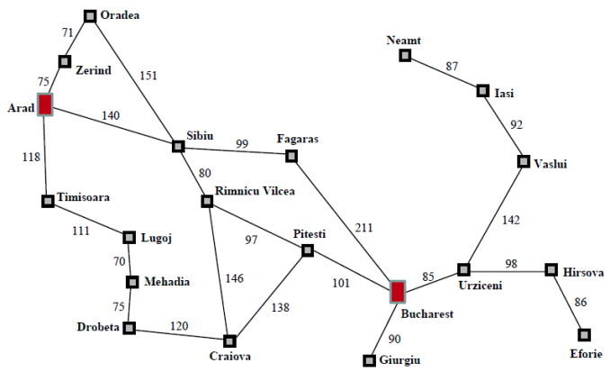
Holiday in Romania

Slide 4
Goal-based Agents
Intelligent agents maximize their performance measure.
Goals help organize behavior by limiting the objectives that the agent is trying to achieve and the actions it considers.

Slide 5
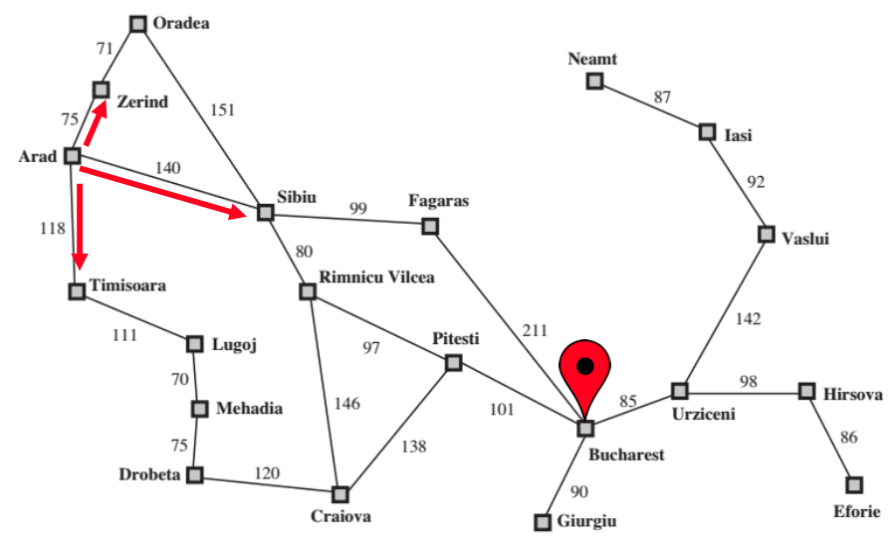
Problem Formulation
Consider a goal to be a set of world states in which the objective is satisfied.
Problem formulation is the process of deciding what actions and states to consider, given a goal.

Slide 6
Properties of the Romania environment
Observable
Each city has a sign indicating its presence for arriving drivers.
The agent always knows the current state.
Discrete
Each city is connected to a small number of other cities.
There are only finitely many actions to choose from any given state.
Known
The agent knows which states are reached by each action.
Deterministic
Each action has exactly one outcome.

Slide 7
Solving problem by searching
Search: the process of looking for a sequence of actions that reaches the goal
A search algorithm takes a problem as input and returns a solution in the form of an action sequence.
Execution phase: once a solution is found, the recommended actions are carried out.

Slide 8
Solving problem by searching
function PROBLEM-SOLVING-AGENT(percept) returns an action
persistent: seq, an action sequence, initially empty
state, some description of the current world state
goal, a goal, initially null
problem, a problem formulation
state ← UPDATE-STATE(state, percept)
if seq is empty then
goal ← FORMULATE-GOAL(state)
problem ← FORMULATE-PROBLEM(state, goal)
seq ← SEARCH(problem)
if seq = failure then return a null action
action ← FIRST(seq)
seq ← REST(seq)
return action

Slide 9
Well-defined problems and solutions
A problem can be defined formally by five components.
Initial state: in which the agent starts
E.g., the agent in Romania has its initial state described as 𝐼𝑛(𝐴𝑟𝑎𝑑)
Actions: the possible actions available to the agent
E.g., 𝐴𝐶𝑇𝐼𝑂𝑁(𝐴𝑟𝑎𝑑) = {
𝐺𝑜(𝑆𝑖𝑏𝑖𝑢), 𝐺𝑜(𝑇𝑖𝑚𝑖𝑠𝑜𝑎𝑟𝑎), 𝐺𝑜(𝑍𝑒𝑟𝑖𝑛𝑑)}
Transition model: what each action does
E.g., 𝑅𝑒𝑠𝑢𝑙𝑡(𝐼𝑛(𝐴𝑟𝑎𝑑), 𝐺𝑜(𝑍𝑒𝑟𝑖𝑛𝑑)) = 𝐼𝑛(𝑍𝑒𝑟𝑖𝑛𝑑)
Successor: a state reachable from a given state by a single action

Slide 10
Well-defined problems and solutions
Goal test: determine whether a given state is a goal state
The goal is specified by either an explicit set of possible goal states or an abstract property.
E.g., 𝐼𝑛(𝐵𝑢𝑐h𝑎𝑟𝑒𝑠𝑡), checkmate
Path cost: a function that sets a numeric cost to each path
Non-negative, reflecting the agent’s performance measure
E.g., 𝑐(𝐼𝑛(𝐴𝑟𝑎𝑑),𝐺𝑜(𝑍𝑒𝑟𝑖𝑛𝑑),𝐼𝑛(𝑍𝑒𝑟𝑖𝑛𝑑)) = 75
An optimal solution has the lowest path cost.

Slide 11
Formulating problems by abstraction
Abstraction creates an approximate and simplified model of the real world, which is too detailed for computers.
This is critical for automated problem solving.
The choice of a good abstraction involves
Remove as much detail as possible while
Retain validity and ensure that the abstract actions are easy to be carried out.

Slide 12
The Vacuum-cleaner world
States: determined by both the agent location and the dirt locations
2 x 2² = 8 possible world states (𝑛 × 2^{𝑛} in general)
Initial state: Any state can be designated as the initial state.
Actions: Left, Right, and Suck
Transition model: The actions have their expected effects.
Goal test: whether all the squares are clean
Path cost: each step costs 1

Slide 13
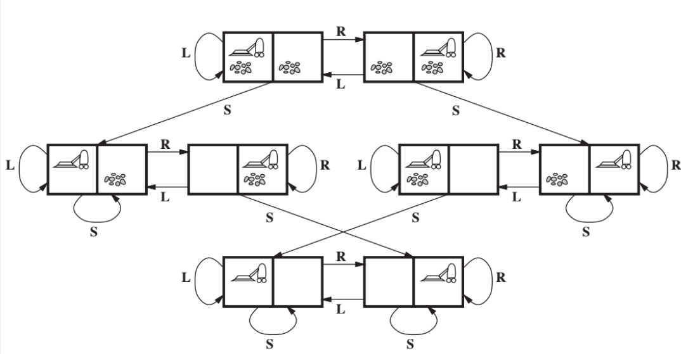
The Vacuum-cleaner world

Slide 14
The 8-puzzle
States: the location of each of the eight tiles and the blank
Initial state: any state can be designated as the initial state
Actions: movements of the blank space
Left, Right, Up, or Down.
Different subsets of these are possible depending on where the blank is
Transition model: return a resulting state given a state and an action
Goal test: whether the state matches the goal configuration
Path cost: each step costs 1

Slide 15
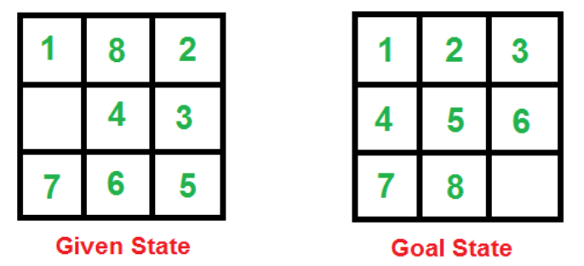
The 8-puzzle

Slide 16
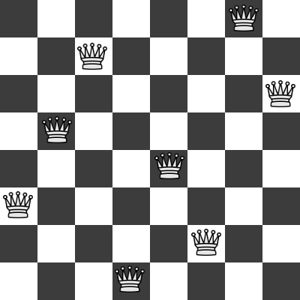
The 8-queens
Incremental formulation: add a queen step-by-step to the empty initial state
Complete-state formulation: start with all 8 queens on the board and move them around
The path cost is trivial because only the final state counts

Slide 17
The 8-queens
States: any arrangement of 0 to 8 queens on the board
Initial state: no queens on the board
Actions: add a queen to any empty square
Transition model: returns the board with a queen added to the specified square
Goal test: 8 queens are on the board, none attacked
64 ∙ 63 ⋯ 57 ≈ 1.8 × 10¹⁴ possible sequences to investigate

Slide 18
Search Tree
Search algorithms consider many possible action sequences to find the solution sequence.
Search tree: the possible action sequences starting at the initial state (root)
Branches are actions and nodes are states in the problem’s state space
Frontier: the set of all leaf nodes available for expansion at any given point
Search algorithms all share the basic structure while vary according to how they choose which state to expand next -- called search strategy.

Slide 19
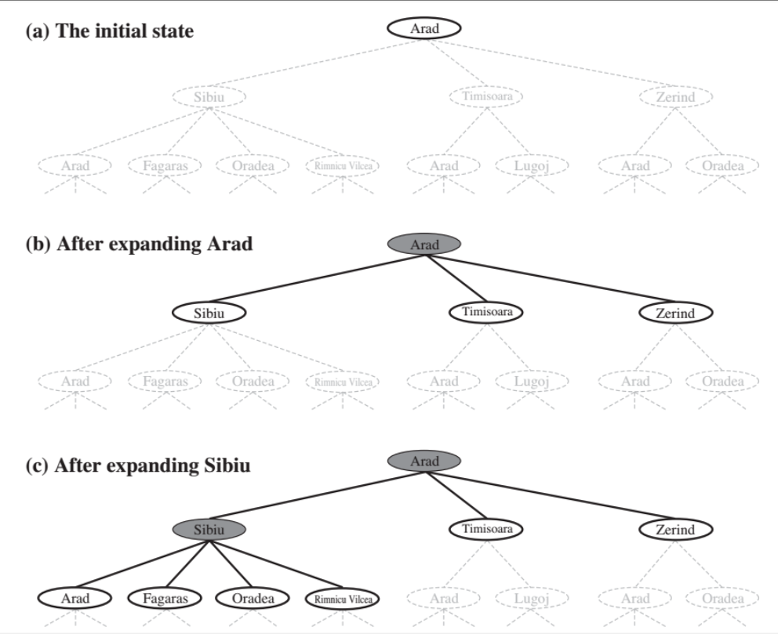
Search Tree

Slide 20
Search Tree
function TREE-SEARCH(problem) returns a solution, or failure
initialize the frontier using the initial state of problem
loop do
if the frontier is empty then return failure
choose a leaf node and remove it from the frontier
if the node contains a goal state then return the corresponding solution
expand the chosen node, adding the resulting nodes to the frontier

Slide 21
Redundant paths
Redundant paths are unavoidable.
Following redundant paths may cause a tractable problem to become intractable.
This is true even for algorithms that know how to avoid infinite loops.

Slide 22
Graph Search
function GRAPH-SEARCH(problem) returns a solution, or failure
initialize the frontier using the initial state of problem
initialize the explored set to be empty
loop do
if the frontier is empty then return failure
choose a leaf node and remove it from the frontier
if the node contains a goal state then return the corresponding solution
add the node to the explored set
expand the chosen node, adding the resulting nodes to the frontier only if not in the frontier nor explored set

Slide 23
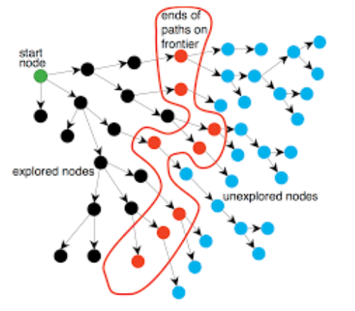
Graph Search

Slide 24
Infrastructure for search algorithms
Each node 𝑛 is structuralized by four components.
𝒏. 𝐒𝐓𝐀𝐓𝐄: the state in the state space to which the node corresponds
𝒏. 𝐏𝐀𝐑𝐄𝐍𝐓: the node in the search tree that generated the node 𝑛
𝒏. 𝐀𝐂𝐓𝐈𝐎𝐍: the action applied to the parent to generate 𝑛
𝒏. 𝐏𝐀𝐓𝐇 − 𝐂𝐎𝐒𝐓 : the cost, denoted by 𝒈(𝒏), of the path from the initial state to the node, as indicated by the parent pointer
Frontier can be implemented with a (priority) queue or stack.
Explored set can be a hash table that allows for efficient checking of repeated states.

Slide 25
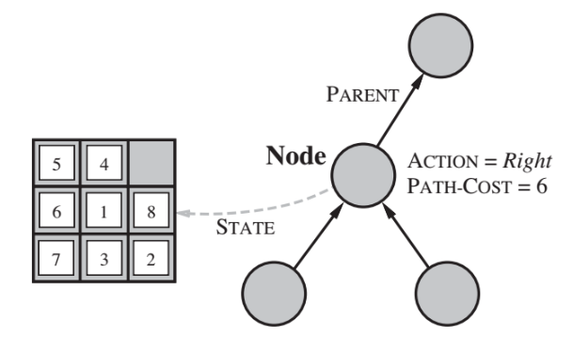
Infrastructure for search algorithms

Slide 26
Problem-solving performance
Completeness: does it always find a solution if one exists?
Time complexity: how long does it take to find a solution?
Space complexity: how much memory is needed to perform the search?
Optimality: does it always find a least-cost solution?

Slide 27
Homework
Task 1:
Given the start state and the goal one of the 8-puzzle in page 15.
Students draw a search tree by the expanding nodes.
The expansion stops when the goal state is expanded.
Task 2:
Program Task 1 in Python using Google Colab
Use graph search instead of tree search

Slide 28
Homework
1 | 8 | 2
 | 4 | 3
7 | 6 | 5
 | 8 | 2
1 | 4 | 3
7 | 6 | 5
8 |  | 2
1 | 4 | 3
7 | 6 | 5
D
L
U
1 | 8 | 2
7 | 4 | 3
 | 6 | 5
1 | 8 | 2
7 | 4 | 3
6 |  | 5
L
1 |  | 2
4 | 8 | 3
7 | 6 | 5
L
1 | 8 | 2
4 |  | 3
7 | 6 | 5
D
U
1 | 8 | 2
4 | 6 | 3
7 |  | 5
1 | 8 | 2
4 | 3
7 | 6 | 5
L

Slide 29
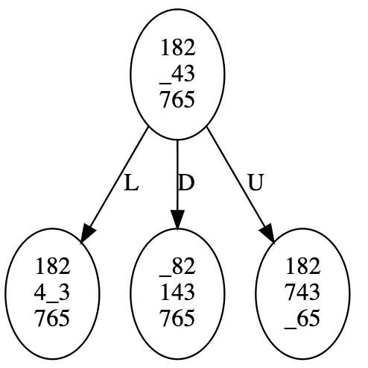
Homework
from graphviz import Digraph
dot = Digraph()
dot.node('0', '182\n_43\n765')
dot.node('1', '182\n4_3\n765')
dot.node('2', '_82\n143\n765')
dot.node('3', '182\n743\n_65')
dot.edge('0', '1', 'L')
dot.edge('0', '2', 'D')
dot.edge('0', '3', 'U')
dot

Slide 30
Homework
Conduct homework in the given notebook

Slide 31
References
Stuart Russell and Peter Norvig. 2009. Artificial Intelligence: A Modern Approach (3rd ed.). Prentice Hall Press, Upper Saddle River, NJ, USA.
Lê Hoài Bắc, Tô Hoài Việt. 2014. Giáo trình Cơ sở Trí tuệ nhân tạo. Khoa Công nghệ Thông tin. Trường ĐH Khoa học Tự nhiên, ĐHQG-HCM.
Nguyễn Ngọc Thảo, Nguyễn Hải Minh. 2020. Bài giảng Cơ sở Trí tuệ Nhân tạo. Khoa Công nghệ Thông tin. Trường ĐH Khoa học Tự nhiên, ĐHQG-HCM.

