Slide 1

Learn C# Programming

Slide 2
Table Of Contents
Chapter 1: Data Types and Operators
Chapter 2: Control Statements and Exceptions

Slide 3
Chapter 1: Data Types and Operators
In this chapter, we will learn about data types and objects in C#.
We will discuss built-in data types, explain the difference between value types and reference types, and learn how to convert between types. We will also discuss the operators defined by the language as we move on.
The following topics will be covered in this chapter:
Basic built-in data types
Variables and constants
Reference types and value types
Nullable type
Arrays
Type conversion
Operators

Slide 4
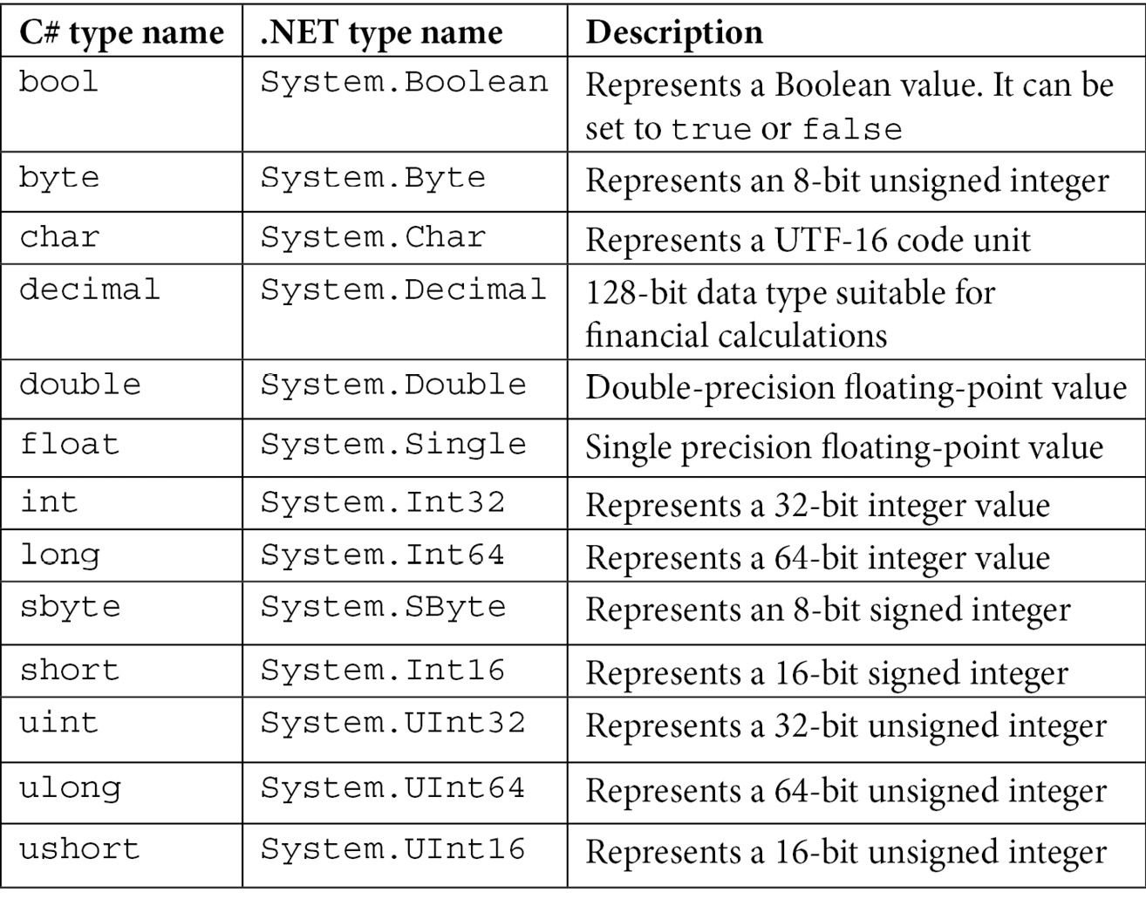
*Basic data types
Simple types:

Slide 5
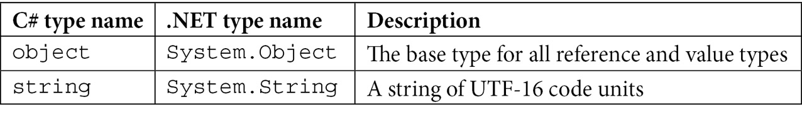
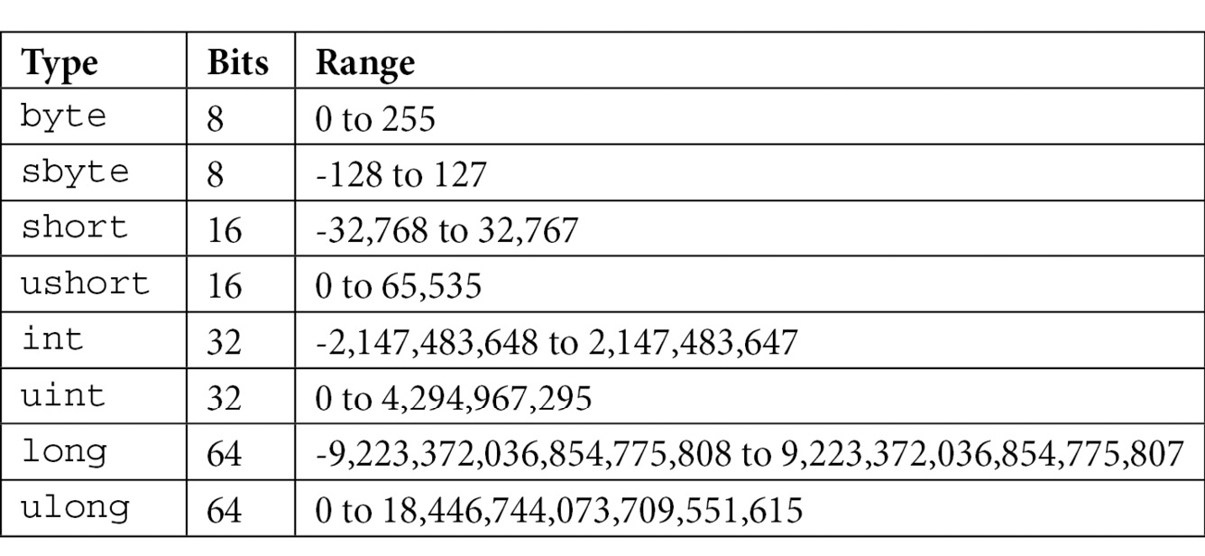
Primitive types:
The integral types: C# supports eight integer types that represent various ranges of integral numbers. The bits range of each of them are shown in the following table:

Slide 6
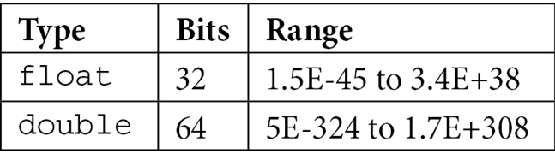
+ Ex:
int dec = 32;
int hex = 0x2A; (Hexadecimal literals)
int bin = 0b_0010_1010; (Binary literals)
The floating-point types:
+Ex:
var a = 42.99;
float b = 19.50f;
System.Double c = -1.23;
(By default, a non-integer number such as 42.99 is considered a double. If you want to specify this as a float type, then you need to suffix the value with the f or F character, such as in 42.99f or 42.99F. Alternatively, you can also explicitly indicate a double literal with the d or D suffix, such as in 42.99d or 42.99D.)

Slide 7
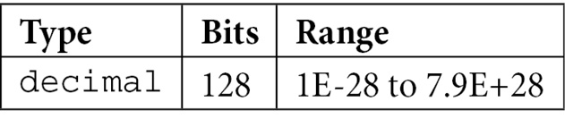
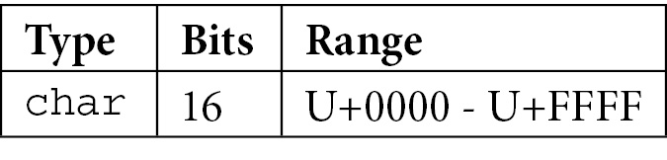
The decimal type:
(A decimal literal can be specified using the m or M suffix as shown in the following snippet:)
Ex:
decimal a = 42.99m;
var b = 12.45m;
System.Decimal c = 100.75M;
The char type:
Ex:
char a = 'A';
char b = '\x0065';
char c = '\u15FE';

Slide 8
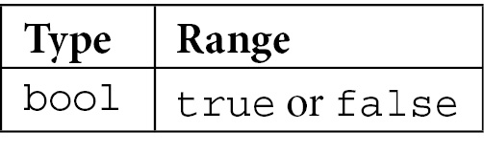
The bool type:
The string type:
+ Strings can be declared and initialized in a variety of ways, as shown here:
string s1; // unitialized
string s2 = null; // initialized with null
string s3 = String.Empty; // empty string
string s4 = "hello world"; // initialized with text
var s5 = "hello world";
System.String s6 = "hello world";
char[] letters = { 'h', 'e', 'l', 'l', 'o'};
string s7 = new string(letters); // from an array of chars
+ The following are the methods that seem to be modifying a string:
Remove(): This removes a part of the string.
ToUpper()/ToLower(): This converts all of the characters into uppercase or lowercase.
var s8 = s6.Remove(5); // hello
var s9 = s6.ToUpper(); // HELLO WORLD

Slide 9
Ex: ToString()
int i = 42;
double d = 19.99;
var s1 = i.ToString();
var s2 = d.ToString();
Strings can be composed in several ways:
Ex:
int i = 42;
string s1 = "This is item " + i.ToString();
string s2 = string.Format("This is item {0}", i);
string s3 = $"This is item {i}";

Slide 10
Variables:
Variables are defined as a named memory location that can be assigned to a value. There are several types of variables, including the following:
Local variables: These are variables that are defined within a method and their scope is local to that method.
Method parameters: These are variables that hold the arguments passed to a method during a function call.
Class fields: These are variables that are defined in the scope of the class and are accessible to all of the class methods and depending on the accessibility of the field to other classes too.
Array elements: These are variables that refer to elements in an array.
In this statement, datatype is the data type of the variable and variable_name is the name of the variable. Here are several examples:
bool f;
char ch = 'x';
int a, b = 20, c = 42;
a = -1;
f = true;

Slide 11
Naming convention
Understanding the scope and lifetime of variables
Let's understand this with the help of an example:
class Program
{
static void Main(string[] args)
{
for (int i = 1; i < 10; i++)
{
Console.WriteLine(i);
}
i = 20; // i is out of scope
}
}

Slide 12
Let's extend the code in the previous example to understand this:
class Program
{
static void Main(string[] args)
{
int a = 5;
for (int i = 1; i < 10; i++)
{
char a = 'w'; // compiler error
if (i % 2 == 0)
{
Console.WriteLine(i + a); // a is within the
// scope of Main
}
}
i = 20; // i is out of scope
}
}

Slide 13
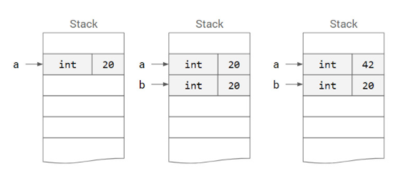
Understanding constants
const int a = 42;
Reference types and value types
Ex: value types
int a = 20;
int b = a; // b is 20
a = 42; // a is 42, b is 20

Slide 14
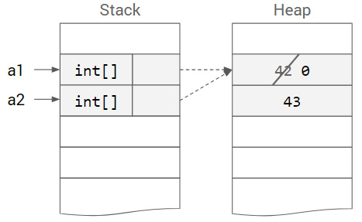
Reference types and value types
Ex: Reference types
int[] a1 = new int[] { 42, 43 };
int[] a2 = a1; // a2 is { 42, 43 }
a1[0] = 0; // a1 is { 0, 43 }, a2 is { 0, 43 }
string s1 = "help";
string s2 = s1; // s2 is "help"
s1 = "demo"; // s1 is "demo", s2 is "help"

Slide 15
Nullable types
Ex:
Nullable<int> a;
Nullable<int> b = null;
Nullable<int> c = 42;
int? a;
int? b = null;
int? c = 42;
(You can use the HasValue property to check whether a nullable type object has a value, and Value to access the underlying value:)
if (c.HasValue)
Console.WriteLine(c.Value);
string? s1 = null; // OK, nullable type
string s2 = null; // error, non-nullable type

Slide 16
Arrays
Ex:
int[] arr1;
int[] arr2 = null;
int[] arr3 = new int[6];
int[] arr4 = new int[] { 1, 1, 2, 3, 5, 8 };
int[] arr5 = new int[6] { 1, 1, 2, 3, 5, 8 };
int[] arr6 = { 1, 1, 2, 3, 5, 8 };
Ex: you can access the elements of the array using the indexer:
for(int i = 0; i < arr6.Length; ++i)
Console.WriteLine(arr6[i]);
foreach(int element in arr6)
Console.WriteLine(element);
Ex: This is shown in the following example:
for (int i = 0; i < arr6.Length; ++i)
arr6[i] *= 2; // OK
foreach (int element in arr6)
element *= 2; // error

Slide 17
Multi-dimensional arrays
Ex:
int[,] arr1;
arr1 = new int[2, 3] { { 1, 2, 3 }, { 4, 5, 6 } };
int[,] arr2 = null;
int[,] arr3 = new int[2,3];
int[,] arr4 = new int[,] { { 1, 2, 3 }, { 4, 5, 6 } };
int[,] arr5 = new int[2,3] { { 1, 2, 3 }, { 4, 5, 6 } };
int[,] arr6 = { { 1, 2, 3 }, { 4, 5, 6 } };
The following example prints the content of the arr6 array to the console:
for (int i = 0; i < arr6.GetLength(0); ++i)
{
for (int j = 0; j < arr6.GetLength(1); ++j)
{
Console.Write($"{arr6[i, j]} ");
}
Console.WriteLine();
}

Slide 18
Jagged arrays
Ex:
int[][] arr1;
int[][] arr2 = null;
int[][] arr3 = new int[2][];
arr3[0] = new int[3];
arr3[1] = new int[] { 1, 1, 2, 3, 5, 8 };
int[][] arr4 = new int[][]
{
new int[] { 1, 2, 3 },
new int[] { 1, 1, 2, 3, 5, 8 }
};
int[][] arr5 =
{
new int[] { 1, 2, 3 },
new int[] { 1, 1, 2, 3, 5, 8 }
};
int[][,] arr6 = new int[][,]
{
new int[,] { { 1, 2}, { 3, 4 } },
new int[,] { {11, 12, 13}, { 14, 15, 16} }
};

Slide 19
Jagged arrays
Ex: The following snippet shows how to print the content of the arr5 array shown earlier:
for(int i = 0; i < arr5.Length; ++i)
{
for(int j = 0; j < arr5[i].Length; ++j)
{
Console.Write($"{arr5[i][j]} ");
}
Console.WriteLine();
}

Slide 20
Conversions with helper classes
Ex: The following listing shows several examples of conversion using helper classes:
DateTime dt1 = DateTime.Parse("2019.08.31");
DateTime.TryParse("2019.08.31", out DateTime dt2);
int i1 = int.Parse("42"); // successful, i1 = 42
int i2 = int.Parse("42.15"); // error, throws exception
int.TryParse("42.15", out int i3); // error, returns false,
// i3 = 0
It is important to note the key difference between Parse() and TryParse()

Slide 21
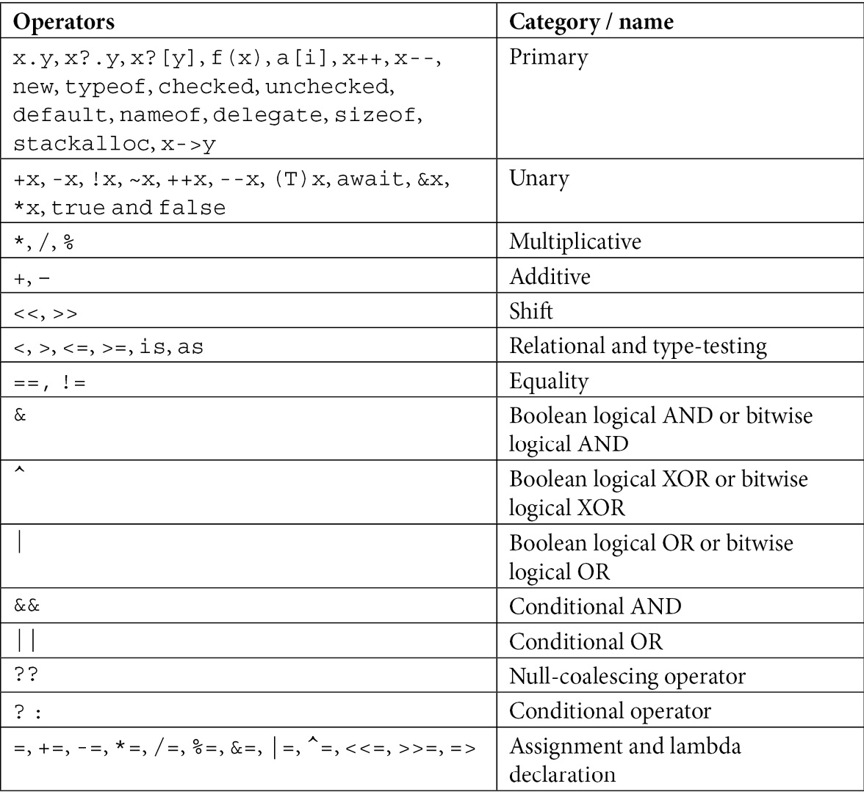
Operators

Slide 22
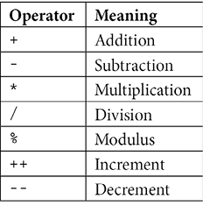
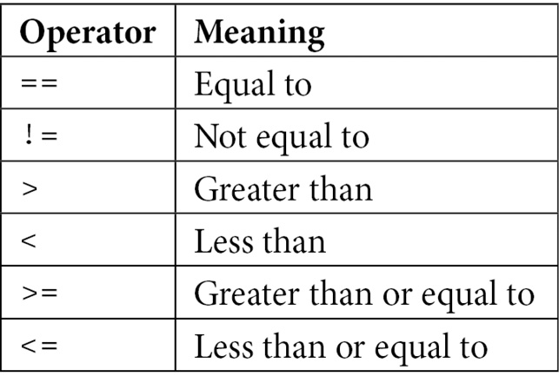
Arithmetic operators: Arithmetic operators perform arithmetic operations on the numerical type and can be unary or binary operators.
Ex:
int a = 10;
int b = a++;
Relational operators: Relational operators, also called comparison operators, perform a comparison on their operands.

Slide 23
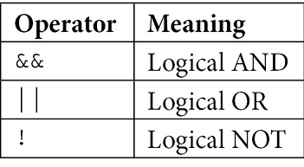
The next code listing shows several relational operators being used:
int a = 42;
int b = 10;
bool v1 = a != b;
bool v2 = 0 <= a && a <= 100;
if(a == 42) { /* ... */ }
Logical operators: Logical operators perform a logical operation on bool operands.
Ex:
The following example shows these operands in use:
bool a = true, b = false;
bool c = a && b;
bool d = a || !b;
In this example, since a is true and b is false, c will be false and d will be true.

Slide 24
Other operators:
Ex:
static int max(int a, int b)
{
return a >= b ? a : b;
}
condition ? ref consequent : ref alternative;
Take a look at the following code snippet:
int? n1 = null;
int n2 = n1 ?? 2; // n2 is set to 2
n1 = 5;
int n3 = n1 ?? 2; // n3 is set to 5
if(a is null)
a = b;
string GetDisplayName(string name, string email)
{
return name ?? email ?? "unknown";
}

Slide 25
Chapter 2: Control Statements and Exceptions
In this chapter, we will explore control statements in C#. Control statements allow us to implement conditional execution paths in our code. We will also learn how to implement exception handling, which will help us to handle errors that might occur while executing our application.
In this chapter, we will cover the following concepts:
Control statements
Exception handling

Slide 26
* Understanding control statements
Control statements allow us to control the flow of execution of a program. They also allow us to execute a particular block of code based on a certain condition. C# defines three categories of control statements, as mentioned here:
Selection statements: if and switch
Iteration statements: for, while, do-while, and foreach
Jump statements: break, continue, goto, return, and yield
We will explore each of these statements in detail in the following sections.

Slide 27
Selection statements
THE IF STATEMENT
The following snippet shows the syntax of an if statement:
Ex1:
if (condition1)
statement1;
else if(condition2)
statement2;
else
statement3;

Slide 28
THE IF STATEMENT
The following snippet shows the syntax of an if statement:
Ex2:
if (condition1)
{
if(condition2)
statement 1;
if(condition3)
statement 2;
else
statement 3;
}
else
{
if(condition4)
statement 4;
else
statement 5;
}

Slide 29
THE IF STATEMENT
The following snippet shows the syntax of an if statement:
Ex3:
class Program
{
static void Main(string[] args)
{
Console.WriteLine("Enter a positive integer");
var line = Console.ReadLine();
int.TryParse(line, out int number);
if (number % 2 == 0)
{
Console.WriteLine("Even number");
}
else
{
Console.WriteLine("Odd number");
}
}
}

Slide 30
THE SWITCH STATEMENT
The syntax of a switch statement is as follows:
Ex1:
switch (expression)
{
case value1:
statement 1;
break;
case value2:
statement 2;
statement 3;
break;
default:
statement 4;
break;
}

Slide 31
THE SWITCH STATEMENT
The syntax of a switch statement is as follows:
Ex2:
Console.WriteLine("Enter number (1-10)");
var line = Console.ReadLine();
int.TryParse(line, out int number);
switch(number)
{
case 1:
Console.WriteLine("Smallest number");
break;
case 2: case 3: case 5: case 7:
Console.WriteLine("Prime number");
break;
case 4: case 6: case 8:
Console.WriteLine("Even number");
break;
case 9:
Console.WriteLine("Odd number");
break;
default:
Console.WriteLine("Not in the range");
break;
}

Slide 32
Iteration statements
for
while
do-while
Foreach
THE FOR LOOP
for(initializer; condition; iterator) (note: iterator is an expression to change (increment/decrement))
{
statement1;
statement2;
}

Slide 33
THE FOR LOOP
Ex1:for (int i = 0; i <= 10; i++)
{
if (i % 2 == 0)
{
Console.WriteLine($"{i} is an even number");
}
else
{
Console.WriteLine($"{i} is an odd number");
}
}
Ex2: for (int i = 1; i < 5; i++)
{
for (int j = 1; j < 3; j++)
{
Console.WriteLine($"i = {i},j = {j}");
}
}

Slide 34
THE FOR LOOP
Ex3:
var arr = new int[3, 2] { { 1, 2, }, { 3, 4 }, { 5, 6 } };
for (int r = 0; r <= arr.GetUpperBound(0); r++)
{
for (int c = 0; c <= arr.GetUpperBound(1); c++)
{
Console.Write($"{arr[r, c]} ");
}
Console.WriteLine();
}

Slide 35
The while loop
The syntax of a while loop is as follows:
while (condition)
{
statement1;
statement2;
}
initializer;
while(condition)
{
statement1;
statement2;
iterator;
}

Slide 36
The While Loop
Ex1:
int i = 0;
while (i <= 10)
{
if (i % 2 == 0)
{
Console.WriteLine($"{i} is an even number");
}
else
{
Console.WriteLine($"{i} is an odd number");
}
i++;
}

Slide 37
THE DO-WHILE LOOP
The syntax of a do-while loop is as follows:
do
{
statement1;
statement2;
} while (condition);

Slide 38
THE DO-WHILE LOOP
Ex1:
int i = 0;
do
{
if (i % 2 == 0)
{
Console.WriteLine($"{i} is an even number");
}
else
{
Console.WriteLine($"{i} is an odd number");
}
i++;
}
while (i <= 10);

Slide 39
THE FOREACH LOOP
The syntax of the foreach loop is as follows:
foreach(datatype iterator in collection)
{
statement1;
statement2;
}
Ex1:
string[] languages = { "Java", "C#", "Python", "C++", "JavaScript" };
foreach (string lang in languages)
{
Console.WriteLine(lang);
}

Slide 40
The jump statements
break
continue
goto
return

Slide 41
THE BREAK STATEMENT
Take a look at the following code snippet:
for (int i = 0; i <= 10; i++)
{
Console.WriteLine(i);
if (i == 5)
break;
}

Slide 42
THE CONTINUE STATEMENT
Take a look at the following code snippet:
for (int i = 0; i <= 10; i++)
{
if (i % 2 == 0)
continue;
Console.WriteLine(i);
}
THE RETURN STATEMENT
The following example shows a possible implementation of a function that returns the nth Fibonacci number:
static int Fibonacci(int n)
{
if (n > 1)
return Fibonacci(n - 1) + Fibonacci(n - 2);
else
return n;
}

Slide 43
THE GOTO STATEMENT
Consider the following code snippet:
for (int i = 0; i <= 10; i++)
{
Console.WriteLine(i);
if (i == 5)
{
goto printmessage;
}
}
printmessage:
Console.WriteLine("The goto statement is executed");

Slide 44
THE YIELD STATEMENT
Consider the following code snippet:
for (int i = 0; i <= 10; i++)
{
Console.WriteLine(i);
if (i == 5)
{
goto printmessage;
}
}
printmessage:
Console.WriteLine("The goto statement is executed");

Slide 45
Exception handling
C# provides us with a built-in exception-handling mechanism to handle these types of errors at the code level. The syntax for exception handling is as follows:
try
{
Statement1;
Statement2;
}
catch (type)
{
// code for error handling
}
finally
{
// code to always run at the end
}

Slide 46
Exception handling
Ex1:
Let's try to understand exception handling with the help of the following code snippet:
class Program
{
static void Main(string[] args)
{
try
{
int a = 10;
int b = a / 0;
}
catch (Exception ex)
{
Console.WriteLine(ex);
}
}
}

Slide 47
Exception handling
Ex2:
void FunctionThatThrows(object o)
{
if (o is null)
throw new ArgumentNullException(nameof(o));
if (!(o is string))
throw new ArgumentException("A string is expected");
// do something
}

Slide 48
Exception handling
Ex2:
try
{
Console.WriteLine("executing");
FunctionThatThrows(42);
}
catch (ArgumentNullException e)
{
Console.WriteLine($"Null argument: {e.Message}");
}
catch (ArgumentException e)
{
Console.WriteLine($"Wrong argument: {e.Message}");
}
catch(Exception e)
{
Console.WriteLine($"Error: {e.Message}");
}
finally
{
Console.WriteLine("done");
}

