Slide 1





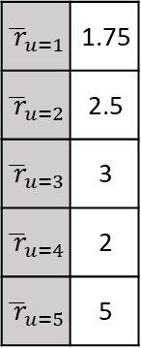



$$γ$$
$${\overline{ r}}_{u}$$
0.4
1.75
0.2
2.5
0
4
0.8
3
$${\overline{ r}}_{u=1}$$ | 1.75
$${\overline{ r}}_{u=2}$$ | 2.5
$${\overline{ r}}_{u=3}$$ | 3
$${\overline{ r}}_{u=4}$$ | 2
$${\overline{ r}}_{u=5}$$ | 5
1 | 3 | ? | 1 | 2
3 |  | 2
5 | 1 | ? | 2 | 4
 | 1 | 2 |  | 3
 | 5 | ?
2
2
2.3
1 | 3 | 4 | 1 | 2
3 |  | 2
5 | 1 | 3.2 | 2 | 4
 | 1 | 2 |  | 3
 | 5 | 4.3
0.1
$$z_{1}$$
0.7
5
0
3.2
$$z_{2}$$
$$δ$$
$${\overline{ r}}_{i}$$
2
2.4
0.5
Item $i$
0
0.9
4.3
$${\overline{ r}}_{i}=2$$
0.4
2
1.1
0.4
Input
Latent
Weights
Output

