Slide 1

# 1 Entrepreneur Training & Career Development Center
Increasing the number of black-owned businesses in the Metro Detroit community through business ownership, mentoring, and career training

Slide 2
OUR MISSION
Our mission is to empower black communities throughout Detroit by increasing the number of black owned businesses. Our efforts will assist in reducing the number of unemployed Detroit residents, improve economic growth in Detroit communities, and create a network of black business owners as leaders who serve as the voice of the City of Detroit. It is our hope that as our communities strengthen, those business leaders become mentors, create employment opportunities for others, challenge elected leaders to improve services in our city, and encourage global retailers to invest in black owned businesses.

Slide 3
OUR GOALS
Increase number of black owned businesses
Create a stronger black economy in Detroit
Reduce unemployment in Detroit
Empower community through business ownership
Re-introduce jobs into Detroit communities
Create a network of business leaders

Slide 4

Black Business Ownership Nationally

Slide 5
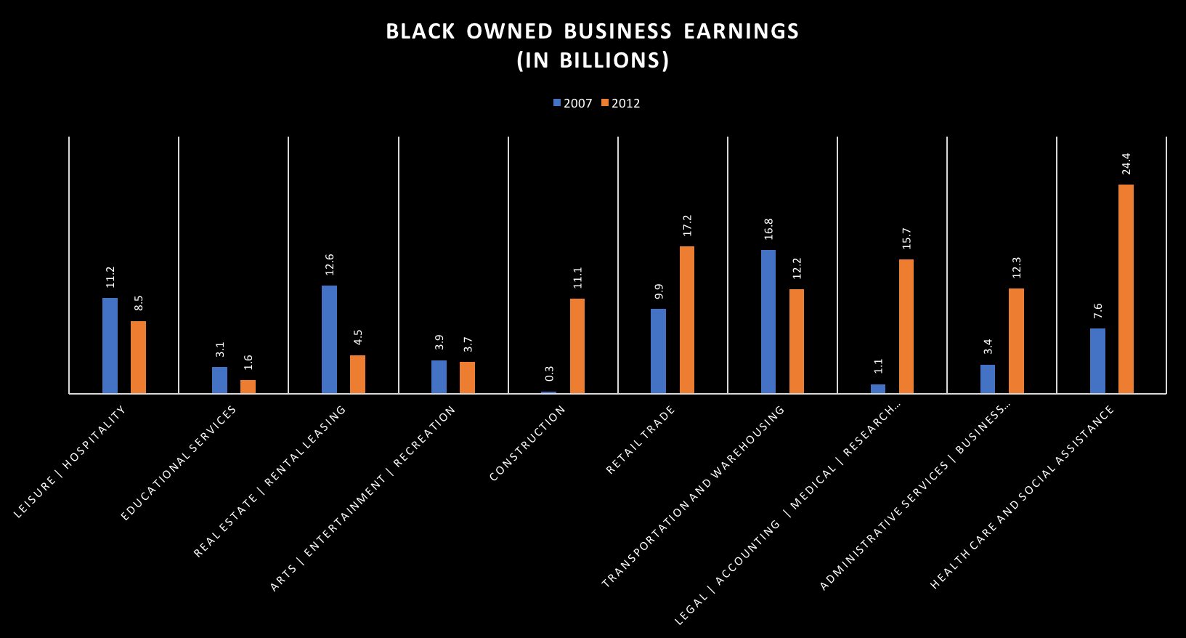
Black Owned Business Earnings

Slide 6
Black Business Overview
Cornered the market in
  Barber Shops
  Beauty Salons
  Carry Out Restaurants
Need to see an increase in
  Gas Stations
  Grocery Stores
  Dry Cleaners
  Upscale Dining Establishments
  Janitorial
  Non-Emergency Medical Transportation

Slide 7
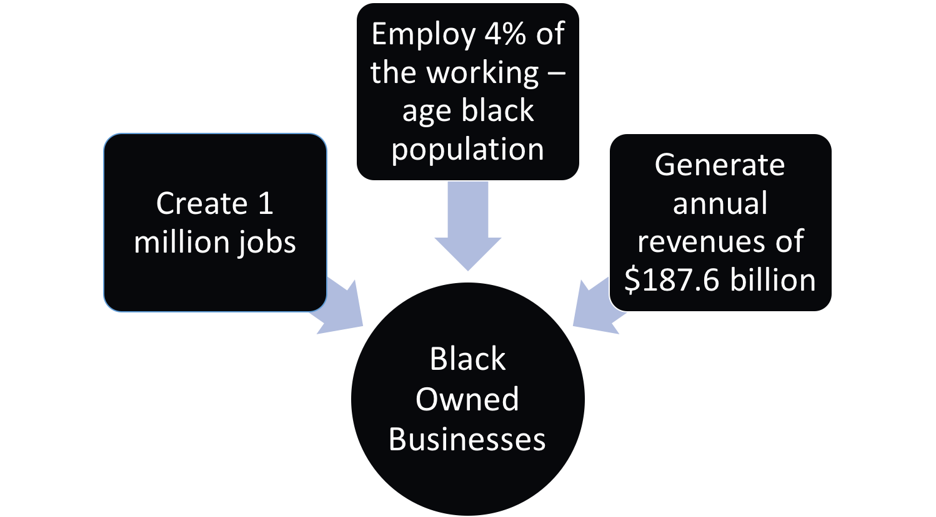
Economic Benefits of Black Business to Communities

Slide 8
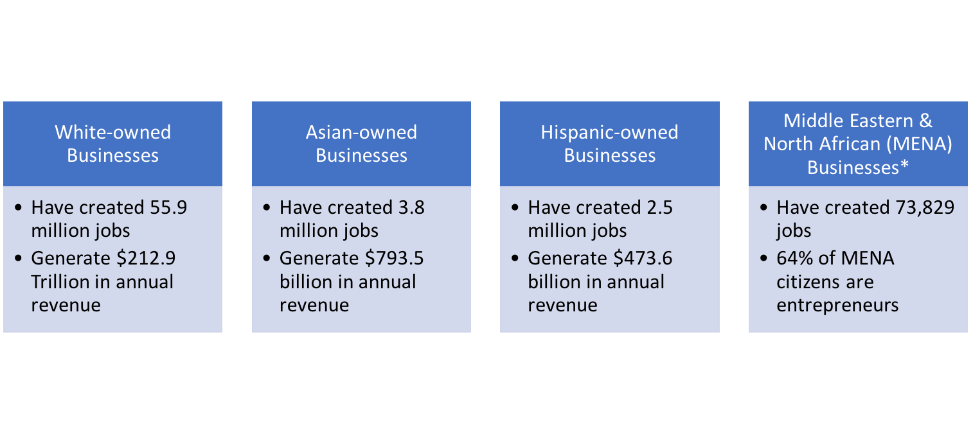
The Power of Business Ownership
*Annual revenue for MENA is unavailable, as these business owners reinvest their profits in their native countries; or use profits to assist other MENA business owners in acquiring their own businesses.

Slide 9
Social Benefits of Black Businesses to Communities
Why Are There No Black Owned Grocery Stores in Detroit
With the exception of Mexican-owned markets, most of Detroit’s 80 non big-box retailer grocery stores are owned by Chaldeans. Black owned grocery stores should be viewed as necessary to the survival of the people they service. Black consumers are in a situation where we are dependent on others for survival, and while inner city stores lack the cleanliness and product quality of their suburban counterparts, Detroiters now spend and estimated $200 million on food in the suburbs. Ownership of neighborhood institutions like grocery stores is one of the things African Americans communities can do to protect themselves from institutional racism and improve their communities.

Slide 10
Success Measures

Slide 11
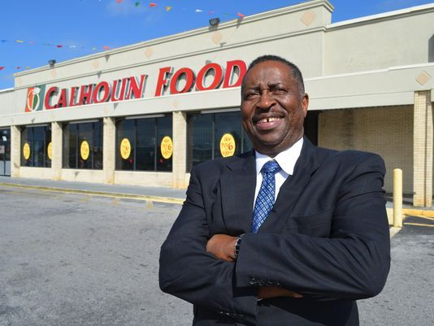
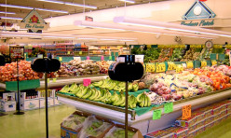
Doug Calhoun
Calhoun Foods
I was a bagging clerk and worked my way through management with Super Foods’ Big Bear, which was owned by Hudson and Thompson. They did franchise stores to other owners who had been loyal employees. I was able to convince the owners that I could be an owner and they gave me an opportunity; so I had to borrow $1 million for a loan package to buy my first store.
I was 32 years old, and it was scary. It was also a huge amount of money in 1984; but I stayed true to my business philosophy. Make sure you satisfy the customer through all means and that you give 150 percent daily.
By working hard, having a good family and my wife allowed me to put the hours in it took to get the job done. And my work was the type of work if I wasn’t at work, you could always tell my work because of the fact that I tried to make sure that I didn’t need to be there for you to see it. When I was stocking groceries, you could walk down the aisle – the owner said, ‘Greg Calhoun worked on this aisle.’ I didn’t have to be there to boost myself. I let my work speak for me. My father taught me that. He was in the brick laying business.
Knowledge of business and making sure that I knew what I was doing. I learned every aspect of the grocery business – I worked in every department so I was knowledgeable. Next, I know how to work with people and get along with people. I learned how to delegate.

Slide 12

What’s the Big Deal About A Black-Owned Grocery Store?
There's a real economic issue. Grocery stores help drive local economies. The local economies thrive when stocked with business owners supporting and spending their money at other neighborhood businesses — developing a prosperous synergy. Grocery stores can be a neighborhood institution, and when a store's ownership and management hauls its profits to the suburbs, as is often the case in Detroit, the neighborhood economy loses an essential link.

Slide 13
Cost of Opening A Grocery Store*
Leasehold Improvements: $100k to $350k
Refrigeration: $150k to $550k
Store Equipment: $70k to $100k
Front End System (POS): $40k to $60k
Initial Inventory: $160k to $190k
Pre-Opening Expenses: $10k to $50k
Grand Opening Advertising: $10k to $40k
Working Capital: $20k to $50k
Security Deposit: $40k to $60k
**Total: $600k to $1.45M
*Numbers based on Sav-a-lot franchise opportunity
**These numbers do not include the acquisition of location or applicable licensing

Slide 14
A Simple Approach to Creating A Business
Finding A Mentor
Technical Skills
Soft Skills
  Communication Skills
  Decision Making
  Self Motivation
  Leadership
  Team-Working
  Creativity & Problem Solving
  Time Management
Business Plan Development
Securing Business Funding
Supportive Data Collections
Business Process Skills
Customer Service Skills

Slide 15
Creating Business Leaders
Through Entrepreneur training and career development

Slide 16
#1 Entrepreneur Training and Career Development Center
We have partnered with current Detroit business leaders to create a program aimed at increasing the number of black entrepreneurs in the City of Detroit and surrounding communities. Our leadership network encompasses a range of diverse skillsets with a proven track record in their respective industries. While many of our leaders are known in the community, our collective goal is to see the Detroit black business community become a financial powerhouse which elected officials recognize as the backbone of the area of Detroit which extends beyond downtown. Our network has collaborated with our team to create a dynamic curriculum offering guidance in the nation’s most in-demand business fields.

Slide 17
Areas of Study
Home Health Care Agency
Direct Care Worker
Certified Nurse Assistant
Group Home / Apartment Program
Transportation Company Entrepreneur Program
Janitorial Entrepreneur Program
Florist Entrepreneur Program
Security Monitoring Service Entrepreneur Program
Executive Administrative Assistant Entrepreneur Program

Slide 18
Additional Services
Clothing / Uniform Assistance through our Dress For Success Vault
We pair our students with a mentor in their field
Career Services
Laptops for Enrolled Students
Business Funding Assistance
Business Licensing Assistance
Business Attorney Referrals
Business Insurance Referrals

Slide 19
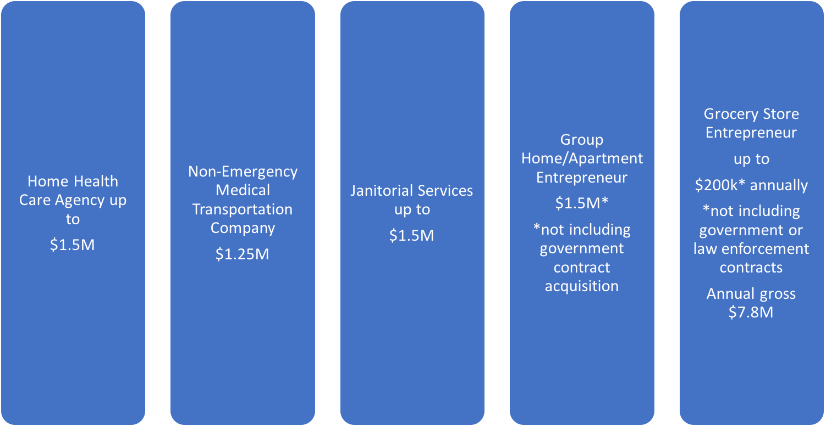
Annual Success Measure by Areas of Study

Slide 20
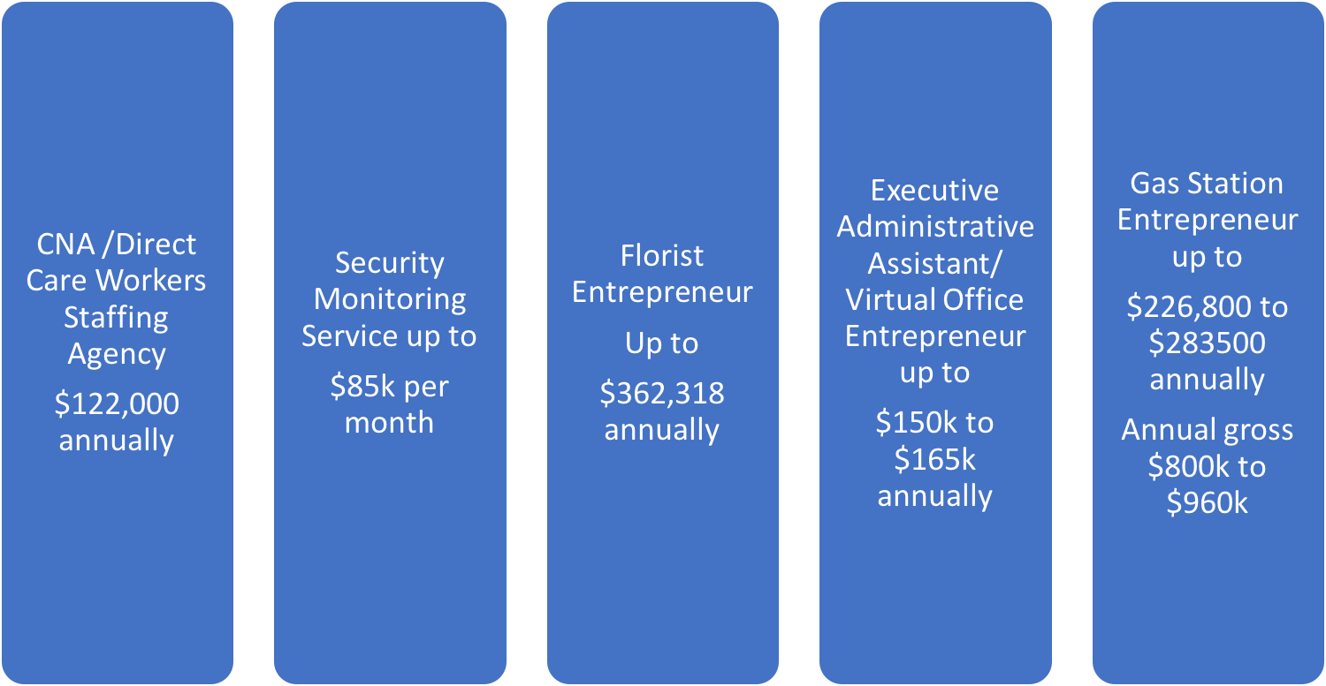
Annual Success Measure by Areas of Study

Slide 21
Employee vs Entrepreneurial Comparisons

Slide 22
Health Care Worker
Health Care Entrepreneur
Home Health Care $10.33
Medical Assistant $16.00
CNA $15.00
Direct Care Worker $9.74
Home Health Care Agency $25,000 - $125,000 per month
Group Home Agency (per person) $199 - $720 per day
Ala carte services - up to an additional $35 - $125 an hour
Assisted Living Facility $3000 per person (monthly) or $1M - $6M annually based on contract acquisition

Slide 23
Transportation Company Employee
Transportation Company Entrepreneur
School Bus Driver $16.00
DDOT Driver $12.06 - $17.33
SMART Driver $12.49 -$21.32
Non-Emergency Medical Transport Driver $8.25 to 14.90
Non-Emergency Medical Transportation company entrepreneurs have an average monthly earning of $10,000 to $90,000 a month
This does not include surplus income from government contracts acquired by the company

Slide 24
Investment Initiative

Slide 25
Strengthening Our Communities
Communities have a great impact on their residents. Residents are more likely to thrive in nurturing communities; a safe place for children to play is one feature of a strong community. Other features include the availability of food, shelter, and medical care for residents, as well as a culture that encourages neighbors to get to know and help one another.
It is imperative we focus on empowering our communities by encouraging the addition of public parks, more recreation centers, black owned gas stations, grocery stores, and fruit markets. Additionally, it is time local celebrities, and athletes invest in the city’s economic future by creating and supporting small businesses within the city.

