Slide 1


Value at Risk calculation in Python
Math 4581
Sumin Kim

Slide 2
What is Value at Risk (VaR)?
Value at Risk is used to measure the risk of the asset such as stock, option or the portfolio.
The difference from volatility is that VaR statistically measure the maximum loss and probability that a portfolio can incur over a period of time, ignoring profits.
There are three methods to calculate Value at Risks :
Historical Method
Variance Covariance Method
Monte Carlo Method

Slide 3
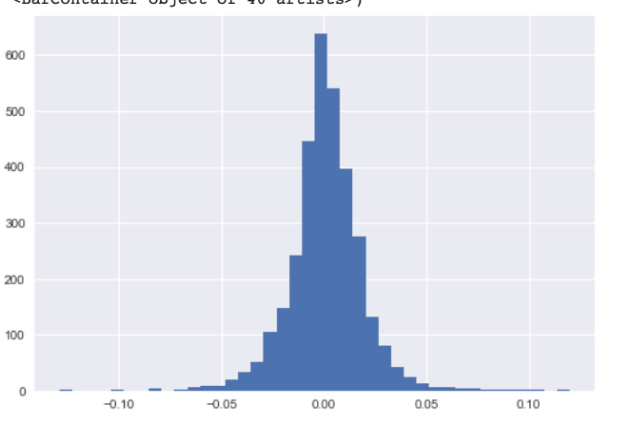
Basic Statistics on the data
I used closing price of AAPL from Jan 2010 to Dec 2022, listed in NASDAQ and performed 3 different methods to calculate VaR.
mean | 48.8987
Standard deviation | 47.4351
Skew | 1.365841
Kurtosis | 0.489691

Slide 4
Historical Method
Historical simulation model estimate VaR by a full valuation method that actually calculates the value of all assets or positions that make up the portfolio through simulation. It has been argued that the historical VaR, which goes through this estimation process, accurately reflects the kurtosis of the market because it is easy to implement and the scenario is derived directly from market data. On the other hand, because the number of scenarios used is limited due to the availability of historical data, this method may have a greater convergence error than Monte Carlo VaR. Of course, this historical VaR can take periods into account , accommodate nonlinearity and nonnormal distributions, reflect both gamma risk and Vega risk and correlations, is not based on specific assumptions about the valuation model or on specific price changes of the underlying asset, and there is not based on a specific valuation model risk. However, if historical data on a specific day are excluded from the analysis without considering the temporarily increased volatility, the risk measurement can change significantly.

Slide 5
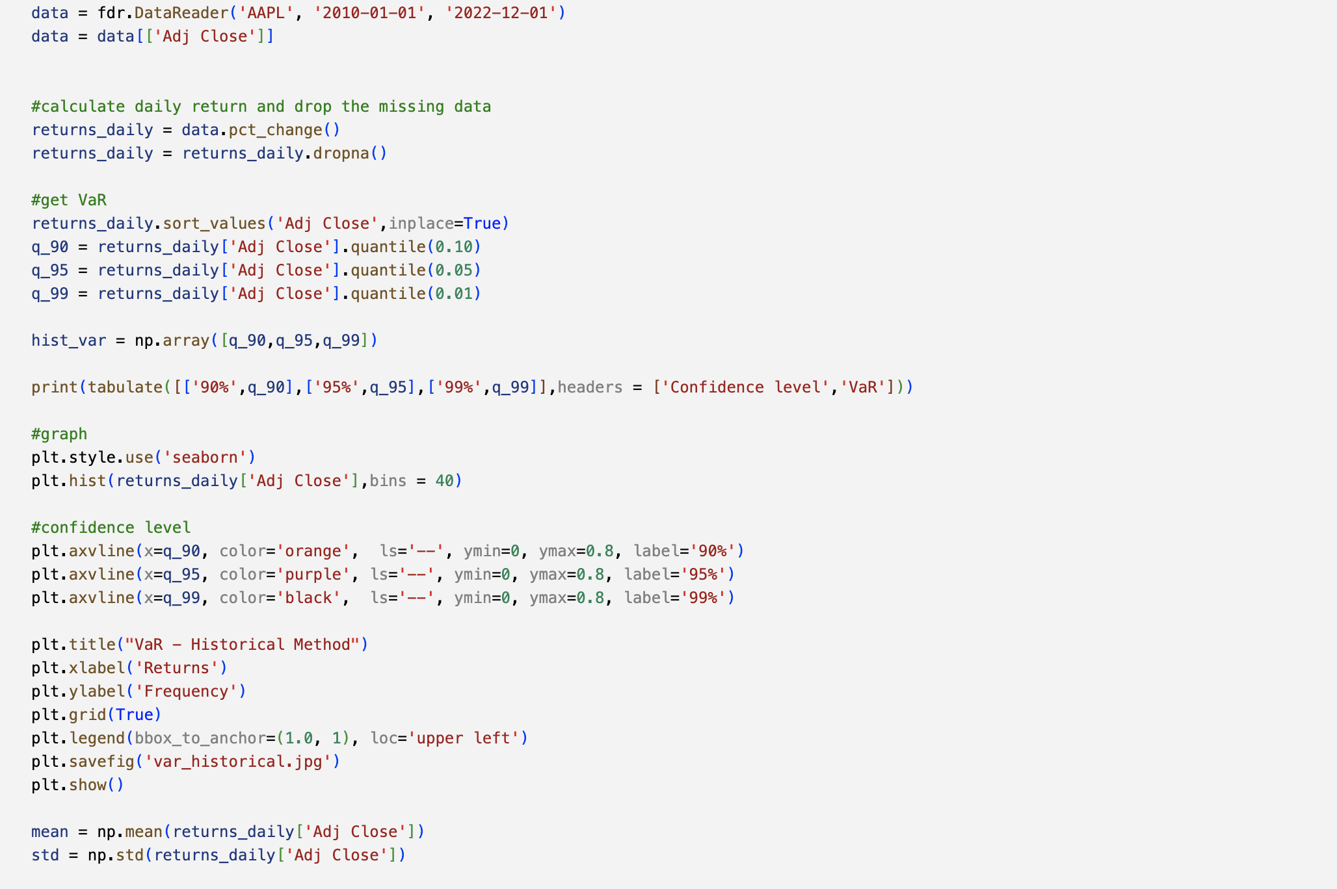
Historical Method - Code

Slide 6
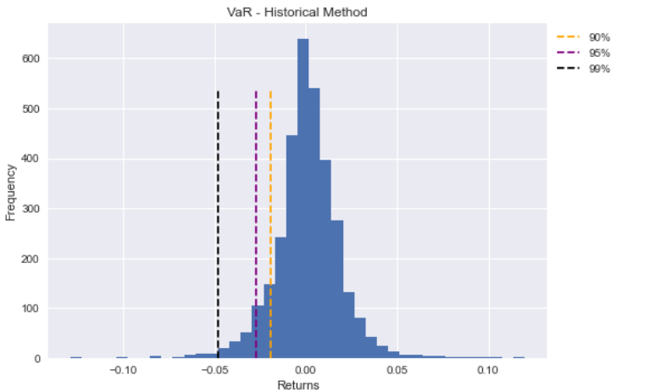
Historical Method - Result
Confidence Level | VaR
Standard deviation | 0.0191951
95% | 0.0270188
99% | 0.0476422

Slide 7
Variance Covariance Method
Variance Covariance method, also callsd Greek VaR, introduces second-order sensitivity to analysis by abandoning the assumption of linearity regarding price volatility of the portfolio among the assumptions of the parametric VaR and adopting a quadratic assumption. Sophisticated calculations are required to obtain accurate VaR estimates by this model, but by orthogonalizing the covariance matrix, the probability variable for the future value of the portfolio can be expressed as the sum of the normal probability variables and constant terms in the chi-squared random variables, and the VaR value of the portfolio can be determined through such characterization. This delta-gamma VaR is reasonable for most portfolios when estimating the adequacy of the secondary assumption and only one day's VaR, except for those portfolios where exposure to exotic derivatives such as near-maturity options or knock-out options is important.

Slide 8
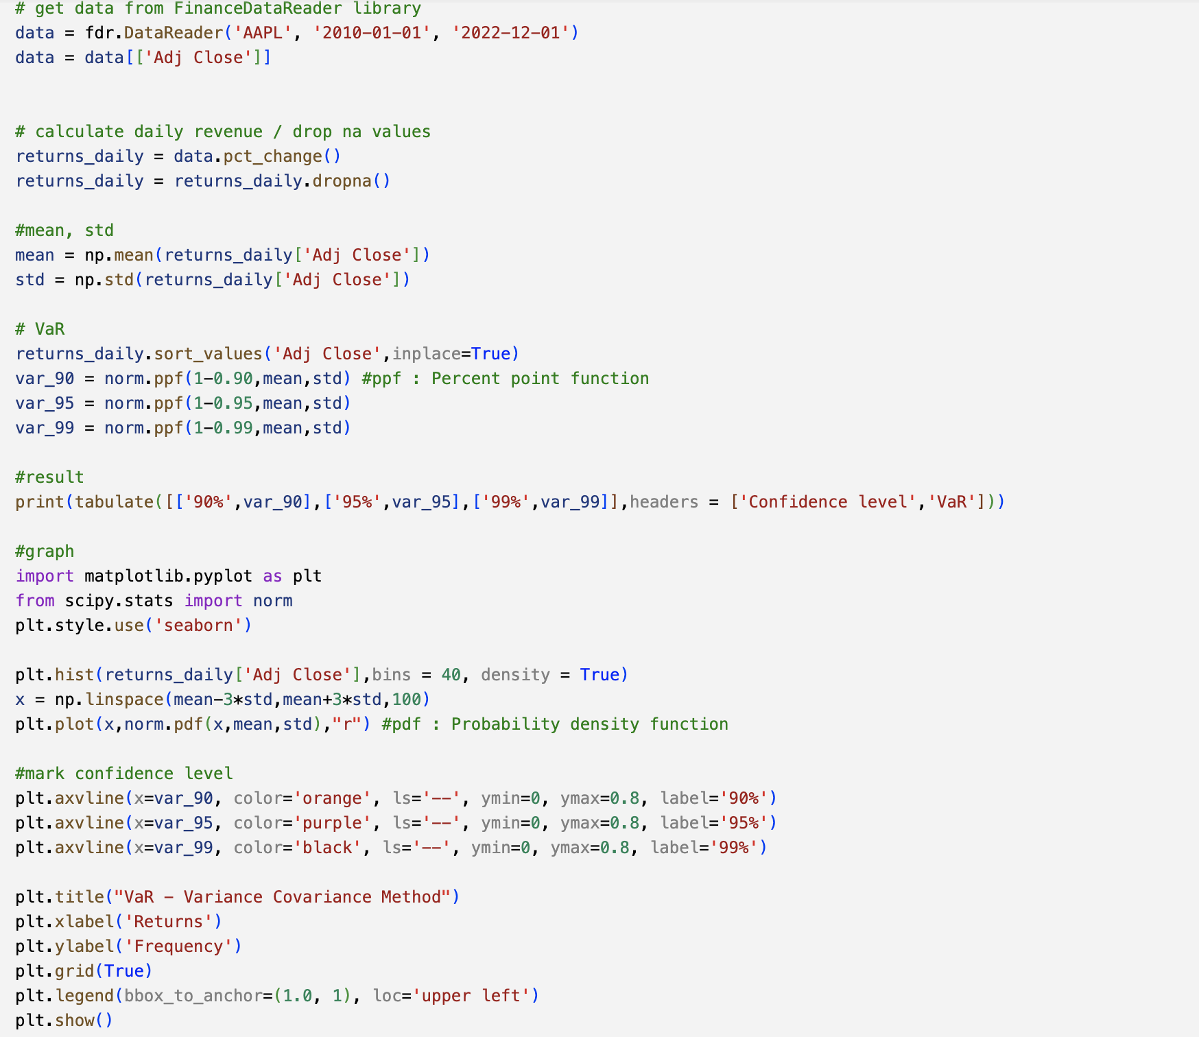
Variance Covariance Method - Code

Slide 9
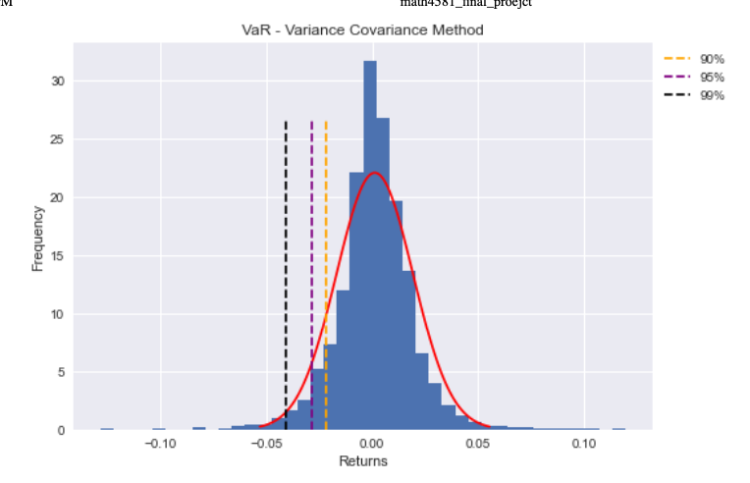
Variance Covariance method - Result
Confidence Level | VaR
90% | 0.0220449
95% | 0.0286133
99% | 0.0409345

Slide 10
Monte Carlo Simulation Method
Monte Carlo or Stochastic simulations model, and is recognized as the most effective way to flexibly evaluate the value of a complex portfolio in various market situations. However, it originated from a method that was applied to roulette games at a famous casino in Monaco, and was initially proposed for valuation of options. The simulation method for the change in market factors in Monte Carlo VaR includes statistical statistical simulation, and matrix multiplication and parameter portfolio revaluation are used as methods to simulate changes in the value of the portfolio.
This Monte Carlo simulation method defines (1) parameters for the market factors (e.g., various interest rates, foreign exchange rates, stock prices, etc.), selects a constant probability model to generate changes in the market factors, and estimates the parameters using historical market data or option data. (2) Based on the estimates of the prescribed parameters, starting with the current price of the market factors and generating random variables in order, the virtual market prices continue to be calculated as many as desired (e.g., 10,000 times). (3) Based on the obtained virtual market price, the value of all assets or positions in the portfolio is calculated as many as desired using a certain valuation model, and the complete distribution of the portfolio's value change (profit or loss) over the target period is formed and the Monte Carlo VaR value is estimated.
This Monte Carlo VaR can take various types of risk into account and variability changes, such as nonlinear price risk and volatility risk, thick fat tail attributes, and extreme situations, and credit risk to some extent. However, the biggest disadvantages are that it is not easy to implement and that it takes a lot of time even on high-speed computers, so if the asset valuation model is complicated, it will be difficult to implement this method frequently. In addition, this method relies on a pricing model such as options, as well as a special probability process of risk factors, so there is a risk that the model will go wrong and should be used in conjunction with other sensitivity analyses.

Slide 11
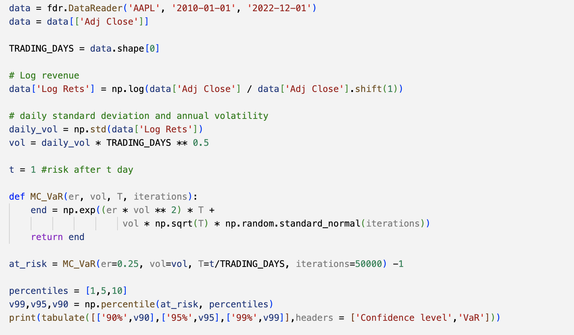
Monte Carlo Simulation Method - Code

Slide 12
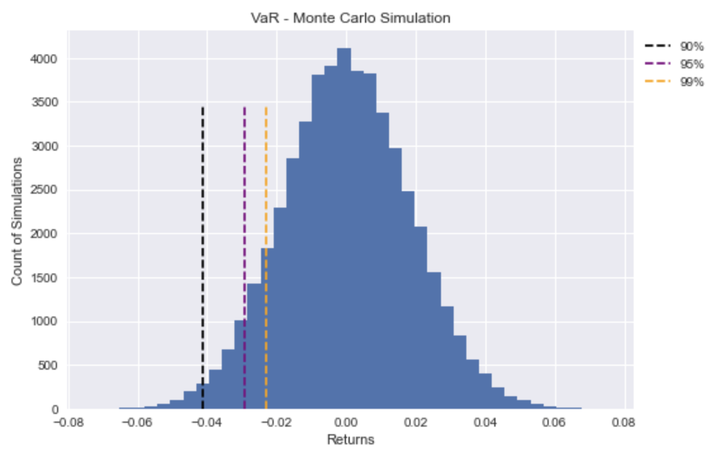
Monte Carlo Simulation Method - Result
Confidence Level | VaR
90% | 0.0229495
95% | 0.0292803
99% | 0.0414315

Slide 13
Result
There’s very small difference among 3 different methods.
VaR is the most basic and representative indicator of risk. All three methods are easy to calculate and efficient. Nevertheless, better VaR values can be obtained by comparing whether the VaR calculated using three indicators for cross-validation is reasonable.
 | Historical | Variance Covariance | Monte Carlo
90% | 0.0191951 | 0.0220449 | 0.0229495
95% | 0.0270188 | 0.0286133 | 0.0292803
99% | 0.0476422 | 0.0409345 | 0.0414315

