Slide 1

Dynamic power management in NVIDIA Jetson TX2
Gon
Mentor : Kasra
Dutt Research Group
Department of Computer Science, School of ICS, UC Irvine
Winter 2018, Internal Group Discussions
Notes:
Hello!
My name is Gon from Kookmin University, Korea. And my mentor is Kasra.
First of all let me thank you all for coming here today.
I’ll talk about Dynamic power management in NVIDIA Jetson TX2.

Slide 2
Index
Project Motivation
2. NVIDIA Jetson TX2
3. Power sensors
4. Experiments
5. Conclusion
Notes:
It’ll be in 5 big parts.
Project Motivation, NVIDIA Jetson TX2, Power Sensors, Experiments and Conclusion.

Slide 3
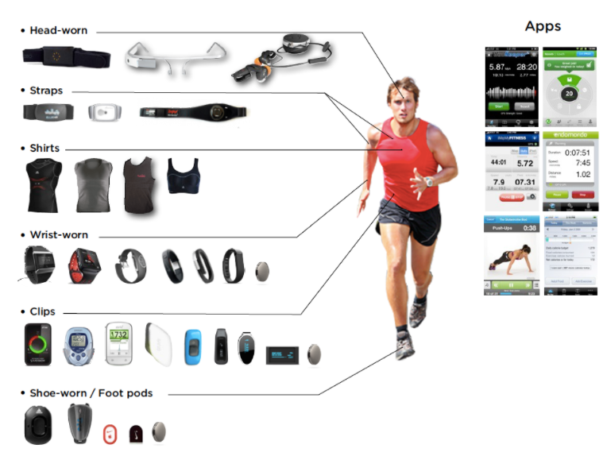
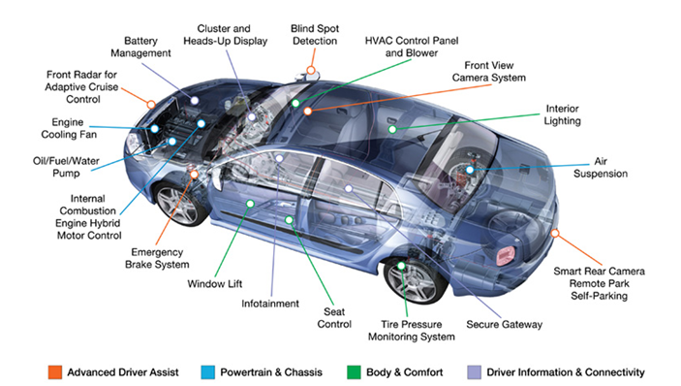
Project motivation
Development of IOT
- Wearable devices - Embedded car
Notes:
With the fast growth of Internet and advance developments on embedded system, the new concept of Internet of Things (IoT) is emerging. Nowadays, IoT is one of the biggest issues in the world. Representatively, there are two main domains that IoT is developed for, wearable devices and embedded systems in autonomous vehicles. These systems require many embedded chips and sensors. This variety of chips and sensors attached to every part and on all the components need enormous energy.
That’s why I get into this project which can reduce the energy of the embedded system. I profiled current, voltage and power. And find where I can reduce the energy by using dvfs system which is dynamic voltage and frequency system. DVFS tool built in TX2 board which is developed for reducing energy.

Slide 4
NVIDIA Jetson TX2
CPU : ARM Cortex-A57(quad-core) 2GHz + NVIDIA Denver2(dual-core) 2GHz
DVFS (Dynamic Voltage and Frequency Scaling)
Notes:
Nvidia Jetson TX2 has two CPU clusters. First one includes two giga hertz ARM cortex and the other is composed of dual core Nvidia denver2 cores.
JetPack 3.0 which is the tool built in this board includes preset platform configurations for setting Jetson TX2. It can provide 5 cpu mode to optimize the energy efficiency. JetPack 3.0 also includes a new command line tool called nvpmodel for switching profiles at run time.
I can reduce the energy by using DVFS mechanism which is Dynamic Voltage and Frequency Scaling. DVFS tool built in TX2 board which is developed for reducing energy

Slide 5
NVIDIA Jetson TX2
CPU MODE :
MAXN
MAXQ
MAXP_CORE_ALL
MAXP_CORE_ARM
MAXP_CORE_DENVER
Notes:
There are 5 cpu modes in the tool called nvpmodel.

Slide 6
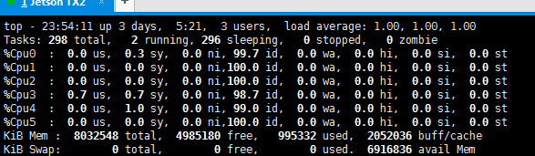

NVIDIA Jetson TX2
CPU MODE :
Command : top & 1
Command : ~/tegrastats
Command : cat /proc/cpuinfo
Notes:
I checked cpu modes work well or not by using command top and push 1. and ~/tegrastats which is built in the tool.
And also can check by using cat /proc/cpuinfo.
Tegrastats is the best to check the frequency. You can see the frequency on the red line.
And I can see cpu0 always working.

Slide 7
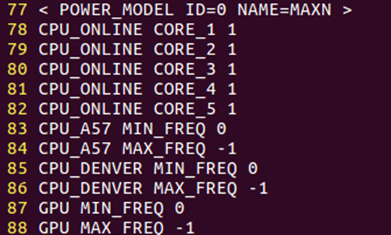
NVIDIA Jetson TX2
CPU MODE :
MAXN
Notes:
This is MAXN mode configuration in nvpmodel.conf file. You can see CPU_ONLINE CORE_NUM and number. 1 is to enable and 0 is to disable.
And there MIN and MAX freq you can see. -1 is no limitation.
MEC???? Memory controller.

Slide 8
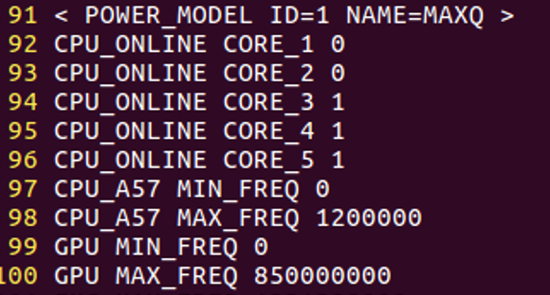
NVIDIA Jetson TX2
CPU MODE :
MAXQ
Notes:
This is MAXQ Mode. Jetson TX2 was designed for peak processing efficiency at 7.5W of power. This level of performance, referred to as Max-Q, represents the peak of the power/throughput curve. Every component on the module including the power supply is optimized to provide highest efficiency at this point.
While Dynamic Voltage and Frequency Scaling (DVFS) permits Jetson TX2 to adjust clock speeds at run time according to user load and power consumption, the Max-Q configuration sets a cap on the clocks to ensure that the application is operating in the most efficient range only.

Slide 9
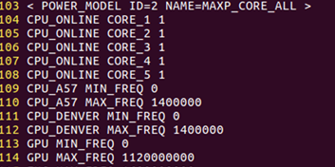
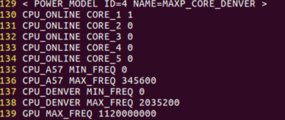
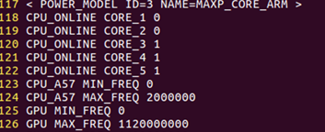
NVIDIA Jetson TX2
CPU MODE :
MAXP_CORE_ALL
MAXP_CORE_ARM
MAXP_CORE_DENVER
Notes:
Max-P, the other preset platform configuration, enables maximum system performance in less than 15W. You can also create custom platform configurations with intermediate frequency targets to allow balancing between peak efficiency and peak performance for your application.

Slide 10
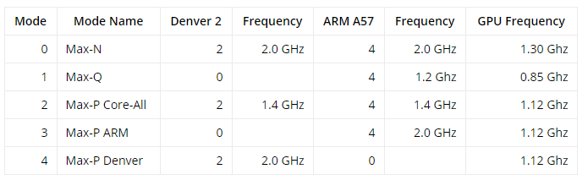
NVIDIA Jetson TX2
CPU MODE :
Notes:
This table is well arranged for all the cpu mode.

Slide 11
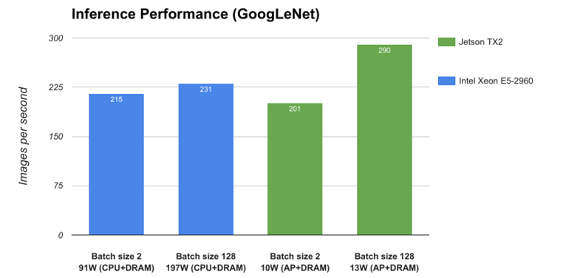
NVIDIA Jetson TX2
- High performance and Low energy
Notes:
Then, let’s see the efficiency about the board.
The greens are for Jetson TX2 and the blues are for Intel Xeon.
You can see Batch size 128, Jetson TX2 shows 290 images performed per second and 13W consumed when the intel Xeon shows 231 images performed per second and 197W consumed. It shows this board has high performance but consuming lower energy. When you see batch size 2 of both, jetson TX2 shows 201 images performed per second and 10W consumed when the intel Xeon shows 215 performed per second and 91W consumed. It shows you can save the energy about 9 time more than intel chips by using Jetson TX2 has similar performance.
This board developed to reduce energy and get high-performance so nvidia also developed the tool about dvfs for this which can adjust dynamic voltage and frequency system.

Slide 12
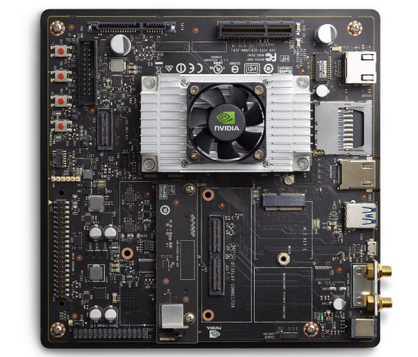
Power sensors
12 Sensors
VDD_SYS_GPU
VDD_SYS_SOC
VDD_4VO_WIFI
VDD_IN
VDD_SYS_CPU
VDD_SYS_DDR
VDD_MUX
VDD_5VO_IO_SYS
VDD_3V3_SYS
VDD_3V3_IO
VDD_1V8_IO
VDD_3V3_SYSi_M2
Notes:
There are 12 Sensor’s on TX2 board which I measured.
I measured all the sensors. But I focus on cpu sensor to analyze.

Slide 13
Experiments
Using Parsec 3.0.
Making Profiler to measure current, voltage and power.
Visualizing and Analyzing.
Notes:
The experiments divided in three small parts. Using parsec version 3.0. Making profiler to measure current, voltage and power of each sensor on TX2. And Visualizing and Analyzing.

Slide 14
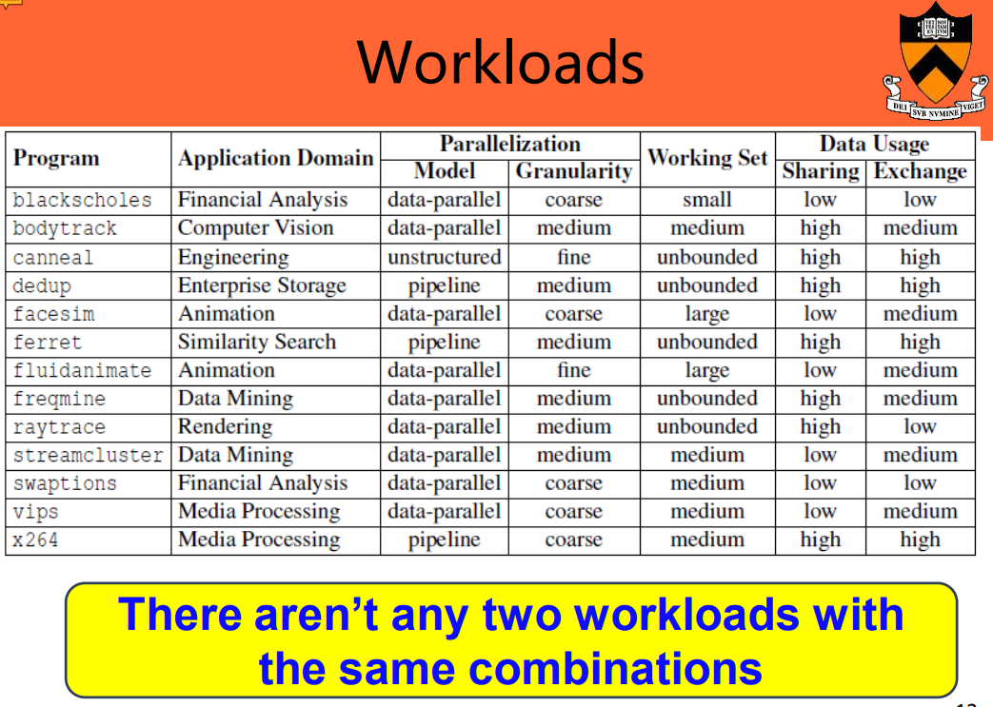
Experiments
Use Parsec 3.0.
Notes:
The Princeton Application Repository for Shared-Memory Computers called PARSEC is a benchmark suite composed of multithreaded programs. The suite focuses on emerging workloads and was designed to be representative of next-generation shared-memory programs for chip-multiprocessors.
I used parsec benchmark to measure diverse situation in computer.
Before I use, I cross-compiled to use parsec 3.0 on TX2 board using arm architecture. All the workloads work well except raytrace.
There are 13 workloads and there aren’t any two workloads with the same combinations except dedup and ferret.

Slide 15
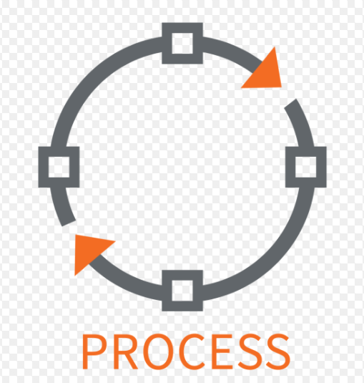



Experiments
Make Profiler to measure current, voltage and power.
Notes:
To make profiler I divided two classes. Sensor and Process. The sensor class is to store sensor information and the process class is to bring data from sensors and to measure to file. So the Process makes the vector sensor and bring all the data in their location. And write to the excel file every 0.1 second.

Slide 16
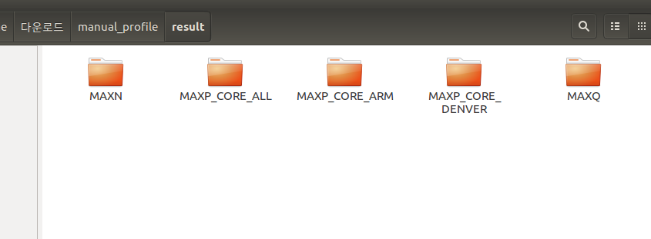
Experiments
Make Profiler to measure current, voltage and power.
Notes:
You can see the 5 directory for each cpu mode I measured.

Slide 17
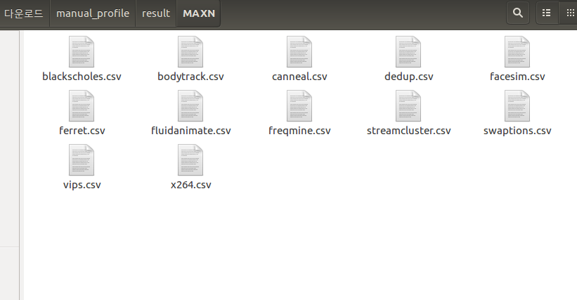
Experiments
Make Profiler to measure current, voltage and power.
Notes:
And there are 12 workloads measurement file formatted csv file in each cpu mode.

Slide 18
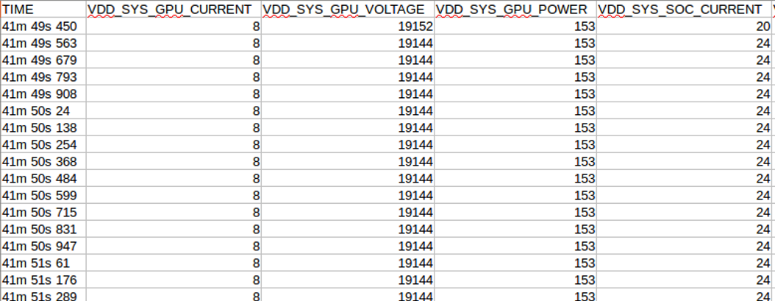
Experiments
Make Profiler to measure current, voltage and power.
Notes:
You can see some part of csv file. And there are Current, voltage and power in each sensor. And you can also see the time measured.

Slide 19
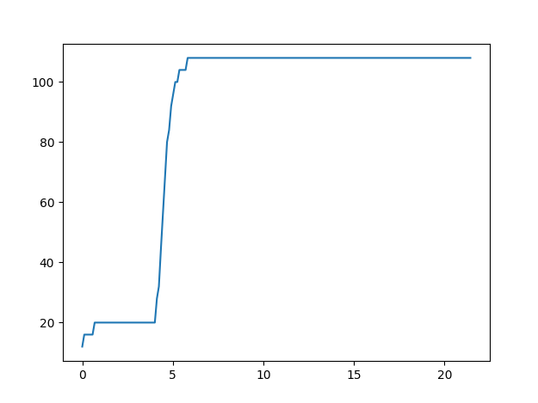
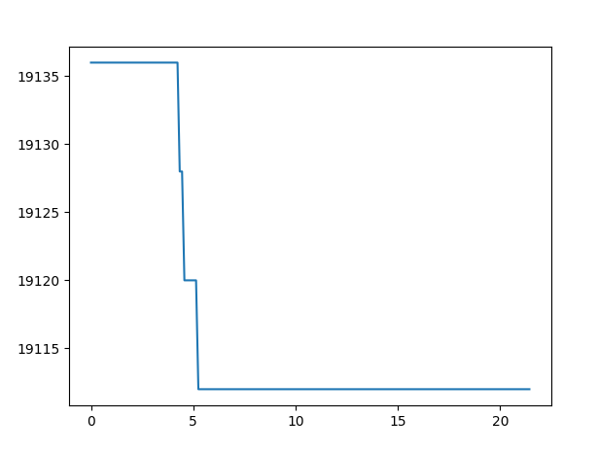
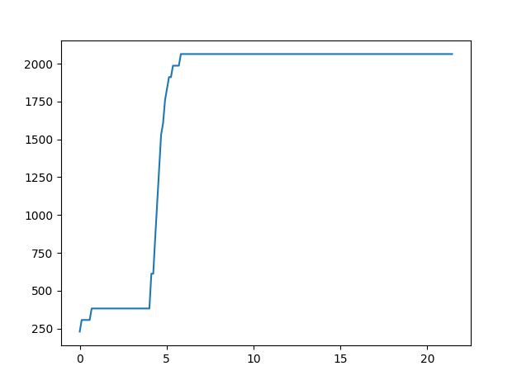
Experiments
Visualizing and Analyzing.
CPU mode : MAXN, Workload : X264, Sensor : CPU
Current Voltage Power
Notes:
I made some graph what I measured.
I measured it on MAXN CPU mode, X264 workload in PARSEC and CPU sensor.
You can see the current rising rapidly at about 4 seconds. Also power is similar graph.
And the voltage is goes down a little. The voltage from 19135 to 19110.
So I want to check the power among each mode.

Slide 20
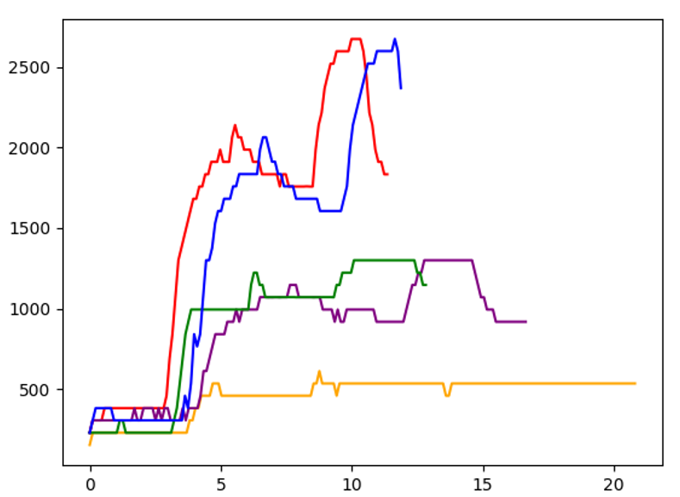
Experiments
Power(mW)
Visualizing and Analyzing. Compare power in each cpu mode.
MAXN
MAXQ
MAXP_CORE_ALL
MAXP_CORE_ARM
MAXP_CORE_DENVER
Time(s)
Facesim
Notes:
There are powers measured in five cpu mode. In this measurement facesim was used which is in parsec workloads.
As I expected MAXN which is the red and consumed the biggest energy finished the workload earlier than any other.
On the other hand, MAXQ which is the orange and consumed the smallest energy finished the workloads late.
You can see the energy and the process speed are mostly inversely proportional.
And I can see some weird thing on this graph.
How can the Denver cpu be so fast?
Take a look on this table. The clock of Denver couldn’t faster than any other.
So I measure it again. But there are the same result. I searched about Denver core. And I can find something about it.
Denver has super instruction pipelining. And also has different L1 and L2 cache. So that makes it.

Slide 21
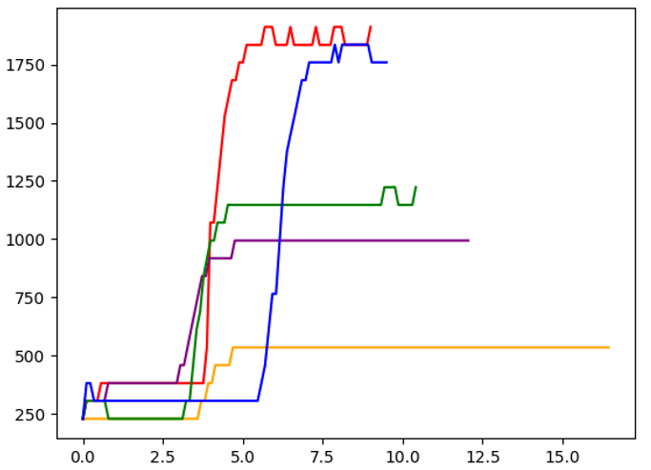
Experiments
Power(mW)
Visualizing and Analyzing. Compare power in each cpu mode.
MAXN
MAXQ
MAXP_CORE_ALL
MAXP_CORE_ARM
MAXP_CORE_DENVER
Time(s)
Vips
Notes:
In this measurement vips was used which is in parsec workloads.
This represent the more power the faster process speed.
You can see it easily.

Slide 22
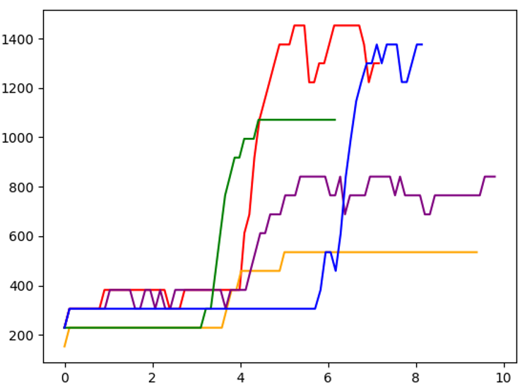
Experiments
Power(mW)
Visualizing and Analyzing.
Compare power in each cpu mode.
MAXN
MAXQ
MAXP_CORE_ALL
MAXP_CORE_ARM
MAXP_CORE_DENVER
Time(s)
Bodytrack
Notes:
But when I measured bodytrack, there are some different phenomenon occurred.
MAXP_CORE_ARM which is the green finished earlier than all of cpu mode.
Even the energy consumption seems to be less than MAXN.
And also MAXP_CORE_ALL which is the purple consumed more energy but finished little later than MAXQ.
There should be some optimization to reduce energy.

Slide 23


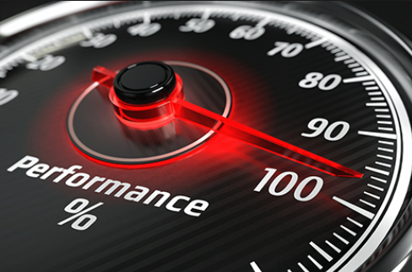
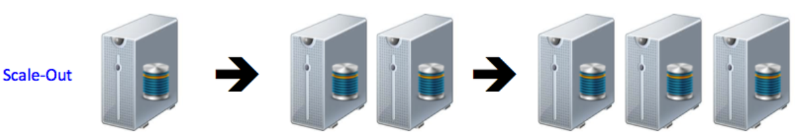
Conclusion
- Energy and speed are not always inversely proportional.
=> Faster is not always the most energy efficient!
- Various goals, require different settings.
Performance
energy efficiency
Lifetime
Etc.
- Multi-processor should be optimize to scale out for workloads.
Notes:
Energy and speed are not always inversely proportional.
So there are some need to optimize the energy and the performance by using dvfs.
For various system goals, designers can select different power management settings for their goals.
And also multi-processor should be optimize to scale out for workloads. Something likes sequential or random access.
Moreover there are some need about researching and notifying about instruction pipeline and cache to make better multi core performance.

Slide 24
Q&A
Thank you.
Kasra Moazzemi. Nikil Dutt. Said.M.Shokair. Sung-soo Lim. Biswadeep.
Notes:
Thank you for your attention.
Please feel free to throw me any questions you may have. I'll do my best to answer each one.

