Slide 1
Task-Based Effectiveness of Basic Visualizations
Authors
Bahador Saket, Alex Endert, Çagatay Demiralp
Team members
Rasa Bhattarai
Reem Othman

Slide 2
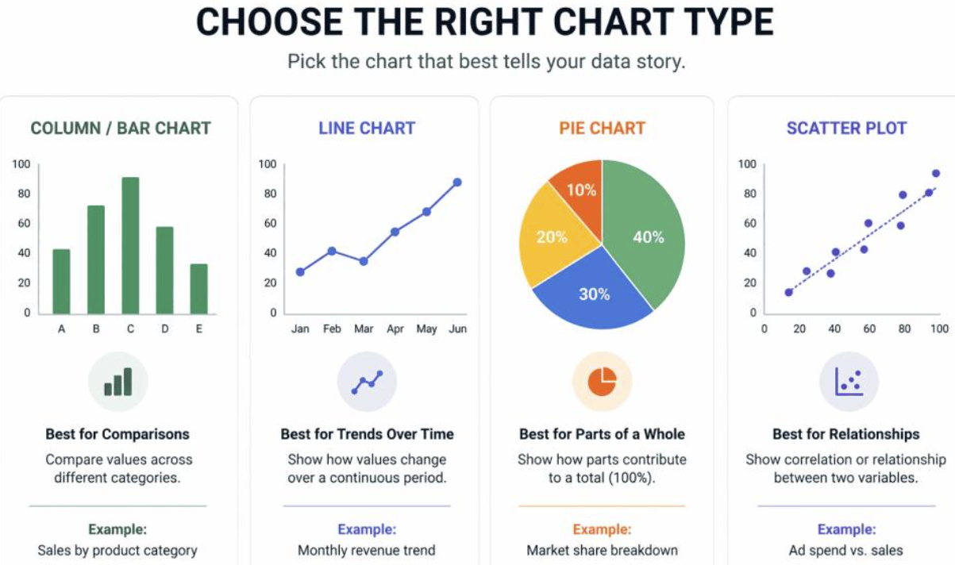
Introduction
Key question : Does visualization effectiveness change depending on the task?
One chart != best for everything

Slide 3
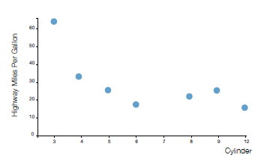
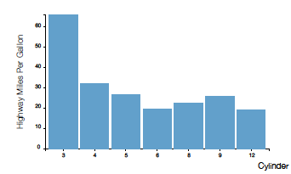
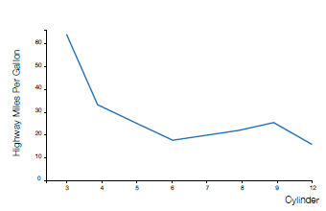
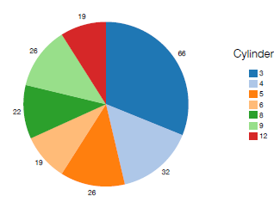
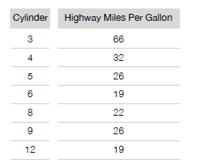
Study design
5 visualization types: Tabular data, Line chart, Bar chart, Scatterplot, Pie Chart
10 tasks : Find correlation, Find anomalies , Find clusters, Find extremum, Retrieve a value, Filter, Order, Compute derived value, Characterize distribution, Determine range
2 datasets : Cars (407 entries), Movies (335 entries)
5 visualizations × 10 tasks × 2 datasets

Slide 4
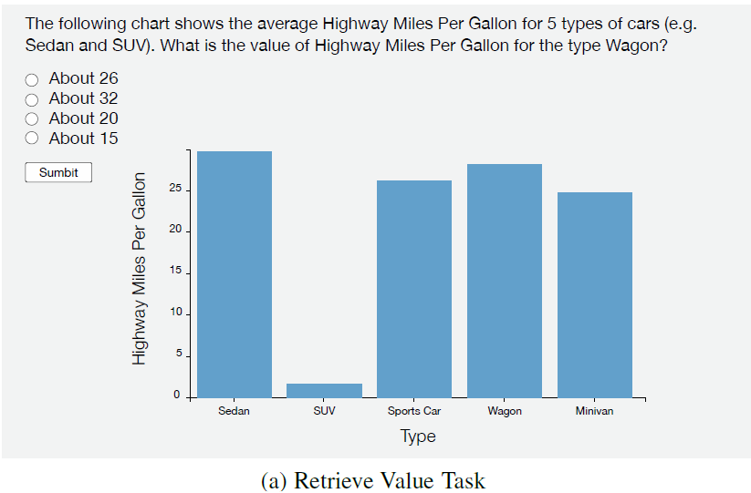
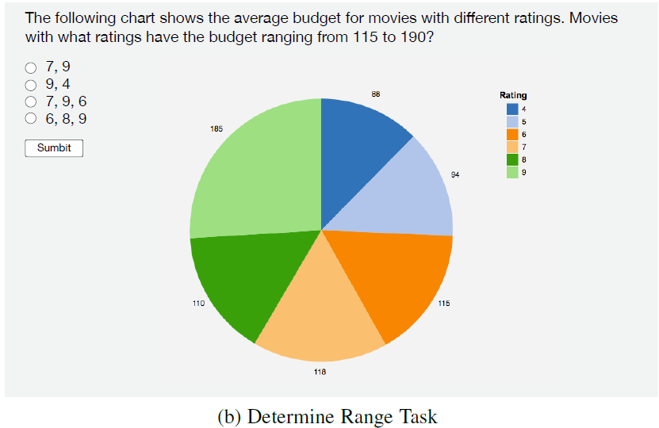
experiment
Training (5 trial Questions + feedback)
Main experiment: 180 participants were randomly assigned to 10 tasks (18 participants per task), 30 Questions/task

Slide 5
experiment
Participants:
180 participants completed the study
Ages 25–40
US-based
Had previous experience with visualizations
For each task, researchers measured:
1. Accuracy
Did they get the answer right?
2. Time
How quickly did they answer?
3. User Preference
Which visualization did they prefer?

Slide 6
results
Bar Chart: fastest and most accurate visualization type
Line Chart: lowest aggregate accuracy and speed but more accurate for Correlation & Distribution
Pie Chart: fast, accurate for many tasks except Correlation/Anomalies/Distribution

Slide 7
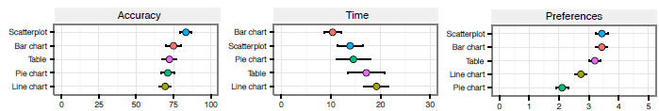
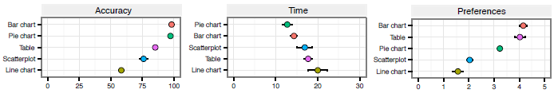
findings
Find Anomalies
Find Clusters

Slide 8
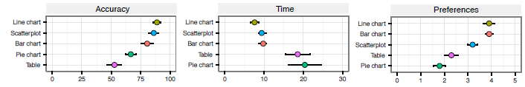
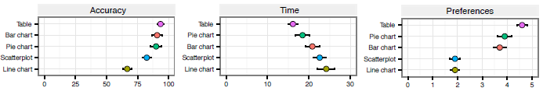
findings
3. Correlation
4. Compute derived value

Slide 9
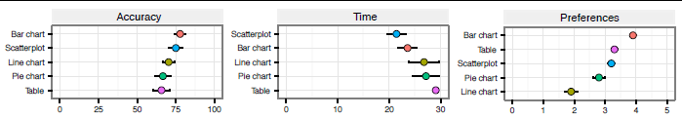
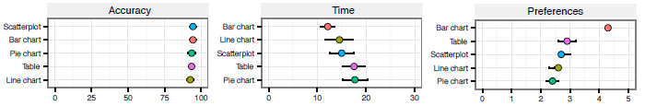
findings
5. Characterize distribution
6. Find Extremum

Slide 10
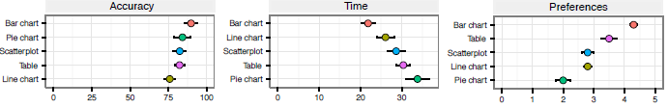
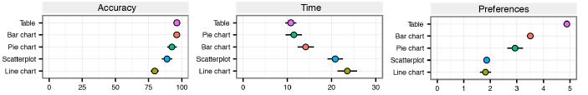
findings
7. Order
8. Retrieve Value

Slide 11
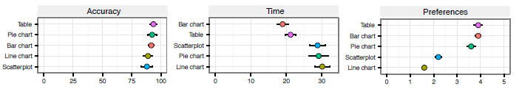
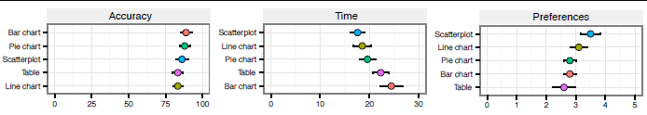
findings
9. Filter
10. Determine range

Slide 12
User preferences findings
User preference positively correlates with accuracy (Pearson’s r=0.68)
Weak negative correlation between performance time & user preferences (Pearson’s r=–0.43)
Bar Chart & Table = most preferred across most of the tasks

Slide 13
guidelines
G1: Use Bar Chart to find Clusters
G2: Use Line Chart to find Correlations
G3: Use Scatterplot to find Anomalies
G4: Avoid Line Chart for precise value reading
G5: Avoid Table/Pie Charts for Correlation tasks

Slide 14
Application: kopol recommender
Can we teach a computer these patterns?
Decision tree trained on collected data
Recommends visualization based on task & data type

Slide 15
Limitation & future work
LIMITATIONS
Only 5–34 visual marks
Static visualizations only
Only 2D visualizations
FUTURE WORK
Test higher datapoint cardinality
Investigate interactive visualizations
Compare more visualization techniques

Slide 16
CONCLUSION
Effectiveness of the visualization types considered significantly changes from one task to another.
TASK
What are you trying to find?
DATA
What are you visualizing?
USER
What can the user understand and use effectively?

Slide 17
QUESTIONS ???

