Slide 1
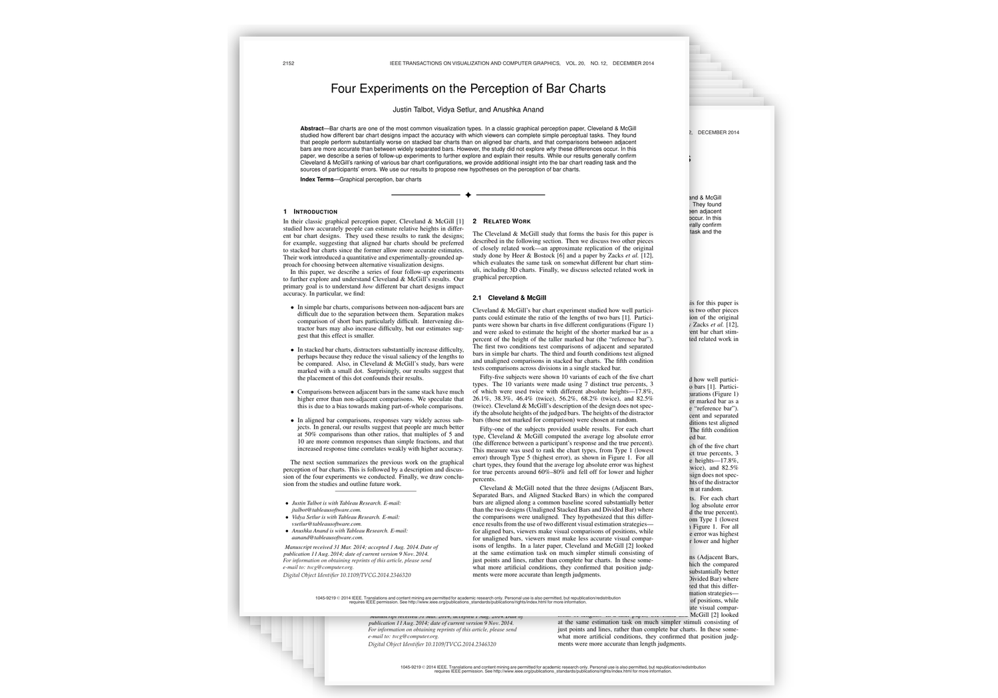
Four Experiments on the
Perception of Bar Charts
Why small design choices change how accurately we read bar charts
Justin Talbot · Vidya Setlur · Anushka Anand
IEEE Transactions on Visualization and Computer Graphics · 2014 – 129 citations
Mouzhar Alhoumsi . Abdulla Abu Ainin

Slide 2
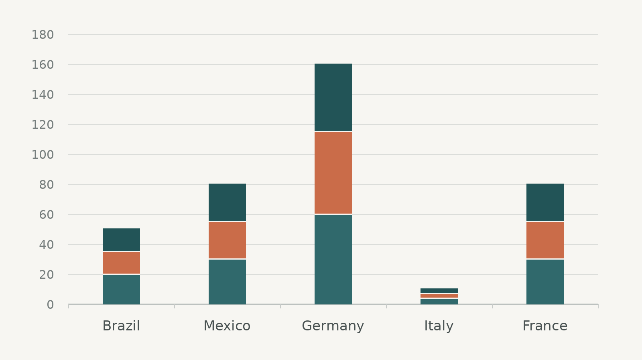
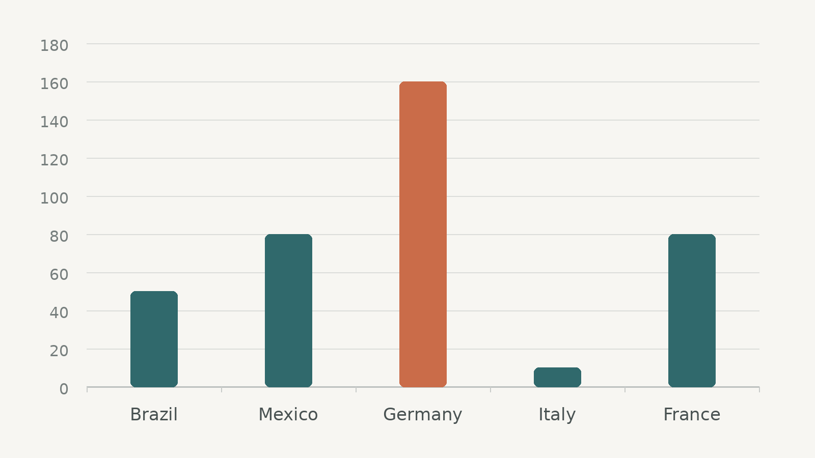
THE STARTING POINT
Introduction
What are bar charts used for?
Goal of the study
Stacked-Bar charts
Simple-Bar charts

Slide 3
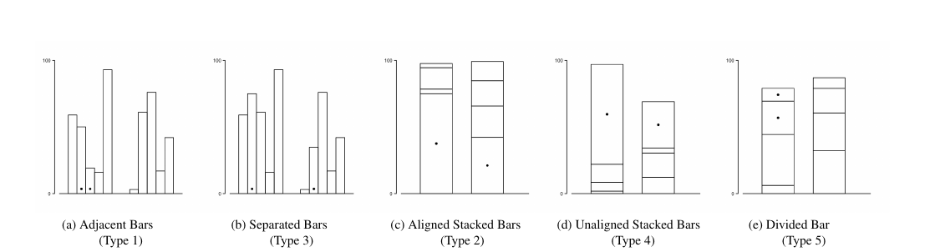
THE STARTING POINT
Related work
Cleveland & McGill showed that perceptual accuracy depends on chart configuration.
The five bar chart tasks studied in Cleveland & McGill
Best to worse

Slide 4
STUDY ROADMAP
Four experiments
01
Adjacent vs. separated bars
Is extra error caused by distance, distractors, or both?
02
Aligned vs. unaligned bars
What makes stacked, unaligned comparisons difficult?
03
Divided bars
Why are segments in the same stack unusually difficult?
04
True percent & rounding
How does the true ratio affect error and how do people estimate?

Slide 5
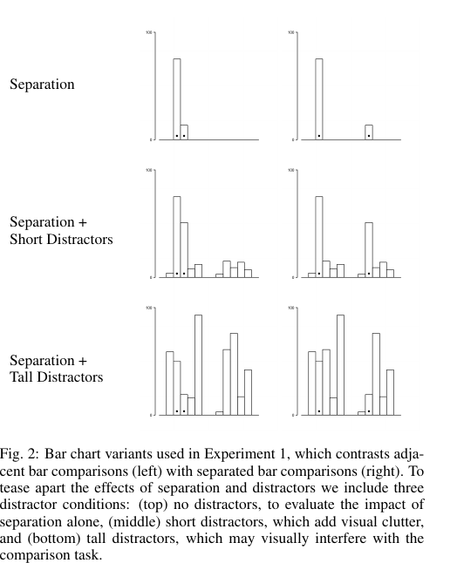
DISTANCE
Experiment 1 · Adjacent vs. separated bars
What changed?
Compared adjacent and separated bars.
Varied distractors: none, short, and tall.
Also varied reference-bar height.
0.81 pp
estimated total separation effect
Separation itself was the main source of difficulty; short bars were especially hard when far apart.
Design implication: sorting, reference lines, or interaction can bring distant values closer for comparison.

Slide 6
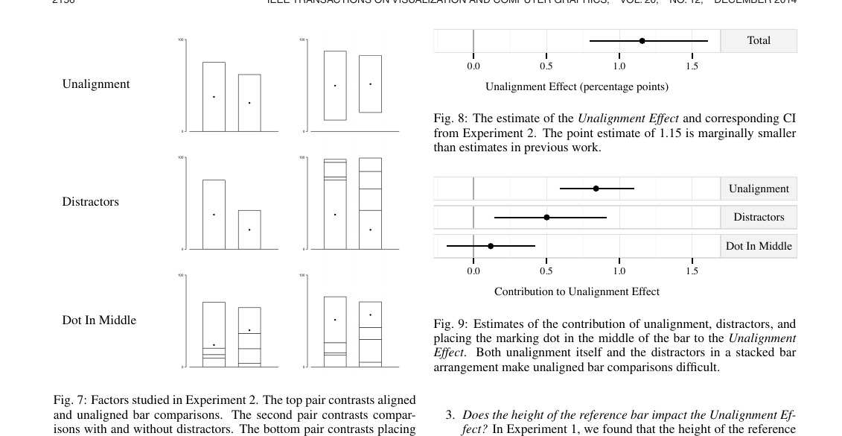
ALIGNMENT
Experiment 2 · Aligned vs. unaligned bars
1.16 pp
unalignment effect
Unaligned comparisons clearly increased error.
Stacked distractors added further difficulty.
A middle marking dot actually made both aligned and unaligned comparisons slightly easier.
A common baseline helps because position is easier to judge than unaligned length.

Slide 7
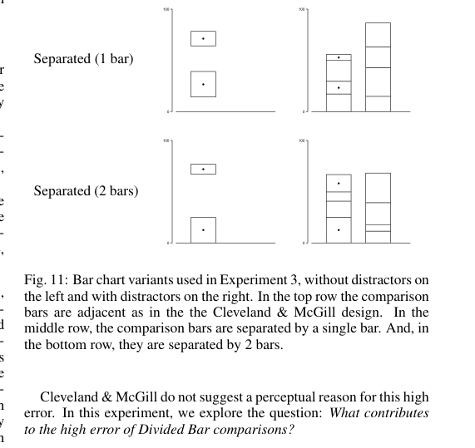
PART-TO-WHOLE BIAS
Experiment 3 · Divided bars
Unexpected result
Adding a gap made the comparison easier.
−0.87 pp
error with one intervening bar vs. adjacent segments
Possible explanation
Adjacent segments may trigger a part-to-whole judgment. Example: 30/60 = 50%, but 30/(30+60) = 33%.
In stacked bars, visual grouping can bias the task—not just make it harder.

Slide 8
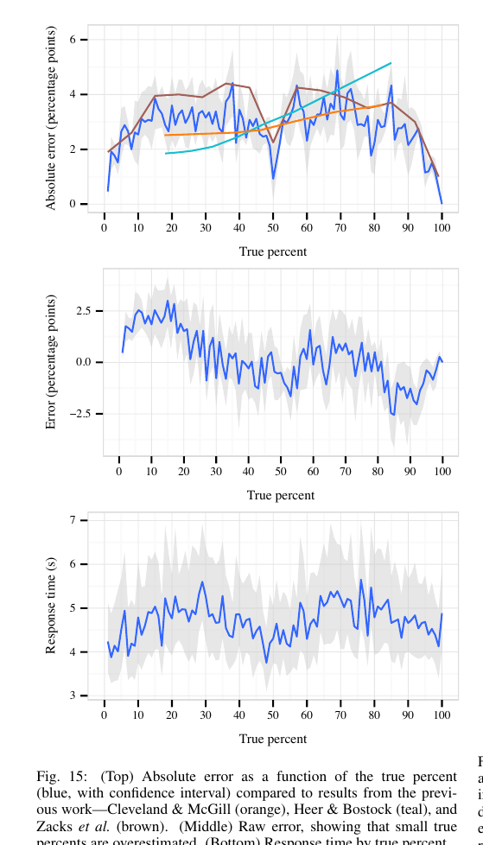
ESTIMATION STRATEGY
Experiment 4 · True percent & rounding
What the curve shows
Error is lowest near 0%, 50%, and 100%.
The error curve is roughly symmetric around 50%.
Small ratios tend to be overestimated; large ratios tend to be underestimated.
Participants strongly favor rounded answers—especially multiples of 10 and 5.
50%
was unusually accurate—not merely a rounding artifact.
Perceptual accuracy depends on the value being judged, not only on the chart design.

Slide 9
WHAT DO THE EXPERIMENTS TELL US?
Discussion
Distance
Separated values are harder to compare especially when bars are short.
Alignment
Shared baselines support more accurate position judgments than unaligned length judgments.
Context
Distractors and visual grouping can change the task people think they are performing.
Human strategy
People use anchors and rounded values; 50% is a particularly strong perceptual reference.
Good visualization design reduces perceptual work

Slide 10
KEY TAKEAWAYS
Conclusion
What can we take from this study?
01
Keep comparisons close
Spatial separation increases estimation error.
02
Prefer common baselines
Aligned position judgments are easier than unaligned length judgments.
03
Be careful with stacked bars
Distractors and part-to-whole grouping can bias comparisons.
04
Design for human estimation
People use anchors, rounding, and especially strong references such as 100%.
Main message
The same data can be easier or harder to understand depending on how it is visually arranged.

