Slide 1
AdaVis : Adaptive and Explainable Visualization Recommendation for Tabular Data
Songheng Zhang , Haotian Li , Huamin Qu , and Yong Wang
Maciej Jan Korzenecki, Petra Horváth

Slide 2
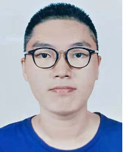
AdaVis : Adaptive and Explainable Visualization Recommendation for Tabular Data
Songheng Zhang , Haotian Li , Huamin Qu , and Yong Wang
Maciej Jan Korzenecki, Petra Horváth

Slide 3
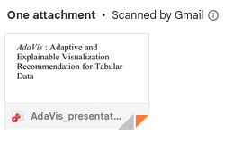
AdaVis : Adaptive and Explainable Visualization Recommendation for Tabular Data
Songheng Zhang , Haotian Li , Huamin Qu , and Yong Wang
Maciej Jan Korzenecki, Petra Horváth
Notes:
~45s for 1-3

Slide 4
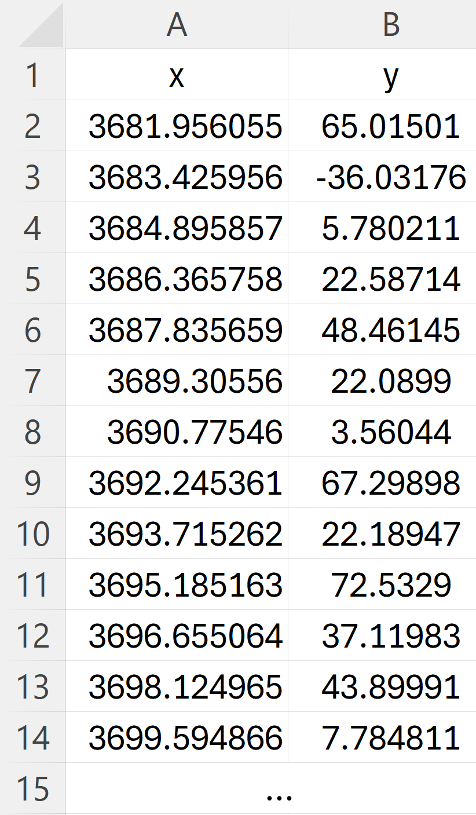

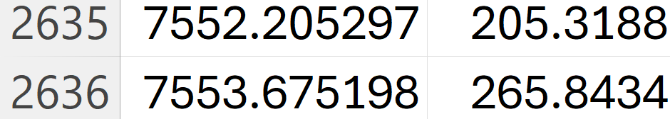
What Charts Should I Use?
…
Notes:
Just 30s

Slide 5
Chart Type | Ranking
 | 1
 | 2
 | 3
 | 4
Recommender
…

Slide 6


Recommender?
Rule-based recommendation
Relies on heuristics
Old!

Slide 7
Recommender?
Rule-based recommendation
Machine-learning-based
Relies on heuristics
Old!
Typically one recommendation
Confusing black box
Notes:
~1minute 45s for 5-7

Slide 8
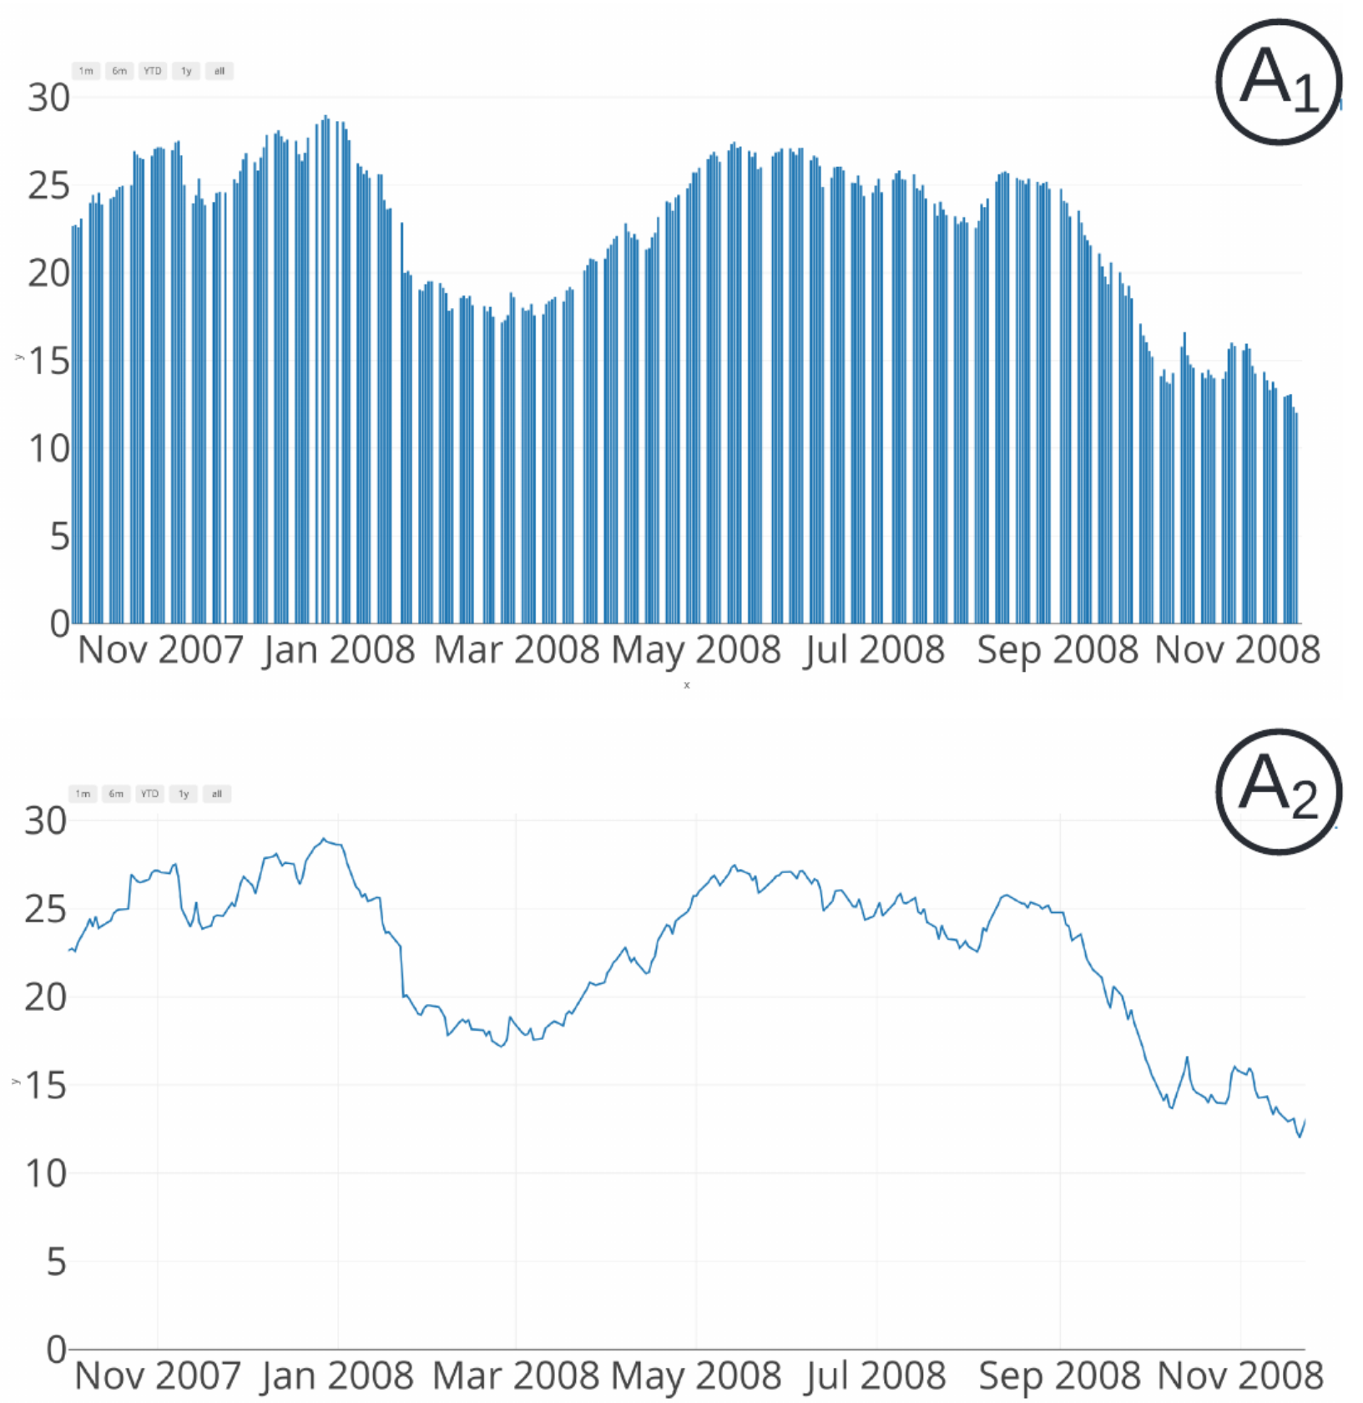
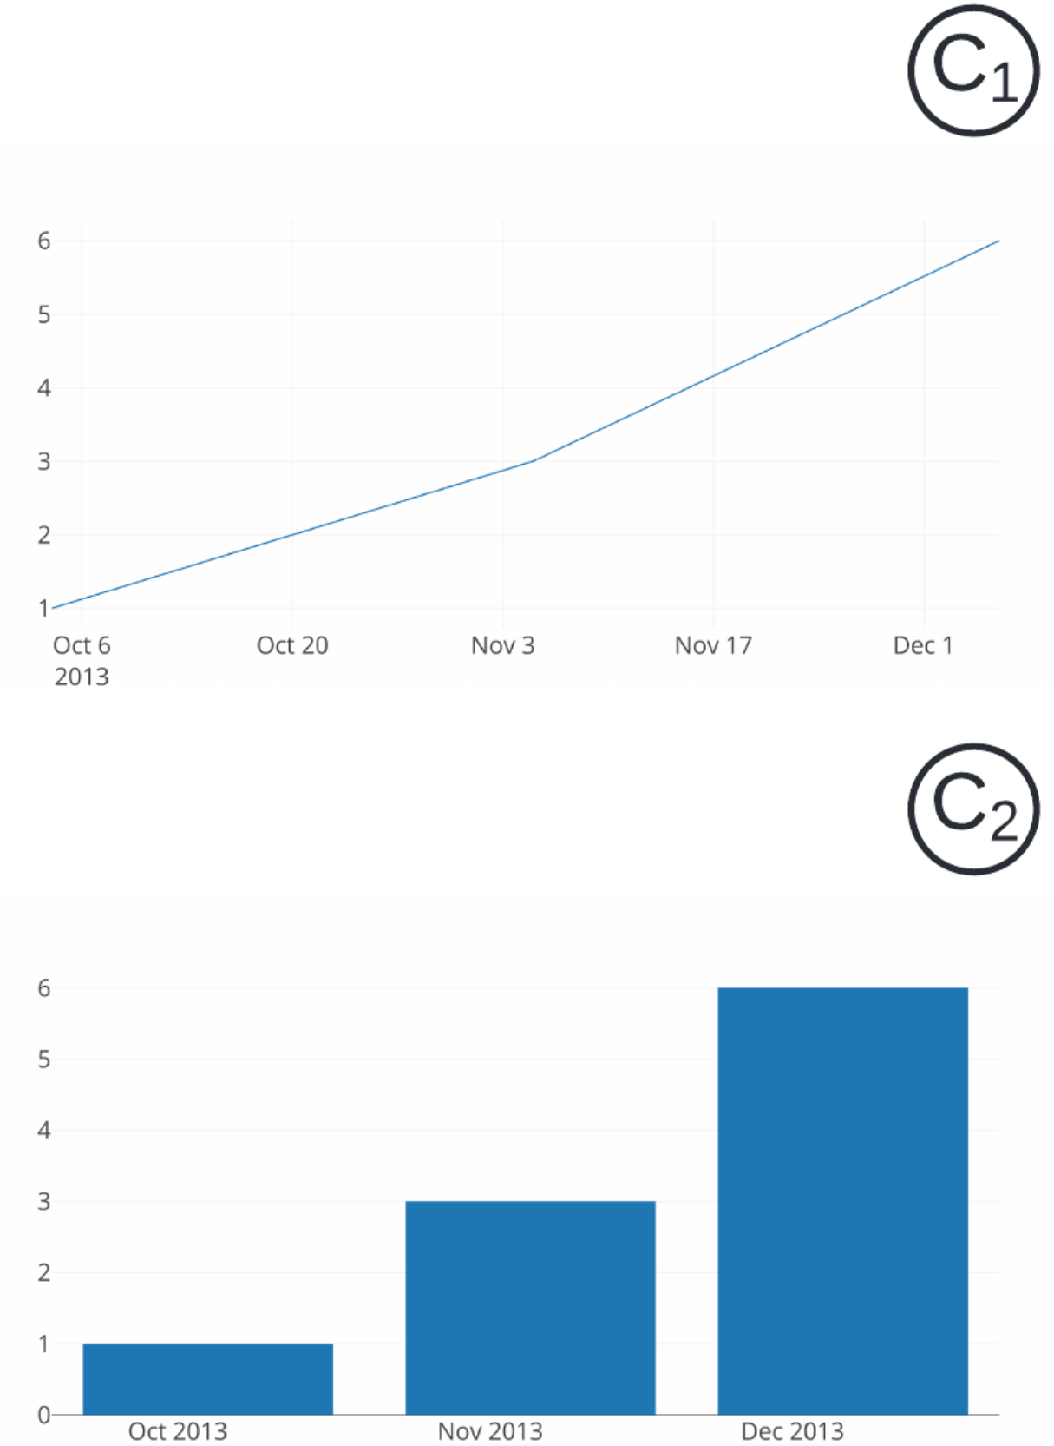
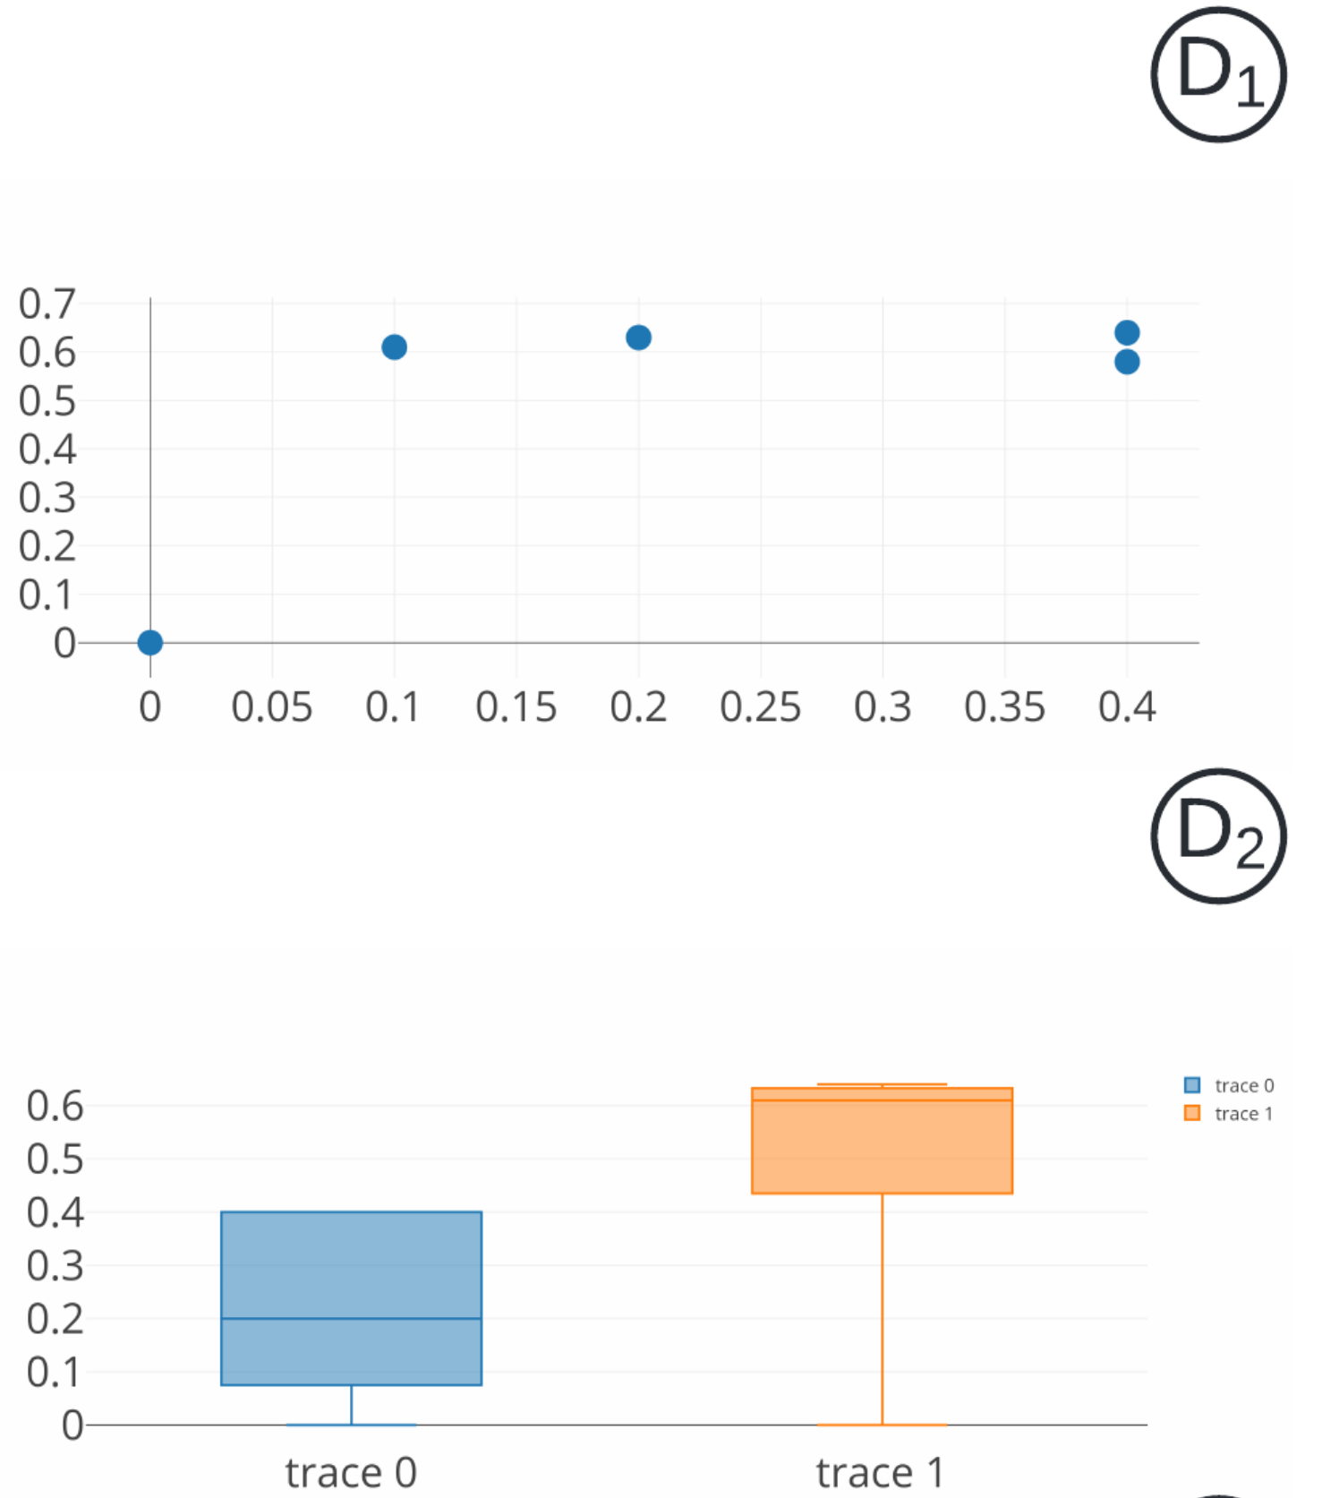
AdaVis
Bar and line are recommended if Column A data values are arranged in disorder ;
Cross-column data types are datetime-numercial.
Line and scatter are recommended if
Cross-column data are significantly correlated,
and fit a linear regression model.
Scatter and box are recommended if
Cross-column data has different data
distributions, and there exist clusters.
Notes:
Around 50s

Slide 9
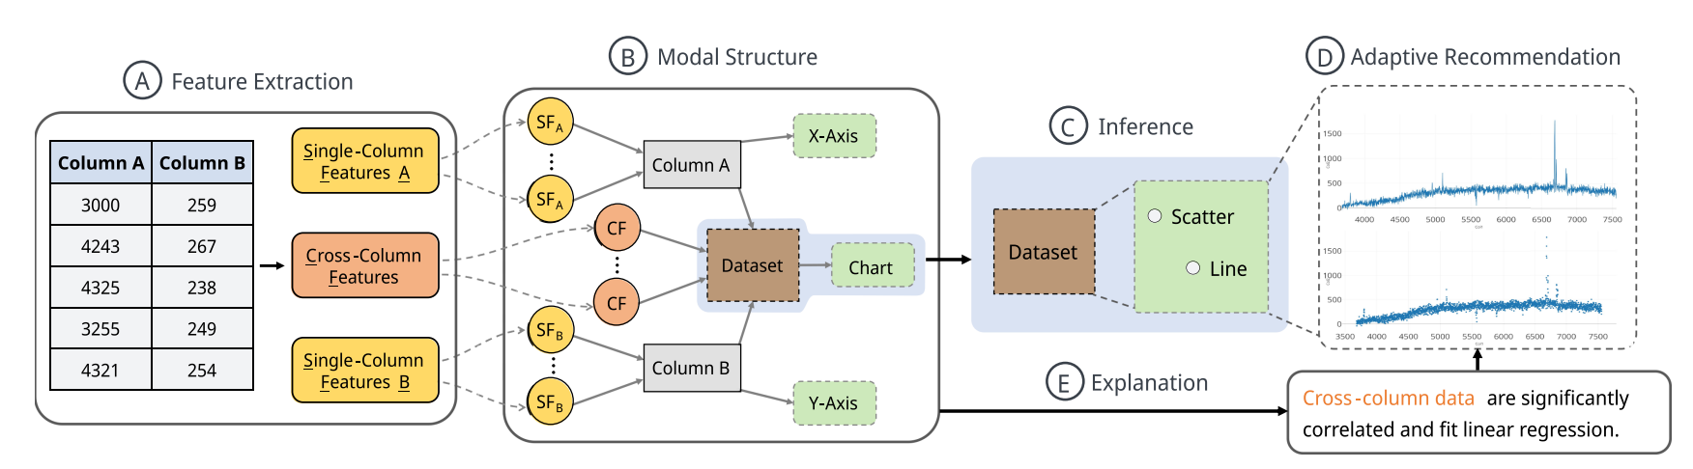

Methodology
Notes:
In the feature extraction stage, the dataset is analysed to extract properties of each column and relations between two columns.

Slide 10
Methodology
Notes:
Then, a knowledge graph is plotted containing these extracted features, the columns, the dataset and the possible visualization choices.

Slide 11
Methodology
Notes:
In the next stage, the defined features are combined into a dataset that includes potentially suitable chart types. The dimensions are assigned to the corresponding columns.

Slide 12
Methodology
Notes:
Next, the software returns one or more suitable graphs.

Slide 13
Methodology
Notes:
And finally, the reasoning is constructed based on the most influential features that got identified by the attention mechanism.

Slide 14
Evaluation
Quantitative
Compared works:
KG4Vis
GQE
Decision Tree
Multiple suitable graphs
Notes:
AdaVis was compared against 3 similar software. At chart type recommendation, only the Decision Tree performed better in axis prediction accuracy.
During the testing AdaVis proved to be able to recommend multiple suitable charts.
(And by adding cross-coumn features, the output improved for all models.)

Slide 15
Evaluation
Quantitative
Compared works:
KG4Vis
GQE
Decision Tree
Multiple suitable graphs
Qualitative
Case studies on 4 datasets
Only performed well with cross-column features
Notes:
In the case studies AdaVis was tested against established design rules.
Without cross-column features, it recommended inappropriate visualization types.

Slide 16
Evaluation
Quantitative
Compared works:
KG4Vis
GQE
Decision Tree
Multiple suitable graphs
Qualitative
Case studies on 4 datasets
Only performed well with cross-column features
Notes:
Otherwise, it followed the visualization guidelines.
And overall, the results are positive (supporting the paper’s claim).

Slide 17
User feedback
6 experts + 6 general users
”It is reasonable to recommend these multiple types of visualizations for the same dataset”
Missing:
Explanation for non-suitable graph
User-centric recommendation
Notes:
12 participants reviewed the tool.
All found most recommendations appropriate and the attached explanations clear.
However, they found some missing features, such as explanation on the not recommended chart types and taking the user’s intent with the dataset into consideration.

Slide 18
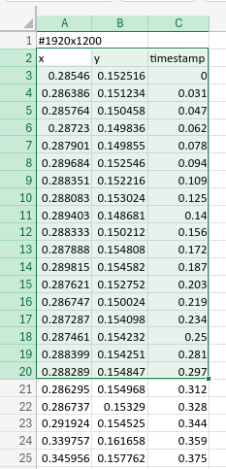
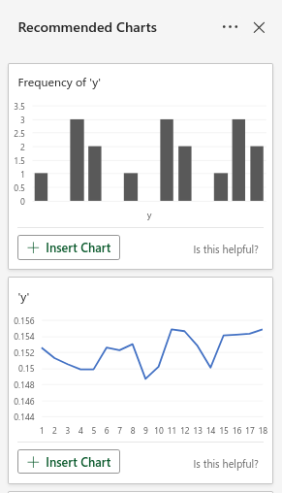
Our Thoughts
Useful for "normal" users, dubious for experts and researchers

Slide 19
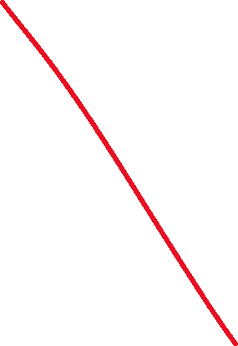
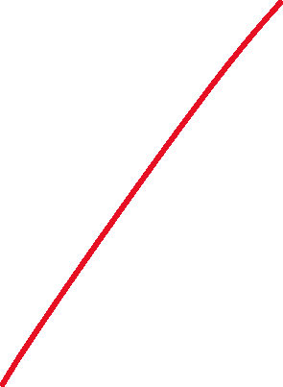
Our Thoughts
Notes:
Around ~1minute 30seconds for 9-10

Slide 20
Thank you for your attention!
Sources:
S. Zhang, H. Li, H. Qu, and Y. Wang, “ADAVIS: Adaptive and Explainable Visualization Recommendation for Tabular data,” IEEE Transactions on Visualization and Computer Graphics, vol. 30, no. 9, pp. 5923–5938, Sep. 2023, doi: 10.1109/tvcg.2023.3316469.
Presentation slides provided by S. Zhang

