Slide 1
Information Visualization
Felix Krull; Moritz Steinke
02.10.2026

Slide 2
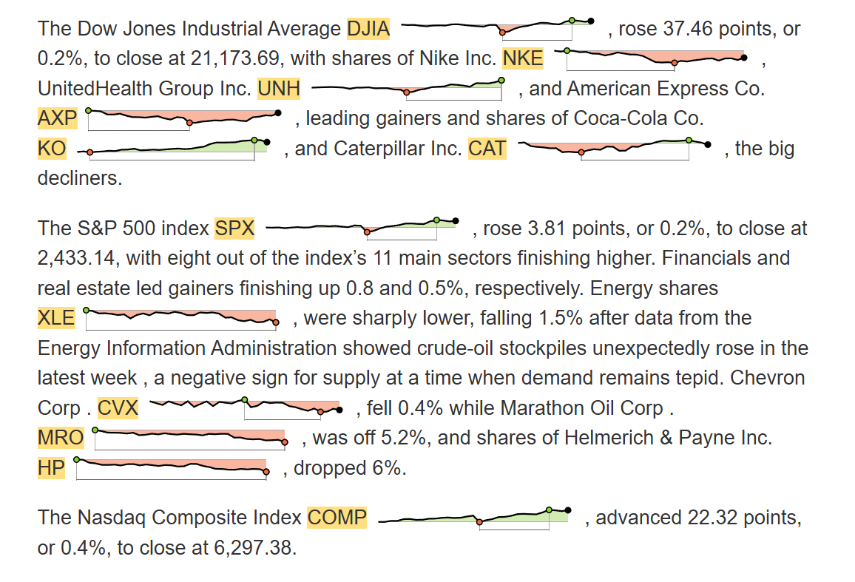
Felix Krull, Moritz Steinke
Which company shows the strongest increase?
Notes:
Imagine you are reading a financial news article like this one.
Small charts showing stock price trends (Word scale vis)
Place data directly next to the company thats discussed; See trend while reading
Now, take a few seconds to look at the charts
Gets harder in longer documents
This is the Problem of the Paper

Slide 3
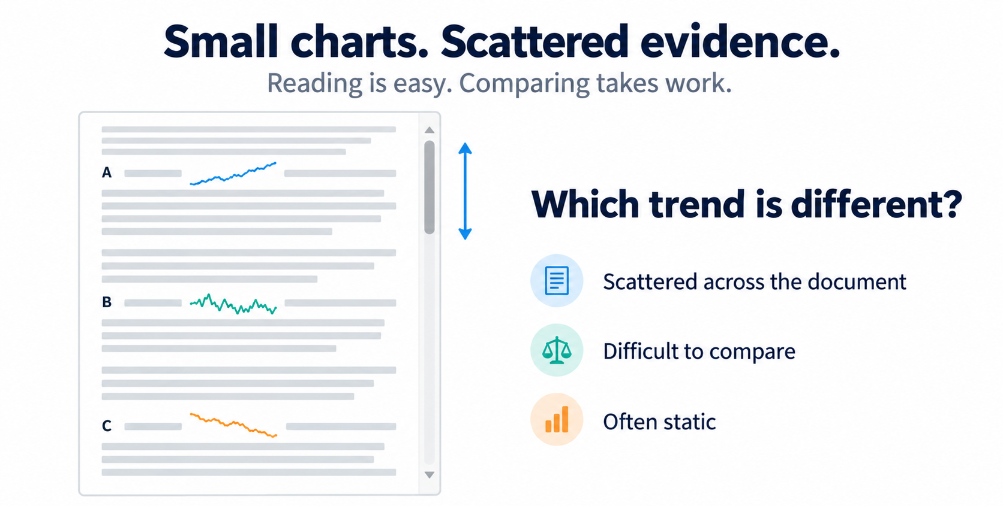
Felix Krull, Moritz Steinke
The Problem: From Reading to Data Exploration
How can we explore the data without losing its textual context?
Notes:
Problem: Comparing multiple visualtions; Maybe requires scorll

Slide 4
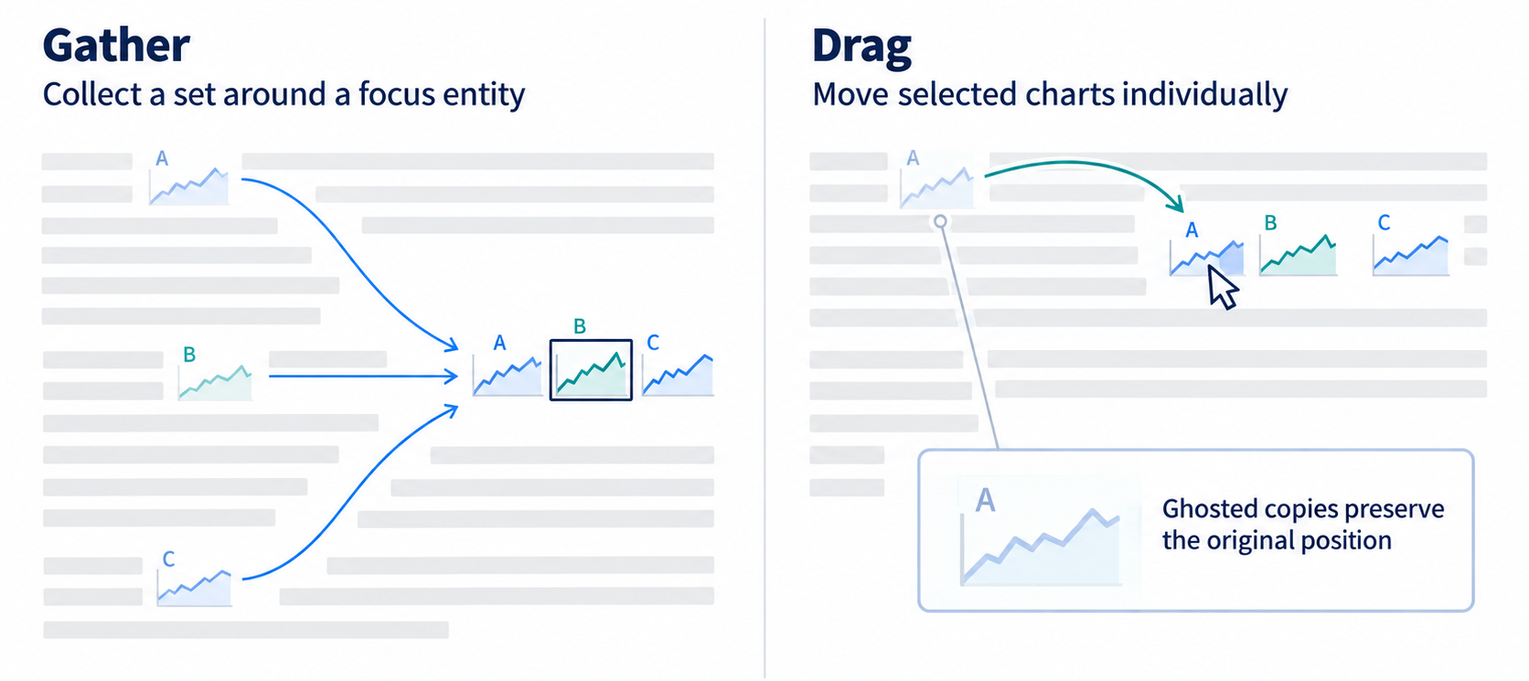
Felix Krull, Moritz Steinke
Collect – Arrange – Compare - Navigate
Bringing Visualizations Together
Notes:
Before we can compare visualizations, we first need to bring them together.
Slect focus entity -> relevant visualizations are collected around this pos.
Drag -> Simpler alternative manually drag charts together.
Original visualization does not disappera; a faded copy stays

Slide 5
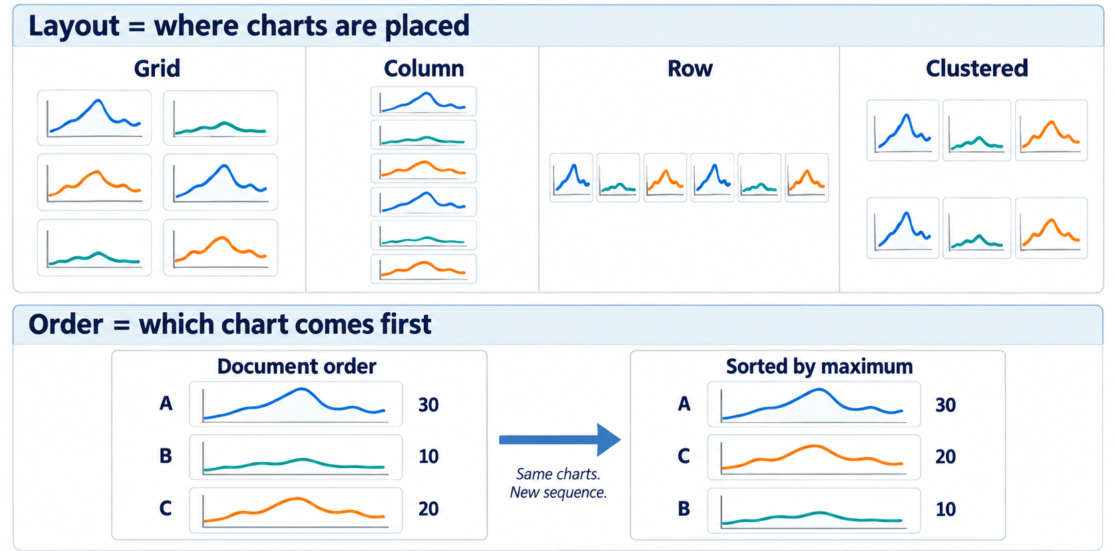
Felix Krull, Moritz Steinke
Collect – Arrange – Compare - Navigate
Organizing Visualizations for Analysis
Arrangement makes patterns and differences easier to see.
Notes:
After collecting; simplying place the together
Grid; to see a lot on one screen
Rows or columns for comparison on a axis
Cluster; groups with similar characteristics
Ordering: manually rearrange or sort according to data
→ Arrangement makes patterns and differences easier to see

Slide 6
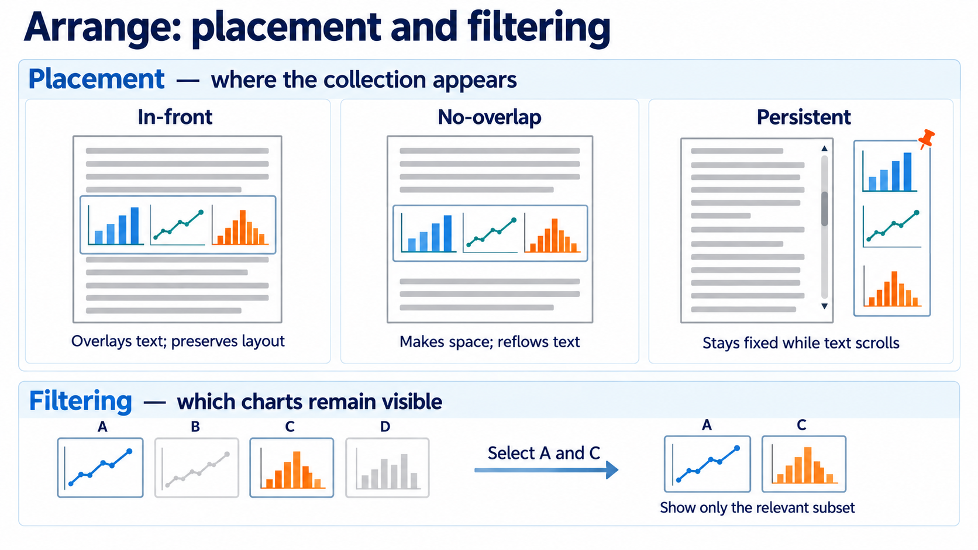
Felix Krull, Moritz Steinke
Collect – Arrange – Compare - Navigate
Organizing Visualizations for Analysis
Arrangement makes patterns and differences easier to see.
Notes:
how to organize them without losing the connection to the text
preserves the document layout but covers some content
where the text is reflowed to create space
Or persisten
Filtering -> User can keep relevant visuals; Helps to focus on the charts that matter.

Slide 7
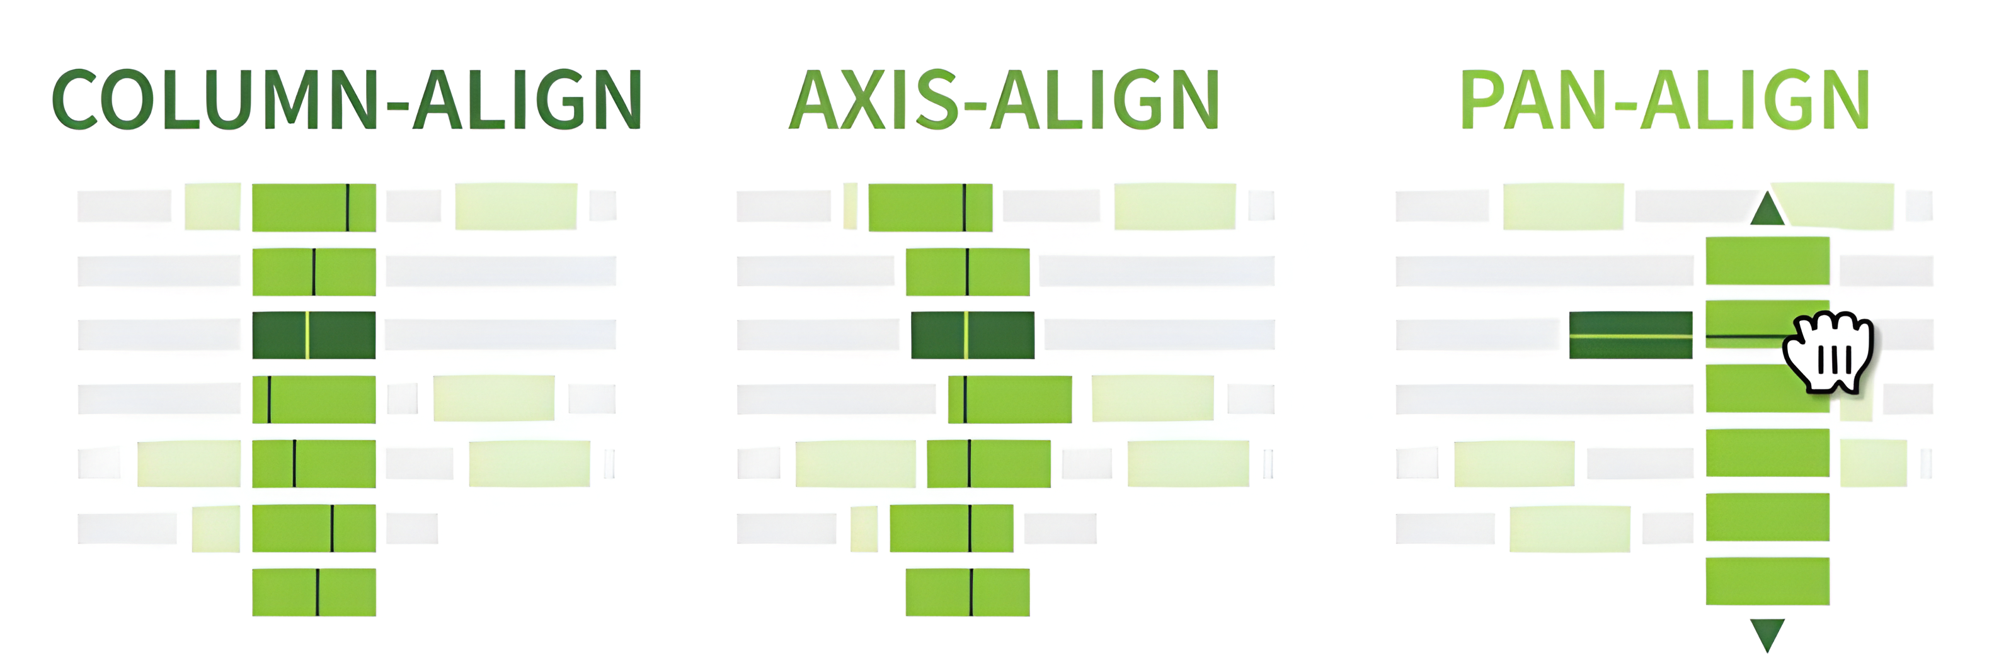
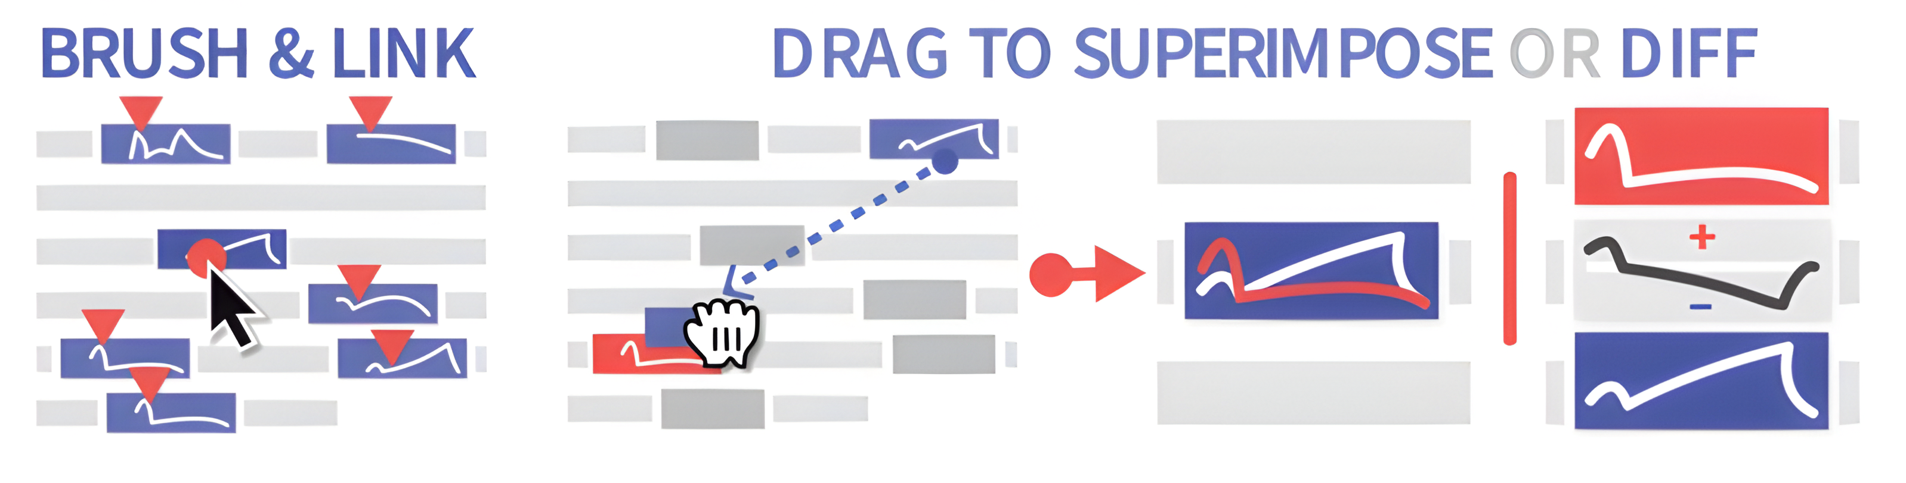
Felix Krull, Moritz Steinke
Collect – Arrange – Compare - Navigate
Comparing word-scale visualizations
Notes:
Aligning
Column-align → compare on the x-axis
Axis-align → shifted x-axis, one data point in the center
Pan-align → interactive side by side
Different chart types need to be grouped before comparison
Direct Comparison
Brushing → highlighting corresponding values in other charts (mouse move on the chart)
Drag → Superimpose two visualizations on top of each other
→ Compute a Diff (or other things) between the charts

Slide 8
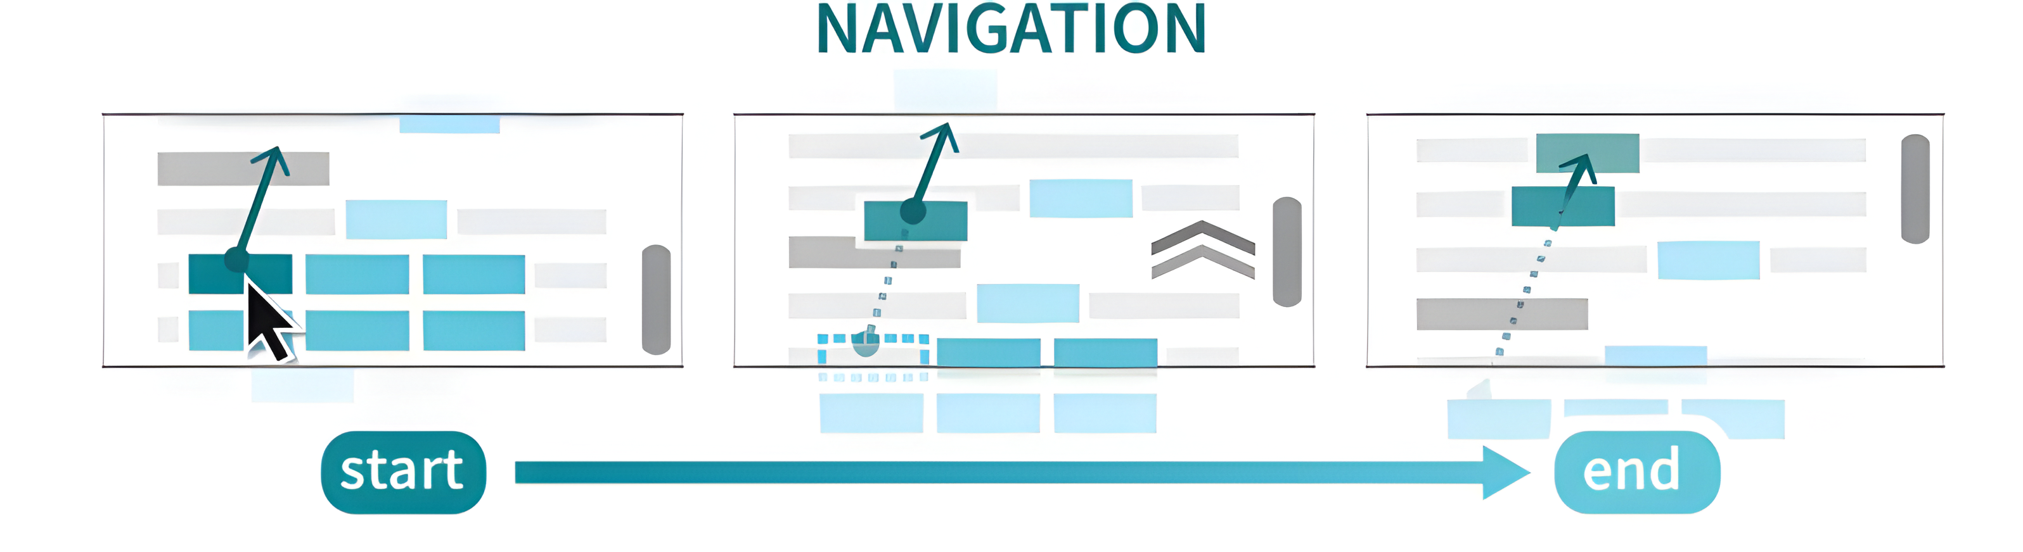
Felix Krull, Moritz Steinke
Collect – Arrange – Compare - Navigate
Navigating the Document
ad-hoc transitions between reading and exploring associated data
jump from a collected view back to the original position supports fluid transitions
Core Navigation interactions properties
promoting flow
enabling seamless switching between
exploration and reading
Word-scale visualizations can serve as an
index or entry point into the document
Notes:
Navigating the Document
ad-hoc transitions between reading a document and exploring associated data
jump from a collected word-scale visualization back to its original position in the document supports fluid transitions
Navigation interactions exhibit two core properties
promoting flow
→ enabling seamless switching between exploration and reading
word-scale visualizations can serve as an index or entry point
into the document
Word-scale visualizations in documents are useful, in part,
because they support ad-hoc transitions between reading a
document and exploring associated data. Interactions that al-
low a reader to jump from a collected word-scale visualization
back to its original position in the document supports fluid
transitions between these modes. These kinds of navigation
interactions exhibit two properties of Elmqvist et al.’s [28]
characterization of fluid interfaces, promoting flow and en-
abling seamless switching between exploration and reading.NAVIGATION
2
start ... end
With these kinds of navigation interactions, sets of collected
word-scale visualizations can serve as an index or entry point
into the document, providing graphical overviews reminiscent
of interfaces like Koch et al.’s “VarifocalReader” [37].

Slide 9
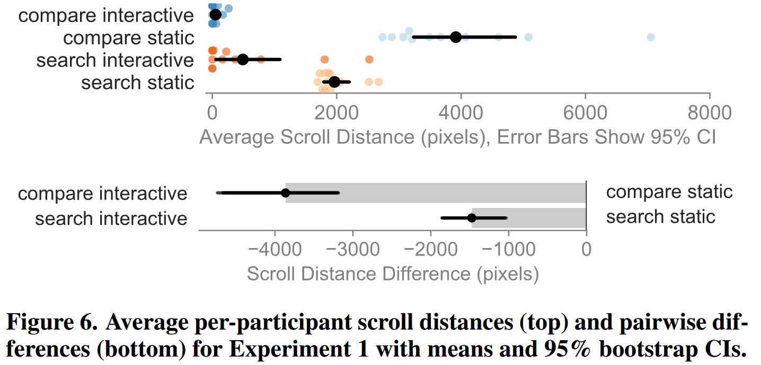
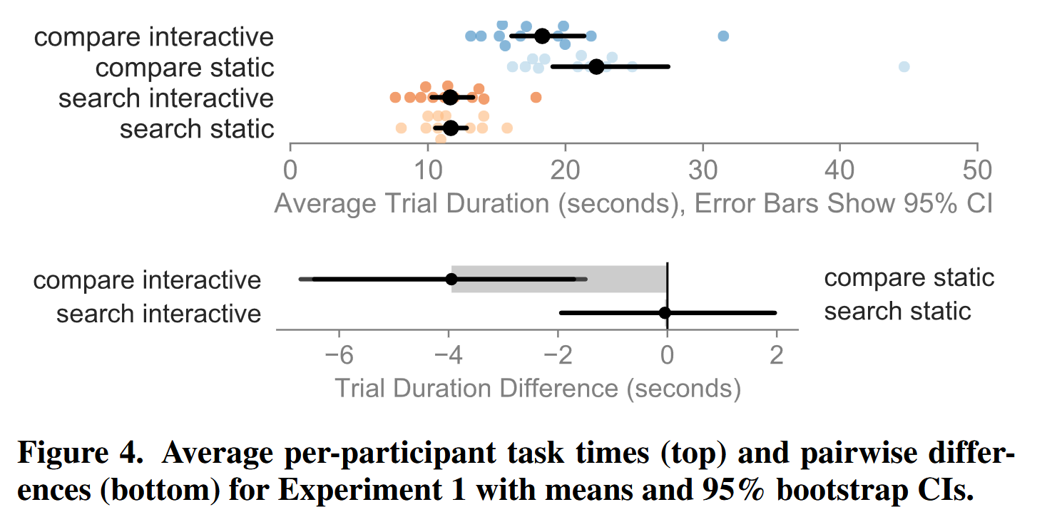
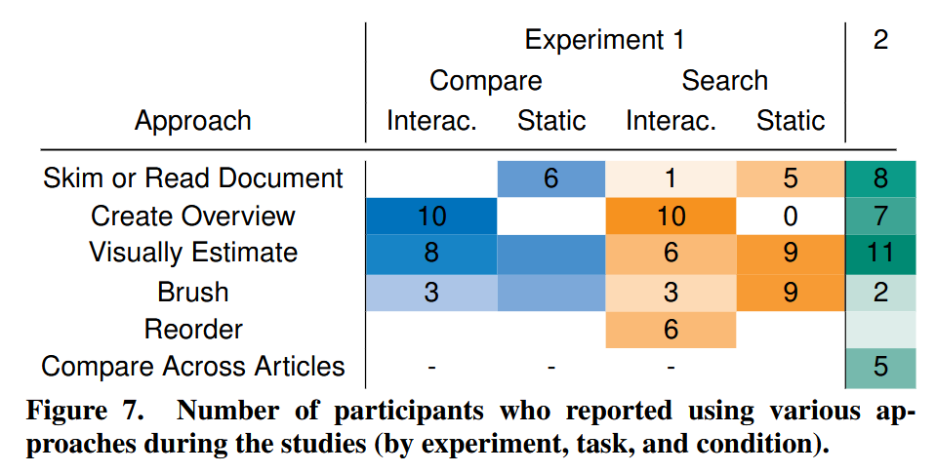
Study
12
6 + 6
20-50 years old
3 undergraduates,
4 PhD researchers,
2 postdocs,
1 designer, 1 engineer, 1 researcher
Experiment 1: Interactive versus Static Gathering
Experiment 2: Open-Ended Exploration Task
Notes:
Participants
6 female and 6 male
ages 20–30 years (9), 31–40 (1), and 41–50 (2)
3 undergraduates,
4 PhD researchers,
2 postdocs,
1 designer,
1 engineer,
1 researcher.
expertise in
visualization HCI (8),
Computer science (2),
topology (1), and publications/web design (1).
Experiment 1,
Only grid layout, brushing and linking
a short news article (756-1368 words, SD=132) with word-scale charts for 16-27 (SD=3) stocks or indexes
Two tasks:
Search
Compare and identify a single outlier
Search. “Did the stock price for LUV spend the majority of the previous month above or below its starting value?”
Compare. “Over the whole period, which stock had the smallest number of days between its highest and lowest points?”
To different measurements:
Static. Participants could scroll through the article, but could not gather or sort word-scale visualizations.
Interactive. Participants could gather all word-scale visualizations into the grid layout, sort them by position in the
document, by last value, or by entity name.
Figure 4
For search no evidence for a difference in speed between the static (M=11.6s, CI=[10.5s,12.8s]) and the interactive condition (M=11.6s, CI=[10.2s,13.2s], Figure 4).
In comparison tasks, participants were faster in the interactive condition (M=18.2s,CI=[16.0s,21.3s]) than the static (M=22.1s, CI=[19.1s,27.0s]).
Figure 6
dramatic differences in amount of scrolling
During search tasks, participants scrolled an average of 1956 pixels (CI=[1801,2184]) in the static condition,
four times as far as in the interactive condition (M=472 pixels,CI=[75,1060]).
even more pronounced for comparison tasks, with participants scrolling
roughly 80 times as far in the static condition (M=3894 pixels, CI=[3271,4732])
Summary
Participants found both the static and the interactive word-
scale visualization helpful and useful for the given tasks.
chose the interactive features when available
ease of comparison
reduced need for scrolling.
perceived reduction in task completion time
We also collected suggestions from participants which included requests for faster gathering animations, showing arrangements next to the cursor, alternative grid arrangements and sorting options, as well as the ability to annotate word-scale visualizations.
Experiment 2: Open-Ended Exploration Task
use a broader set of view manipulation interactions to solve an open-ended analysis task.
3 MarketWatch articles from mid-2017. Two articles included 27 stock charts while the third included 20.
open-ended question to make a decision based on both the text and the word-scale visualizations:
Exploration Task. “Imagine that it is August 4th, 2017 and you are preparing to make some new investments. Using
the information in the 3 provided articles, list the top 3-5 stocks or indexes you would consider investing in and briefly
explain why you would choose each.”
all of the gathering, sorting, and brushing and linking interactions fromExperiment 1.
Additional layouts (grid, column, and row),
placement options (in-front and no-overlap),
alignments (column-aligned and row pan-aligned).
document navigation interaction, which allowed to navigate from visualizations back to positions in text.
simple hovering interaction, that allowed participants to see where in the document a word-scale visualization came from.
Experiment 2
all participants except P07 used gathering to perform a visualization-centric analysis of the texts
At the end of the study participants described the approaches they used to answer the question (Figure 7).
Summary
participants made good use of the available interactive options (Figure 8),
using a variety of actions. Yet, participants used a somewhat different mix
of interactions than in Experiment 1, which is not surprising
given the more exploratory prompt.
Despite training, participants made little use of sorting and navigation in particular.
The improvements and feedback we received for Experiment 2 were similar to those we collected for Experiment 1 and were mainly concerned with the positioning of the grid as well as the slow animation speed.

Slide 10
Demo
  Eye tracking article
  Stock chart article
  History article

Slide 11
Key Takeaways
Felix Krull, Moritz Steinke
From the Paper
Faster comparisons: 18.2s vs. 22.1s
Fewer errors: 3.2% vs. 10.9%
Gathering strongly reduced navigation through the document → Less Scrolling
Effects on readability and text comprehension require further research
Our Takeaways
Embedded visuals can interrupt the reading flow
Prefer focused interactions over too many features
Users can switch between reading the text and exploring the data

Slide 12
Questions?

