Slide 1
INTRO TO GAME DEVELOPMENT
WEEK 08 Statemaches & Animation

Slide 2

Sprite Sheet
A sprite sheet is a chuck of bitmap images that flow together in an animation in one graphic.
Notes:
You can use this joint to make two points overlap. Those two points can be two Rigidbody2D components or a Rigidbody2D component and a fixed position in the world. (Connect to a fixed position in the world by setting Connected Rigidbody to None). The joint applies a linear force to both connected rigid body objects.
The joint has a simulated rotational motor which you can turn on or off. Set the Maximum Motor Speed and Maximum Motor Force to control the angular speed (Torque), and make the two rigid body objects rotate in an arc relative to each other. Set the limits of the arc using Lower Angle and Upper Angle.
Hinge Joint 2D has three simultaneous constraints. All are optional:
Maintain a relative linear distance between two anchor points on two rigid body objects.
Maintain an angular speed between two anchor points on two rigid body objects (limited with a maximum torque in Maximum Motor Force .
Maintain an angle within a specified arc.
For Example:
You can use this joint to construct physical objects that need to react as if they are connected with a rotational pivot. Such as:
A see-saw pivot where the horizontal section is connected to the base. (Use the joint’s Angle Limits to simulate the highest and lowest point of the see-saw’s movement.)
A pair of scissors connected together with a hinge pivot. (You can use the joint’s Angle Limits to simulate the closing and maximum opening of the scisssors.)
A simple wheel connected to the body of a car with the pivot connecting the wheel at its center to the car. (In this example you can use the joint’s motor to rotate the wheel.)

Slide 3
Tutorial walk through 1
Animations in 2D
https://www.raywenderlich.com/61532/unity-2d-tutorial-getting-started
Notes:
You can use this joint to make two points overlap. Those two points can be two Rigidbody2D components or a Rigidbody2D component and a fixed position in the world. (Connect to a fixed position in the world by setting Connected Rigidbody to None). The joint applies a linear force to both connected rigid body objects.
The joint has a simulated rotational motor which you can turn on or off. Set the Maximum Motor Speed and Maximum Motor Force to control the angular speed (Torque), and make the two rigid body objects rotate in an arc relative to each other. Set the limits of the arc using Lower Angle and Upper Angle.
Hinge Joint 2D has three simultaneous constraints. All are optional:
Maintain a relative linear distance between two anchor points on two rigid body objects.
Maintain an angular speed between two anchor points on two rigid body objects (limited with a maximum torque in Maximum Motor Force .
Maintain an angle within a specified arc.
For Example:
You can use this joint to construct physical objects that need to react as if they are connected with a rotational pivot. Such as:
A see-saw pivot where the horizontal section is connected to the base. (Use the joint’s Angle Limits to simulate the highest and lowest point of the see-saw’s movement.)
A pair of scissors connected together with a hinge pivot. (You can use the joint’s Angle Limits to simulate the closing and maximum opening of the scisssors.)
A simple wheel connected to the body of a car with the pivot connecting the wheel at its center to the car. (In this example you can use the joint’s motor to rotate the wheel.)

Slide 4
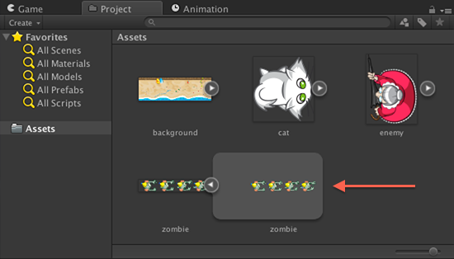
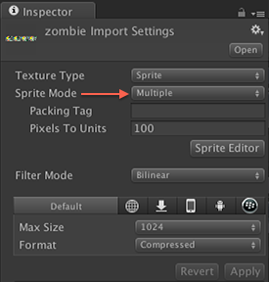
Sprite Sheet
Making one here is relatively easy.
Simply select the graphic, go to the inspector and choose multiple
Notes:
You can use this joint to make two points overlap. Those two points can be two Rigidbody2D components or a Rigidbody2D component and a fixed position in the world. (Connect to a fixed position in the world by setting Connected Rigidbody to None). The joint applies a linear force to both connected rigid body objects.
The joint has a simulated rotational motor which you can turn on or off. Set the Maximum Motor Speed and Maximum Motor Force to control the angular speed (Torque), and make the two rigid body objects rotate in an arc relative to each other. Set the limits of the arc using Lower Angle and Upper Angle.
Hinge Joint 2D has three simultaneous constraints. All are optional:
Maintain a relative linear distance between two anchor points on two rigid body objects.
Maintain an angular speed between two anchor points on two rigid body objects (limited with a maximum torque in Maximum Motor Force .
Maintain an angle within a specified arc.
For Example:
You can use this joint to construct physical objects that need to react as if they are connected with a rotational pivot. Such as:
A see-saw pivot where the horizontal section is connected to the base. (Use the joint’s Angle Limits to simulate the highest and lowest point of the see-saw’s movement.)
A pair of scissors connected together with a hinge pivot. (You can use the joint’s Angle Limits to simulate the closing and maximum opening of the scisssors.)
A simple wheel connected to the body of a car with the pivot connecting the wheel at its center to the car. (In this example you can use the joint’s motor to rotate the wheel.)

Slide 5
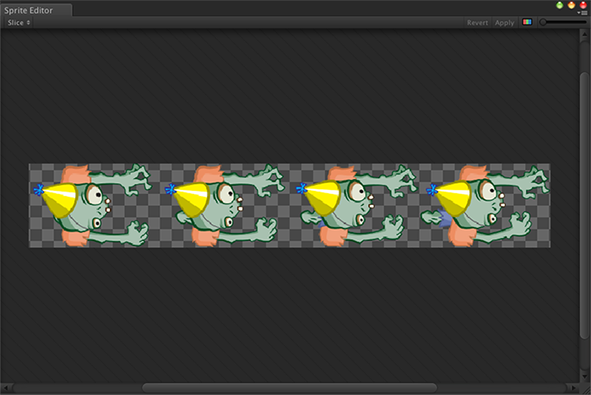
Sprite Sheet

Slide 6
Sorting layers
Sorting layers in unity control the order things are drawn in.
Layers control game interactions like what can interact with them. You can use them to set up what can collide with an object.

Slide 7
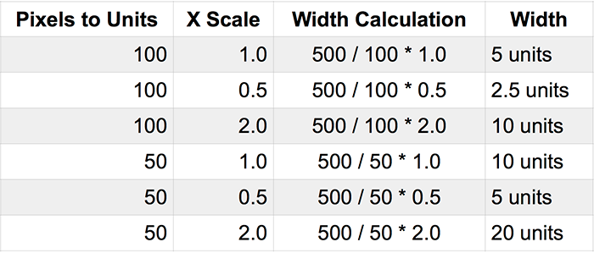
Size vs Camera position

Slide 8
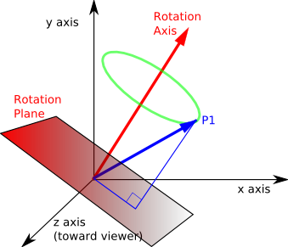
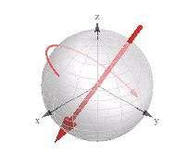
Quaternions
https://www.youtube.com/watch?v=uRKZnFAR7yw
https://www.youtube.com/watch?v=0_XoZc-A1HU
https://www.youtube.com/watch?v=g22jAtg3QAk
Notes:
One of the visualization methods I like is to represent quaternion (orientation in 3d space) as vector (x,y,z components) + spin (the rotation around that vector, stored in w component).
If you are looking for some online visualizer for quaternions, you can always use wolframalpha:
This way, people can also understand the SLERP mechanism because they can picture quaternions on a 3D sphere, while the spin can be seen as the scalar rotation motion by that vector (guess it's something similar to what some mathematicians call a rotor

Slide 9
Packed sprites
All the sprites live on one graphic and then we step from one to the next. Unity handles all this and it’s a really nice new feature that means you only ever need to load up one graphic and then just jump around it.
Notes:
One of the visualization methods I like is to represent quaternion (orientation in 3d space) as vector (x,y,z components) + spin (the rotation around that vector, stored in w component).
If you are looking for some online visualizer for quaternions, you can always use wolframalpha:
This way, people can also understand the SLERP mechanism because they can picture quaternions on a 3D sphere, while the spin can be seen as the scalar rotation motion by that vector (guess it's something similar to what some mathematicians call a rotor

Slide 10
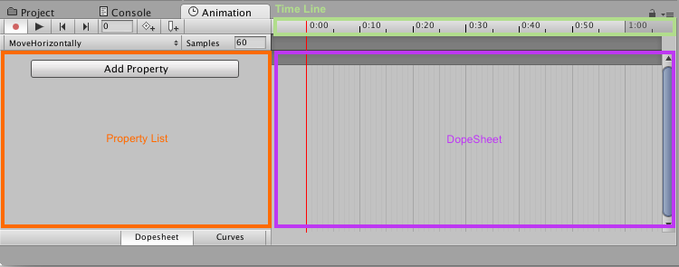
Animation in Unity
Notes:
One of the visualization methods I like is to represent quaternion (orientation in 3d space) as vector (x,y,z components) + spin (the rotation around that vector, stored in w component).
If you are looking for some online visualizer for quaternions, you can always use wolframalpha:
This way, people can also understand the SLERP mechanism because they can picture quaternions on a 3D sphere, while the spin can be seen as the scalar rotation motion by that vector (guess it's something similar to what some mathematicians call a rotor

Slide 11
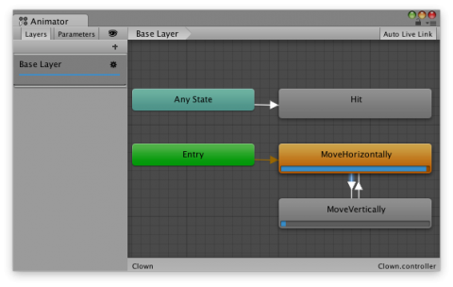
Mechanim - unity’s state machine engine
Notes:
One of the visualization methods I like is to represent quaternion (orientation in 3d space) as vector (x,y,z components) + spin (the rotation around that vector, stored in w component).
If you are looking for some online visualizer for quaternions, you can always use wolframalpha:
This way, people can also understand the SLERP mechanism because they can picture quaternions on a 3D sphere, while the spin can be seen as the scalar rotation motion by that vector (guess it's something similar to what some mathematicians call a rotor

Slide 12
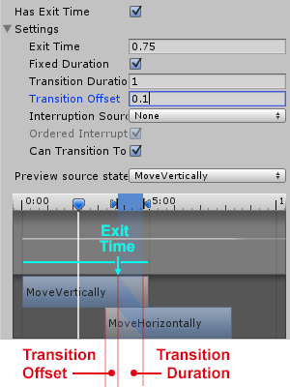
Transitions
Notes:
One of the visualization methods I like is to represent quaternion (orientation in 3d space) as vector (x,y,z components) + spin (the rotation around that vector, stored in w component).
If you are looking for some online visualizer for quaternions, you can always use wolframalpha:
This way, people can also understand the SLERP mechanism because they can picture quaternions on a 3D sphere, while the spin can be seen as the scalar rotation motion by that vector (guess it's something similar to what some mathematicians call a rotor

