Slide 1
Back-Propagation Neural Network – Classification Iris Dataset

Slide 2
Pseudo-code
This pseudocode aims to allow user to use any number of hidden layer with any number of node without any modification except on the parameter.
w_matrix, B_Matrix = initiaterandom()
dataset, Training_set = datasets()
for i in range(number_of_iteration):
for j in range(len(dataset)):
h_value, y_output = forward_prop(dataset, w_matrix, b_matrix)
Δw, Δb = back_prop(h_value, y_output, dataset, w_matrix, b_matrix)
new_w_matrix, new_b_matrix = adjust_weightandbias(w_matrix, b_matrix, Δw, Δb)
y_output_list.append(y_output)
# find the error rate
for j in range(len(y_output_list)):
error = meansquared_error(y_output_list[j]

Slide 3
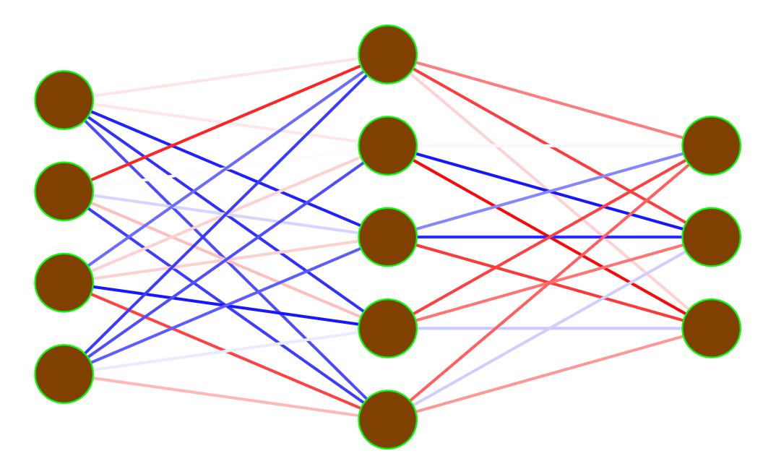
Layer Composition
Hidden Layer
Sepal Length
Setosa
Sepal Width
Versicolor
Petal Length
Virginica
Petal Width

Slide 4
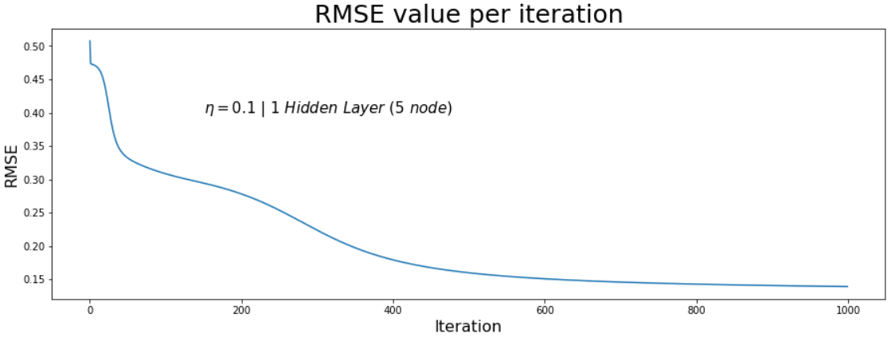
Results
Learning rate by default is set at 0.1
Number of iteration is 1000
Hidden nodes is set default at 5/3 of Output’s neuron

Slide 5
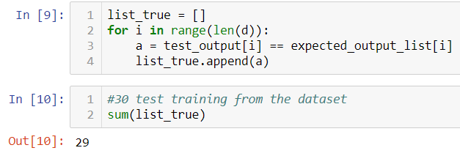
Results (cont)
From 150 Iris’ Dataset, 120 of them is randomly selected to be the training dataset
The rest of them is then used to test the recall process of the back-propagation neural network.
All of the test datasets are correctly classified if it’s trained with enough iteration.

Slide 6
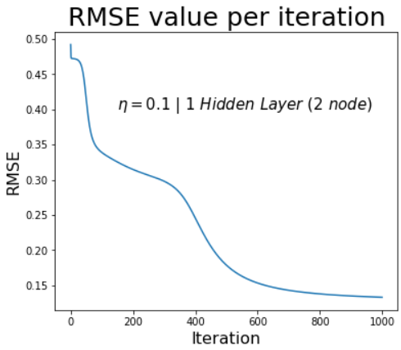
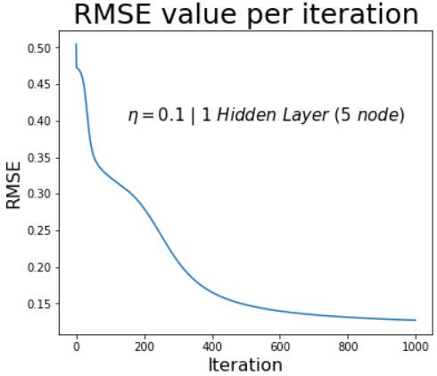

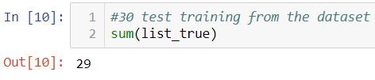
Variations-HiddenLayer
Different number of nodes

Slide 7
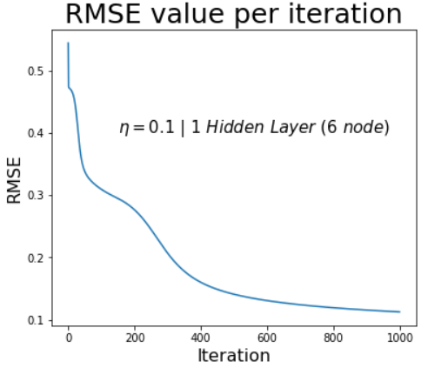
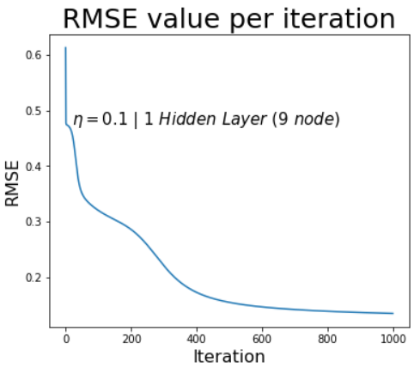
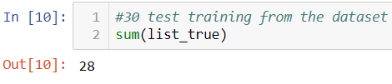

Variations-HiddenLayer (cont)

Slide 8
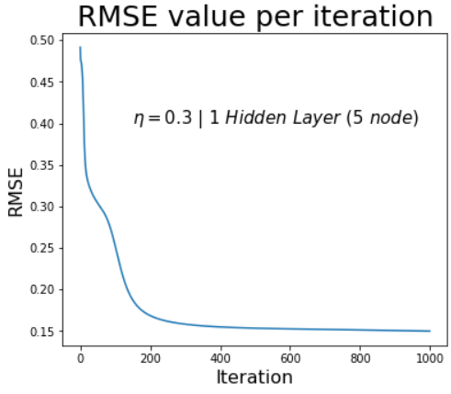

Variations-LearningRate
Different value of learning rate

Slide 9
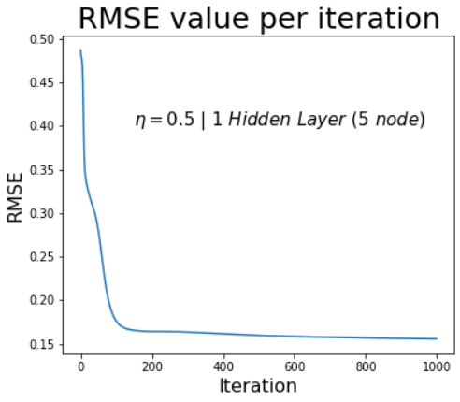
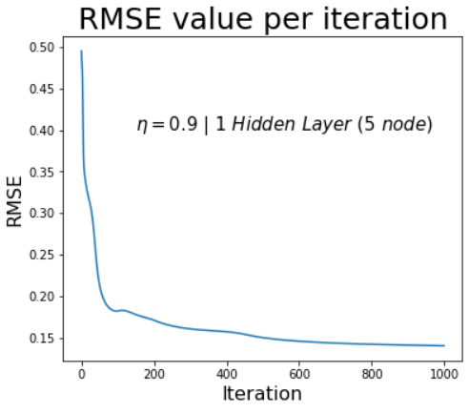


Variations-LearningRate (cont)

Slide 10
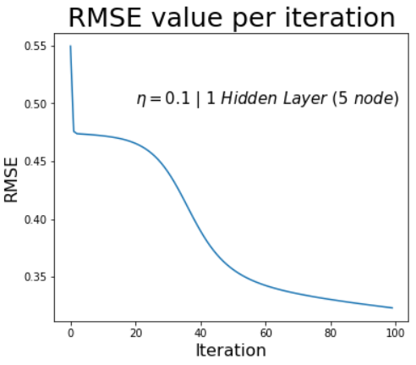
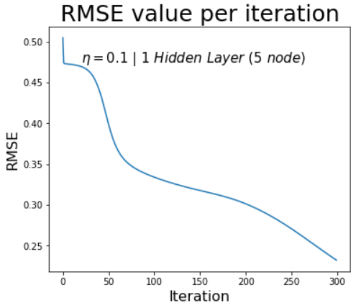
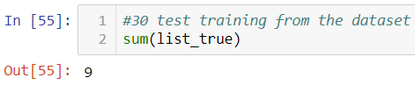
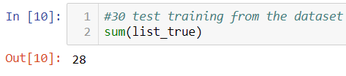
Variations-Iteration
Different number of iteration

Slide 11
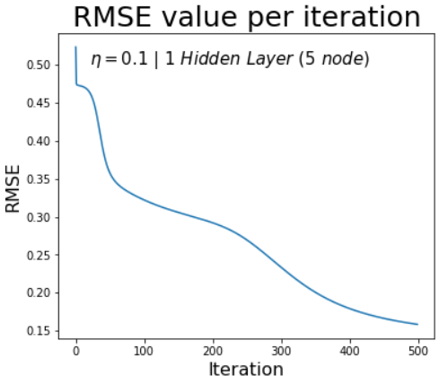
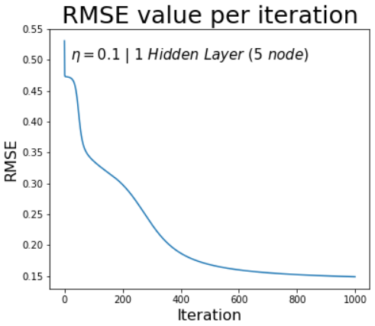


Variations-Iteration (cont)

Slide 12
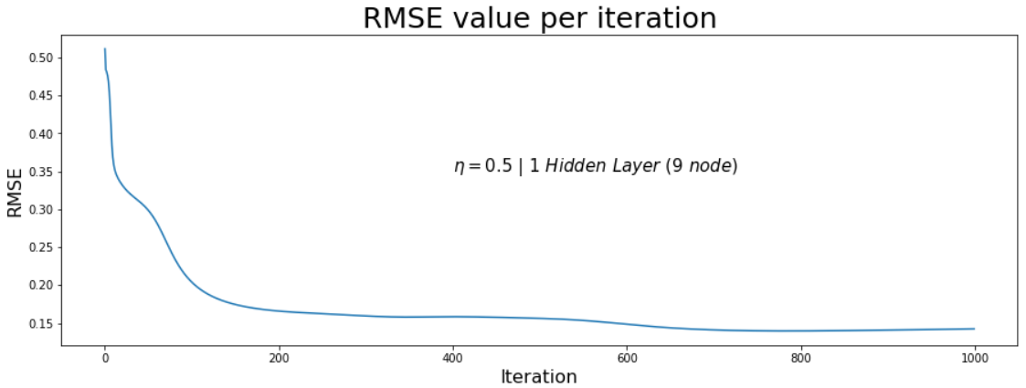

Variations
Testing the variation, we can see which error is going down faster than the other. Therefore, we conclude that best parameter model for our classification is:
  Iteration = 1000, Learning rate = 0.5, Hidden node = 9

