Slide 1
Big Data Project 1 Ticketing-System Load
Group 4
M10601007 陳志瑄
M10601013 康嘉恩
M10601207 梁勤萱
M10601803 Arnold Samuel Chan
M10601833 Wilson Simon
M10601836 Frederik Darwin

Slide 2
Outline
Steps of analyzing the data
Answering 1st Question
Answering 2nd Question

Slide 3
Steps
Preprocessing the data into the correct form
Processing the data into the needed form for analyzing
Plot the data
Analyze

Slide 4
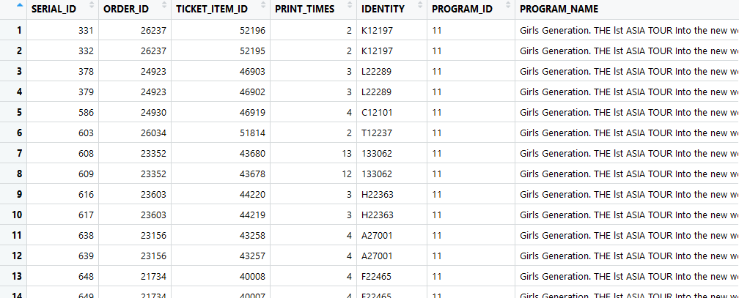

Steps(1):Preprocessing the data into the correct form
1. Preprocessing the Data : Merging the same customer
More than half of the data have this phenomenon.
Every row in the data means every one ticket that have been bought by buyer
But for system-load problem, we need to know how many person that accessing the website. Thus, we merge the same buyer into one datarow.
df_ori = original data
df = merged data
merged
Most of people won’t go to the concert alone.

Slide 5
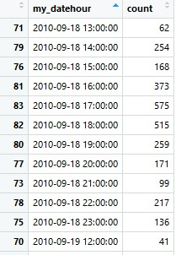
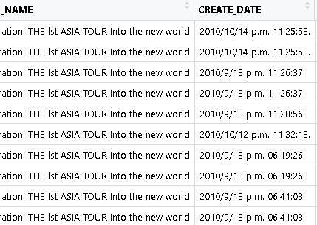
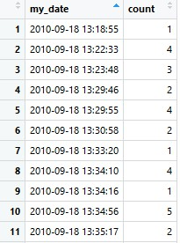
Steps(2):Processing the data into the needed form for analyzing
2. Processing the data : by hour, by minutes
Hourly
Transform data By Hour
Purpose:
To count the customer buying the ticket at that whole time
Minutely
Transform data By minutes

Slide 6
Steps(2):Processing the data into the needed form for analyzing
4. Processing the data : by hour, by minutes (2.)
X
Base on left side data table:
We decided to use the hourly data since it aggregates the data and easier to be analyzed
This will be our first definition of “system-load”
Hourly
Minutely

Slide 7
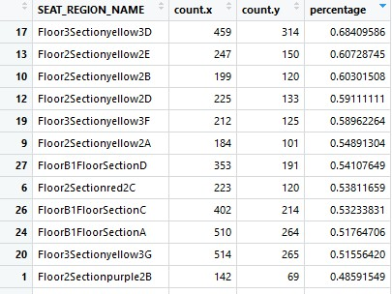
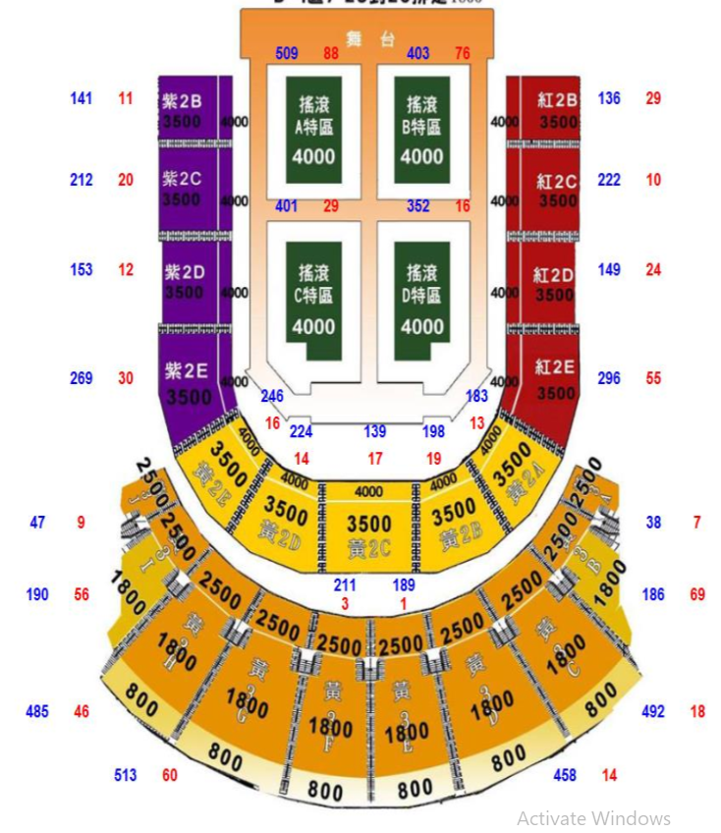
Steps(2):Processing the data into the needed form for analyzing
2. Processing the data : The favorite seat region in the first day of selling
Count.X = Total Ticket sold at seat region in whole data
Count.Y = Total Ticket sold at seat region in the first day of registration

Slide 8
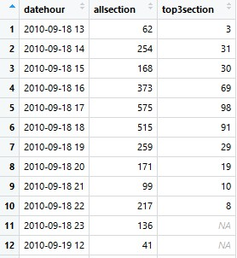
Steps(2):Processing the data into the needed form for analyzing
2. Processing the data : The favorite seat region in the first day of selling
By compiling the ticket sold in top 3 seat region hourly, We can analyze the how heavy is the server to process the same seats region, especially in the first 12-hours.
This will be used for our second definition of system-load

Slide 9
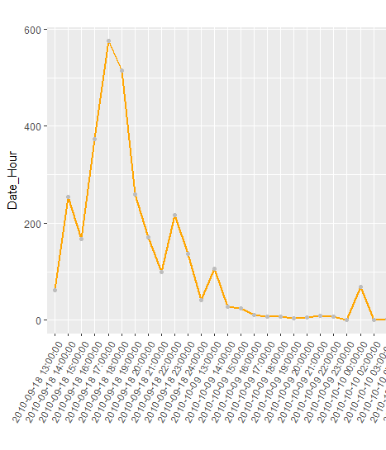
Step (3&4):Plot the data&Analyze
3. Plot the data + Analyze : Customer access
1st analysis: The server broke down at the first time when the registration opened. So people need a lot of time to submit their request. That’s why at 17.00 (when the server already fixed), the request suddenly jumped to 575 customers.
2nd analysis: The most people bought the ticket at the first day of the registration, especially between 17.00-17.59, which around 575 customers accessed the website. This is the time where the work-hour already passed.
Customer

Slide 10
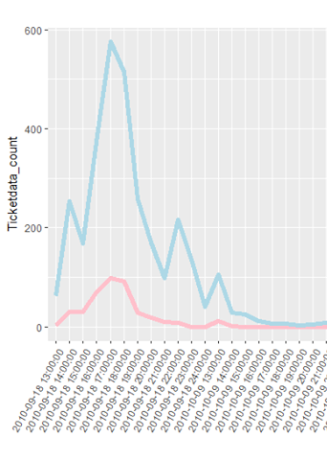
Step (3&4):Plot the data&Analyze
3. Plot the data + Analyze (2) :
The graphs illustrates the rate of customer buying the top 3 seat regions from the website.
The red-colored line represents the customer who bought the top 3 seat regions
From this plot we can conclude that the top 3 seat regions tickets also mostly has been sold on 17.00

Slide 11
1st Question
Please define your “system loading” measurement. Carefully provide the details on the report slide. BE Creative!!!
server limit
First definition: System will be broken down if the server serve more than particular number of customer. In this case, the upper bound is 575 customer

Slide 12
1st Question
Please define your “system loading” measurement. Carefully provide the details on the report slide. BE Creative!!!
Additional: In real world, the system-load will be highly depend on the session that customer made by the server (login time, logout time). However, such data are not provided. Thus, more accurate definition cannot be showed
Answer:
Second definition: System will need to process the request based on the seat region that customer want since the system need to choose which seat is available to customer (assumption). Thus, as more customer buys the same seat region ticket, as heavier the system-load will be.

Slide 13
2nd Question
Use your defined “system loading” to analyze the “efficiency” of selling the tickets by the ticketing system. Do you find any interesting pattern based on the data?
Answer:
The calculation only done into first definition (customer number) since the data can easily be intrepreted
→ Maximum customer : 575 (assume that is the most customer server can serve) Total average customer per hour : 40.18072 person Efficiency : 40.18072/575 = 6.99%
Because the registration period is quite long, but the server-load mostly happened in the first day.

