Slide 1
ML-POWERED OBJECTIFICATION AND SUBJECTIFICATION OF TEXT
An ML Project by Kieran Mendoza, Wang Hengyue

Slide 2
Presentation Flow
PART 1
Introduction Dataset Data Preprocessing Objectivity Detection Results
PART 2
Objectivity-Subjectivity Conversion Results Reflection Conclusion and Recommendations
PART 3 Project Showcase

Slide 3
Part 1

Slide 4
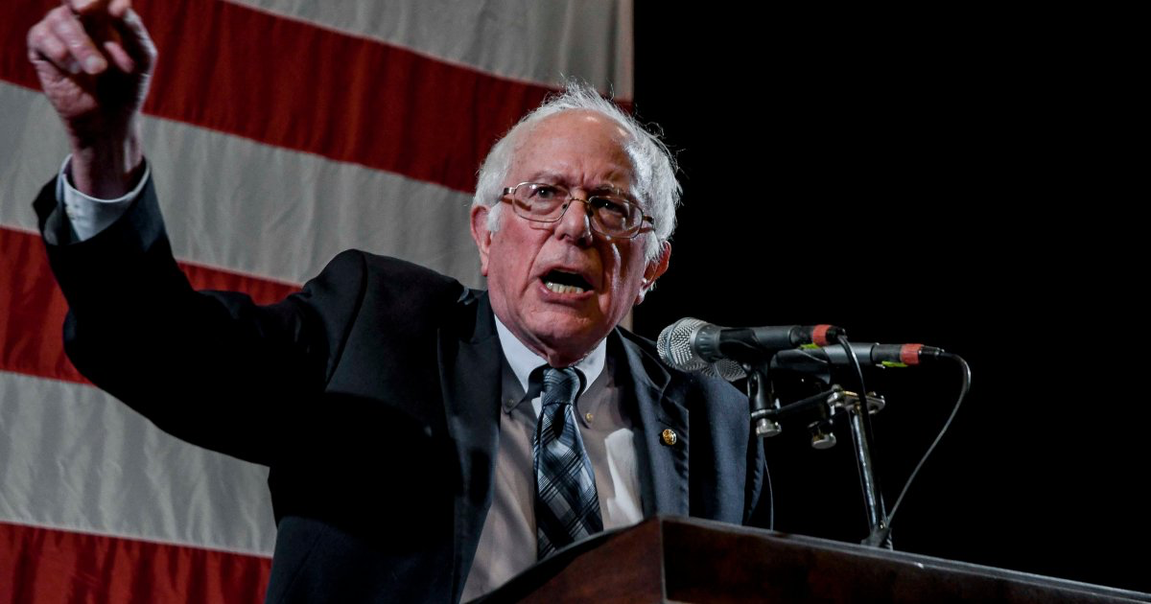
Introduction
Biases of some journalists and certain politicians may cloud the truth, or the piece may need some spicing up to attract more readers.
This project aims to be able to:
Detect the author sentiment
Detect the text objectivity
Transform the text (objectification and subjectification)

Slide 5


Dataset
Rotten Tomatoes movie review data (2004-2005) (subjective)
Positive and negative sentiments
IMDb plot summaries (objective)
To be compared with movie review quotes

Slide 6
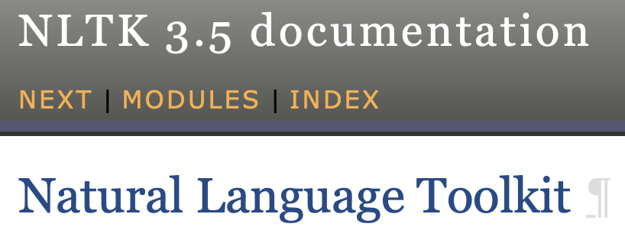
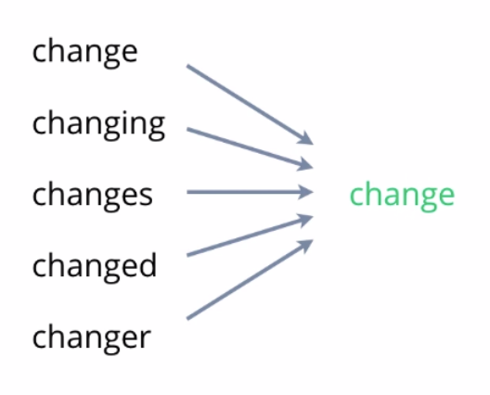
Data Preprocessing (feat. NLP)
Basically nltk, a very useful framework for Natural Language Processing
But additionally, the dataset used had plenty of formatting issues and needed to be converted to .txt first before it can be read (annoying!)
To ensure that the text is consistent and easier to train on, we used lemmatization, stopwords and the removal of punctuation marks.

Slide 7
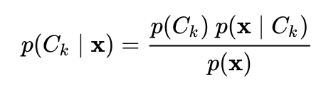
Objectivity Detection
Trained in a Supervised manner, using Naiïve Bayes.
Why? Naiïve-Bayes is proven in the field of NLP, it is a probabilistic classifier. It is also simpler than other solutions like SVM and neural networks. It is fast and accurate!!

Slide 8
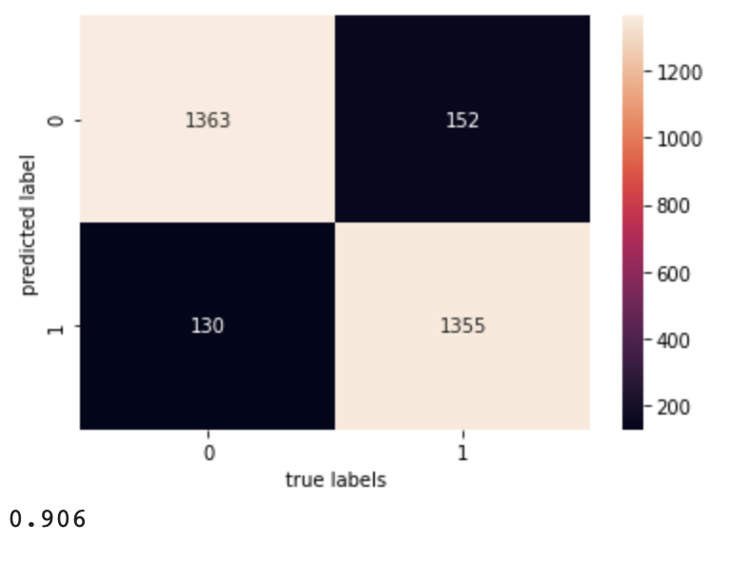
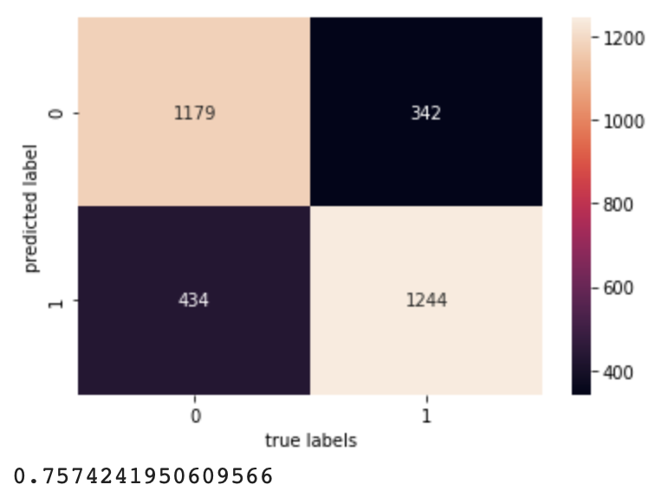
Approach 1: Objectivity detection via sentiment
Approach 2: Direct objectivity detection
We attempted two approaches to find the optimal method to detect objectivity - indirect and direct. Clearly, the second model is preferable.

Slide 9
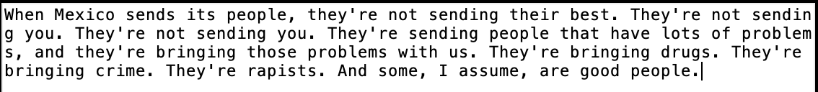



Slide 10
Part 2

Slide 11
Objectivity-Subjectivity Conversion
We use a naiïve method of text transformation, by taking the most subjective/objective synonym and substituting it into some of the words. As expected, this led to incoherence of the text and loss of content.

Slide 12
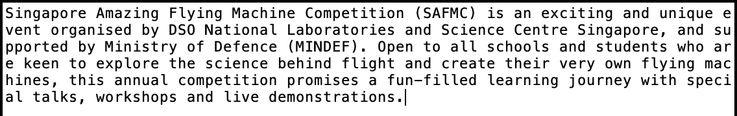
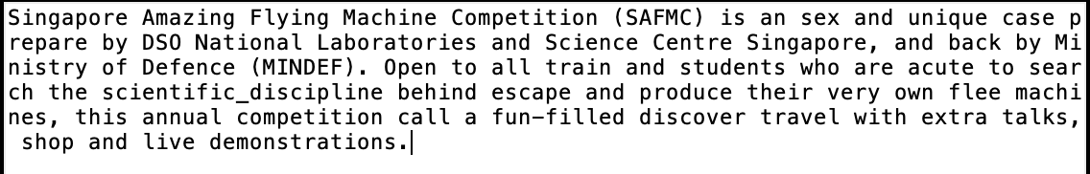
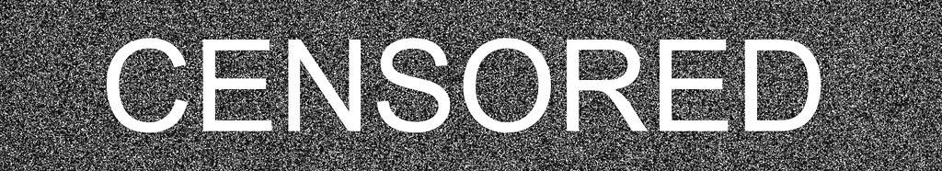
Naiïve Objectification
Terrible is simply an understatement to describe this model.

Slide 13
Using the model outlined in Structured content preservation for unsupervised text style transfer (Tian et. al, 2018) we get better results

Slide 14
Limitations and Conclusions
Objectivity detector is useful for highly polarised statements BUT does not work as well on lengthy op-eds and news articles → attributed to the facts diluting the overall subjectivity of the text.

Slide 15



Reflection
Three main components to be talked about:
Ideation process
Time management
Work division

Slide 16
Let’s View Not a Fact Checker
Please, give our app some respect. And yes, that is 69.46% subjective.

