Slide 1

OAKLAND MOTOR CARE LTD
Workshop Operations Platform
Feature Overview
Created and Powered by Qeem Labs Ltd

Slide 2
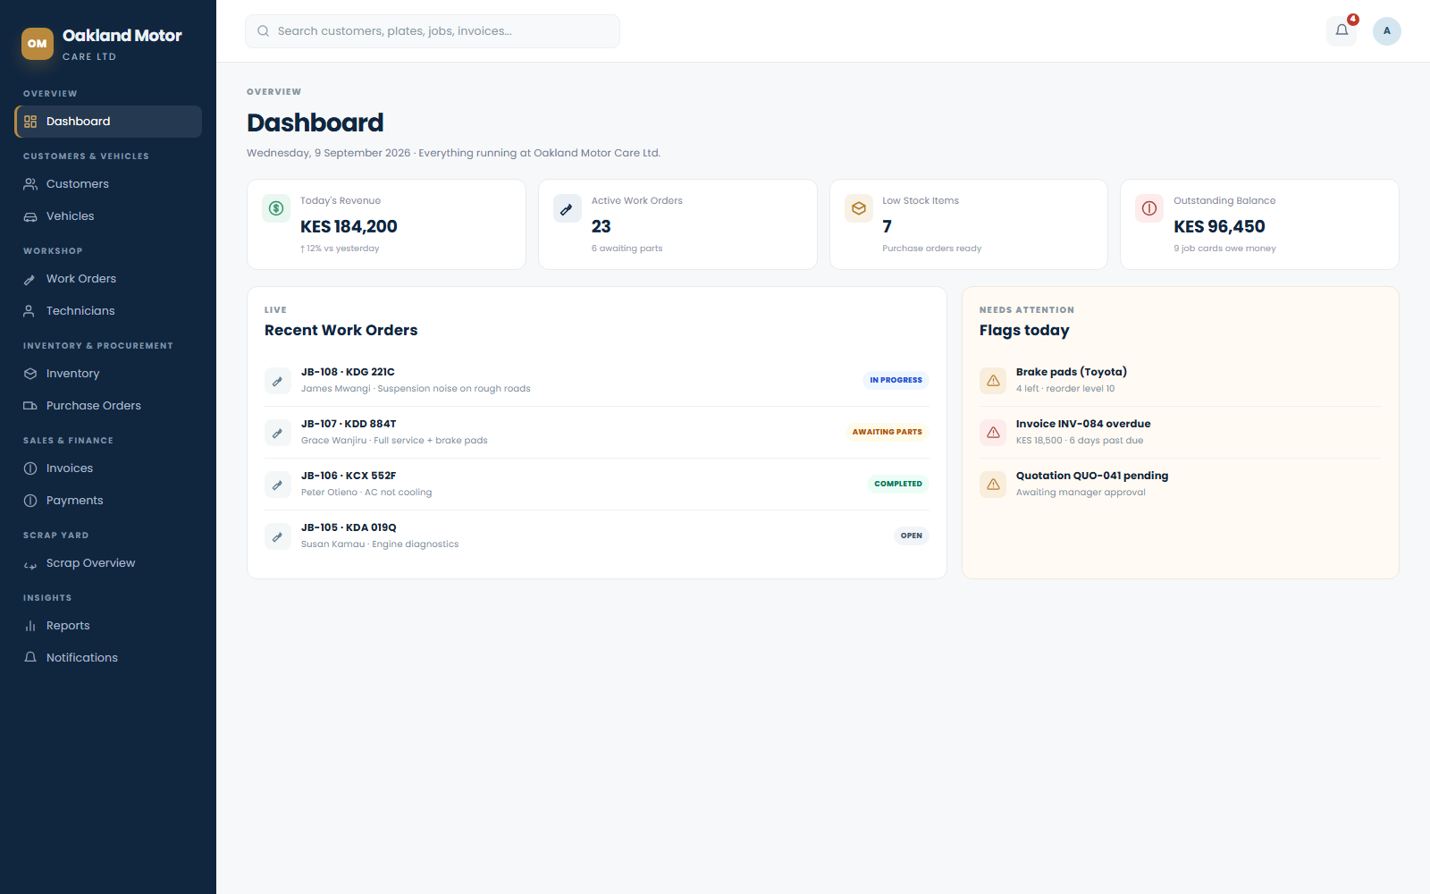
INTRODUCTION
One System, the Whole Workshop
Oakland Motor Care Ltd runs customers, vehicles, jobs, inventory, sales, scrap and finance from a single, real-time dashboard.
✦ Built for the front desk to the workshop floor. Every role — service advisor, technician, storekeeper, manager, admin — works from the same live data.
✦ Nothing is typed twice. A job card feeds its own quotation, invoice, parts issue and stock movement automatically.
✦ Money is always accounted for. Deposits, part-payments and full settlements are tracked down to the shilling, on every job, sale and scrap transaction.
✦ Installable as an app. Works as a Progressive Web App on desktop and mobile — add it to a home screen like a native app.
The live Dashboard — today's numbers, at a glance
OAKLAND MOTOR CARE LTD • INTRODUCTION
2

Slide 3
OVERVIEW
A Dashboard That Actually Tells You Something
Revenue, active jobs, low stock and outstanding balances — the moment you log in.
✦ Live KPI cards today's revenue, active work orders, low stock count, outstanding balance.
✦ Recent Work Orders feed see the whole shop's status without opening a single job.
✦ Needs Attention panel low stock, overdue invoices and pending approvals surfaced automatically.
✦ One click away every card and row is clickable straight through to the record.
OAKLAND MOTOR CARE LTD • DASHBOARD
3

Slide 4
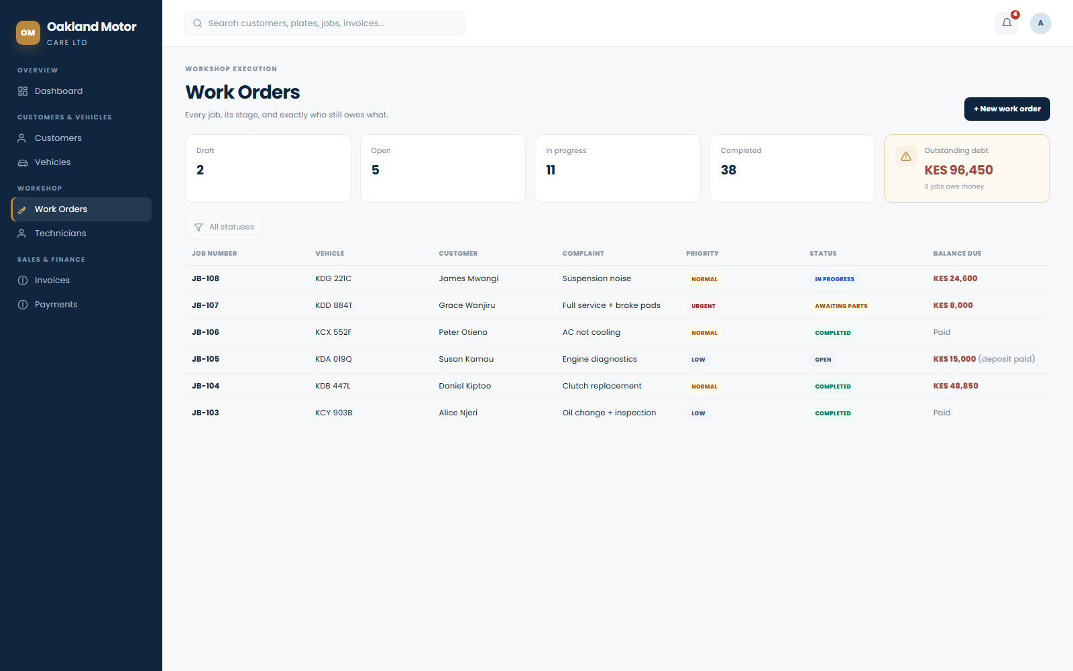
WORKSHOP EXECUTION
Work Orders, With a Full Debt Pipeline
Deposits, part-payments and balances owed — visible on every job card and the list itself, not buried in a separate ledger.
✦ Deposits any time. record a part-payment the moment a customer pays it — no invoice has to exist first.
✦ Balance Due on every row. the Work Orders list shows exactly who owes what, with a one-click debt filter.
✦ Full status pipeline. Draft → Open → In Progress → Completed, with technician sign-off at every stage.
✦ Parts, labour & other charges combined automatically into one running total per job.
OAKLAND MOTOR CARE LTD • WORK ORDERS
4

Slide 5
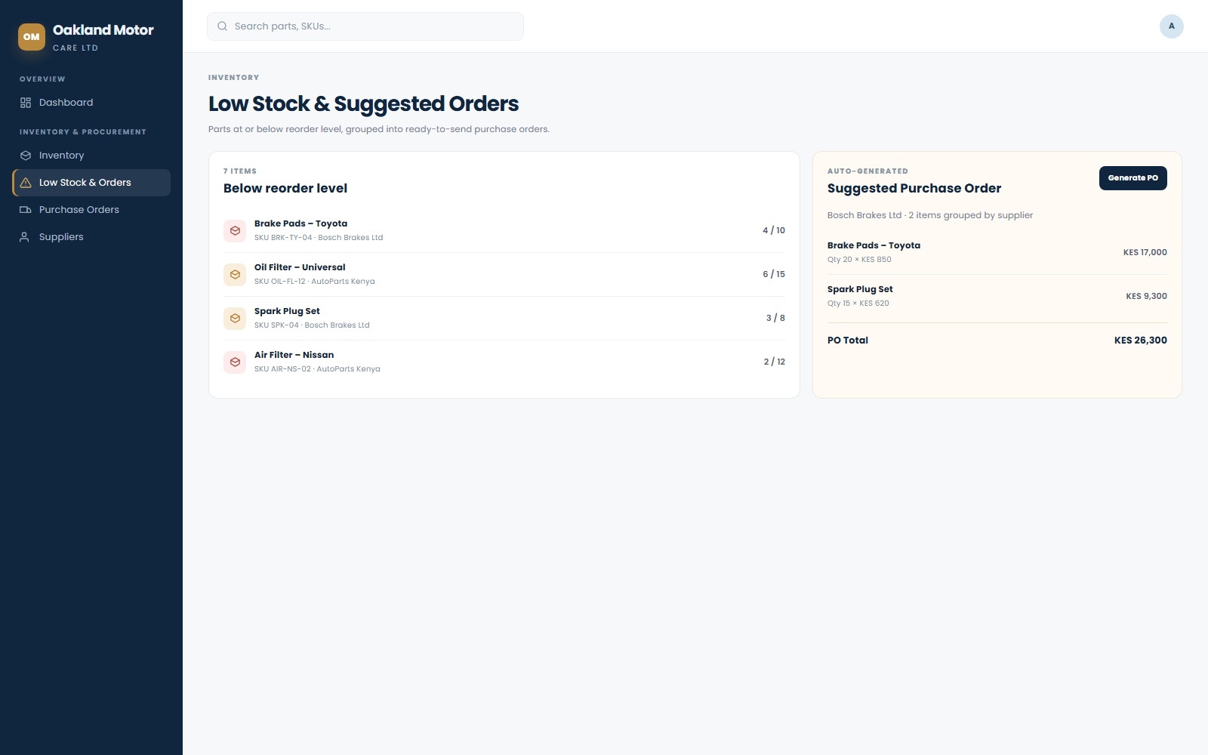
INVENTORY & PROCUREMENT
Low Stock Restocks Itself
Parts at or below their reorder level are grouped by supplier into a ready-to-send purchase order.
✦ Auto-grouped by supplier. one purchase order per supplier, generated from live stock levels.
✦ Editable before sending. adjust quantities and costs, then export a clean PDF.
✦ Full parts catalogue. SKU, cost vs. selling price, stock on hand, and traceable stock movements.
✦ Goods receipt built in. receiving stock against a PO updates quantities and cost automatically.
OAKLAND MOTOR CARE LTD • INVENTORY
5

Slide 6
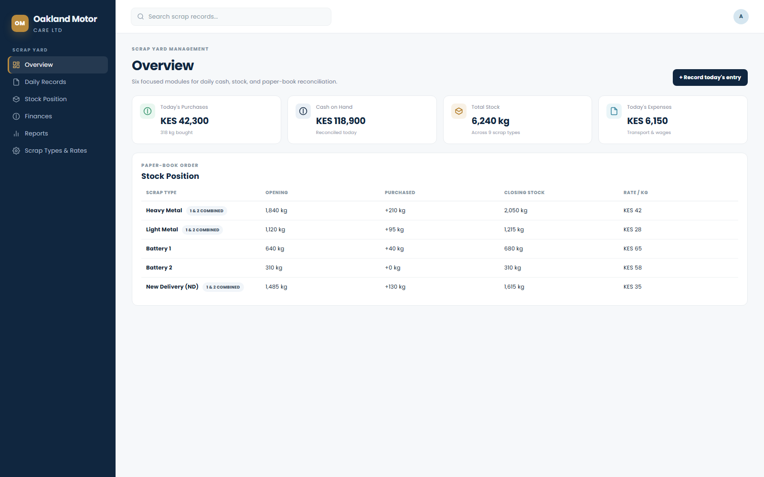
SCRAP YARD MANAGEMENT
A Purpose-Built Module of Its Own
Six focused areas that mirror the paper daily-cash book the yard already runs on.
✦ Overview, Daily Records, Stock Position, Finances, Reports, Scrap Types & Rates.
✦ One dialog records cash, purchases and expenses for the day together.
✦ Supplier-price variants (Heavy, Light, ND) roll up into one stock line; batteries stay separate.
✦ Reconciliation receipts compare expected vs. counted stock, with a reasoned variance trail.
OAKLAND MOTOR CARE LTD • SCRAP YARD
6

Slide 7
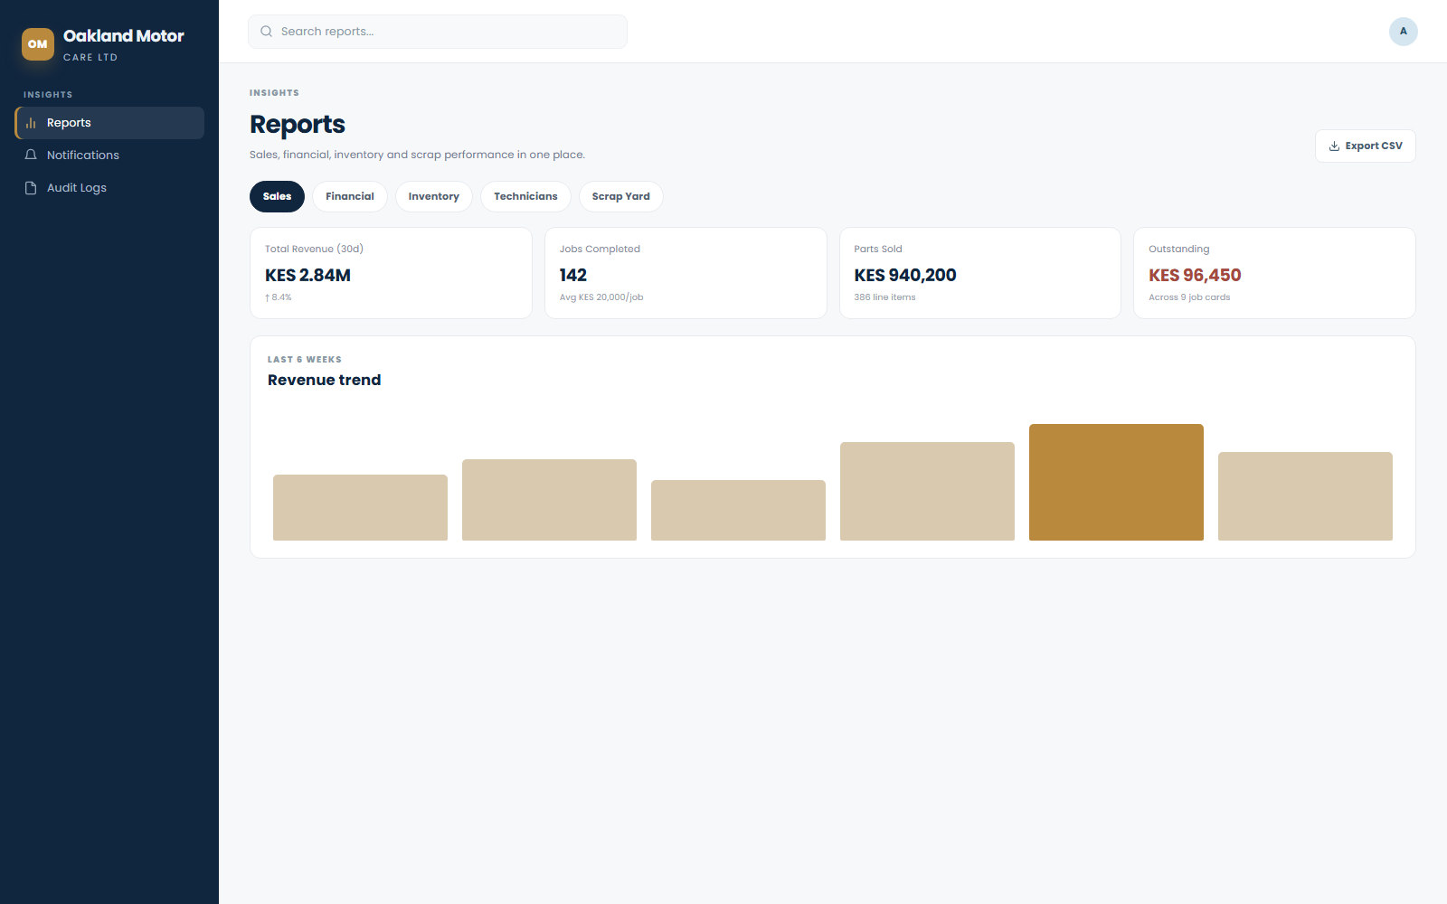
INSIGHTS
Reports That Cover the Whole Business
Sales, financial, inventory, technician and scrap-yard performance — filterable and exportable.
✦ Five report types. Sales, Financial, Inventory, Technicians, Scrap Yard — one screen, one export.
✦ Technician drill-down. see exactly who generated how much revenue.
✦ CSV export everywhere. payments, receipts, work orders and reports all export cleanly.
✦ Printable documents. job cards, invoices, purchase orders and receipts export as PDF or image.
OAKLAND MOTOR CARE LTD • REPORTS
7

Slide 8
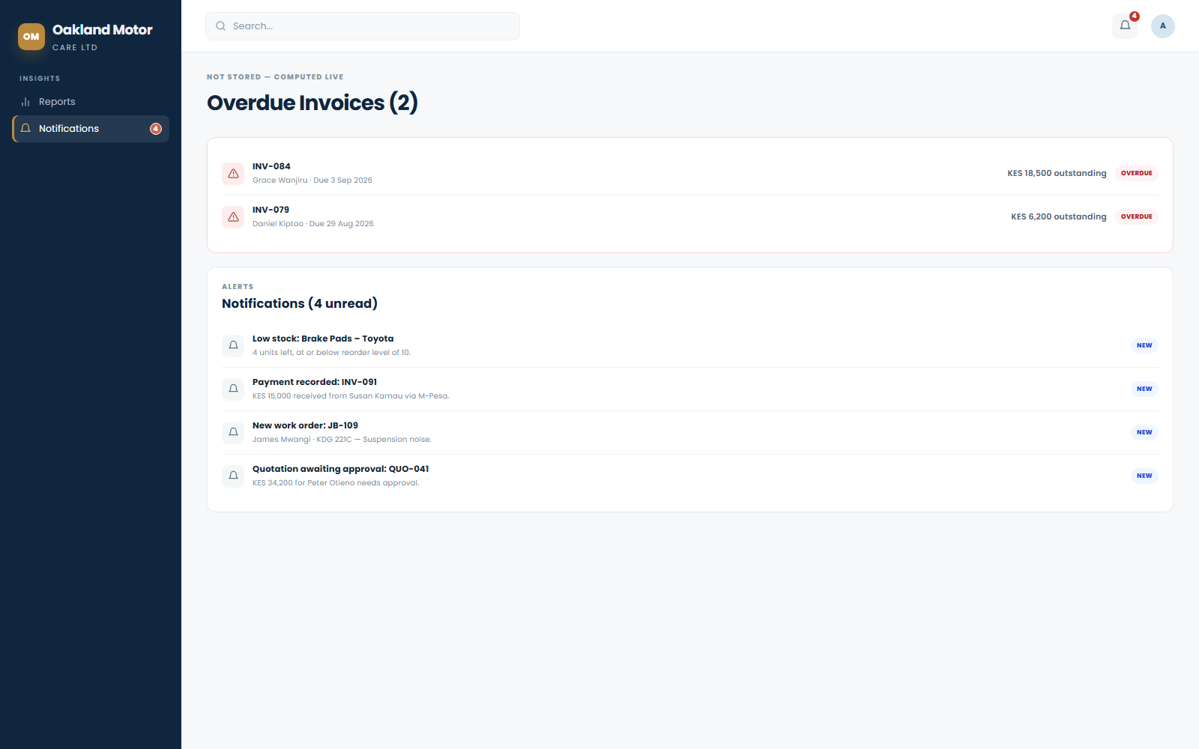
STAY INFORMED
Real Alerts, Not a Silent Inbox
Every meaningful event in the workshop raises a notification — to the people who actually need to see it.
✦ Low stock, quotations and purchase orders awaiting approval, technician assignments, payments received.
✦ New work orders, scrap entries and sales notify the right people automatically.
✦ Overdue invoices computed live and surfaced right on the notifications page.
✦ An unread count follows you everywhere — sidebar, bell icon and page title.
OAKLAND MOTOR CARE LTD • NOTIFICATIONS
8

Slide 9
EVERY MODULE
The Complete Feature Set
Customers & Vehicles
Workshop
Inventory & Procurement
✦ Customer directory
✦ Vehicle records
✦ Vehicle Register (in/out log)
✦ Work orders & full status pipeline
✦ Debt & deposit pipeline
✦ Technician assignment & revenue
✦ Parts catalogue & stock movements
✦ Auto-generated purchase orders
✦ Supplier directory
Sales & Finance
Scrap Yard
Operations & Insights
✦ Quotations → Invoices
✦ Payments with M-Pesa support
✦ General (ad-hoc) receipts
✦ 6 dedicated modules
✦ Daily cash & purchase entry
✦ Stock reconciliation reports
✦ Sales module for counter parts
✦ 5-category reports & CSV export
✦ Live notifications & audit log
OAKLAND MOTOR CARE LTD • FEATURE OVERVIEW
9

Slide 10
TRUST & ACCESS CONTROL
Built on Real Access Control
Every write goes through a permission check — not just a hidden button.
✦ Role-based permissions. Administrator and Manager roles, each scoped to exactly what they should see and do.
✦ Row-level security in the database. access is enforced at the data layer, not just the screen.
✦ Full audit trail. every sensitive change is logged with who, what and when.
✦ Secure account lifecycle. invite or create staff accounts, suspend or reactivate access instantly.
✦ Password visibility toggle on every sign-in, reset and account-creation field.
Ongoing practice
✦ Every access-control policy and privileged function is independently reviewed on a regular basis.
✦ Principle of least privilege enforced throughout — access is granted, never assumed.
✦ Protection lives at the database layer, not just the screen, so it can't be bypassed by going around the UI.
✦ New features are checked against the same standard before they ship.
OAKLAND MOTOR CARE LTD • SECURITY
10

Slide 11
Workshop Operations, Simplified.
From the moment a car rolls in to the moment the balance is settled — one system, one source of truth.
OAKLAND MOTOR CARE LTD
Created and Powered by Qeem Labs Ltd

