Slide 1
The Sounder Interface
WD Henderson
September, 2008

Slide 2
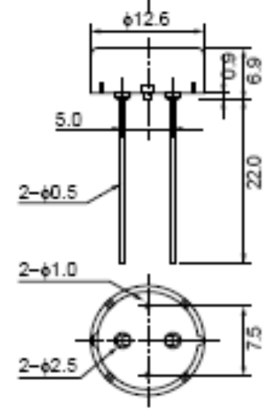

Introduction
The Powertip PKM13EPY-4000-A0 is a Piezoelectric Sounder:
  3v p-p input
  Sound output up to 20kHz
  Best frequency response using
  square waves
  About 70dB output at 10cm
  Supplied on tape for
  automatic insertion

Slide 3
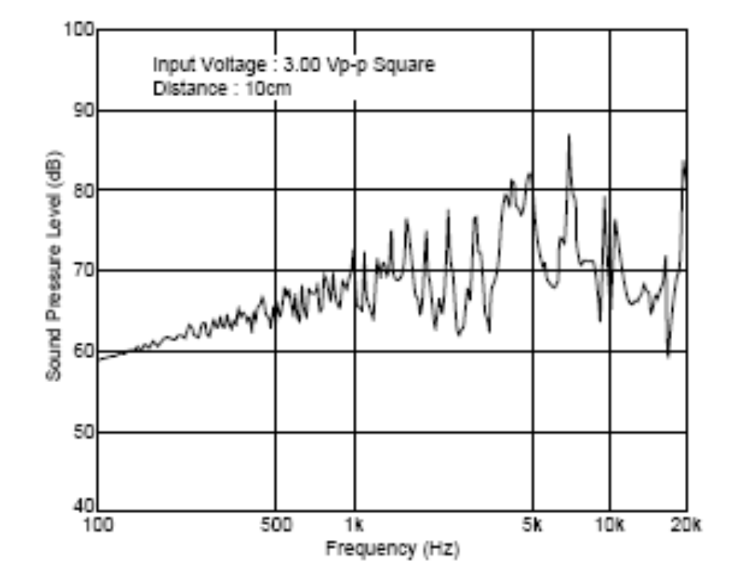
Frequency Response

Slide 4
The Interface
The device is connected to P6 on GPIO interface of the ARM7 processor
ARM7
Processor
200Ω
P6
GND

Slide 5
Generating Sound
ARM7
Processor
200Ω
P6
GND
While (1) {
set P6;
delay;
clear P6;
delay;
}
Period

Slide 6
ARM7 Configuration
/* No inputs for sounderTest */
#define INPUTS 0x00000000
/* A single output at P6 for the sounder */
#define OUTPUTS 0x00000040
/* AT91InitialisePIO
*
* Initialise GPIO for Sounder – P6
* O: Output
* x x x x x x x x x x x x x x x x x x x x x x x x x O x x x x x x
* 31 27 23 19 15 11 7 3 0
*/
void AT91InitialisePIO() {
__PIO_PER = INPUTS | OUTPUTS; // Enable PIO Controller for I/O
__PIO_OER = OUTPUTS; // Output enable
__PIO_ODR = INPUTS; // Output disable
__PIO_CODR = OUTPUTS; // Clear Outputs
__PIO_IDR = INPUTS; // Disable interrupts on Inputs
}

Slide 7
Output to the Sounder
/* sound.h */
#define SND 0x00000040 /* P6 */
/* sound.c */
/*
* Sounder_on
* Turn sounder on
*/
static void Sounder_on(){
OutputHigh( SND );
}
/*
* Sounder_off
* Turn sounder off
*/
static void Sounder_off(){
OutputLow( SND );
}

Slide 8
Low-level Output Functions
/* AT91PIO.c */
/*
* Clear a port bit
*/
void OutputLow( unsigned long bit ){
__PIO_CODR = bit;
}
/*
* Set a port bit
*/
void OutputHigh( unsigned long bit ){
__PIO_SODR = bit;
}
CODR
Clear Output Data Register
SODR
Set Output Data Register

Slide 9
Tone Output
/* sound.c */
/*
* Make a click sound
*/
void Click( void ) {
int i;
for ( i= 0; i< 5; i++ ) {
OutputHigh( SND );
Delay_ms(1);
OutputLow( SND );
Delay_ms(1);
}
}
5 rapid pulses – period = 2ms

Slide 10

A Note - Duration
Semibreve - whole note
Minim - ½ note
Crotchet – 1/4 note
Quaver – 1/8 note
Semiquaver – 1/16 note
Demisemiquaver – 1/32 note
If the Semibreve lasts 1s, the quaver lasts 1/8s

Slide 11
Notes – frequency - pitch
A – 440Hz
F
D
B
G
E
G – 392Hz
Crotchet Duration= 1/4s Number of cycles= 440/4= 110
Each cycle the signal is high for 1 / 110 / 2 = 0.0045s (4.5ms)

Slide 12
Storing the Period and Duration
/* Structure holding the halfduration and cycles values for a note */
struct note_record {
int halfDuration; /* Micro seconds */
int cycles[6]; /* Cycles for a semi-breve */
} noteTable[100];
/* An array of note frequency values - Hz */
float noteFrequency[]= { 16.35, 17.32, 18.35, 19.45, 20.6 , 21.83,
23.12, 24.50, 25.96, 27.50, 29.14, 30.87,
32.7, 34.65, 36.71, 38.89, 41.20, 43.65,
46.25, 49.00, 51.91, 55.00, 58.27, 61.74,
65.41, 69.30, 73.42, 77.78, 82.41, 87.31,
92.50, 98.00, 103.83, 110.00, 116.54, 123.47,
130.81, 138.59, 146.83, 155.56, 164.81, 174.61,
185.00, 196.00, 207.65, 220.00, 233.08, 246.94,
261.63, 277.18, 293.66, 311.13, 329.63, 349.23,
369.99, 392.00, 415.30, 440.00, 466.16, 493.88,
523.25, 554.37, 587.33, 622.25, 659.26, 698.46,
739.99, 783.99, 830.61, 880.00, 932.33, 987.77,
……. ….. …..
};
A – 440Hz

Slide 13
Some enums
/* Names of note durations - semibreve...demisemiquaver */
enum dur {sb,m,c,q,sq,dsq};
/* Names of notes, middle C is c4 */
enum note {c0,c0s,d0,d0s,e0,f0,f0s,g0,g0s,a0,a0s,b0,
c1,c1s,d1,d1s,e1,f1,f1s,g1,g1s,a1,a1s,b1,
c2,c2s,d2,d2s,e2,f2,f2s,g2,g2s,a2,a2s,b2,
c3,c3s,d3,d3s,e3,f3,f3s,g3,g3s,a3,a3s,b3,
c4,c4s,d4,d4s,e4,f4,f4s,g4,g4s,a4,a4s,b4,
c5,c5s,d5,d5s,e5,f5,f5s,g5,g5s,a5,a5s,b5,
c6,c6s,d6,d6s,e6,f6,f6s,g6,g6s,a6,a6s,b6,
c7,c7s,d7,d7s,e7,f7,f7s,g7,g7s,a7,a7s,b7,
c8,c8s,d8,d8s};
Middle C

Slide 14
Playing a Note
Number of cycles in a note
void playNote(int t, int n) {
int i;
for (i=0; i< noteTable[t].cycles[n]; i++){
Sounder_on();
Delay_us(noteTable[t].halfDuration);
Sounder_off();
Delay_us(noteTable[t].halfDuration);
}
}
Duration of ½ period

Slide 15
Some “Music”
soundInit(); /* Initialise sound interface */
/* Jesu, Joy of Man's Desiring - J.S. Bach */
/* Bar 1 */
playNote(g3,c);
playNote(a3,c);
playNote(b3,c);
playNote(d4,c);
playNote(c4,c);
playNote(c4,c);
playNote(e4,c);
etc.

Slide 16
Test Software
AT91PIO.c
void AT91InitialisePIO(){
}
void OutputHigh( ){
__PIO_SODR = bit;
}
sound.c
sounderOn(){
OutputHigh( SND );
};
soundInit(){
}
playNote(){
Sounder_on();
}
soundertest.c
soundInit();
playNote();

