Slide 1
The XBee Interface
WD Henderson
September, 2008

Slide 2
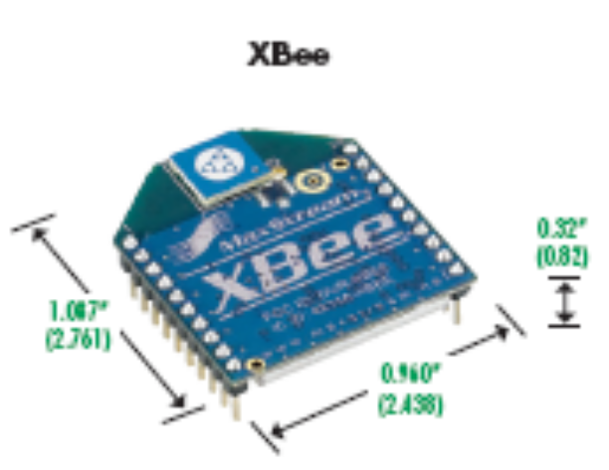
Introduction
The XBee is a ZigBee/802.15.4 comunications device:
  ISM 2.4 GHz
  Sort range – 30m indoors
  90m outdoors
  Modest data rate: 250kbps
  Power output 1mW (0dBm)
  Low-power consumption – 50mA
  Serial interface with microcontroller
  Point-to-point, peer-to-peer or point-to-multipoint (star) configurations
  Low cost - £12

Slide 3
XBee Interface
Antenna
Serial Port
UART
3V
ARM7
XBee
Module
Tx
DIN
Rx
DOUT
GND

Slide 4
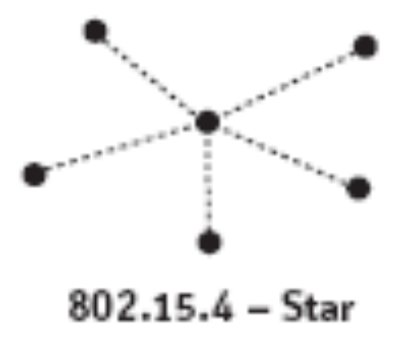
XBee and 802.15.4
Can form:
  Point-to-point,
  peer-to-peer or
  point-to-multipoint (star)
Application
XBee
Data Link
802.15.4
Physical

Slide 5
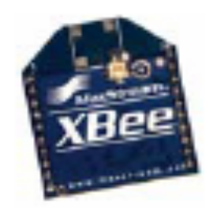
Personal Area Network - PAN
Channel= 0x10
PAN ID= 0x3330
MY= 0x0004
DH= 0x0000
DL= 0x0007
Channel= 0x10
PAN ID= 0x3330
MY= 0x0007
DH= 0x0000
DL= 0x0004

Slide 6
Initialisation (1)
int XBeeInit( unsigned int Channel,
unsigned int PANID,
unsigned int MY,
unsigned int DH,
unsigned int DL ){
char commandString[100];
int n;
/* Check parameters */
if ( ( Channel < 0x0B ) || ( Channel > 0x1A ) )
return -1;
if ( ( PANID > 0xFFFF ) || (if ( MY > 0xFFFF ) )
return -1;
/* Flush Rx buffer */
ReceiveLine(commandString, 2000);
/* Send command prefix */
SendData( "+++", 3 );
Delay_ms(2000);

Slide 7
Initialisation (2)
/* Assemble command string */
sprintf( commandString, "ATICH%.2X,D%.4X,MY%.4X,DH%.8X,DL%.8X,CN\r",
Channel, PANID, MY, DH, DL );
/* Send command string to XBee module */
SendData( commandString, 46 );
/* Wait for 6 "OK" response */
n= ReceiveLine(commandString, 2000);
commandString[n]= 0;
/* Check response from XBee module */
if ( *strstr(commandString,"OKOKOKOKOKOKOK") == NULL )
return -2;
else
return 0;
}
An AT command – see manual
There are 46 chars in the above command
Reply string from XBee

Slide 8
Data Reception
Interupt service for character reception
UART
‘e’
void UartRxrdy() {
unsigned char value;
value = (*getchar_function)();
if (rptr >= RXBUF_SIZE)
return;
rbuf[rptr++] = value;
}
Character Buffer - rbuf
X
B
e
e
0
rptr
RXBUF_SIZE

Slide 9
Example Initialisation
/* Initialise XBee module
Channel= 0x10
PAN ID= 0x3330
Source address= 0x0001
Destination address= 0x0000 0000 0000 FFFF
a broadcast address */
XBeeCode= XBeeInit( 0x10, 0x3330, 0x0001,
0x00000000, 0x0000FFFF );
if ( XBeeCode == 0 )
LCD_PutString("XBee OK\n");
else if ( XBeeCode == -2 )
LCD_PutString("XBee init error\n");
else if ( XBeeCode == -1 )
LCD_PutString("XBee param error\n");

Slide 10
Transmitting and Receiving Data
Tx
tString[0]= ‘F'; /* Tx a single character */
SendData( tString, 1 );
Number of chars read
Rx
if ( ( nChars= ReceiveLine(rString, 100) ) != 0 ) {
rString[nChars]= 0;
LCD_ClearDisplay();
playNote( c4, q );
LCD_PutString(rString);
}
How long to wait in ms
Convert to a string

