Slide 1




WELCOME TO
EXPLORER’S PACK
HIKES
SURVIVAL MANUAL
SETTINGS
CAMERA
Notes:
This prototype is interactive! Start a slide show and click around to see functionality.

Slide 2

HOME PAGE TIPS
ON
DARK MODE
OFF
ABOUT
Thank you for using Explorer’s Pack! This app was created with users in mind. We offer a standard hiking survival manual, a camera and hiking logs.
Please direct inquiries to explorerspack@gmail.com

Slide 3










SEARCH THE SURVIVAL MANUAL
POWER
PLANNING
MEDICINE
SHELTER
WATER
FIRE
FOOD
PLANTS
ANIMALS

Slide 4
SEARCH THE SURVIVAL MANUAL
WATER
Water is one of your most urgent needs in a survival situation. You can't live long without it, especially in hot areas where you lose water rapidly through perspiration. Even in cold areas, you need a minimum of 2 liters of water each day to maintain efficiency. More than three-fourths of your body is composed of fluids. Your body loses fluid because of heat, cold, stress, and exertion. To function effectively, you must replace the fluid your body loses. So, one of your first goals is to obtain an adequate supply of water is composed of fluids.
SOURCES
PURIFICATION
FILTRATION

Slide 5
POISON IVY
FRESHWATER FISH
POWER
PLANNING
MEDICINE
SHELTER
WATER
FIRE
FOOD
PLANTS
ANIMALS

Slide 6
POISON IVY
…if you are extremely sensitive to poison ivy, avoid products…
…jewelweed juice when applied to poison ivy, rashes, or insect stings.
MEDICINE

Slide 7
FRESHWATER FISH
8-16. There are no poisonous freshwater fish. However, the common barbel…
8-17. Cook all freshwater fish to kill parasites. As a precaution…
FOOD
…piranha are the only significantly dangerous freshwater fish…
ANIMALS

Slide 8
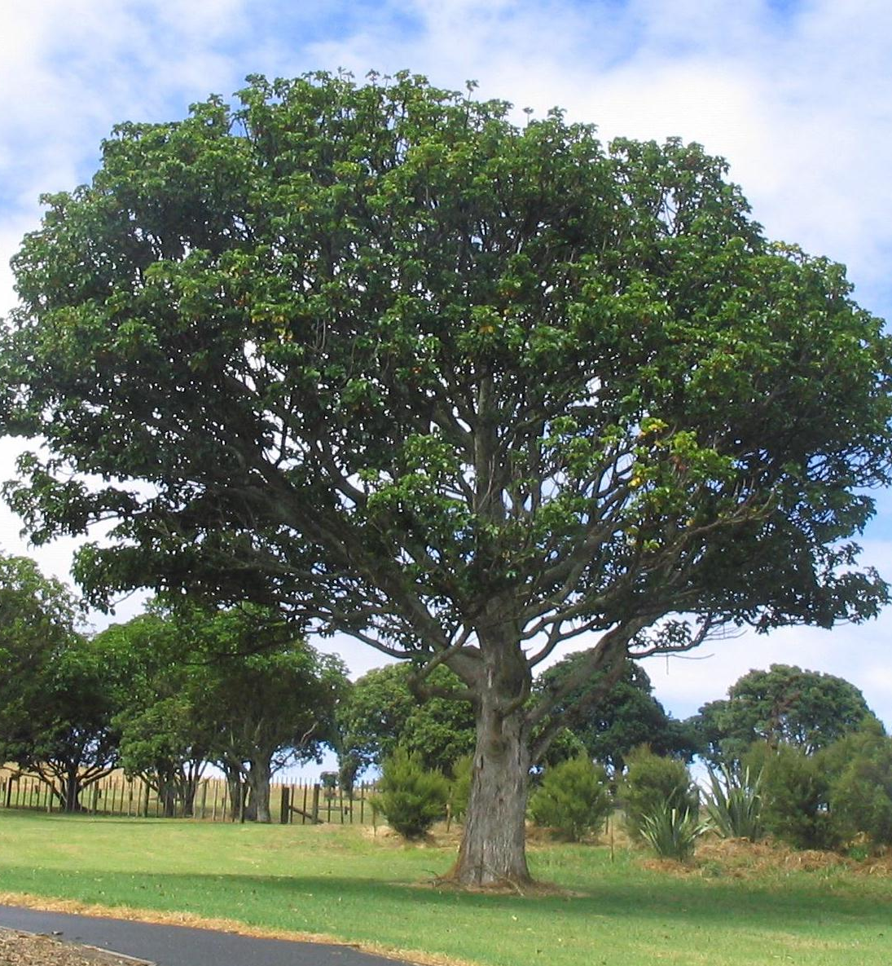

Slide 9
WOULD YOU LIKE TO SAVE THIS TO A HIKE?
YES
NO

Slide 10
WHICH HIKE?
ARTIST POINT
BAKER LAKE

Slide 11
ARTIST POINT HIKE
BAKER HIKE
ADD HIKE

Slide 12
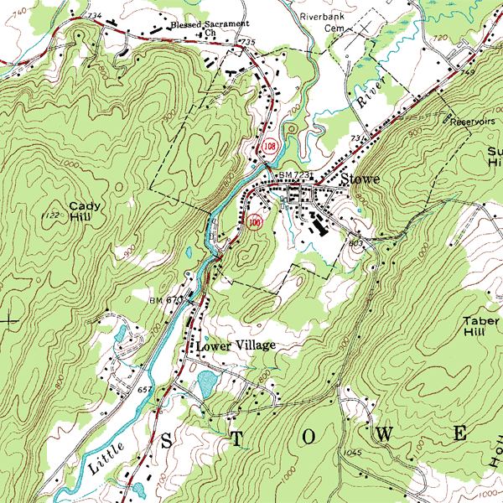

BAKER LAKE HIKE
NOTES
MAP
PHOTOS

Slide 13
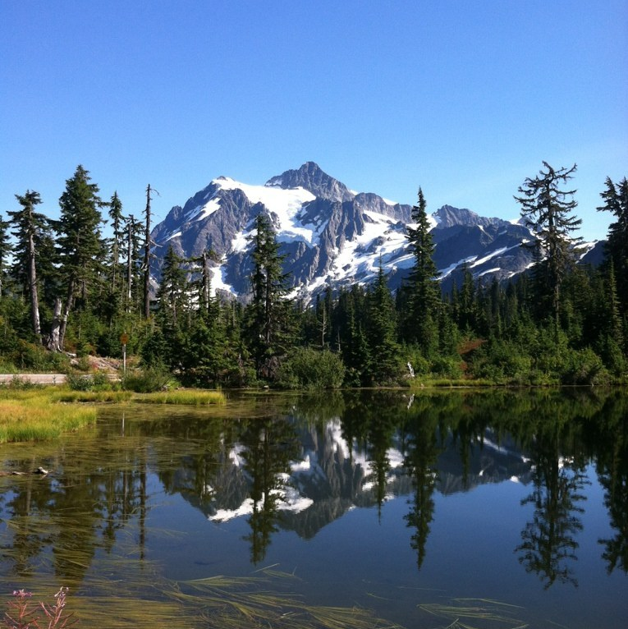
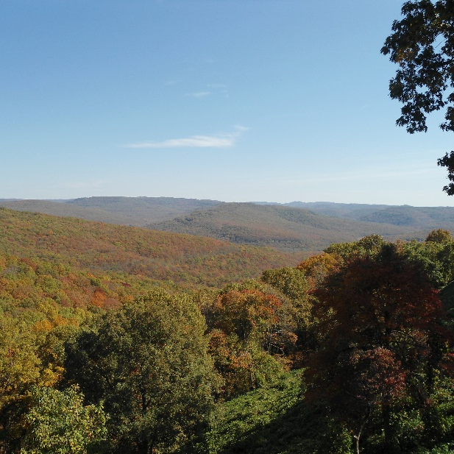
ARTIST POINT HIKE
NOTES
MAP
PHOTOS

Slide 14
HIKE NAME
NOTES
ADD MAP
CREATE

Slide 15
HIKE NAME
SEHOME HILL ARBORETUM HIKE
NOTES
SEARCH FOR HIKE
CREATE

Slide 16
SEHOME HILL ARBORETUM HIKE
NOTES
MAP
PHOTOS

Slide 17
ARTIST POINT HIKE
BAKER HIKE
SEHOME HILL ARBORETUM
ADD HIKE

