Slide 1
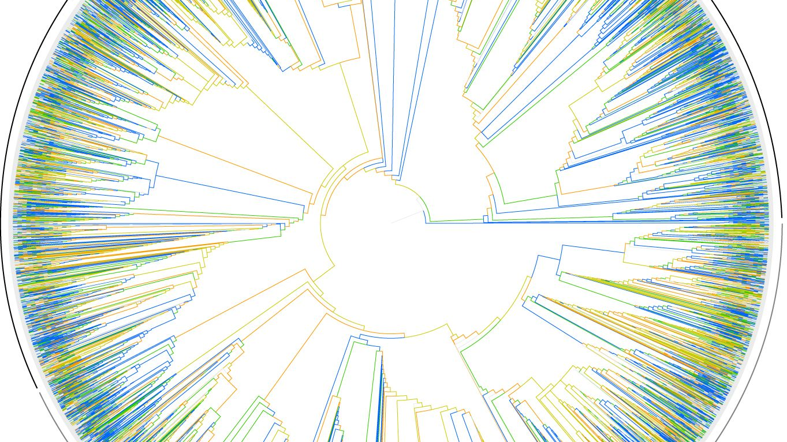
Phylogenetic analyses of contentious relationships between genera in Erwiniaceae and identification of horizontal gene transfer events
Kimberly Hinz
Notes:
https://www.pinterest.ca/pin/347340189992893352/?lp=true

Slide 2

Contentious Relationships
Mixta, Pantoea, Erwinia, and Tatumella
Many studies have been done, all proposing different results.
WHY?
Different genes
Different methods
Notes:
In my research, I’m focusing on these four genera: Mixta, Pantoea, Erwinia, and Tatumella
Many studies have already been done, analyzing the phylogenetic relationships of these genera
All have given contentious results.
This may because each study either chose different core genes to form their phylogenetic hypothesis or they chose a different method to run the analysis.
An example of the latter is on the next slide.

Slide 3
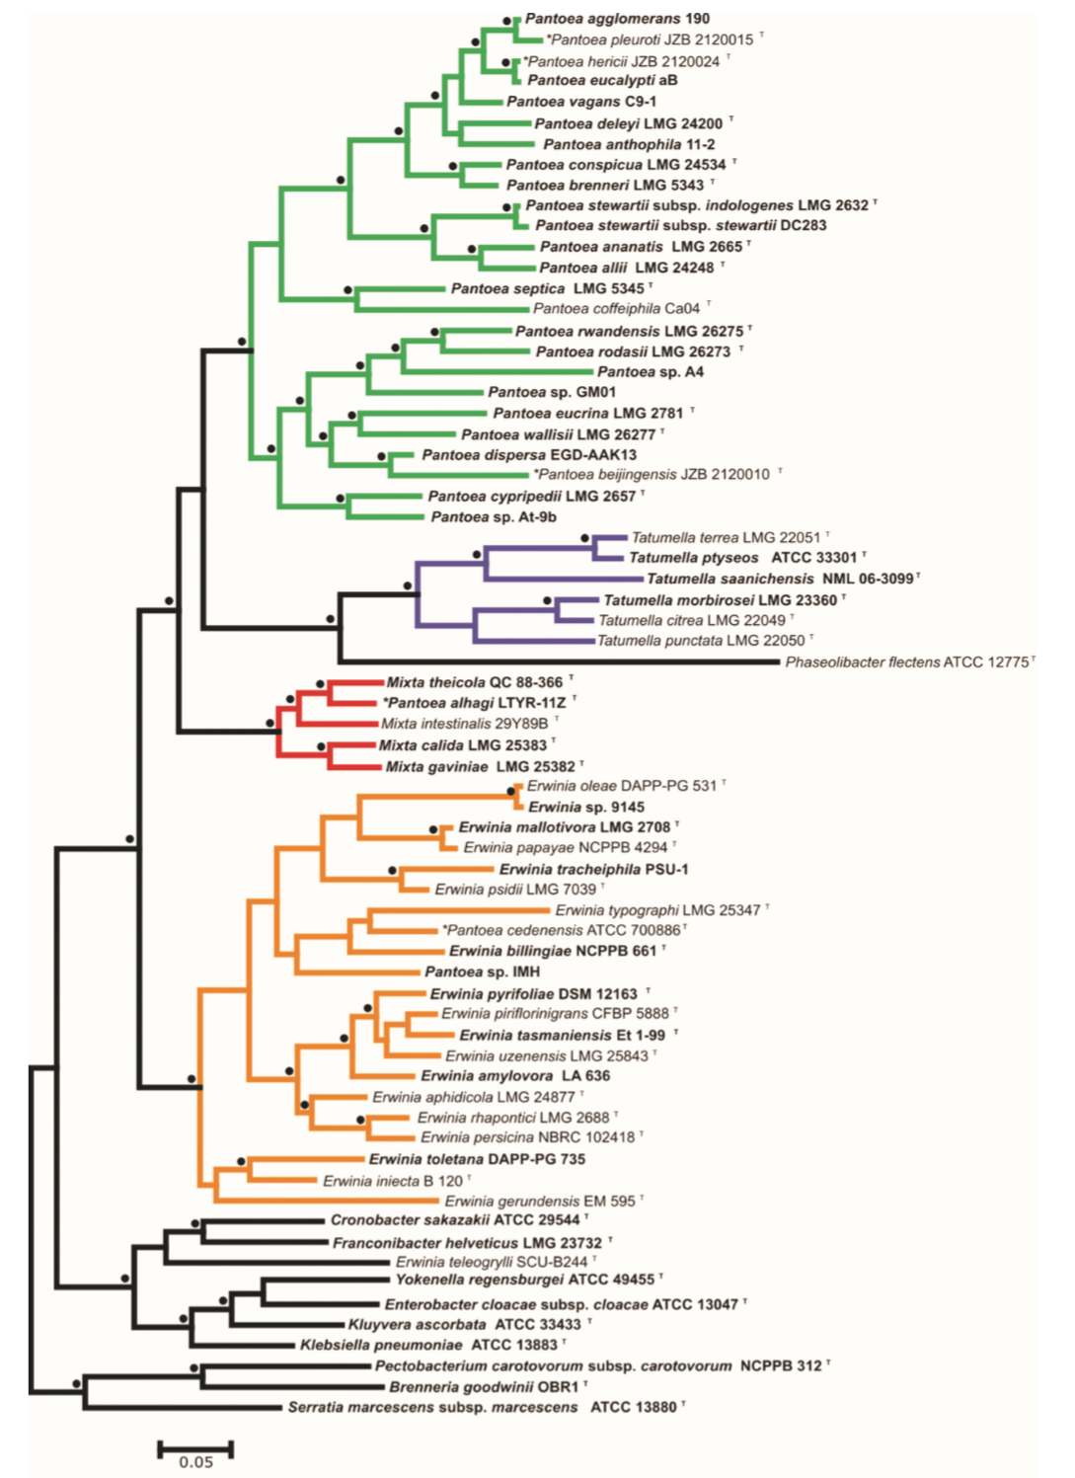
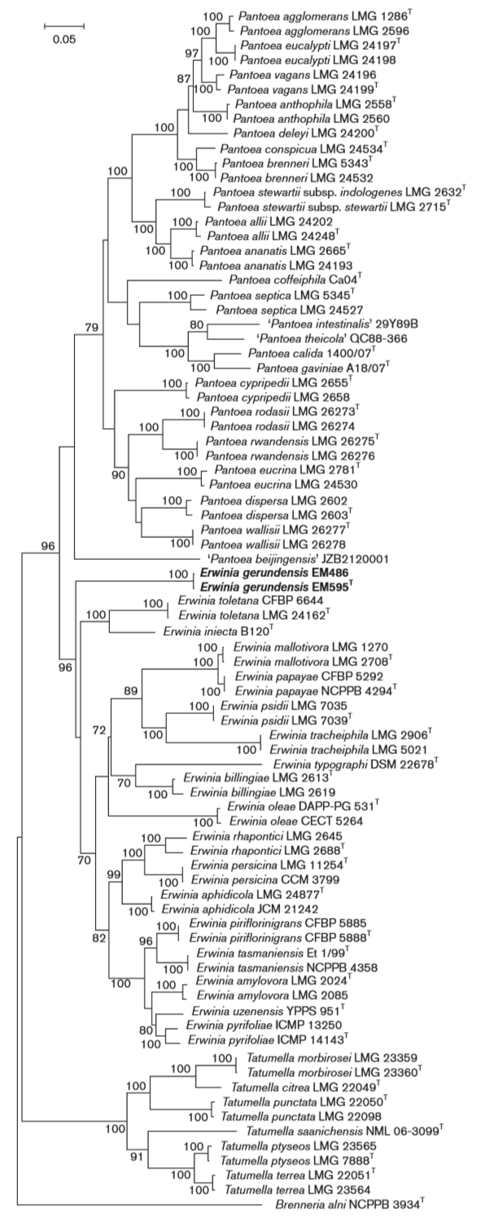









Notes:
LEFT: paper released last year by Palmer et al. RIGHT: paper released in 2016 by Rezzonico et al.
Both conducted maximum likelihood trees with ATPD, GYRB, INFB, and RPOB
BUT, Palmer et al. reconstructed protein sequences and Rezzonico et al. used nucleotide sequences.
Point out where Mixta is, where Pantoea and Erwinia are, and where Tatumella is

Slide 4
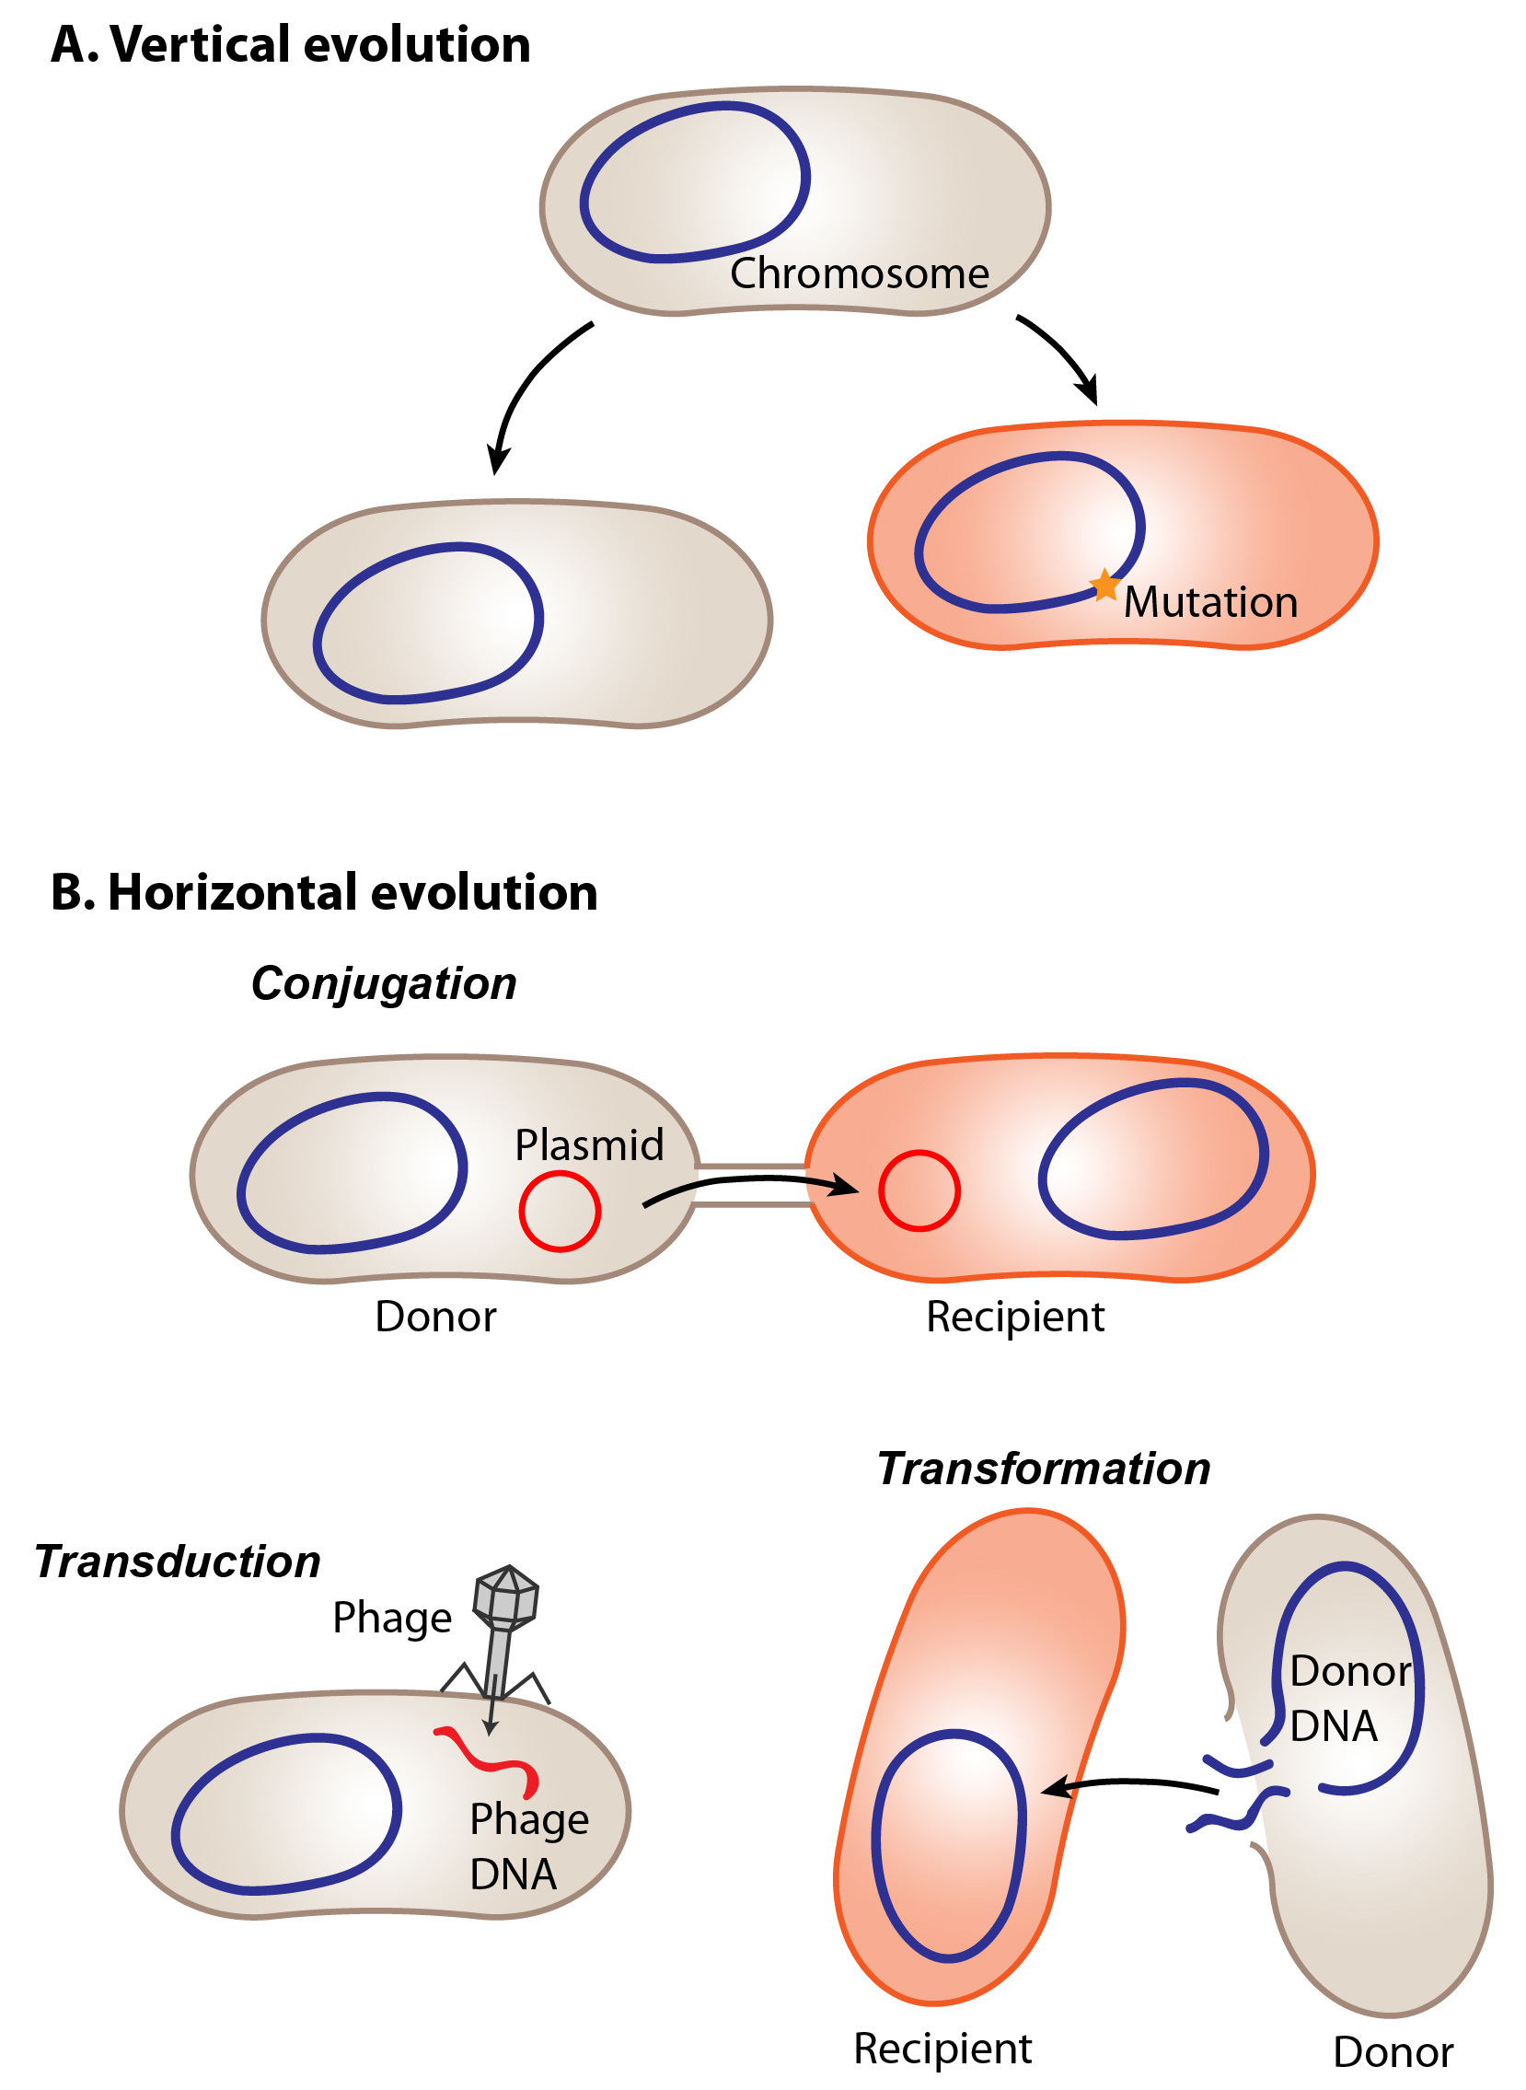
HGT Events
Horizontal Gene Transfer (HGT)
Occurs frequently in prokaryotes
Acquire novel genes
Notes:
We all know what horizontal gene transfer, so I don’t have to explain it.
HGT may be another cause of the contentious phylogenetic relationships because it provides the prokaryote of study new genetic information that did not arise through evolution from its ancestors.
If you use genes that arose from HGT in phylogenetic analysis, the strains of interest will be pulled away from their true closest relatives and towards the donor strains

Slide 5
Experimental Design
Phylogenetic Analysis:
More than one gene
Nucleotide sequences rather than amino acid sequences
Homologues for all four genera and outgroup
Conserved genes
Genes cannot be recently horizontally transferred
HGT Identification
GC content within a sliding window
BLAST

Slide 6
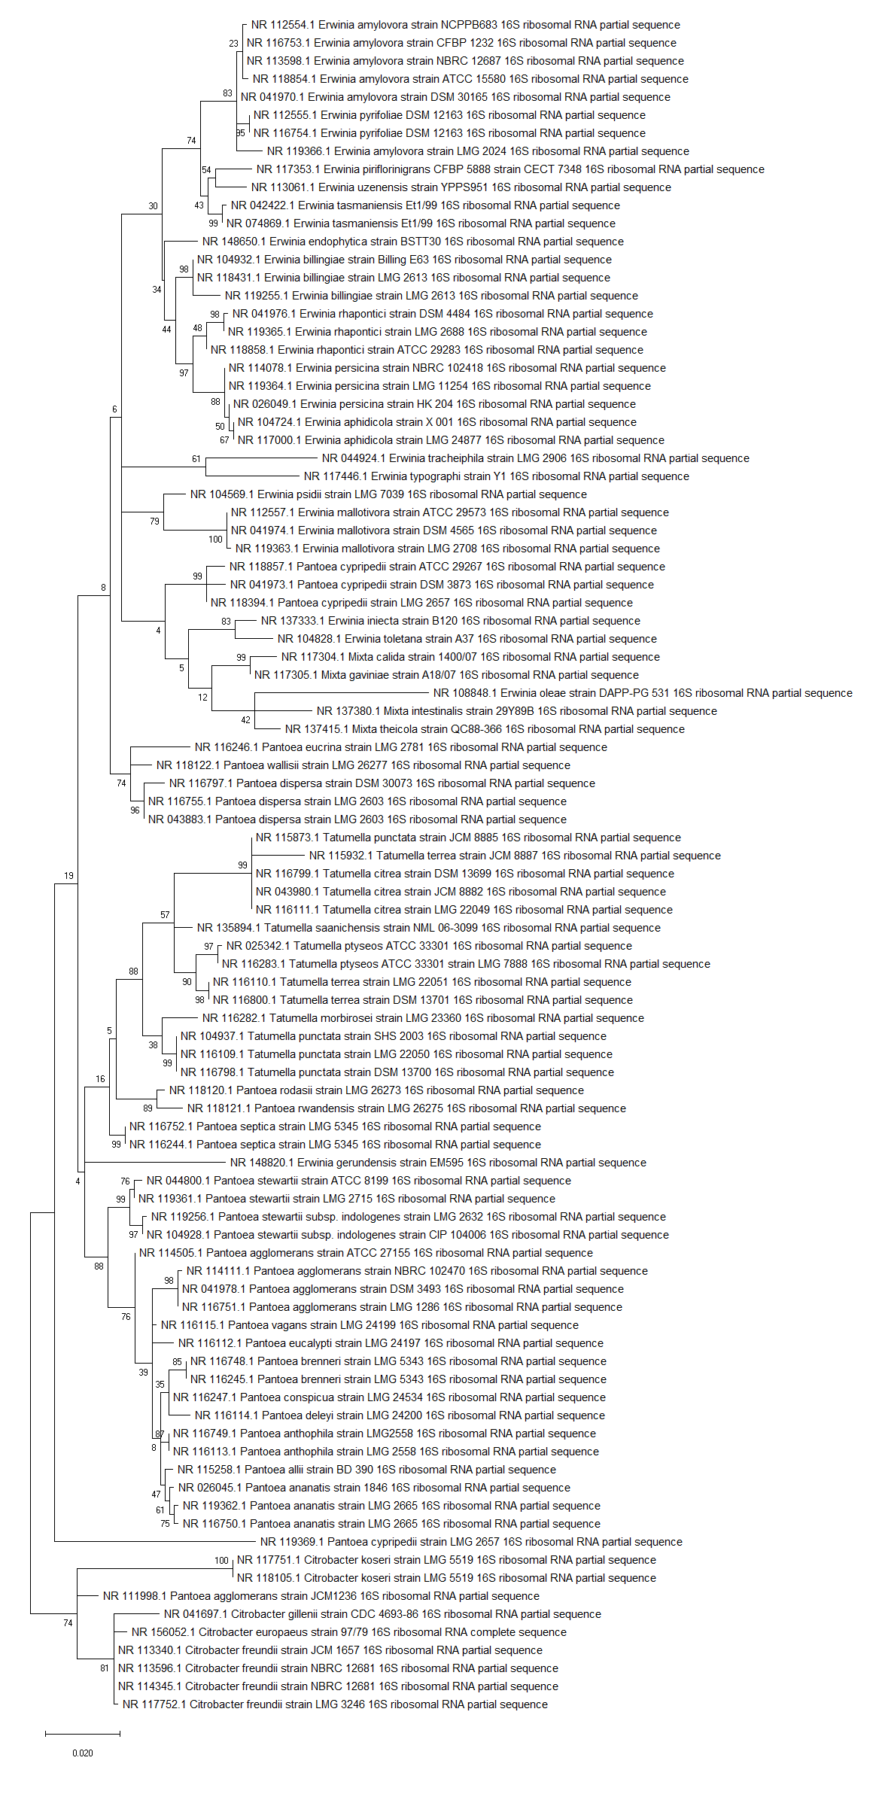
Preliminary Results: 16S rRNA Tree
Notes:
All are the types strains of the species
Genera are not distinctly separated
Mixta is grouped with both Pantoea and Erwinia species
Pantoea and Erwinia intermixed with each other
Tatumella species, however, have grouped together
Common species are grouped together
One P. agglomerans strain has grouped with the outgroup, Citrobacter
Model is Tamura-3 1992 with discrete Gamma distribution to model evolutionary rate differences and invariable sites

Slide 7
Mosaic Mixta
10 genomes
Determine homologous genes
Distance matrices for each gene
Categorize each gene origin
Determine gene position in Mixta
Mixta species
Notes:
Can also be used to determine HGT

Slide 8
Thank you

