Slide 1
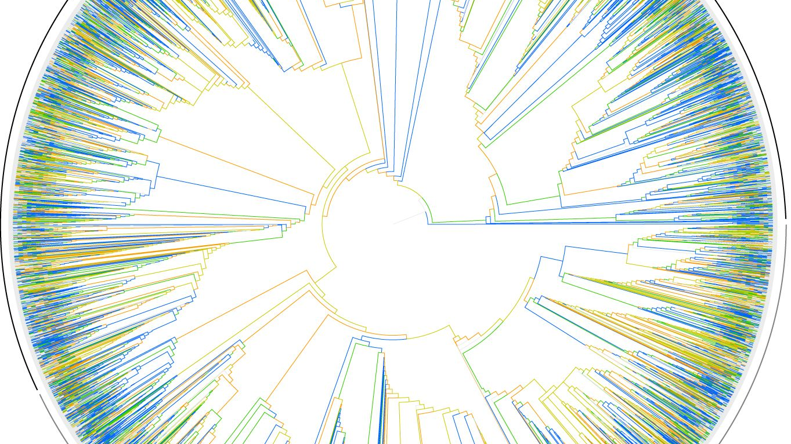
Lab Update: Mosaic Mixta
Kimberly Hinz
Notes:
https://www.pinterest.ca/pin/347340189992893352/?lp=true

Slide 2
Mosaic Mixta
10 genomes
Determine homologous genes
Distance matrices for each gene
Categorize each gene origin
Determine gene position in Mixta
Mixta species
Notes:
Can also be used to determine HGT

Slide 3

10 Genomes
Mixta calida
Mixta gaviniae
Pantoea septica
Pantoea agglomerans
Tatumella saanichensis
Tatumella ptyseos
Citrobacter freundii
Enterobacter cloacae

Slide 4




Homologous Genes
get_homologues
1284 genes
Converted to fasta
Potential issues:
Truncated
Split

Slide 5
Solution: Filter
/
10 sequences
1
Check for 20 rows in the fasta file.
No truncated genes
2
Length of sequences >= 90% of the longest sequence
Also shortened the sequence names
3
Gene ID, species’ name, and strain
1284 sequence → 1035 sequences

Slide 6
Gene Alignment
R package msa::msaClustalW
100 (maximum) iterations
Default settings
Output: fasta files
Notes:
Cluster: nj
Gap opening penalty: 15.0
Gap extension penalty: 6.66
Substitution matrix: possible

Slide 7
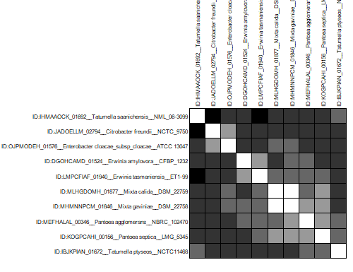
Distance Matrices
R packages ape and adegenet
Tamura 1992 model
Suggested by MEGAX using 4 random genes
Pairwise deletions
Output: csv files

Slide 8
Categorize Genes by Closest Relative
 | Mixta calida | Mixta gaviniae
Pantoea | 904 genes 79 P. agglomerans 825 P. septica | 903 genes 71 P. agglomerans 832 P. septica
Erwinia | 102 genes 49 E. amylovora 53 E. tasmaniensis | 108 genes 52 E. amylovora 56 E. tasmaniensis
Tatumella | 5 genes 3 T. ptyseos 2 T. saanichensis | 6 genes 3 T. ptyseos 3 T. saanichensis
Outgroup | 18 genes 8 C. freundii 10 E. cloacae | 18 genes 7 C. freundii 11 E. cloacae
Notes:
show differences in distances across genes
Are the differences significant?
Take non-Pantoea and make a tree
Take Pantoea and make a tree
Compare with amino acids tree
R package for model test

Slide 9
Next Steps
Phylogenetic trees
Determine gene position in M. calida and M. gaviniae
Original files contained nucleotide positions
Identify patterns in gene relatives
Explore genes related to outgroups
Horizontal gene transfer?
Notes:
ATG TTG GTG
also look at the 3' end to make sure the gene doesn't start with this
get_homologues should be in right order 5 to 3

Slide 10
Thank you

