Slide 1
Audio Spectrum Analyzer LED Display
Kimberly Loza, Nestor Vasquez, Rosemarie Dehesa

Slide 2
Goals
Program the microcontroller to take in audio waveforms then convert the amplitude as an LED output
Creating an LED display that mimics an audio
Original plan to use Adafruit LED strip

Slide 3
Materials
TI Launchpad
Over 150 LEDs
Several Wires and Breadboards
Grove Sound Sensor

Slide 4
Grove Sound Sensor
Detects sound strength of environment
Simple microphone (LM358 amplifier)
Easy to use, Uses Standard 4-pin Grove Cables, Integrates Easily with logic modules

Slide 5
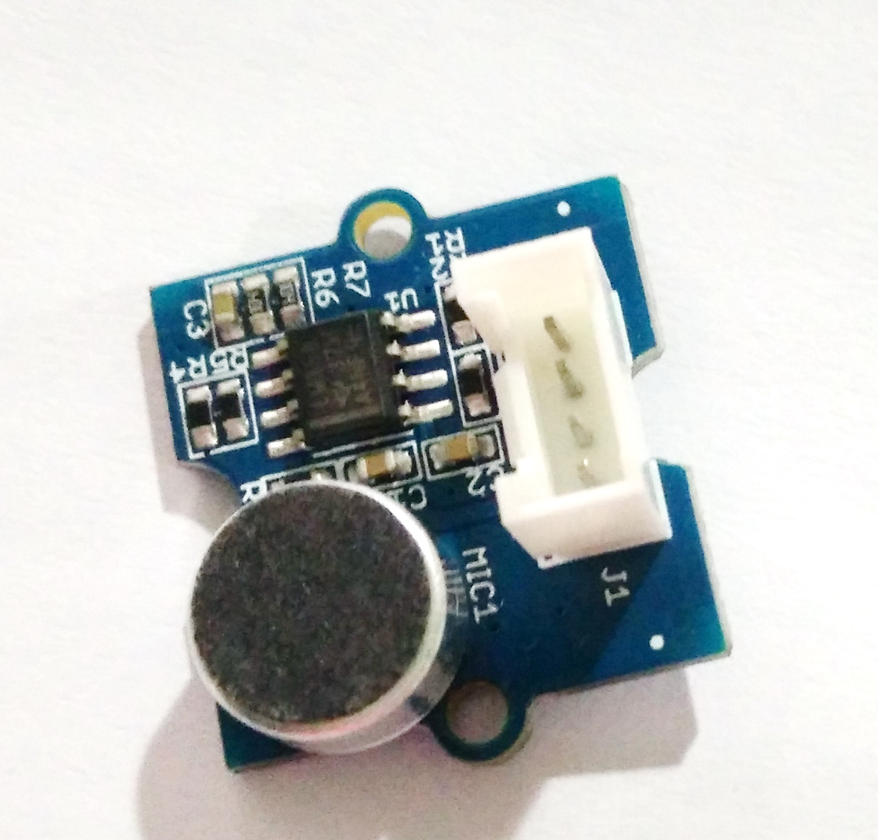

Slide 6
Project Design
10 LED segments
Green LED lowest to Red LED highest threshold
Interrupts if the audio level surpasses max threshold

Slide 7
IDE Energia
Easier to use
Different pin set-up than Kiel
Mainly written in C

Slide 8
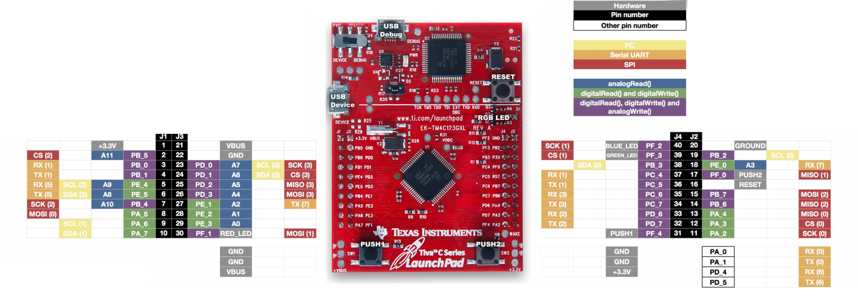
Energia Pin Schematic

Slide 9
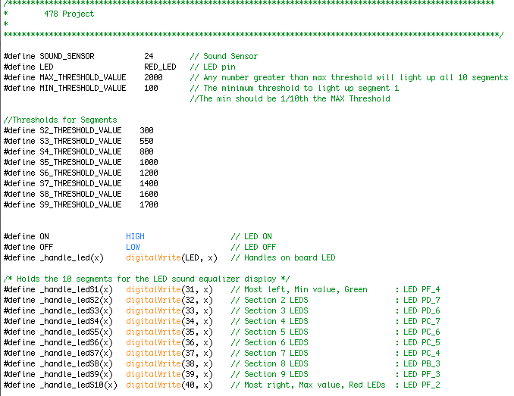
Code Setup

Slide 10
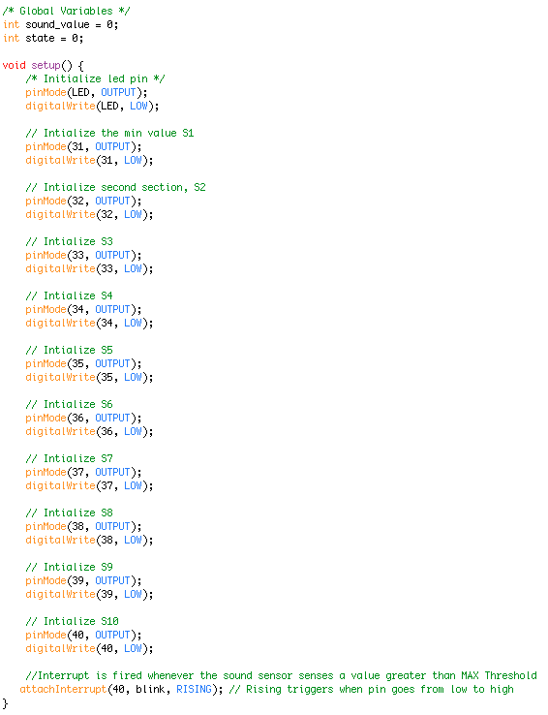

Slide 11
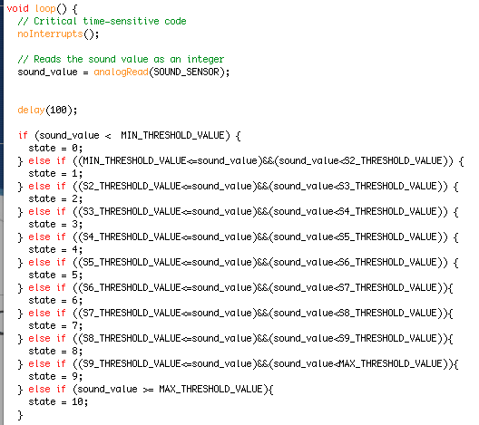

Slide 12
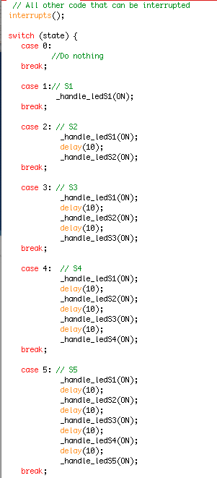

Slide 13
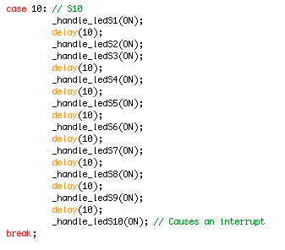
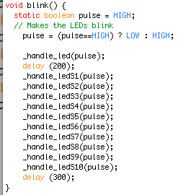
Interrupt

Slide 14
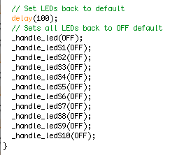
Defaults

Slide 15
Demo

