Slide 1
Snp Plot hand paste-ups

Slide 2
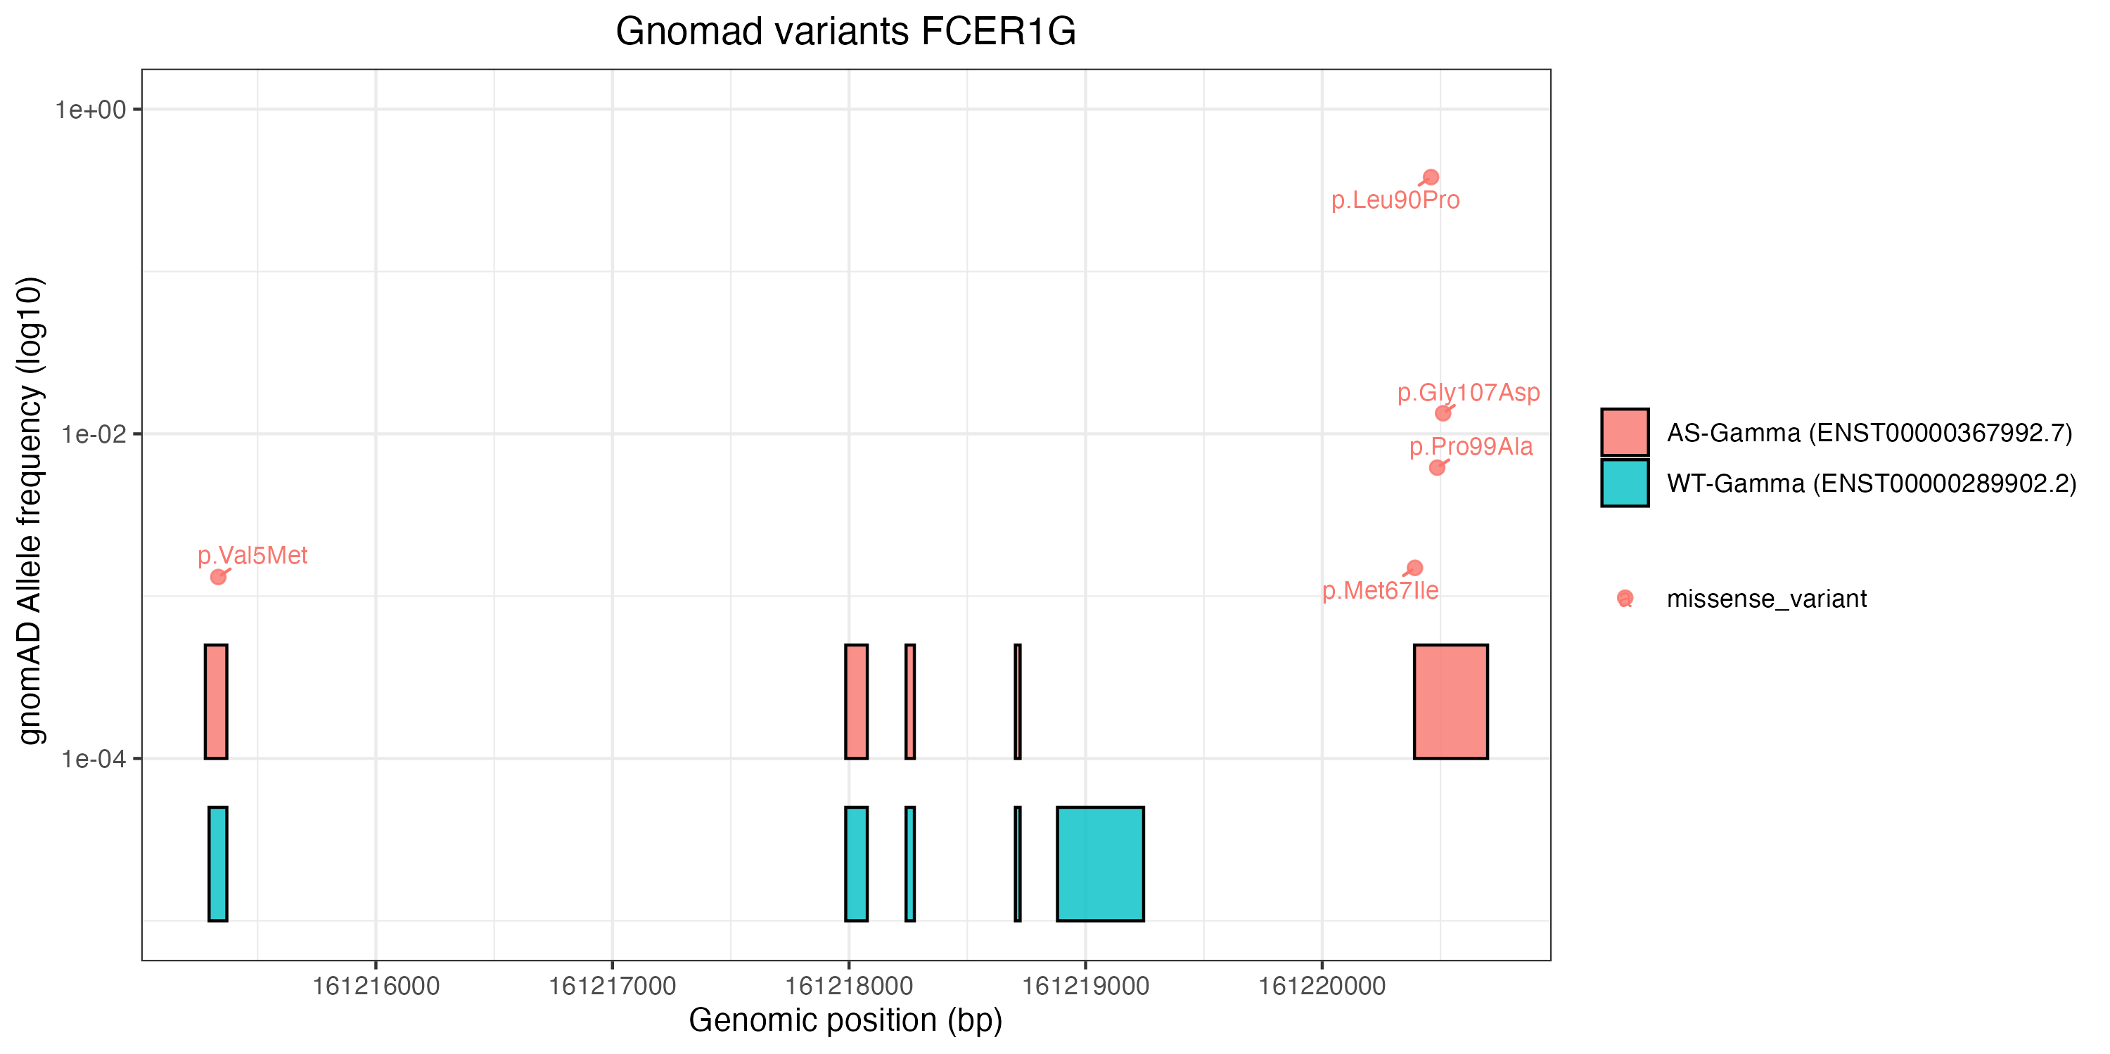
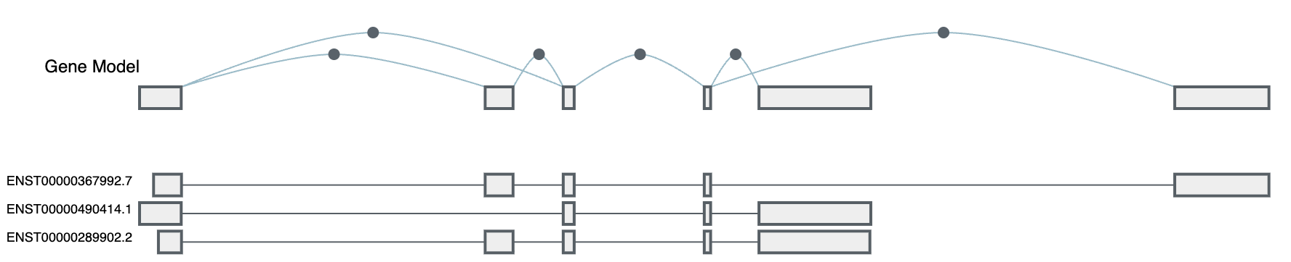
R
UCSC
GTex
Notes:
SNP plot in R: https://github.com/KimberlyLab/fcer1g_gnomad_snps
Transcript figure: https://gtexportal.org/home/gene/FCER1G/exonExpressionTab

Slide 3
gnomAD variants in FCER1G (non-synonymous coding; AF>0.001)
FCER1G exons
1
2
3
4
5
P(A)
5’
P(A)
WT-FcRγ mRNA
AS-FcRγ mRNA
Notes:
Exon diagram copied from Figure 1 (2025-12-08; v3-2-5)
SNP plot in R: https://github.com/KimberlyLab/fcer1g_gnomad_snps

Slide 4
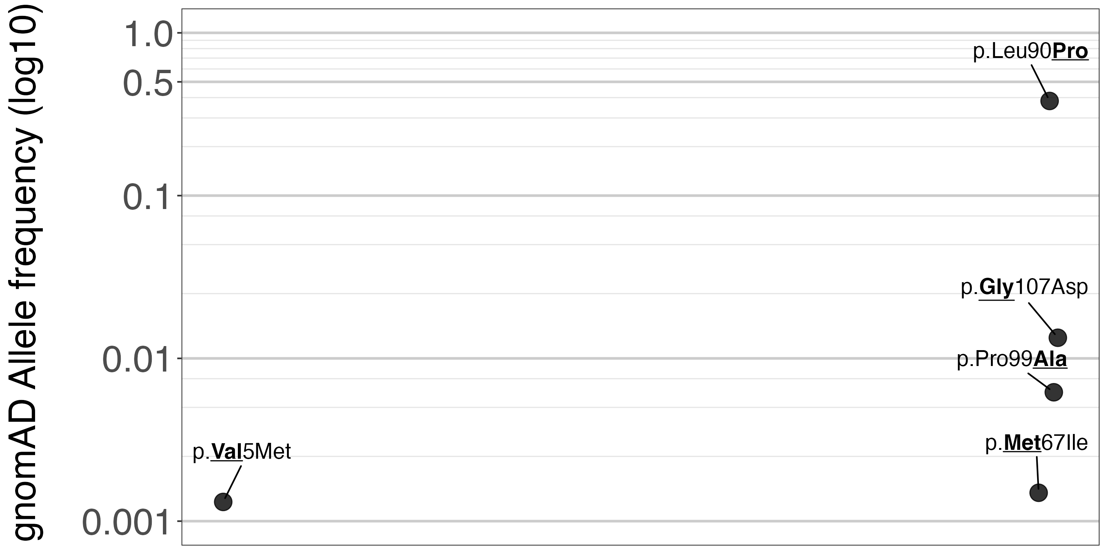
gnomAD variants in FCER1G (non-synonymous coding; AF>0.001)
WT-FcRγ mRNA
AS-FcRγ mRNA
1
2
3
4
5
P(A)
5’
P(A)
Notes:
Exon diagram copied from Figure 1 1 (2025-12-08; v3-2-5), and fixed up + red line
SNP plot in R: https://github.com/KimberlyLab/fcer1g_gnomad_snps

