Slide 1



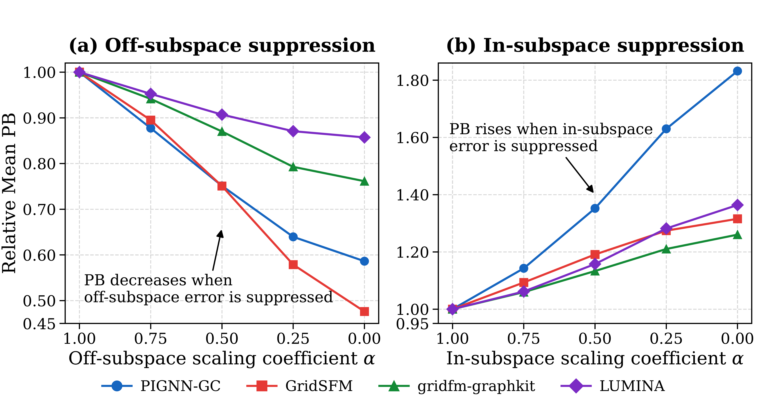
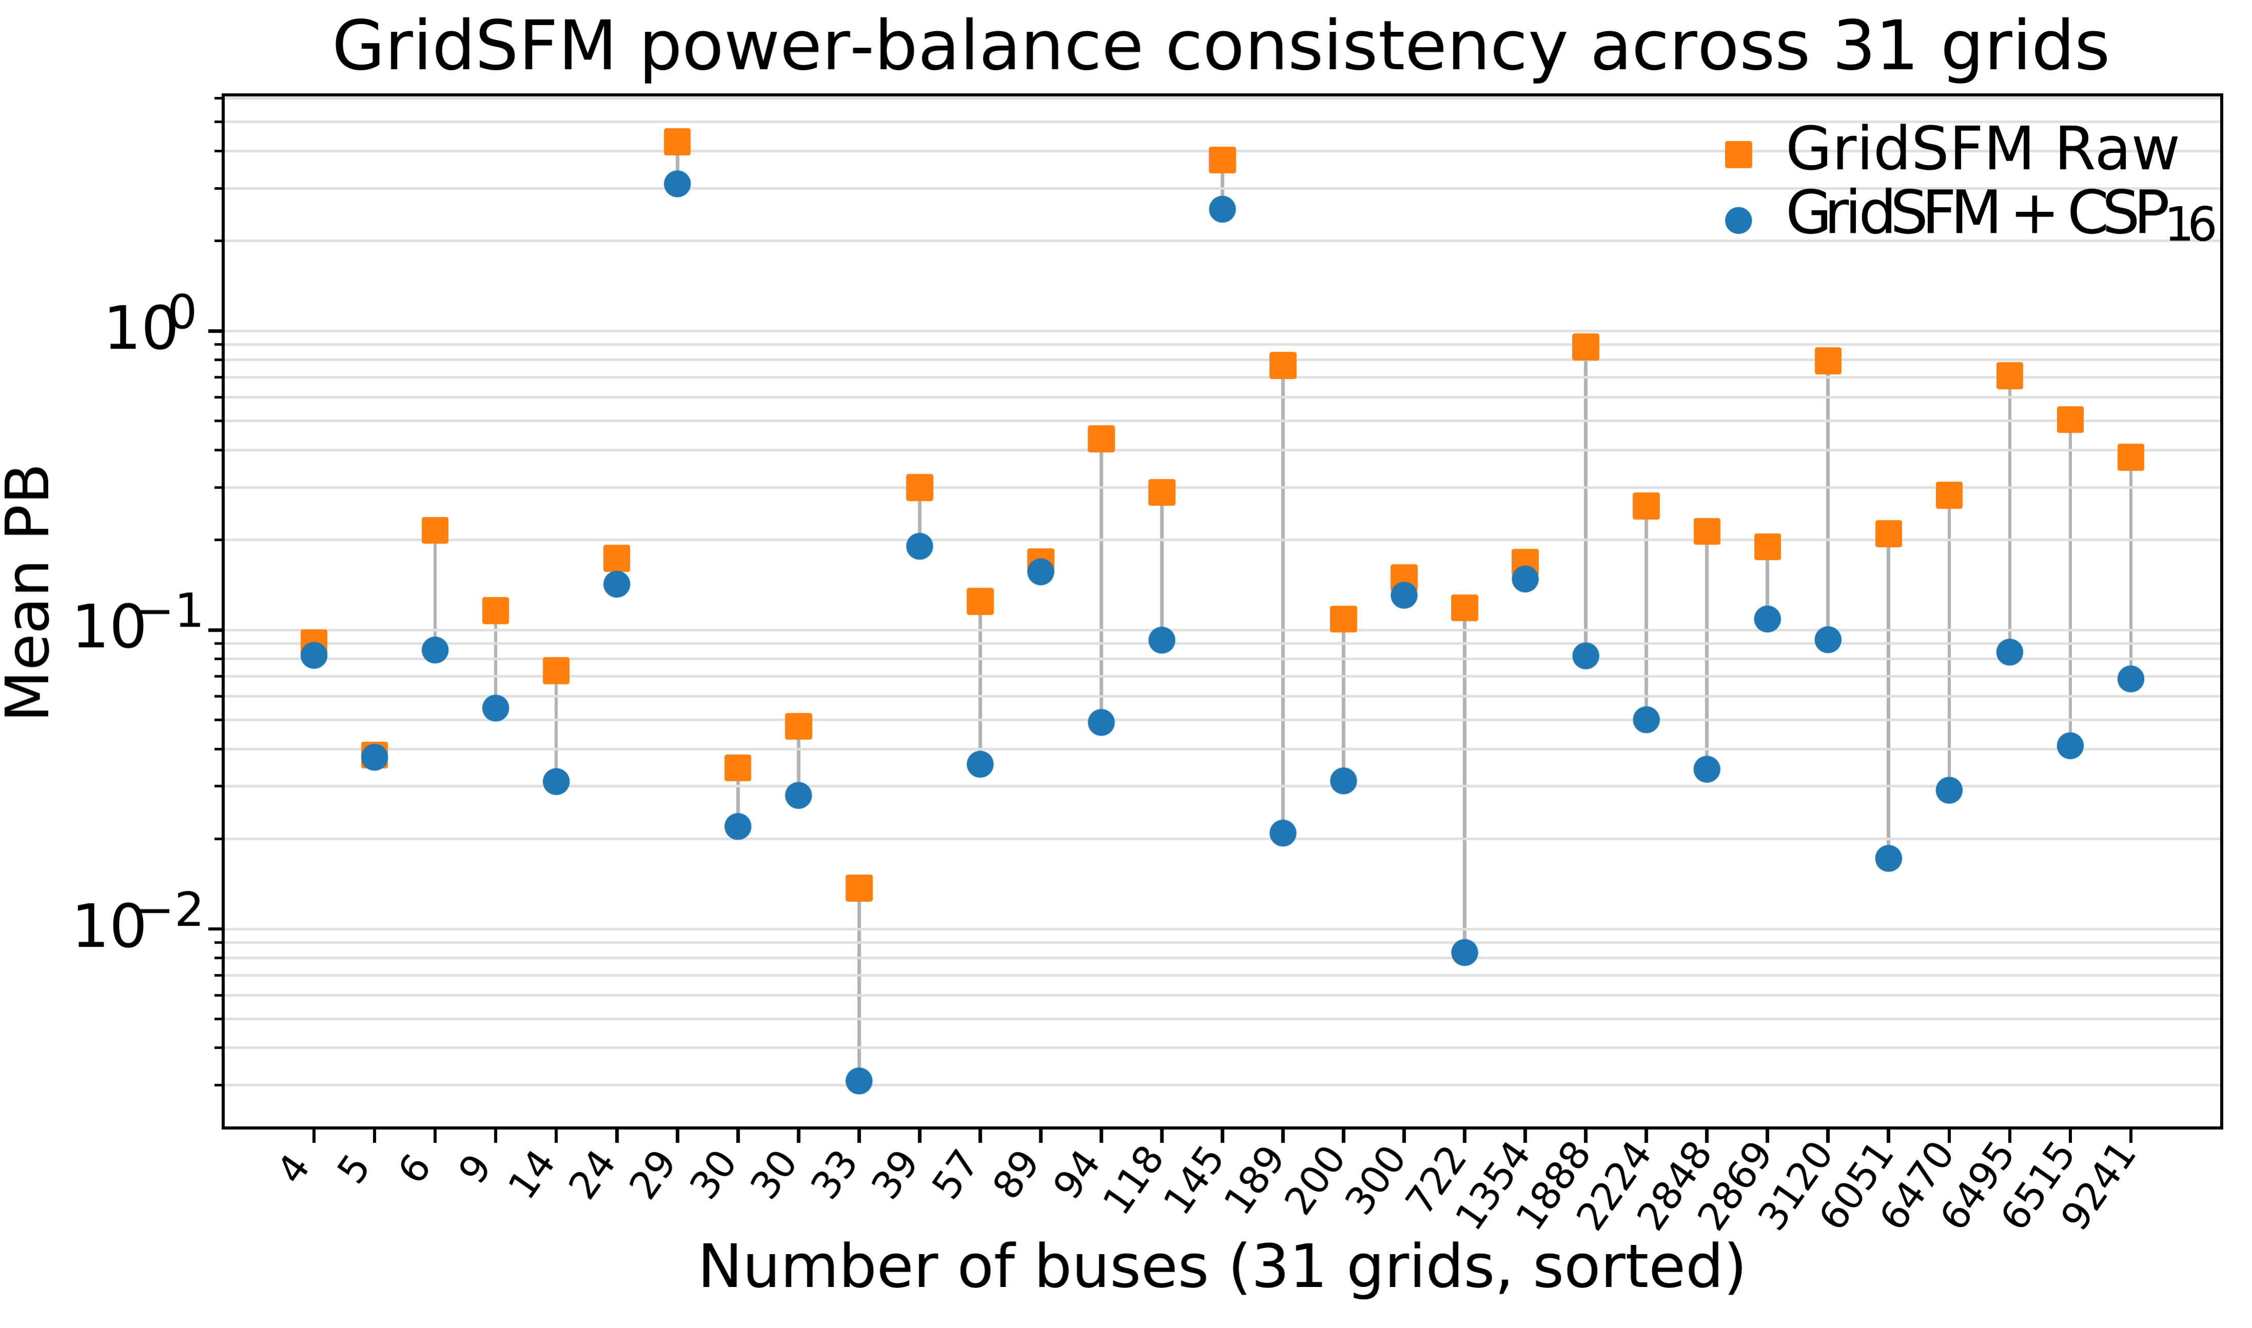
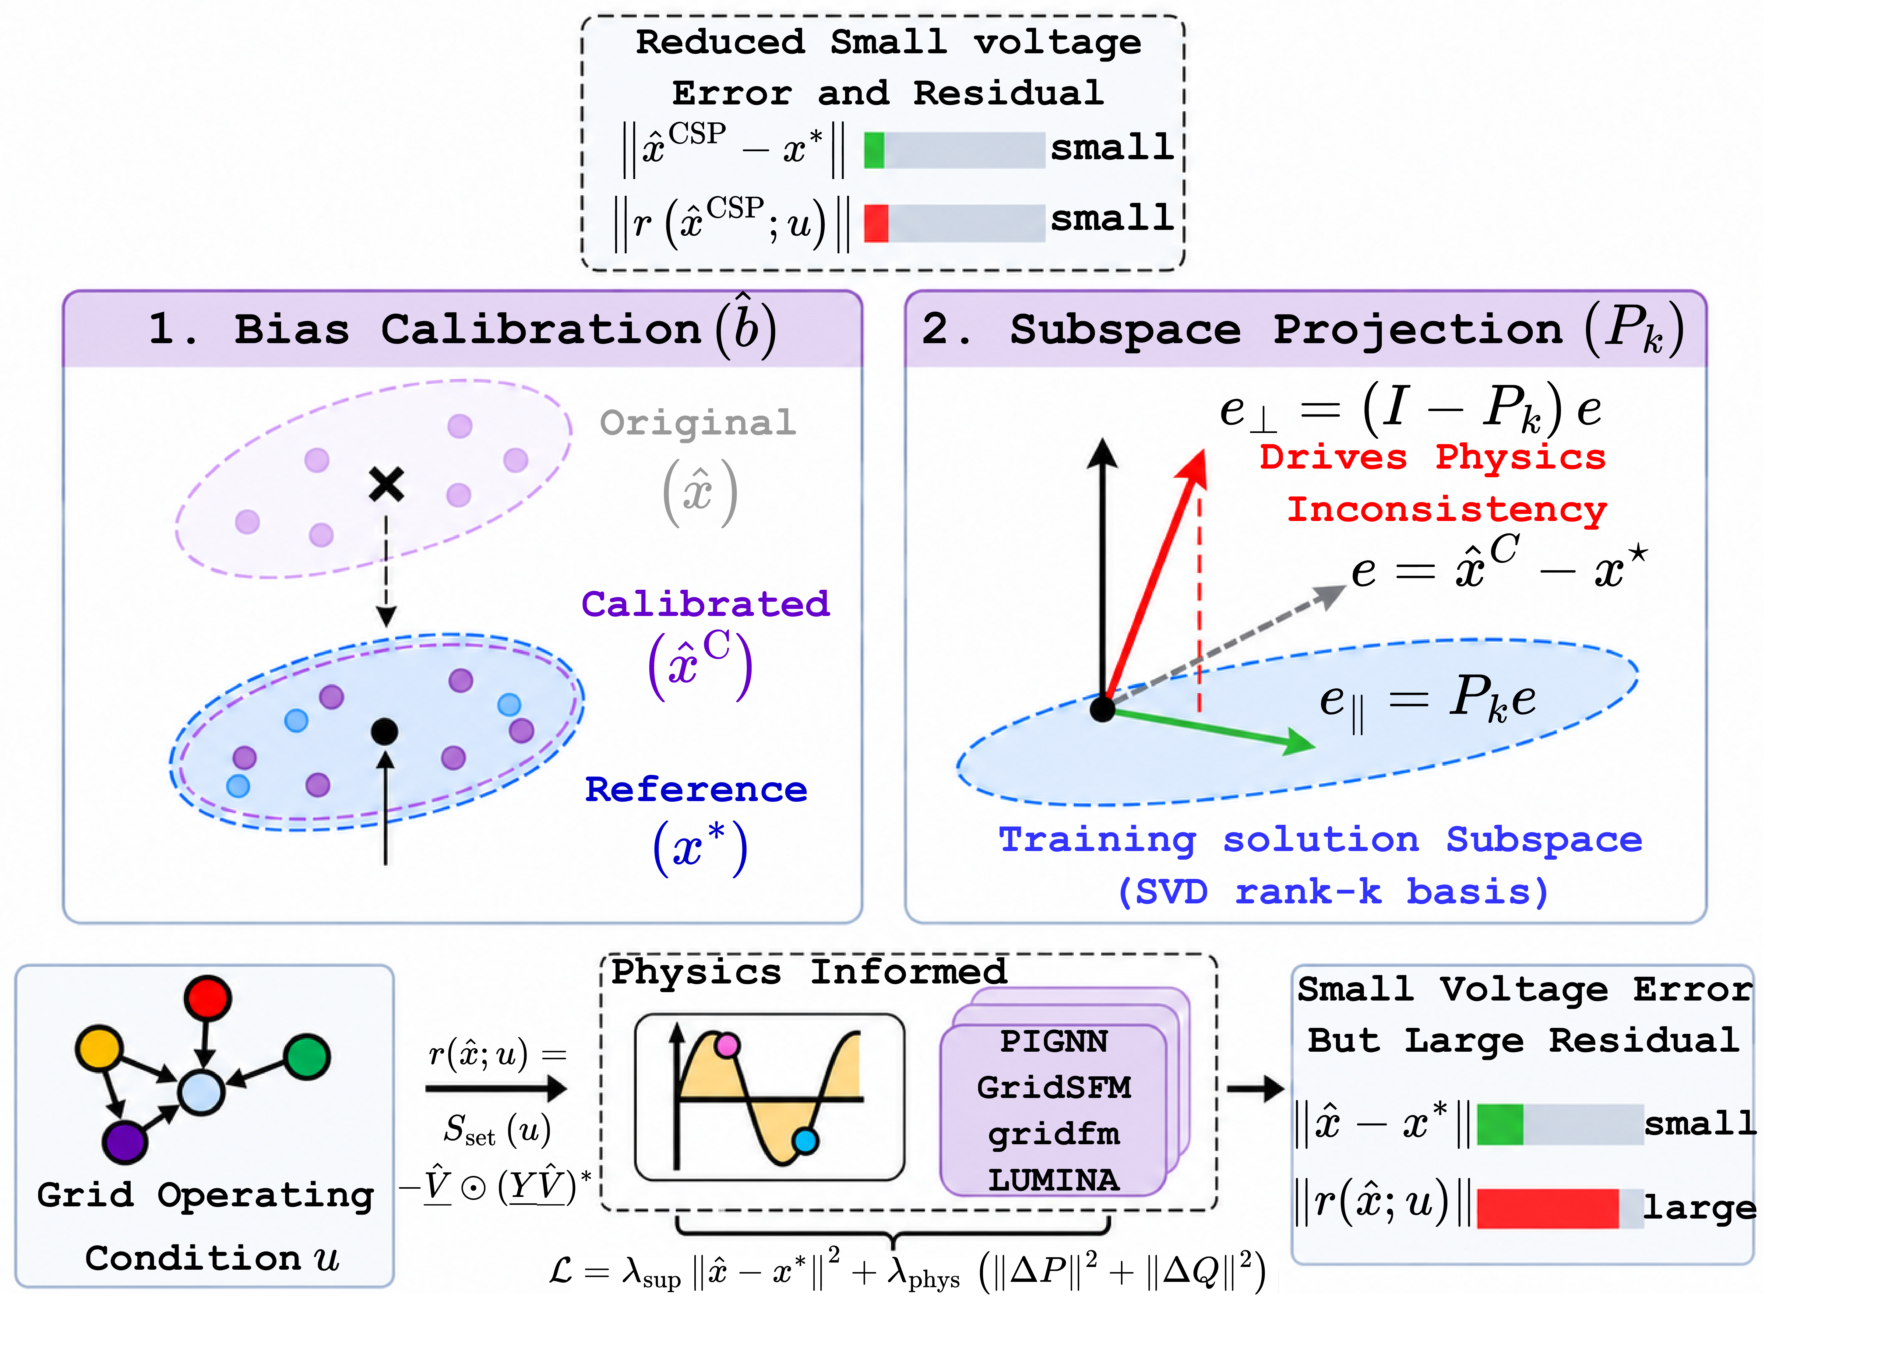
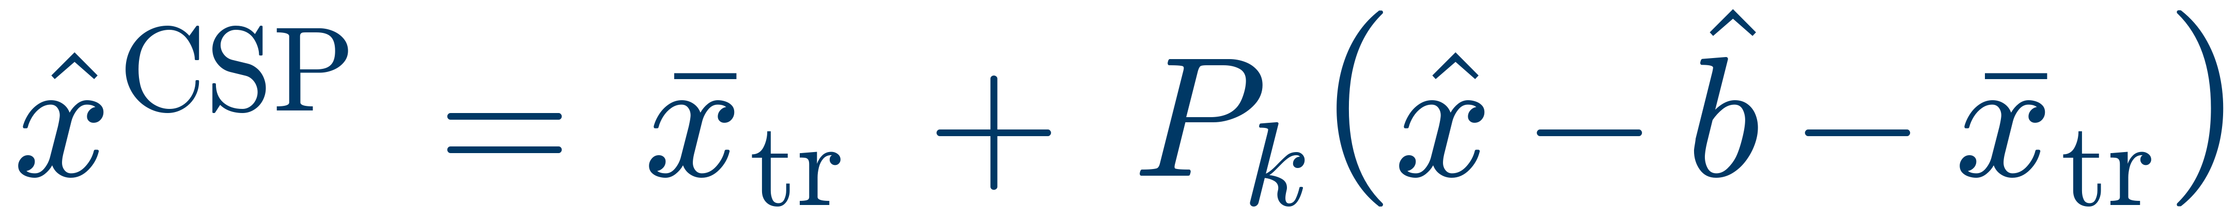




6th Workshop Conference on Foundation Models of the Electric Grid
29–30 October 2026 · Porto, Portugal
Physics-Informed but Not Physics-Consistent:
Error Geometry and Subspace Projection for Neural AC Power Flow
Changhun Kim¹, Timon Conrad², Redwanul Karim¹, Karan Pahlajani¹, Julian Oelhaf¹, David Riebesel², Tomás Arias-Vergara¹, Andreas Maier¹, Johann Jäger², Siming Bayer¹
¹Pattern Recognition Lab · ²Institute of Electrical Energy Systems · Friedrich-Alexander-Universität Erlangen-Nürnberg, Germany
Small voltage errors ≠ small AC power-balance residuals — the error direction explains this accuracy–consistency gap.
Calibrated solution-subspace projection (CSP) cuts power-balance residuals by 38–69 % on four frozen neural solvers — without retraining.
Motivation & Objective
C3 · Results: Four Frozen Neural Solvers
Neural AC power-flow surrogates use supervised losses on Newton–Raphson (NR) solutions; graph neural solvers and grid foundation models add physics-informed losses as soft penalties. Feasibility-seeking and NR warm starts also help.
Accuracy–consistency gap: small voltage errors do not imply small AC power-balance (PB) residuals; errors of the same magnitude can give very different residuals.
Hypothesis: AC-PF solutions are low-dimensional [5, 6], so the error direction — its part outside the NR solution subspace — drives PB inconsistency.
2224-bus GB network · 37k NR operating points · Mean PB reduction of CSP (k = 16) vs. calibrated output
−67.0 %
PIGNN-GC
−37.8 %
GridSFM
−40.5 %
gridfm-graphkit
−68.9 %
LUMINA
C1 · Finding: Off-Subspace Errors Drive Violations
Model | Mean PB ↓ C → CSP | Max PB ↓ C → CSP | V RMSE ↓ C → CSP (×10⁻³) | R²_{w} ↑ C → CSP
PIGNN-GC | .167 → .055 | 190 → 3.9 | 13.9 → 12.2 | .67 → .83
GridSFM | .083 → .051 | 7.3 → 4.9 | 10.9 → 7.8 | .77 → .94
gridfm-graphkit | .077 → .046 | 18.9 → 5.1 | 7.5 → 6.1 | .91 → .96
LUMINA | .214 → .067 | 20.7 → 4.6 | 17.8 → 15.7 | .44 → .91
Errors are split into in- and off-subspace parts (rank-16 SVD basis of training NR solutions). At fixed norm, removing the off-subspace part lowers PB in all four models; removing the in-subspace part raises it.
Mean over 3 seeds; PB in p.u. (100 MVA). C = train-only bias calibration. R²w = tracking of scenario-dependent voltage variation. Inference cost unchanged.
Generalization: 31 Grids & Newton Warm Start
Local AC Jacobian: off-subspace directions are 1,563× more residual-sensitive than in-subspace ones (median gain ratio).
C2 · Method: Calibrated Subspace Projection
GridSFM raw vs. with CSP (k = 16) on 31 systems (IEEE, PEGASE, RTE, GB, CIM; s ub-kV to 750 kV), log scale.
31 / 31
grids with lower Mean PB
(4 – 9,241 buses)
21–96 %
lower PB after one Newton
step started from CSP
Conclusion
Error direction, not only magnitude, explains the accuracy–consistency gap: off-subspace errors drive PB violations.
CSP is a plug-in correction: training data only, no retraining, negligible cost.
Lower PB and lower V RMSE on all four surrogates; gains carry over to 31 grids and Newton warm starts.
For grid foundation models: evaluate and design for error direction, not only magnitude.
Calibrate: remove the systematic, train-estimated bias b̂.
Project: suppress off-subspace components (top-16 SVD directions).
Lightweight post-processing · training data only · no retraining
References [1] C. Kim et al., PIGNN-Attn-LS, ICASSP 2026. [2] W. Yang et al., GridSFM, MSR white paper, 2026. [3] GridFM Team, gridfm-graphkit v0.9.0, 2026. [4] Y. Li et al., LUMINA, arXiv:2603.04300. [5] S. Park et al., IEEE Trans. Power Syst., 2024. [6] S. Chevalier et al., IEEE Trans. Power Syst., 2022.
Contact
Changhun Kim
Pattern Recognition Lab, FAU Erlangen-Nürnberg
✉ changhun.kim@fau.de
Code: github.com/Kimchangheon/neural-acpf-error-geometry
Paper: arXiv:2610.05959
Scan: Google Scholar
Supported by the GridAssist project under the “OptiNetD” initiative of the German Federal Ministry for Economic Affairs and Energy (BMWE), and by HPC resources from NHR@FAU, partially funded by the DFG.
Notes:
Hello everyone. Let me introduce our paper, “Physics-Informed but Not Physics-Consistent: Error Geometry and Subspace Projection for Neural AC Power Flow.”
[Background] Neural AC power-flow surrogates are trained with supervised losses on Newton–Raphson solutions. Foundation models such as gridfm-graphkit, GridSFM and LUMINA can add physics-informed losses as soft penalties. Feasibility-seeking methods also exist, and for exact consistency we can warm-start Newton–Raphson.
[Gap] But even with both losses, small voltage errors don’t guarantee small power-balance residuals. Errors of the same magnitude can give very different residuals. We call this the accuracy–consistency gap.
[Hypothesis] AC power-flow solutions are known to be low-dimensional; Park et al., for example, used PCA for AC-OPF. So we hypothesized that the error’s direction matters, especially the part outside the subspace of Newton–Raphson solutions.
We make three contributions.
[C1] First, we split each model’s error into in- and off-subspace parts using an SVD basis of the training solutions. Fixed-norm experiments and Jacobian analysis show that off-subspace errors dominate the residual.
[C2] Second, we propose CSP, Calibrated Solution-Subspace Projection. It removes the systematic bias, then suppresses the off-subspace components. It uses only training data, with no retraining.
[C3] Third, on the 2,224-bus GB network, CSP reduces both power-balance residuals and voltage-magnitude errors in all four models, and it gives a better starting point for one Newton step.
So the error’s direction, not only its magnitude, explains the gap. Thank you.

