Slide 1





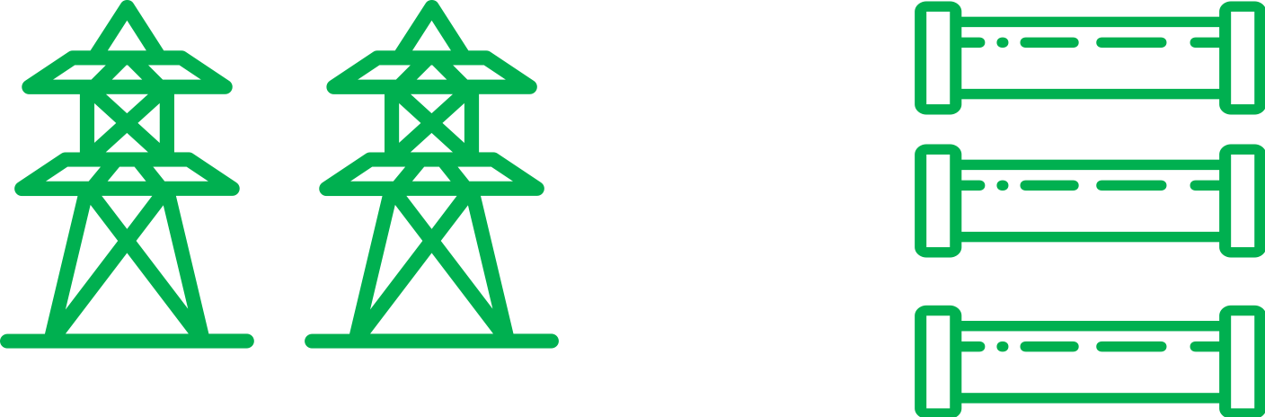
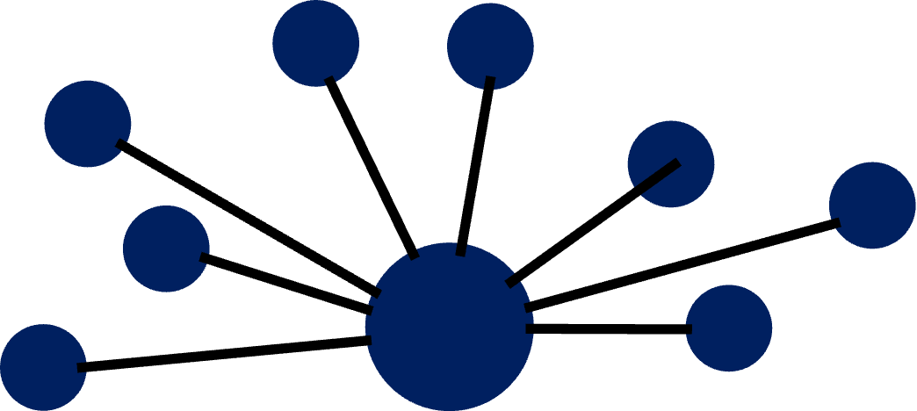
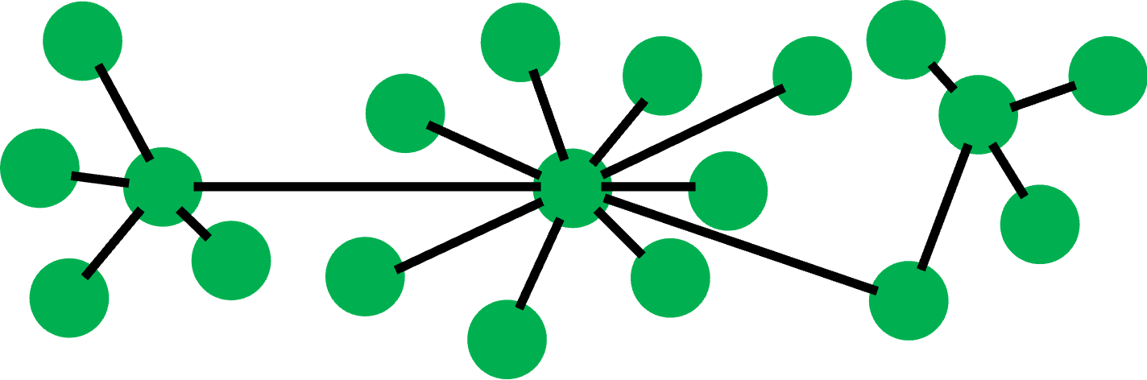


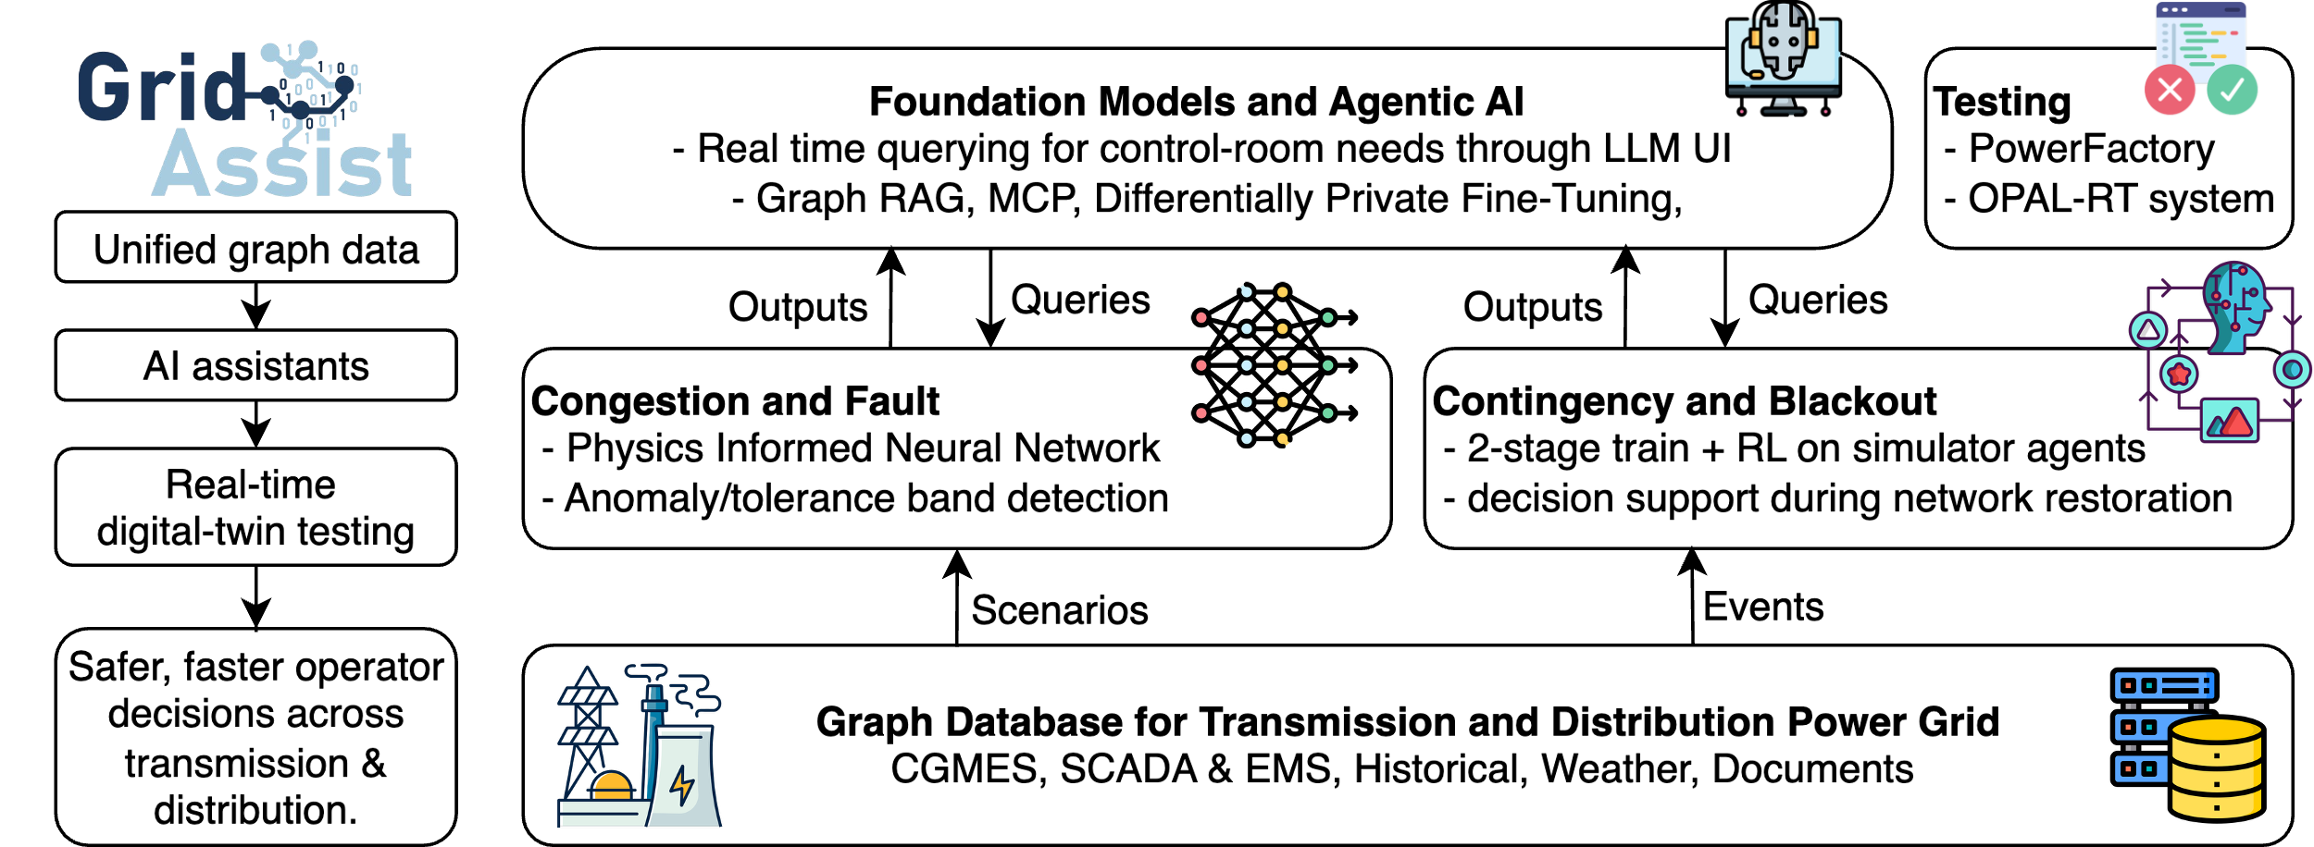
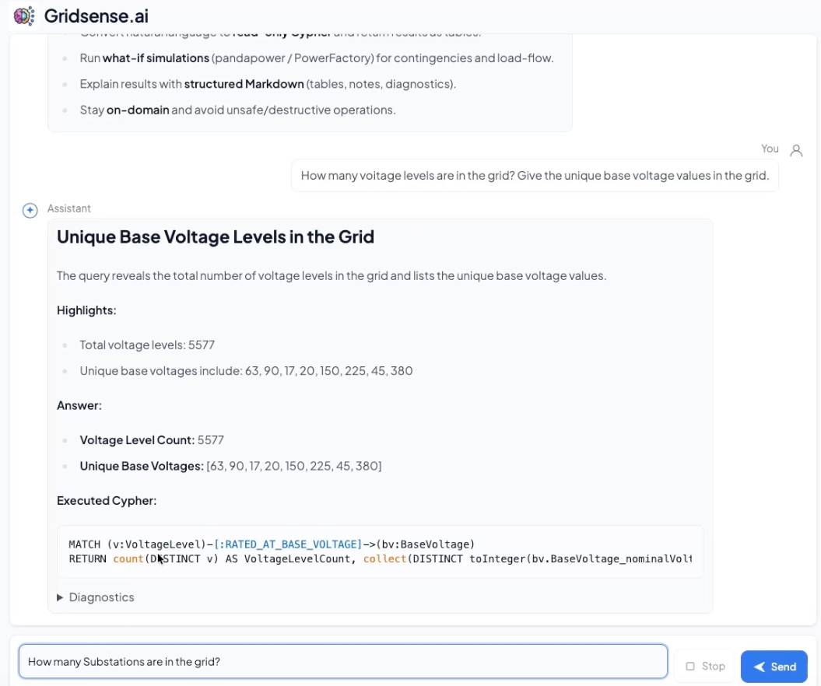
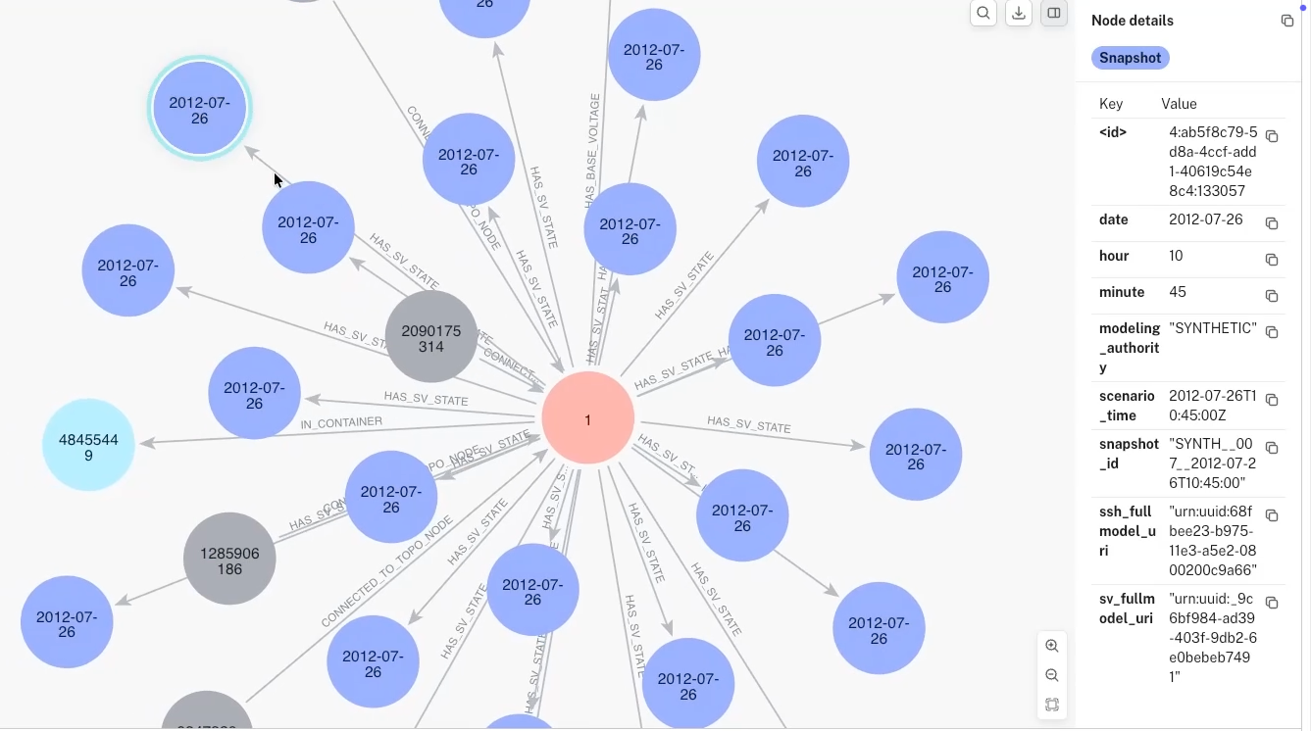

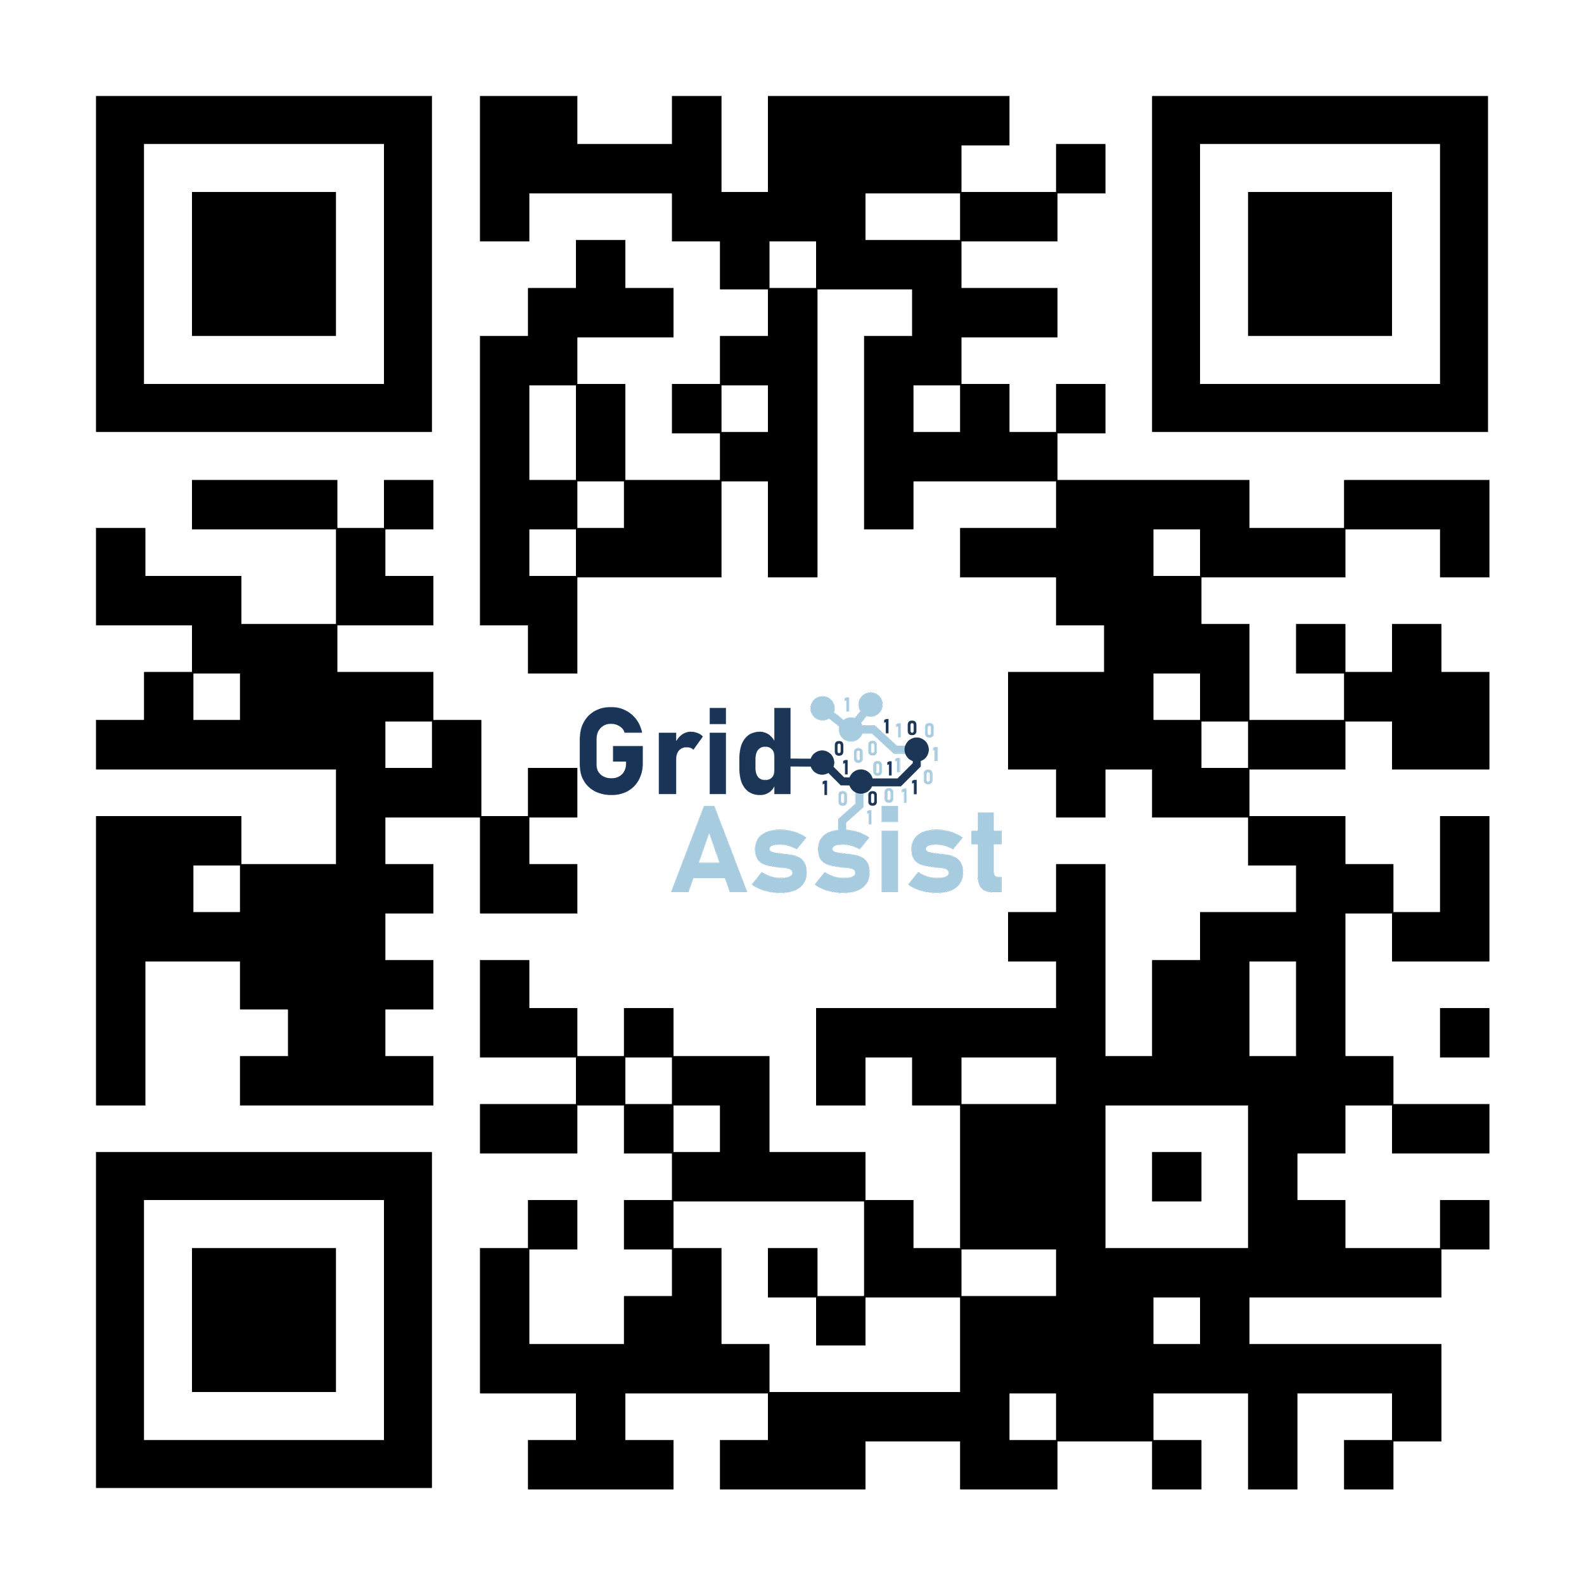


GridSense: Ask your Power Grid
Changhun Kim¹, Redwanul Karim¹, Julian Oelhaf¹, Nora Gourmelon¹, Tomás Arias Vergara¹, Timon Conrad², David Riebesel², Lukas Mayerhofer³, Fabian Mengele³, Michael Jaworski³, Johann Jäger², Andreas Maier¹, and Siming Bayer¹
¹ Pattern Recognition Lab, Department of Computer Science, Friedrich-Alexander University Erlangen-Nürnberg, Erlangen, Germany
² Institute of Electrical Energy Systems, Department of Electrical Engineering, Friedrich-Alexander University Erlangen-Nürnberg, Erlangen, Germany
³ LEW Distribution Grid GmbH, Lechwerke AG, Augsburg, Germany
Germany's Energy Transition: Transforming Power Generation, Transmission, and Distribution.
THEN
NOW
THEN
NOW
Production
Transmission
Market
Power Flow Direction
GridAssist: AI + Knowledge Graphs for Safter, Faster Power Grid Operations
GridSense: Live Demo Scenarios
Power Grid Graph Database based on Neo4j
Static Common Information Model Knowledge Graph (Hierarchy + Topology + Equipment)
Dynamic Snapshot Overlay (Snapshot nodes + state relationships)
Contact
Changhun Kim
Pattern Recognition Lab, Department of Computer Science,
Friedrich-Alexander University Erlangen-Nürnberg, Erlangen, Germany
Changhun.kim@fau.de
 +49 9131 85-27872

