Slide 1




GridSense: Ask Your Power Grid
LLM-based power-grid analysis
IEEE PES GM 2026 Panel EDPG4: Power Grid Artificial Intelligence - European Solutions
Tuesday, July 21, 2026 | Room 511A
Changhun Kim, FAU Pattern Recognition Lab
Notes:
Hello everyone. My name is Changhun Kim, from the Pattern Recognition Lab at Friedrich-Alexander University Erlangen-Nürnberg in Germany.
Today, I will present our ongoing work, GridSense: Ask Your Power Grid, which is an LLM-based approach for power-grid analysis. This work is part of the GridAssist consortium, together with colleagues from our lab and Professor Jaeger’s group as well as companies like siemens opal-rt, TSO and DSO.

Slide 2
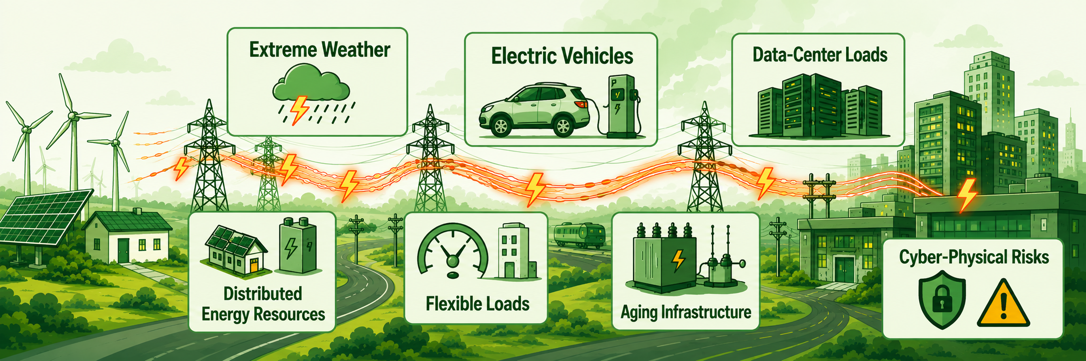
Why
Why now? Grid operation is becoming context-intensive
Modern grid operation must reason across highly dynamic and uncertain conditions: DERs, extreme weather, EVs, flexible loads, data-center demand, aging infrastructure, and cyber-physical risks.
The bottleneck is the human effort required to connect heterogeneous grid data, engineering tools, and operator intent into one reliable decision workflow.
Dynamic grid
>
Fragmented data + tools
>
Operator decision
Notes:
Let me start with the motivation.
Modern grid operation is becoming both data-intensive and context-intensive. Operators increasingly need to reason across dynamic and uncertain conditions: distributed energy resources, extreme weather, electric vehicles, flexible loads, data-center demand, aging infrastructure, and cyber-physical risks.
Because of this, even a single operational question often depends on many pieces of context. Operators need to identify the relevant data, understand the current grid state, choose the right analysis method, and interpret the result in a way that supports a decision. GridSense is useful because it helps connect these scattered pieces into one reliable workflow.
---
Modern grid operation is becoming data-intensive and context-intensive with the highly dynamic and uncertain properties.
Operators need to reason across topology, assets, measurements, simulations, weather, flexibility, and operational constraints.
But these pieces are often separated across different tools and data formats, so even simple questions can become manual workflows. The difficult part is not only running a power-flow calculation. The difficult part is connecting the right data, tools, and operational intent into one reliable decision workflow.

Slide 3
Recent Grid Agent papers
LLMs are useful when they orchestrate, not when they replace tools
LLM + structured grid data + deterministic tools + validation = useful engineering assistant
Grid-Agent
GridMind
Autonomous violation detection and corrective control.
Conversational ACOPF and N-1 contingency analysis.
Shared core
LLM agents
+ grid data
+ tools
+ modular
+ extensible
Control + remediation
Analysis capabilities
Topology changes, dispatch, load adjustment.
Workflow orchestration with deterministic solvers.
X-GridAgent
Broad grid analysis with RAG, MCP, and extensible tool servers.
Understand the user’s intent and orchestrate the workflow, while the numerical and factual claims remain grounded.
LLM
+
Grid data
+
Tools
+
Validation
CIM/CGMES, topology, assets, measurements.
Power flow, OPF, contingency, restoration logic.
Schemas, solver checks, audit trail, human approval.
The LLM provides intent understanding, planning, context, and explanation. The grid facts come from data and tools.
Notes:
Of course, GridSense is not the only work exploring LLM agent for power systems. Recent LLM-based grid-agent systems already show important directions.
For example, Grid-Agent focuses on autonomous violation detection and corrective control. GridMind focuses on conversational AC optimal power flow and N-1 contingency analysis. X-GridAgent takes a broader direction, using RAG, MCP, and extensible tool servers for different power-grid analysis tasks.
Although these systems differ in scope, they share one engineering pattern: rather than simply guessing grid answers, they are used to call deterministic tools, access structured grid data, and produce results that can be validated and explained.
---
Recent LLM-agent research shows a promising direction: LLMs should not replace power-system tools, but they can act as an intent-understanding and orchestration layer connected to structured data, solvers, validation, and audit trails.
Recent LLM-agent research gives a useful message. LLMs should not replace power-system tools, protection logic, or operator judgment. Their value is different. GridMind shows conversational scientific computing with deterministic solvers. Grid-Agent shows planning with sandbox validation and rollback. X-GridAgent shows natural-language coordination of multiple grid-analysis tools. So the LLM is valuable as an intent-understanding and orchestration layer, while the numerical and factual claims remain grounded.

Slide 4
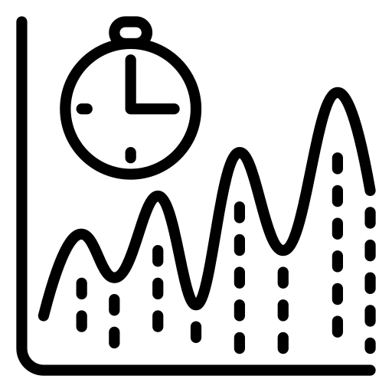


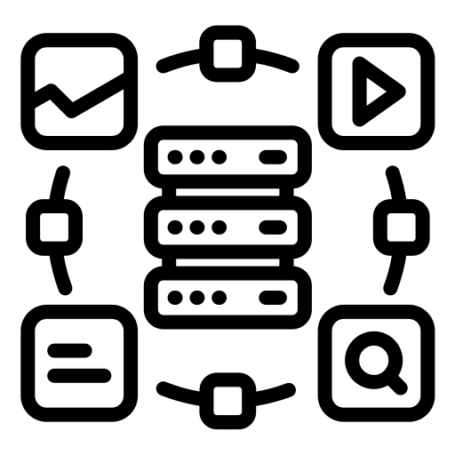
GridSense Novelty
GridSense grounds in Knowledge Graph
Compared with generic LLM-agent grid frameworks, GridSense starts from CGMES/CIM and turns the grid model into a queryable heterogeneous Neo4j graph.
GridSense adds the missing data foundation
Existing agentic grid AI
GridSense result
Grid-Agent, GridMind, and X-GridAgent show LLMs can coordinate analysis and tools.
CGMES / CIM
>
Neo4j graph
>
Cypher retrieval
LLM answers are grounded in explicit graph evidence, not only conversational reasoning.
European standard grid model
Topology, assets, equipment, context
Schema-aware, traceable answers
Time-series snapshots
Restoration paths
Weather context
Heterogeneous graph
Novelty: GridSense turns European standard grid data into a solid graph-grounded evidence layer for LLM-based operation support.
Operating states are linked to the same equipment graph.
Shortest-path search supports candidate energization routes.
External risk data can enrich topology-aware decisions.
Grid, time, weather, documents, and analysis outputs share one evidence layer.
Notes:
So what is the novelty of GridSense?
Compared with these existing LLM-agent approaches, GridSense adds a data foundation that is especially relevant for European grid operation. It starts from European standard grid data, namely CGMES. Then it converts the grid model into a heterogeneous Neo4j graph database.
On top of this graph, GridSense uses schema-aware Cypher queries for correct and traceable retrieval. This means the LLM is not answering from memory. It is guided by the graph schema, retrieves explicit grid evidence, and produces answers that can be checked.
This graph foundation also allows us to go beyond static grid topology. We can link time-series operating snapshots to the same physical assets. We can use shortest-path algorithms for restoration support. And we can incorporate external context, such as weather data, into the same heterogeneous graph.
So the key novelty is not simply natural-language interaction. The key novelty is knoweldge graph-grounded, standards-based, and verifiable grid intelligence.
GridSense follows this principle. It lets users ask natural-language questions about the power grid, translates them into graph-based
queries and analysis workflows, and returns answers grounded in the grid model. In this sense, GridSense is not a chatbot for the grid; it is a human-centered interface to structured, verifiable grid intelligence.”
Here I want to emphasize the novelty of GridSense compared with existing LLM-agent grid methods. Grid-Agent, GridMind, and X-GridAgent show that LLM agents can coordinate grid analysis and tools. GridSense adds a data foundation that is especially relevant for European grid operation. It starts from CGMES and CIM, converts the grid model into a heterogeneous Neo4j graph, and uses schema-aware Cypher queries for correct, traceable retrieval. On top of that graph, GridSense can link time-series operating snapshots to the same assets, use shortest-path algorithms for restoration support, and incorporate weather or other external context. So the key novelty is not simply natural language. It is graph-grounded, standards-based, verifiable grid intelligence.

Slide 5
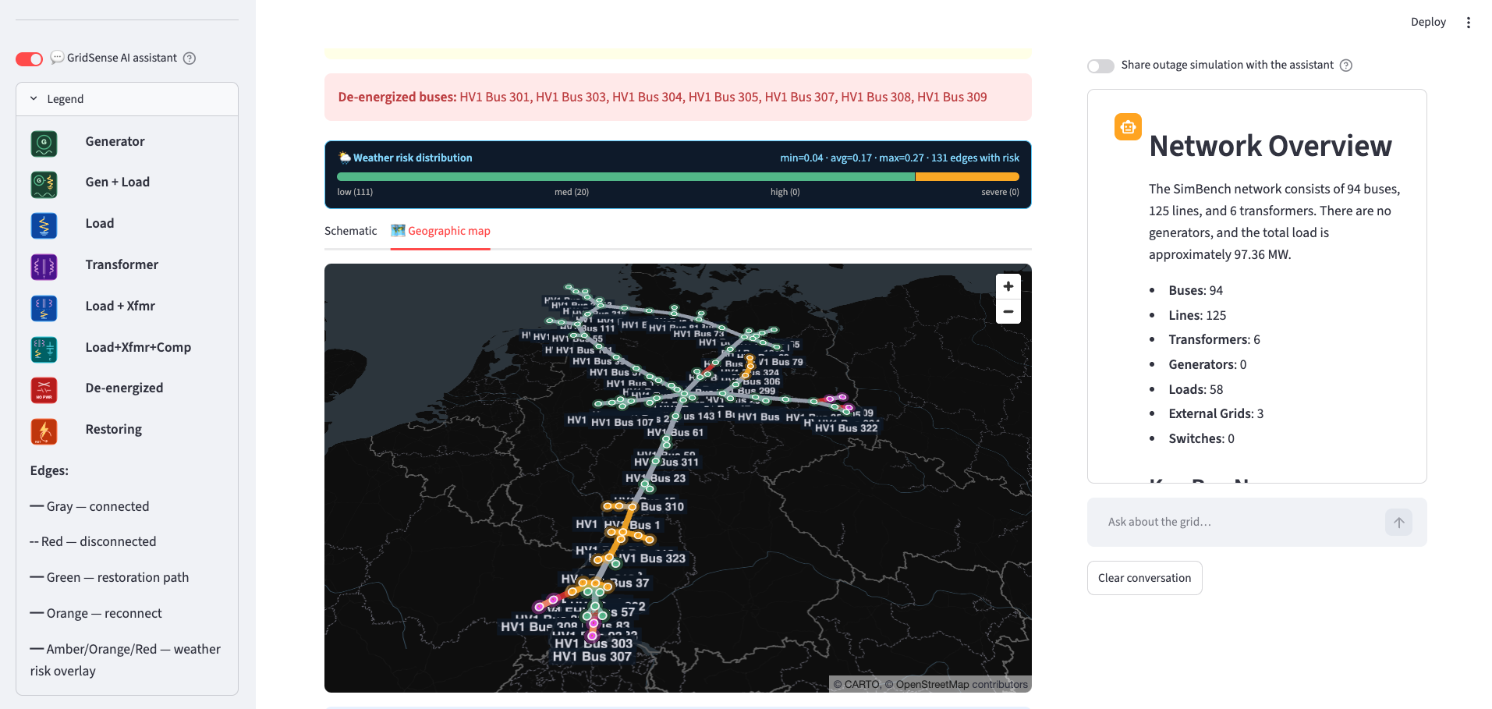
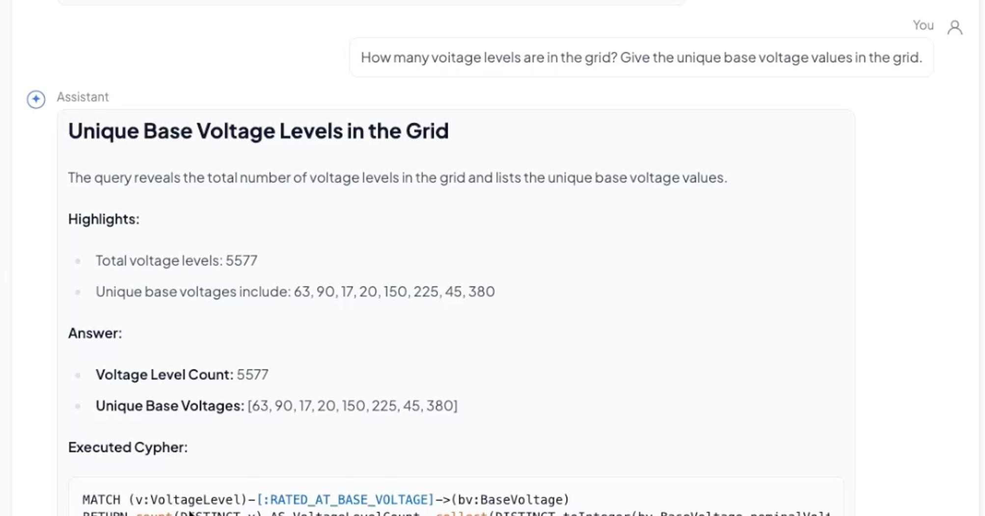
Demo 1
The visible product is a grid interface, not a simple chat UI
The operator can ask a natural-language question, inspect the returned answer, and see the executed Cypher for audit.
Notes:
From now on, I will show you the demo video of GridSense which has
---
Finally, let me show how this appears to the user.
The interface is designed to be simple for the operator. The operator sees the grid, asks a question in natural language, and receives an answer. But importantly, the generated Cypher query is also visible.
This is a central design choice. GridSense should be conversational, but it should not be opaque. The user can see not only the final answer, but also the evidence path behind that answer. In this way, the LLM becomes an interface to structured grid knowledge, while the graph database remains the source of truth.

Slide 6
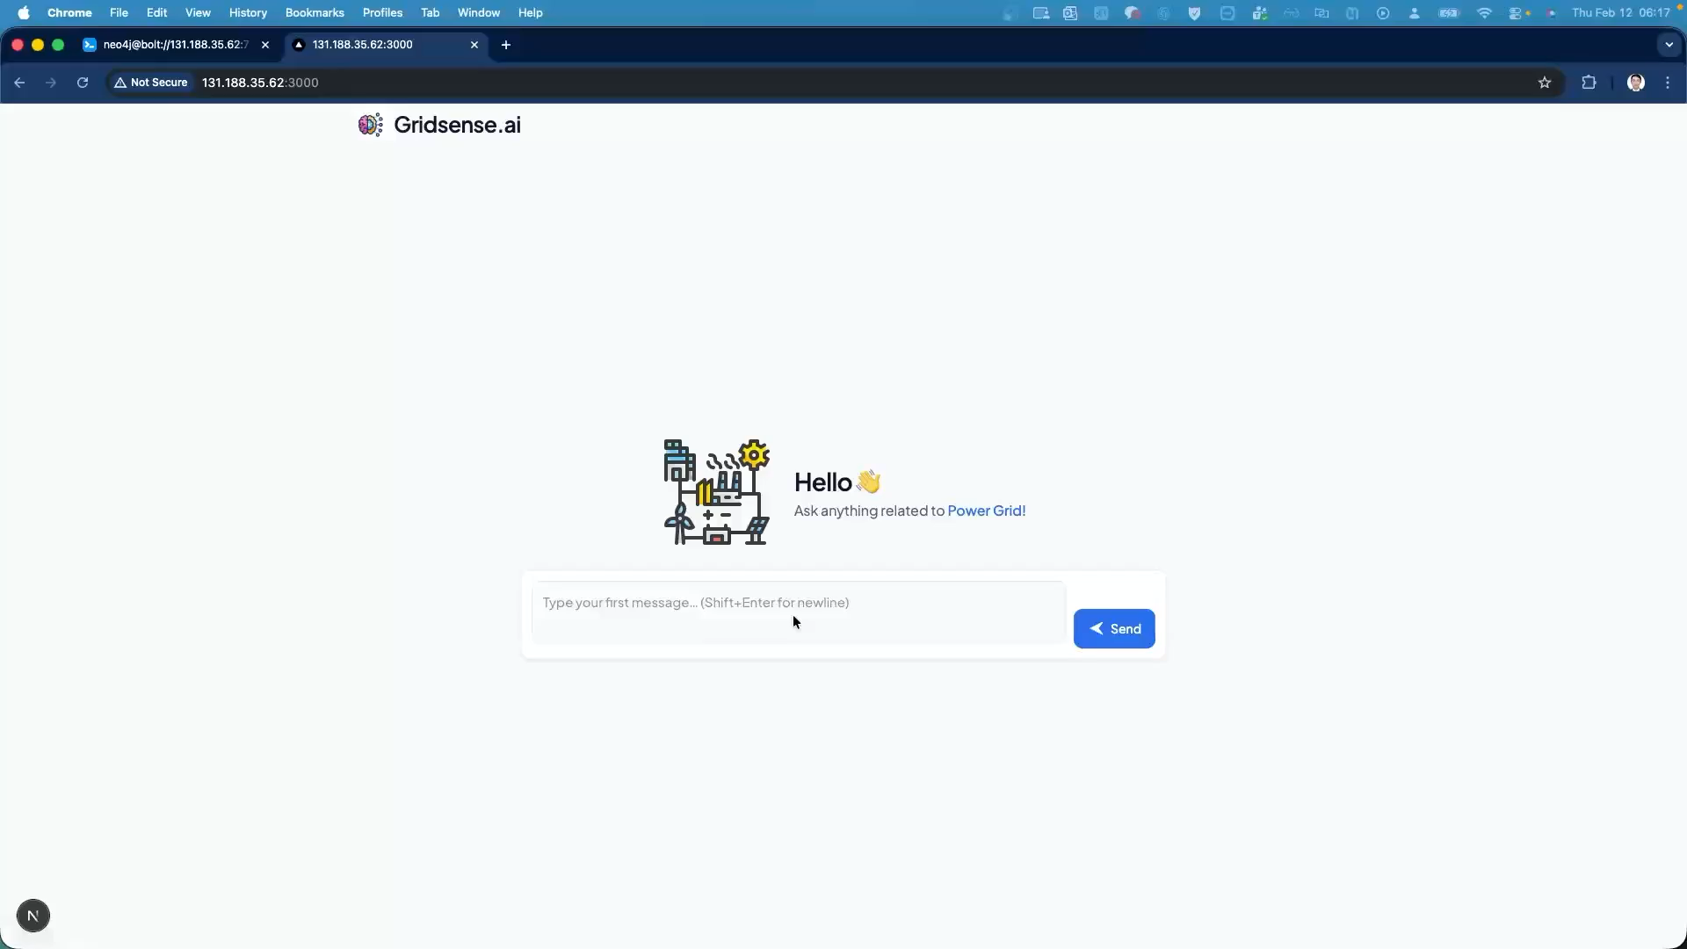

Slide 7
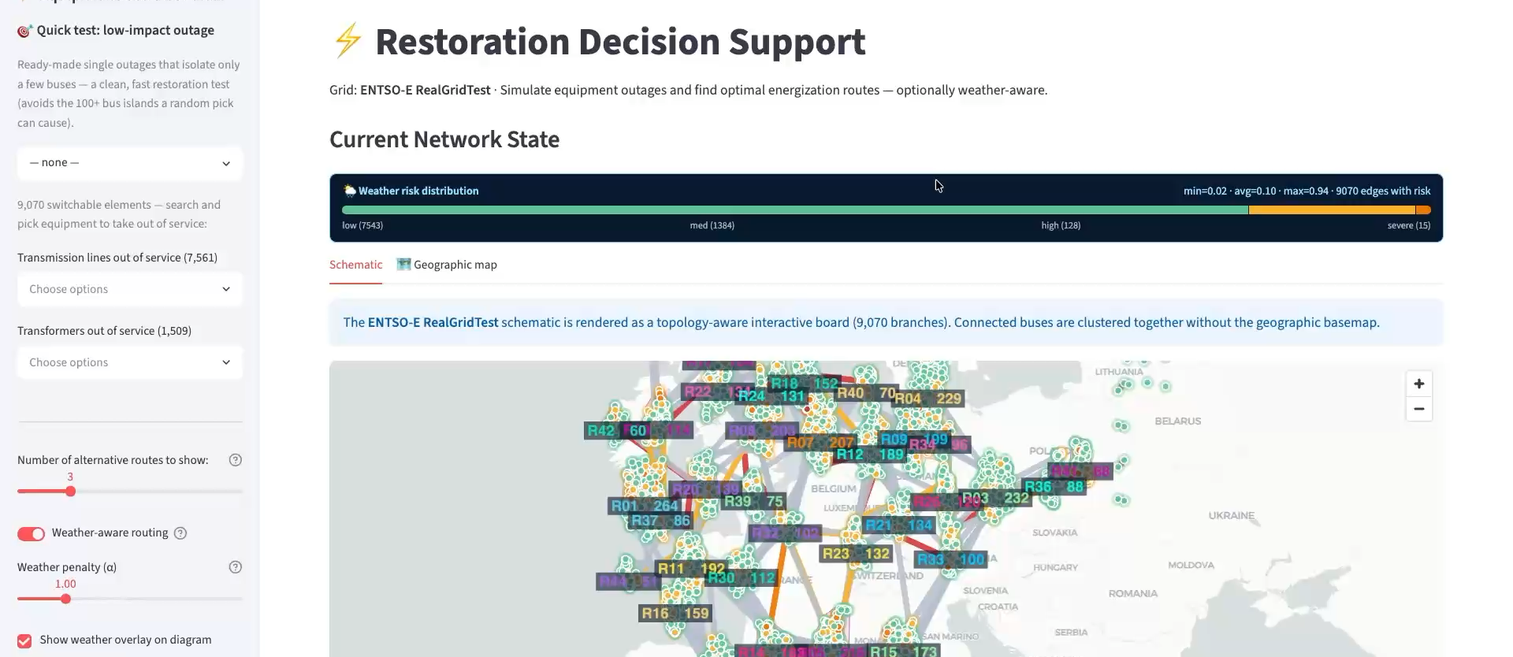
Demo 2
Restoration support turns graph search into operator options
Outage simulation -> energized/de-energized area detection -> candidate energization routes -> switching actions for human review.
Demo clip: restoration
Operator output
Candidate routes, ranked alternatives, and switching actions for review.
Notes:
The restoration demo is the strongest operational example. After an outage, GridSense detects energized and de-energized areas, searches candidate restoration paths, ranks alternatives, and lists equipment that must be reclosed or reconnected. This remains decision support; the operator reviews the evidence and approves actions.

Slide 8


Slide 9
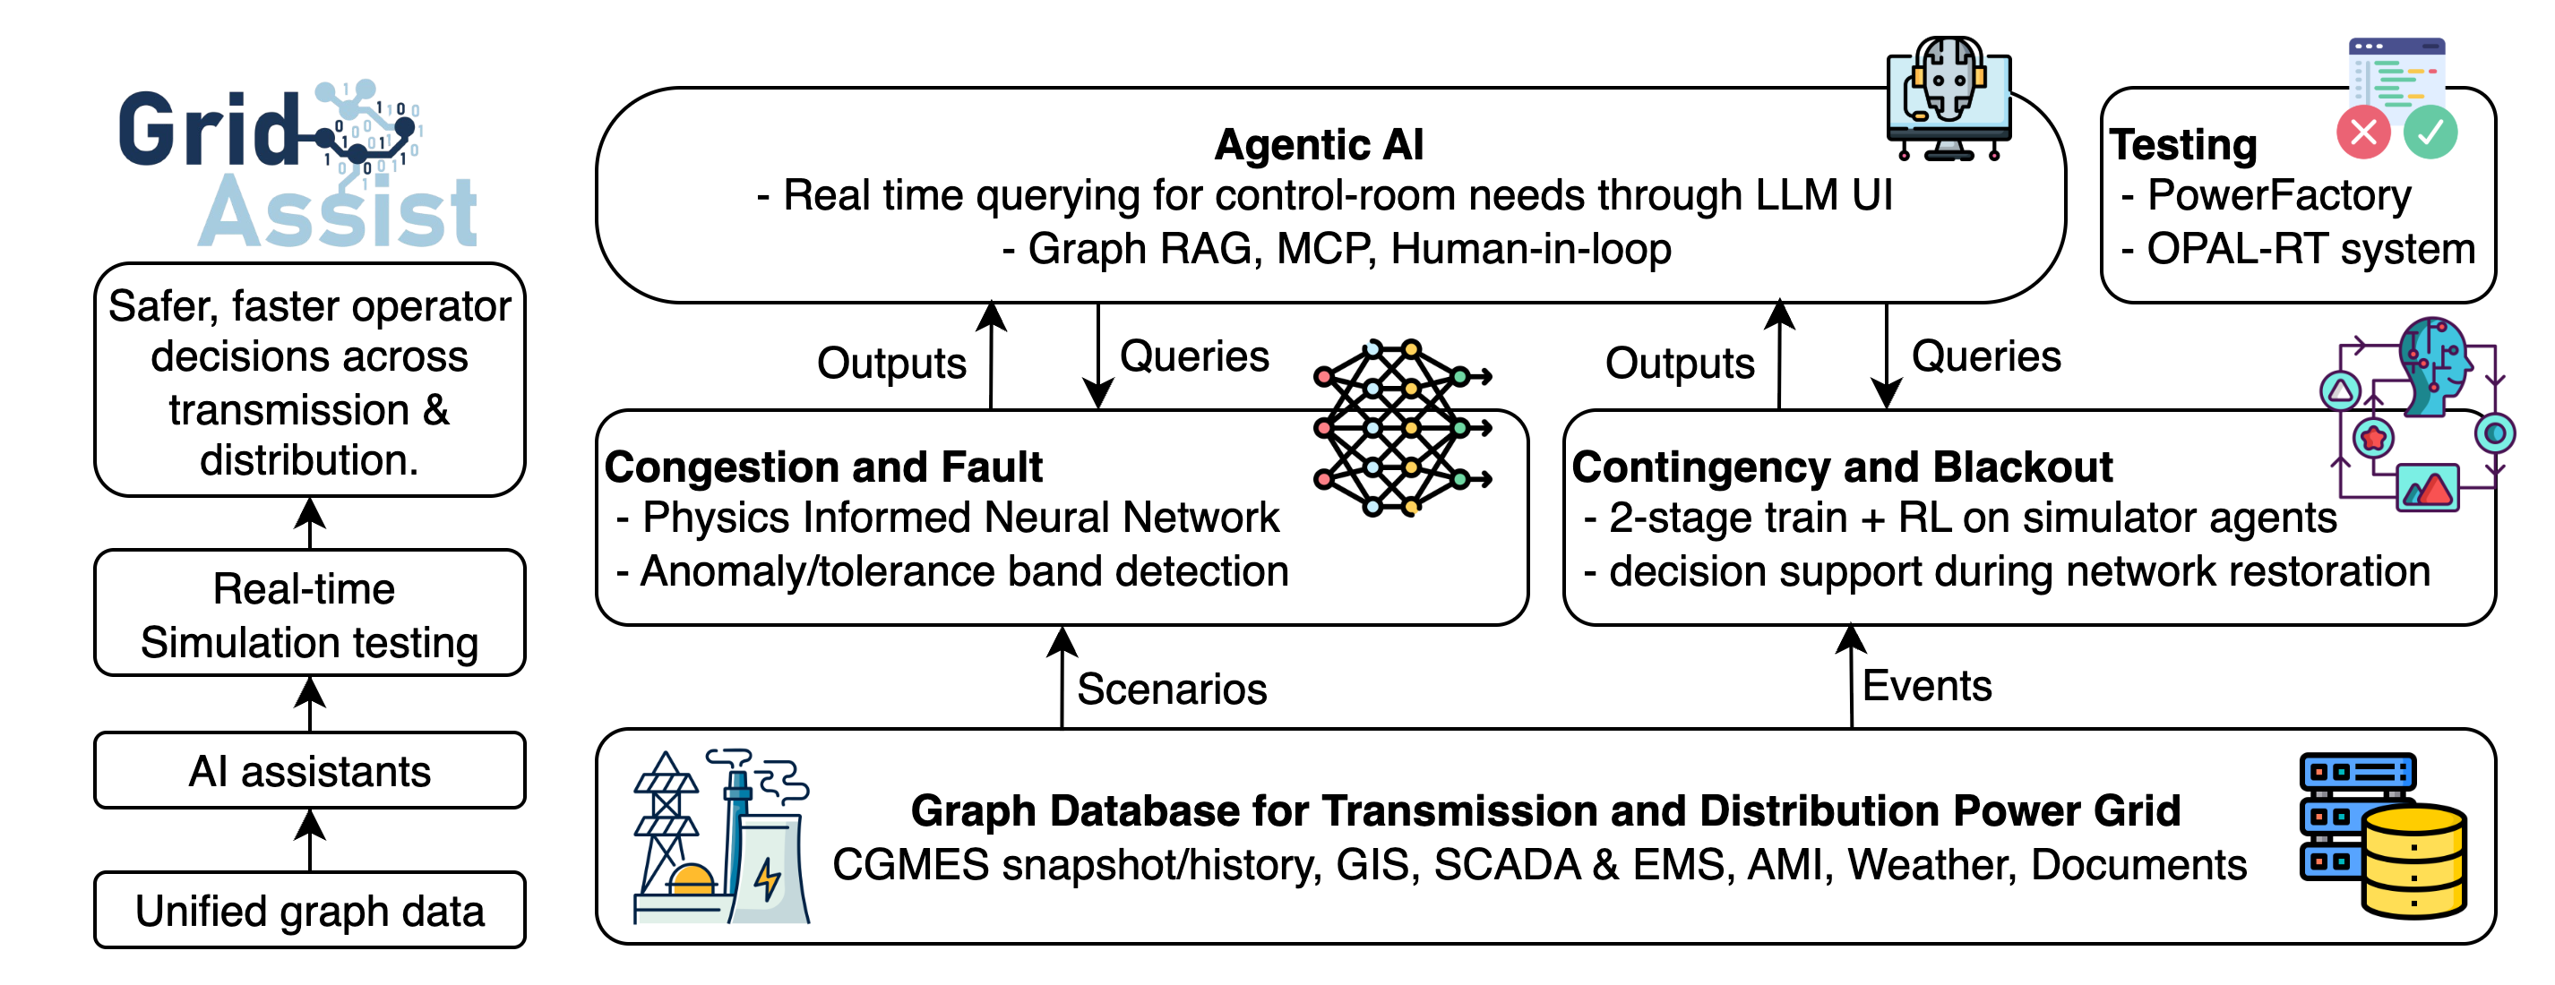
Demo 3
Graph queries become engineering computation
Language specifies intent. Tools and code perform numerical analysis.
Notes:
For numerical analysis, the LLM should not invent calculations. The graph query retrieves connectivity and parameters. Then deterministic computation or solver tools do the numerical work. This is the pattern we want in power systems: language for intent, databases for facts, and tools for physics.

Slide 10
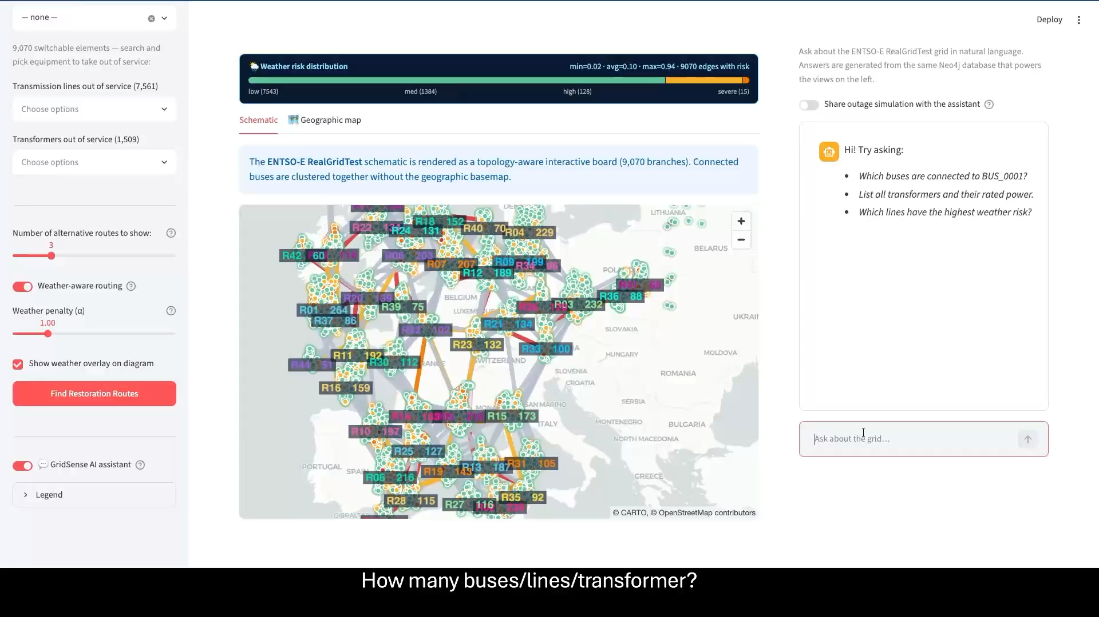

Slide 11
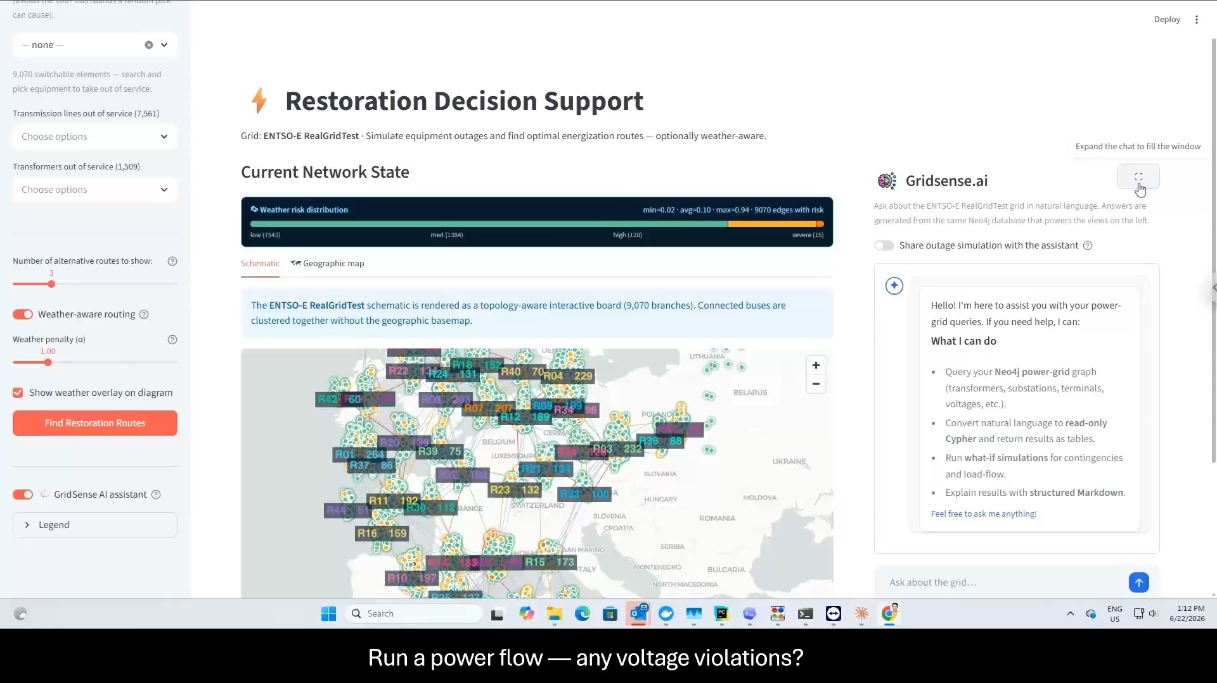

Slide 12
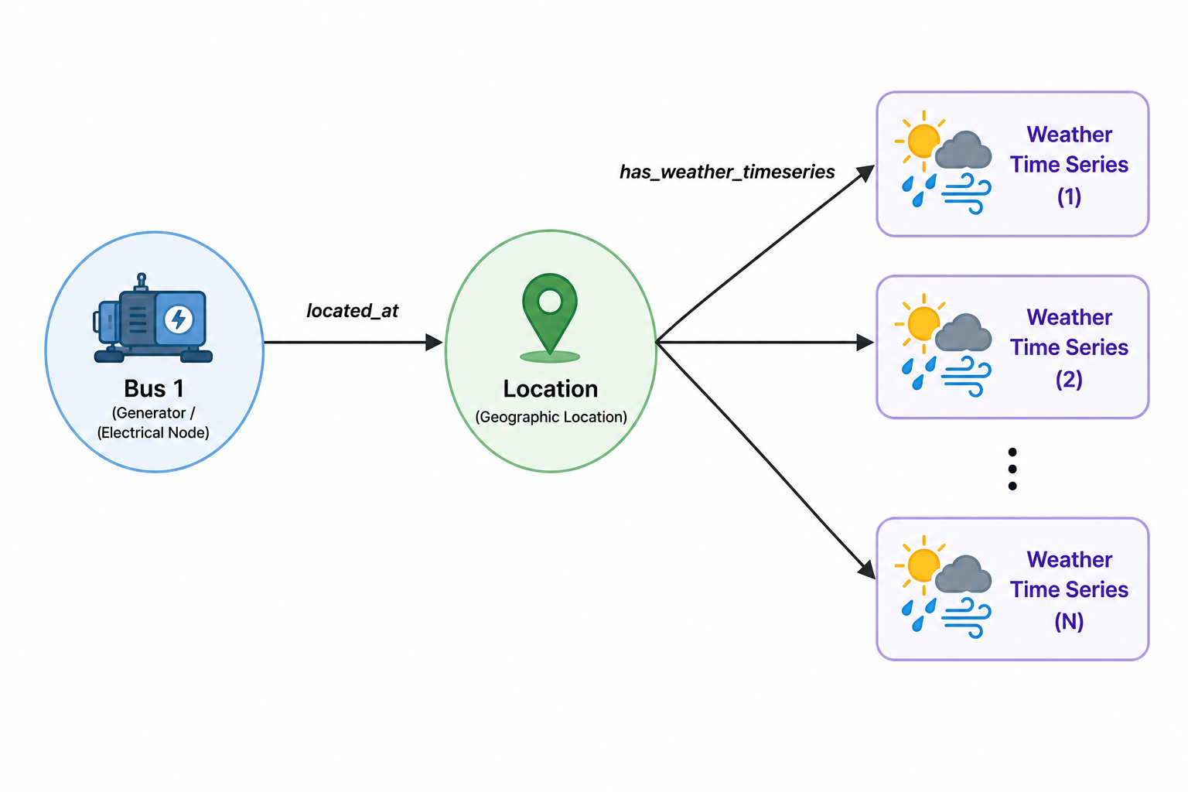
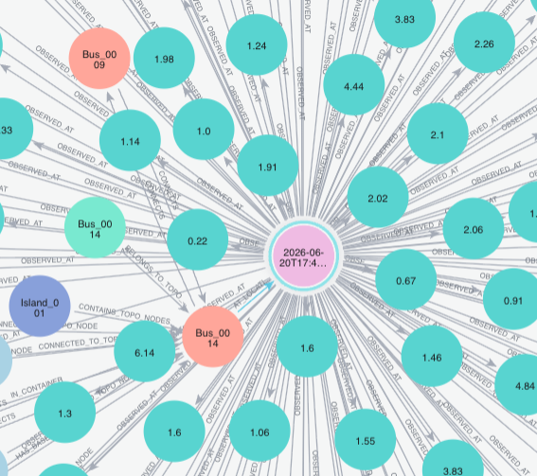
Demo 4
Weather-aware operation
Optional exogenous context:
- Temperature, wind, gusts, precipitation, snowfall, humidity, CAPE, soil moisture.
- Routing can penalize high-risk branches.
Purpose: enrich the decision context without replacing protection or operational rules.
Notes:
In the first demo, the user asks basic operational questions such as how many buses, lines, or transformers are in the model. The answer is not impressive because it is a count. It is impressive because the system finds the right graph objects, generates the Cypher, executes it, and returns a traceable answer.

Slide 13
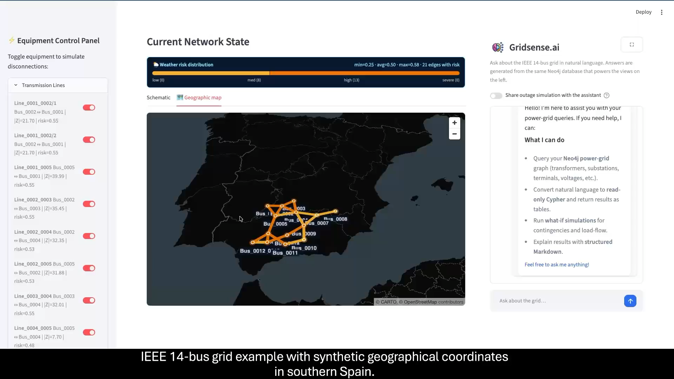

Slide 14
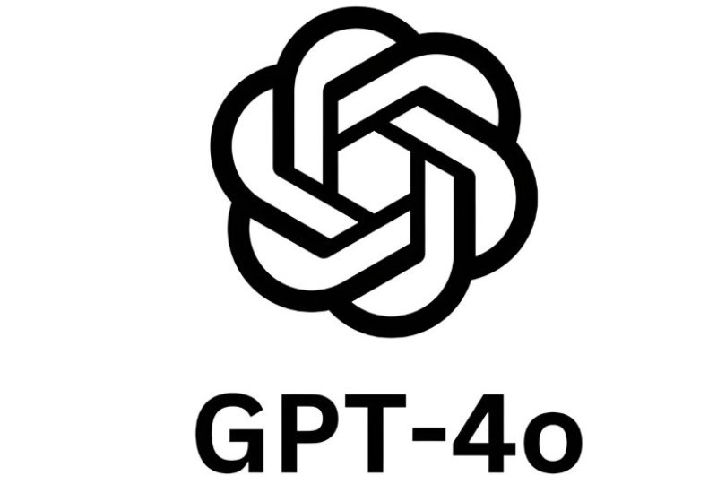
Trust
Trust comes from grounding, tools, and approval
Grounding, visible queries, verified tools, and human approval define the trust boundary.
104
31.73%
71.15%
Safety stance
semantic questions
LangChain workflow
LangGraph workflow
Decision support first: critical actions require explicit human approval.
Remaining work
Complex multi-hop topology and fault reasoning stay active research targets.
Notes:
Trust is the central issue. GridSense does not claim that an LLM should autonomously operate the grid. The safeguards are grounding, visible Cypher, verified tool execution, and human approval for critical actions. In our prototype validation, moving from a simpler LangChain setup to a LangGraph workflow improved overall accuracy from 31.73 percent to 71.15 percent on 104 semantic questions at GPT4o.

Slide 15
European Fit
The European value is interoperability plus auditability
European fit = standards-based data import + auditable answers + extensible context.
CGMES/CIM first
Bring your own grid
Critical-infra aware
Works from European interoperability standards instead of proprietary-only assumptions.
Import documentation supports a user's own CGMES/CIM data.
Demo data can be anonymized while preserving topology-aware analysis.
Extensible context
GIS, SCADA/EMS, AMI, weather, documents, and maintenance data can be linked into the graph.
Notes:
For a European AI solution, the key requirement is to work with existing grid data in a transparent and interoperable way. GridSense starts from CGMES and CIM, supports a bring-your-own-grid workflow, and can extend the graph with GIS, SCADA or EMS, AMI, weather, documents, and maintenance context.

Slide 16
Roadmap
The next step is controlled tool use, not autonomous action
GridSense reasoning core -> Neo4j/MCP -> pandapower or PowerFactory tools -> OPAL-RT validation -> human approval.
LangGraph core
Neo4j / Model Context Protocol
Power-flow tools
OPAL-RT validation
Human approval
>
>
>
>
Roadmap message
Agentic AI should call controlled tools and produce evidence, not execute unreviewed grid actions.
Notes:
The roadmap is a controlled agentic workflow. The LangGraph reasoning core interprets the question. Neo4j and files provide context. Trusted tools such as pandapower, PowerFactory, or task-specific neural network modules run calculations. OPAL-RT’s ePHASORSIM can support real-time validation. The final step is still human approval.

Slide 17
Takeaway
Ask the grid, but verify the answer
Three things to remember:
Natural-language interface
Graph evidence layer
Solvers + human review
Operators ask operational questions directly.
Answers are grounded in retrieved CGMES/CIM graph results.
Numerical work and critical actions stay verifiable.
GridSense bridges interoperable grid models and trustworthy operator assistance.
Notes:
Finally, to wrap up this presentation, the main takeaway is: ask the grid, but verify the answer. Natural language is the interface. The graph is the evidence layer. Solvers and humans keep the system safe. GridSense is a bridge from interoperable grid models to trustworthy operator assistance for the control room of the future.

Slide 18
GridSense: Ask Your Power Grid
Questions and discussion
Changhun Kim | FAU Pattern Recognition Lab
changhun.kim@fau.de
IEEE PES GM 2026 | EDPG4 Panel
Notes:
Thank you. I am happy to discuss the graph representation, the LLM-to-Cypher workflow, or the restoration and tool-integration demos.

Slide 19
Backup slides

Slide 20
Backup
Graph model detail
Static CIM graph:
- Equipment hierarchy and topology.
- Terminals connect equipment to topological nodes.
- Switch and breaker status remain queryable.
Dynamic snapshot overlay:
- Each timestamp links states to the same assets.
- Supports transformer trends, bus voltages, flows, tap positions, and switching history.
Notes:
Use this backup slide if someone asks how the graph is organized. The static layer stores the physical and logical model. The dynamic layer stores operating states as snapshots linked back to the same equipment.

Slide 21
Backup
Cypher-to-Y-bus detail
Core retrieval pattern:
MATCH (bus1)<-[:CONNECTED_TO_TOPO_NODE]-(:Terminal)
-[:PART_OF_EQUIPMENT]->(line:ACLineSegment),
(line)<-[:PART_OF_EQUIPMENT]-(:Terminal)
-[:CONNECTED_TO_TOPO_NODE]->(bus2)
RETURN bus1, bus2, line.r, line.x
Meaning: retrieve electrical edges and parameters, then compute with trusted code.
Notes:
Use this slide if someone asks how a graph query becomes a power-system matrix. The query recovers the two endpoint buses of each line and the electrical parameters. Then a normal numerical routine builds the Y-bus matrix.

Slide 22
Backup
Validation detail
Validation setup:
- 104 semantic questions.
- Six feature groups: counting, topology, connectivity, aggregation, electrical values, fault/state validation.
- Evaluation compares generated Cypher results with ground truth.
Observed prototype result:
- Earlier LangChain workflow: 31.73% overall accuracy.
- LangGraph workflow: 71.15% overall accuracy.
- Hard cases remain multi-hop topology and fault reasoning.
Notes:
Use this backup slide for validation questions. The validation was not based on subjective answer quality; it compared the generated Cypher result with expected ground truth. The improved workflow performed much better, but complex topology and fault reasoning remain important research problems.

Slide 23
Backup
Restoration algorithm detail
Restoration planner primitives:
- Weakly connected components detect energized and de-energized islands.
- Weighted path search finds candidate energization routes.
- Yen's K-shortest paths ranks alternatives.
- Dijkstra can find generator-to-route prefixes.
- The result is a ranked option list, not an automatic switching command.
Notes:
Use this slide for algorithm questions. The restoration planner is deliberately built from explainable graph primitives. The output is a ranked list of candidate options and equipment actions for human review.

Slide 24
Backup
Weather-aware operation detail
Optional exogenous context:
- Temperature, wind, gusts, precipitation, snowfall, humidity, CAPE, soil moisture.
- Hazard scores normalize risk per branch or location.
- Routing can penalize high-risk branches.
Purpose: enrich the decision context without replacing protection or operational rules.
Notes:
Use this backup slide if someone asks about weather. The current concept treats weather as exogenous context. It can explain likely fault causes, flag risky paths, and penalize restoration routes through high-risk branches.

Slide 25




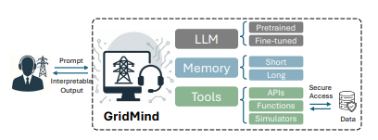
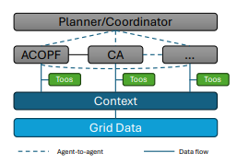

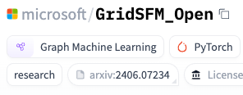
Emerging Agentic AI for
Power grid
01
02
03
04
05
Grid foundation models
Tool integration
Research ecosystem
Public investment
Future control rooms
GridFM, GridSFM
PowerMCP
NREL and DOE;
Fraunhofer, DFKI
ARPA-E;
Redispatch2.0, CINEA
Horizon Europe
Siemens, Hitachi, GE
Notes:
And It shows the recent trend of agentic AI for Power gird across academia can indistruy
First there are Grid foundation models from the linux founcdation and microsft and Havard univ release Power Agent opensource commnigut
There are some poupur open source community such as GridFM and GridSFM and Power agetn

Slide 26
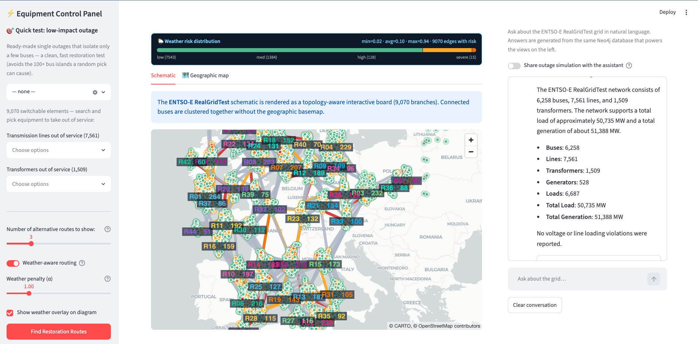
Gridsense.ai
+ Restoration support and Model Context Protocol

Slide 27
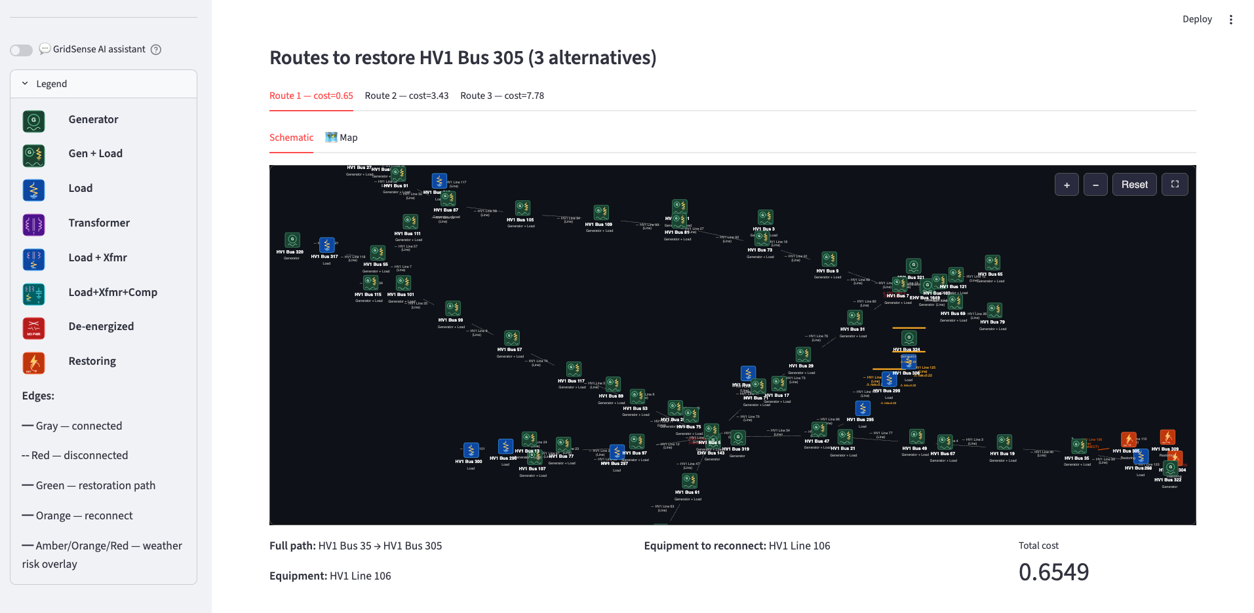
Gridsense.ai
Simbench 94buses 125lines

Slide 28
Gridsense.ai
Simbench 94buses 125lines

Slide 29
Graph-based restoration planner
1️⃣ Detect energized vs de-energized areas
2️⃣ Search candidate energization/restoration paths on a weighted network
3️⃣ rank alternative path
4️⃣ Identify equipment that must be reclosed/reconnected
Goo et al. 2016: “Development of a Sequential Restoration Strategy Based on the Enhanced Dijkstra Algorithm for Korean Power Systems”. Use an enhanced Dijkstra approach to determine generator start-up and restoration sequence.
Nasr et al. 2018: “Power System Restoration Planning Strategy Based on Optimal Energizing Time of Sectionalizing Islands”. It explicitly uses k-shortest paths based on Dijkstra’s algorithm for energizing paths.
Quirós-Tortós & Terzija 2013: “A graph theory based new approach for power system restoration”. It uses graph modeling, sectionalization, and k-shortest simple paths from black-start units to non-black-start units and loads.
Detection: WCC (weakly connected components)
Main restoration route search: Yen’s K-shortest paths
Generator-to-route prefix: Dijkstra
Notes:
1) CGMES (the blueprint)
What it is: A standardized file that describes the network at a point in time—buses, lines, transformers, generators, switch states, electrical parameters.
How it’s used: Load the snapshot into a simulator to run power flow or contingency studies.
Easy example: “If Line L-10 trips, will anything overload?” → Load CGMES, run the study, see the result.
Limit: Great for studies, but it’s just a snapshot. It doesn’t tell you where equipment sits on a map, what’s happening live, or which customers are out.
2) GIS (the map)
What it is: Geographic positions of substations, poles, towers, underground routes, and right-of-way.
How it’s used: Locate assets, plan switching or patrol routes, overlay risks (e.g., flood zones).
Easy example: “Where is the open point that isolated Feeder F-17?” → The map shows the exact pole and switch to close.
3) SCADA & EMS (the live sensors and control room apps)
SCADA = live measurements and remote control (voltages, currents, breaker status).
EMS = control-room apps that use SCADA data (state estimation, contingency checks, optimal dispatch).
How they’re used: See what’s happening now, receive alarms, and make safe control actions.
Easy example: “Is Bus B really low voltage?” → SCADA confirms the low reading and shows a nearby line is heavily loaded.

Slide 30
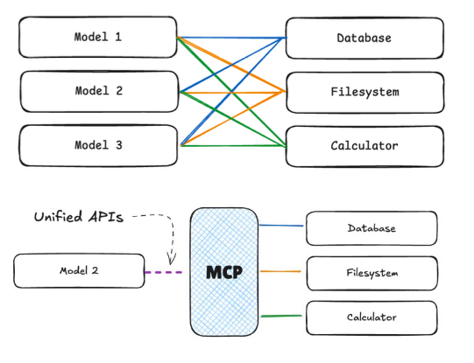
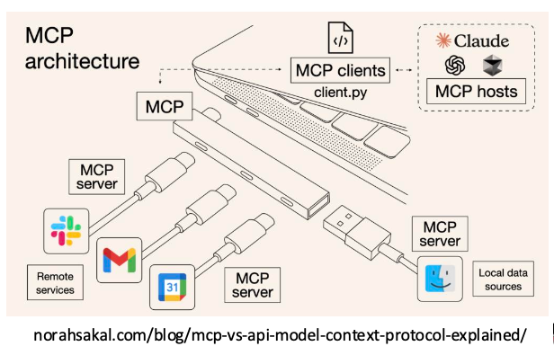
What is MCP
(Model Context Protocol)
MCP is like a universal translator that helps LLMs
talk to many external tools and data sources in a standard
way: making them more useful, flexible, and trustworthy.
Some General Tutorial about MCP
modelcontextprotocol.io
huggingface.co/learn/mcp-course

Slide 31
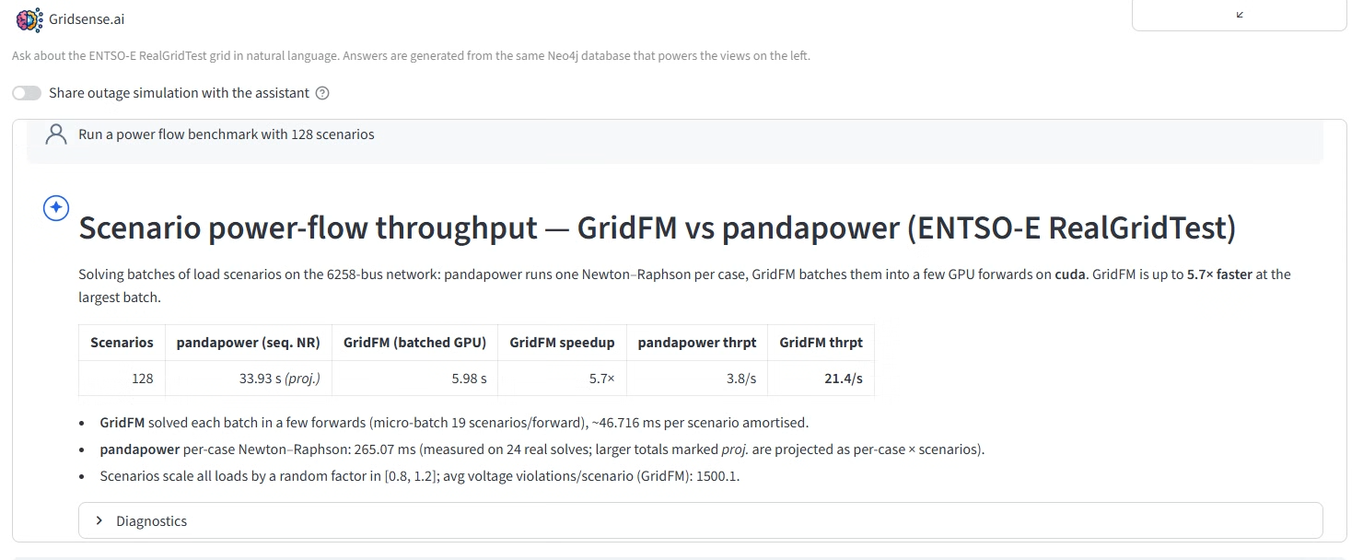
Power Flow surrogate
Power flow with neural network
Run a power flow benchmark with 128 scenarios
Notes:
CAPE (Convective Available Potential Energy) — a measure of atmospheric instability (in J/kg). It indicates how much energy is available for air to rise rapidly. High CAPE means strong updrafts, which fuel thunderstorms and lightning. Values above 2,500–3,500 J/kg signal severe thunderstorm potential.
Wind gusts — brief, sudden increases in wind speed that exceed the sustained (average) wind speed. For example, sustained wind might be 15 m/s but gusts can spike to 25 m/s. Gusts are more dangerous to power lines than steady wind because of the sudden mechanical stress they impose.

Slide 32
Weather Hazard Score
Wind, Ice, Lightning, Flood, Sildfile, Thermal
RAW INPUTS
HAZARD SCORES
COMPOSITE RISK
Open-Meteo variables used by the pipeline:
BASED ON IEEE STANDARD [3]
Composite risk = max(wind, ice, lightning, flood, wildfire, thermal)
Wind
sigmoid(max(speed, gust))
Temperature
Wind speed
50% at 20 m/s sustained, or 25 m/s gust
Ice
precip ramp if -3C <= T <= +2C
Wind gusts
Precipitation
0% below 0.1 mm, 100% from 5 mm
Lightning
CAPE ramp
Worst-case reduction: one severe hazard is enough to dominate the final score.
Snowfall
Relative humidity
0% below 500 J/kg, 100% from 3,500 J/kg
Flood
precipitation ramp
CAPE
Soil moisture
0% below 5 mm, 100% from 50 mm
Wildfire
geometric mean(hot, dry, windy) x dry-soil penalty
Each hazard score is normalized to 0~1 before aggregation.
temp sigmoid at 30C, wind sigmoid at 8 m/s, low RH, dry soil
W
I
L
F
W
T
Thermal
temperature ramp
max
0% at 30C or below, 100% at 45C or above
Raw meteorological variables are transformed into normalized hazard scores, then combined through a worst-case composite risk rule.
Notes:
CAPE (Convective Available Potential Energy) — a measure of atmospheric instability (in J/kg). It indicates how much energy is available for air to rise rapidly. High CAPE means strong updrafts, which fuel thunderstorms and lightning. Values above 2,500–3,500 J/kg signal severe thunderstorm potential.
Wind gusts — brief, sudden increases in wind speed that exceed the sustained (average) wind speed. For example, sustained wind might be 15 m/s but gusts can spike to 25 m/s. Gusts are more dangerous to power lines than steady wind because of the sudden mechanical stress they impose.

Slide 33

Forecast horizon available
Open-Meteo support up to 16 days
Metric | Value
Configured horizon | 120 h (5 days), hourly
Forecast window in DB | 2026-06-20 → 2026-06-24 23:00 UTC
Future hourly points from now | 101 hours per bus
Resolution | 1 hour
Buses (Locations) | 14
Total future risk points | 101 × 14 = ~1,414
Notes:
CAPE (Convective Available Potential Energy) — a measure of atmospheric instability (in J/kg). It indicates how much energy is available for air to rise rapidly. High CAPE means strong updrafts, which fuel thunderstorms and lightning. Values above 2,500–3,500 J/kg signal severe thunderstorm potential.
Wind gusts — brief, sudden increases in wind speed that exceed the sustained (average) wind speed. For example, sustained wind might be 15 m/s but gusts can spike to 25 m/s. Gusts are more dangerous to power lines than steady wind because of the sudden mechanical stress they impose.

Slide 34
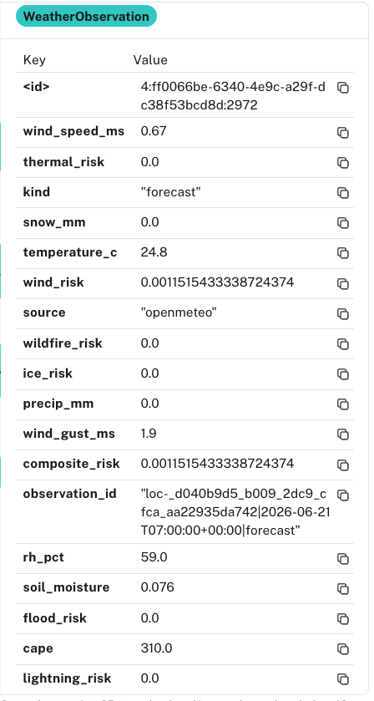
Forecast horizon available
Open-Meteo support up to 16 days
[1] Open-Meteo, “Weather Forecast API Documentation” and “Historical Weather API Documentation,” Open-Meteo Documentation. Online: https://open-meteo.com/en/docs and https://open-meteo.com/en/docs/historical-weather-api. Accessed: 27 May 2026.
[2] IEEE Standards Association, “IEEE Std 738-2023: IEEE Standard for Calculating the Current-Temperature Relationship of Bare Overhead Conductors,” IEEE SA. Online: https://standards.ieee.org/ieee/738/4997/. Accessed: 27 May 2026.
[3] IEEE Standards Association, “IEEE Std C57.91-2025: IEEE Guide for Loading Mineral-Oil-Immersed Transformers and Step-Voltage Regulators,” IEEE SA. Online: https://standards.ieee.org/ieee/C57.91/5297/. Accessed: 27 May 2026.
[4] International Electrotechnical Commission (IEC), “IEC 60826:2003, Design criteria of overhead transmission lines,” IEC Webstore. Online: https://webstore.iec.ch/en/publication/33148. See also: IEEE Standards Association, “National Electrical Safety Code (NESC).” Online: https://standards.ieee.org/products-programs/nesc/. Accessed: 27 May 2026.
[5] World Meteorological Organization (WMO), “Character and intensity of precipitation,” International Cloud Atlas. Online: https://cloudatlas.wmo.int/en/character-and-intensity-of-precipitation.html. Accessed: 27 May 2026.
Notes:
CAPE (Convective Available Potential Energy) — a measure of atmospheric instability (in J/kg). It indicates how much energy is available for air to rise rapidly. High CAPE means strong updrafts, which fuel thunderstorms and lightning. Values above 2,500–3,500 J/kg signal severe thunderstorm potential.
Wind gusts — brief, sudden increases in wind speed that exceed the sustained (average) wind speed. For example, sustained wind might be 15 m/s but gusts can spike to 25 m/s. Gusts are more dangerous to power lines than steady wind because of the sudden mechanical stress they impose.

Slide 35
Integration into TP6
Connect Opal-RT eHASORSIM/HYPERSIM
User Request → GridSense.ai→ Specialized Domain MCPs
1️⃣ TP5 LLM Agent (Reasoning Core)
  Interprets the user request and formulates an execution plan.
  Routes tasks to the appropriate domain MCPs based on intent and context.
2️⃣ Neo4j / File MCP
  Explores grid snapshots, topology, and affected regions from stored data.
  Provides structural and historical context to the reasoning loop.
3️⃣ TP3 MCP
  Executes power-flow, contingency, congestion-relief, and restoration analyses.
  Returns validated numerical results and stability indicators.
4️⃣ OPAL-RT MCP
  Performs real-time simulation or dry-run tests of the proposed restoration plan.
  Enables safety-checked deployment in cyber-physical environments.
5️⃣ Summary & Approval Step
  Aggregates results, evidence, and snapshot references (IDs, file paths).
  Prepares a structured summary for human approval or revision before final action.

Slide 36

GridOS – General Electric
Accelerating Energy Transition for Utilities
GridOS Architecture
Operator Dashboard + Forecasting + Contingency Control
Digital Dynamic Line Rating
Outage / Restoration Map
Inertia Forecast Dashboard
Data Management + GIS Network View
WAMS / PMU Oscillation Monitoring
[6] Open-Meteo, “Weather Forecast API Documentation” and “Historical Weather API Documentation,” Open-Meteo Documentation. Online: https://open-meteo.com/en/docs and https://open-meteo.com/en/docs/historical-weather-api. Accessed: 27 May 2026.
[7] IEEE Standards Association, “IEEE Std 738-2023: IEEE Standard for Calculating the Current-Temperature Relationship of Bare Overhead Conductors,” IEEE SA. Online: https://standards.ieee.org/ieee/738/4997/. Accessed: 27 May 2026.
[8] IEEE Standards Association, “IEEE Std C57.91-2025: IEEE Guide for Loading Mineral-Oil-Immersed Transformers and Step-Voltage Regulators,” IEEE SA. Online: https://standards.ieee.org/ieee/C57.91/5297/. Accessed: 27 May 2026.
[9] International Electrotechnical Commission (IEC), “IEC 60826:2003, Design criteria of overhead transmission lines,” IEC Webstore. Online: https://webstore.iec.ch/en/publication/33148. See also: IEEE Standards Association, “National Electrical Safety Code (NESC).” Online: https://standards.ieee.org/products-programs/nesc/. Accessed: 27 May 2026.
[10] World Meteorological Organization (WMO), “Character and intensity of precipitation,” International Cloud Atlas. Online: https://cloudatlas.wmo.int/en/character-and-intensity-of-precipitation.html. Accessed: 27 May 2026.
Notes:
Extend the system with the forecast-oriented use case discussed with LVN for the Augsburg region, where users can ask the LLM interface about expected lightning or severe-weather risk in the LVN grid. [6]
Connect validated real grid-operator coordinates from CGMES/GIS so that the map view can move from demonstration mode to an operational geographic view.
Calibrate weather-risk models with asset-specific limits and historical outage/weather data.
Extend the LLM interface into a controlled tool-calling layer through which external functions for congestion management, contingency analysis, mathematical grid calculations, and restoration support can be invoked, similar to the principle of delegating complex calculations to specialized computational tools rather than expecting the language model itself to perform them.
Extend the system with the forecast-oriented use case discussed with LVN for the Augsburg region, where users can ask the LLM interface about expected lightning or severe-weather risk in the LVN grid. [6]
Validate on real LVN grid models and integrate with TP3 workflows for automated fault management and grid restoration.

Slide 37
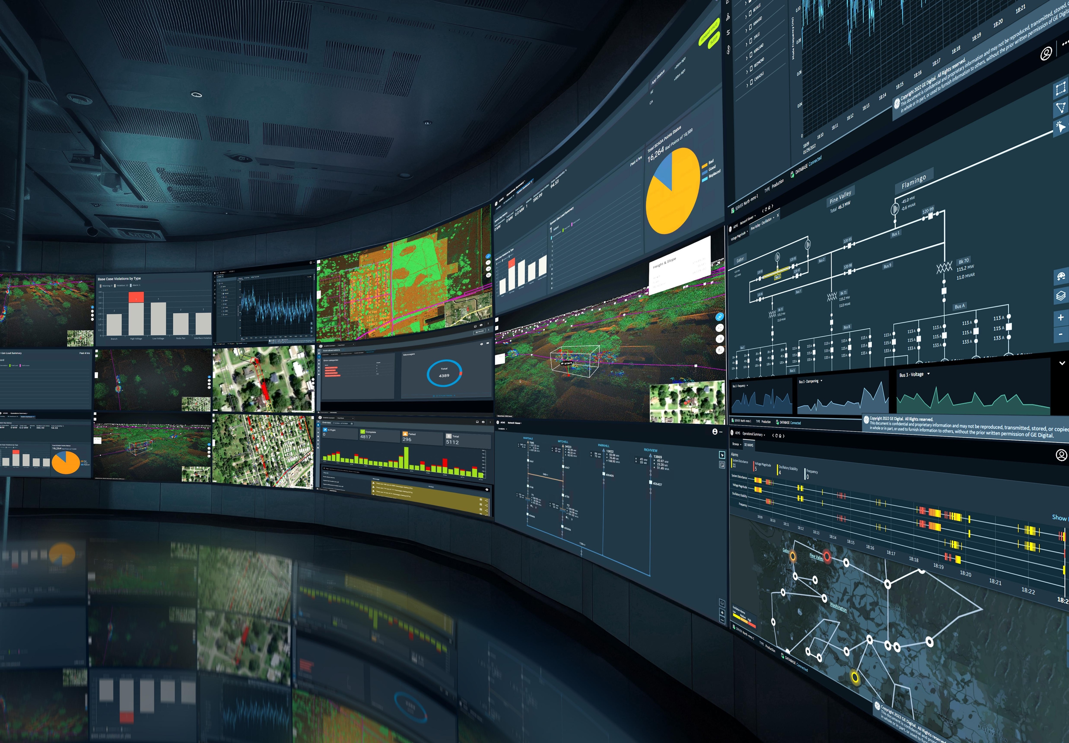
Additional Source
Control room of the Future
GridOS : GE Vernova – Unified grid intelligence platform integrating EMS,ADMS, operational data, AI
Control room of the Future : Hitachi Energy – AI, Digital Twins, Grid automation
Grid AI Lab Orlando”. : Siemens – realistic grid testing lab to safely validate and stress-test grid operation.
Notes:
Finally, I want to wrap this up by introducing some additional sources related to the idea of the “control room of the future.”
Here, GridOS from GE Vernova is especially aligned with the idea of TP5, since it aims to build a unified grid intelligence platform based on data from SCADA, AMI, EMS, ADMS, and other operational data.
Hitachi Energy also explicitly uses the term “control room of the future,” emphasizing AI, digital twins, and grid automation.
Siemens is also moving in this direction with its Grid AI Lab Orlando, which provides a realistic testing environment to safely validate and stress-test grid operation methods.
So overall, these industrial examples show that our direction is well aligned with current trends toward AI-based and data-driven grid operation.

Slide 38
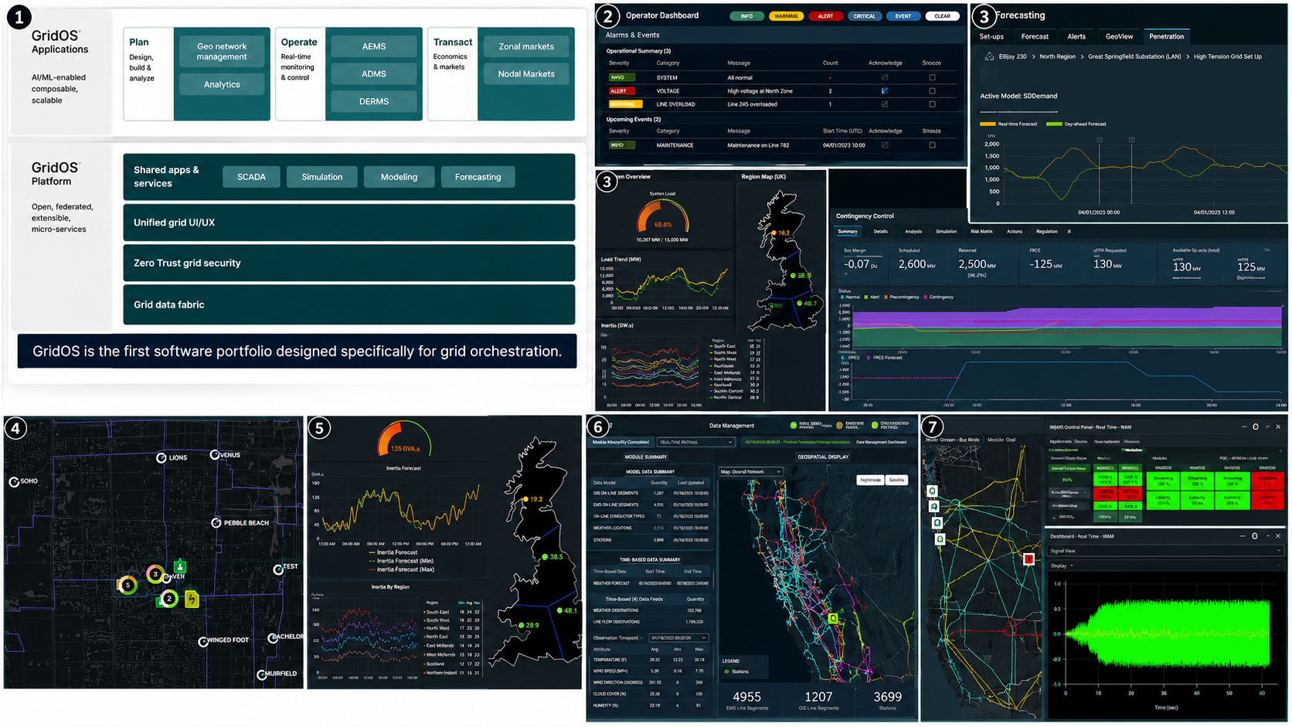
GridOS – General Electric
Accelerating Energy Transition for Utilities
GridOS Case-Study
Notes:
첫 번째 이미지는 GridOS 전체 아키텍처를 보여주는 슬라이드로 보인다. 상단은 GridOS Applications, 하단은 GridOS Platform이다. 애플리케이션 레벨에서는 Plan, Operate, Transact가 나뉘어 있고, 각각 계획·운영·시장 기능을 담당한다. Plan에는 geo network management, analytics가 있고, Operate에는 AEMS, ADMS, DERMS가 있다. 즉 송전 EMS, 배전 ADMS, DER 관리까지 하나의 운영 포트폴리오로 묶겠다는 메시지다. 하단 플랫폼에는 SCADA, simulation, modeling, forecasting, unified UI/UX, zero-trust security, grid data fabric이 보인다. 핵심은 GridOS가 단순한 EMS 화면이 아니라, 데이터·보안·시뮬레이션·예측·운영 앱을 공통 플랫폼 위에 올리는 “grid orchestration software”라는 점이다.
두 번째 이미지는 통합 운영 대시보드처럼 보인다. 왼쪽 위는 operator dashboard로, 경보나 operational item을 우선순위별로 보여주는 화면 같다. 오른쪽 위는 forecasting 화면으로, active power 또는 load forecast 곡선을 보여준다. 왼쪽 아래는 지역별 부하/수요 또는 inertia 관련 시계열과 영국 지도 기반 지역 표시로 보인다. 오른쪽 아래는 contingency control 또는 market/constraint monitoring 비슷한 화면으로, 여러 지표를 카드 형태로 보여주고 시간대별 상태를 시각화한다. 즉 이 이미지는 GridOS가 관제센터에서 “상황 인식 + 예측 + 지역별 계통 상태 + 제약/contingency 모니터링”을 한 화면 체계로 묶는다는 것을 보여준다.
세 번째 이미지는 Digital Dynamic Line Rating 화면으로 보인다. 왼쪽에는 송전선로 지도, 오른쪽에는 real-time rating gain과 forecasted rating gain 그래프가 있다. 상단에는 normal rating, dynamic rating, emergency rating 같은 값들이 표시된다. 이 기능은 날씨, 온도, 풍속, 일사량 같은 조건을 반영해서 송전선의 실제 허용용량을 정적으로 고정하지 않고 동적으로 계산하는 기능이다. 즉 “지금 이 선로가 실제로는 얼마나 더 전력을 흘릴 수 있는가?”를 보여주는 도구다. GridAssist 관점에서는 congestion management와 매우 직접적으로 연결된다.
네 번째 이미지는 배전망 또는 지역망의 outage/restoration 지도처럼 보인다. 어두운 지도 위에 Feeder 또는 지역 노드들이 표시되고, 가운데에는 숫자 2, 3, 5 같은 이벤트 마커와 전기 아이콘이 있다. 이는 고장 위치, switching 후보, 복구 작업 지점, 또는 crew/asset 위치를 나타내는 화면일 가능성이 있다. 오른쪽에는 모바일 화면 같은 패널이 보여서 field crew와 control room 간의 연결도 암시한다. 기능적으로는 fault localization, outage management, switching coordination, restoration workflow에 가깝다.
다섯 번째 이미지는 지역별 예측 및 계통 관성(inertia) 또는 안정도 관련 모니터링 화면으로 보인다. 왼쪽에는 inertia forecast라고 보이는 시계열이 있고, 아래에는 지역별 예측값들이 여러 선으로 표시된다. 오른쪽에는 영국 지도 위에 지역별 숫자 값이 표시된다. 이 화면은 단순 부하 예측보다는 system stability, inertia, regional adequacy 또는 operational security metric을 지역 단위로 예측하는 기능일 가능성이 있다. 재생에너지 비중이 높아질수록 관성이 낮아지고 주파수 안정도가 어려워지기 때문에, 이런 화면은 미래 관제센터에서 중요한 기능이 된다.
여섯 번째 이미지는 데이터 관리 및 네트워크 모델 관리 화면이다. 왼쪽에는 module summary, model data summary, time-based data summary 같은 표가 있고, 오른쪽에는 캘리포니아/네바다 주변 송전망 지도가 색상별로 표시된다. 하단에는 line segments, substations 같은 숫자도 보인다. 이는 GridOS가 단순 시각화만 하는 것이 아니라 GIS, EMS, weather observation, line flow forecast, network model 같은 데이터를 통합 관리한다는 것을 보여준다. GridAssist의 “graph database for transmission and distribution power grid”와 가장 가까운 부분이다.
일곱 번째 이미지는 WAMS 또는 PMU 기반 wide-area monitoring 화면으로 보인다. 왼쪽 지도에는 계통 선로와 지역이 표시되고, 오른쪽에는 WAMS Control Panel, Real-Time WAM 같은 문구와 함께 녹색/빨간색 상태 박스, 그리고 고주파 진동 파형 같은 실시간 신호가 보인다. 이는 PMU 데이터를 이용한 광역 계통 감시, 동요 감지, 주파수/전압 안정도 모니터링, oscillation detection 기능으로 추정된다. 즉 blackout prevention, contingency detection, dynamic security assessment와 연결된다.
전체적으로 보면 GE Vernova GridOS가 보여주는 핵심 기능은 다음과 같아.
GridOS는 EMS/ADMS/DERMS를 하나로 묶고, 그 아래에 SCADA, simulation, modeling, forecasting, security, data fabric을 공통 플랫폼으로 제공하려는 구조다. 실제 UI에서는 dynamic line rating, outage/restoration map, forecasting, regional stability monitoring, network model management, WAMS/PMU monitoring 같은 기능을 보여준다. 즉 GridAssist가 목표로 하는 “graph data + AI assistant + real-time digital twin + congestion/fault/contingency support”와 방향이 상당히 비슷하다.
GridAssist와 비교하면, GE Vernova는 이미 운영 플랫폼과 UI/데이터 통합에 강하고, GridAssist는 여기에 LLM agent, Graph RAG, MCP, Foundation Model 기반 reasoning layer를 더 명확하게 얹는 방향으로 차별화할 수 있어.

Slide 39
A four-stage path to
trusted deployment
1
2
3
4
Data + graph
Workflow-based
Sandbox agent
Human-in-the-Loop Operating
CIM / CGMES
SCADA / EMS
Weather / historian
Analyze
Summarize
Recommend
Switching plan
Restoration plan
Contingency study
Create studies
Tickets / reports
Operator notes
GridSense evolve as a bounded Grid Copilot rather than a fully autonomous control agent

Slide 40
Cypher query example
Cypher + Neo4j
MATCH
(bus1:TopologicalNode)<-[:CONNECTED_TO_TOPO_NODE]-(:Terminal)
-[:PART_OF_EQUIPMENT]->(line:ACLineSegment), ← pattern-A
(line)<-[:PART_OF_EQUIPMENT]-(:Terminal)
-[:CONNECTED_TO_TOPO_NODE]->(bus2:TopologicalNode) ← pattern-B
WHERE bus1.id IN $bus_ids AND bus2.id IN $bus_ids AND elementId(bus1) < elementId(bus2)
RETURN
bus1.id AS bus1_id, Neo4j/CIM ID of the first bus (bus1).
bus2.id AS bus2_id, (bus2).
line.ACLineSegment_r AS r,
line.ACLineSegment_x AS x
pattern-A | “There is a Terminal that is attached to bus1 and belongs to an ACLineSegment we’ll call line.”
pattern-B | “The same line also has another Terminal that is attached to bus2.”
Notes:
Quick context and objectives (5 min) — Changhun
TP5 progress demo: GridSense AI (Neo4j + Heo1 grid from LEW) (15 min) — Redwanul
Neo4j schema overview and ingestion path
Live queries via the LLM chatbot
Validation results (15 min) — Ragav
Basic parameter verification checks
Multi-query prompts → responses → result-consistency snapshots
Next steps on reliability and consistency (10 min) — Redwanul, All
Using MCP to connect tools/data and ensure consistent answers across question variants
Literature and building blocks for agentic AI (10 min) — Ragav, Changhun, All
Brief overview: GridMind, PowerAgent, and related agentic frameworks we can leverage
Data roadmap (5 min) — EES, All
Expanding beyond CGMES to include GIS/SCADA/AMI/vendor data sources
OPAL-RT × FAU internship/Master’s opportunity (10 min) — All
Scope, MCP server integration, expected deliverables, supervision plan, and next actions
Further discussions

Slide 41
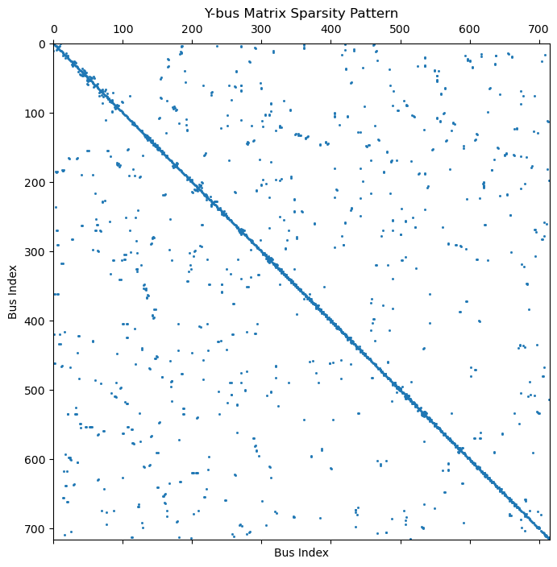
Build Y-bus matrix
Cypher + Neo4j
Notes:
Quick context and objectives (5 min) — Changhun
TP5 progress demo: GridSense AI (Neo4j + Heo1 grid from LEW) (15 min) — Redwanul
Neo4j schema overview and ingestion path
Live queries via the LLM chatbot
Validation results (15 min) — Ragav
Basic parameter verification checks
Multi-query prompts → responses → result-consistency snapshots
Next steps on reliability and consistency (10 min) — Redwanul, All
Using MCP to connect tools/data and ensure consistent answers across question variants
Literature and building blocks for agentic AI (10 min) — Ragav, Changhun, All
Brief overview: GridMind, PowerAgent, and related agentic frameworks we can leverage
Data roadmap (5 min) — EES, All
Expanding beyond CGMES to include GIS/SCADA/AMI/vendor data sources
OPAL-RT × FAU internship/Master’s opportunity (10 min) — All
Scope, MCP server integration, expected deliverables, supervision plan, and next actions
Further discussions

Slide 42
Validation results (basic parameter verification, result-consistency)

Slide 43
Experimental setup
Test Data:
  A set of 104 Semantic Questions categorized into 6 distinct Features.
Model :
  GPT 4.1
  Input:
    Semantic Question (e.g., "How many Substations are in the database?")
  LLM Task:
    Generate a Neo4j Cypher query.
  Execution:
    Run the Generated_Cypher against the Neo4j database.
  Evaluation:
    Compare the Cypher_LLM_Result against the Expected Output (Ground Truth)

Slide 44
Test sample
Question | Neo4j Cypher | Expected Output | Generated_Cypher | Generated_Output | Human_Readable
How many PowerTransformer nodes are in the database? | MATCH (pt:PowerTransformer) RETURN count(pt) AS PowerTransformerCount; | 216 | MATCH (p:PowerTransformer) RETURN count(p) AS numberOfNodes | {'numberOfNodes': 216} | **Summary:** There are **216** PowerTransformer nodes in the database. No further calculations or analysis required. The raw data provided already answers the question directly.
Find the VoltageLevel entity that is node to the maximum number of open breakers. | MATCH (v:VoltageLevel)<-[:IN_CONTAINER]-(b:Breaker {Switch_open: 'true'}) WITH v, COUNT(b) AS OpenBreakerCount RETURN v.IdentifiedObject_name, OpenBreakerCount ORDER BY OpenBreakerCount DESC LIMIT 1; | "SA" (with 9 Open Breakers) | MATCH (vl:VoltageLevel)<-[:IN_CONTAINER]-(b:Breaker) WHERE b.Switch_open = 'true' WITH vl, COUNT(b) AS breakerCount ORDER BY breakerCount DESC LIMIT 1 RETURN vl.IdentifiedObject_name AS VoltageLevelName, breakerCount | [{'VoltageLevelName': 'SA', 'breakerCount': 9}] | **Summary:** The voltage level with the highest number of open breakers is **'SA'**, which has **9** open breakers. No additional calculations are required, as the raw data already provides the necessary information.

Slide 45

Gridsense.ai - Validation
(developed with LangChain)
Feature | Total Questions | Accuracy
Counting | 21 | 71.43%
Fault Analysis & State Change Validation Set | 15 | 53.33%
Topology & Network Structure | 14 | 14.28%
Mathematics and aggregation | 15 | 20%
Connectivity between nodes- values | 21 | 4.76%
Electrical Properties / Operational Values. | 18 | 27,77%
System achieved 31.73% overall accuracy
  Success - 33
  Mismatch - 39
  Failed to extract data- 32
Major Struggle with Complex Logic
Notes:
Quick context and objectives (5 min) — Changhun
TP5 progress demo: GridSense AI (Neo4j + Heo1 grid from LEW) (15 min) — Redwanul
Neo4j schema overview and ingestion path
Live queries via the LLM chatbot
Validation results (15 min) — Ragav
Basic parameter verification checks
Multi-query prompts → responses → result-consistency snapshots
Next steps on reliability and consistency (10 min) — Redwanul, All
Using MCP to connect tools/data and ensure consistent answers across question variants
Literature and building blocks for agentic AI (10 min) — Ragav, Changhun, All
Brief overview: GridMind, PowerAgent, and related agentic frameworks we can leverage
Data roadmap (5 min) — EES, All
Expanding beyond CGMES to include GIS/SCADA/AMI/vendor data sources
OPAL-RT × FAU internship/Master’s opportunity (10 min) — All
Scope, MCP server integration, expected deliverables, supervision plan, and next actions
Further discussions

Slide 46

Gridsense.ai - Validation
(developed with LangGraph)
Feature | Total Questions | Accuracy
Counting | 21 | 85.71%
Mathematics and aggregation | 15 | 73.33%
Connectivity between nodes- values | 21 | 42.85%
Topology & Network Structure | 14 | 71.14%
Electrical Properties / Operational Values. | 18 | 100.00%
Fault Analysis & State Change Validation Set | 15 | 60.00%
System achieved 71.15% overall accuracy
  Success - 74
  Mismatch - 20
  Failed to extract data- 10
Model showed improvements across almost all feature categories
Topology, Connectivity, Mathematics and Fault analysis remain the model's primary challenge
Notes:
Quick context and objectives (5 min) — Changhun
TP5 progress demo: GridSense AI (Neo4j + Heo1 grid from LEW) (15 min) — Redwanul
Neo4j schema overview and ingestion path
Live queries via the LLM chatbot
Validation results (15 min) — Ragav
Basic parameter verification checks
Multi-query prompts → responses → result-consistency snapshots
Next steps on reliability and consistency (10 min) — Redwanul, All
Using MCP to connect tools/data and ensure consistent answers across question variants
Literature and building blocks for agentic AI (10 min) — Ragav, Changhun, All
Brief overview: GridMind, PowerAgent, and related agentic frameworks we can leverage
Data roadmap (5 min) — EES, All
Expanding beyond CGMES to include GIS/SCADA/AMI/vendor data sources
OPAL-RT × FAU internship/Master’s opportunity (10 min) — All
Scope, MCP server integration, expected deliverables, supervision plan, and next actions
Further discussions

Slide 47
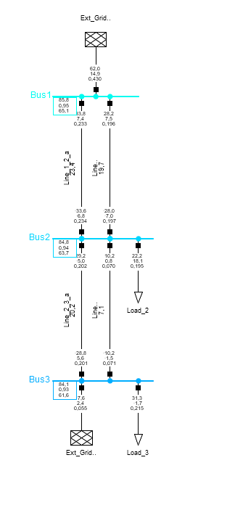
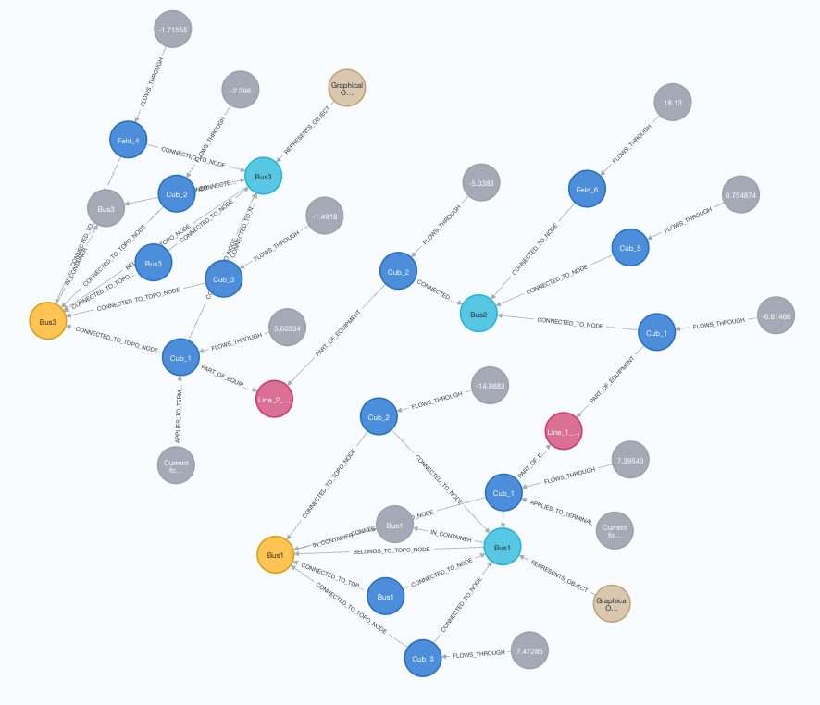
3 buses example
Notes:
Neo4j graphdatase

Slide 48
What can be queried from CGMES?
There are different breaker types worth modeling explicitly.
Lines can be switched on/off, so their current status should be queryable.
Biggest gain: add historical CIM snapshots (not just the latest). Use Neo4j to find the baseline/newest file and align IDs; since CIM structure is stable, you can parse the same values across snapshots to build time series.
With history, you can ask richer questions (e.g., which transformer had the highest utilization over time, which switches/topologies are almost always in one state), greatly expanding the query set.
Notes:
Neo4j graphdatase

Slide 49
Advantages of Neo4j
Cypher + Neo4j
CGMES is an exchange format(large XML), not a query engine. → query engine like Neo4j required
LLM-agent friendly: Convert natural language into Cypher to safely specify scope/assumptions/constraints, while numerical results come from solver tools → prevents hallucinations.
CGMES history/version management: Structure diffs across snapshots and asset state histories to enable cumulative what-if analysis, rollback, and reproducibility.
Subcase slicing: Extract only the affected region in the graph and pass it to PF/OPF/contingency solvers → faster runs, better convergence, lower cost, and easier auditing.
Exploration & explainability: Multi-hop path/impact/causal queries make it easy to provide evidence-backed answers to questions like “Why did this bus voltage drop?”
Multi-source data fusion: Unify CGMES + GIS + SCADA/AMI + asset/maintenance/weather in a single schema → richer operational context.
Notes:
Limitations of using CGMES directly (without a graph layer)
Poor ad-hoc querying & causality: CGMES is an exchange format (large XML/containers), not a query engine. It struggles Multi-hop “why/impact/path” questions that must follow many connections through the network. And complicated retrival questions such as building Y-admittance matrix can be easily solved with query engine.
Weak temporal handling: Snapshots are just files; no native, queryable history/diff across time. Versioning, rollback, and provenance require custom code.
Subcase extraction overhead: No built-in way to slice “affected regions” cleanly; you’ll re-implement topology walks and export logic for every study.
Limited explainability/auditability: Hard to link solver outputs back to precise assets/paths and keep a navigable audit trail for operators.
Data fusion friction: Integrating GIS, SCADA/EMS, AMI, maintenance, and weather with CGMES needs bespoke ETL and key mapping; no unified, queryable schema.
LLM integration risk: Natural-language queries must jump straight to files/APIs; without a structured knowledge layer, it’s easier for the agent to pick the wrong scope or omit constraints.
Performance & ergonomics: Parsing large CGMES payloads repeatedly is heavy; incremental, interactive exploration (what-if loops) is awkward compared to graph queries.
Static by design: CGMES snapshots don’t natively represent live telemetry/state changes; aligning with real-time streams needs extra infrastructure.

Slide 50
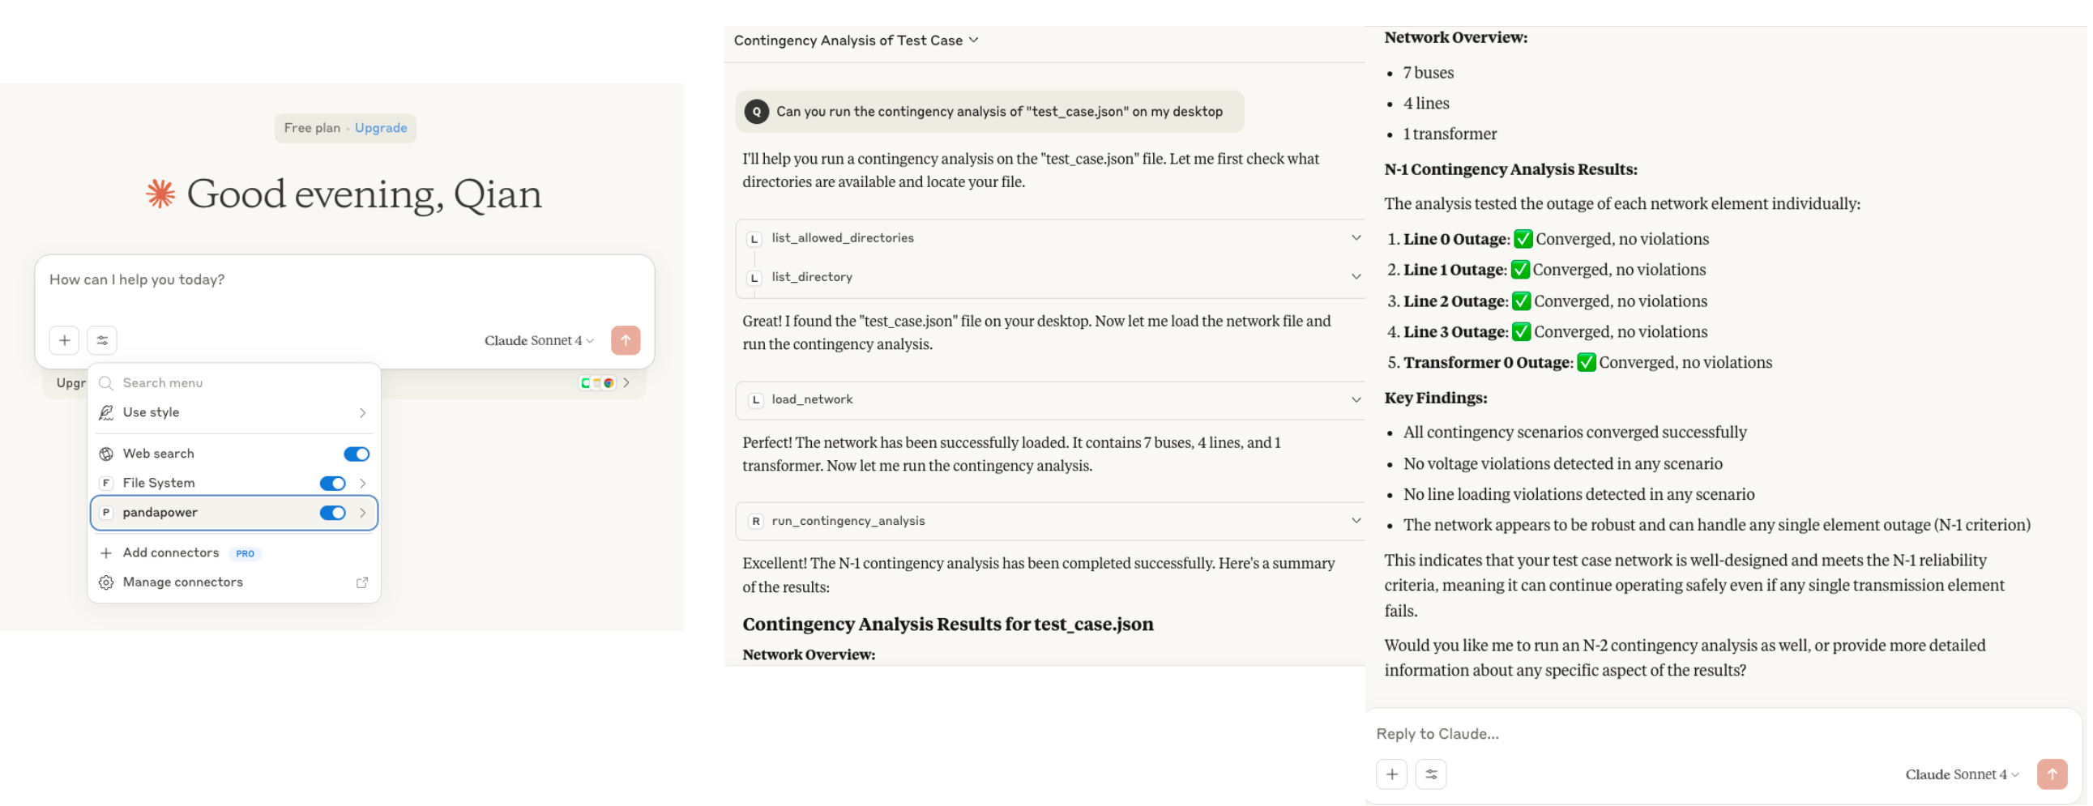
MCP for Pandapower
https://github.com/Power-Agent/PowerMCP

Slide 51
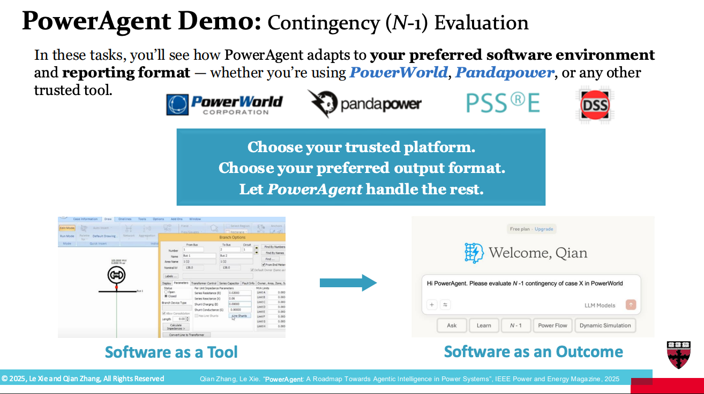

PowerAgent

Slide 52
TP5 milestone
5.1: Creation of a Knowledge Database for Heterogeneous Power Grid Data Sources
Current power grid operations rely on fragmented data sources: network topology is in GIS (Geographic Information Systems), operational data in SCADA, and metering data in manufacturer-specific formats. The goal of this Work Package is to integrate these disparate sources into a Graph Database (Knowledge Graph) to enable deep analysis, real-time processing, and AI-supported troubleshooting.
2. Methodology & Technologies
To achieve the integration and analysis goals, the following methods are being utilized:
Graph Database: Storing data as nodes and edges to model complex relationships (superior to relational databases for this use case).
Knowledge Inference: Using rule-based, ontology-based, and ML-based logic to fill data gaps.
AI & NLP: Utilizing Large Language Models (LLM) and Natural Language Processing for the user interface.
Gamification: Applied within the methodology (context implies potential user engagement strategies).
Develop a practical knowledge graph and LLM-based user interface for control center users by integrating heterogeneous grid data.
Notes:
5.1: Creation of a Knowledge Database for Heterogeneous Power Grid Data Sources
Overview Current power grid operations rely on fragmented data sources: network topology is in GIS (Geographic Information Systems), operational data in SCADA, and metering data in manufacturer-specific formats. The goal of this Work Package is to integrate these disparate sources into a Graph Database (Knowledge Graph) to enable deep analysis, real-time processing, and AI-supported troubleshooting.
2. Methodology & Technologies
To achieve the integration and analysis goals, the following methods are being utilized:
Graph Database: Storing data as nodes and edges to model complex relationships (superior to relational databases for this use case).
Knowledge Inference: Using rule-based, ontology-based, and ML-based logic to fill data gaps.
AI & NLP: Utilizing Large Language Models (LLM) and Natural Language Processing for the user interface.
Gamification: Applied within the methodology (context implies potential user engagement strategies).

Slide 53
TP5 milestone
4. Risk Management
Potential Risk | Countermeasure
Data Unavailability: Real data is not available sufficiently or in a timely manner. | Synthetic Data: Realistic data will be generated using expert knowledge, simulation, or data augmentation techniques.
Regulatory Hurdles: Data protection regulations causing delays. | [Addressed in prerequisites: Data protection aspects must be clarified and documented early]
Quality Issues: Poor data quality requiring high coordination effort. | [Addressed via Data Cleansing tasks allocated to FAU]
Notes:
5.1: Creation of a Knowledge Database for Heterogeneous Power Grid Data Sources
Overview Current power grid operations rely on fragmented data sources: network topology is in GIS (Geographic Information Systems), operational data in SCADA, and metering data in manufacturer-specific formats. The goal of this Work Package is to integrate these disparate sources into a Graph Database (Knowledge Graph) to enable deep analysis, real-time processing, and AI-supported troubleshooting.
2. Methodology & Technologies
To achieve the integration and analysis goals, the following methods are being utilized:
Graph Database: Storing data as nodes and edges to model complex relationships (superior to relational databases for this use case).
Knowledge Inference: Using rule-based, ontology-based, and ML-based logic to fill data gaps.
AI & NLP: Utilizing Large Language Models (LLM) and Natural Language Processing for the user interface.
Gamification: Applied within the methodology (context implies potential user engagement strategies).

Slide 54
TP5 milestone
5. Deliverables & Milestones
Results:
  Integrated and structured data with a defined ontology.
  A networked knowledge graph enabling robust AI applications (e.g., troubleshooting).
  An intuitive User Interface (UI) powered by an LLM.
Primary Milestone (MS 5.1.1): Graph database is implemented and ready for use.
Notes:
5.1: Creation of a Knowledge Database for Heterogeneous Power Grid Data Sources
Overview Current power grid operations rely on fragmented data sources: network topology is in GIS (Geographic Information Systems), operational data in SCADA, and metering data in manufacturer-specific formats. The goal of this Work Package is to integrate these disparate sources into a Graph Database (Knowledge Graph) to enable deep analysis, real-time processing, and AI-supported troubleshooting.
2. Methodology & Technologies
To achieve the integration and analysis goals, the following methods are being utilized:
Graph Database: Storing data as nodes and edges to model complex relationships (superior to relational databases for this use case).
Knowledge Inference: Using rule-based, ontology-based, and ML-based logic to fill data gaps.
AI & NLP: Utilizing Large Language Models (LLM) and Natural Language Processing for the user interface.
Gamification: Applied within the methodology (context implies potential user engagement strategies).

Slide 55
Next steps on reliability and scalability(MCP)

Slide 56
Reason-Act-Reflect loop
Control pattern for LLM agents
Reason – Plan the next step(s) using the goal and current context.
Act – Call a trusted external tool or function with validated inputs.
Reflect – Compare the tool’s result against the goal and constraints, detect inconsistencies, update the plan, and repeat until success (or escalate to a human).
Reason
Act
Reflect
Why This Pattern Matters
🧮 Prevents hallucinated numbers: Computation is off-loaded to verifiable tools.
🔍 Catches errors early: Reflection stage validates expected vs actual outcomes.
🔁 Enables iterative reasoning: Supports multi-step plans and adaptive corrections.

Slide 57
Preventing Hallucination and Ensuring Trustworthy Actions
1️⃣ Verified Computation
  Domain agents invoke trusted library functions (not LLM-generated math).
  → e.g., PowerFactory, TP3 functions, PandaPower for power-flow and contingency analysis.
  Results come from real simulations or APIs, not fabricated estimates.
  This ensures numerical correctness and domain consistency.
2️⃣ How Hallucinations Can Still Occur
  Wrong function call: LLM may misinterpret the intent or choose the wrong API.
  Misread output: Incorrectly formatted or summarized results.
  Prevention strategies:
    Enforce input/output schemas to validate function calls.
    Use structured templates for controlled result summarization.

Slide 58
Preventing Hallucination and Ensuring Trustworthy Actions (Cont.)
3️⃣ Human-in-the-Loop Safeguard
  For critical actions (e.g., switching, restoration), agent requires explicit human approval.
  The loop becomes: Reason → Act → Reflect → Approve/Revise → Act…
  Guarantees safety, accountability, and traceability in grid operations.

Slide 59
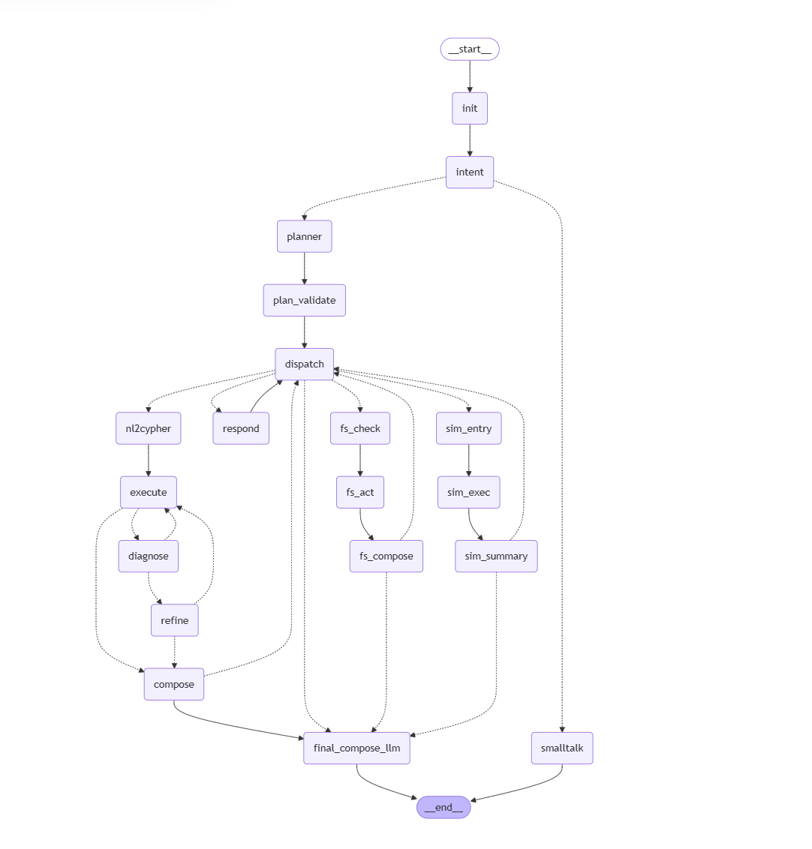
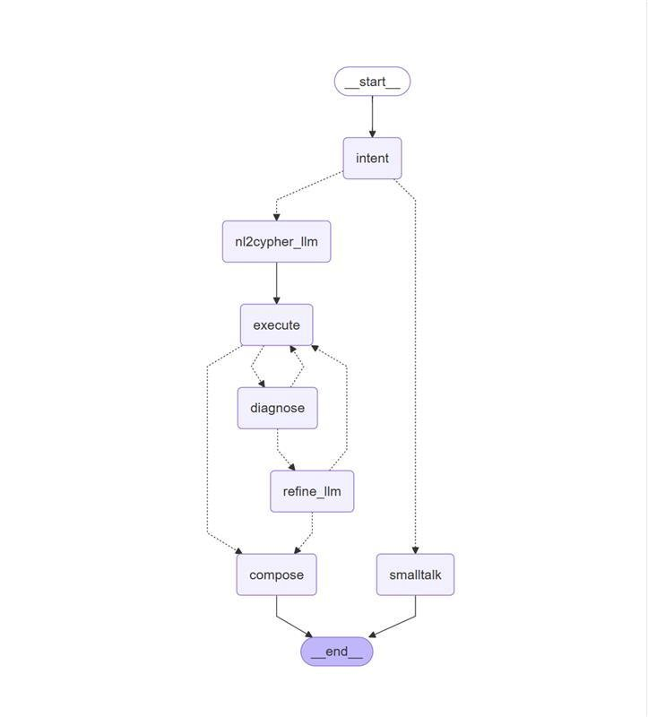


Current Status and
Future Goal
We are here!
What we want to become!

Slide 60

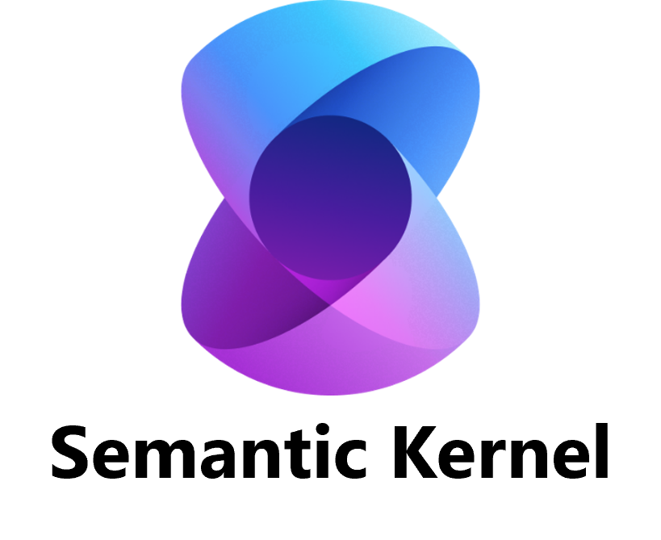
Orchestration strategies
LangGraph
  Excels in structured, multi-step reasoning with persistent memory
  Ideal for planning, diagnostics, and maintenance workflows.
CrewAI
  Provides flexible, role-based orchestration
  Well-suited for real-time grid contingencies where agents act as dispatcher, coordinator, or field technician.
Semantic Kernel
  Enables skill-based orchestration that blends LLM reasoning with deterministic functions and memory
  Ideal for multi-tool integration and enterprise-scale automation.
Notes:
Quick context and objectives (5 min) — Changhun
TP5 progress demo: GridSense AI (Neo4j + Heo1 grid from LEW) (15 min) — Redwanul
Neo4j schema overview and ingestion path
Live queries via the LLM chatbot
Validation results (15 min) — Ragav
Basic parameter verification checks
Multi-query prompts → responses → result-consistency snapshots
Next steps on reliability and consistency (10 min) — Redwanul, All
Using MCP to connect tools/data and ensure consistent answers across question variants
Literature and building blocks for agentic AI (10 min) — Ragav, Changhun, All
Brief overview: GridMind, PowerAgent, and related agentic frameworks we can leverage
Data roadmap (5 min) — EES, All
Expanding beyond CGMES to include GIS/SCADA/AMI/vendor data sources
OPAL-RT × FAU internship/Master’s opportunity (10 min) — All
Scope, MCP server integration, expected deliverables, supervision plan, and next actions
Further discussions

Slide 61
What is MCP
(Model Context Protocol)
MCP is like a universal translator that helps LLMs
talk to many external tools and data sources in a standard
way: making them more useful, flexible, and trustworthy.
Some General Tutorial about MCP
modelcontextprotocol.io
huggingface.co/learn/mcp-course

Slide 62
Grid Assist
User Request → Grid Assist → Specialized Domain MCPs
1️⃣ TP5 LLM Agent (Reasoning Core)
  Interprets the user request and formulates an execution plan.
  Routes tasks to the appropriate domain MCPs based on intent and context.
2️⃣ Neo4j / File MCP
  Explores grid snapshots, topology, and affected regions from stored data.
  Provides structural and historical context to the reasoning loop.
3️⃣ TP3 MCP
  Executes power-flow, contingency, congestion-relief, and restoration analyses.
  Returns validated numerical results and stability indicators.
4️⃣ OPAL-RT MCP
  Performs real-time simulation or dry-run tests of the proposed restoration plan.
  Enables safety-checked deployment in cyber-physical environments.
5️⃣ Summary & Approval Step
  Aggregates results, evidence, and snapshot references (IDs, file paths).
  Prepares a structured summary for human approval or revision before final action.

Slide 63
Grid Assist
TP3 (Automated congestion management & restoration AI)
  Expose TP3 modules (physics-informed NN for congestion, RL restoration sequences) as MCP server “tools”, so the LLM/agent can safely call:
    Functions like tp3.loadflow / tp3.congestion_suggest / tp3.restore_plan / tp3.contingency_run
    Numerical results come from solvers (power flow/OPF/contingency) → prevents hallucinations
  With a corresponding MCP server on the OPAL-RT side (e.g., HYPERSIM/ePHASORSIM API wrapper) and bidirectional integration, TP3 policies can be validated in closed loop on a real-time model.
(1) a control path, where TP3 applies its computed policy or actions to the OPAL-RT system, and
(2) an observation path, where OPAL-RT streams real-time states and results back to TP3,
are both active at the same time — enabling a closed feedback loop of policy proposal → application → observation → validation and refinement.
Whether tp3.loadflow operates on CGMES XML files or on Neo4j-based subcases, it generates actions and predictions through offline computation.
The OPAL-RT MCP server then applies and executes those actions on the real-time model, streams back the live results, and TP3 uses this feedback to confirm or adjust its policy.
The key point is to share common asset/switch/equipment IDs and schema definitions so that the offline (subcase) and real-time (full model) environments remain consistent and interoperable.

Slide 64
Grid Assist
TP5 (GridAssist LLM/agent)
  TP5 LLM agent can:
    Programmatically operate modeling environments (MATLAB/Simulink/HYPERSIM: open/edit params/run),
    Explore data sources such as Neo4j/CGMES/files, and
    Call solver tools → collect results/summarize/link evidence,
    orchestrating all this into one workflow.
  TP5’s “natural language → grid analysis & simulation → evidence-based report” pipeline becomes robust under the MCP standard.

Slide 65
Grid Assist
TP6 (OPAL-RT real-time validation/field replication)
  Once the OPAL-RT MCP server exists:
    CGMES snapshot → (converter) → load as an OPAL-RT real-time model
    Inject scenarios (faults/switching/load ramps) & stream live KPIs
    Run closed-loop HIL/CIL tests including relays/controllers—automated by the agent
  This matches TP6’s goal of vendor-agnostic, standards-based validation.

Slide 66
Literature and building blocks for agentic AI (PowerAgent, GridMind) (10 min) — Ragav, Changhun, All

Slide 67
Agentic AI
Agentic AI – Plan, Reason, Act, Coordinate tools and Maintain context​
  Why in power grid domain? ​
    Rising complexity​
    Many Traditional workflows​
    Requirement of Interactive analyses
GridMind - ​Multi-Agent AI System for Power system analysis
  Goal - Integrate LLMs with high-fidelity, deterministic engineering solver
  System Architecture - Multi-Agent Orchestration using specialized agents ( ACOPF, Contingency Analysis, coordinator) to break down and execute complex workflows.
  Key Innovation - Conversational scientific computing
  Core value - Mitigate hallucination
Source: GridMind: LLMs-Powered Agents for Power System Analysis and Operations — Jin, H., Kim, K., & Kwon, J. (2025). arXiv:2509.02494v1

Slide 68
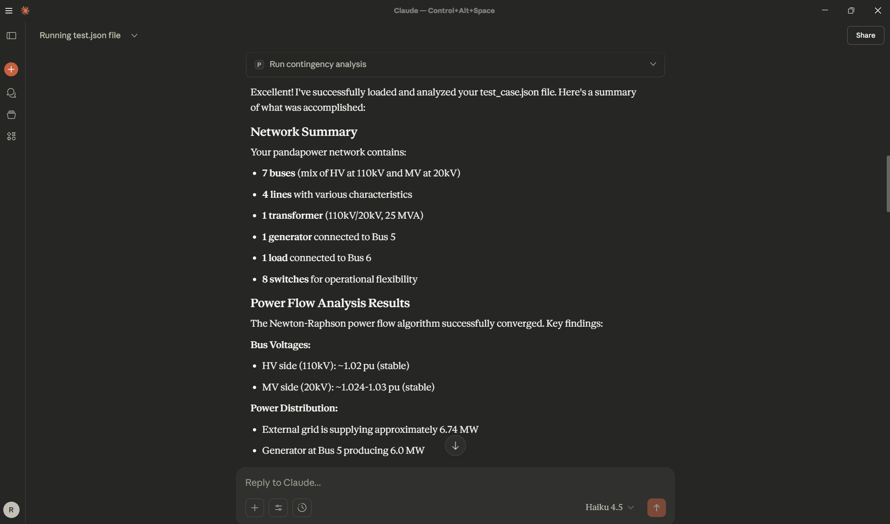
PowerAgent
Agentic intelligence in power systems
  Key blocks
    PowerFM - Fine-tuned LLM for power systems task
    PowerMCP - Allowing the model to interact with domain tools
    PowerWF – Modular agentic workflows, Multi agent
Demo – Integration of PowerMCP with Claude

Slide 69
Data roadmap (beyond CGMES to include GIS/SCADA/AMI/Bendor data sources) (5 min) — EES, All

Slide 70





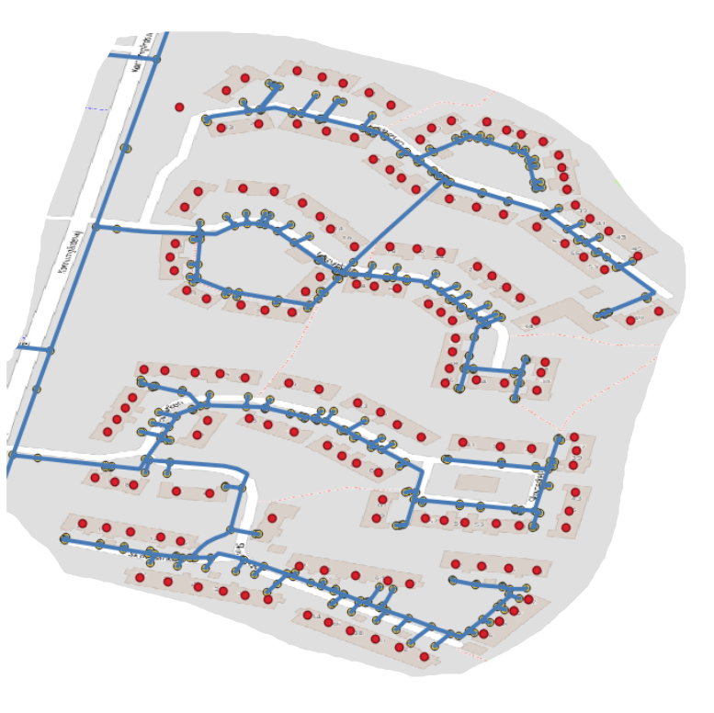


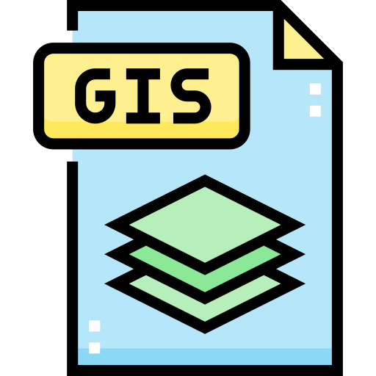


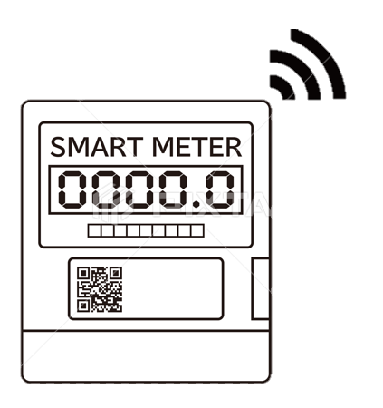


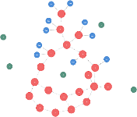



UtilityTwin case
Source
Location
Quality
…
GIS Data – Network Topology:
Geospatial data of the Bronderslev network.
Pipe
Type
Size
Fault
…
Meter Data
Consumption, operational attributes
Nodes
Pipes
Pumps
Valves
Hydrants
Reservoirs
…
SCADA
Operational data of network
Reservoir
Head
Altitude
…
Processing/Pump station
Capacity
Operators
…
Cadastre Data
Property and land data
Elasticsearch
5 years
Utility Employee
Expertise
Equipments
…
Network
SCADA
Meters
Type
Values
Consumer
Faults
Replacements
…
Meter
Cadastre
Consumer
Weather
Fault
Type
Cost
…
Utility Twin

Slide 71
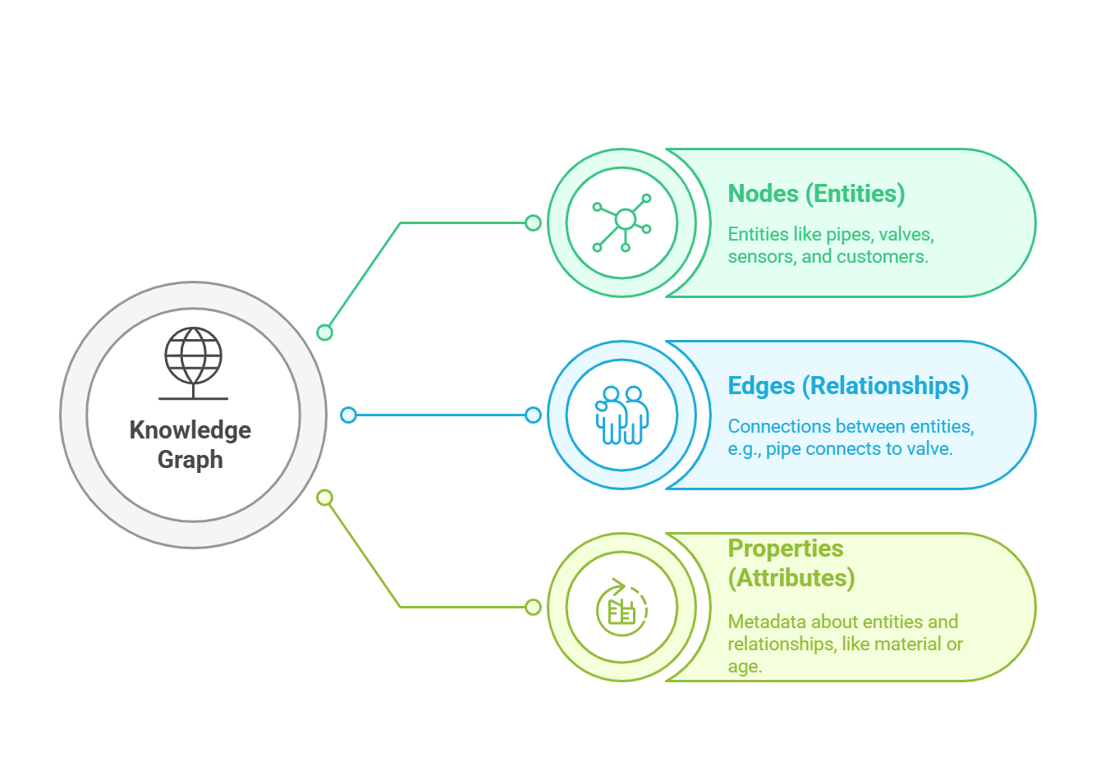
UtilityTwin case
Social Network for Utility Infrastructure

Slide 72
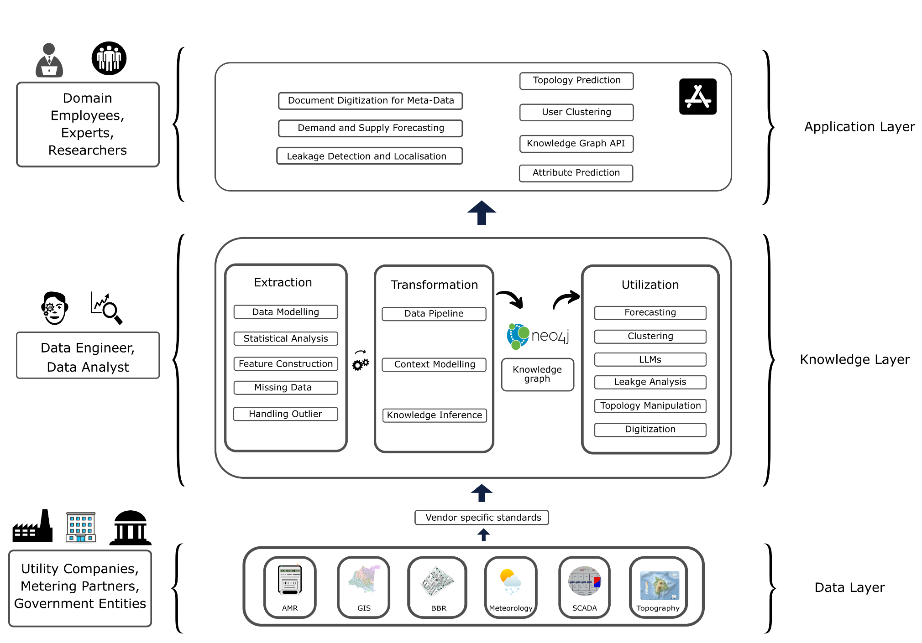
UtilityTwin case

Slide 73
Why go beyond CGMES?
1️⃣ CGMES (the blueprint)
  What: Snapshot of the network (buses, lines, transformers, switch states, parameters).
  Use: Power-flow/contingency studies.
  Limit: No map, no live status, no customer view.
2️⃣ GIS (the map)
  What: Locations of substations, poles/towers, underground routes.
  Why it helps: Shows where the issue is and the exact switch/pole to operate.
  Example: “Why is Feeder F-17 islanded?” → Map highlights the open switch to close.
3️⃣ SCADA & EMS (live sensors & control-room apps)
  What: Real-time measurements and alarms; apps that analyze them.
  Why it helps: Confirms what’s happening now and why.
  Example: Bus voltage looks low → SCADA confirms it and shows a nearby line is heavily loaded.
Notes:
1) CGMES (the blueprint)
What it is: A standardized file that describes the network at a point in time—buses, lines, transformers, generators, switch states, electrical parameters.
How it’s used: Load the snapshot into a simulator to run power flow or contingency studies.
Easy example: “If Line L-10 trips, will anything overload?” → Load CGMES, run the study, see the result.
Limit: Great for studies, but it’s just a snapshot. It doesn’t tell you where equipment sits on a map, what’s happening live, or which customers are out.
2) GIS (the map)
What it is: Geographic positions of substations, poles, towers, underground routes, and right-of-way.
How it’s used: Locate assets, plan switching or patrol routes, overlay risks (e.g., flood zones).
Easy example: “Where is the open point that isolated Feeder F-17?” → The map shows the exact pole and switch to close.
3) SCADA & EMS (the live sensors and control room apps)
SCADA = live measurements and remote control (voltages, currents, breaker status).
EMS = control-room apps that use SCADA data (state estimation, contingency checks, optimal dispatch).
How they’re used: See what’s happening now, receive alarms, and make safe control actions.
Easy example: “Is Bus B really low voltage?” → SCADA confirms the low reading and shows a nearby line is heavily loaded.

Slide 74
Why go beyond CGMES?
4️⃣ AMI / MDMS (smart meters at customers)
  What: Home/factory meters that report voltage and “I’m out/back” pings.
  Why it helps: Verifies restoration at street level; monitors low-voltage quality.
  Example: After switching, meters under a transformer start reporting “back online” → restoration confirmed.
5️⃣ Vendor / OMS / CMMS (protection & maintenance)
  What: Relay settings, outage tickets/crew work, maintenance status.
  Why it helps: Prevents unsafe recommendations; respects work in progress.
  Example: Tie switch looks good electrically, but the bay is under maintenance → action is blocked; alternate path proposed.
6️⃣ PMU (phasor measurement units)
  What: High-speed, GPS-timed measurements of grid angles and frequency.
  Why it helps: Safe re-closing and stability checks.
  Example: Angle difference is small and frequency aligned → safe to re-close an intertie.
Notes:
4) AMI / MDMS (the customer smart meters)
AMI = smart meters at homes/factories that can report voltage and “I’m out” pings.
MDMS = database that stores smart-meter data.
How they’re used: Verify restorations, monitor low-voltage quality, support billing/analysis.
Easy example: After a switching plan, meters in the affected street start reporting “back online” → you know service was restored without calling customers.
5) Vendor / OMS / CMMS (protection & maintenance records)
Vendor/protection settings = relay and device configurations.
OMS (Outage Management System) = tickets, crew dispatch, outage areas.
CMMS (Maintenance) = work orders, asset condition, parts.
How they’re used: Keep operations safe (respect relay limits), avoid switching through equipment under maintenance, track outages.
Easy example: The agent suggests closing a tie switch, but records show that bay is under maintenance today → block the action and suggest an alternate path.
6) PMU (the high-speed “angle” meters)
What it is: Special devices that measure voltages/currents with GPS time, capturing grid angles very fast.
How it’s used: Check stability and synchronize islands before reclosing.
Easy example: Before re-closing an intertie, PMU shows the angle difference is small and frequency matches → safe to reclose.

Slide 75
Why go beyond CGMES?
7️⃣ Weather / Nowcast
  What: Live/forecast wind, lightning, temperature, storms.
  Why it helps: Explains faults and flags risks ahead of time.
  Example: Lightning cell over Line L-233 → fault risk alert; if a trip occurs, ticket links to that storm.
8️⃣ Documents (CGMES profiles description, Standard Operating Procedures, operator reports)
  What: Detailed CGMES field/profile docs, standard operating procedures & one-line diagrams, and operator reports (blackout, contingency, congestion), plus protection/SCADA tag lists.
  Why it helps: Removes ambiguity on data fields, grounds actions in official procedures, speeds root-cause with prior cases, and makes decisions auditable.
  Example: Before reclosing tie SW-T-19, the agent surfaces the SOP sync-check steps and confirms interlocks/maintenance status; or when asked “What is tapPosition?”, it shows the CGMES definition with units and valid ranges.
Notes:
7) Weather / Nowcast (conditions outside)
What it is: Live or forecast weather layers—wind, lightning, temperature, storms.
How it’s used: Predict trouble spots, explain faults, plan crews.
Easy example: A lightning cell passes over Line L-233; moments later the breaker trips → the outage ticket links to that storm cell as likely cause.

Slide 76
Why go beyond CGMES?
1️⃣ CGMES (the blueprint) : Snapshot of the network (buses, lines, transformers, switch states, parameters).
2️⃣ GIS (the map) : Locations of substations, poles/towers, underground routes.
3️⃣ SCADA / EMS (live sensors & control-room apps) : Real-time measurements
4️⃣ AMI / MDMS (smart meters at customers) : Home/factory meters that report voltage and “I’m out/back” pings.
5️⃣ Vendor / OMS / CMMS (protection & maintenance) : Relay settings, outage tickets/crew work, maintenance status.
6️⃣ PMU (phasor measurement units) : High-speed, GPS-timed measurements of grid angles and frequency.
7️⃣ Weather / nowcast (wind, lightning) : Live/forecast wind, lightning, temperature, storms.
Faster root-cause: Map + sensors pinpoint the exact open switch or overloaded span.
Trustworthy actions: Smart meters & SCADA confirm reality before executing a plan.
Safer operations: Protection/maintenance data avoids unsafe switching.
Quicker restoration: AMI pings verify success instantly—no phone calls needed.
Proactive ops: Weather & PMU turn reactive fixes into early interventions.
Auditable decisions: Every step is tied to data sources, tickets, and procedures.

Slide 77
Demo 3
Ask the grid basic operational questions
Demo cue: natural-language query -> Cypher -> count/list result.
Use this slide to play the short basic-query clip if time allows.
Demo clip: basic query
While playing
Show that the system produces a query, executes it, and exposes the evidence.
Notes:
In the first demo, the user asks basic operational questions such as how many buses, lines, or transformers are in the model. The answer is not impressive because it is a count. It is impressive because the system finds the right graph objects, generates the Cypher, executes it, and returns a traceable answer.

Slide 78
Demo 2
Graph queries become engineering computation
Retrieve topology and line parameters from Neo4j, then hand computation to trusted code.
MATCH (bus1)<-[:CONNECTED_TO_TOPO_NODE]-(:Terminal)
-[:PART_OF_EQUIPMENT]->(line:ACLineSegment),
(line)<-[:PART_OF_EQUIPMENT]-(:Terminal)
-[:CONNECTED_TO_TOPO_NODE]->(bus2)
RETURN bus1, bus2, line.r, line.x
Graph edges
>
Y-bus matrix
>
Solver / analysis
Key principle
Language specifies intent. Tools and code perform numerical analysis.
Notes:
For numerical analysis, the LLM should not invent calculations. The graph query retrieves connectivity and parameters. Then deterministic computation or solver tools do the numerical work. This is the pattern we want in power systems: language for intent, databases for facts, and tools for physics.

Slide 79
Graph Model
GridSense: ask the grid, verify the evidence
GridSense lets users ask natural-language questions about the grid model, translates them into graph-based queries and analysis workflows, and returns answers grounded in retrieved grid evidence.
It is not a chatbot for the grid. It is a human-centered interface to structured, verifiable grid intelligence.
Natural-language question
>
Schema-aware graph query
>
Retrieved grid evidence
>
Grounded answer
Knowledge graph as evidence layer
Design stance
Natural language is the interface. The graph and tools decide what can be verified.
Topology, assets, equipment, and operating snapshots stay queryable and traceable.
Notes:
GridSense follows this principle. We do not want an LLM that invents answers about the grid. We want an interface that lets the operator ask the grid model directly. The LLM interprets the question, the knowledge graph grounds the answer in topology and asset relationships, domain tools can provide computation, and the final response remains traceable to the data and query results. In this sense, GridSense is a bridge between interoperable grid models and trustworthy operator assistance.

