Slide 1


Physics-Informed GNN for Medium-
High Voltage AC Power Flow with Edge-Aware Attention and
Line Search Correction Operator
PV
PQ
Slack
PQ
PQ
PQ
A structure-aware and inference-correctable GNN surrogate
Changhun Kim, Timon Conrad, Redwanul Karim, Julian Oelhaf,
David Riebesel, Tomas Arias-Vergara, Andreas Maier, Johann Jaeger,
Siming Bayer
Pattern Recognition Lab and Institute of Electrical Energy Systems
Friedrich-Alexander-Universitaet Erlangen-Nuernberg (FAU), Germany
Contact: changhun.kim@fau.de
Notes:
Good morning, I’m presenting our work on physics-informed graph neural networks for medium-high voltage AC power flow with Edge-Award Attention and Line Search Correction Operator. This topic is basically about addressing limits of vanilla graph neural networks by adding task-specific structure for a certain domain which is here the electrical power system.
So let’s dive together into this topic.
a structure-aware and inference-correctable GNN surrogate to solve underdetermined non-linear equations in the power system.

Slide 2



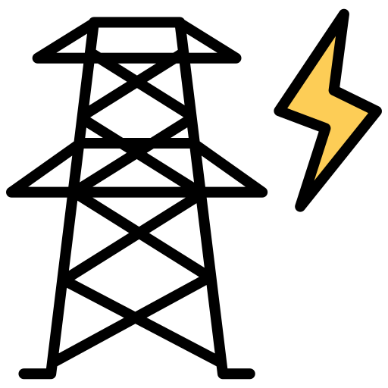



Motivation and Problem
Introduction
AC-PF
Generator
Generator
Slack
Load
Load
Load
HV + MV
THOUSANDS OF CASES
Speed is useful only if the predictions stay physical.
Notes:
Time: 1 min
First, let me introduce the problem behind this work: AC power flow.
In the recent German power grid, the increasing penetration of renewable energy and various types of loads are causing grid congestion, often due to voltage overloads at certain nodes.”
And managing this congestion requires solving thousands of AC power flow scenarios in few seconds.
So in practice, the speed of the solver is very important.
But Speed is useful only if the predictions stay physical.
But speed alone is not enough. The predictions also need to remain physically meaningful.
---
First, let me introduce the problem behind this work: AC power flow simulation.
Grid operators need to solve many AC power flow cases, especially for congestion management in medium- and high-voltage grids.
Which detects and relieve overloaded nodes before security limits are violated
Here, congestion management means detecting and relieving overloaded lines before security limits are violated, and faster physically reliable AC power-flow screening helps operators evaluate more corrective actions, reduce curtailment and redispatch effort, and therefore lower operating costs.
So in practice, for the fast screening the speed of the solver is very important.
But speed is useful only if the predictions stay physical.
---
First of all, we need to understand the problem that GNN aims to solve.
The answer is AC power-flow simulation.
This is a task that solves a non-linear equation which is “underdetermined” in a power grid.
Grid Operators need to solve thousands of ac power flow scenarios across high voltage and medium voltage grids for congestion management. So the throughput of an algorithm to solve is really important
However traditional iterative solver such as newton Raphson are slow and not naturally gpu friendly.
So neural network based leaned surrogate are attractive because it can be ran fast in gpu
But speed alone is not enough: predictions must remain physically meaningful.

Slide 3
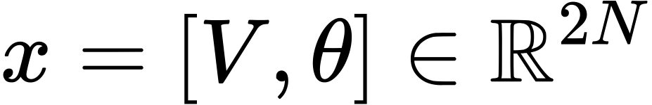
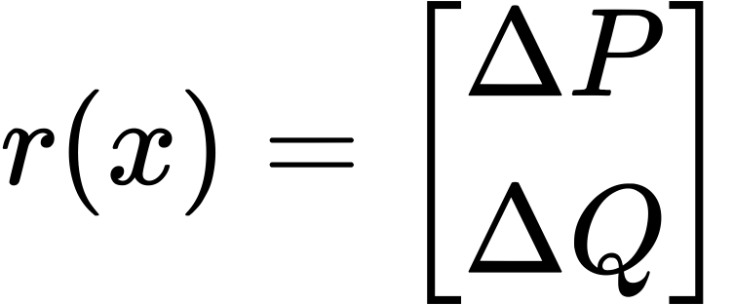
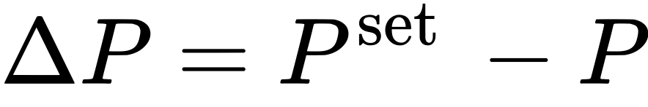
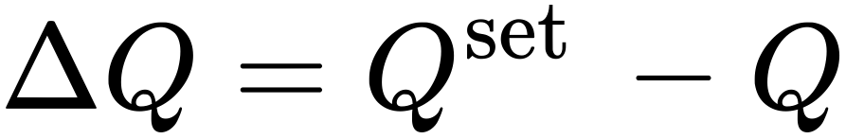
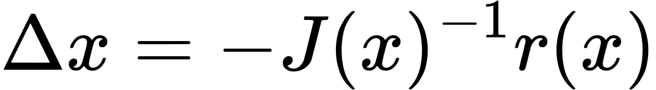
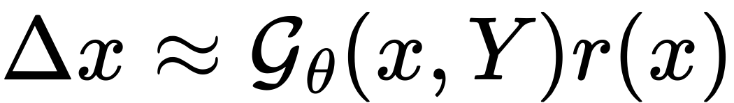
Graph Formulation of AC Power Flow
Method
P | Q | V | θ
P | Q | V | θ
Grid as a graph
AC-PF
Node voltage states
Generator
Generator
Slack
Power-flow mismatch
Load
P | Q | V | θ
P | Q | V | θ
Load
Load
P | Q | V | θ
P | Q | V | θ
Newton Rapson Solver
Graph Neural Solver
The goal of AC-PF is to find the unknown node voltage states across all nodes by solving nonlinear power flow equations.
Notes:
Let me first formulate the AC power flow problem as a graph problem.
Each node is one of the following types: slack, generator, or load, and each edge is a transmission line with admittance features. Each node has four features: active power, reactive power, voltage magnitude, and angle.
The goal of AC power flow is to find the unknown voltage states at all nodes by solving the nonlinear power-flow equations for P and Q in terms of voltage and admittance.
To solve this, we use either Newton–Raphson or a graph neural solver, which replaces the Jacobian matrix with a graph neural network.

Slide 4
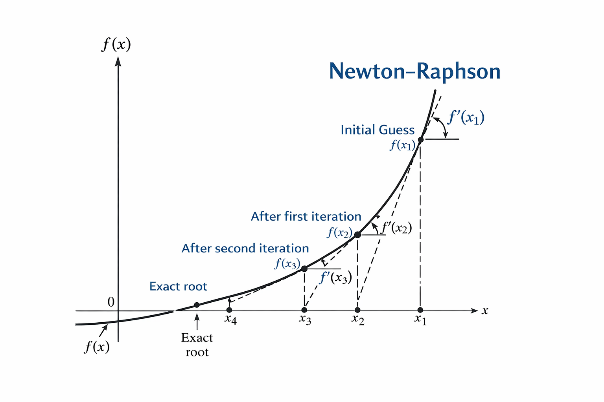
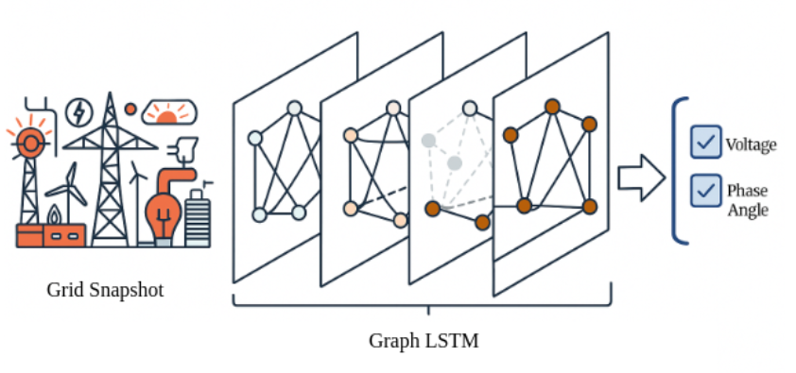
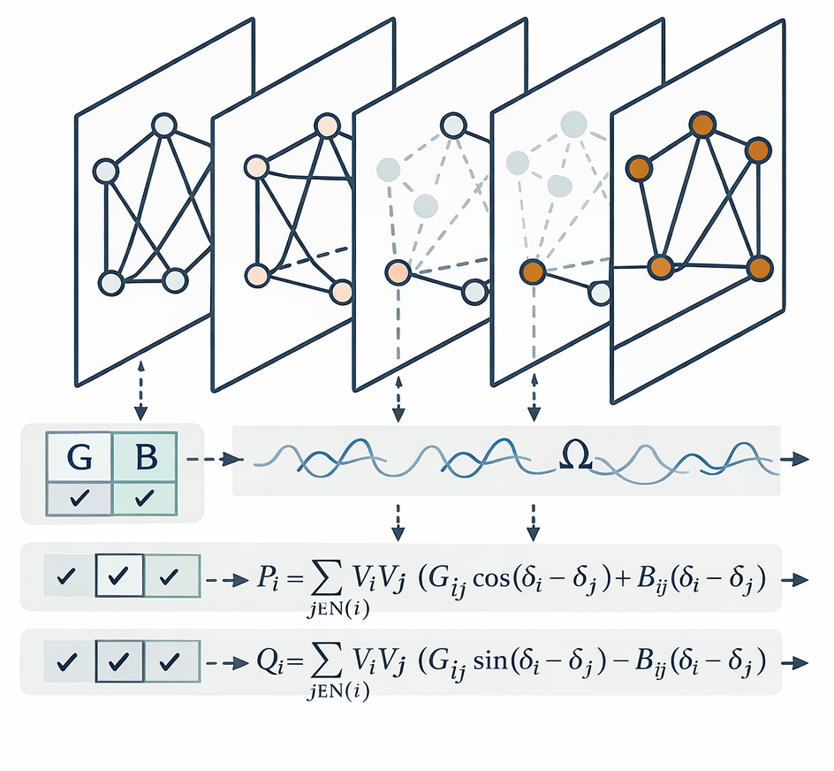
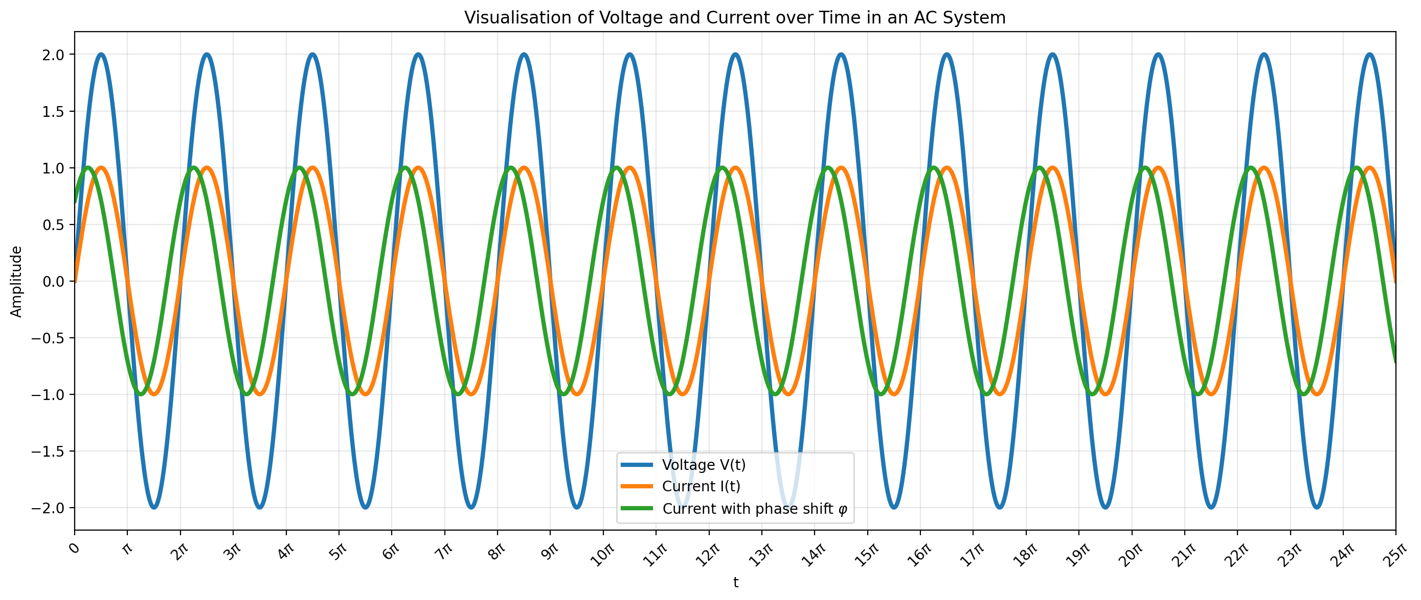
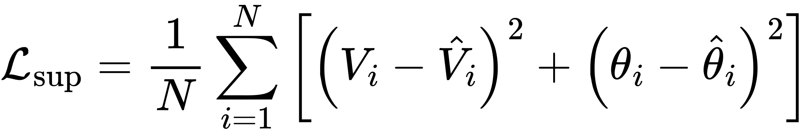
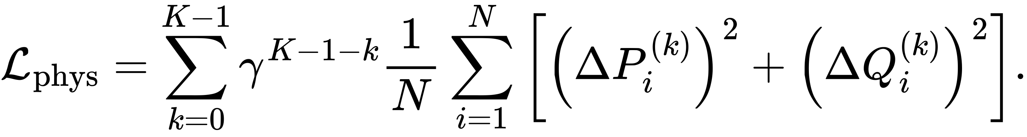
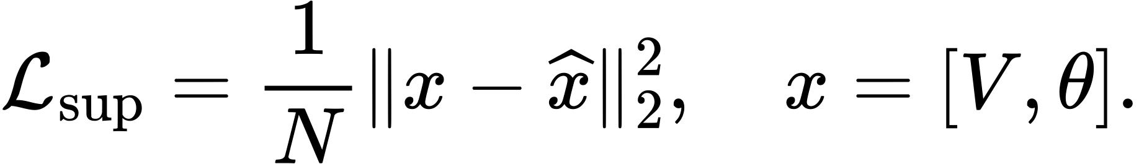
Limitations of existing method familes
State of the arts
1. Newton-Raphson
2. Supervised GNN
3. Physics Informed GNN
P
Q
Notes:
Time: 1 min
However, There are the limitations of newton-Raphson and existing graph neural network based ac-power flow solver. First, Newton-Rapshon is slow due to the computation of jacobian matrix and its inverse by repeated sparse factorization which is not gpu friendly. Second, Supervised GNN is fast enough because it can utilize the gpu’s computational power. But it requires labeled training data from Newton–Raphson and is not physically grounded, since the physical equations are incorporated neither through the model structure nor through the loss function. Third recent physics informed GNN somehow successfully incorperted physics equations but the structure awareness is still limited and there is no mechanism that gurantee the phsycially paulsible behavior during inference.
---
before going to our work, let me briefly compare the existing method families. Newton–Raphson is physically grounded and accurate, but repeated sparse factorization limits throughput. Plain GNN surrogates are fast and can generalize across graph sizes, but they need require Newton-Raphson labels, so that important physical structure is mostly implict. Existing physics-informed GNNs improve learning by penalizing the violation of physical equations as a regularizer during training, but there is no mechanim that guarantees physically plausible behavior at inference time. So none of these options fully gives us both fast inference and trustworthy physical behavior.
---
This slide positions our method relative to the main families. Newton-Raphson is physically grounded, but repeated sparse factorization limits throughput. Plain GNN surrogates transfer across graph sizes, but they do not encode enough physics. Existing PIGNNs improve training with physics losses, yet those losses become inoperative at inference. Our method keeps the surrogate speed advantage while adding explicit line physics in the forward pass and a corrective decrease criterion at deployment.

Slide 5
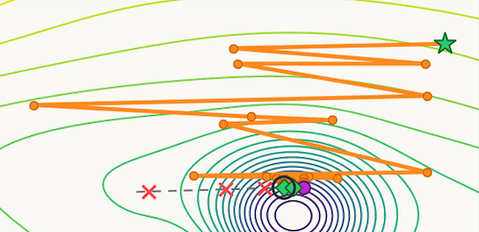
Research Question and Gap
Introduction
Can we design a more trustworthy physics-informed GNN solver with greater strucrue-awareness and an inference-correctable mechanism?
Representation gap
Standard message passing treats neighbors too uniformly and underuses line information.
Inference gap
Physics-informed enters only through the training objective as a regularizer, but it doesn’t provide a mechanism that guarantees physically plausible behavior at inference
n1
n2
n1
n2
strong
weak
strong
i
target node
weak
i
target node
n4
n3
n4
n3
transformer
phase-shifted
transformer
phase-shifted
Notes:
Time: 1 min
This leads to our research question: can we design a more trustworthy physics-informed GNN solver with greater structural awareness and an inference-correctable mechanism?
These questions arise from the two main gaps in previous methods.
The first is the representation gap, which is caused by uniform message aggregation through a multi-layer perceptron.
that models the influence of each neighbor differently based on the line parameters.
in reailty
The second is the inference gap, which arises because physics-informed enters only through the training objective as a regularizer, but becomes inoperative during inference.
in reaility
First, there is a representation gap in the existing method that utilize standard message passing gnn. it treats neighbors uniformly and underuses line-specific electrical information.
Second, there is an inference gap: physics is usually introduced only through the training loss, so it becomes inactive once the model is deployed.
As a result, existing models are physics-informed during training, but not necessarily physics-guided at inference.
This leads to our research question: can we design a physics informed GNN surrogate that not only enforce physics through loss function but also structurally captures line-specific electrical interactions? We define this representation gap that is devired from standard message passing which treats neighbors too uniformly and undersues line information.
And the other question was can we make the predictions still correctable at inference time? So we define this as a inference gap to compensate inoperative loss during inference
and still remains correctable at inference time? We identify two main gaps. First, there is a representation gap, because standard message passing underuses admittance-dependent edge structure. Second, there is a trust gap, because the physics loss helps only during training and does not actively improve behavior at deployment. Our method is designed to address both.
---
The research question is whether we can design a GNN surrogate that captures line-specific electrical interactions better and remains correctable at inference time. Existing PIGNNs already use physics-informed training, but two gaps remain. First, standard message passing underuses admittance-dependent edge structure. Second, the physics loss is only active during training, so it does not enforce better behavior once the model is deployed. That creates both a representation gap and a trust gap.
The research question is simple. Can we design a GNN surrogate that better captures line-specific electrical structure and also behaves more reliably at inference time? Existing approaches already use physics-informed learning, but there are still two gaps. First, message passing often treats neighboring interactions too uniformly. Second, the physics term often helps only during training, not during deployment. So there is a representation gap and an inference gap.

Slide 6
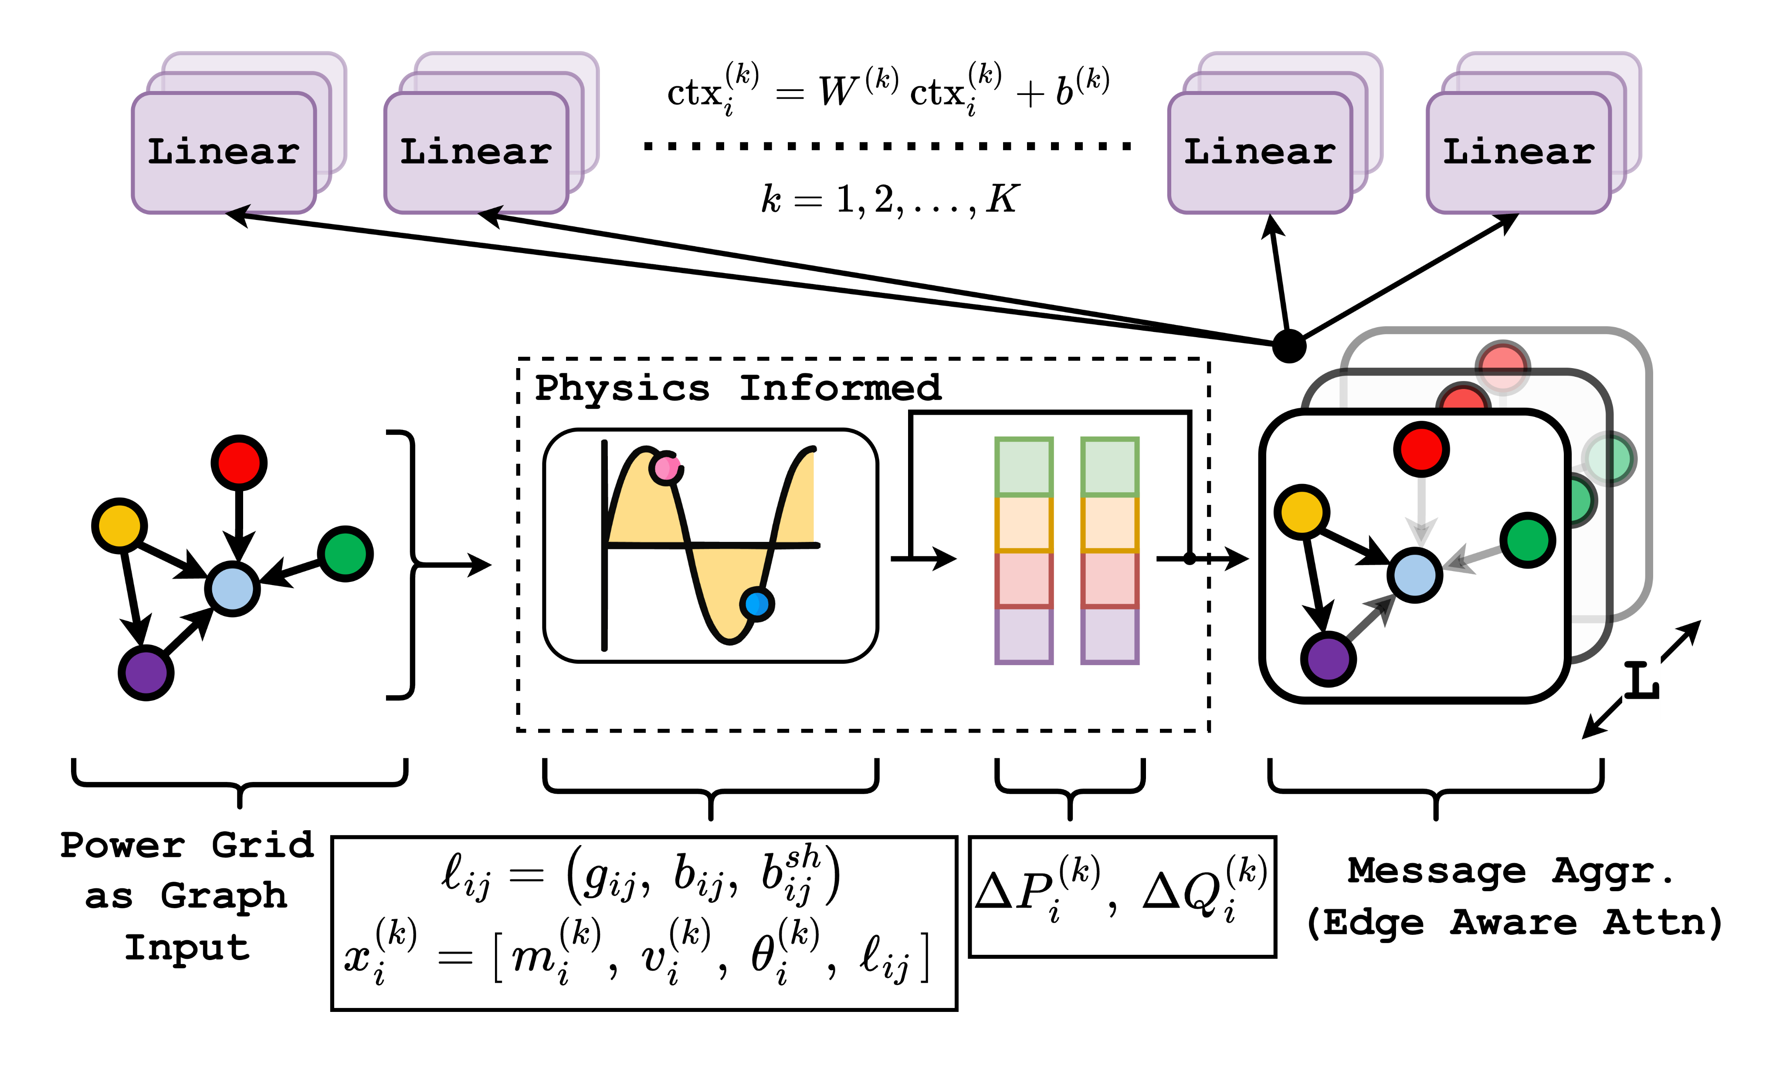
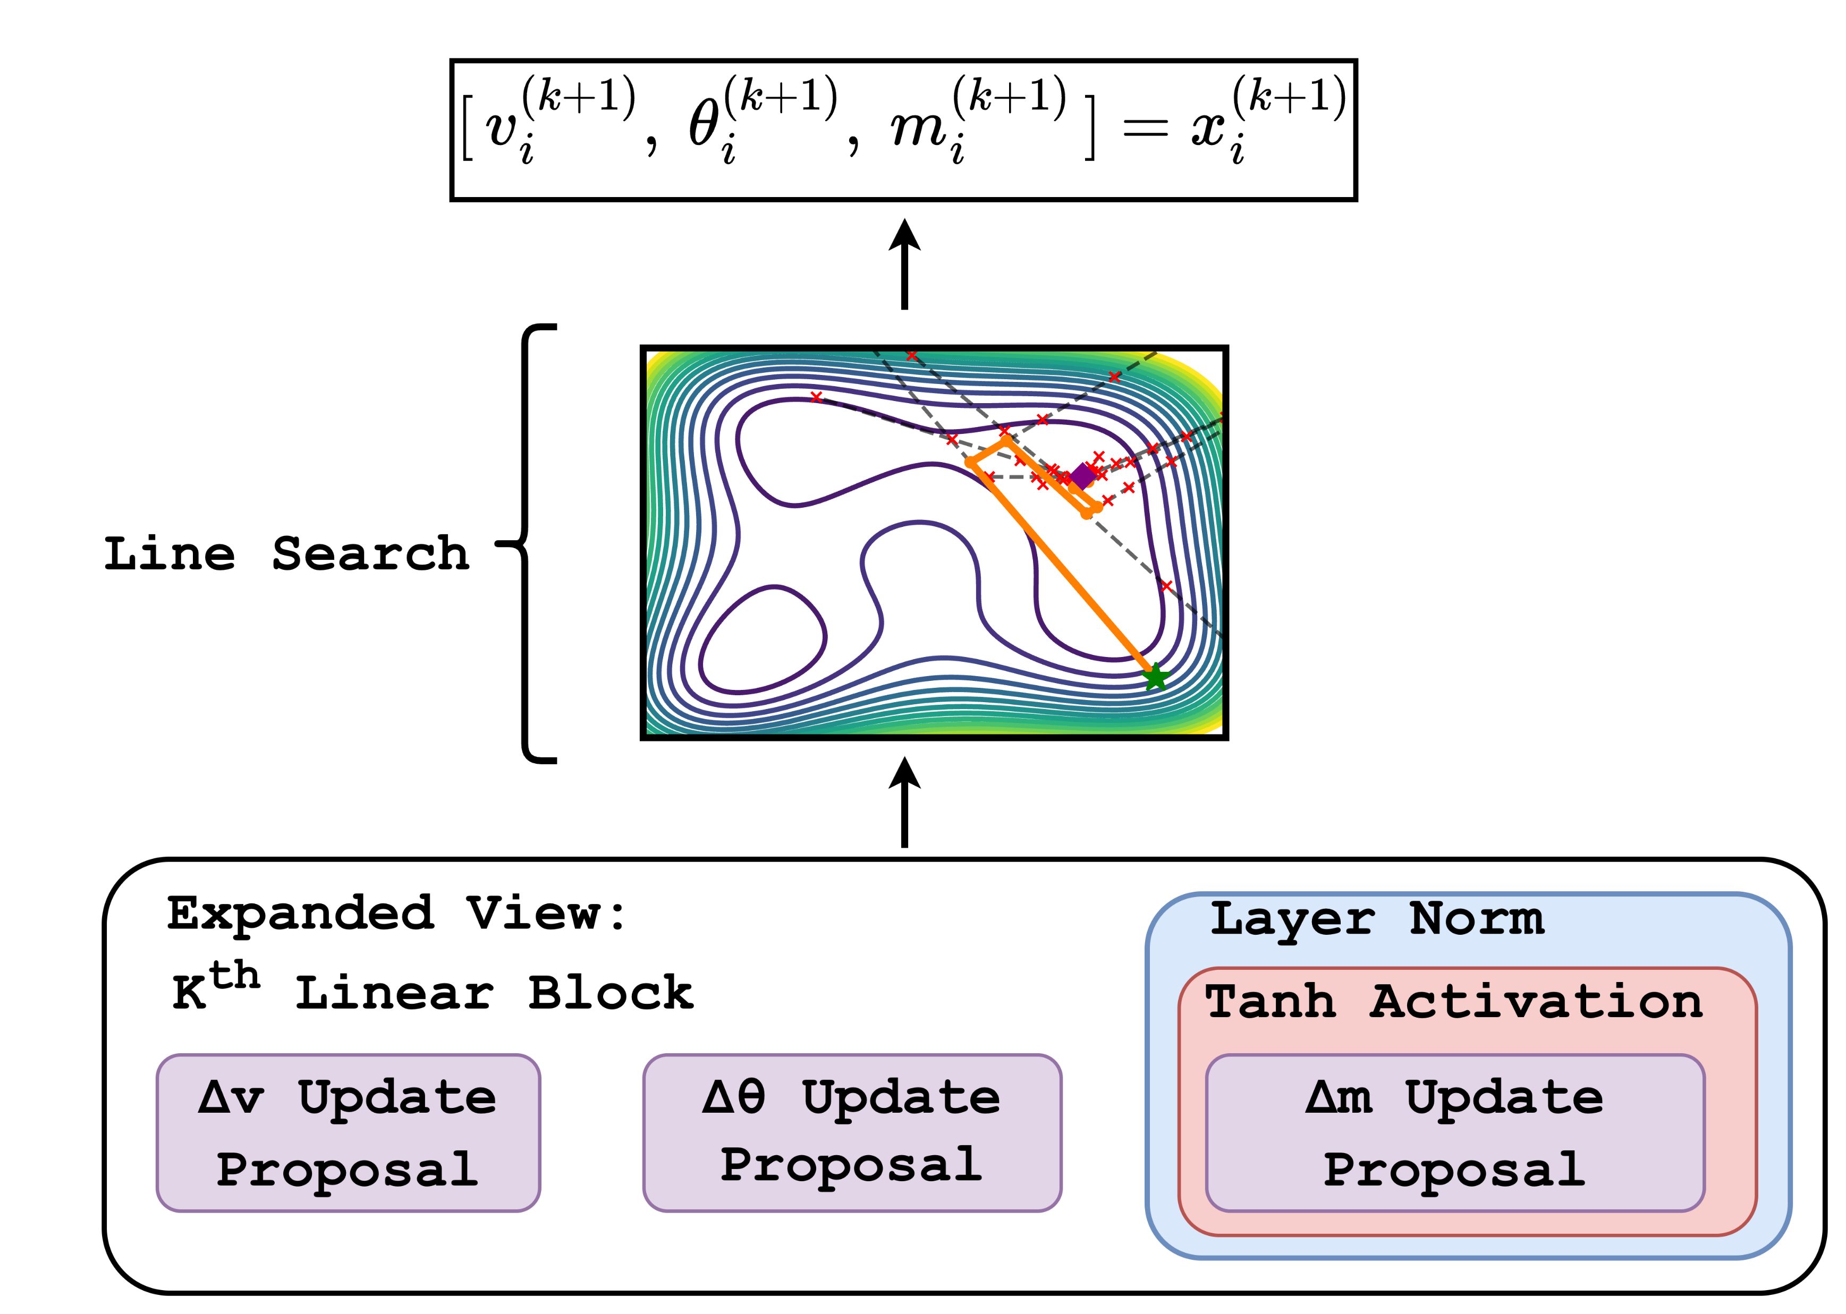
Method Overview
Method
Notes:
Our method is designed to close both gaps with two main components.
First, for the representation gap, we use a transformer-style edge aware-attention message aggregator that models the influcne of each neighbors differently based on the line parameters,
Second for the infernce gap, we use a backtracking line search based correcction mechanism instead of directly accept5ing the raw update proposal.
For next 2 slides, we will take a closer look at the two main components.
---
First, to better capture the physical laws during message aggregation, we use a transformer-style edge aware-attention aggregator instead of using multi-layer perception aggregator
that models the influence of each neighbor differently based on the line parameters.
Second, at inference time, we apply a backtracking line-search based correction mechanism instead of directly accepting the raw update proposal.
---For next 2 slides, we will take a closer look at the two main components.
we run a physics-informed graph network on the grid, where edge-aware self-attention lets each transmission line influence the buses differently. At each iteration, the model uses both the current state and the physical mismatch to propose updates for voltage and angle. Second, at inference time, we apply a line-search correction instead of directly trusting the raw prediction. This ensures that the final update actually reduces the power-flow residual. So representation is improved by attention, and trustworthiness is improved by line search.

Slide 7
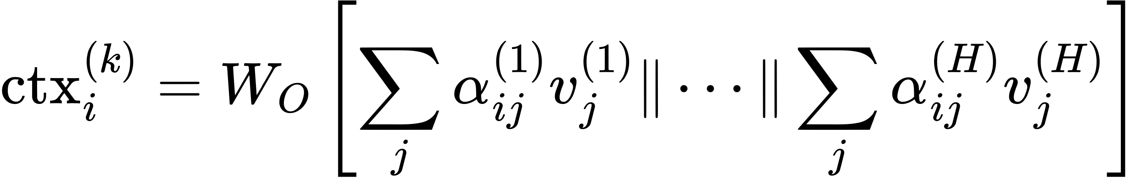
Edge-Aware Attention
Method
INTUITION
1
Node projections
n1
n2
strong
i
target node
weak
2
Edge-conditioned attention score
n3
n4
3
Multi-head aggregated context
transformer
phase-shifted
Isotropic → Anisotropic
graph filter
Fully differentiable known-operator layer that makes edge coupling explicit in the forward pass, unlike MLP style aggregation where it is only implicit via node features
Notes:
Time: 2 min
So in Edge-Aware Attention, the query is the projection of the target node i’s features, while the keys and values are the projections of the neighboring nodes j’s features.
And at the sacled dot project q ,k we add a physics-based edge bias
This gives us an edge-conditioned attention score, so it basically moves from an isotropic to an anisotropic graph filter that models the influence of each neighbor differently based on the line parameters.
.
Additionally, it acheives the greater strucutre-awareness, since this edge-aware attention works as a fully differentiable known-operator layer that makes edge coupling explicit in the forward pass, unlike MLP-style aggregation, where it is only implicit through node features.
first project the physics informed node features x = [del P, delQ, V, thetha and the meesage] of node I
Add a physics-based edge bias from $\ell_{i j}$
and normalize over incoming neighbors of $i$ :
---
This is the first main technical idea. Rather than aggregating neighbors uniformly, we score each interaction with attention that includes an explicit edge-dependent bias term. That bias is computed from line features, so the model directly injects admittance information into the forward pass. In known-operator learning language, this behaves like a lightweight differentiable operator layer. It also allows directional asymmetry, because alpha_ij does not need to equal alpha_ji, which matches the anisotropic structure of the power-flow Jacobian. The result is a more faithful approximation of the local inverse-Jacobian action than isotropic aggregation.

Slide 8
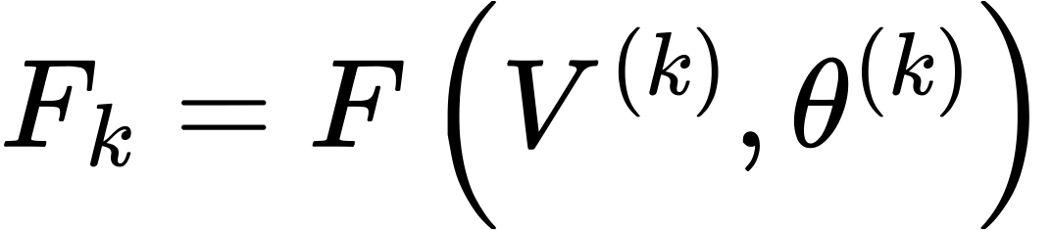
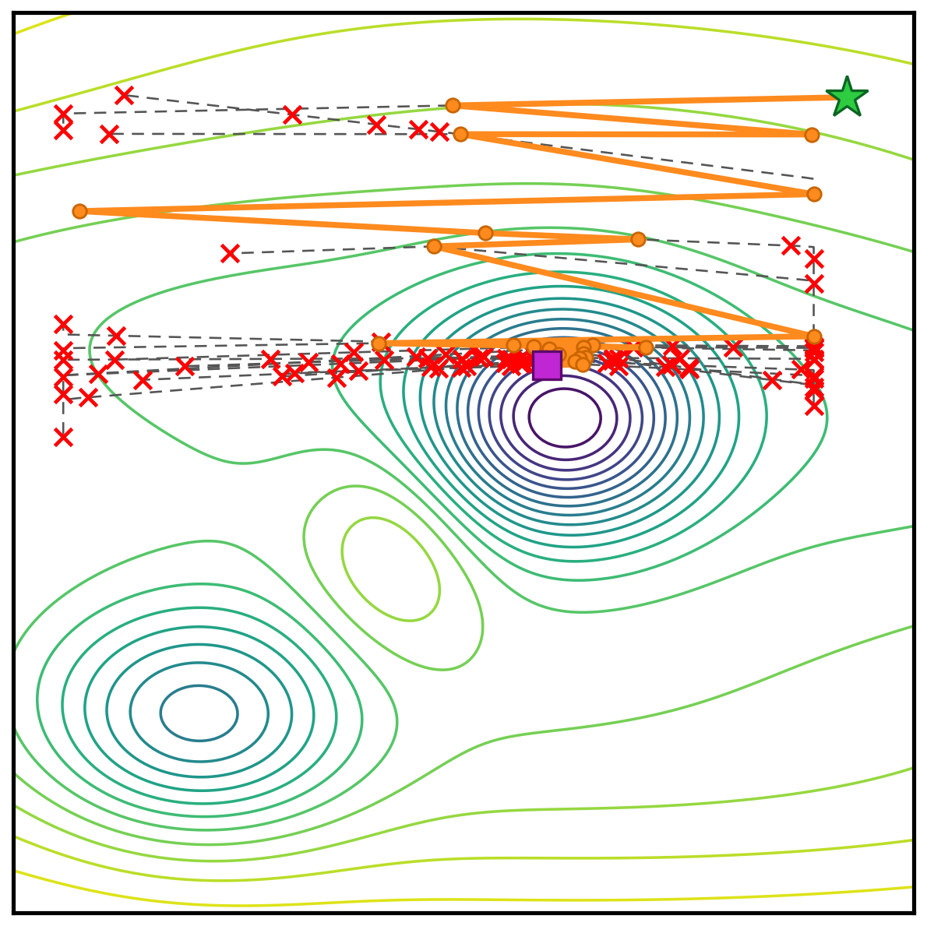
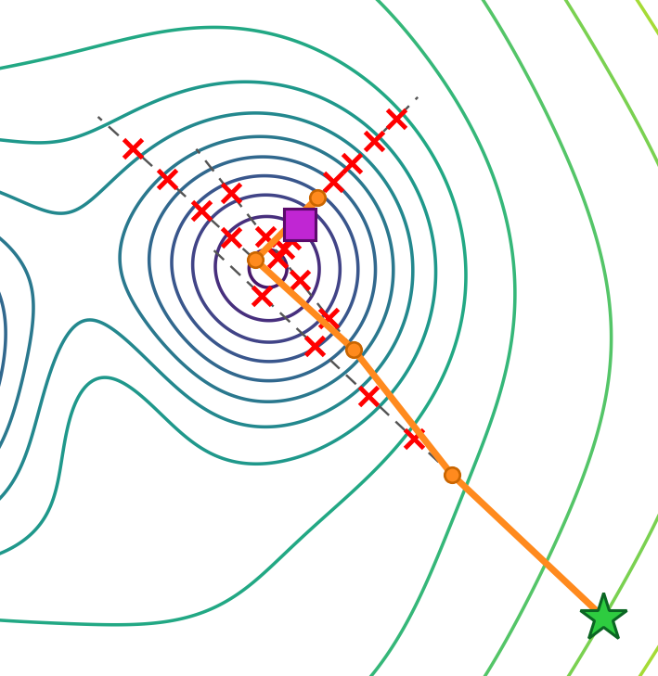
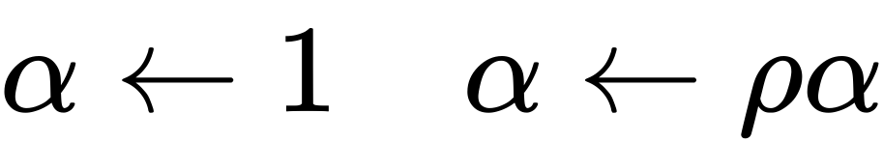
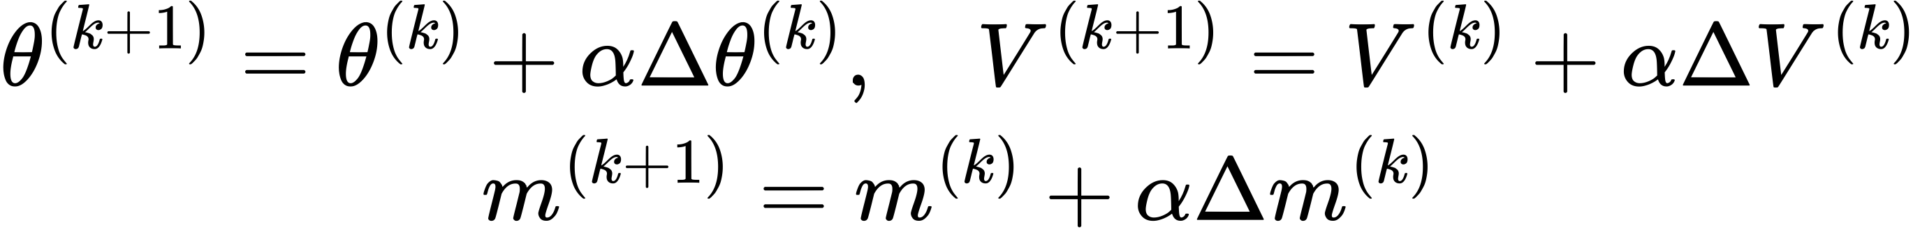
Backtracking Line Search
Method
INTUITION
1
Merit function
Start
Accepted
2
Backtracking rule
Rejected
3
Accepted update
End
https://convex-optimization-for-all.github.io/contents/chapter06/2021/03/20/06_02_02_backtracking_line_search/
Notes:
Time: 2 min
Time: 2 min
The backtracking line search works as a update-correction mechanism at each message-passing step k.
We define a merit function as the infinity norm of the P and Q residuals over all nodes. Iff the current step size does not reduce the value of the merit function sufficiently, the method backtracks to one step before, reduces the step size, and checks again whether the merit function decreases enough.
By doing so, we can compensate for the inoperative physics loss during inference, resulting in more stable and physically plausible behavior.
---
This slide is a simplified oral version of Algorithm 1. The merit function is the maximum of the active- and reactive-power mismatch infinity norms. We start with the full neural update, set alpha equal to one, and test whether the trial step reduces the mismatch enough according to the Armijo condition. If it does not, we shrink alpha by rho and try again. Once a step passes, we apply it to theta, V, and the latent state m. For presentation clarity, this slide omits the explicit update caps and wrap or clip operators, but the backtracking logic matches the paper.

Slide 9
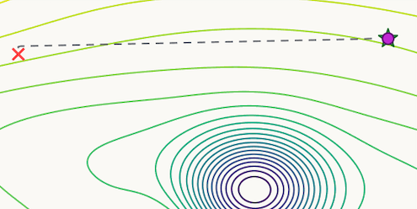
Backtracking Line Search
Method
INTUITION
1
Merit function
Start
Start
Accepted
2
Backtracking rule
Rejected
Rejected
3
Accepted update
End
https://convex-optimization-for-all.github.io/contents/chapter06/2021/03/20/06_02_02_backtracking_line_search/
Notes:
Time: 2 min
Time: 2 min
The backtracking line search works as a update-correction mechanism at each message-passing step k.
We define a merit function as the infinity norm of the P and Q residuals over all nodes. Iff the current step size does not reduce the value of the merit function sufficiently, the method backtracks to one step before, reduces the step size, and checks again whether the merit function decreases enough.
By doing so, we can compensate for the inoperative physics loss during inference, resulting in more stable and physically plausible behavior.
---
This slide is a simplified oral version of Algorithm 1. The merit function is the maximum of the active- and reactive-power mismatch infinity norms. We start with the full neural update, set alpha equal to one, and test whether the trial step reduces the mismatch enough according to the Armijo condition. If it does not, we shrink alpha by rho and try again. Once a step passes, we apply it to theta, V, and the latent state m. For presentation clarity, this slide omits the explicit update caps and wrap or clip operators, but the backtracking logic matches the paper.

Slide 10
Backtracking Line Search
Method
INTUITION
1
Merit function
Backtrack
Start
Start
Accepted
2
Backtracking rule
Rejected
Rejected
3
Accepted update
End
https://convex-optimization-for-all.github.io/contents/chapter06/2021/03/20/06_02_02_backtracking_line_search/
Notes:
Time: 2 min
Time: 2 min
The backtracking line search works as a update-correction mechanism at each message-passing step k.
We define a merit function as the infinity norm of the P and Q residuals over all nodes. Iff the current step size does not reduce the value of the merit function sufficiently, the method backtracks to one step before, reduces the step size, and checks again whether the merit function decreases enough.
By doing so, we can compensate for the inoperative physics loss during inference, resulting in more stable and physically plausible behavior.
---
This slide is a simplified oral version of Algorithm 1. The merit function is the maximum of the active- and reactive-power mismatch infinity norms. We start with the full neural update, set alpha equal to one, and test whether the trial step reduces the mismatch enough according to the Armijo condition. If it does not, we shrink alpha by rho and try again. Once a step passes, we apply it to theta, V, and the latent state m. For presentation clarity, this slide omits the explicit update caps and wrap or clip operators, but the backtracking logic matches the paper.

Slide 11
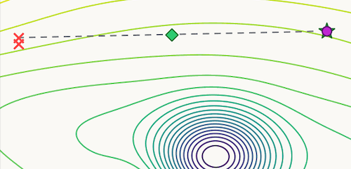
Backtracking Line Search
Method
INTUITION
1
Merit function
F is decreased enough
Start
Accepted
2
Backtracking rule
Rejected
3
Accepted update
End
https://convex-optimization-for-all.github.io/contents/chapter06/2021/03/20/06_02_02_backtracking_line_search/
Notes:
Time: 2 min
Time: 2 min
The backtracking line search works as a update-correction mechanism at each message-passing step k.
We define a merit function as the infinity norm of the P and Q residuals over all nodes. Iff the current step size does not reduce the value of the merit function sufficiently, the method backtracks to one step before, reduces the step size, and checks again whether the merit function decreases enough.
By doing so, we can compensate for the inoperative physics loss during inference, resulting in more stable and physically plausible behavior.
---
This slide is a simplified oral version of Algorithm 1. The merit function is the maximum of the active- and reactive-power mismatch infinity norms. We start with the full neural update, set alpha equal to one, and test whether the trial step reduces the mismatch enough according to the Armijo condition. If it does not, we shrink alpha by rho and try again. Once a step passes, we apply it to theta, V, and the latent state m. For presentation clarity, this slide omits the explicit update caps and wrap or clip operators, but the backtracking logic matches the paper.

Slide 12
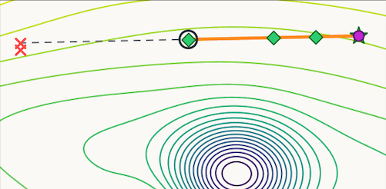
Backtracking Line Search
Method
INTUITION
1
Merit function
Accepted update
Start
Accepted
2
Backtracking rule
Rejected
3
Accepted update
End
https://convex-optimization-for-all.github.io/contents/chapter06/2021/03/20/06_02_02_backtracking_line_search/
Notes:
Time: 2 min
Time: 2 min
The backtracking line search works as a update-correction mechanism at each message-passing step k.
We define a merit function as the infinity norm of the P and Q residuals over all nodes. Iff the current step size does not reduce the value of the merit function sufficiently, the method backtracks to one step before, reduces the step size, and checks again whether the merit function decreases enough.
By doing so, we can compensate for the inoperative physics loss during inference, resulting in more stable and physically plausible behavior.
---
This slide is a simplified oral version of Algorithm 1. The merit function is the maximum of the active- and reactive-power mismatch infinity norms. We start with the full neural update, set alpha equal to one, and test whether the trial step reduces the mismatch enough according to the Armijo condition. If it does not, we shrink alpha by rho and try again. Once a step passes, we apply it to theta, V, and the latent state m. For presentation clarity, this slide omits the explicit update caps and wrap or clip operators, but the backtracking logic matches the paper.

Slide 13
Backtracking Line Search
Method
INTUITION
1
Merit function
Start
Accepted
Start
Accepted
2
Backtracking rule
Rejected
3
Accepted update
Rejected
End
End
https://convex-optimization-for-all.github.io/contents/chapter06/2021/03/20/06_02_02_backtracking_line_search/
Notes:
Time: 2 min
Time: 2 min
The backtracking line search works as a update-correction mechanism at each message-passing step k.
We define a merit function as the infinity norm of the P and Q residuals over all nodes. Iff the current step size does not reduce the value of the merit function sufficiently, the method backtracks to one step before, reduces the step size, and checks again whether the merit function decreases enough.
By doing so, we can compensate for the inoperative physics loss during inference, resulting in more stable and physically plausible behavior.
---
This slide is a simplified oral version of Algorithm 1. The merit function is the maximum of the active- and reactive-power mismatch infinity norms. We start with the full neural update, set alpha equal to one, and test whether the trial step reduces the mismatch enough according to the Armijo condition. If it does not, we shrink alpha by rho and try again. Once a step passes, we apply it to theta, V, and the latent state m. For presentation clarity, this slide omits the explicit update caps and wrap or clip operators, but the backtracking logic matches the paper.

Slide 14
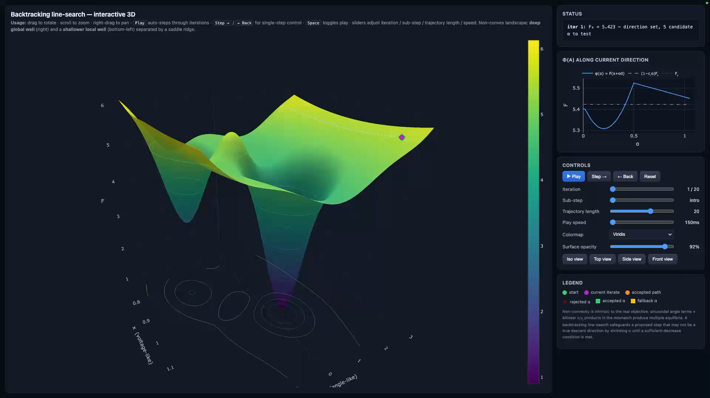

Slide 15
Experimental Setup
Experiments
Data
European/German-inspired MV and HV parameter ranges
33,182 HV scenarios and 31,500 MV scenarios
All training cases use grid sizes from 4 to 32
Training
Physics informed loss discounted over steps
K = 40 correction steps
AdamW + cosine LR schedule
Evaluation
Comparison against Newton-Raphson
Voltage RMSE, angle RMSE
Single-case and multi-scenario throughput
Train / val / test = 1 : 1 : 1
RTX 3070 + i7-12700
Block-diagonal batching
Notes:
Time: 2 min
And the experiments were conducted with the following settings.
First, for the dataset, we generated diverse grid scenarios using European- and German-inspired medium- and high-voltage parameter ranges for both node and edge features. After removing outliers, the dataset consists of about 30,000 scenarios. All training cases use grid sizes from 4 to 32 nodes with various topologies.
Second, for training, we used only the physics loss, discounted over k message-passing correction steps, without any supervised loss based on Newton–Raphson labels. We used AdamW with a cosine learning-rate schedule. The training and test sets were split equally, since we could generate sufficient data from the given parameter ranges. The experiments were run on an RTX 3070 8GB GPU with an i7 CPU with 20 cores, and the batching strategy was block-diagonal batching rather than same-size batching.
For evaluation, we used Newton–Raphson solutions only as reference labels to measure the RMSE of the voltage and angle outputs from the physics-informed method.
We also evaluated both single-scenario and multi-scenario throughput against Newton–Raphson.

Slide 16
Main Results with ablation study
Experiments
QUESTION 1
QUESTION 2
Effect of the message aggregator
Effect of inference correction
Fixed condition: Voltage caps + line search
Fixed model: PIGNN-Attn. Compare no-correction, only caps, only line search, and combined.
MLP
Attn
HV Voltage
-39%
base
only Caps
only LS
Caps + LS
5.4e-4
3.3e-4
HV Angle
-73%
0.30
0.08
HV Voltage
-96%
8.0e-3
5.4e-4
4.6e-4
3.3e-4
MV Voltage
-62%
p.u.
1.7e-3
6.4e-4
HV Angle
-88%
MV Angle
0.67
0.16
0.12
0.08
-72%
1.45
0.41
deg
Main Takeaway: Attention improves representation, line search drives robustness.
Notes:
Time: 2 min
This is the main results table with the ablation study.
We report test RMSE for voltage magnitude and angle on the high-voltage, medium-voltage, and the combined dataset.
The voltage update cap bounds the maximum update at each iteration k.
The ablation compares two things: first, MLP versus attention-based aggregation, and second, the effect of the inference correction mechanism, namely voltage update caps and line search.
Overall, the attention-based aggregator performs better than the MLP-based one in most settings. This gain is especially clear in the medium-voltage case, where the grid is more anisotropic.
We also find that voltage update caps and line search improve performance consistently across almost all cases. For the high-voltage dataset, the best result comes from PIGNN-Attn with both voltage caps and line search. For the medium-voltage dataset, the variant without voltage caps performs slightly better. And for the combined HV+MV dataset, the full model again performs best overall.
So the main takeaway is that edge-aware attention improves the representation, and line search improves robustness. Together, they reduce the voltage RMSE to 3.3 \times 10^{-4} and the angle RMSE to 0.08, which is 99.5% and 87.1% lower than the PIGNN-MLP baseline.
---
And this is the main result table with ablation study.
We reported test RMSE of voltage magnitude and Angle across Hight voltage dataset and Medium voltage dataset and the combined dataset of High voltage and medium voltage.
And the abalation is basically test the MLP vs attention based aggregator and the effect of update correction method the voltage update caps and line search.
For most of the cases attn aggregator outperform mlp aggregator and especially in the medium voltage attn aggregator is notablely better as it has more anisotropy in the grid
and voltage update caps and line search is significantly improve the result across all over the result as the best performer of HV is PIGNN-Attn with voltage update caps and line seasrch and for medium voltage without voltage update caps is slightly better performce and for HV+MV the full model also best performed aomong all other settings.
So to summarize the result the edge aware attention improves the representation and lin search drives robustness resulting in 3.3eto the 04 voltage rmse and 0.08 angle rmse which is 99.5 and 87.1 percent lower than PIGNN-MLP baseline.
Here we compared our PIGNN(physics informed graph neural network) with Attention aggregator to the baseline PIGNN with MLP aggregator
And for ablation we tested 3 mechanism first aagregator MLP vs attention, second per-iteration voltage update caps and third backtracking line search.
And the resulst consistently show attn aggregator outperform the mlp aggregator all over the cases and voltage update cpas and line search is particually helpful to reduce the rmse of both voltage mangnitude and angle.
we start from base model without any update correction mechanism to adding both voltage update caps or line search.
This slide is a simplified oral version of Algorithm 1. The merit function is the maximum of the active- and reactive-power mismatch infinity norms. We start with the full neural update, set alpha equal to one, and test whether the trial step reduces the mismatch enough according to the Armijo condition. If it does not, we shrink alpha by rho and try again. Once a step passes, we apply it to theta, V, and the latent state m. For presentation clarity, this slide omits the explicit update caps and wrap or clip operators, but the backtracking logic matches the paper.

Slide 17
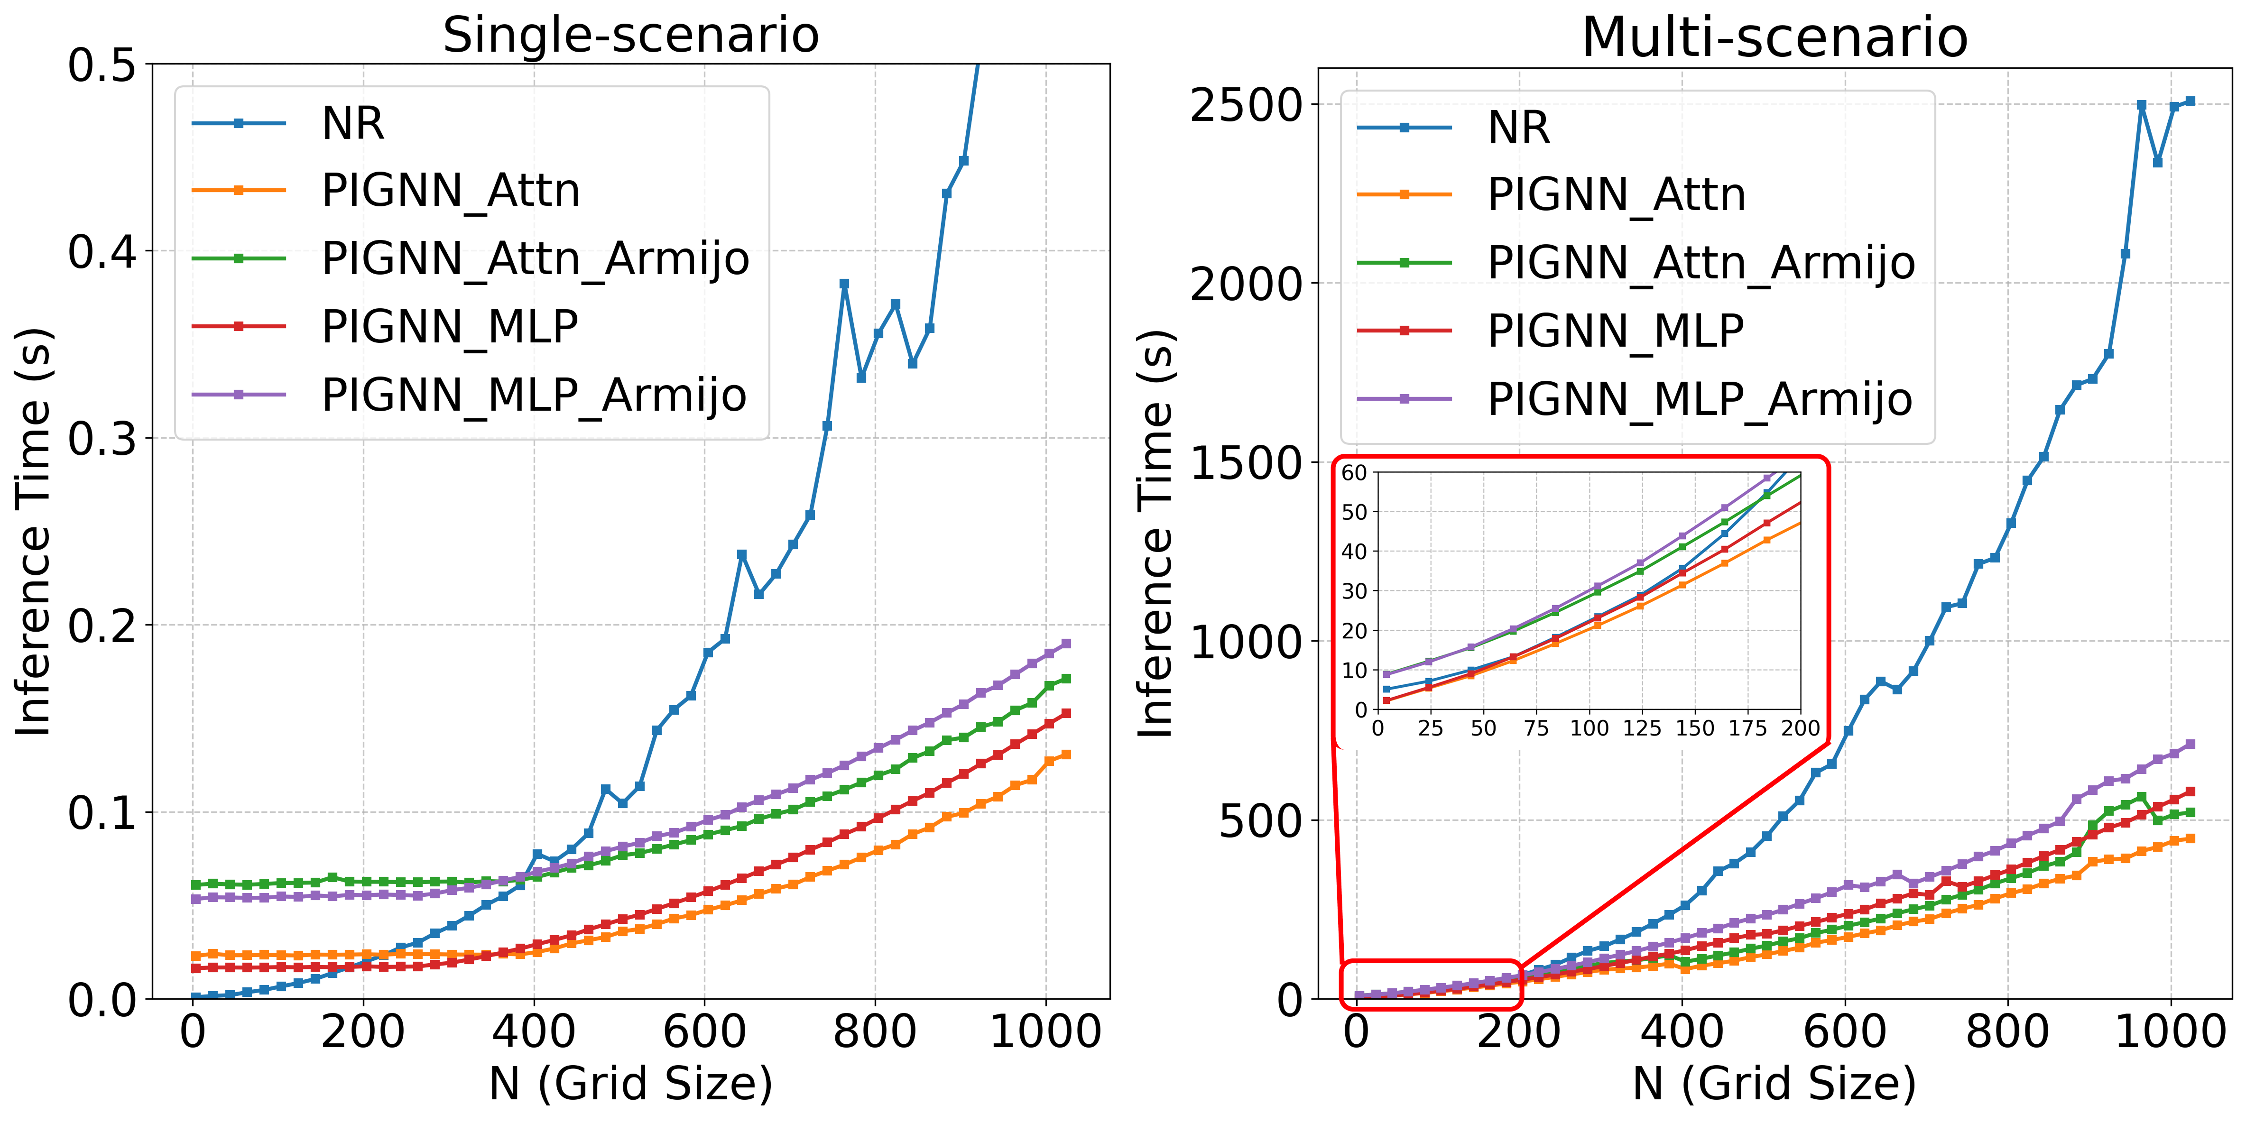
Throughput
Experiments
Single-scenario regime
1 case per N, one CPU worker for NR. ,GPU batch size 1 for PIGNN
Multi-scenario regime
4096 cases per N, 20 CPU workers for NR, one 8 GB GPU with streaming micro-batches PIGNN.
2x faster on average for N=256 to 896
Faster at all tested grid sizes
Notes:
Time: 1 min
We benchmark the throughput of our PIGNN, implemented in PyTorch, against a Newton–Raphson baseline implemented as an optimized, vectorized NumPy solver.
The results are reported as the median inference time over multiple runs, with 2 warmup and 5 repeat cycles.
In both regimes, the Newton–Raphson increases superlinearly but polynominally, while the PIGNN grows more gently.
In single-scenario runs, Newton–Raphson is competitive for smaller grid size, but PIGNN becomes faster as N increases.
In multi-scenario runs, PIGNN is consistently faster across all grid sizes.
---
We benchmark the throughput of our PIGNN, implemented in PyTorch, against a Newton-Raphson baseline coded as an optimized, vectorized NumPy solver.
Results are reported as median inference time over multiple runs with 2 warmup and 5 repeat cycles.
As you can see across both regimes NR time scales super-linearly but polynomially with N while PIGNN grows more gentle.
IN single-scenario run, NR is competitive for N < 200 but PIGNN becomes faster as N increase. In multi-scenario runs PIGNN acheives about 3x higher throughput than NR on average and is consistently faster across all gird sizes
This slide should not repeat Table 2. Instead, it explains why the pattern in Table 2 happens. Attention improves the quality of the learned correction direction by making aggregation edge-aware. Update caps prevent overly aggressive moves, but on their own they are not the main source of robustness. The line search is the dominant inference-time mechanism: it controls how much of the proposed step is actually applied and enforces residual decrease. So the clean message is that attention improves the proposal, while line search and caps stabilize its execution.

Slide 18
Conclusion
Conclusion
01
Physics-aware representation
Edge-aware attention injects line admittance information directly into message scoring.
02
Physics-aware inference
Backtracking line search restores an operative decrease criterion at deployment.
03
Empirical outcome
The final model reaches NR-level accuracy while retaining substantial throughput advantages.
Broader message: encode the right structure both in representation and in inference, and surrogate AC power-flow solvers become both accurate and usable.
Notes:
Time: 1 min
Now we can conclude this work by revisiting the two key priors we addressed.
At the representation level, edge-aware attention brings line physics directly into the aggregation operator. This makes the layer a fully differentiable known-operator layer inside the computational graph, while also capturing the anisotropy of the grid.
At the inference level, backtracking line search restores the physical decrease criterion operative again during inference.
Together, these changes provide Newton–Raphson-level accuracy with meaningful throughput advantages. This highlights the promise of graph representation learning for power systems and motivates future work on broader scalability, more rigorous benchmarking, and integration into operational systems.
---
Now we can conclude this work by revisiting the two important priors that we tackled.
At the representation level, edge-aware attention brings the line physics directly into the aggregation operator, resulting in a fully differentiable known-operator layer inside the computational graph, while also capturing the grid’s anisotropy.
At the inference level, backtracking line search makes the physical decrease criterion operative again at deployment.
Together, these changes give NR-level accuracy with meaningful throughput advantages, which highlight the promise of neural-network-based solvers for power systems and motivate future work on broader scalability, rigorous benchmarking, and integration into operational systems.
To conclude, the paper's message is that two priors matter. At the representation level, edge-aware attention brings line physics directly into the aggregation operator. At the inference level, backtracking line search makes the physical decrease criterion operative again at deployment. Together these changes give NR-level accuracy with meaningful throughput advantages, which supports the broader case for neural-network-based solvers in power systems.

Slide 19
``
Thank you for your attention!
Any Questions?

