Slide 1
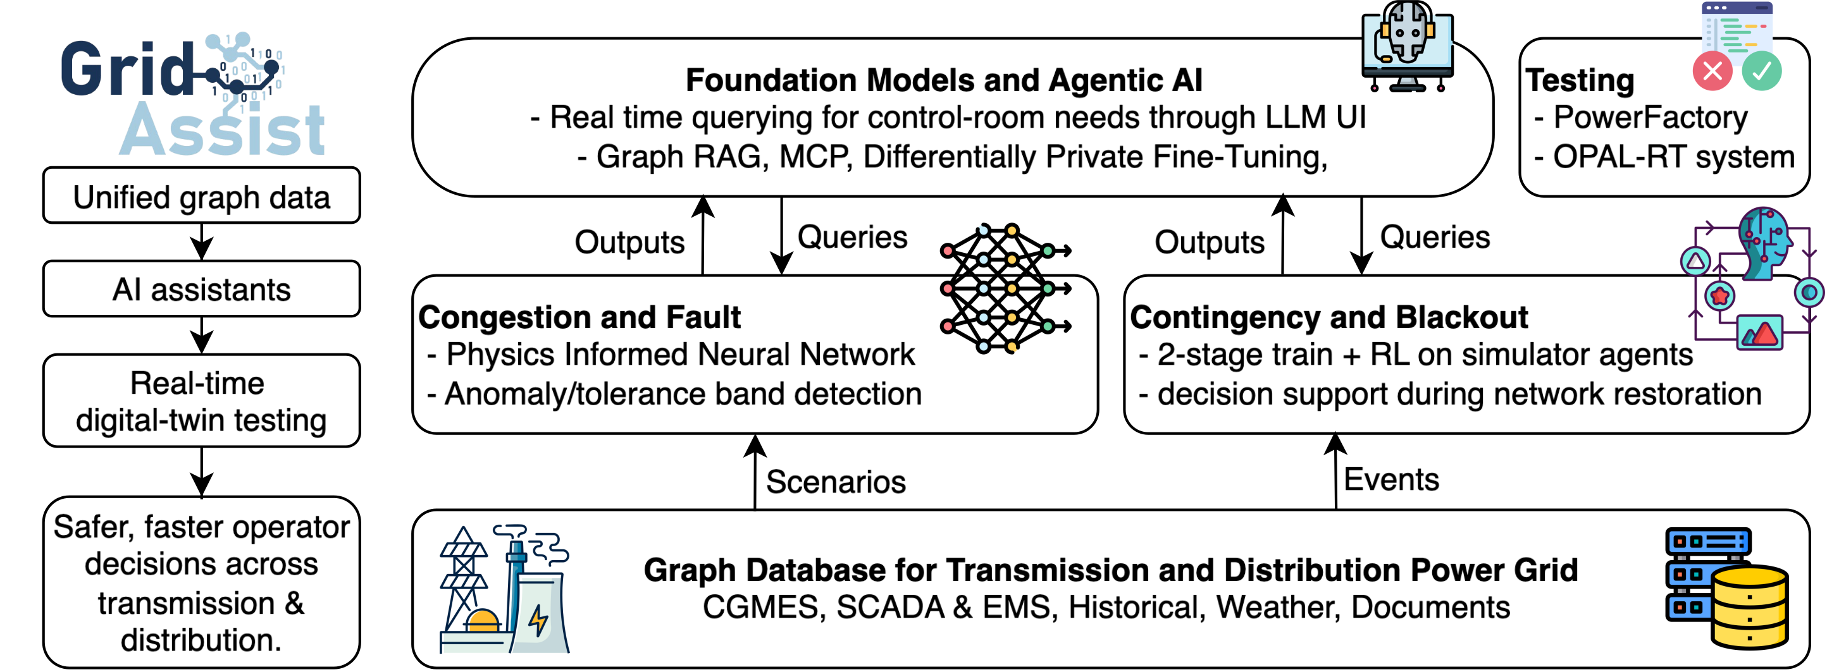
GridAssist
AI assistance for transmission and distribution grid operation
Our contribution: physics-informed AC power flow and graph-grounded operator assistance
Unified grid data connects neural solvers and LLM agents with engineering tools and digital-twin testing.
Notes:
GridAssist combines a graph database for heterogeneous grid data with AI modules for congestion and fault analysis, contingency and blackout support, and an LLM interface. The supplied project architecture distinguishes planned tool and digital-twin integrations. Changhun’s contribution presented here covers neural AC power flow and GridSense. Sources: supplied images/GridAssist.svg; GridSense_IEEE_GM_panel_Changhun_Kim.pptx, slides 4, 35, 52–55, 62–64; GridFM2026_Poster_Kim_v3.pptx. Author: Changhun Kim, Pattern Recognition Lab, FAU.

Slide 2
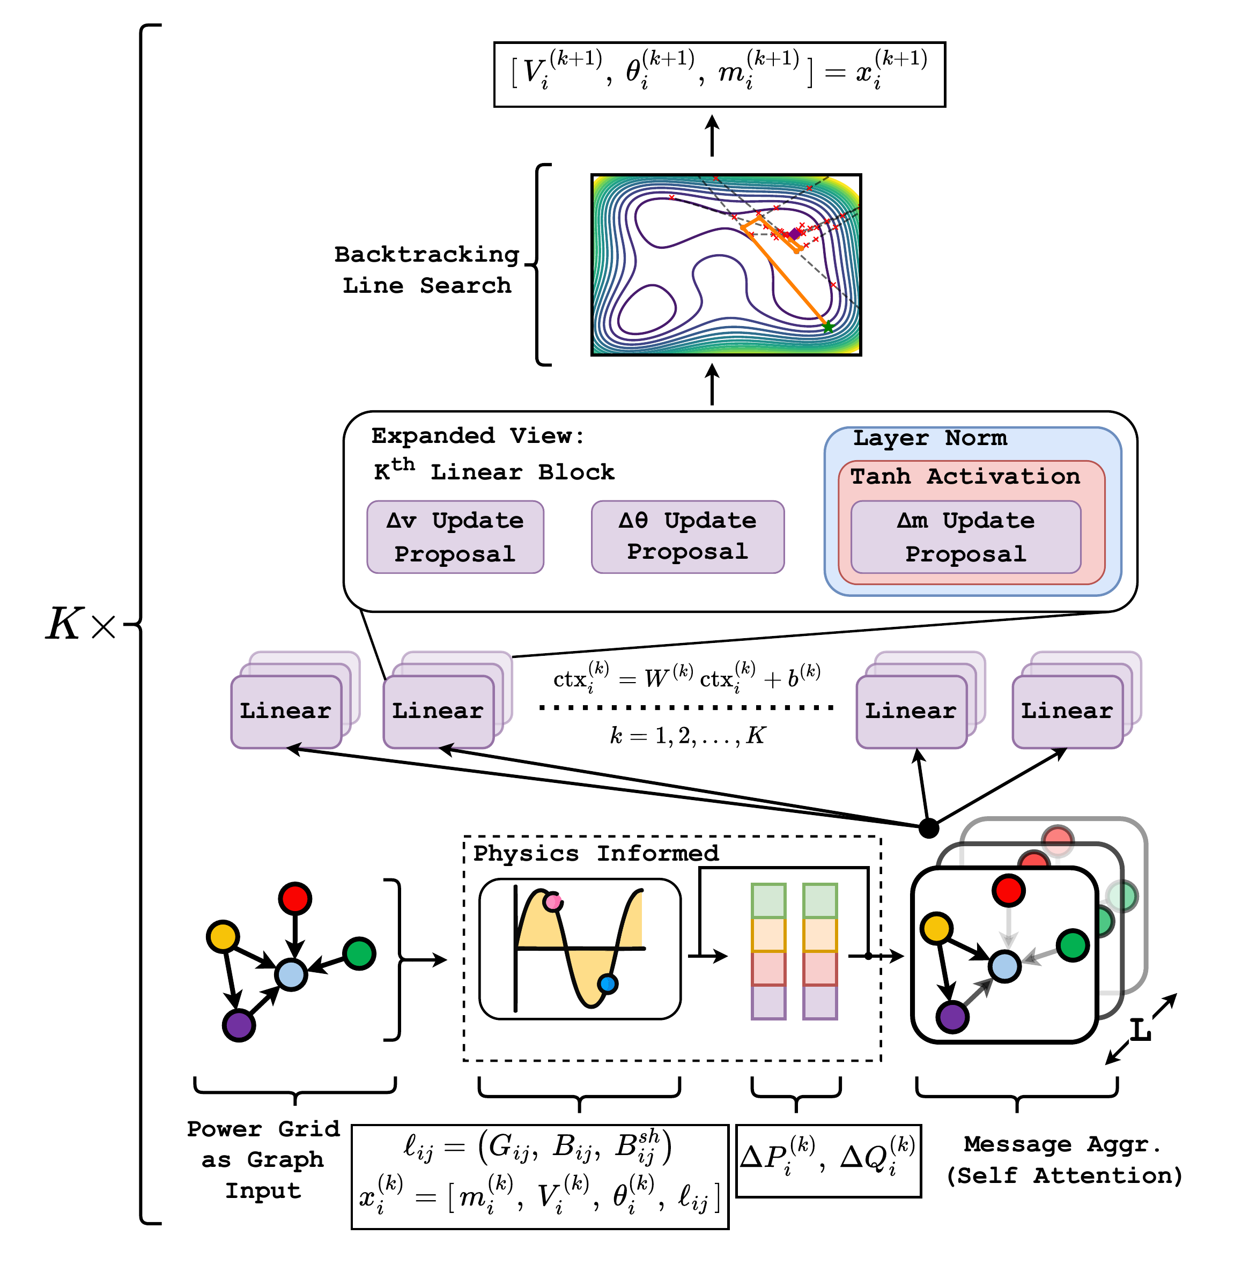
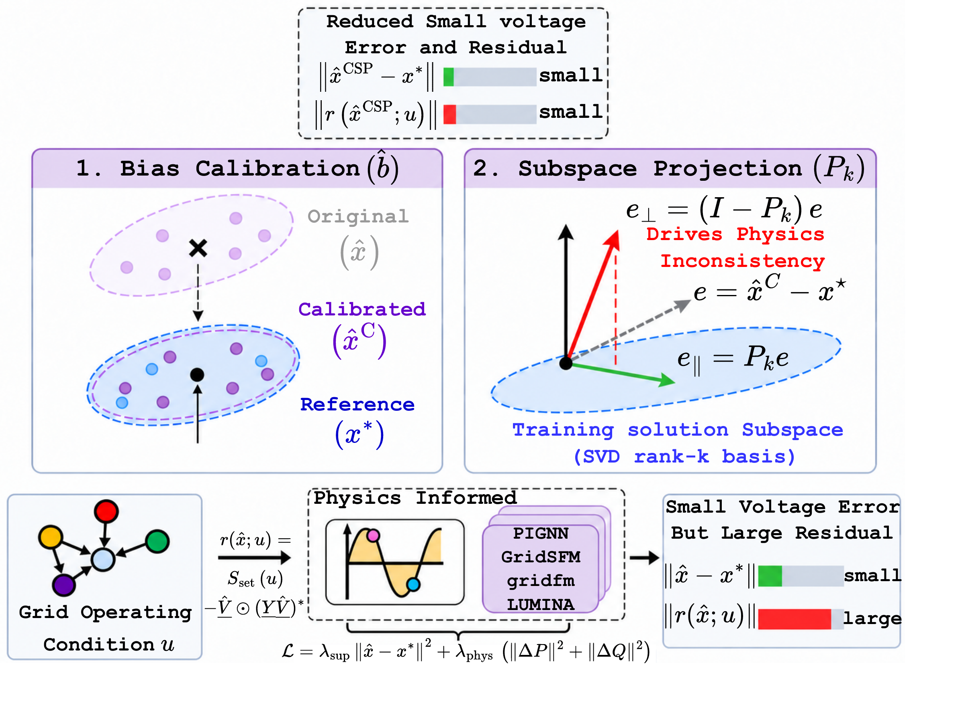
Physics-informed neural AC power flow
Attention and line search at inference, followed by solution-subspace correction
PIGNN-Attn-LS [1]
Calibrated subspace projection [2]
ICASSP 2026
ICASSP 2027 submitted · GridFM 2026 poster accepted
Edge-aware attention with backtracking line search
38–69% lower mean power-balance residuals
Four frozen solvers, GB 2224-bus grid, vs. bias-calibrated outputs
[1] C. Kim et al., “Physics-Informed GNN for Medium-High Voltage AC Power Flow with Edge-Aware Attention and Line Search Correction Operator,” ICASSP 2026, pp. 1281–1285.
[2] C. Kim et al., “Physics-Informed but Not Physics-Consistent: Error Geometry and Subspace Projection for Neural AC Power Flow,” arXiv:2610.05959, 2026.
[3] R. Karim, C. Kim et al., “Parameter-Efficient Domain Adaptation of Physics-Informed Self-Attention based GNNs for AC Power Flow Prediction,” EUSIPCO 2026, presented. arXiv:2602.18227.
Notes:
[1] Changhun Kim, Timon Conrad, Redwanul Karim, Julian Oelhaf, David Riebesel, Tomás Arias-Vergara, Andreas Maier, Johann Jäger and Siming Bayer, “Physics-Informed GNN for Medium-High Voltage AC Power Flow with Edge-Aware Attention and Line Search Correction Operator,” ICASSP 2026, Barcelona, Spain, pp. 1281–1285. DOI: 10.1109/ICASSP55912.2026.11463241. Source figure: images/PIGNN_Attn_LS.drawio (5).pdf. Edge-aware attention uses line information, while backtracking line search checks the power-flow merit function at inference.
[2] Changhun Kim, Timon Conrad, Redwanul Karim, Karan Pahlajani, Julian Oelhaf, David Riebesel, Tomás Arias-Vergara, Andreas Maier, Johann Jäger and Siming Bayer, “Physics-Informed but Not Physics-Consistent: Error Geometry and Subspace Projection for Neural AC Power Flow,” arXiv:2610.05959, 2026, https://arxiv.org/abs/2610.05959. ICASSP 2027 submitted (confirmed in arXiv comments), GridFM 2026 poster accepted (author-provided status). Figure: images/csp_diagram_finished_big.pdf. ¹Mean PB reductions relative to train-only bias-calibrated outputs on a 2224-bus GB network: 67.0% for PIGNN-GC, 37.8% for GridSFM, 40.5% for gridfm-graphkit, 68.9% for LUMINA. Frozen solvers, no retraining. Source: supplied GridFM2026 poster and arXiv abstract. The projection reduces violations empirically and does not establish exact feasibility.
[3] Redwanul Karim, Changhun Kim, Timon Conrad, Nora Gourmelon, Julian Oelhaf, David Riebesel, Tomás Arias-Vergara, Andreas Maier, Johann Jäger and Siming Bayer, “Parameter-Efficient Domain Adaptation of Physics-Informed Self-Attention based GNNs for AC Power Flow Prediction,” arXiv:2602.18227, 2026, https://arxiv.org/abs/2602.18227. EUSIPCO 2026 accepted and presented (author-provided status). Related work applies LoRA to attention projections with selective prediction-head fine-tuning for MV-to-HV transfer.

Slide 3
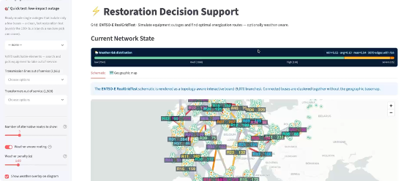
GridSense: Ask Your Power Grid
Natural-language access to grid evidence and restoration decision support
Graph-grounded answers
CIM/CGMES grid models in Neo4j support traceable queries about topology and equipment.
Restoration support
Inspect outage areas and candidate energization routes, with switching actions for human review.
Watch the demo videos on YouTube
Grid queries, engineering analysis and restoration scenarios
Notes:
GridSense uses CIM/CGMES grid models in Neo4j as a knowledge-graph evidence layer. A schema-aware workflow translates natural-language requests into Cypher retrieval and analysis. The screenshot illustrates restoration decision support, outage inspection, weather-aware routing controls and a geographic grid view. Candidate routes and switching actions support human review. Sources: supplied images/Gridsense_captured.png; GridSense_IEEE_GM_panel_Changhun_Kim.pptx, slides 4, 5, 7, 9, 79; GridSense.pptx. Demo playlist: https://www.youtube.com/playlist?list=PL2EIbrGMjR_m2khSEMiUtbKo0dY-LOn3-

