Slide 1
CS35L – F16
Slide set: | 1.1
Slide topics: | Linux basics
Assignment: | 1

Slide 2
What’s this class about?
“Fundamentals of commonly used software tools and environments, particularly open-source tools to be used in upper division computer science courses.”

Slide 3
What is open source software?
Source code is publicly available
Anyone is allowed to modify the source code
Examples
Firefox
Android
Apache

Slide 4
GNU/Linux
Open-source operating system
Kernel: core of operating system
Allocates time and memory to programs
Handles file system and communication between software and hardware
Shell: interface between user and kernel
Interprets commands user types in
Takes necessary action to cause commands to be carried out
Programs

Slide 5
Which Linux for this course?
Ubuntu Linux Distribution
Most popular
Frequently updated, fixed release cycle (6 months)
Simple installation and booting
Nice set of pre-installed packages
Seasnet servers:
Red Hat

Slide 6
Options
1) SEAS Server – best option, highly recommend
lnxsrv.seas.ucla.edu
Username: SEAS ID
Password: SEAS password
On windows: putty or cygwin
2) On your computer
Install or try Ubuntu
Run with Windows (https://wiki.ubuntu.com/WubiGuide)
Easy to remove Ubuntu from Windows via Control Panel, if you don’t need Ubuntu.

Slide 7
3) Virtual Machine
VMWare
Virtual Box
4) Live CDs on BH3760 Computers
Don’t install Ubuntu
Try Ubuntu

Slide 8
Connecting to SEAS from Windows
Putty
Recommended
Small and easy to use
Homepage: http://www.chiark.greenend.org.uk/~sgtatham/putty/download.html
Download: http://the.earth.li/~sgtatham/putty/latest/x86/putty.exe
Host name: lnxsrv.seas.ucla.edu
User name: your SEAS user name

Slide 9
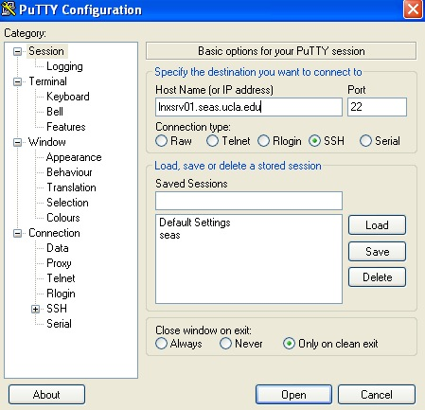
Putty

Slide 10
Connecting to SEAS from OS X or Linux
Terminal
$ ssh username@lnxsrv.seas.ucla.edu
Username = your SEAS user name

Slide 11
GUI vs CLI
GUI: Grahpic User Interface
Introduced in reaction to the perceived steep learning curve of command-line interfaces (CLI)
Examples of GUI of Linux:
X a windowing system for bitmap (a mapping from some domain to bits) displays
Version 11 (hence "X11") since September 1987
Does not mandate user interface, so a great verity

Slide 12
GUI vs CLI
CLI: command-line interfaces
Shell is a user interface for access to an operating system's services
Usually a command-line interpreter or shell that provides a traditional Unix-like command line user interface
First released in 1989

Slide 13
Examples of CLI
Bash
A command processor that typically runs in a text window, where the user types commands that cause actions.
Bash can also read commands from a file, called a script.
Xterm
A standard terminal emulator for the X Window System
Can be within a graphical interface

Slide 14
Command Line Interface vs. Graphical User Interface
CLI
GUI
Steep learning curve
Pure control (e.g., scripting)
Cumbersome multitasking
Convenient remote access
Intuitive
Limited control
Easy multitasking
Bulky remote access

Slide 15
The Basics: Shell
<up arrow>: previous command
<tab>: auto-complete
!!: replace with previous command
![str]: refer to previous command with str
^[str]: replace with command referred to as str

Slide 16
Files and Processes
Everything is either a process or a file:
Process: an executing program identified by PID
File: collection of data
A document
Text of program written in high-level language
Executable
Directory
Devices

Slide 17
Linux File System Layout
Tree structured hierarchy
/
root
bin
dev
home
usr
tmp
lakers
celtics
bulls
lib
README
music
doc
game1
game2
Notes:
Each file is under a directory.
A directory is also a file.
Only one root “/”.
Regular files can only be leaves.
e.g., documents, music, etc.

Slide 18
Absolute Path vs. Relative Path
/
root
bin
dev
home
usr
tmp
lakers
celtics
bulls
lib
README
music
doc
game1
game2
Current directory: home

Slide 19
Important Directories
/ The slash / character alone denotes the root of the file system tree.
/bin Stands for binaries and contains certain fundamental utilities
/boot Contains all the files needed for successful booting process
/dev Stands for devices.
/ etc Contains system-wide configuration files and system databases
/home Contains user home directories on Linux and some other systems
/lib Originally essential libraries
/opt Contains locally installed software
/usr The user file system
/var Stands for variable
/log Contains system log files.

Slide 20
The Basics: Moving Around
pwd: print working directory
cd: change directory
~ home directory
. current directory
/ root directory, or directory separator
.. parent directory

Slide 21
The Basics: Dealing with Files
mv: move/rename a file
cp: copy a file
rm: remove a file
r: remove directories and their contents recursively
mkdir: make a directory
rmdir: remove an empty directory
ls: list contents of a directory
d: list only directories
a: list all files including hidden ones
l: show long listing including permission info
s: show size of each file, in blocks

Slide 22
The Basics: Changing File Attributes
ln: create a link
Hard links: point to physical data
Soft links aka symbolic links (-s): point to a file
touch: update access & modification time to current time
touch filename
touch -t 201101311759.30 filename
Change filename’s access & modification time to (year 2011 January day 31 time 17:59:30)

Slide 24
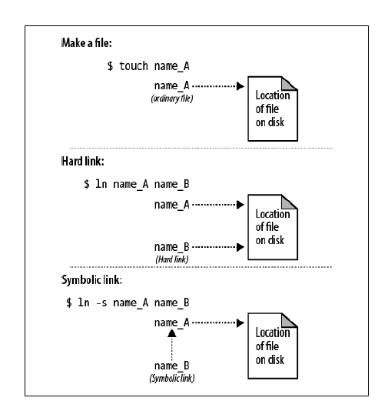
Symbolic Links vs. Hard Links
readlink command

Slide 25
Create two files
$ touch blah1 $ touch blah2
Fill contents into the files and print them
$ echo "Cat" > blah1 $ echo "Dog" > blah2
$cat blah1; cat blah2
Cat
Dog
Create links
$ ln blah1 blah1-hard $ ln -s blah2 blah2-soft $ ls –l
blah1 blah1-hard blah2 blah2-soft -> blah2
Change the original file
$ mv blah1 blah1-new $ cat blah1-hard
Cat
$ mv blah2 blah2-new $ cat blah2-soft
cat: blah2-soft: No such file or directory

Slide 26
Linux File Permissions

Slide 27
Unix permissions
Owner permissions − The owner's permissions determine what actions the owner of the file can perform on the file.
Group permissions − The group's permissions determine what actions a user, who is a member of the group that a file belongs to, can perform on the file.
Others permissions − The permissions for others indicate what action all other users can perform on the file

Slide 28
Unix permissions
The SUID and SGID bits will appear as the letter "s"
Located in the permission bits where the owners execute permission would normally reside.
A capital letter S in the execute position instead of a lowercase s indicates that the execute bit is not set.
Execute as the owner/group permissions not the user
$ ls -l /usr/bin/passwd
-r-sr-xr-x 1 root bin 19031 Feb 7 13:47 /usr/bin/passwd*

Slide 29
Special Permissions
sticky bit (o+t)
On shared directories, it locks files within the directory from being modified/deleted by users other than the file creator, owner of the directory, or root, even if others have write permissions (Example: /tmp)
setuid, setgid (u+s, g+s)
On executables, it grants access to the process that runs this file based on the owner/group of the file, rather than the user running the executable file

Slide 30
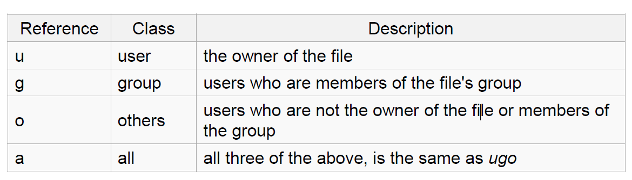
Linux File Permissions
chmod
read (r), write (w), executable (x)
User, group, others

Slide 31
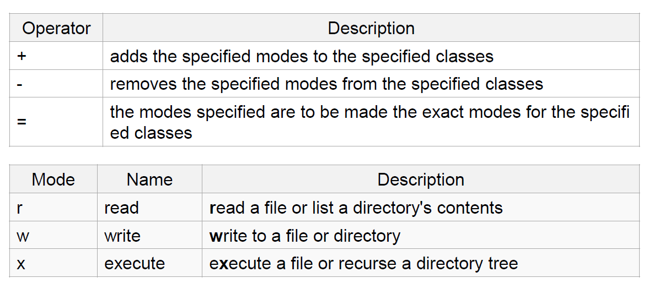
The Basics: chmod (symbolic)

Slide 32
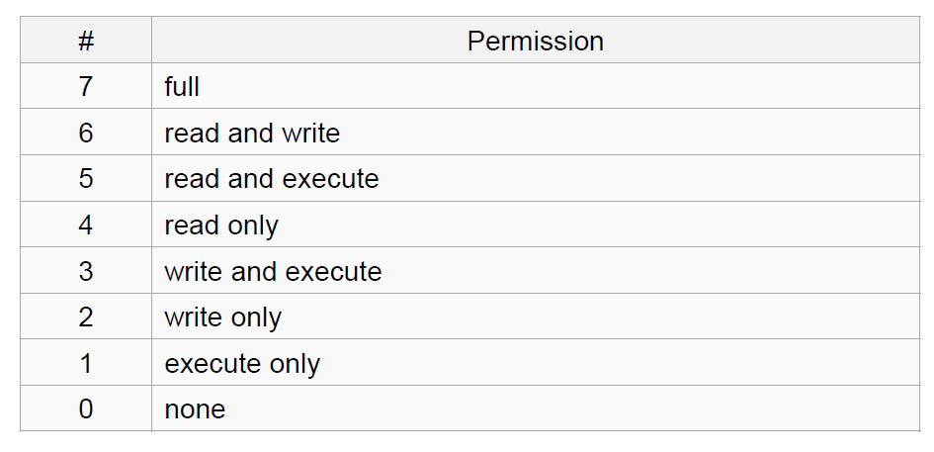
The Basics: chmod (numeric)
Usage
– chmod [''references''][''operator''][''modes''] ''file1'' ...
Example: chmod ug+rw mydir, chmod a-w myfile,
Example: chmod ug=rx mydir, chmod 664 myfile

Slide 33
The Basics: find
-type: type of a file (e.g: directory, symbolic link)
-perm: permission of a file
-name: name of a file
-user: owner of a file
-maxdepth: how many levels to search

Slide 34
The Basics: Look These Up
cat
head
tail
du
ps
kill
diff
cmp
wc
sort

Slide 35
File Name Matching
?: matches any single character in a filename
*: matches one or more characters in a filename
[]: matches any one of the characters between the brackets. Use ‘-’ to separate a range of consecutive characters.

Slide 36
find Examples
Examples
find . -name my*
find . -name my* -type f
find / -type f -name myfile –print

Slide 37
The Basics: find
-type: type of a file (e.g,, directory, symbolic link)
-perm: permission of a file
-name: name of a file
-prune: don’t descend into a directory
-o: or
-ls: list current file

Slide 38
man
Extensive documentation that comes preinstalled with almost all substantial Unix and Unix-like operating systems
Usage
read a manual page for a Linux command
man <command_name>
man section command_name
1 User Commands 2 System Calls 3 C Library Functions 4 Devices and Special Files 5 File Formats and Conventions 6 Games et. al. 7 Miscellanea 8 System Administration tools and Daemons
Hit “q” to get out of man page

Slide 39
wh… Commands
whatis <command>: returns Name section of man page
whereis <command>: locates the binary, source, and manual page files for a command

Slide 40
Assignment 1
Hints for first 10 questions:
man man
which
find
readlink
man chmod
man find
find
whereis, man find
find, sort
localedef

Slide 41
Assignment 1 – Example ans1.txt
ans1.txt is specifically for LABORATORY section
1. Here is the answer to question 1
2. Here is the answer to question 2
3. Here is the answer to question 3
…..

Slide 42
Assignment 1 – Example key1.txt
key1.txt is specifically for HOMEWORK section
C-s H E L L O W O R L D
C-s H T M L
C-d
C-n
M-x goto-line Enter 1 2 3 Enter

