Slide 1
CS35L – F16
Slide set: | 10
Slide topics: | Course review
Assignment: | None

Slide 2
Notes about these review slides:
Not comprehensive!
Meant to give you a review of some of the concepts we covered in the course
Conceptual understanding of concepts is more important that rote memorization
The final is open book/note, if you need something specific you’ll have it in front of you!
Questions are posed throughout the review slides
Strive to be able to confidently answer all these questions

Slide 3
Final Information
Monday, December 5th 2016
3:00pm-6:00pm (3 hours)
Boelter 3760 (our regular room)
Open book and open note
50% of course grade (from syllabus)
No calculators, smartphones, smartwatches, etc.

Slide 4
Week 1

Slide 5
GNU/Linux
Open-source operating system
Kernel: core of operating system
Allocates time and memory to programs
Handles file system and communication between software and hardware
Shell: interface between user and kernel
Interprets commands user types in
Takes necessary action to cause commands to be carried out
Programs
Why is the system broken up into these different parts?

Slide 6
Files and Processes
Everything is either a process or a file:
Process: an executing program identified by PID
File: collection of data
A document
Text of program written in high-level language
Executable
Directory
Devices

Slide 7
The Basics: Shell
CLI utilities from week 1 you should be familiar with:
pwd
cd
mv
cp
rm
mkdir
rmdir
ls
ln
touch
find
whatis
whereis
man
ps
kill
diff
wget

Slide 8
The Basics: Shell
How do I find where files are on the system?
How do I find out what options are available for a particular utility?
When is a file a file and when is it a process?
What types of links are there?

Slide 9
Absolute Path vs. Relative Path
/
root
bin
dev
home
usr
tmp
lakers
celtics
bulls
lib
README
music
doc
game1
game2
Current directory: home
What are the differences between absolute and relative paths?

Slide 10
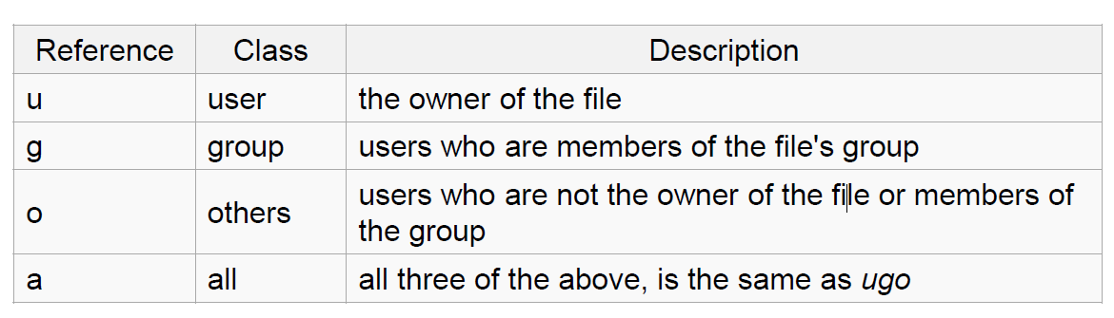
Linux File Permissions
chmod
read (r), write (w), executable (x)
User, group, others
Why do we have permissions at all?

Slide 11
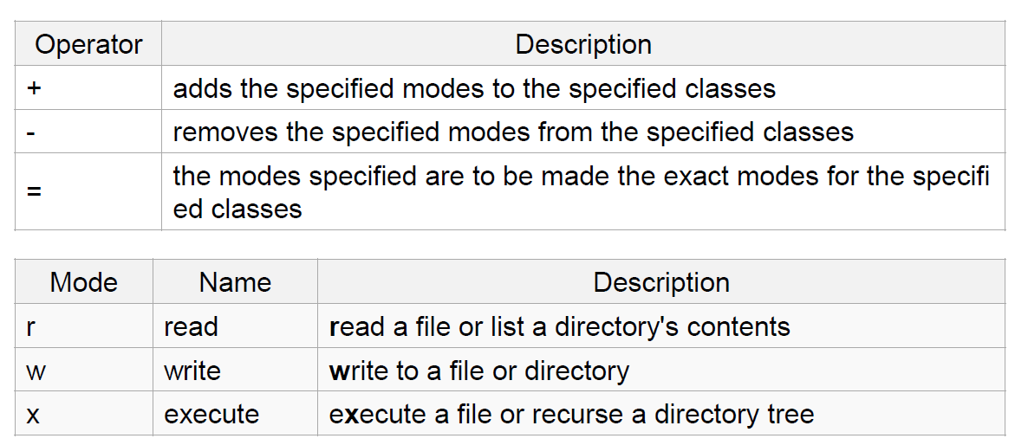
The Basics: chmod (symbolic)

Slide 12
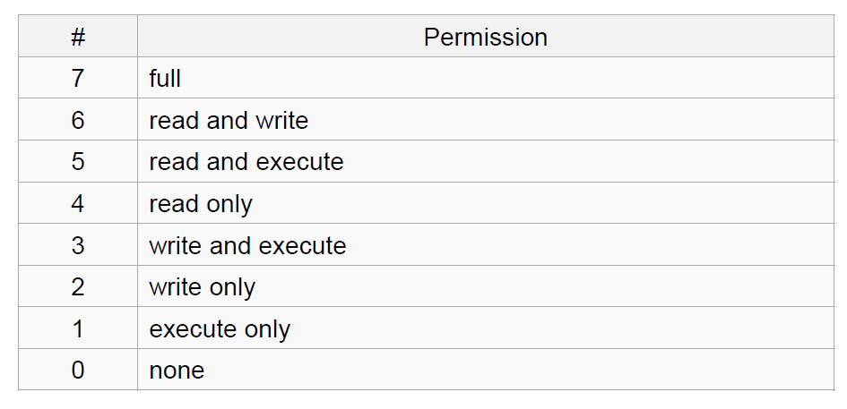
The Basics: chmod (numeric)
Usage
– chmod [''references''][''operator''][''modes''] ''file1'' ...
Example: chmod ug+rw mydir, chmod a-w myfile,
Example: chmod ug=rx mydir, chmod 664 myfile

Slide 13
Week 2

Slide 14
Locale
A locale
Set of parameters that define a user’s cultural preferences
Language
Country
Other area-specific things
What else does the locale affect?
locale command
prints information about the current locale environment to standard output
Notes:
14

Slide 15
Environment Variables
Variables that can be accessed from any child process
Why do we have these at all? What functions do they serve?
Common ones:
HOME: path to user’s home directory
PATH: list of directories to search in for command to execute
Change value:
export VARIABLE=…

Slide 16
Locale Settings Can Affect Program Behavior!!
Default sort order for the sort command depends:
LC_COLLATE=‘C’: sorting is in ASCII order
LC_COLLATE=‘en_US’: sorting is case insensitive except when the two strings are otherwise equal and one has an uppercase letter earlier than the other.
Other locales have other sort orders!

Slide 17
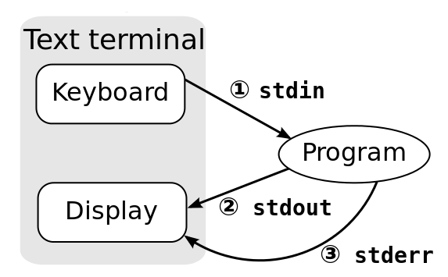
Standard Streams
Every program has these 3 streams to interact with the world
stdin (0): contains data going into a program
stdout (1): where a program writes its output data
stderr (2): where a program writes its error msgs

Slide 18
Redirection and Pipelines
program < file redirects file to programs’s stdin:
cat <file
program > file redirects program's stdout to file2:
cat <file >file2
program 2> file redirects program's stderr to file2:
cat <file 2>file2
program >> file appends program’s stdout to file
program1 | program2 assigns stdout of program1 as the stdin of program2; text 'flows' through the pipeline
cat <file | sort >file2
Why would we want to redirect I/O? What are some examples of use cases for I/O redirection? How do we implement this in C?
Notes:
18

Slide 19
Regular Expressions
Table 3-1. POSIX BRE and ERE metacharacters
Notation that lets you search for text with a particular pattern:
For example: starts with the letter a, ends with three uppercase letters, etc.
Why do these exist? Are the expressions the same across languages?
What’s the difference between a basic and an extended regular expression? When would I use either?
How do I write a regular expression to accomplish x?
http://regexpal.com/ to test your regex expressions
Simple regex tutorial http://www.icewarp.com/support/online_help/203030104.htm

Slide 20
4 Basic Concepts
Quantification
How many times of previous expression?
Most common quantifiers: ?(0 or 1), *(0 or more), +(1 or more)
Grouping
Which subset of previous expression?
Grouping operator: ()
Alternation
Which choices?
Operators: [] and |
Hello|World [A B C]
Anchors
Where?
Characters: ^ (beginning) and $ (end)
How do I use a combination of the above to accomplish tasks?

Slide 21
Regular Expressions
Character | BRE / ERE | Meaning in a pattern
\ | Both | Usually, turn off the special meaning of the following character. Occasionally, enable a special meaning for the following character, such as for \(...\) and \{...\}.
. | Both | Match any single character except NULL. Individual programs may also disallow matching newline.
* | Both | Match any number (or none) of the single character that immediately precedes it. For EREs, the preceding character can instead be a regular expression. For example, since . (dot) means any character, .* means "match any number of any character." For BREs, * is not special if it's the first character of a regular expression.
^ | Both | Match the following regular expression at the beginning of the line or string. BRE: special only at the beginning of a regular expression. ERE: special everywhere.

Slide 22
Regular Expressions (cont’d)
$ | Both | Match the preceding regular expression at the end of the line or string. BRE: special only at the end of a regular expression. ERE: special everywhere.
[...] | Both | Termed a bracket expression, this matches any one of the enclosed characters. A hyphen (-) indicates a range of consecutive characters. (Caution: ranges are locale-sensitive, and thus not portable.) A circumflex (^) as the first character in the brackets reverses the sense: it matches any one character not in the list. A hyphen or close bracket (]) as the first character is treated as a member of the list. All other metacharacters are treated as members of the list (i.e., literally). Bracket expressions may contain collating symbols, equivalence classes, and character classes (described shortly).
\{n,m\} | BRE | Termed an interval expression, this matches a range of occurrences of the single character that immediately precedes it. \{n\} matches exactly n occurrences, \{n,\} matches at least n occurrences, and \{n,m\} matches any number of occurrences between n and m. n and m must be between 0 and RE_DUP_MAX (minimum value: 255), inclusive.
\( \) | BRE | Save the pattern enclosed between \( and \) in a special holding space. Up to nine subpatterns can be saved on a single pattern. The text matched by the subpatterns can be reused later in the same pattern, by the escape sequences \1 to \9. For example, \(ab\).*\1 matches two occurrences of ab, with any number of characters in between.

Slide 23
Regular Expressions (cont’d)
\n | BRE | Replay the nth subpattern enclosed in \( and \) into the pattern at this point. n is a number from 1 to 9, with 1 starting on the left.
{n,m} | ERE | Just like the BRE \{n,m\} earlier, but without the backslashes in front of the braces.
+ | ERE | Match one or more instances of the preceding regular expression.
? | ERE | Match zero or one instances of the preceding regular expression.
| | ERE | Match the regular expression specified before or after.
( ) | ERE | Apply a match to the enclosed group of regular expressions.

Slide 24
Examples
Expression | Matches
tolstoy | The seven letters tolstoy, anywhere on a line
^tolstoy | The seven letters tolstoy, at the beginning of a line
tolstoy$ | The seven letters tolstoy, at the end of a line
^tolstoy$ | A line containing exactly the seven letters tolstoy, and nothing else
[Tt]olstoy | Either the seven letters Tolstoy, or the seven letters tolstoy, anywhere on a line
tol.toy | The three letters tol, any character, and the three letters toy, anywhere on a line
tol.*toy | The three letters tol, any sequence of zero or more characters, and the three letters toy, anywhere on a line (e.g., toltoy, tolstoy, tolWHOtoy, and so on)

Slide 25
Text Processing Tools
You should be familiar with:
wc: outputs a one-line report of lines, words, and bytes
head: extract top of files
tail: extracts bottom of files
tr: translate or delete characters
grep: print lines matching a pattern
sort: sort lines of text files
sed: filtering and transforming text
What are the differences between tr, sed, and grep? When would I use each one?
How can I combine and use these tools together?

Slide 26
sort, comm, and tr
sort: sorts lines of text files
Usage: sort [OPTION]…[FILE]…
Sort order depends on locale
C locale: ASCII sorting
comm: compare two sorted files line by line
Usage: comm [OPTION]…FILE1 FILE2
Comparison depends on locale
tr: translate or delete characters
Usage: tr [OPTION]…SET1 [SET2]
You’ve implemented comm and tr by hand, do you remember how you did that?

Slide 27
Week 3

Slide 28
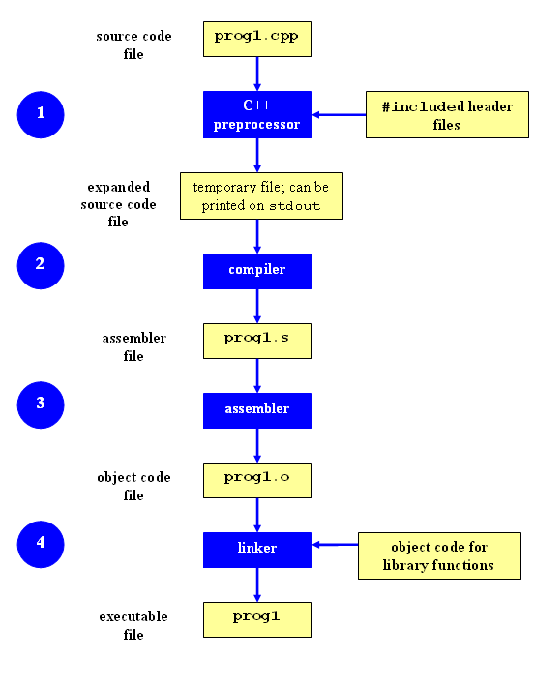
Compilation Process
Compilation

Slide 29
Compilation Process
Why do we have this process?
What are the different components of the process?
“I just typed gcc to compile my programs… does that mean gcc has all of the components within it?”
Why can’t I execute individual object code files?
What are the differences between open source and closed source software? When would I want to use one or the other?

Slide 30
Make
Utility for managing large software projects
Compiles files and keeps them up-to-date
Efficient Compilation (only files that need to be recompiled)
Why do we have make at all?

Slide 31
Build Process
configure
Script that checks details about the machine before installation
Dependency between packages
Creates ‘Makefile’
make
Requires ‘Makefile’ to run
Compiles all the program code and creates executables in current temporary directory
make install
make utility searches for a label named install within the Makefile, and executes only that section of it
executables are copied into the final directories (system directories)

Slide 32
Patching
A patch is a piece of software designed to fix problems with or update a computer program
It’s a diff file that includes the changes made to a file
A person who has the original (buggy) file can use the patch command with the diff file to add the changes to their original file
Why not just change the original source code to fix it? Why do we have patches?

Slide 33
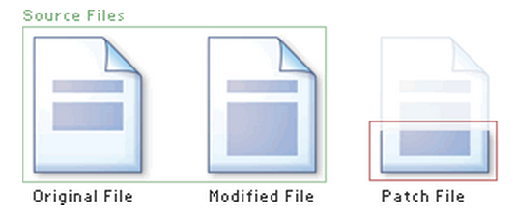
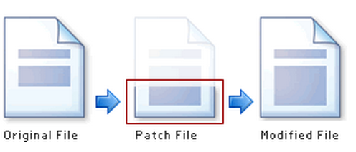
Applying a Patch

Slide 34
diff Unified Format
diff –u original_file modified_file
--- path/to/original_file
+++ path/to/modified_file
@@ -l,s +l,s @@
@@: beginning of a hunk
l: beginning line number
s: number of lines the change hunk applies to for each file
A line with a:
- sign was deleted from the original
+ sign was added to the original
stayed the same

Slide 35
What is Python?
Not just a scripting language
Object-Oriented language
Classes
Member functions
Compiled and interpreted
Python code is compiled to bytecode
Bytecode interpreted by Python interpreter
Not as fast as C but easy to learn, read and use
You should know how to write basic programs in python

Slide 36
Comm.py
Support all options for comm
-1, -2, -3 and combinations
Extra option –u for comparing unsorted files
Support all type of arguments
File names and – for stdin
Be familiar with how the linux comm utility works
You should be able to write the comm utility by hand

Slide 37
Week 4

Slide 38
Software development process
●
Involves making a lot of changes to code
New features added Bugs fixed
Performance enhancements
–
–
–
●
Software team has many people working on the same/different parts of code
Many versions of software released
●
–
Ubuntu 10, Ubuntu 12, etc
Need to be able to fix bugs for Ubuntu 10 for customers using it, even though you have shipped Ubuntu 12.
–
How do we deal with all of this?

Slide 39
Source/Version Control
●
Track changes to code and other files related to the software
–
What new files were added? What changes made to files?
Which version had what changes? Which user made the changes?
–
–
–
●
Track entire history of the software Version control software
●
–
GIT, Subversion, Perforce
This seems complicated. Why bother with source control?
What are the strengths and weaknesses of source control?
When would I want to use it? How do I use it?

Slide 40
Terms used
●
Repository
–
Files and folder related to the software code Full History of the software
–
●
Working copy
–
Copy of software's files in the repository
●
Check-out
–
To create a working copy of the repository
●
Check-in / Commit
–
Write the changes made in the working copy to the repository
Commits are recorded by the VCS
–

Slide 41
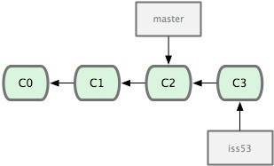
Terms used
Head
Refers to a commit object
There can be many heads in a repository
HEAD
Refers to the currently active head
Detached HEAD
If a commit is not pointed to by a branch
This is okay if you want to just take a look at the code and if you don't commit any new changes
If the new commits have to be preserved then a new branch has to be created
git checkout v3.0 -b BranchVersion3.1
Branch
Refers to a head and its entire set of ancestor commits
Master
Default branch
Image Source: git-scm.com

Slide 42
What Is a Branch?
A pointer to one of the commits in the repo (head) + all ancestor commits
When you first create a repo, are there any branches?
Default branch named ‘master’
The default master branch
points to last commit made
moves forward automatically, every time you commit

Slide 43
Questions
What is the difference between a working copy and the repository?
What is a commit? What should be in a commit? How many files should commits contain?
What are the differences between head and HEAD?
Why bother having branches at all? Why can’t we just all work on the same single master branch?
What happens when we perform a merge? How does it work?

Slide 44

Git States
Index(cache)
git checkout
git add
git commit
Image Source: git-scm.com

Slide 45
Git commands
●
Repository creation
–
$ git init
$ git clone
(Start a new repository)
(Create a copy of an exisiting repository)
–
●
Branching
–
$ git checkout <tag/commit> -b <new_branch_name> (creates a new branch)
●
Commits
–
$ git add
$ git commit
(Stage modified/new files)
(check-in the changes to the repository)
–
●
Getting info
–
$ git status
$ git diff
$ git log
$ git show
(Shows modified files, new files, etc) (compares working copy with staged files) (Shows history of commits)
(Show a certain object in the repository)
–
–
–
●
Getting help
–
$ git help
You should be familiar with how these commands
work and when to use them.

Slide 46
More Git Commands
●
Reverting
–
$ git checkout HEAD main.cpp
●
Gets the HEAD revision for the working copy
–
$ git checkout -- main.cpp
●
Reverts changes in the working directory
–
$ git revert
●
Reverting commits (this creates new commits)
●
Cleaning up untracked files
–
$ git clean
●
Tagging
–
Human readable pointers to specific commits $ git tag -a v1.0 –m 'Version 1.0'
–
●
This will name the HEAD commit as v1.0
You should be familiar with how these commands
work and when to use them.

Slide 47
Week 5

Slide 48
Debugger
A program that is used to run and debug other (target) programs
Advantages:
Programmer can:
step through source code line by line
each line is executed on demand
interact with and inspect program at run-time
If program crashes, the debugger outputs where and why it crashed
Why have a debugger?
When do I use a debugger?

Slide 49
Using GDB
Compile Program
Normally: $ gcc [flags] <source files> -o <output file>
Debugging: $ gcc [other flags] –g <source files> -o <output file>
enables built-in debugging support
Specify Program to Debug
$ gdb <executable>
or
$ gdb
(gdb) file <executable>

Slide 50
Using GDB
3. Run Program
(gdb) run or
(gdb) run [arguments]
4. In GDB Interactive Shell
Tab to Autocomplete, up-down arrows to recall history
help [command] to get more info about a command
5. Exit the gdb Debugger
(gdb) quit

Slide 51
Run-Time Errors
Segmentation fault
Program received signal SIGSEGV, Segmentation fault. 0x0000000000400524 in function (arr=0x7fffc902a270, r1=2, c1=5, r2=4, c2=6) at file.c:12
Line number where it crashed and parameters to the function that caused the error
Logic Error
Program will run and exit successfully
How do we find bugs?

Slide 52
Setting Breakpoints
Breakpoints
used to stop the running program at a specific point
If the program reaches that location when running, it will pause and prompt you for another command
Example:
(gdb) break file1.c:6
Program will pause when it reaches line 6 of file1.c
(gdb) break my_function
Program will pause at the first line of my_function every time it is called
(gdb) break [position] if expression
Program will pause at specified position only when the expression evaluates to true
How do we know where to set breakpoints?
What do we do once we’ve stopped at a breakpoint?

Slide 53
Deleting, Disabling and Ignoring BPs
(gdb) delete [bp_number | range]
Deletes the specified breakpoint or range of breakpoints
(gdb) disable [ bp_number | range]
Temporarily deactivates a breakpoint or a range of breakpoints
(gdb) enable [ bp_number | range]
Restores disabled breakpoints
If no arguments are provided to the above commands, all breakpoints are affected!!
(gdb) ignore bp_number iterations
Instructs GDB to pass over a breakpoint without stopping a certain number of times.
bp_number: the number of a breakpoint
Iterations: the number of times you want it to be passed over

Slide 54
Displaying Data
Why would we want to interrupt execution?
to see data of interest at run-time:
(gdb) print [/format] expression
Prints the value of the specified expression in the specified format
Formats:
d: Decimal notation (default format for integers)
x: Hexadecimal notation
o: Octal notation
t: Binary notation
What’s the point of displaying data?
What sort of data might we want to display?
How can we use displayed data?

Slide 55
Resuming Execution After a Break
When a program stops at a breakpoint
4 possible kinds of gdb operations:
c or continue: debugger will continue executing until next breakpoint
s or step: debugger will continue to next source line
n or next: debugger will continue to next source line in the current (innermost) stack frame
f or finish: debugger will resume execution until the current function returns. Execution stops immediately after the program flow returns to the function's caller
the function's return value and the line containing the next statement are displayed
What is the difference between ‘s’ and ‘n’?
When would we use each one of the above?

Slide 56
Stack Info
A program is made up of one or more functions which interact by calling each other
Every time a function is called, an area of memory is set aside for it. This area of memory is called a stack frame and holds the following crucial info:
storage space for all the local variables
the memory address to return to when the called function returns
the arguments, or parameters, of the called function
Each function call gets its own stack frame. Collectively, all the stack frames make up the call stack
Why does the stack exist at all? How is the stack different than the heap?

Slide 57
Analyzing the Stack in GDB
(gdb) backtrace|bt
Shows the call trace (the call stack)
Without function calls:
#0 main () at program.c:10
one frame on the stack, numbered 0, and it belongs to main()
After call to function display()
#0 display (z=5, zptr=0xbffffb34) at program.c:15
#1 0x08048455 in main () at program.c:10
Two stack frames: frame 1 belonging to main() and frame 0 belonging to display().
Each frame listing gives
the arguments to that function
the line number that's currently being executed within that frame

Slide 58
C Programming
You should be able to develop a basic C program that incorporates the following:
Basic data types
Control/flow (if, while, etc)
Pointers
Structs
Dynamic memory
Basic I/O

Slide 59
Dynamic Memory
Memory that is allocated at runtime
Why?
Allocated on the heap
Why not the stack?
void *malloc (size_t size);
Allocates size bytes and returns a pointer to the allocated memory
void *realloc (void *ptr, size_t size);
Changes the size of the memory block pointed to by ptr to size bytes
void free (void *ptr);
Frees the block of memory pointed to by ptr
What happens if I never call free?
What happens if I try to put data into dynamic memory but I haven’t yet called malloc?

Slide 60
Week 6

Slide 61
Processor Modes
Operating modes that place restrictions on the type of operations that can be performed by running processes
User mode: restricted access to system resources
Kernel/Supervisor mode: unrestricted access
System resources?
Memory
I/O Devices
CPU
Why have different modes? How do we switch modes?

Slide 62
User Mode vs. Kernel Mode
Hardware contains a mode-bit, e.g. 0 means kernel mode, 1 means user mode
User mode
CPU restricted to unprivileged instructions and a specified area of memory
Supervisor/kernel mode
CPU is unrestricted, can use all instructions, access all areas of memory and take over the CPU anytime
What happens if user code is given unrestricted access to CPU?

Slide 63
Why Dual-Mode Operation?
System resources are shared among processes
OS must ensure:
Protection
an incorrect/malicious program cannot cause damage to other processes or the system as a whole
Fairness
Make sure processes have a fair use of devices and the CPU

Slide 64
How to Achieve Protection and Fairness
Goals:
I/O Protection
Prevent processes from performing illegal I/O operations
Memory Protection
Prevent processes from accessing illegal memory and modifying kernel code and data structures
CPU Protection
Prevent a process from using the CPU for too long
=> instructions that might affect goals are privileged and can only be executed by trusted code

Slide 65
System Calls
Special type of function that:
Used by user-level processes to request a service from the kernel
Changes the CPU’s mode from user mode to kernel mode to enable more capabilities
Is part of the kernel of the OS
Verifies that the user should be allowed to do the requested action and then does the action (kernel performs the operation on behalf of the user)
Is the only way a user program can perform privileged operations
When do I need to use system calls?

Slide 66
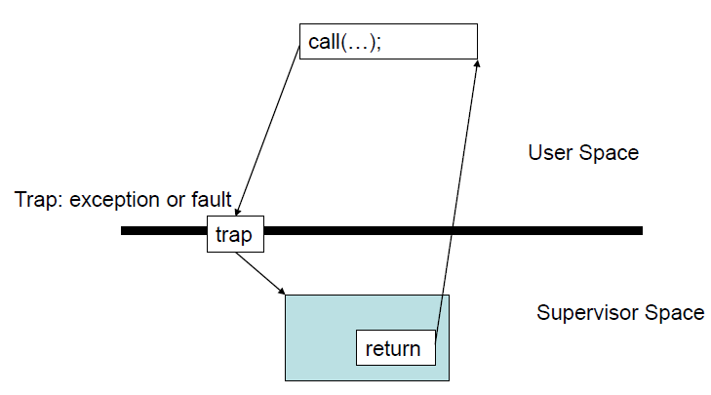
System Calls
When a system call is made, the program being executed is interrupted and control is passed to the kernel
If operation is valid the kernel performs it

Slide 67
System Call Overhead
System calls are expensive and can hurt performance
The system must do many things
Process is interrupted & computer saves its state
OS takes control of CPU & verifies validity of op.
OS performs requested action
OS restores saved context, switches to user mode
OS gives control of the CPU back to user process

Slide 68
Library Functions
Functions that are a part of standard C library
To avoid system call overhead use equivalent library functions
getchar, putchar vs. read, write (for standard I/O)
fopen, fclose vs. open, close (for file I/O), etc.
How do these functions perform privileged operations?
They make system calls
What are the benefits and tradeoffs of using either system calls or C library functions?

Slide 69
Unbuffered vs. Buffered I/O
Unbuffered
Every byte is read/written by the kernel through a system call
Buffered
collect as many bytes as possible (in a buffer) and read more than a single byte (into buffer) at a time and use one system call for a block of bytes
Buffered I/O decreases the number of read/write system calls and the corresponding overhead
Which is faster in what applications? When would you use buffered or unbuffered I/O?

Slide 70
Week 7

Slide 71
Parallelism
Executing several computations simultaneously to gain performance
Different forms of parallelism
Multitasking
Several processes are scheduled alternately or possibly simultaneously on a multiprocessing system
Multithreading
Same job is broken logically into pieces (threads) which may be executed simultaneously on a multiprocessing system
What’s the point of parallelism? Isn’t it just too complicated?
How can you decide whether your application should use multiple processes or multiple threads? Or both?

Slide 72
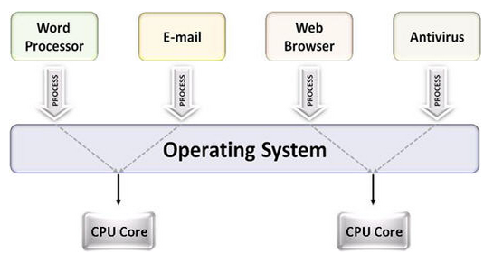
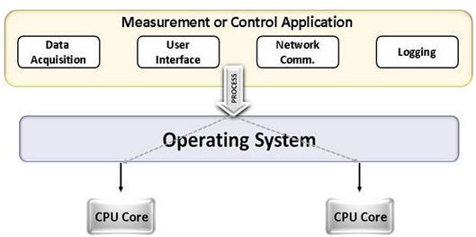
Multitasking vs. Multithreading
Multitasking
Multitasking
Multithreading

Slide 73
Multithreading & Multitasking: Comparison
Multithreading
Threads share the same address space
Light-weight creation/destruction
Easy inter-thread communication
An error in one thread can bring down all threads in process
Multitasking
Processes are insulated from each other
Expensive creation/destruction
Expensive IPC
An error in one process cannot bring down another process

Slide 74
What is a thread?
A flow of instructions, path of execution within a process
The smallest unit of processing scheduled by OS
A process consists of at least one thread
Multiple threads can be run on:
A uniprocessor (time-sharing)
Processor switches between different threads
Parallelism is an illusion
A multiprocessor
Multiple processors or cores run the threads at the same time
True parallelism

Slide 75
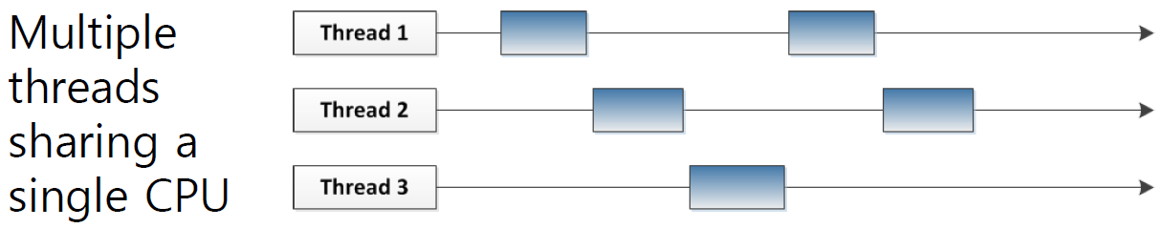
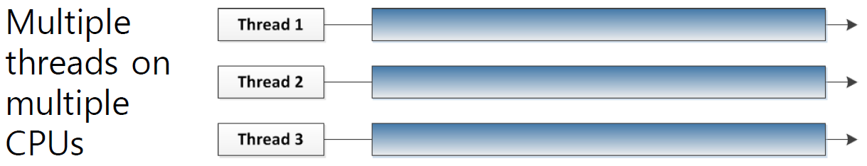

Slide 76
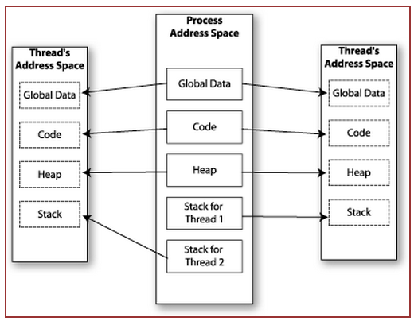

Memory Layout: Multithreaded Program
Why share the same code?
Why share the same heap?

Slide 77
Shared Memory
Makes multithreaded programming
Powerful
can easily access data and share it among threads
More efficient
No need for system calls when sharing data
Thread creation and destruction less expensive than process creation and destruction
Non-trivial
Have to prevent several threads from accessing and changing the same shared data at the same time (synchronization)
What happens when we have race conditions?

Slide 78
Race Condition
A
B
C
int count = 0; void increment()
{ count = count + 1; }
r(count) : 0
w(count) : 1
time
r(count) : 1
r(count) : 1
w(count) : 2
w(count) : 2
Result depends on order of execution
=> Synchronization needed

Slide 79
pthread_create
Function: creates a new thread and makes it executable
Can be called any number of times from anywhere within code
Return value:
Success: zero
Failure: error number
How do we keep track of threads within a program’s execution? How many can we have?
How do we pass data to threads we create? How do we tell them what to work on?
What happens if our application isn’t “embarassingly parallel”?

Slide 80
Parameters
int pthread_create( pthread_t *tid, const pthread_attr_t *attr,
void *(my_function)(void *), void *arg );
tid: unique identifier for newly created thread
attr: object that holds thread attributes (priority, stack size, etc.)
Pass in NULL for default attributes
my_function: function that thread will execute once it is created
arg: a single argument that may be passed to my_function
Pass in NULL if no arguments

Slide 81
pthread_join
Function: makes originating thread wait for the completion of all its spawned threads’ tasks
Without join, the originating thread would exit as soon as it completes its job
A spawned thread can get aborted even if it is in the middle of its chore
Return value:
Success: zero
Failure: error number
Why join at all? What does a join guarantee?

Slide 82
Arguments
int pthread_join(pthread_t tid, void **status);
tid: thread ID of thread to wait on
status: the exit status of the target thread is stored in the location pointed to by *status
Pass in NULL if no status is needed

Slide 83
Week 8

Slide 84
Static Linking
Carried out only once to produce an executable file
If static libraries are called, the linker will copy all the modules referenced by the program to the executable
Static libraries are typically denoted by the .a file extension
When would I use static linking? Why would I use it?

Slide 85
Dynamic Linking
Allows a process to add, remove, replace or
relocate object modules during its execution.
If shared libraries are called:
Only copy a little reference information when the executable file is created
Complete the linking during loading time or running time
Dynamic libraries are typically denoted by the .so file extension
.dll on Windows
When would I use dynamic linking? Why would I use it?

Slide 86
Linking and Loading
Linker collects procedures and links them together object modules into one executable program
Why isn't everything written as just one big program, saving the necessity of linking?
Efficiency: if just one function is changed in a 100K line program, why recompile the whole program? Just recompile the one function and relink.
Multiple-language programs
Other reasons?
When does linking happen? When does loading happen?

Slide 87
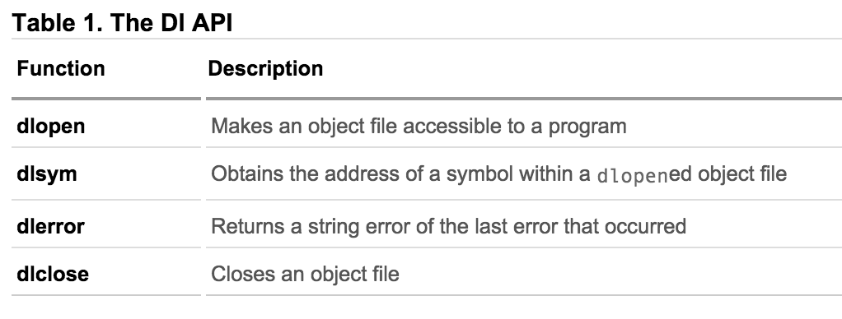
How are libraries dynamically loaded?

Slide 88
Dynamic linking
Unix systems: Code is typically compiled as a dynamic shared object (DSO)
Dynamic vs. static linking resulting size $ gcc -static hello.c -o hello-static $ gcc hello.c -o hello-dynamic $ ls -l hello 80 hello.c 13724 hello-dynamic 383 hello.s 1688756 hello-static
If you are the sysadmin, which do you prefer?
What is the difference between linking and loading?

Slide 89
Advantages of dynamic linking
The executable is typically smaller
When the library is changed, the code that references it does not usually need to be recompiled
The executable accesses the .so at run time; therefore, multiple programs can access the same .so at the same time
Memory footprint amortized across all programs using the same .so
What other advantages are there of dynamic linking?

Slide 90
Disadvantages of dynamic linking
Performance hit
Need to load shared objects (at least once)
Need to resolve addresses (once or every time)
Remember back to the system call assignment…
What if the necessary dynamic library is missing?
What if we have the library, but it is the wrong version?

Slide 91
Week 9

Slide 92
Communication Over the Internet
What type of guarantees do we want?
Confidentiality
Message secrecy
Data integrity
Message consistency
Authentication
Identity confirmation
Authorization
Specifying access rights to resources
Why do we want these guarantees?

Slide 93
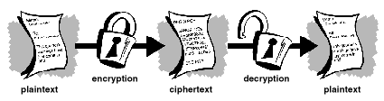
Cryptography
●
Plaintext – Actual message
●
Ciphertext – Encrypted message (unreadable gibberish)
●
Encryption – Going from plaintext to ciphertext
Be familiar with all of these terms
and what they mean/represent.
●
Decryption – Going from ciphertext to plaintext
●
Secret key
–
Part of the mathematical function used to encrypt/decrypt. Good key makes it hard to get back plaintext from ciphertext
–
Image Source: gpgtools.org

Slide 94
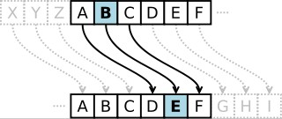
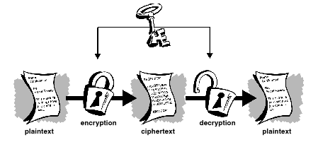
Symmetric-key Encrption
●
Same secret key used for encryption and decryption
●
Example : Data Encryption Standard (DES)
●
Caesar's cipher
–
Map the alphabet to a shifted version
●
ABCDEFGHIJKLMNOPQRSTUVWXYZ DEFGHIJKLMNOPQRSTUVWXYZABC
●
–
Plaintext – SECRET. Ciphertext – VHFUHW Key is 3 (number of shifts of the alphabet)
–
●
Key distribution is a problem
Image Source: wikipedia
–
The secret key has to be delivered in a safe way to the recipient Chance of key being compromised
–
Image Source: gpgtools.org

Slide 95
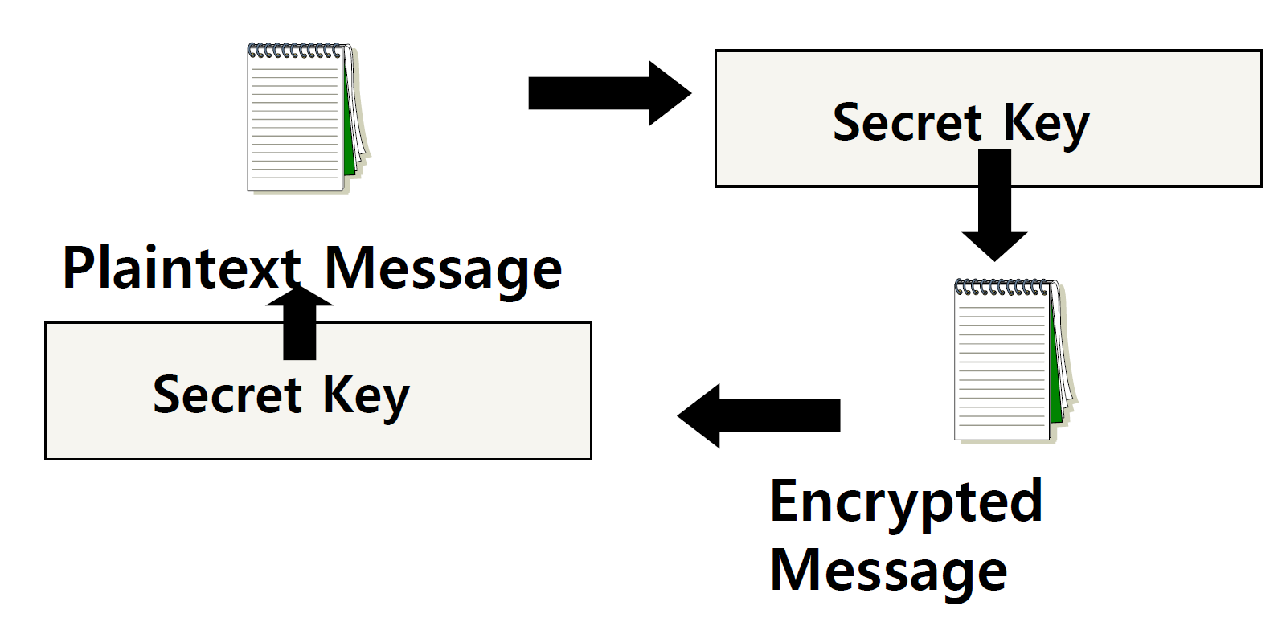
Secret Key (symmetric) Cryptography
A single key is used to both encrypt and decrypt a message

Slide 96
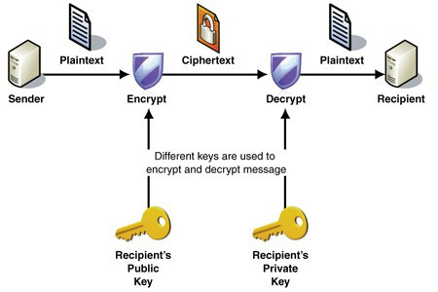
Public-key Encryption (Asymmetric)
●
Uses a pair of keys for encryption
–
Public key – Published and known to everyone
Private key – Secret key known only to the owner
–
●
Encryption
–
Use public key to encrypt messages
Anyone can encrypt message, but they cannot decrypt the ciphertext
–
●
Decryption
–
Use private key to decrypt messages
●
Example : RSA – Rivest, Shamir & Adleman
–
Property used - Difficulty of factoring large
integers to prime numbers
N = p * q (3233 = 61 * 53)
N is a large integer and p, q are prime numbers N is part of the public key
http://en.wikipedia.org/wiki/RSA_Factoring_Challenge
–
–
Image Source: MSDN
–
–

Slide 97
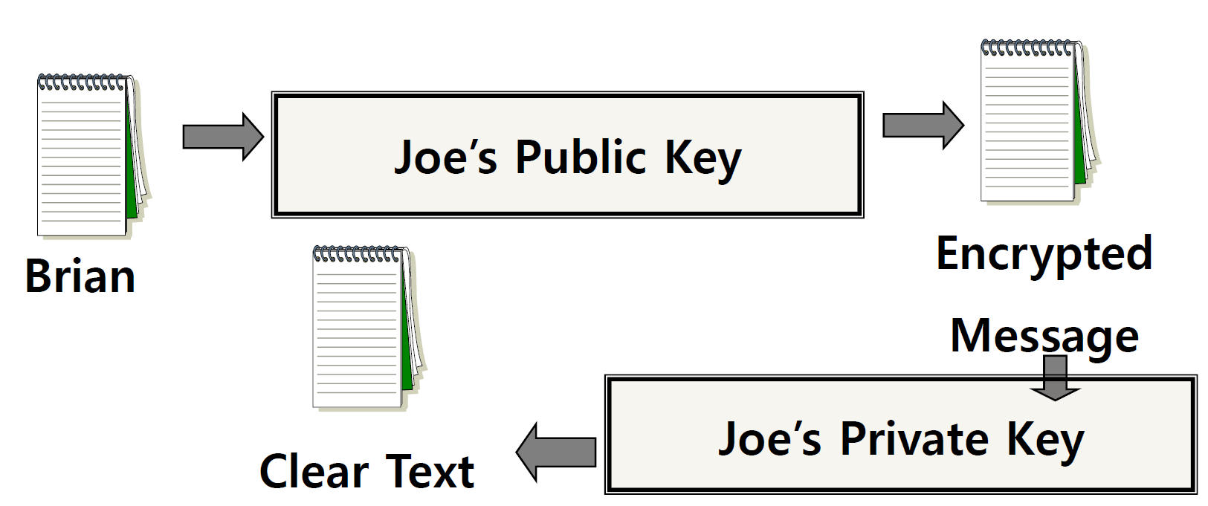
Public Key (asymmetric) Cryptography
Two keys are used: a public and a private key. If a message is encrypted with one key, it has to be decrypted with the other.

Slide 98
Encryption questions
Why have encryption?
What are the differences between symmetric and asymmetric encryption? When would I use one or the other?
What is used on the Internet? What is a certificate authority?
How can I trust a message came from someone?

Slide 99
Digital Signature
An electronic stamp or seal
almost exactly like a written signature, except more guarantees!
Is appended to a document
Or sent separately (detached signature)
Ensures data integrity
document was not changed during transmission
How are signatures different than encryption?

Slide 100
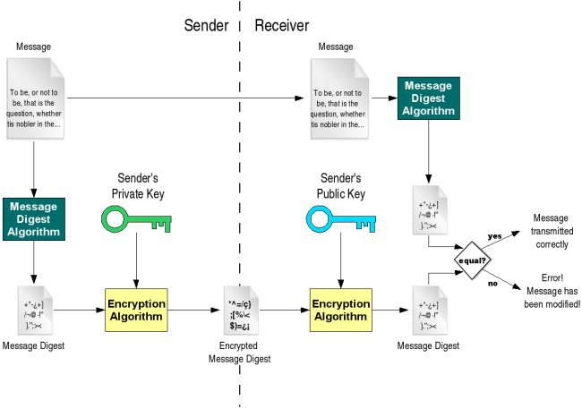
Digital Signature
You should understand
this entire slide.
Verifies document integrity Does it prove origin?
Who is Certificate Authority (CA) ?
●
●
Image Source : gdp.globus.org
●

Slide 101
Detached Signature
Digital signatures can either be attached to the message or detached
A detached signature is stored and transmitted separately from the message it signs
Commonly used to validate software distributed in compressed tar files
You can't sign such a file internally without altering its contents, so the signature is created in a separate file
Why detach at all? Why are signatures useful?
Who can create a signature? How do I verify a signature?

Slide 102
Good luck on all of your finals and have a great winter break! ☺

