Slide 1
CS35L – F16
Slide set: | 3.2
Slide topics: | Python
Assignment: | 3

Slide 2
What is Python?
Not just a scripting language
Object-Oriented language
Classes
Member functions
Compiled and interpreted
Python code is compiled to bytecode
Bytecode interpreted by Python interpreter
Not as fast as C but easy to learn, read and use
Very popular at Google and others!

Slide 3
Optparse Library
Powerful library for parsing command-line options
Argument:
String entered on the command line and passed in to the script
Elements of sys.argv[1:] (sys.argv[0] is the name of the program being executed)
Option:
An argument that supplies extra information to customize the execution of a program
Option Argument:
An argument that follows an option and is closely associated with it. It is consumed from the argument list when the option is

Slide 4
Python List
Common data structure in Python
A python list is like a C array but much more:
Dynamic (mutable): expands as new items are added
Heterogeneous: can hold objects of different types
How to access elements?
List_name[index]

Slide 5
Example
>>> t = [123, 3.0, ‘hello!’]
>>> print t[0]
123
>>> print t[1]
3.0
>>> print t[2]
hello!

Slide 6
Example – Merging Lists
>>> list1 = [1, 2, 3, 4]
>>> list2 = [5, 6, 7, 8]
>>> merged_list = list1 + list2
>>> print merged_list
Output: [1, 2, 3, 4, 5, 6, 7, 8]

Slide 7
Python Dictionary
Essentially a hash table
Provides key-value (pair) storage capability
Instantiation:
dict = {}
This creates an EMPTY dictionary
Keys are unique, values are not!
Keys must be immutable (strings, numbers, tuples)

Slide 8
Example
dict = {}
dict[‘hello’] = “world”
print dict[‘hello’]
world
dict[‘power’] = 9001
if (dict[‘power’] > 9000):
print “It is over “, dict[‘power’]
It is over 9001
del dict[‘hello’]
del dict

Slide 9
for loops
list = [‘Mary’, ‘had’, ‘a’, ‘little’, ‘lamb’]
for i in list:
print i
Result:
Mary
had
a
little
lamb
for i in range(len(list)):
print i
Result:
0
1
2
3
4

Slide 10
Indentation
Python has no braces or keywords for code blocks
C delimiter: {}
bash delimiter:
then…else…fi (if statements)
do…done (while, for loops)
Indentation makes all the difference
Tabs change code’s meaning!!

Slide 11
Homework 3
randline.py script
Input: a file and a number n
Output: n random lines from file
Get familiar with language + understand what code does
Answer some questions about script
Implement comm utility in python

Slide 12
Running randline.py
Run it
./randline.py –n 3 filename (need execute permission)
python randline.py –n 3 filename (no execute permission)
randline.py has 3 command-line arguments:
n: specifies the number of lines to write
option
3: number of lines
option argument to n
filename: file to choose lines from
argument to script
Output: 3 random lines from the input file

Slide 13
Python Walk-Through
#!/usr/bin/python
import random, sys
from optparse import OptionParser
class randline:
def __init__(self, filename):
f = open (filename, 'r')
self.lines = f.readlines()
f.close ()
def chooseline(self):
return random.choice(self.lines)
def main():
version_msg = "%prog 2.0"
usage_msg = """%prog [OPTION]...
FILE Output randomly selected lines from FILE."""
Tells the shell which interpreter to use
Import statements, similar to include statements
Import OptionParser class from optparse module
The beginning of the class statement: randline
The constructor
Creates a file handle
Reads the file into a list of strings called lines
Close the file
The beginning of a function belonging to randline
Randomly select a number between 0 and the size of lines and returns the line corresponding to the randomly selected number
The beginning of main function
version message
usage message

Slide 14
Python Walk-Through
parser = OptionParser(version=version_msg, usage=usage_msg) parser.add_option("-n", "--numlines", action="store", dest="numlines", default=1, help="output NUMLINES lines (default 1)")
options, args = parser.parse_args(sys.argv[1:])
try:
numlines = int(options.numlines)
except:
parser.error("invalid NUMLINES: {0}". format(options.numlines))
if numlines < 0:
parser.error("negative count: {0}". format(numlines))
if len(args) != 1:
parser.error("wrong number of operands")
input_file = args[0]
try:
generator = randline(input_file)
for index in range(numlines):
sys.stdout.write(generator.chooseline())
except IOError as (errno, strerror):
parser.error("I/O error({0}): {1}". format(errno, strerror))
if __name__ == "__main__":
main()
Creates OptionParser instance
Start defining options, action “store” tells optparse to take next argument and store to the right destination which is “numlines”. Set the default value of “numlines” to 1 and help message.
options: an object containing all option args
args: list of positional args leftover after parsing options
Try block
get numline from options and convert to integer
Exception handling
error message if numlines is not integer type, replace {0} w/ input
If numlines is negative
error message
If length of args is not 1 (no file name or more than one file name)
error message
Assign the first and only argument to variable input_file
Try block
instantiate randline object with parameter input_file
for loop, iterate from 0 to numlines – 1
print the randomly chosen line
Exception handling
error message in the format of “I/O error (errno):strerror
In order to make the Python file a standalone program

Slide 15
Comm.py
Support all options for comm
-1, -2, -3 and combinations
Extra option –u for comparing unsorted files
Support all type of arguments
File names and – for stdin
If you are unsure of how something should be output, run a test using existing comm utility!
Create your own test inputs

Slide 16
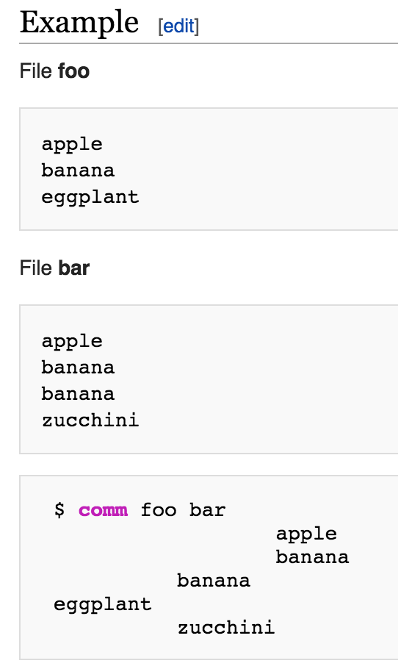

Slide 17
Homework 3 Hints
The comm options -123 are Boolean
Which action should you use?
Q4: Python 3 vs. Python 2
Look up “automatic tuple unpacking”
Python 3 is installed in /usr/local/cs/bin
export PATH=/usr/local/cs/bin:$PATH

Slide 18
Homework 3 Hints
Check the comm utility source (link on Slides 3.1 on CCLE)
Use the same logic (except for –u option)
Remember to support input from STDIN
$ cat input1.txt | python comm.py input2.txt –
Use randline.py as a starting point
Modify to work exactly like comm

