Slide 1
CS35L – F16
Slide set: | 4.1
Slide topics: | Source control, Git
Assignment: | 4

Slide 2
Software development process
●
Involves making a lot of changes to code
New features added Bugs fixed
Performance enhancements
–
–
–
●
Software team has many people working on the same/different parts of code
Many versions of software released
●
–
Ubuntu 10, Ubuntu 12, etc
Need to be able to fix bugs for Ubuntu 10 for customers using it, even though you have shipped Ubuntu 12.
–

Slide 3
Source/Version Control
●
Track changes to code and other files related to the software
–
What new files were added? What changes made to files?
Which version had what changes? Which user made the changes?
–
–
–
●
Track entire history of the software Version control software
●
–
GIT, Subversion, Perforce

Slide 4
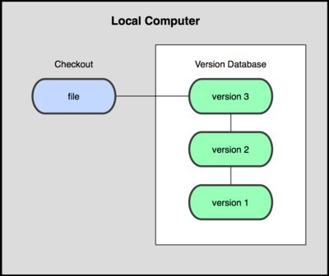
Local VCS
●
Organize different versions as folders on the local machine
No server involved
Other users should copy it via disk/network
●
●
Image Source: git-scm.com

Slide 5
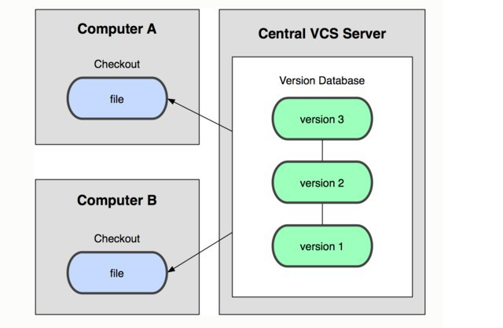
Centralized VCS
●
Version history sits on a central server
Users will get a working copy of the files
Changes have to be committed to the server
All users can get the changes
●
●
●
Image Source: git-scm.com

Slide 6
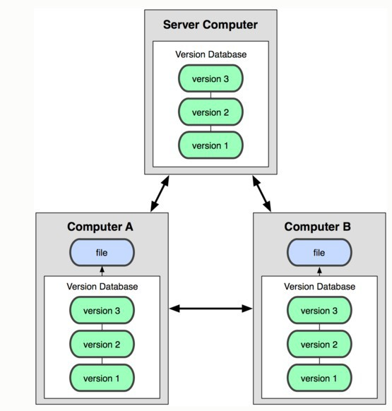
Distributed VCS
Version history is replicated at every user's machine
Users have version control all the time
Changes can be communicated between users
Git is distributed
●
●
●
●
Image Source: git-scm.com

Slide 7
Terms used
●
Repository
–
Files and folder related to the software code Full History of the software
–
●
Working copy
–
Copy of software's files in the repository
●
Check-out
–
To create a working copy of the repository
●
Check-in / Commit
–
Write the changes made in the working copy to the repository
Commits are recorded by the VCS
–

Slide 8
GIT Source control

Slide 9
GIT Repository Objects
●
Objects used by GIT to implement source control
–
Blobs
●
Sequence of bytes
–
Trees
●
Groups blobs/trees together
–
Commit
●
Refers to a particular “git commit” Contains all information about the commit
●
–
Tags
Just a named commit object for convenience (example: versions of the software)
Objects uniquely identified with hashes
●
●

Slide 10

Git States
Index(cache)
git checkout
git add
git commit
Image Source: git-scm.com

Slide 11
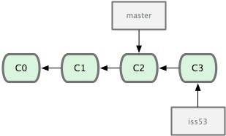
Terms used
Head
Refers to a commit object
There can be many heads in a repository
HEAD
Refers to the currently active head
Detached HEAD
If a commit is not pointed to by a branch
This is okay if you want to just take a look at the code and if you don't commit any new changes
If the new commits have to be preserved then a new branch has to be created
git checkout v3.0 -b BranchVersion3.1
Branch
Refers to a head and its entire set of ancestor commits
Master
Default branch
Image Source: git-scm.com

Slide 12
First Git Repository
$ mkdir gitroot
$ cd gitroot
$ git init
creates an empty git repo (.git directory with all necessary subdirectories)
$ echo “Hello World” > hello.txt
$ git add .
Adds content to the index
Must be run prior to a commit
$ git commit –m ‘Check in number one’

Slide 13
Working With Git
$ echo “I love Git” >> hello.txt
$ git status
Shows list of modified files
hello.txt
$ git diff
Shows changes we made compared to index
$ git add hello.txt
$ git diff
No changes shown as diff compares to the index
$ git diff HEAD
Now we can see changes in working version
$ git commit –m “Second commit”

Slide 14
Git commands
●
Repository creation
–
$ git init
$ git clone
(Start a new repository)
(Create a copy of an exisiting repository)
–
●
Branching
–
$ git checkout <tag/commit> -b <new_branch_name> (creates a new branch)
●
Commits
–
$ git add
$ git commit
(Stage modified/new files)
(check-in the changes to the repository)
–
●
Getting info
–
$ git status
$ git diff
$ git log
$ git show
(Shows modified files, new files, etc) (compares working copy with staged files) (Shows history of commits)
(Show a certain object in the repository)
–
–
–
●
Getting help
–
$ git help

Slide 15
Git integrating changes
Required when there are changes in multiple branches
Two main ways to integrate changes from one branch to another – merge and rebase
Merge is simple and straightforward
Rebase is much cleaner

Slide 16
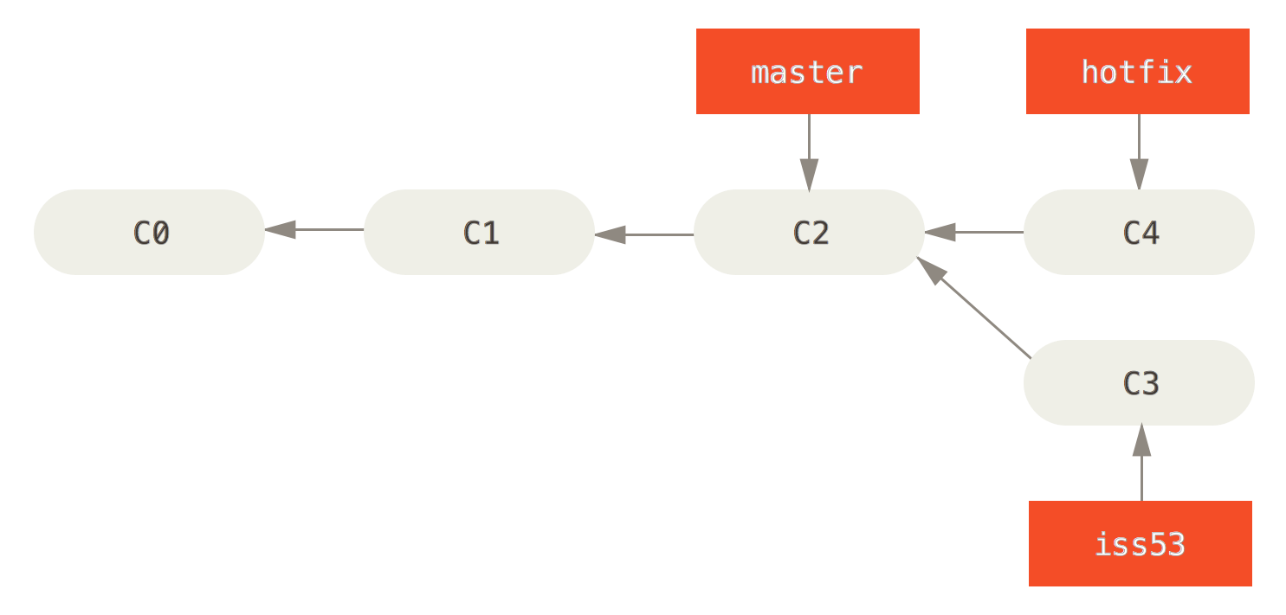
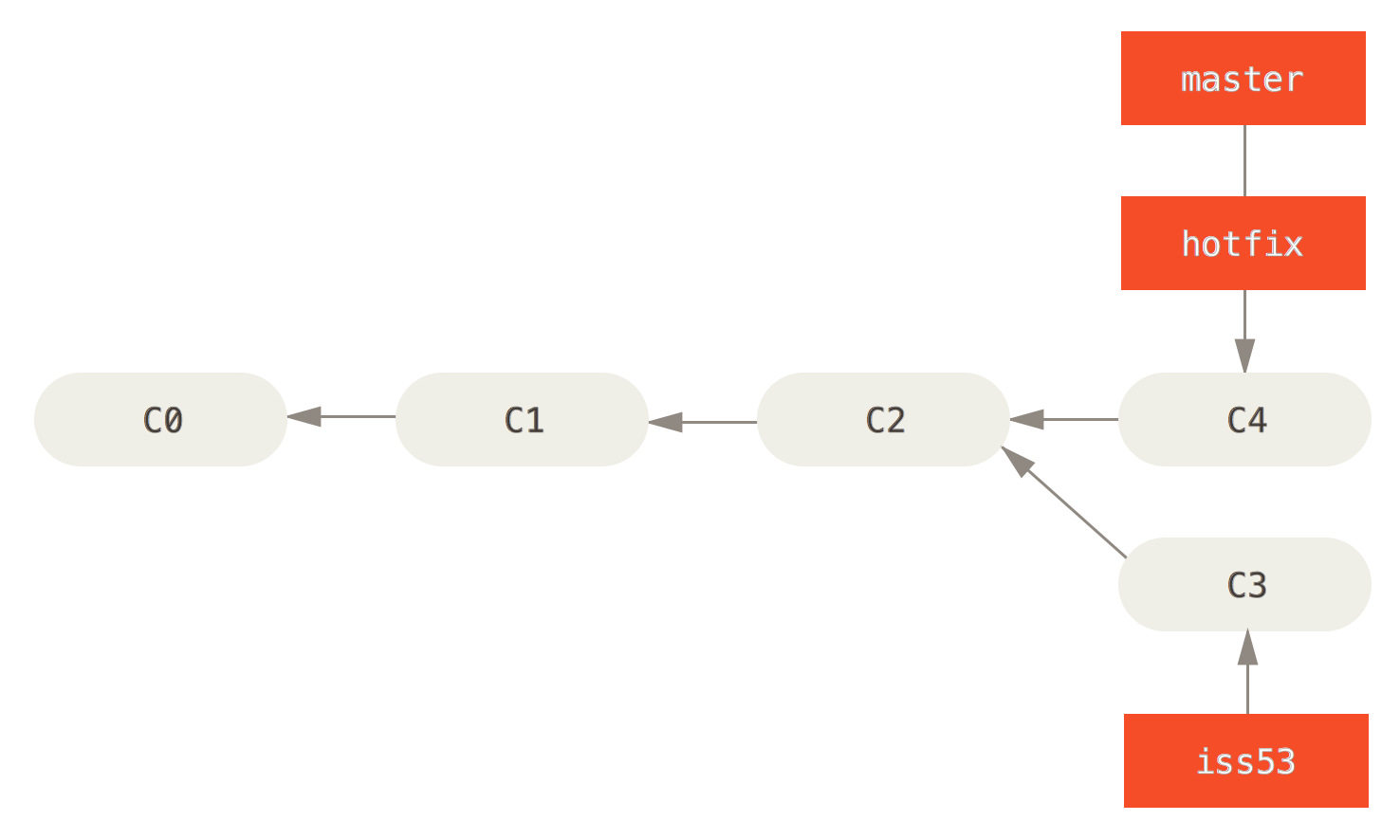
Git merge

Slide 17
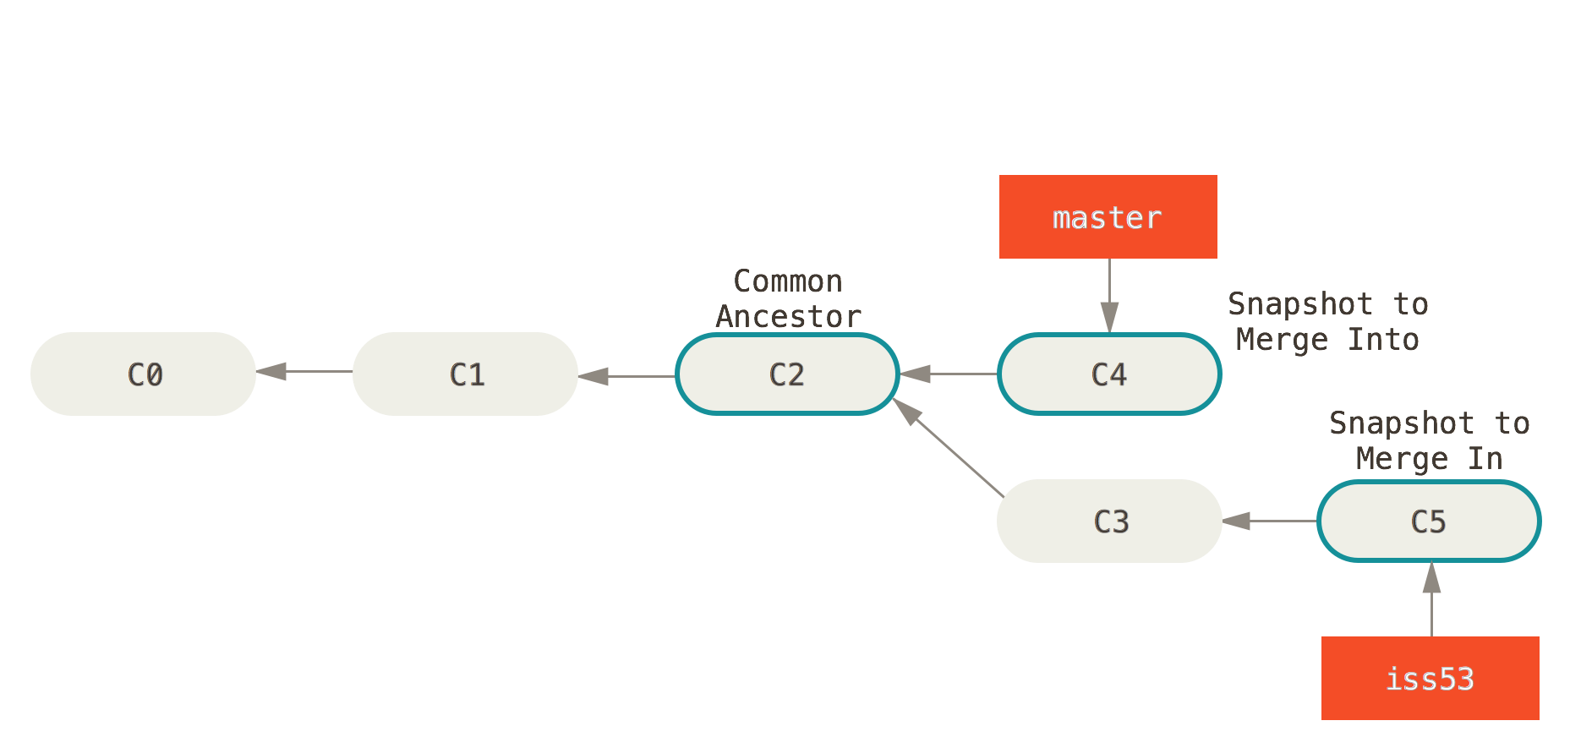
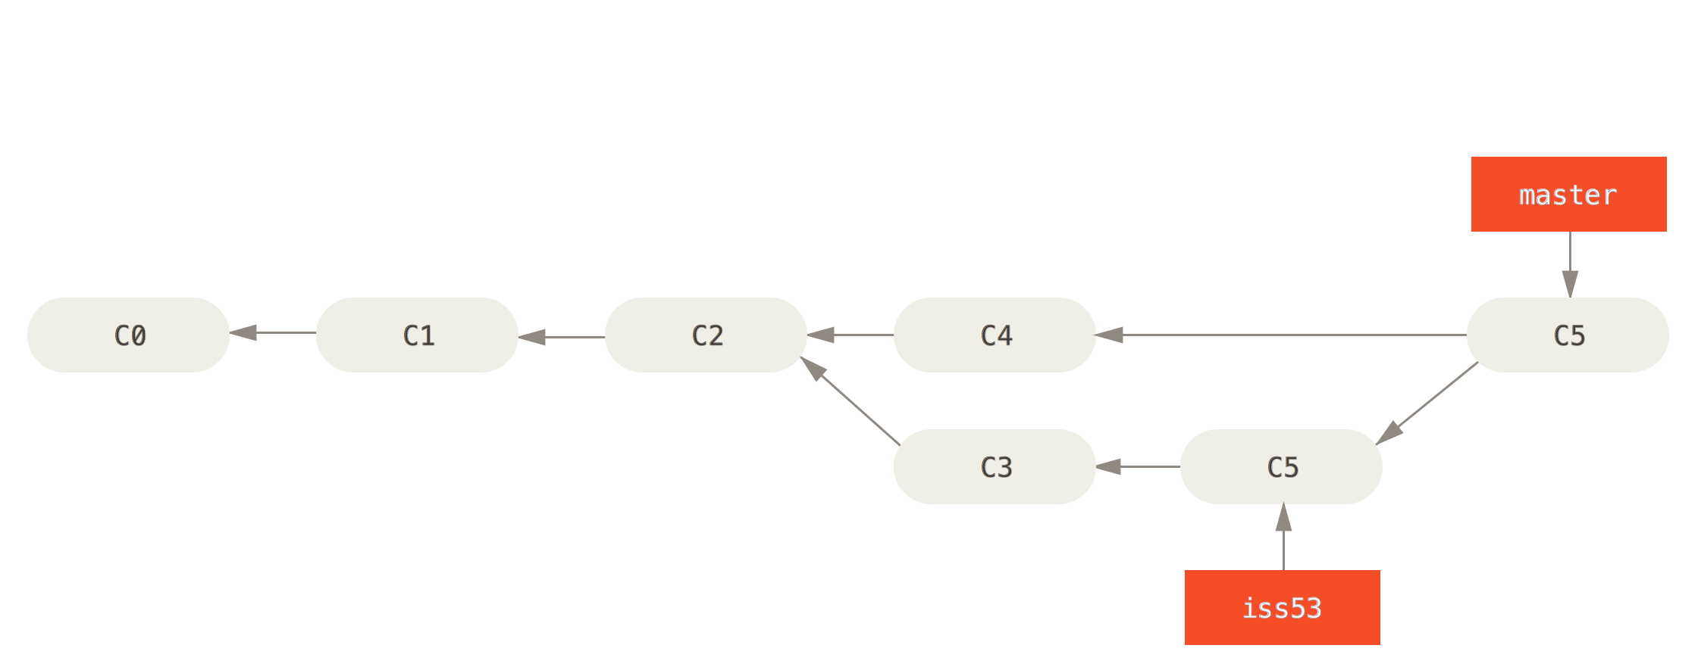
Git merge

Slide 18
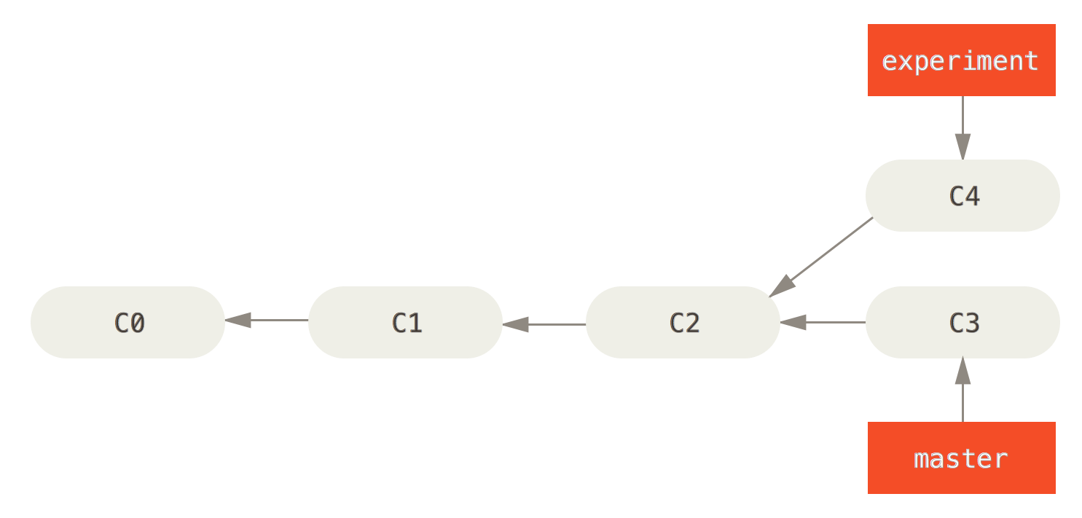
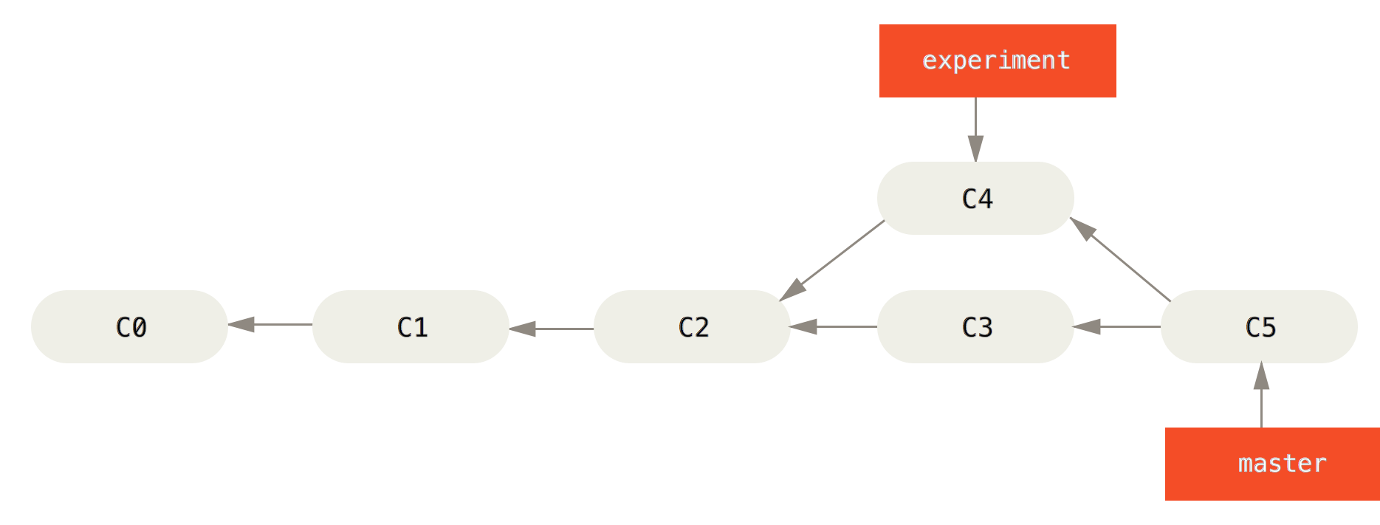
Git rebase

Slide 19
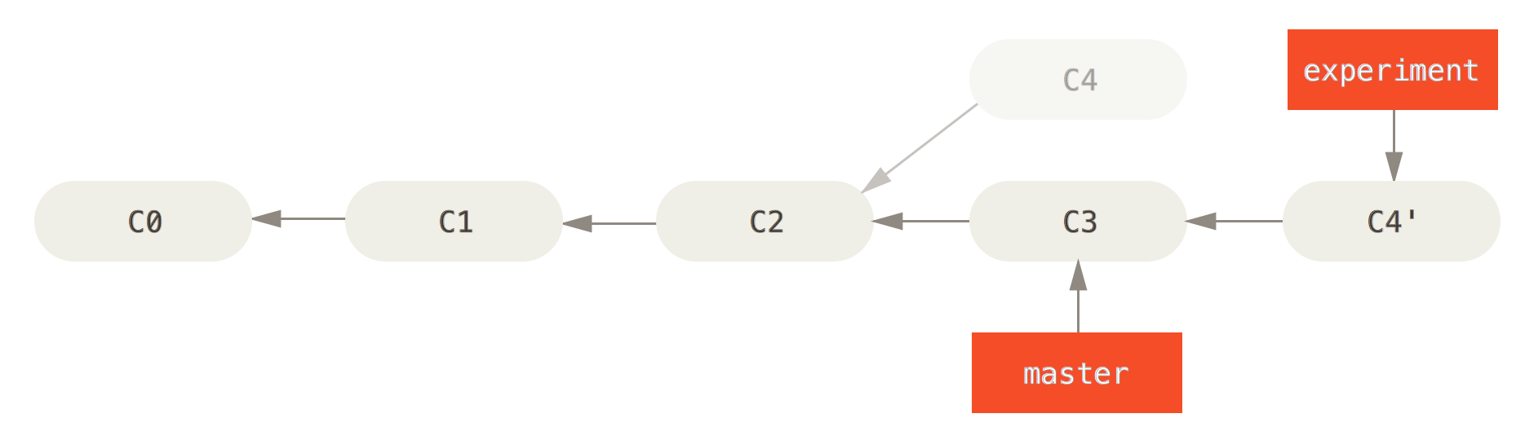
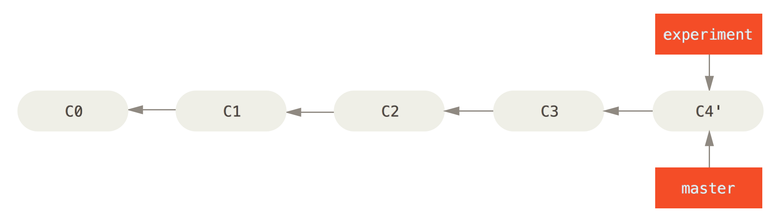
Git rebase

Slide 20
More Git Commands
●
Reverting
–
$ git checkout HEAD main.cpp
●
Gets the HEAD revision for the working copy
–
$ git checkout -- main.cpp
●
Reverts changes in the working directory
–
$ git revert
●
Reverting commits (this creates new commits)
●
Cleaning up untracked files
–
$ git clean
●
Tagging
–
Human readable pointers to specific commits $ git tag -a v1.0 –m 'Version 1.0'
–
●
This will name the HEAD commit as v1.0

Slide 21
Assignment 4
Fix an issue with diff diagnostic - apply a patch to a previous version
Installing Git
Ubuntu: $ sudo apt-get install git
SEASnet
Git is installed in /usr/local/cs/bin
Add it to PATH variable or use whole path
$ export PATH=/usr/local/cs/bin:$PATH
Make a directory ‘gitroot’ and get a copy of the Diffutils Git repository
$ mkdir gitroot
$ cd gitroot
$ git clone git://git.savannah.gnu.org/diffutils.git
Follow steps in lab and use man git to find commands

Slide 22
Hints
git clone
git log
git tag
git show <hash>
git checkout v3.0 –b <branchname>

