Slide 1
CS35L – F16
Slide set: | 7.1
Slide topics: | Multithreaded performance
Assignment: | 7

Slide 2
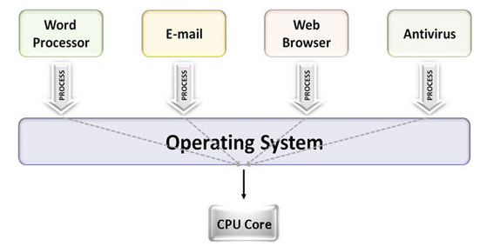
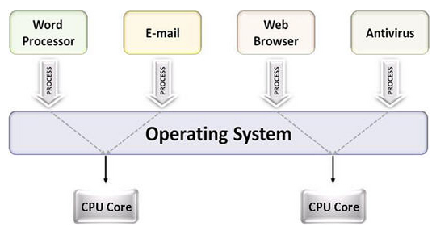
Multiprocessing
The use of multiple CPUs/cores to run multiple tasks simultaneously
Uniprocessing system
Multiprocessing system

Slide 3
Parallelism
Executing several computations simultaneously to gain performance
Different forms of parallelism
Multitasking
Several processes are scheduled alternately or possibly simultaneously on a multiprocessing system
Multithreading
Same job is broken logically into pieces (threads) which may be executed simultaneously on a multiprocessing system

Slide 4
What is a thread?
A flow of instructions, path of execution within a process
The smallest unit of processing scheduled by OS
A process consists of at least one thread
Multiple threads can be run on:
A uniprocessor (time-sharing)
Processor switches between different threads
Parallelism is an illusion
A multiprocessor
Multiple processors or cores run the threads at the same time
True parallelism

Slide 5
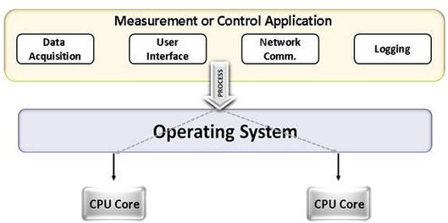
Multitasking vs. Multithreading
Multitasking
Multitasking
Multithreading

Slide 6
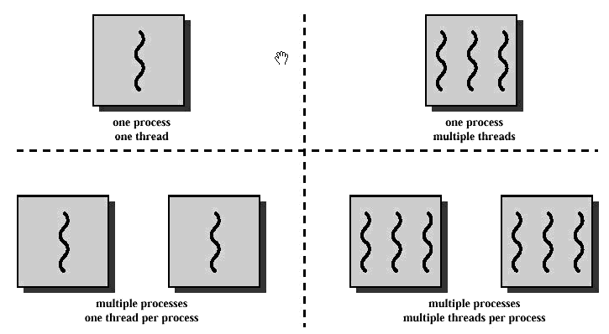
Multithreading
Multitasking

Slide 7
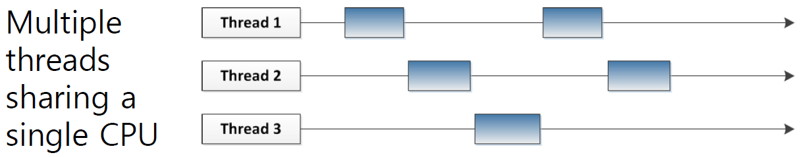
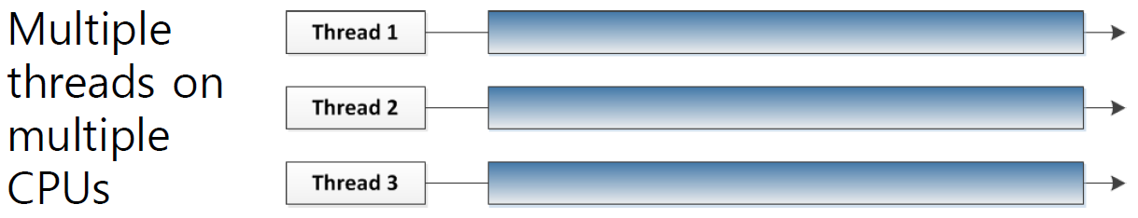

Slide 8
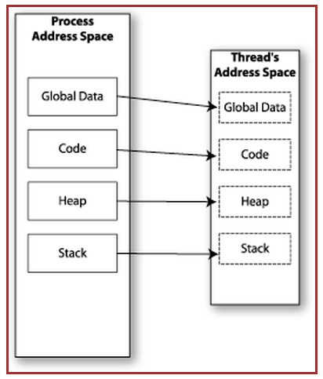

Memory Layout: Single-Threaded Program

Slide 9
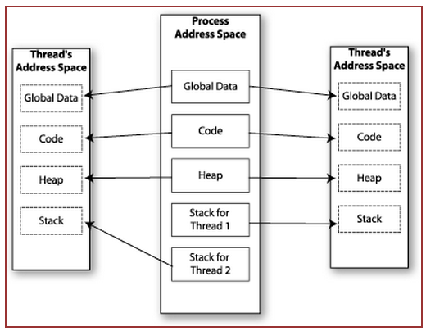

Memory Layout: Multithreaded Program

Slide 10
Multitasking
$ tr -cs 'A-Za-z' '[\n*]' | sort -u | comm -23 – words
Process 1 (tr)
Process 2 (sort)
Process 3 (comm)
Each process has its own
address space
How do these processes
communicate?
Pipes/System Calls

Slide 11
Multithreading
Threads share all of the process's memory except for their stacks
=> Data sharing requires no extra work (no system calls, pipes, etc.)

Slide 12
Shared Memory
Makes multithreaded programming
Powerful
can easily access data and share it among threads
More efficient
No need for system calls when sharing data
Thread creation and destruction less expensive than process creation and destruction
Non-trivial
Have to prevent several threads from accessing and changing the same shared data at the same time (synchronization)

Slide 13
Race Condition
A
B
C
int count = 0; void increment()
{ count = count + 1; }
r(count) : 0
w(count) : 1
time
r(count) : 1
r(count) : 1
w(count) : 2
w(count) : 2
Result depends on order of execution
=> Synchronization needed

Slide 14
Multithreading & Multitasking: Comparison
Multithreading
Threads share the same address space
Light-weight creation/destruction
Easy inter-thread communication
An error in one thread can bring down all threads in process
Multitasking
Processes are insulated from each other
Expensive creation/destruction
Expensive IPC
An error in one process cannot bring down another process

Slide 15
Basic pthread Functions
There are 5 basic pthread functions:
1. pthread_create: creates a new thread within a process
2. pthread_join: waits for another thread to terminate
3. pthread_equal: compares thread ids to see if they refer to the same thread
4. pthread_self: returns the id of the calling thread
5. pthread_exit: terminates the currently running thread

Slide 16
pthread_create
Function: creates a new thread and makes it executable
Can be called any number of times from anywhere within code
Return value:
Success: zero
Failure: error number

Slide 17
Parameters
int pthread_create( pthread_t *tid, const pthread_attr_t *attr,
void *(my_function)(void *), void *arg );
tid: unique identifier for newly created thread
attr: object that holds thread attributes (priority, stack size, etc.)
Pass in NULL for default attributes
my_function: function that thread will execute once it is created
arg: a single argument that may be passed to my_function
Pass in NULL if no arguments

Slide 18
pthread_create Example
#include <pthread.h> …
void *printMsg(void *thread_num) {
int t_num = (int) thread_num;
printf(“It’s me, thread #%d!\n”, t_num); }
int main() {
pthread_t tids[3];
int t;
for(t = 0; t < 3; t++) {
ret = pthread_create(&tids[t], NULL, printMsg, (void *) t);
if(ret) {
printf(“Error creating thread. Error code is %d\n”, ret”);
exit(-1); }
}
}
Possible problem with this code?
If main thread finishes before all threads finish their job -> incorrect results

Slide 19
pthread_join
Function: makes originating thread wait for the completion of all its spawned threads’ tasks
Without join, the originating thread would exit as soon as it completes its job
A spawned thread can get aborted even if it is in the middle of its chore
Return value:
Success: zero
Failure: error number

Slide 20
Arguments
int pthread_join(pthread_t tid, void **status);
tid: thread ID of thread to wait on
status: the exit status of the target thread is stored in the location pointed to by *status
Pass in NULL if no status is needed

Slide 21
pthread_join Example
#include <pthread.h> …
#define NUM_THREADS 5
void *PrintHello(void *thread_ num) {
printf("\n%d: Hello World!\n", (int) thread_num); }
int main() {
pthread_t threads[NUM_THREADS];
int ret, t;
for(t = 0; t < NUM_THREADS; t++) {
printf("Creating thread %d\n", t);
ret = pthread_create(&threads[t], NULL, PrintHello, (void *) t);
// check return value }
for(t = 0; t < NUM_THREADS; t++) {
ret = pthread_join(threads[t], NULL);
// check return value }
}

Slide 22
Lab 7
Evaluate the performance of multithreaded sort
Add /usr/local/cs/bin to PATH
$ export PATH=/usr/local/cs/bin:$PATH
Generate a file containing 10M random double-precision floating point numbers, one per line with no white space
/dev/urandom: pseudo-random number generator
Disk quota exceeded
http://www.seasnet.ucla.edu/seasnet-account-quotas/

Slide 23
Lab 7
od
write the contents of its input files to standard output in a user-specified format
Options
-t : select output format
-N <count>: Format no more than count bytes of input
sed, tr
Remove address, delete spaces, add newlines between each float

Slide 24
Lab 7
use time -p to time the command sort -g on the data you generated
Send output to /dev/null
Run sort with the --parallel option and the
–g option: compare by general numeric value
Use time command to record the real, user and system time when running sort with 1, 2, 4, and 8 threads
$ time –p sort –g file_name > /dev/null (1 thread)
$ time –p sort –g --parallel=[2, 4, or 8] file_name > /dev/null
Record the times and steps in log.txt

