Slide 1
CS35L – F16
Slide set: | 8.1
Slide topics: | Dynamic linking
Assignment: | 8

Slide 2
Building an executable file
source
code
compiler
object
code
linker
executable
file
Translates programming
language statements into
cpu’s machine-language
instructions
Takes one or more object files generated by a compiler and combines them into a single executable file

Slide 3
Static Linking
Carried out only once to produce an executable file
If static libraries are called, the linker will copy all the modules referenced by the program to the executable
Static libraries are typically denoted by the .a file extension

Slide 4
source
code
compiler
object
code
linker
executable
file
object
code
library
A previously compiled
collection of standard
program functions

Slide 5
Dynamic Linking
Allows a process to add, remove, replace or
relocate object modules during its execution.
If shared libraries are called:
Only copy a little reference information when the executable file is created
Complete the linking during loading time or running time
Dynamic libraries are typically denoted by the .so file extension
.dll on Windows

Slide 6
Linking and Loading
Linker collects procedures and links together the object modules into one executable program
Why isn't everything written as just one big program, saving the necessity of linking?
Efficiency: if just one function is changed in a 100K line program, why recompile the whole program? Just recompile the one function and relink.
Multiple-language programs
Other reasons?

Slide 7
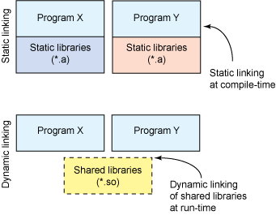

Slide 8
Dynamic linking
Unix systems: Code is typically compiled as a dynamic shared object (DSO)
Dynamic vs. static linking resulting size $ gcc -static hello.c -o hello-static $ gcc hello.c -o hello-dynamic $ ls -l hello 80 hello.c 13724 hello-dynamic 383 hello.s 1688756 hello-static
If you are the sysadmin, which do you prefer?

Slide 9
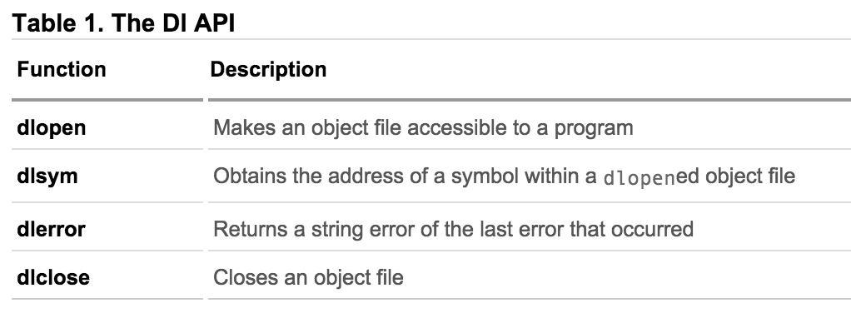
How are libraries dynamically loaded?

Slide 10
Advantages of dynamic linking
The executable is typically smaller
When the library is changed, the code that references it does not usually need to be recompiled
The executable accesses the .so at run time; therefore, multiple programs can access the same .so at the same time
Memory footprint amortized across all programs using the same .so

Slide 11
Smaller is more efficient
object
file
object
file
static linking
function
library
function
library
executable
files
object
file
object
file
dynamic linking
function
library
pointer
shared
function
library

Slide 12
Disadvantages of dynamic linking
Performance hit
Need to load shared objects (at least once)
Need to resolve addresses (once or every time)
Remember back to the system call assignment…
What if the necessary dynamic library is missing?
What if we have the library, but it is the wrong version?

Slide 13
GCC Flags
-fPIC: Compiler directive to output position independent code, a characteristic required by shared libraries.
-llibrary: Link with "liblibrary.a”
Without -L to directly specify the path, /usr/lib is used.
-L: At compile time, find the library from this path.
-Wl,rpath=.: -Wl passes options to linker. -rpath at runtime finds .so from this path.
-c: Generate object code from c code.
-shared: Produce a shared object which can then be linked with other objects to form an executable.
https://gcc.gnu.org/onlinedocs/gcc/Link-Options.html#Link-Options

Slide 14
Creating static and shared libs in GCC
●
mymath.h
●
mul5.c
●
add1.c
#ifndef MY_MATH_H
#include "mymath.h"
#include "mymath.h"
#define MY_MATH_H
void mul5(int *i)
void add1(int *i)
void mul5(int *i);
{
{
void add1(int *i);
*i *= 5;
*i += 1;
#endif
}
}
gcc -c mul5.c -o mul5.o gcc -c add1.c -o add1.o
ar -cvq libmymath.a mul5.o add1.o ----> (static lib)
gcc -shared -fpic -o libmymath.so mul5.o add1.o -----> (shared lib)
●
●
●
●

Slide 15
Dynamic loading
#include <stdio.h>
#include <dlfcn.h>
int main(int argc, char* argv[]) {
int i = 10;
void (*myfunc)(int *); void *dl_handle;
char *error;
dl_handle = dlopen("libmymath.so", RTLD_LAZY);//RTLD_NOW
if(!dl_handle) {
printf("dlopen() error - %s\n", dlerror()); return 1;
}
//Calling mul5(&i);
myfunc = dlsym(dl_handle, "mul5"); error = dlerror();
if(error != NULL) {
printf("dlsym mul5 error - %s\n", error); return 1;
}
myfunc(&i);
//Calling add1(&i);
myfunc = dlsym(dl_handle, "add1"); error = dlerror();
if(error != NULL) {
printf("dlsym add1 error - %s\n", error); return 1;
}
myfunc(&i);
printf("i = %d\n", i);
dlclose(dl_handle);
return 0;
}
Copy the code into main.c gcc main.c -o main -ldl
You will have to set the environment variable LD_LIBRARY_PATH to
include the path that contains libmymath.so
●
●
●

Slide 16
Attributes of Functions
Used to declare certain things about functions called in your program
Help the compiler optimize calls and check code
Also used to control memory placement, code generation options or call/return conventions within the function being annotated
Introduced by the attribute keyword on a declaration, followed by an attribute specification inside double parentheses

Slide 17
Attributes of Functions
__attribute__ ((__constructor__))
Is run when dlopen() is called
__attribute__ ((__destructor__))
Is run when dlclose() is called
Example:
__attribute__ ((__constructor__))
void to_run_before (void) {
printf("pre_func\n");
}

Slide 18
Lab 8
Write and build simple “cos(0.5)” program in C
Use ldd to investigate which dynamic libraries your cos program loads
Use strace to investigate which system calls your cos program makes
Use “ls /usr/bin | awk ‘NR%101==UID%101’” to find ~25 linux commands to use ldd on
Record output for each one in your log and investigate any errors you might see
From all dynamic libraries you find, create a sorted list
Remember to remove the duplicates!

