Slide 1
NUMBER SYSTEMS

Slide 2
Introduction
Number Systems used in Computer & ICT:
Binary (base 2)
Octal (base 8)
Hexadecimal (base 16)

Slide 3
BINARY NUMBER SYSTEM
Refers to numbers with a base/radix of 2
Given that digital logic and memory devices are based on two
electrical states (on and off), it is natural to use a number system,
called the binary number system, which contains only two
symbols, namely 0 and 1.

Slide 4

Binary
Each digit position in a binary number represents a power of
two. So, when we write a binary number, each binary digit is multiplied by an appropriate power of 2 based on the position in the number:
For example:

Slide 5
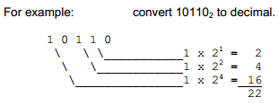
Binary to Decimal Conversion

Slide 6
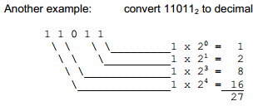
Binary to Decimal Conversion Ex 2

Slide 7
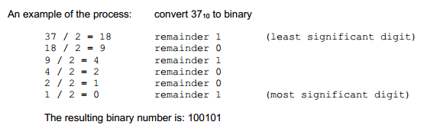
Decimal to Binary

Slide 8
Decimal to Binary
Convert 9310 to binary

Slide 9
Decimal to Binary
The resulting binary number is: 1011101

Slide 10
HEXADECIMAL
base 16.
The following are the hexadecimal numerals:
0, 1, 2, 3, 4, 5, 6, 7, 8, 9, A, B, C, D, E, F

Slide 11
Why hexadecimal?
The reason for the common use of hexadecimal numbers is the relationship between the numbers 2 and 16. Sixteen is a power of 2 (16 = 24). Because of this relationship, four digits in a binary number can be represented with a single hexadecimal digit. This makes conversion between binary and hexadecimal numbers very easy, and hexadecimal can be used to write large binary numbers with much fewer digits.
Writing a 16 or 32 bit binary number would be quite tedious and error prone. By using hexadecimal, the numbers can be written with fewer digits and much less likelihood of error.

Slide 12

Binary to Hexadecimal

Slide 13

Binary to Hex

Slide 14
Convert to hex

Slide 15

Hex to Binary
To convert a hexadecimal number to a binary number, convert each hexadecimal digit into a group of 4 binary digits.

Slide 16
Hex Representation
In the C and C++ languages, hexadecimal constants are represented with a ‘0x’ preceding the number, as in: 0x317F, or 0x1234, or 0xAF.
In assembler programming languages that follow the Motorola style, hexadecimal constants begin with a ‘$’ character. So in this case: $371F or $FABC or $01 are valid hexadecimal constants

Slide 17

Binary Coded Decimal
numbers are represented in a decimal form, however each decimal digit is encoded using a four bit binary number.

Slide 18

BCD

Slide 19
Bits, bytes and words
Each binary digit is known as a bit.
Given a fixed number of n bits, (a word), which the arithmetic unit of a computer is designed to handle, then there are 2^{n} separate binary numbers that can be accommodated. For example, in 8 bits, one can accommodate the binary numbers corresponding to decimal 0 to 255 (256 different numbers).
Current computers have word lengths of 32 or 64 bits.

Slide 20
Memory Hierarchy
I bit = I binary digit (1 bit) =0 or 1
I nibble = 4 bits
1 byte = 8 bits
I Kilobyte(KB) = 2¹⁰ bytes
1 Megabyte (MB) = 2²⁰ bytes
1 Gigabyte (GB) = 2³⁰ bytes
Terabyte >> Petabyte >> Exabyte >> Zettabyte >> Yottabyte

Slide 21
Further Reading
Converting binary and decimal numbers with fractions
Octal Numbering System
Addition and Subtraction of Binary numbers

Slide 22
Computer communications and networks
A computer network or data network is a telecommunications network that allows computers to exchange data. In computer networks, networked computing devices pass data to each other along data connections. Data is transferred in the form of packets.
Networking devices may include gateways, routers, network bridges, modems, wireless access points, networking cables, line drivers, switches, hubs, and repeaters; and may also include hybrid network devices such as multilayer switches, protocol converters, bridge routers, proxy servers, firewalls, network address translators, multiplexers, network interface controllers, wireless network interface controllers, ISDN terminal adapters and other related hardware.

Slide 23
Classification of Networks
Point- to –Point
Broadcast
Broadcast(all)
Multicast(some)
Unicast(one)

Slide 24
Classification according to Extent
Personal Area Network (PAN)
Local Area Network (LAN)
Metropolitan Area Network
Wide Area Network(WAN)

Slide 25
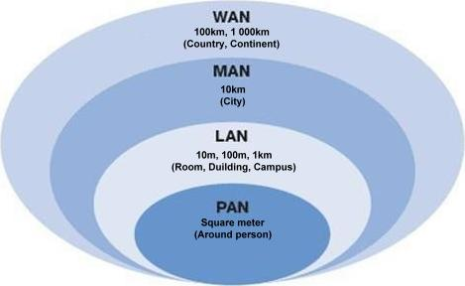

Slide 26
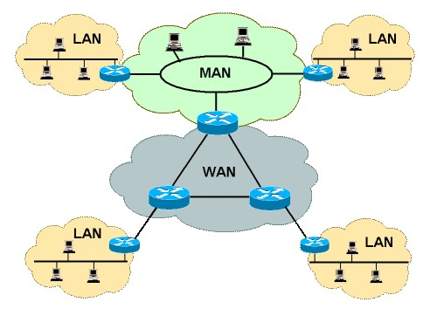

Slide 27
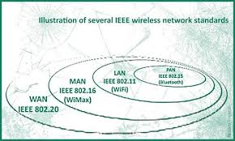

Slide 28
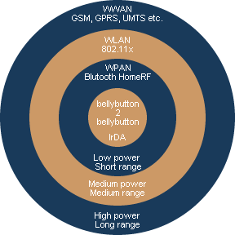

Slide 29
PAN
Handsets, PDA, Mobile Phone
Bluetooth, Infrared, NFC,USB

Slide 30
LAN
Computers connected over Ethernet cables.
Network coordinated by a switch and hubs
An Ethernet hub, active hub, network hub, repeater hub, multiport repeater or hub is a device for connecting multiple Ethernet devices together and making them act as a single network segment.

Slide 31
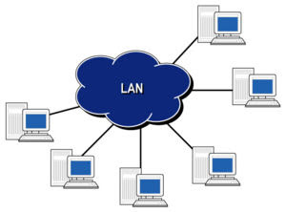

Slide 32
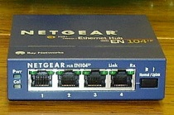
Network Hub

Slide 33
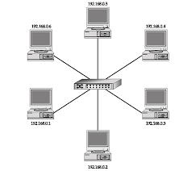

Slide 34
Network Switch
A network switch (sometimes known as a switching hub) is a computer networking device that is used to connect devices together on a computer network, by using a form of packet switching to forward data to the destination device. A network switch is considered more advanced than a hub because a switch will only forward a message to one or multiple devices that need to receive it, rather than broadcasting the same message out of each of its ports

Slide 35
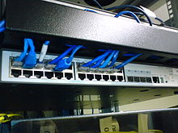

Network Switch

Slide 36
Network Bridge
A network bridge is a network device that connects multiple network segments.
A network bridge is software or hardware that connects two or more networks so that they can communicate.
People with home or small office networks generally use a bridge when they have different types of networks but they want to exchange information or share files among all of the computers on those networks.
Here's an example. Let's say you have two networks: in one, the computers are connected with cables; and in the other, the computers are connected using wireless technology. The wired computers can only communicate with other wired computers, and the wireless computers can only communicate with other wireless computers. With a network bridge, all of the computers can communicate with each other.

Slide 37
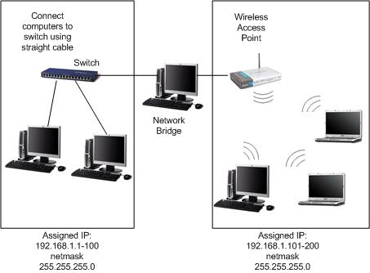

Slide 38
Router
A router connects two or more different networks &forwards data packets btn them.
They forward packets from one router to another through an internetwork until it reaches its destination node. Forwarded from one line by a routing table or policy based on the network address information.
Home & small office routers connects to Internet via an ISP. Enterprise routers, connect large business or ISP networks to fast optical fibres (Internet backbone)
A router may integrate a firewall, VPN handling, and other security functions.
Typically dedicated hardware devices, but software-based routers exist.

Slide 39
GATEWAY
Network node equipped for interfacing with another network that uses different communication protocols.
May have two different hardware interfaces e.g. Wireless LAN and Ethernet (LAN)
Cloud gateway - translates cloud storage APIs such as SOAP or REST (public cloud) to block-based storage protocols (private cloud) – data protection.
IoT (modular/embedded) gateway – bridges gap between nodes (factory, home, etc.); the Cloud (data collection, storage &manipulation); and the local or offline (field) processing equipment (smartphones, tablets etc.)
software-based? Read about Software Defined Networking and Virtualisation

Slide 40
CABLES
Media | Bandwidth | Distance
Coaxial (thick/thinnet) | 10 Mbps | (185, 500)
Cat 3 -UTP | 10 Mbps | 100m
Cat 5 - UTP | 100 Mbps | 100m
Cat 5e/6/7 | 1 Gbps | 100m
SMF/MMF | 1-10bps | 0.2-40km

Slide 41
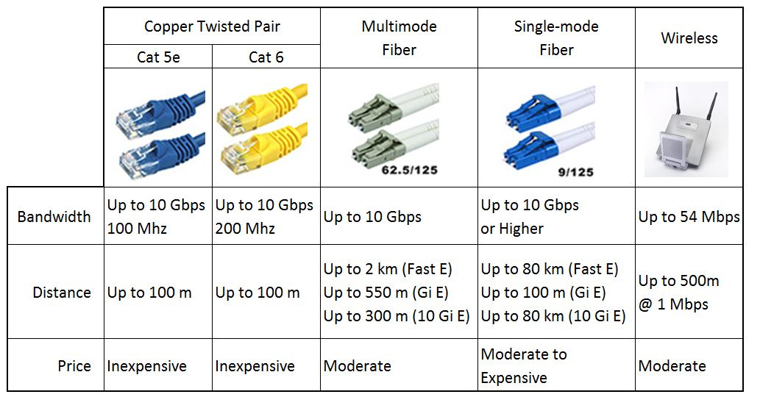
CABLES

Slide 42
Router
Read about SDN, Routers, Switches
Read about details of categories of Ethernet cables

