Slide 1
COMPUTER ARCHITECTURE
Harvard and von neumann

Slide 2
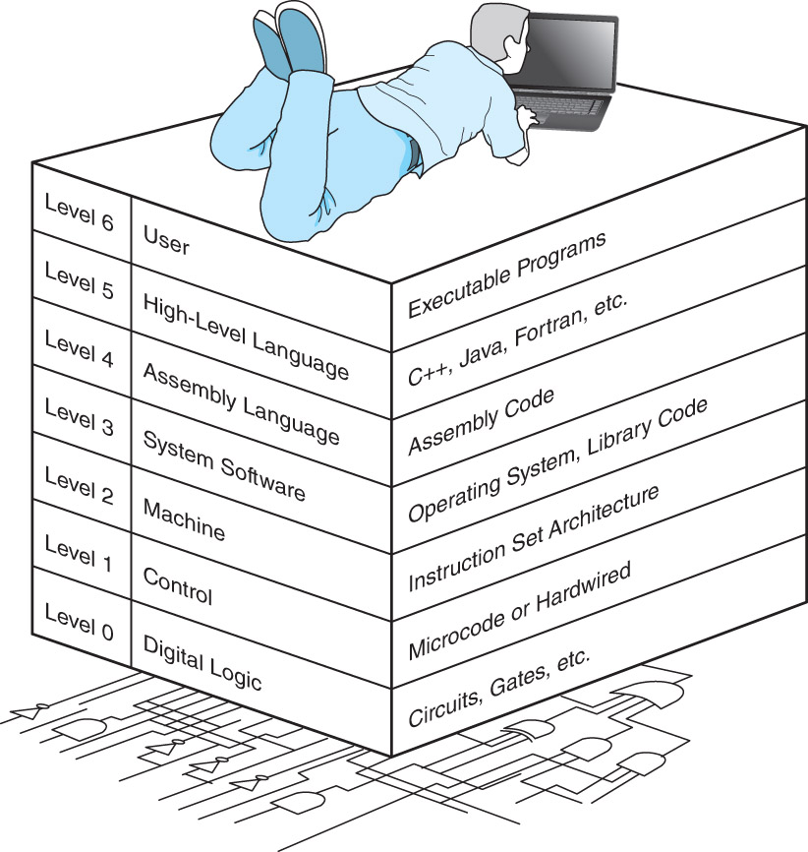
Abstraction of computing

Slide 3
Overview
Architecture (Machine organization) overview
CPU
Harvard
von Neumann
CISC vs. RISC

Slide 4
Computer COMPONENTS
Major components of a computer
Central Processing Unit (CPU)
memory
Bus
to move information from one component to another
divided into three sub-buses, one each for data, addresses and control signals
Peripheral devices

Slide 5
CPU
The Central Processing Unit ( CPU)
Often referred to as the “brain” of the computer.
Responsible for controlling all activities of the computer system.
CPU are mounted is mounted on a Motherboard along with most of other electronics
Features
performs arithmetic and logical operations
synchronous operation

Slide 6
CPU
The three major components of the CPU are:
1. Arithmetic Unit (Computations performed)
Accumulator (Results of computations kept here)
2. Control Unit (Has two locations where numbers are kept)
Instruction Register (Instruction placed here for analysis)
Program Counter (Which instruction will be performed next?)
General-purpose registers, etc.
3. Instruction Decoding Unit (Decodes the instruction)

Slide 7
memory
oprn
addr 1
Memory
stores programs and data
organized as
bit
byte = 8 bits (smallest addressable location)
word = 4 bytes (typically; machine dependent)
instructions consist of operation codes and addresses
oprn
addr 1
addr 2
oprn
addr 1
addr 2
addr 3

Slide 8
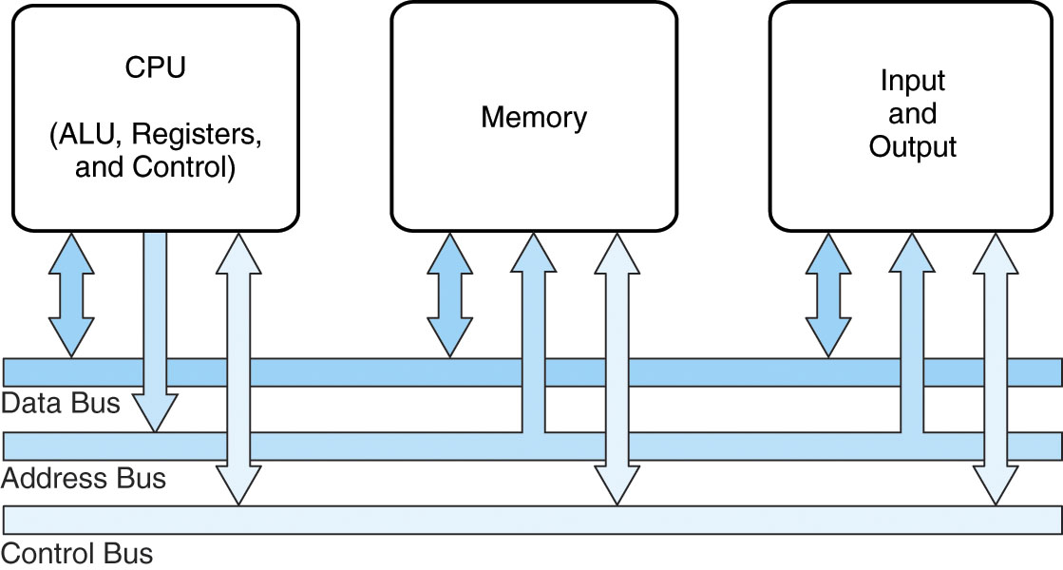
Computer COMPONENTS
Major components of a computer
Central Processing Unit (CPU)
memory
Bus or I/O System
to move information from one component to another
divided into three sub-buses, one each for data, addresses and control signals
*Peripheral devices e.g. secondary storage
v

Slide 9
BUSES
Function
to move information from one component to another
divided into three sub-buses, one each for data, addresses and control signals
Types
Address bus
Data bus
Control Bus
v

Slide 10
Computer Architecture
Architecture is concerned with
internal structures of each
Interconnections - speed and width
relative speeds of components
Balance is often critical execution speed and connections

Slide 11
Von Neumann
Institute for Advanced Studies machine (1947)“von Neumann machine”
This model of the typical digital computer is often called the von Neumann computer.
Programs and data are stored in the same memory: primary memory.
The computer can only perform one instruction at a time.
Separate CPU and memory distinguishes programmable computer.
Memory holds data, instructions.
Central processing unit (CPU) fetches instructions from memory.
ALU performs transfers between memory and I/O devices
note two instructions per memory word
Notes:
Named after John von Neumann,
Princeton, he designed a
computer architecture whereby
data and instructions would be
retrieved from memory,
operated on by an ALU, and
moved back to memory (or I/O)
This architecture is the basis for
most modern computers (only
parallel processors and a few
other unique architectures use
a different model)
Hardware consists of 3 units
CPU (control unit, ALU, registers)
Memory (stores programs and data)
I/O System (including secondary storage)
Instructions in memory are executed sequentially unless
a program instruction explicitly changes the order

Slide 12
Von Neumann
Named after John von Neumann, Princeton, he designed computer architecture whereby data and instructions would be retrieved from memory, operated on by an ALU, and moved back to memory (or I/O)
This architecture is the basis for most modern computers (only parallel processors and a few other unique architectures use a different model)
Hardware consists of 3 units: CPU (control unit, ALU, registers) , Memory (stores programs and data) and I/O System (including secondary storage)
Instructions in memory are executed sequentially unless a program instruction explicitly changes the order
Notes:
Named after John von Neumann,
Princeton, he designed a
computer architecture whereby
data and instructions would be
retrieved from memory,
operated on by an ALU, and
moved back to memory (or I/O)
This architecture is the basis for
most modern computers (only
parallel processors and a few
other unique architectures use
a different model)
Hardware consists of 3 units
CPU (control unit, ALU, registers)
Memory (stores programs and data)
I/O System (including secondary storage)
Instructions in memory are executed sequentially unless
a program instruction explicitly changes the order

Slide 13
VNA
Primary Memory
Input
Units
CPU
(Central Processing Unit)
Output
Units
Arithmetic - Logic Unit
main memory
Input- Output Equipment
op code
address
Program Control Unit

Slide 14
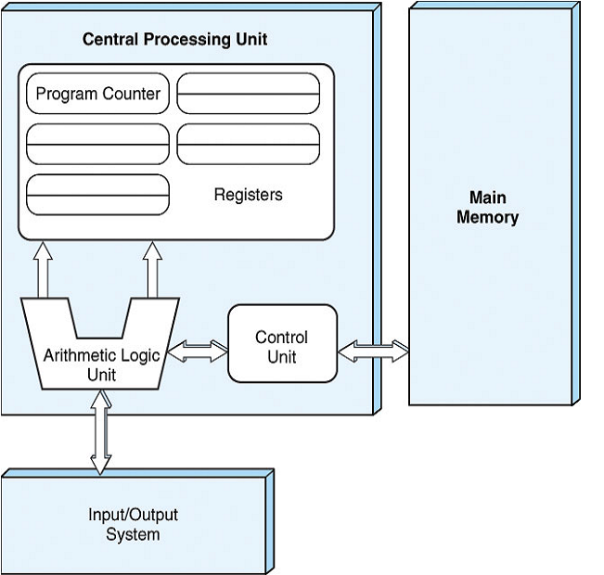

Slide 15
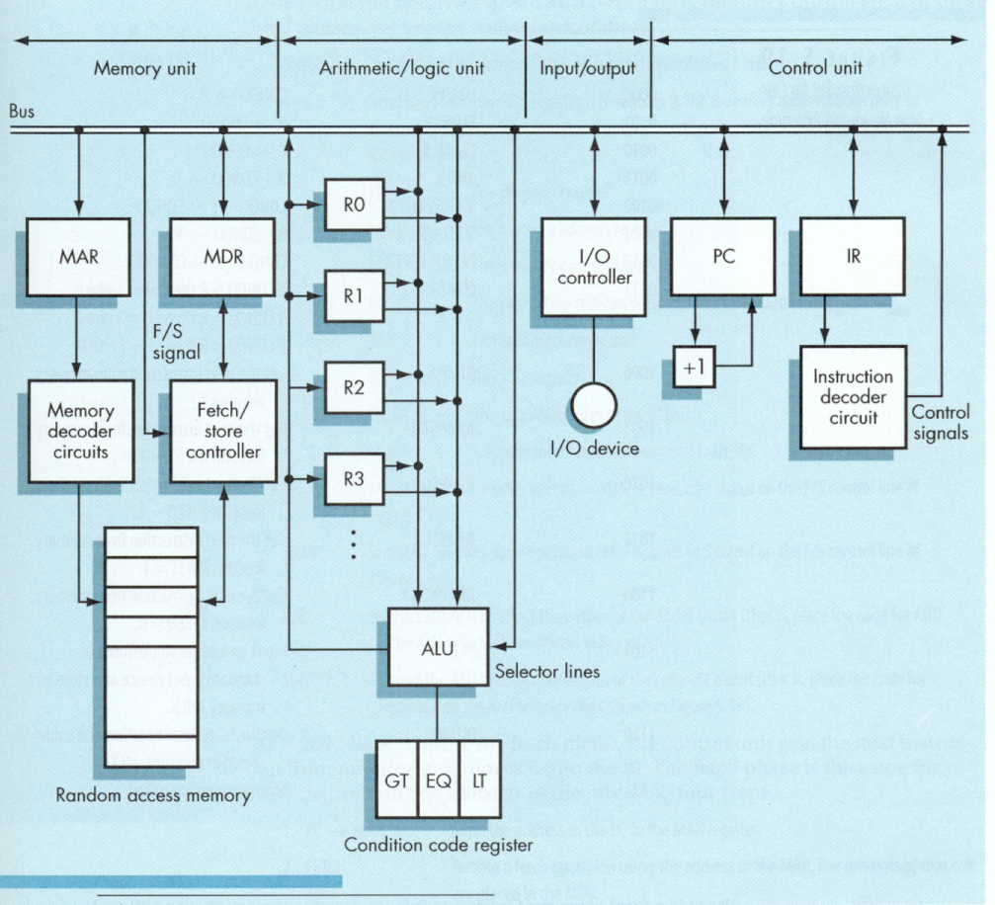

Slide 16
VARIATIONS
single pathway used to move both data and instructions between memory, I/O and CPU
the pathway is implemented as a bus
the single pathway creates a bottleneck
known as the von Neumann bottleneck
A variation of this architecture is the Harvard architecture which separates data and instructions into two pathways
Another variation, used in most computers, is the system bus version in which there are different buses between CPU and memory and memory and I/O

Slide 17
OPS
The von Neumann architecture operates on the fetch-execute cycle
Fetch an instruction from memory as indicated by the Program Counter register
Decode the instruction in the control unit
Data operands needed for the instruction are fetched from memory
Execute the instruction in the ALU storing the result in a register
Move the result back to memory if needed

Slide 18
Harvard architecture
Harvard architecture is a computer architecture with physically separate storage and signal pathways for instructions and data.
Originated from Harvard Mark I relay-based computer,
stored instructions on punched tape (24 bits wide) and data in electro-mechanical counters (23 digits wide).
had limited data storage, entirely contained within the data processing unit,
provided no access to the instruction storage as data,
made loading and modifying programs an entirely offline process.

Slide 19
The Harvard Architecture (2)
In a computer with a von Neumann architecture (and no cache), the CPU can be either reading an instruction or reading/writing data from/to the memory.
Both cannot occur at the same time since the instructions and data use the same bus system.
In a computer using the Harvard architecture, the CPU can read both an instruction and perform a data memory access at the same time, even without a cache.
A Harvard architecture computer can thus be faster for a given circuit complexity because instruction fetches and data access do not contend for a single memory pathway.

Slide 20
The Harvard Architecture (3)
In a Harvard architecture, there is no need to make the two memories share characteristics. In particular, the word width, timing, implementation technology, and memory address structure can differ.
In some systems, instructions can be stored in read-only memory while data memory generally requires read-write memory.
Instruction memory is often wider than data memory.

Slide 21
Harvard architecture
address
CPU
data memory
data
PC
address
program memory
data

Slide 22
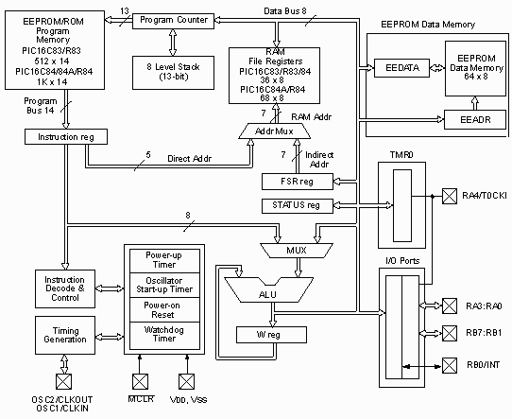
Harvard Architecture Example
Block Diagram of the PIC16C8X
Notes:
http://www.seattlerobotics.org/encoder/may97/picchip.html

Slide 23
Modified Harvard Architecture
The Modified Harvard architecture is very like the Harvard architecture but provides a pathway between the instruction memory and the CPU that allows words from the instruction memory to be treated as read-only data.
This allows constant data, particularly text strings, to be accessed without first having to be copied into data memory, thus preserving more data memory for read/write variables.
Special machine language instructions are provided to read data from the instruction memory.
Standards-based high-level languages, such as the C language, do not support the Modified Harvard Architecture, so that in-line assembly or non-standard extensions are needed to take advantage of it.
Most modern computers that are documented as Harvard Architecture are, in fact, Modified Harvard Architecture.

Slide 24
von Neumann vs. Harvard
Harvard can’t use self-modifying code.
Harvard allows two simultaneous memory fetches.
Most DSPs use Harvard architecture for streaming data:
greater memory bandwidth;
more predictable bandwidth.

Slide 25
CISC v RISC
CISC = Complex Instruction Set Computer
RISC = Reduced Instruction Set Computer

Slide 26
RISC vs. CISC
Complex instruction set computer (CISC):
many addressing modes;
many operations.
Reduced instruction set computer (RISC):
load/store;
pipelinable instructions.

Slide 27
CISC vs. RISC (continued)
Historically, machines tend to add features over time
instruction opcodes
IBM 70X went from 24 opcodes to 185 in 10 years
same time performance increased 30 times
addressing modes
special purpose registers
Motivations are to
improve efficiency, since complex instructions can be implemented in hardware and execute faster
make life easier for compiler writers
support more complex higher-level languages

Slide 28
CISC vs. RISC
Examination of actual code indicated many of these features were not used
RISC advocates proposed
simple, limited instruction set
large number of general purpose registers
and mostly register operations
optimized instruction pipeline
Benefits should include
faster execution of instructions commonly used
faster design and implementation

