Slide 1
CMP 2203
LECTURE 10

Slide 2
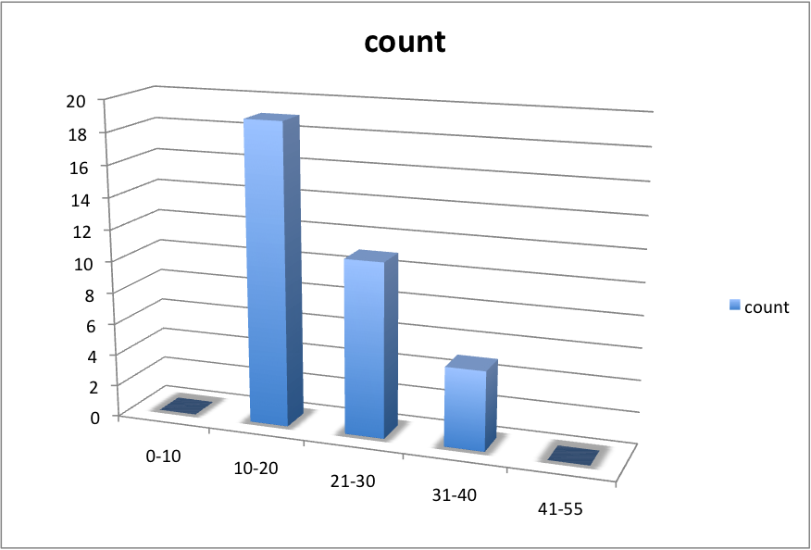
CAT 1 Performance

Slide 3
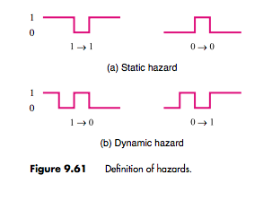
Hazards
We don’t want glitches in signals to occur
Designer should be aware of possible sources in circuit and avoid them
Glitches caused by the structure of a given circuit and propagation delays are called hazards
Static hazards: exist if a signal is supposed to remain at a certain logic value when an input variable changes its value but instead undergoes a momentary change
Dynamic hazards exist if a change from one logic value to another produces oscillation before signal remains stable

Slide 4
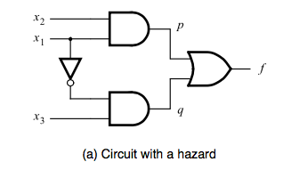
Static Hazards
Consider circuit indicated
Assume x₁ = x₂ = x₃ = 1; f =1
Now let x₁ change from 1 to 0; f should remain 1
Due to propagation delay, x₁ change will be seen at p before q because of extra NOT gate
For a short time p and q will be 0, f = 0

Slide 5
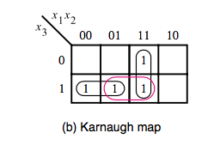
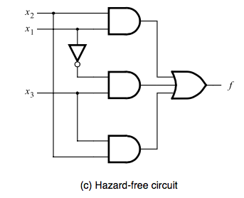
Static Hazards
Observing Karnaugh map, hazard occurs during transition from
Potential hazard exists whenever two adjacent 1’s in Karnaugh map are not covered by a single product term
Eliminate them by adding a loop to include adjacent 1s

Slide 6
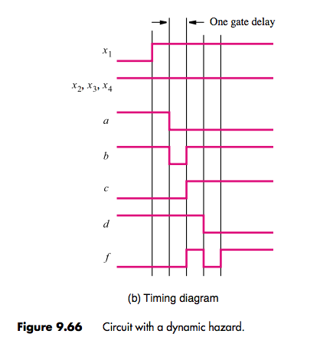
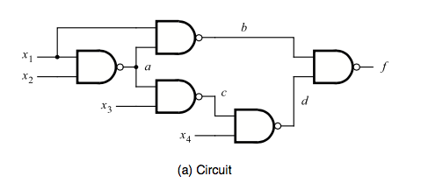
Dynamic Hazards
Causes glitches on 0 to 1 or 1 to 0 transitions of an output signal
Example: time between two lines = one gate delay
Found in multilevel circuits obtained using factoring or decomposition
Circuit with dynamic hazard must also have a static hazard
Hard to detect and solve
Use two-level circuits and ensure no static hazards

Slide 7
Significance of Hazards
A glitch in an asynchronous sequential circuit can cause it to enter an incorrect state and become stable in that state
Circuits that generate next state variables must be hazard free
We did not worry about this in combinational circuits. Why? Homework

Slide 8
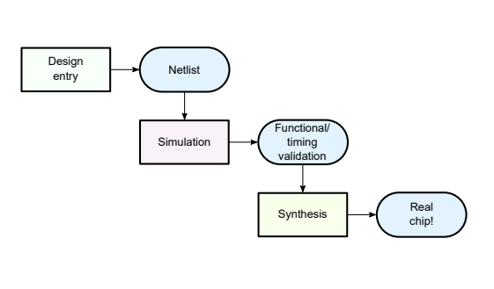
Digital Design Process
Source: http://www.fke.utm.my/nadzir/courses/SKEE2263/notes/bm01-intro.pdf
Notes:
Design entry: schematic capture / HDL
Design files compiled to netlists
Netlists simulated

Slide 9
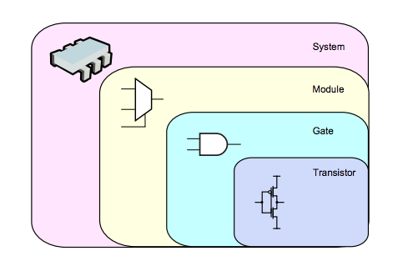
Levels of Abstraction
Levels | Physical Objects | Behavioral forms
System | Processors, controllers, memory etc | Executable programs
Register | Adders, comparators, registers, counters | Instructions, Register Transfer Level, flow charts
Gate | Gates, flip-flops | Boolean equations, finite state machines
Transistor | Transistors, resistors, capacitors | Current- voltage equations
Abstraction: associating higher level behavior with a component to hide the complex inner details of that component
Free designer from “nitty gritty”
Notes:
e.g. group transistors to gates: don’t just say e.g. OR gate is a group of transistors but we attached high level behavior to it
U need an adder. You know it adds two numbers. Use it in ur circuit. Don’t need to know if inside is a ripple carry adder or some other complex development. You just need to know its delay, size etc.

Slide 10
Digital System Design
Hierarchy: divide system into modules, and further subdividing them until the pieces are manageable
Modularity: modules have well defined functions and interfaces so can work together
Regularity: tries to unify different modules. Common modules re-used to minimize distinct modules that must be designed

Slide 11
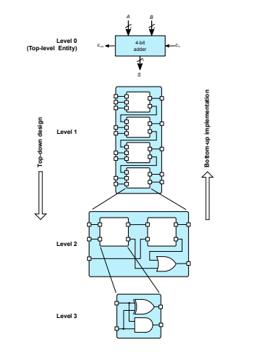
Top-Down
4-bit adder
Start with high level system design
Define subsystems with specific tasks
Identify major blocks and, define inputs an outputs of each
Split into smaller, more detailed sub systems until simple enough to substitute primitive blocks i.e. gates and flip-flops
http://www.fke.utm.my/nadzir/courses/SKEE2263/notes/bm01-intro.pdf

Slide 12
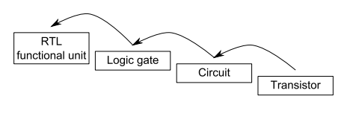
Bottom Up
Build components from primitive level first
Test
When errors eliminated, store components in library module
Build higher level components using library modules
Keep adding modules to library
Complete when entity level is reached

Slide 13
Digital System Design
Both methods used in digital design
System designer creates RTL models from high-level specification
Breaks down high level specification to small set of functions which can be realized with simple circuit
When all functions defined, each is realized with a circuit module that is designed, implemented and tested individually ( bottom-up)

Slide 14
Divide and Conquer
Break up a complex circuit into pieces called blocks
Interconnect the blocks to form the circuit
Carefully define the functions of each block so that function formed by interconnecting blocks obeys initial circuit specification
Repeat as necessary

Slide 15
Building Blocks
Review:
Adders
Shifters
Registers
ALU
From previous lectures!

Slide 16
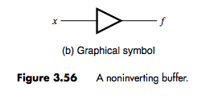
Buffers
Logic gate with one input x and one output f, which produces f = x
Used in circuits which drive large capacitive loads hence transistors used are larger than those in usual logic gates
Inverting buffer produces same output as inverter but built with larger transistors. Same symbol as NOT gate
Used to improve speed of circuits, can handle large amounts of current

Slide 17
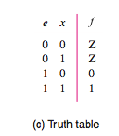
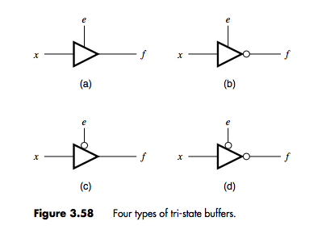
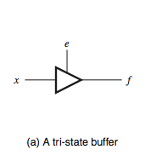
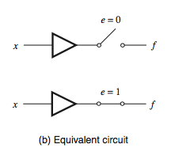
Tri-state Buffer
One input, one output and a control (enable) input
Enable input used to determine if buffer produces an output signal or not
Tri state because 2 output states and a third sate Z called high impedance state which produces no output signal
4 types:
output when
output when
and
produce output when enable is 0 i.e. enable is active low

Slide 18
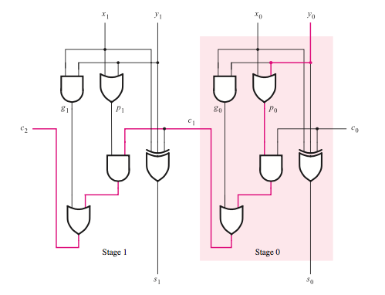
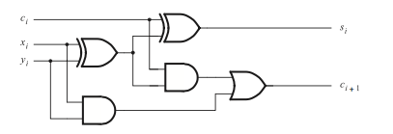
Design of Arithmetic Circuits: Schematic Capture
Draw schematic that contains necessary logic gates
E.g. n-bit adder
Draw a schematic that represents a full adder
Draw a higher level schematic that connects together n instances of the full adder

Slide 19
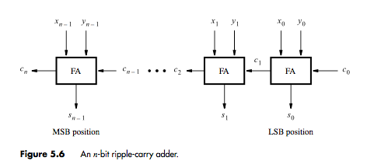
Schematic Capture
Method is cumbersome especially when dealing with large number of bits
Better approach is to use pre-defined sub-circuits
Tools provide commonly used blocks in library

Slide 20
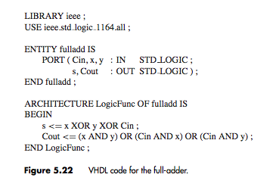
Circuit Design using VHDL
Create VHDL entity for a full-adder
Create higher level entity that uses n instances of the adder
3 inputs: C_{in}, x and y
Two ouptuts: s and C_{out}
s and C_{out} are described by logic equations

Slide 21
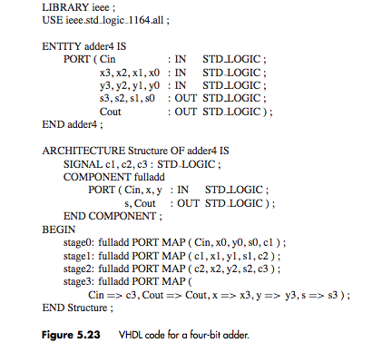
Circuit Design using VHDL
4-bit adder uses full adder entity as a sub-circuit
Homework : Register Transfer Level Code

Slide 22
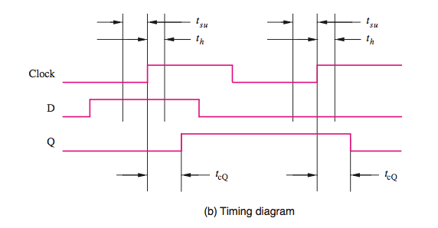
Timing Recap
Setup time, hold time: minimum time that D signal must remain stable before and after clock edge
Data input must be stable during these periods before and after clock edge
Propagation delay
Metastability
Review from previous lecture

Slide 23
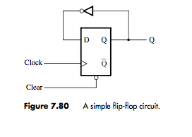
Timing analysis of Flip-Flop Circuits
Consider circuit below
Calculate the maximum clock frequency for which the circuit will operate correctly and if there are any hold time variations
Assume t_{su} = 0.6ns, t_{h} = 0.4ns and 0.8ns ≤ t_{cQ} ≤ 1.0 ns
To calculate the minimum period of clock signal, consider all paths which start and end at flip-flops
Only 1 path from data loading into flip-flop at +ve clock edge , propagate to Q after delay, pass through not gate and appear at D input
Note: Consider max. t_{cQ} since need to know longest delay in circuit. Assume delay for gate = 1 + 0.1k; k is the number of inputs

Slide 24
Timing analysis of Flip-Flop Circuits
Hold time violations:
Consider shortest delay from +ve clock edge to change in value of D input
=0.8+1.1=1.9ns > t_{h} so no hold time violation

Slide 25
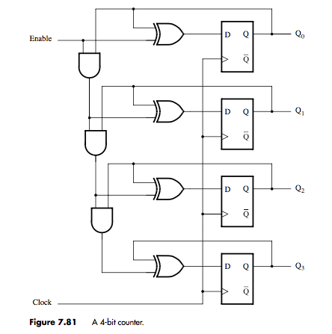
Example 2
Identify longest path i.e. critical path: determines clock frequency
Critical path is from Q₀ to Q₃
Clock to delay for Q₀, 3 AND gates, 1 XOR gate and setup time of flip-flop Q₃

Slide 26
Example 2
Shortest paths are form each flip flop to themselves
t_{cQ} + t_{XOR} = 0.8 + 1.2 = 2 ns ; no hold time violations
What if there is a delay in arrival of clock signal at one flip flop? E.g. Q₃
This is called clock skew
Skew in this case will reduce delay because it provides additional time before data is loaded into the flip flop and delay becomes for t_{skew} = 1.5 ns
The critical path changes to Q₀ to Q₂ giving F_{max} = 192.31 MHz
If skew was negative i.e. clock arrives earlier at Q₃, F_{max} would have been reduced
Hold time for flip flop Q₃ also increase to t_{h} + t_{skew}
In a circuit, time hold violations mean circuit will not work reliably for any clock frequency
Need synchronization

Slide 27
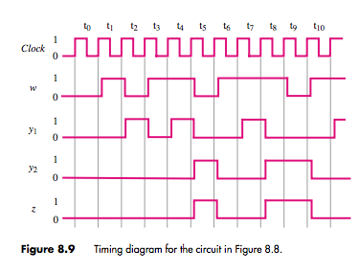
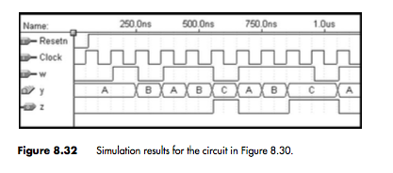
Timing Simulations
Useful for testing designs
Gives waveforms corresponding to timing diagrams
Can compare with timing diagram to verify output

Slide 28
Programmable Logic Devices
Type of application specific integrated circuits (ASICs)
Contain several gates
Three types: Simple PLDs, Complex PLDs and Field Programmable Gate Arrays
CPLDs and FPGAs commonly referred to as high-capacity PLDs.
SPLDs have ≤ 600 gates and CPLDs have hundreds of thousands of gates
SPLDs are cheaper and less complex and have fewer internal programmable signal connections

Slide 29
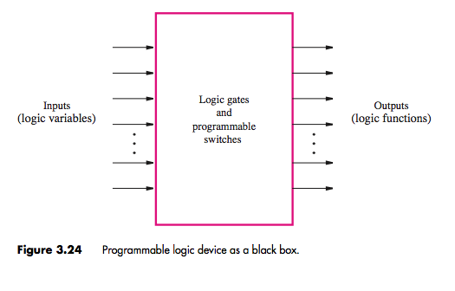
Programmable Logic Devices
General purpose chip
Consists of several logic elements (gates and programmable switches) which can be customized in many different ways
Switches allow logic in PLD to be connected together in required way

Slide 30
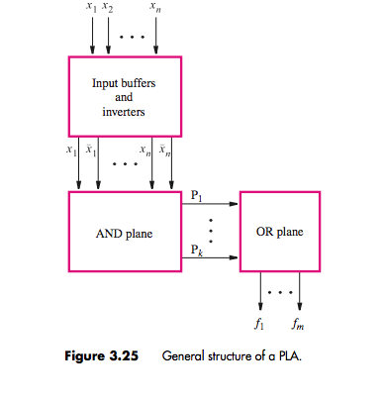
Programmable Logic Array (PLA)
First type developed
Bases on fact that logic functions result from “sum-of-products”
Inputs to PLA pass through buffers which provide both true value and complement of inputs
Fed to AND array and then input to OR array
Each connection to an AND gate is programmable

Slide 31
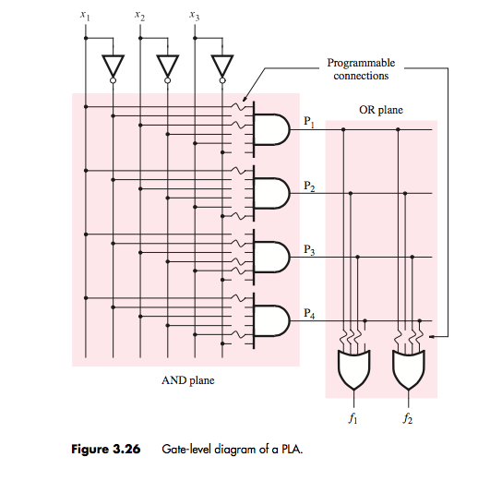
PLA
Can realize any output function combination
Limited by size of AND plane (only 4 product terms in this case
Typical commercial PLAs have 16 inputs, 32 product terms and 8 outputs

Slide 32
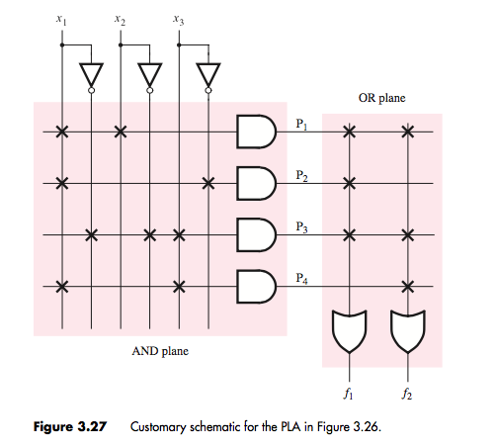
PLA
Typical drawing in literature for larger chips is as below
Gates depicted with single line
Possible inputs to gate are shown with vertical lines
X indicates programmable connection

Slide 33
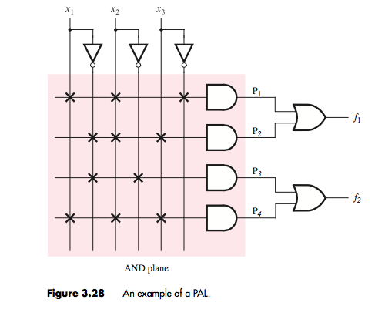
Programmable Array Logic (PAL)
PLA – both AND and OR planes programmable
Switches at time were hard to manufacture correctly and reduced speed of circuits
Developed PAL
Only AND plane programmable
Simpler to manufacture, cheaper and better performance BUT less flexible due to hardwired OR gate inputs
To compensate for flexibility, manufactured in various sizes
OR gate output can be connected to other circuitry before output pin. Called macro cell

Slide 34
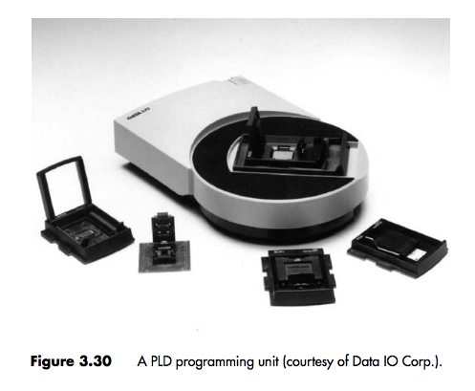
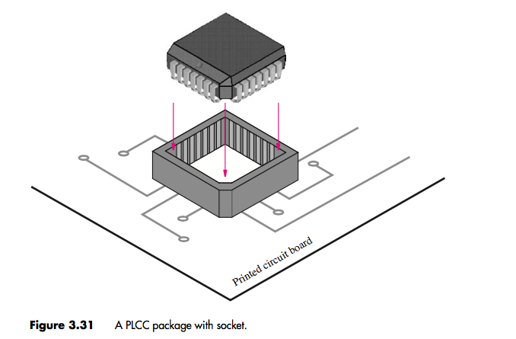
Programming PALs and PLAs
Use CAD tool
Several switches: cannot be manually specified by user
Connect computer to programming unit
CAD tool generates a programming file/ fuse map
Place PLD in programming unit
File transferred to chip
Simple PLDs
This procedure assumes chip is removable. Provide socket on PCB where chip fits
Also in-system programming (ISP) possible for larger chips : program while still attached to board

Slide 35
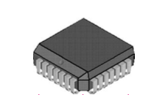
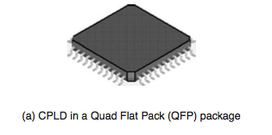
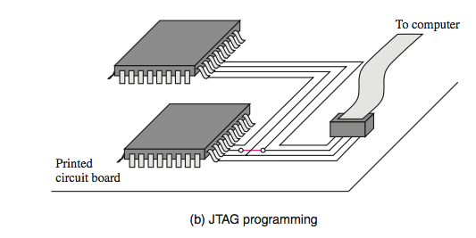
Complex PLDs
For circuits with many inputs and outputs
Can use multiple SPLDs or CPLDs
CPLD has many blocks on a chip interconnected by wires
Each block is similar to PAL or PLA
Each PAL-like block also connected to I/O block which provides the input and output pins
Commercial CPLDs can contain >100 PAL-like blocks
Programmed with ISP: many pins which are fragile; removing not a good option
Also sockets are expensive
Include connector on PCB, connected to computer via a cable
Programming circuitry standardised by IEEE called a JTAG port

Slide 36
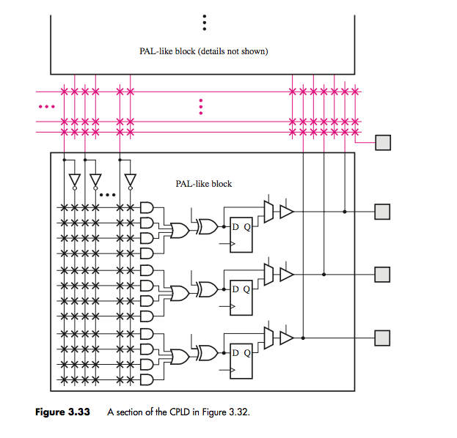
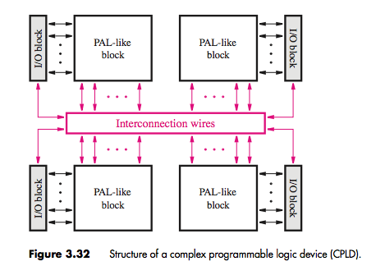
CPLDs
Macrocell in example includes XOR, flip flop, multiplexer, tri-state buffer

Slide 37
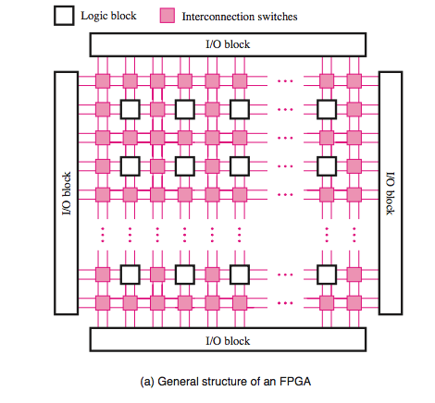
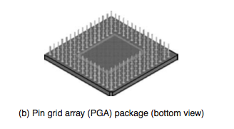
FPGAs
Larger logic capacity than S/CPLDs
Don’t contain AND or OR planes but logic blocks which implement required functions
Consists of: logic blocks, I/O blocks for connecting to pins and interconnection wires+ switches
Logic blocks arranged in 2D-array and wires organized in routing channels between rows and columns of logic blocks
Boxes hold switches which connect block I/O terminals to interconnection wires , one interconnection wire to another (e.g. vertical to horizontal wire) and I/O blocks to wires

Slide 38
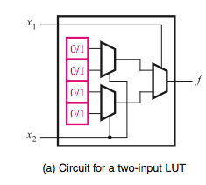
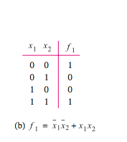
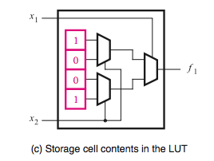
FPGAs
Each logic block has small number of inputs and outputs
Logic blocks are usually lookup tables (LUTs) containing storage cells used to implement a small logic function
Each cell can hold 1 value
Stored value is output of cell
E.g. 2 input LUT below can be used to implement truth table function
Storage cells in LUT are volatile (need reprogramming when power supply to chip is turned off)
Usually include a PROM which stores data permanently on chip and loads content to storage cells on FPGA when powered on

Slide 39
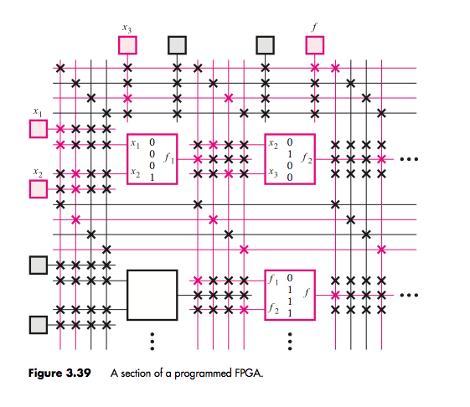
FPGA

Slide 40
Handout and Further Reading
Brown chapter 3, 7 and 9
Verilog and VHDL practice : Use online resources ➔I will not teach this in class
Last Lecture 12th April
CAT 2: 17th April : All material up-to last lecture
Use remaining time after next week to study for your exam and to complete your LABs

