Slide 1
CMP 2203
LECTURE 11

Slide 2
Testing Logic Circuits
Why do we test? What is testing?
Ned to verify final circuit achieves design objectives (functional and timing specs.)
Ensure manufacturing process hasn’t introduced flaws (need to test all copies of circuit)
Suspected faults in installed equipment in field
Testing
Applies pre-defined sets of inputs (tests) to a circuit and compares observed outputs with pattern expected from a correctly functioning circuit.
Defining small number of test to adequately verify correctness of circuit is a daunting task.

Slide 3
Fault Model
Possible circuit faults are with wires and transistors: broken switches, shorted wires, broken wires, unwanted connections between wires etc.
Stuck-at-Model
Assume all faults manifest themselves as some wires (gate inputs or outputs) being stuck at logic level 0 or 1
If a wire w has an undesirable signal that is always equal to logic 0, then w is stuck-at-0 (w/0). Similar for 1

Slide 4
Testing Logic Circuits
Single and multiple Faults can occur in a circuit
Working with multiple faults is difficult because each fault can happen in many different ways.
From experience, tests which can detect single faults can also detect multiple faults
A fault is detected if the output value produced by a faulty circuit is different from the value produced by a working circuit when a test is applied at the input
A complete set of tests used for a given circuit is called a “test set”

Slide 5
Design for Testability
2 key considerations: observability and controllability
Ensure designer provides means of setting or resetting key nodes in the system (controllability) and observing the response at key points (observability).
Inputs to a device under test are subjected to a test pattern (test vector) which supplies a set of binary values to detect faults.
Test pattern generation is done using automatic test pattern generators (ATPGs)

Slide 6
Testing Combinational Circuits
Generate a set of test patterns which will detect all possible fault combinations
For N input circuit, generate all possible 2^{N} combinations and observe the outputs
Called exhaustive testing
Practical for small value of N

Slide 7
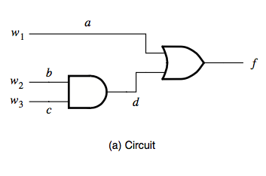
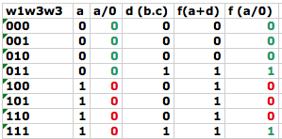
Testing Combinational Circuits
Apply test set that comprises all possible input violations
Check output values produced by all combinations in truth table
Luckily, no need to apply all 2^{N} valuations for N-input circuit
Example
Evaluate all cases for a/0 and compare with expected output
Only 3 cases give wrong answer
Testing 3 combinations will identify this fault
Repeat for other cases
Test set: [100, 101, 110]

Slide 8
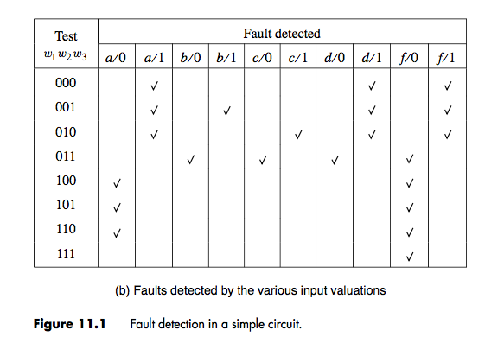
Testing Combinational Circuits
Minimal test set can be derived from table by inspection
Faults covered by one test must be included [001, 010, 011]
For remaining uncovered tests, chose arbitrarily since can be covered by multiple tests
Complete test set for this circuit can be {001,010,011,100 or 101 or 110}
Observe:
Test set generally smaller than 2^{N}
Still impractical for large circuits
Solution: Path sensitizing

Slide 9
Path Sensitizing
Select a path from the site of the possible fault through a sequence of gates leading to the output of circuitry under test
3 steps:
Manifestation: Specify input at site of assumed fault to generate a value opposite to assumed stuck at value: (0 for /1 and 1 for /0)
Propagation: Determine inputs of other gates so as to propagate fault along path to selected primary output. i.e. Set AND/NAND inputs to 1 and OR/NOR inputs to 0
Consistency (justification): trace backward to find values of other inputs, hence determine test vector

Slide 10
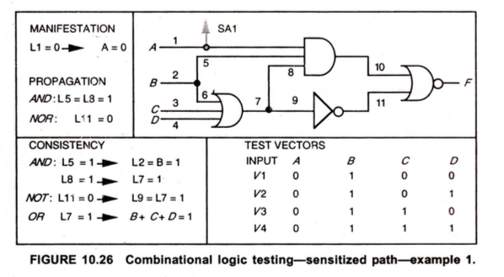
Example : Path Sensitizing
Draw this circuit on your own and follow the steps!

Slide 11
Example
Assume L1/1
Manifestation: Set to opposite value i.e. L1=0 ➔ A = 0
Propagation
We want to propagate fault along path 1-10-F
Set all other inputs (excluding those along path) to AND gate = 1 and OR = 0
L5, L8 =1 (AND)
L11 = 0 (OR)

Slide 12
Example
0
1
1
0
Assume L1/1
Manifestation: Set to opposite value i.e. L1=0 ➔ A=0
Propagation
We want to propagate fault along path 1-10-F
Set all other inputs (excluding those along path) to AND gate = 1 and OR = 0
L5, L8 =1 (AND)
L11 = 0 (OR)

Slide 13
Example
0
1
1
0
Consistency
L10 = 0 (L1.L5.L8)
L8 = L7 =L9 =1
L5 =L2=L6=1
L3+L4+L6=1
A=0; B=1; B+C+D=1 ➔TEST VECTOR
A | B | C | D
0 | 1 | 0 | 0
0 | 1 | 0 | 1
0 | 1 | 1 | 0
0 | 1 | 1 | 1

Slide 14
D-algorithm & PODEM
Homework

Slide 15
Testing Sequential Circuits
More difficult because of presence of memory elements
Circuit can therefore be in various states and response to externally applied inputs depends on state of the circuit
We could test by comparing behavior with functionality in state table BUT it is extremely difficult because we cannot observe state of circuit by looking at external pins
So how do we verify that the state we require was reached?
Better approach is to design sequential circuits such that they are easily testable

Slide 16
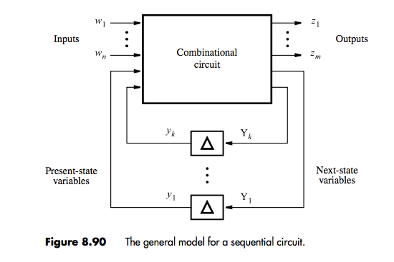
Design for Testability
Synchronous sequential circuit has combinational circuit that implements output and next state functions + flip flop which hold state information during clock cycle
Inputs are primary inputs w and present state variables y
outputs are primary outputs z and next state variables Y
Test combinational part as before
To observe values of next state outputs and to apply present state inputs, use multiplexers to select either test vector or usual state variable in normal operation

Slide 17
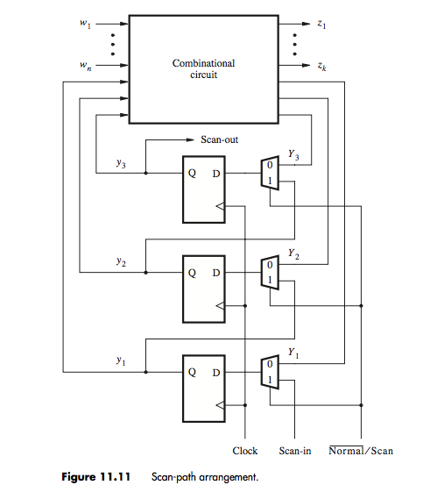
Scan-Path Technique
This technique configures the logic such that inputs and outputs of combinational circuit can be accessed and the storage elements reconfigured to form a shift register known as the scan path
Multiplexer applies flip flop input either for normal operation or testing using control signal normal’/scan
Normal operation: flip flop inputs are Y1 to Y3
Testing: scan in present state variables y1 to y3
Scan-in and scan-out pins are externally accessible

Slide 18
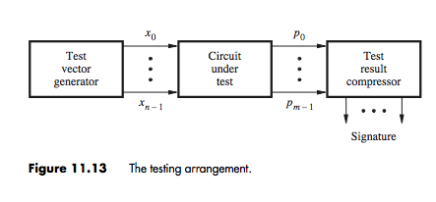
Built-in-self-test (BIST)
Before: applying external inputs and comparing results with expected behavior of the circuit
BIST Uses a test vector generator to produce test vectors that can be applied to circuit
Pre-determine response of circuit using simulator of CAD system and store response on chip so that it can be compared with test result
Use pseudo random generators

Slide 19
BIST
Not practical to store large number of test responses on chip
Compress results of tests into single pattern called a signature
Signature can be interpreted as result of all the tests done
Compare this pattern with the pre-determined one to test if circuit is functioning properly

Slide 20
Boundary Scan
A circuit can only be tested if we have access to primary inputs and outputs
If chips soldered onto a PCB, it becomes impossible to attach test pins to probes
Extend scan-path concept to to board level
Place a scan path cell (shift register) adjacent to each component pin and interconnect the cells so as to form a chain around the border for the circuit. BST circuits then connected together to form a single path.
Connect each primary input or output through D flip flop and provide for test mode in which all flip flops can be connected to a shift register.
Can then use shift register path to scan in and out test information via two pins (input and output).
Can connect output pin of one chip to input of another hence connecting all pins to a board-wide shift register
Approach used in IEEE Standard 11.49.1 (Read more about this)

Slide 21
Information
CAT 2 : 17th April, 10. A.M Sharp! ( 2 or 3 questions)
Students who were active in class will get 5 extra marks on both CATs
About the exam
5 questions; answer 4
1 number will be compulsory
Explain what you are doing. I will be testing your understanding of the material rather than your memory skills! (e.g. in your CAT a good number of you crammed the adder, XOR for the counter – Carry?? Sum??
Be clear and concise ( try not to story tell)
Use diagrams where possible
If you don’t know, you don’t know: try not to gamble annoys ➔ the examiner
Label ALL inputs and outputs correctly
If I have to guess what you are doing, you will not get full marks

Slide 22
References
Brown, Chapter 11
Douglas Pucknell, Kamran Eshraghian, Basic VLSI Design, Chapter 10

