Slide 1
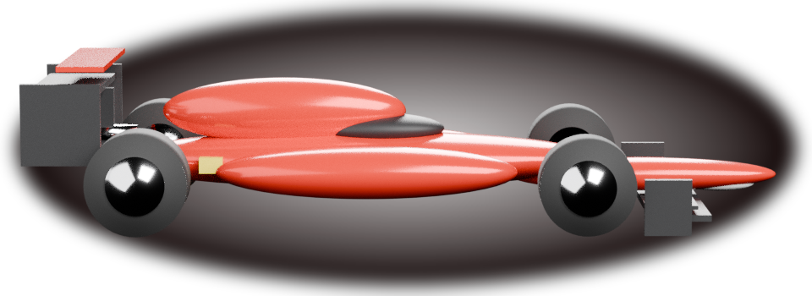
SEASON 2004
FERRARI
F2004
The most dominant car
Formula 1 has ever seen.

Slide 2
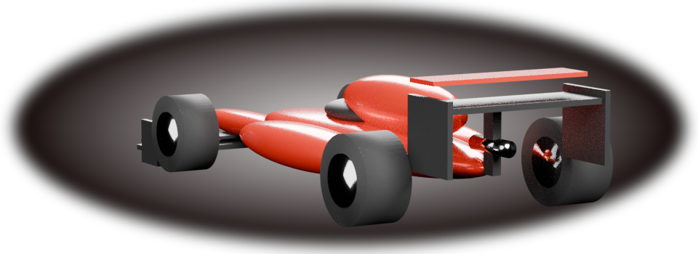
THE SEASON
Fifteen wins.
Eighteen races.
15 of 18 — no other constructor
won more than a single race.

Slide 3
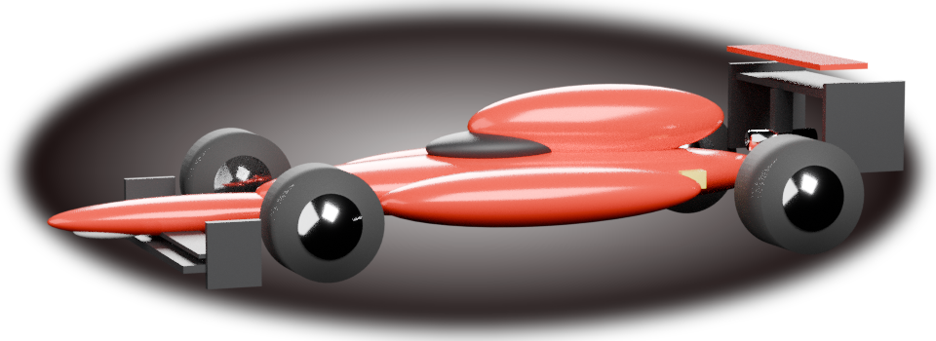
THE MACHINE
Built to be
unfollowable.
A V10 that screamed to 19,000 rpm
in an era of no substitutions.

Slide 4
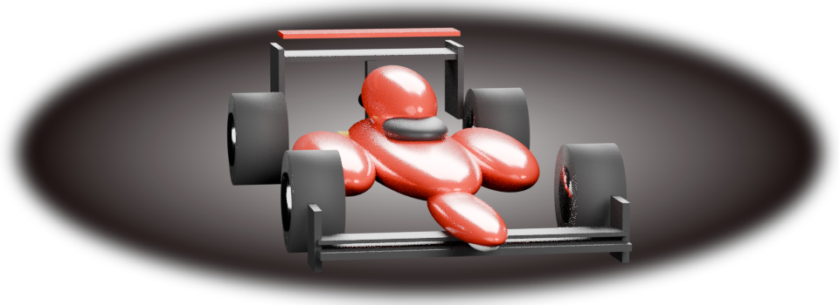
BY THE NUMBERS
Three figures.
865
horsepower
from 3.0 litres, no turbo
600
kilograms
fully fuelled, driver aboard
0.9
tonnes of downforce
more than the car weighs

Slide 5
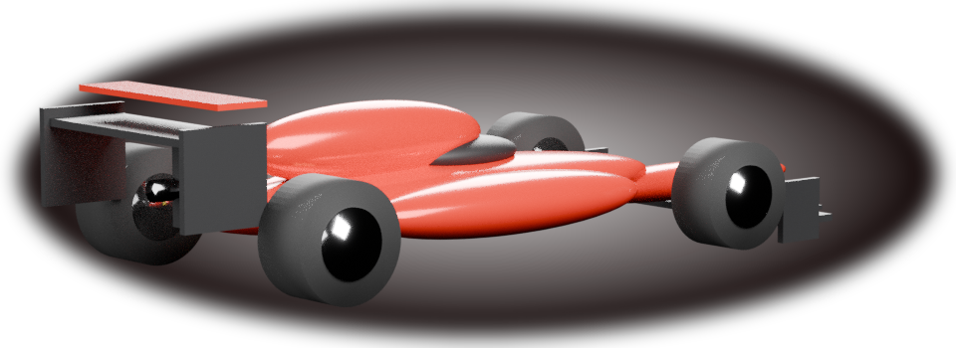
THE LEGACY
Built once.
Never matched.

