Slide 1
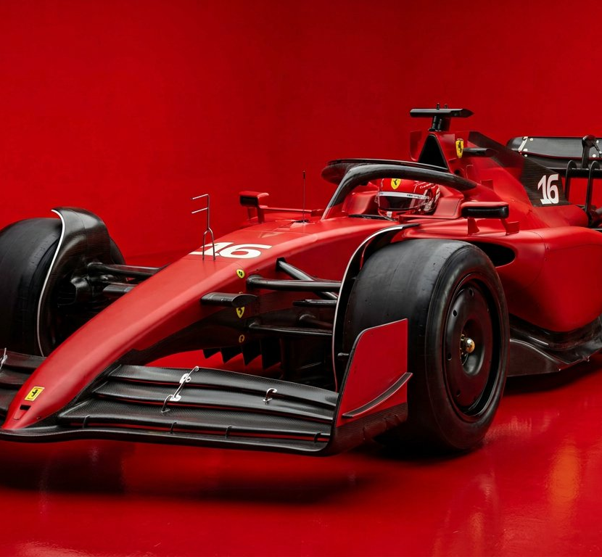
SEASON 2004
FERRARI
F2004
The most dominant car
Formula 1 has ever seen.

Slide 2
THE SEASON
Fifteen wins.
Eighteen races.
Ferrari
15
BAR Honda
1
Renault
1
Williams
1
15 of 18 — no other constructor
won more than a single race.

Slide 3
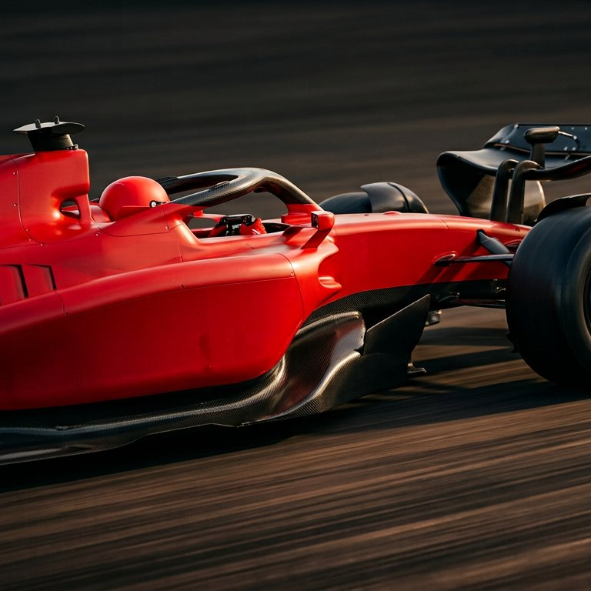
THE MACHINE
Built to be
unfollowable.
A V10 that screamed to 19,000 rpm
in an era of no substitutions.

Slide 4
BY THE NUMBERS
Three figures.
865
horsepower
from 3.0 litres, no turbo
600
kilograms
fully fuelled, driver aboard
0.9
tonnes of downforce
more than the car weighs

Slide 5
THE LEGACY
Built once.
Never matched.

