Slide 1
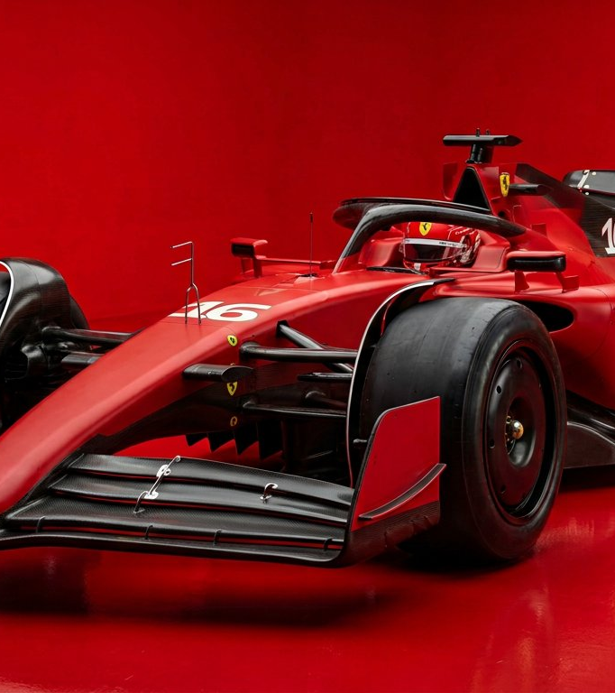
SEASON 2004
FERRARI
F2004
The most dominant car
in Formula 1 history.

Slide 2
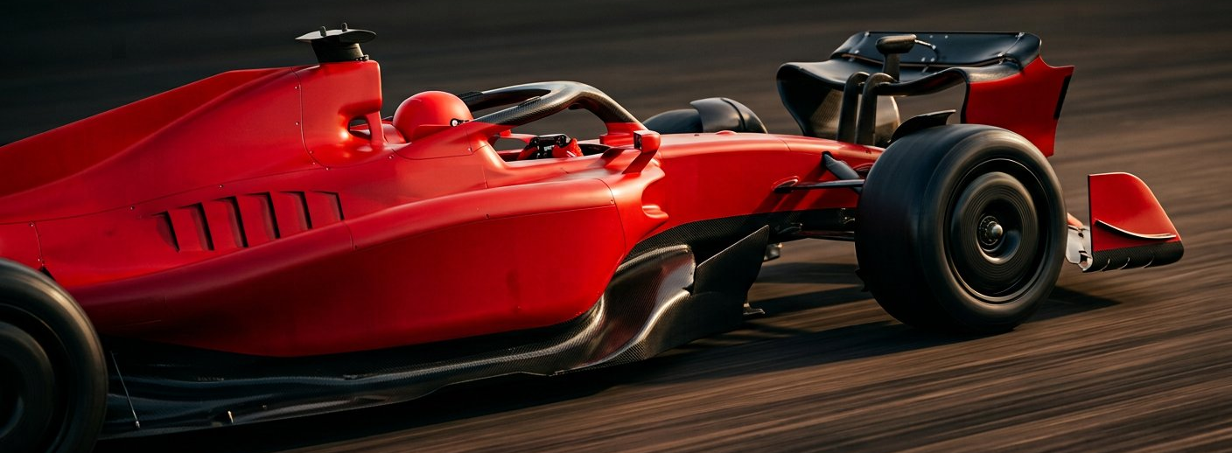
THE NUMBERS
15 wins from 18 races.
A season so complete it was never repeated.

Slide 3
UNDER THE SKIN
Power is nothing without grip.
865
600
0.9
horsepower
kg total
tonnes downforce
V10, naturally aspirated
with driver and fuel
generated by the wings
19,000 rpm
carbon monocoque
at maximum speed

Slide 4
THE LEGACY
Built once.
Never matched.

