Slide 1
DOWNFORCE
The invisible hand that wins races

Slide 2
DOWNFORCE
An F1 car at 250 km/h generates enough
downforce to drive on the ceiling.
NOT A METAPHOR
The wing pushes the car into the road harder
than gravity pulls it down.

Slide 3
DOWNFORCE
THE TRADE
THE ANSWER
More wing angle means more grip
Every track gets its own balance.
in the corners — and more drag
Monaco: maximum wing.
on the straights.
Monza: almost none.

Slide 4
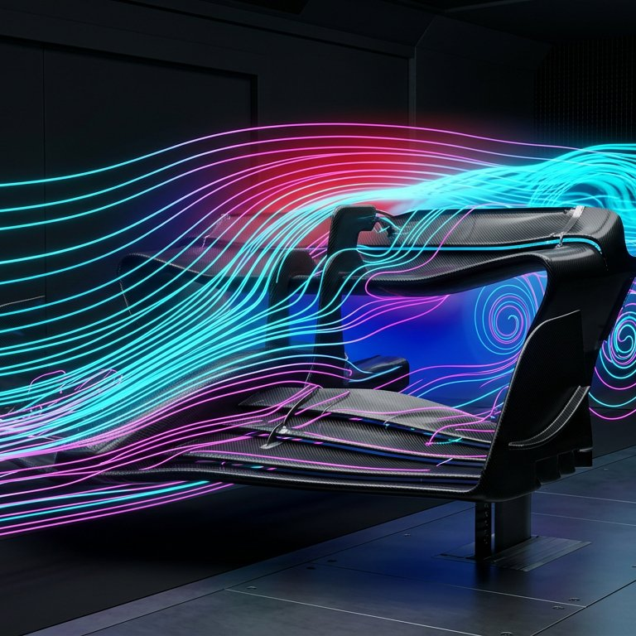
Thousands of runs until the air
SIMULATED
behaves exactly as intended.

Slide 5
It is air,
arranged.
142
118
96
61
Monaco
Hungary
Spa
Monza

