Slide 1
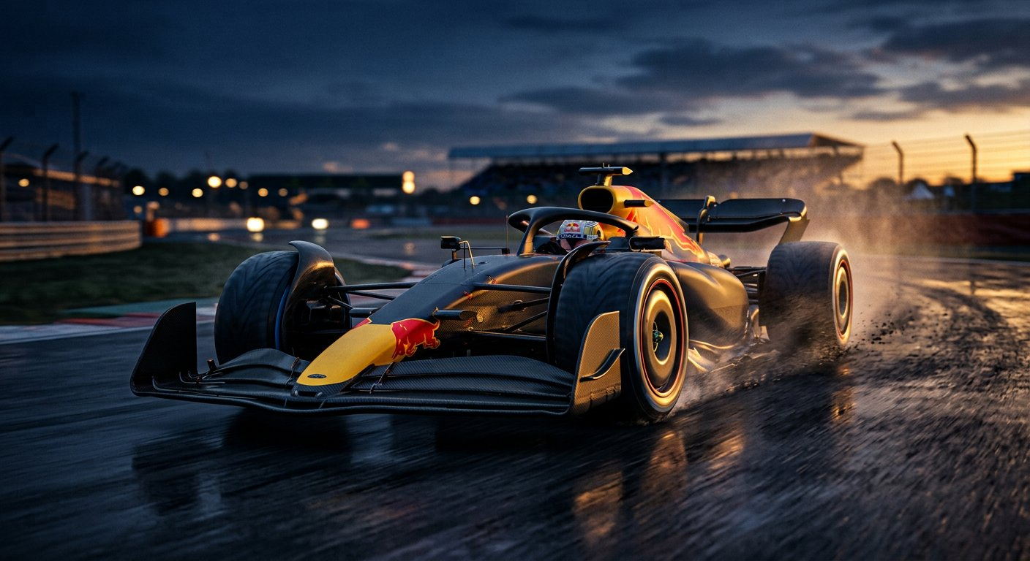
FORMULA 1 · 2026
THE SHAPE
OF SPEED
How aerodynamics quietly decides
a world championship
Generated locally · native PPTX · editable

Slide 2

THE PRINCIPLE
Air is not empty.
It is a tool.
A wing angled against the flow
pressure split
High above, low beneath
net force down
The car is pressed into the road
grip, for free
Computational flow visualisation · image generated locally

Slide 3
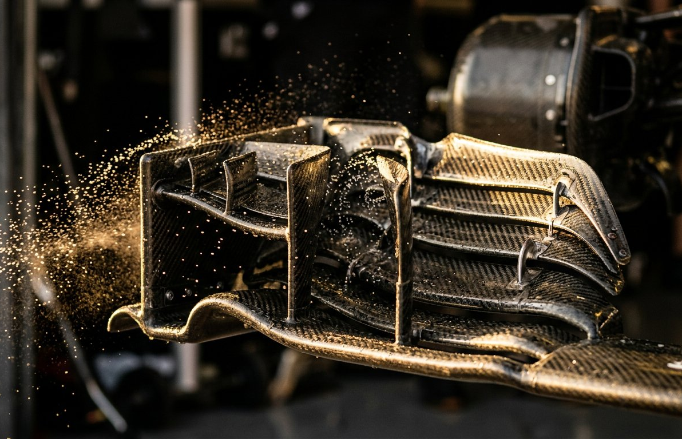
SCALE
The same car, two different jobs
FRONT WING
WHOLE CAR
Shapes the air before it
Every surface is one
reaches the rest of the car.
continuous compromise.
Both images generated locally · embedded as native pictures

Slide 4
THE MEASURE
Where the tenths are actually won
142
118
96
61
Low speed
Medium
Fast
Straight
Downforce index, 100 = straight-line baseline. Slow corners dominate the lap — which is where the wing earns its keep.

Slide 5
THE TAKEAWAY
Speed is not
an accident.
It is air, arranged on purpose.
ppt-master · native shapes, native animation

