Slide 1
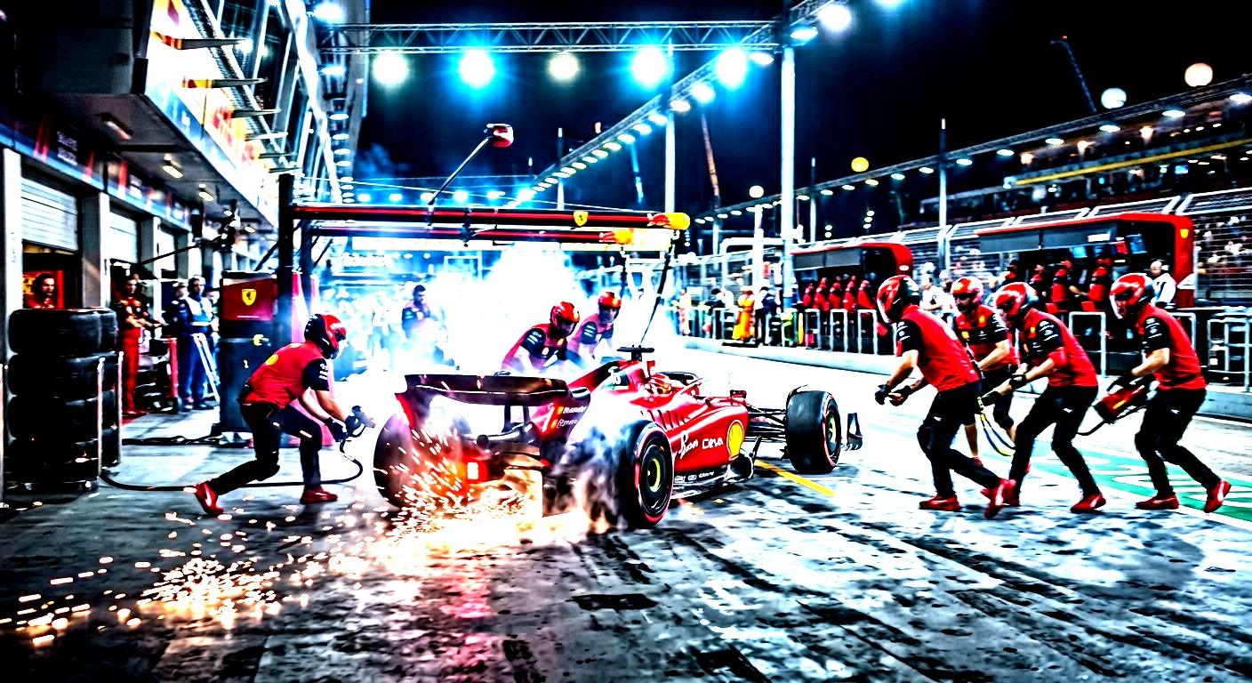
AERODYNAMICS · 01
GRIP IS
INVISIBLE
The wing presses the car into the road

Slide 2
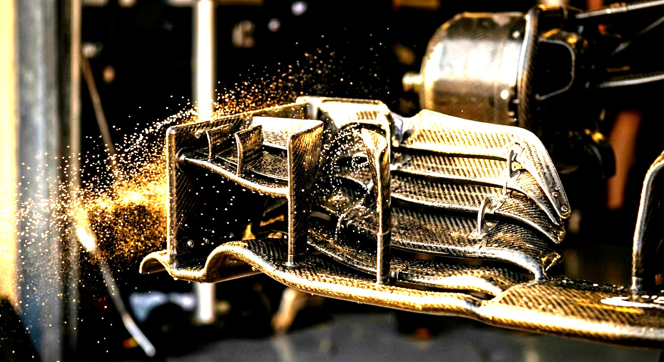
AERODYNAMICS · 02
THE PRINCIPLE
Air is not empty.
At 250 km/h the car makes enough
downforce to drive on the ceiling.
ppt-master · native

Slide 3
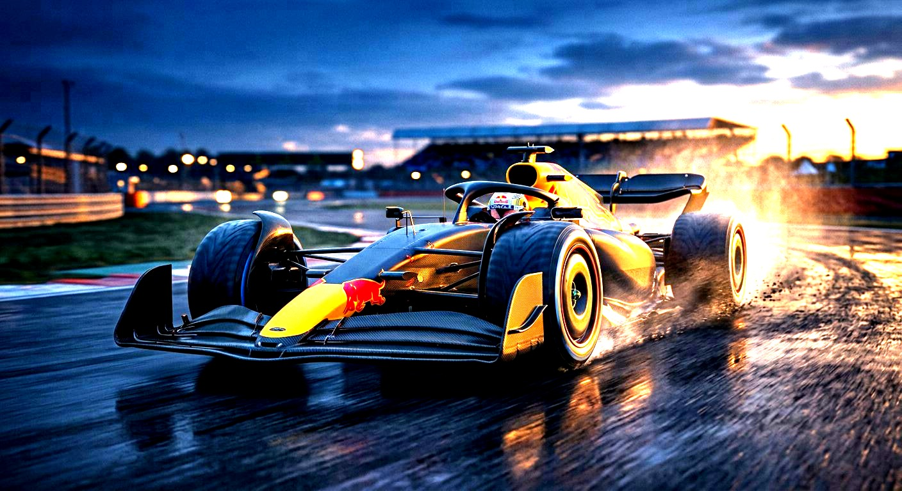
AERODYNAMICS · 03
EVIDENCE
Thousands of runs
before a single part is ever cut.
ppt-master · native

Slide 4
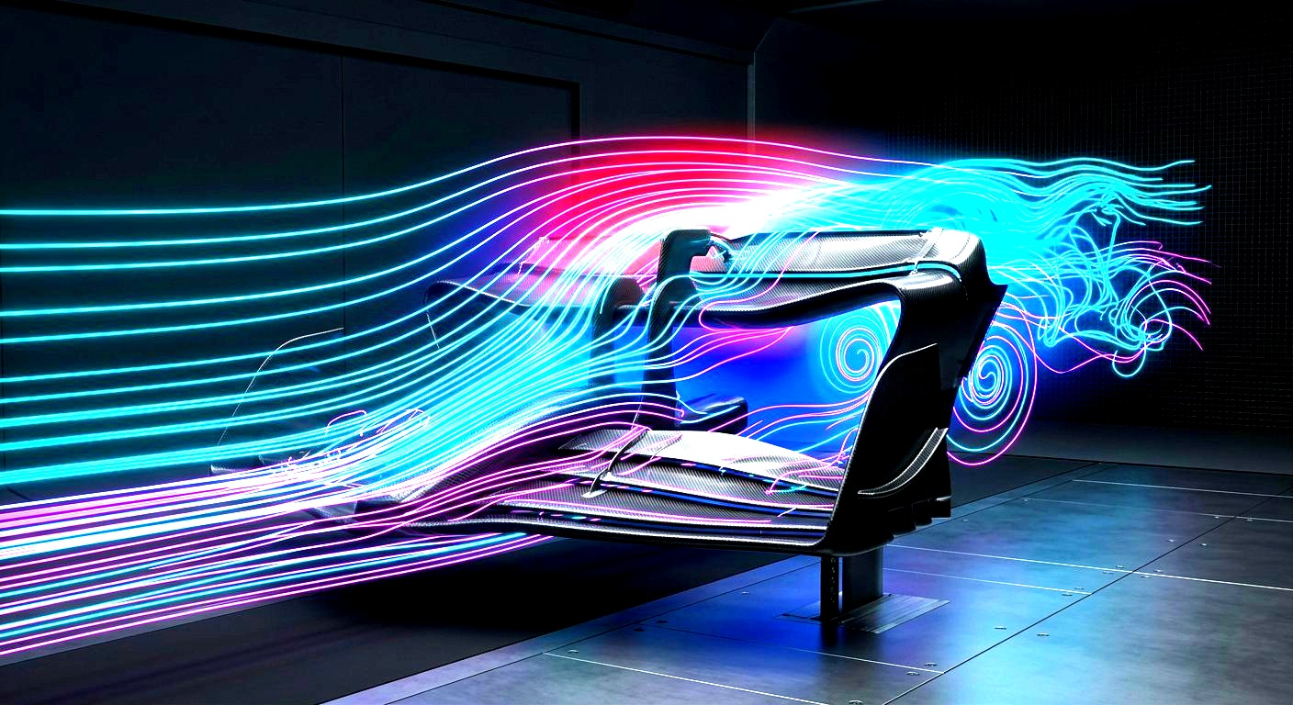
AERODYNAMICS · 04
SO WHAT
Speed is
arranged.
ppt-master · native

