Slide 1
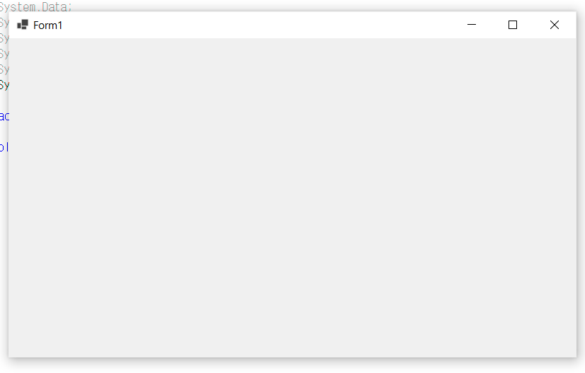
using System;
using System.Collections.Generic;
using System.Linq;
using System.Threading.Tasks;
using System.Windows.Forms;
namespace HelloForm
{
static class Program
{
/// <summary>
/// The main entry point for the application.
/// </summary>
[STAThread]
static void Main()
{
Application.SetHighDpiMode(HighDpiMode.SystemAware);
Application.EnableVisualStyles();
Application.SetCompatibleTextRenderingDefault(false);
Application.Run(new Form1());
}
}
}

Slide 2
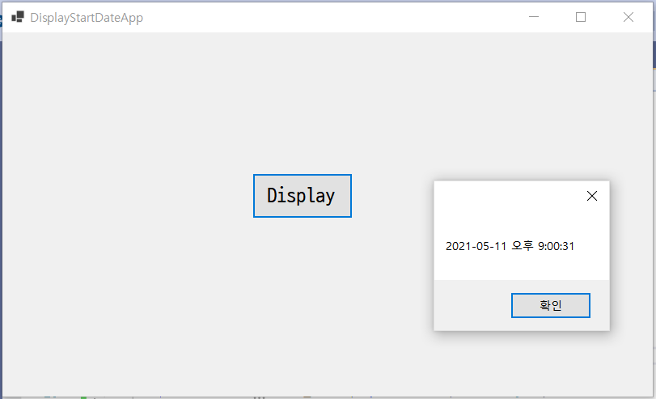
using System;
using System.Collections.Generic;
using System.ComponentModel;
using System.Data;
using System.Drawing;
using System.Linq;
using System.Text;
using System.Threading.Tasks;
using System.Windows.Forms;
namespace HelloForm
{
public partial class Form1 : Form
{
public Form1()
{
InitializeComponent();
startDateTime = DateTime.Now;
}
DateTime startDateTime;
public DateTime GetStartDateTime()
{
return startDateTime;
}
private void button1_Click(object sender, EventArgs e)
{
MessageBox.Show(GetStartDateTime().ToString());
}
}
}

Slide 3
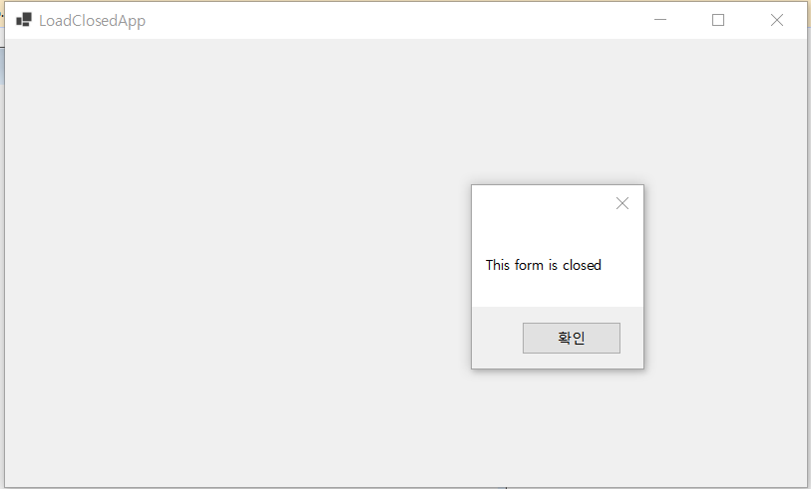
using System;
using System.Collections.Generic;
using System.ComponentModel;
using System.Data;
using System.Drawing;
using System.Linq;
using System.Text;
using System.Threading.Tasks;
using System.Windows.Forms;
namespace HelloForm
{
public partial class Form1 : Form
{
public Form1()
{
InitializeComponent();
}
private void Form1_Load(object sender, EventArgs e)
{
MessageBox.Show("This form is loaded");
}
private void Form1_FormClosed(object sender, FormClosedEventArgs e)
{
MessageBox.Show("This form is closed");
}
}
}

Slide 4
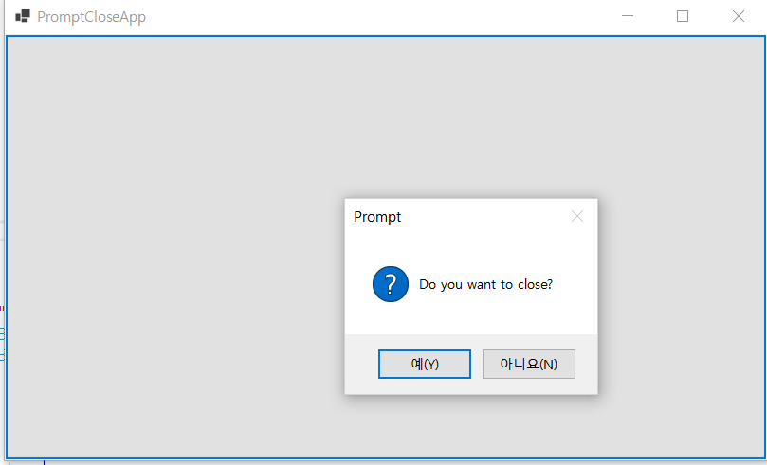
using System;
using System.Collections.Generic;
using System.ComponentModel;
using System.Data;
using System.Drawing;
using System.Linq;
using System.Text;
using System.Threading.Tasks;
using System.Windows.Forms;
namespace HelloForm
{
public partial class Form1 : Form
{
public Form1()
{
InitializeComponent();
}
private void Form1_FormClosing(object sender, FormClosingEventArgs e)
{
if (MessageBox.Show("Do you want to close?",
"Prompt",
MessageBoxButtons.YesNo,
MessageBoxIcon.Question) == DialogResult.Yes)
{
e.Cancel = false;
}
else
{
e.Cancel = true;
}
}
private void button1_Click(object sender, EventArgs e)
{
Close();
}
}
}

Slide 5
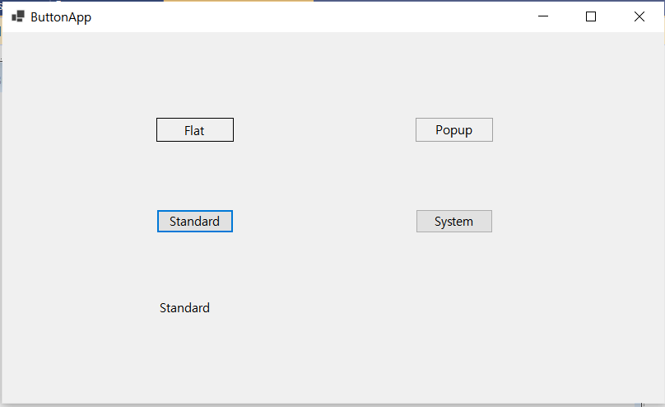
using System;
using System.Collections.Generic;
using System.ComponentModel;
using System.Data;
using System.Drawing;
using System.Linq;
using System.Text;
using System.Threading.Tasks;
using System.Windows.Forms;
namespace HelloForm
{
public partial class Form1 : Form
{
public Form1()
{
InitializeComponent();
}
private void button1_Click_1(object sender, EventArgs e)
{
label1.Text = FlatStyle.Flat.ToString();
}
private void button2_Click(object sender, EventArgs e)
{
label1.Text = FlatStyle.Popup.ToString();
}
private void button3_Click(object sender, EventArgs e)
{
label1.Text = FlatStyle.Standard.ToString();
}
private void button4_Click(object sender, EventArgs e)
{
label1.Text = FlatStyle.System.ToString();
}
}
}

Slide 6
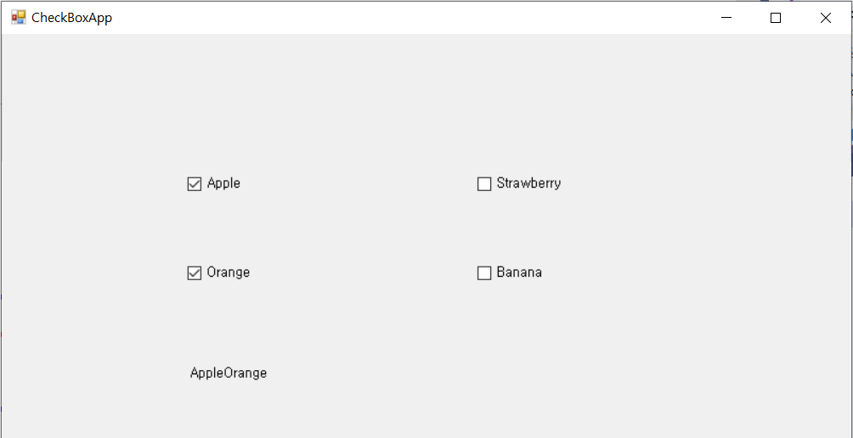
using System;
using System.Collections.Generic;
using System.ComponentModel;
using System.Data;
using System.Drawing;
using System.Linq;
using System.Text;
using System.Threading.Tasks;
using System.Windows.Forms;
namespace HelloForm
{
public partial class Form1 : Form
{
public Form1()
{
InitializeComponent();
}
private void UpdateLabel(string s, bool b)
{
if (b)
{
label1.Text += s; // label1의 Text 프로퍼티에 문자열 추가
}
else
{
string strTemp = label1.Text;
int i = strTemp.IndexOf(s);
label1.Text = strTemp.Remove(i, s.Length);
}
}
private void checkBox1_CheckedChanged(object sender, EventArgs e)
{
UpdateLabel(checkBox1.Text, checkBox1.Checked);
}
private void checkBox2_CheckedChanged(object sender, EventArgs e)
{
UpdateLabel(checkBox2.Text, checkBox2.Checked);
}
private void checkBox3_CheckedChanged(object sender, EventArgs e)
{
UpdateLabel(checkBox3.Text, checkBox3.Checked);
}
private void checkBox4_CheckedChanged(object sender, EventArgs e)
{
UpdateLabel(checkBox4.Text, checkBox4.Checked);
}
}
}

Slide 7
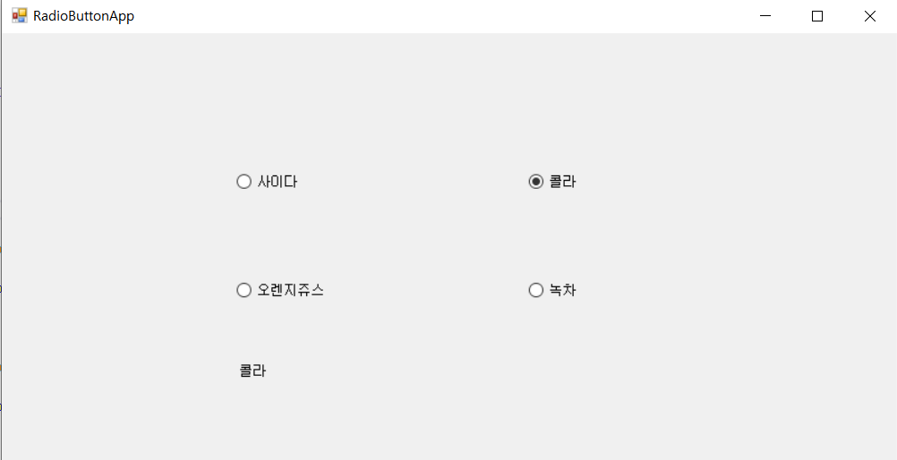
using System;
using System.Collections.Generic;
using System.ComponentModel;
using System.Data;
using System.Drawing;
using System.Linq;
using System.Text;
using System.Threading.Tasks;
using System.Windows.Forms;
namespace HelloForm
{
public partial class Form1 : Form
{
public Form1()
{
InitializeComponent();
}
private void radioButton1_CheckedChanged(object sender, EventArgs e)
{
label1.Text = radioButton1.Text;
}
private void radioButton2_CheckedChanged(object sender, EventArgs e)
{
label1.Text = radioButton2.Text;
}
private void radioButton3_CheckedChanged(object sender, EventArgs e)
{
label1.Text = radioButton3.Text;
}
private void radioButton4_CheckedChanged(object sender, EventArgs e)
{
label1.Text = radioButton4.Text;
}
}
}

Slide 8
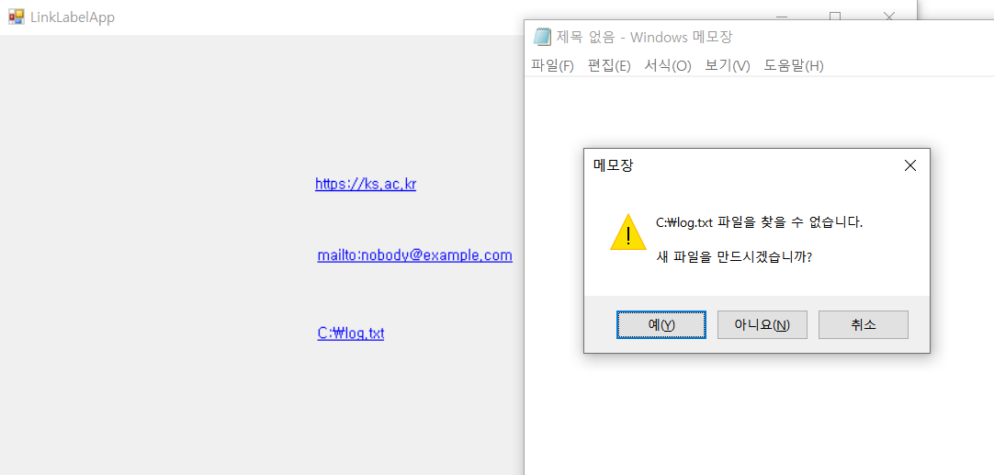
using System;
using System.Collections.Generic;
using System.ComponentModel;
using System.Data;
using System.Drawing;
using System.Linq;
using System.Text;
using System.Threading.Tasks;
using System.Windows.Forms;
using System.Diagnostics;
namespace HelloForm
{
public partial class Form1 : Form
{
public Form1()
{
InitializeComponent();
}
private void linkLabel1_LinkClicked(object sender, LinkLabelLinkClickedEventArgs e)
{
Process.Start(linkLabel1.Text);
}
private void linkLabel2_LinkClicked(object sender, LinkLabelLinkClickedEventArgs e)
{
Process.Start(linkLabel1.Text);
}
private void Form1_Load(object sender, EventArgs e)
{
Process.Start("Notepad.exe", linkLabel3.Text);
}
}
}

Slide 9
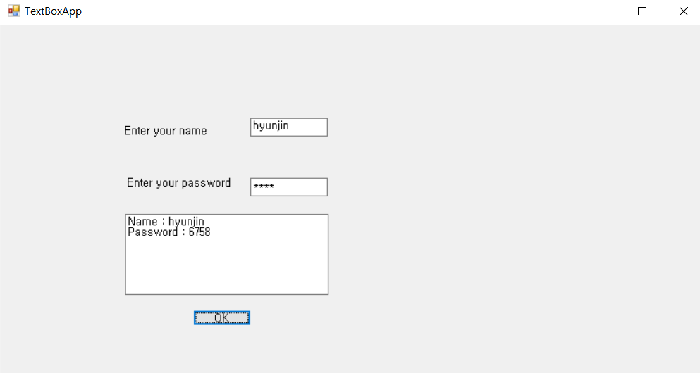
using System;
using System.Collections.Generic;
using System.ComponentModel;
using System.Data;
using System.Drawing;
using System.Linq;
using System.Text;
using System.Threading.Tasks;
using System.Windows.Forms;
using System.Diagnostics;
namespace HelloForm
{
public partial class Form1 : Form
{
public Form1()
{
InitializeComponent();
}
private void button1_Click(object sender, EventArgs e)
{
textBox3.Text = "Name : " + textBox1.Text +
"\r\nPassword : " + textBox2.Text;
}
}
}

Slide 10
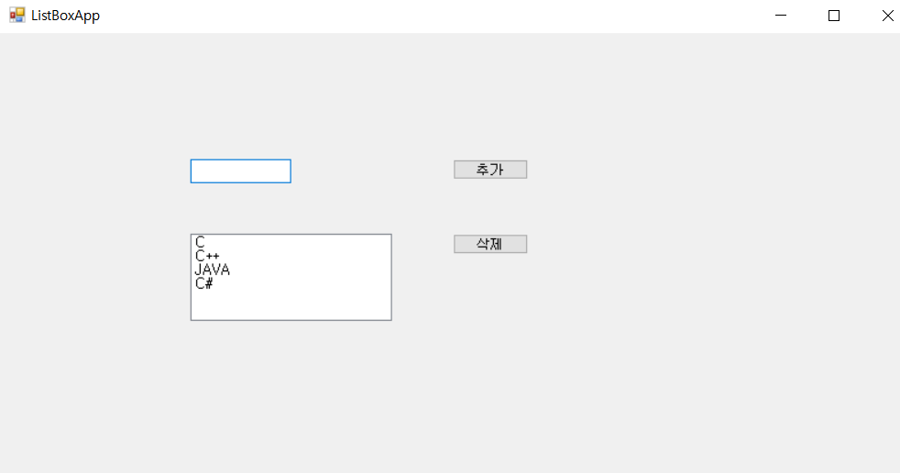
using System;
using System.Collections.Generic;
using System.ComponentModel;
using System.Data;
using System.Drawing;
using System.Linq;
using System.Text;
using System.Threading.Tasks;
using System.Windows.Forms;
using System.Diagnostics;
namespace HelloForm
{
public partial class Form1 : Form
{
public Form1()
{
InitializeComponent();
}
private void button1_Click(object sender, EventArgs e)
{
if (textBox1.Text != "")
{ //리스트 상자 추가
listBox1.Items.Add(textBox1.Text);
textBox1.Text = "";
}
}
private void button2_Click(object sender, EventArgs e)
{
if (listBox1.SelectedIndex > -1)
listBox1.Items.RemoveAt(listBox1.SelectedIndex);
//리스트 상자의 선택된 항목을 제거
}
}
}

Slide 11
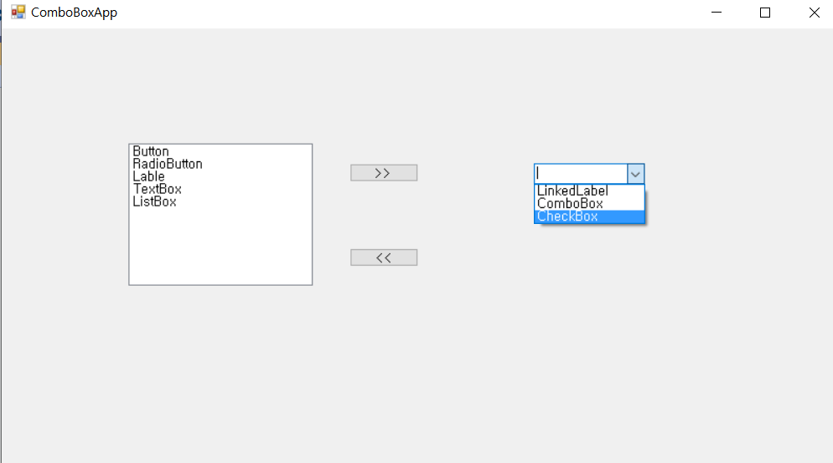
using System;
using System.Windows.Forms;
namespace HelloForm
{
public partial class Form1 : Form
{
public Form1()
{
InitializeComponent();
}
private void button1_Click(object sender, EventArgs e)
{
if (listBox1.SelectedItem != null)
{
//리스트 상자의 선택 항목을 콤보 상자에 추가
comboBox1.Items.Add(listBox1.SelectedItem);
//리스트 상자에서 선택 항목을 삭제
listBox1.Items.Remove(listBox1.SelectedItem);
}
}
private void button2_Click(object sender, EventArgs e)
{
if (comboBox1.SelectedItem != null)
{
//리스트 상자의 선택 항목을 콤보 상자에 추가
listBox1.Items.Add(comboBox1.SelectedItem);
//리스트 상자의 선택 항목을 삭제
comboBox1.Items.Remove(comboBox1.SelectedItem);
}
}
}
}

Slide 12
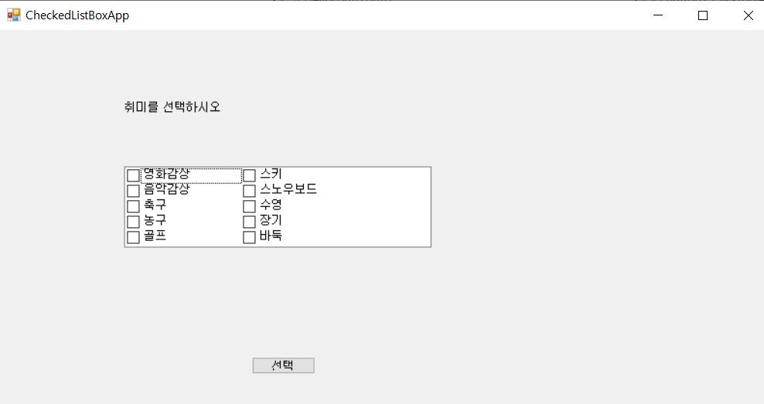
using System;
using System.Windows.Forms;
namespace HelloForm
{
public partial class Form1 : Form
{
public Form1()
{
InitializeComponent();
}
private void button1_Click(object sender, EventArgs e)
{
string strTemp = "";
foreach (object obj in checkedListBox1.CheckedItems)
{
strTemp += obj.ToString();
strTemp += " ";
}
MessageBox.Show("당신의 취미는 " + strTemp + "입니다.");
}
}
}

Slide 13
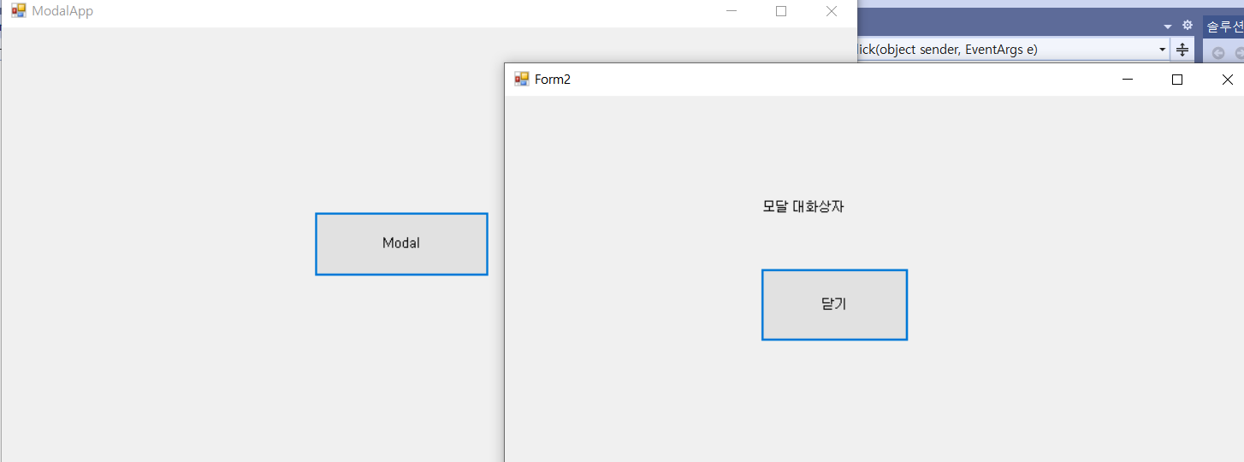
using System;
using System.Collections.Generic;
using System.ComponentModel;
using System.Data;
using System.Drawing;
using System.Linq;
using System.Text;
using System.Threading.Tasks;
using System.Windows.Forms;
namespace HelloForm
{
public partial class Form2 : Form
{
public Form2()
{
InitializeComponent();
}
private void button1_Click(object sender, EventArgs e)
{
Close();
}
}
}
using System;
using System.Windows.Forms;
namespace HelloForm
{
public partial class Form1 : Form
{
public Form1()
{
InitializeComponent();
}
private void button1_Click(object sender, EventArgs e)
{
Form2 form2 = new Form2();
form2.ShowDialog(); // form2를 모달 방식으로 띄운다.
}
}
}

Slide 14
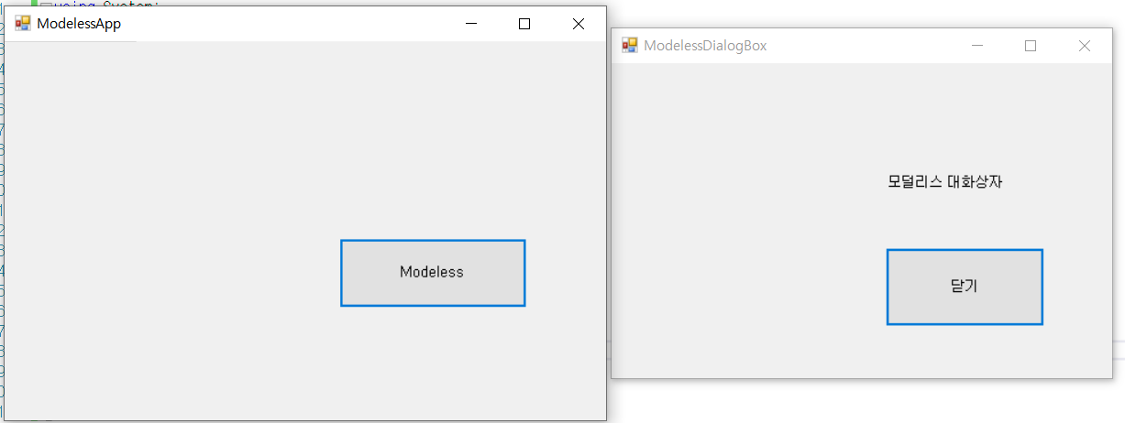
using System;
using System.Windows.Forms;
namespace HelloForm
{
public partial class Form2 : Form
{
public Form2()
{
InitializeComponent();
}
private void button1_Click(object sender, EventArgs e)
{
Close();
}
}
}
using System;
using System.Windows.Forms;
namespace HelloForm
{
public partial class Form1 : Form
{
public Form1()
{
InitializeComponent();
}
private void button1_Click(object sender, EventArgs e)
{
Form2 form2 = new Form2();
form2.Show(); // form2를 모덜리스 방식으로 띄운다.
}
}
}

Slide 15
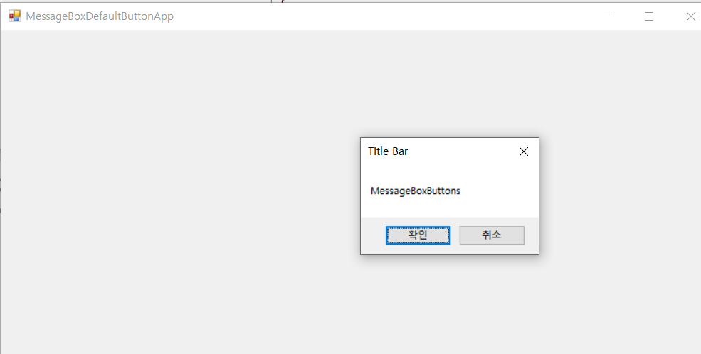
using System;
using System.Windows.Forms;
namespace HelloForm
{
public partial class Form1 : Form
{
public Form1()
{
InitializeComponent();
}
private void Form1_Load(object sender, EventArgs e)
{
}
private void Form1_Click(object sender, EventArgs e)
{
MessageBox.Show("MessageBoxButtons", "Title Bar",
MessageBoxButtons.OKCancel);
}
}
}

Slide 16
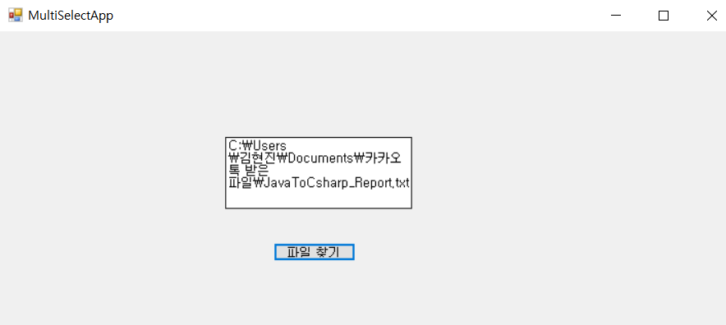
using System;
using System.Windows.Forms;
namespace HelloForm
{
public partial class Form1 : Form
{
public Form1()
{
InitializeComponent();
}
private void button1_Click(object sender, EventArgs e)
{
openFileDialog1.InitialDirectory = @"C:\";
openFileDialog1.Filter
= "텍스트 파일(*.txt)|*.txt|모든 파일(*.*)|*.*";
openFileDialog1.FilterIndex = 1; // "텍스트 파일(*.txt)|*.txt“
openFileDialog1.RestoreDirectory = true;
openFileDialog1.ShowDialog();
textBox1.Text = openFileDialog1.FileName;
}
}
}

Slide 17
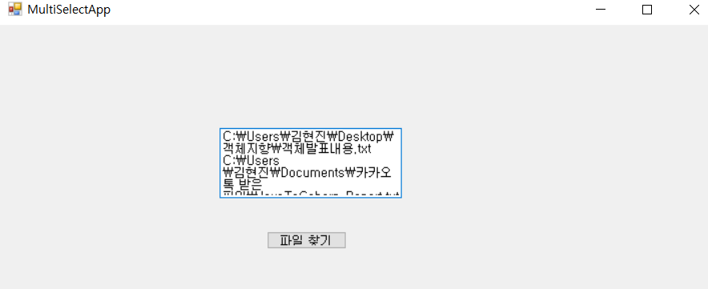
using System;
using System.Windows.Forms;
namespace HelloForm
{
public partial class Form1 : Form
{
public Form1()
{
InitializeComponent();
}
private void button1_Click(object sender, EventArgs e)
{
openFileDialog1.InitialDirectory = @"C:\";
openFileDialog1.Filter
= "텍스트 파일(*.txt)|*.txt|모든 파일(*.*)|*.*";
openFileDialog1.FilterIndex = 1;
openFileDialog1.RestoreDirectory = true;
openFileDialog1.Multiselect = true;
openFileDialog1.ShowDialog();
foreach (string strTmp in openFileDialog1.FileNames)
{
textBox1.Text += strTmp;
textBox1.Text += "\r\n";
}
}
}
}

Slide 18
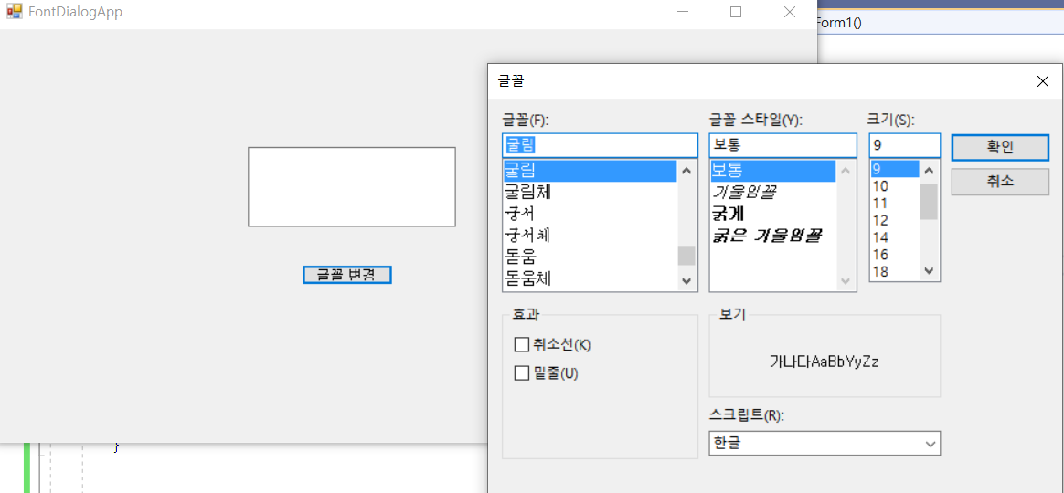
using System;
using System.Windows.Forms;
namespace HelloForm
{
public partial class Form1 : Form
{
public Form1()
{
InitializeComponent();
}
private void button1_Click(object sender, EventArgs e)
{
fontDialog1.ShowDialog();
textBox1.Font = fontDialog1.Font;
textBox1.ForeColor = fontDialog1.Color;
}
}
}

Slide 19
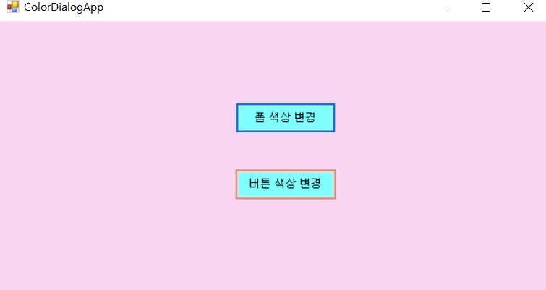
using System;
using System.Windows.Forms;
namespace HelloForm
{
public partial class Form1 : Form
{
public Form1()
{
InitializeComponent();
}
private void button1_Click(object sender, EventArgs e)
{
colorDialog1.ShowDialog();
this.BackColor = colorDialog1.Color;
}
private void button2_Click(object sender, EventArgs e)
{
colorDialog1.ShowDialog();
button1.BackColor = colorDialog1.Color;
button2.BackColor = colorDialog1.Color;
}
}
}

Slide 20
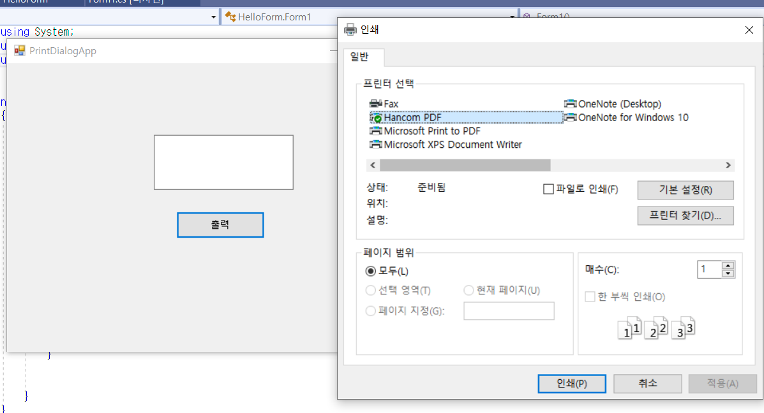
using System;
using System.Windows.Forms;
using System.Drawing.Printing;
namespace HelloForm
{
public partial class Form1 : Form
{
public Form1()
{
InitializeComponent();
}
private void button1_Click(object sender, EventArgs e)
{
PrinterSettings printer = new PrinterSettings();
PrintDocument pd = new PrintDocument();
printDialog1.PrinterSettings = printer;
printDialog1.Document = pd;
printDialog1.ShowDialog();
}
}
}

